Slide 1
Modelling Neutral and Non-Neutral Mechanisms of Community Assembly
Amy Solman

Slide 2
Inferring Ecological Stochasticity (adapted from Zhou, 2017)
What methods can we use to understand the extent to which dispersal, drift and diversification are driving community assembly?
Multivariate Analysis
Null Models
Neutral Models

Slide 3
Multivariate Analysis
Used for:
Examining the relative importance of selection and dispersal on shaping community structure
Elucidating the relative importance of contemporary selection (what’s happening now) and historical contingency (what happened previously) in driving community structure and biogeography. Measure contemporary selection through partial correlation between biotic structure and current environmental variables + controlling for geographic distance = contemporary environment effect. Recent investigations indicate historical contingency is not as important to community structure as contemporary selection.

Slide 4
Multivariate Analysis 1: Comparison of communities within and between environments
Methods include:
Permutational multivariate analysis of variance (PERMANOVA)
Analysis of similarities
Permutational analysis of multivariate dispersions (PERNDISP)
Principal-coordination analysis (PCoA)
Nonmetric multidimensional scaling (NMDS)
Principal-component analysis (PCA)
Detrended correspondence analysis (DCA)
The above methods should be used with a null model to compare observed diversity with null diversity and infer stochasticity.

Slide 5
Multivariate Analysis 2: Correlations between communities and their environment
Methods:
Mantel test
Multiple regression on (dis)similarity matrices (MRM)
Redundancy analysis (RDA)
Canonical correspondence analysis (CCA)
If lots of the variation in community structure is explained by environmental variables, we know selection is playing a strong role in controlling the community structure. The reverse indicates strong evidence for the role of stochastic mechanisms. WARNING: Selection and dispersal may cause similar patterns. Resolve this by extending the analysis…

Slide 6
Multivariate Analysis 3: Variation-partitioning analysis (VPA)
How to look for the the relative influences of selection and dispersal on community composition using VPA
Control for geographic distance, then find correlation between community structure and environmental variables = environmental effect (selection)
Control for environmental variables, then find the correlation between community structure and geographic distance = distance effect (dispersal – and other spatial effects e.g. drift)
Quantify interaction between environmental variables and distance = remaining unexplained variation (due to unmeasured variables, biotic selection, drift, issues with the methodology?)

Slide 7
Multivariate Analysis 3: Variation-partitioning analysis (VPA) Type I
Raw environmental data + spatial x-y coordinates directly used to correlated community changes, for example:
VPA based on RDA for linear regression
Partial pCCA for unimodal regression
Addresses questions about observed variations in community structure

Slide 8
Multivariate Analysis 3: Variation-partitioning analysis (VPA) Type II (DIST)
Indirect approach using three distance matrices
Community dissimilarity + geographic distance + environmental similarity used to establish correlations between environment, space and community, for example:
VPA based on partial Mantel test (rarely used)
MRM
Distance-based RDA
Addresses questions on the variation measured by the dissimilarity metrics e.g. differences in species occurrence determined by the Jaccard index, differences in community structure determined by the Bray-Curtis index, phylogenetic dissimilarity determined by the UniFrac index

Slide 9
Multivariate Analysis: Problems
1. Unmeasured environmental variables – impossible to measure everything! Can lead to overestimations of the impact of distance effect
Solution:
Decompose spatial distance into various spatial variables based on spatial eigenvector analysis
Combine special variables with other environmental variables and decompose into principal components (PCs)
Associate PCs with beta diversity metrics related to selection (e.g. beta nearest taxon index)
If one of the PCs is significantly associated with selection but there is no obvious loading of any measured environmental variables (other than spatial variables) this probably represents unmeasured environmental factors
This is the first time unmeasured environmental variables has been disentangled from stochastic processes, but it could still be linked to drift or methodological artifacts.
2. Simulation models have found that VPA is unable to correctly predict the environmental and spatial mechanisms driving community composition – despite the fact that this is widely used for discerning deterministic and stochastic processes in community assembly.
Solution:
Multivariate analysis should be used as an exploratory tool, along with neutral and null models, to assess the relative importance of neutral and non-neutral processes.

Slide 10
Neutral Models
10 different models in the literature, including:
Hubbell’s neutral model, a spatially implicit neutral model (SINM)
Rosindell et al (2008), a spatially explicit neutral model (SENM)
Rosindell & Cornell (2013), a SENM

Slide 11
Neutral Model Assumptions (taken from Etienne et al., 2007)
The neutrality assumption (functional equivalence among different species)
The point mutation assumption (speciation takes place by point mutation)
The zero-sum assumption (for every death there is a corresponding birth i.e. the community size does not change)

Slide 12
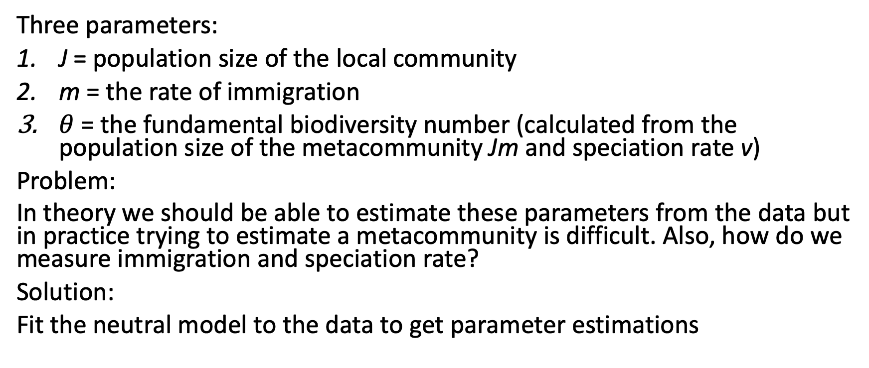
Hubbell’s Neutral Model
Three parameters:
J = population size of the local community
m = the rate of immigration
$θ$ = the fundamental biodiversity number (calculated from the population size of the metacommunity Jm and speciation rate v)
Problem:
In theory we should be able to estimate these parameters from the data but in practice trying to estimate a metacommunity is difficult. Also, how do we measure immigration and speciation rate?
Solution:
Fit the neutral model to the data to get parameter estimations

Slide 13
Neutral Models: What are they for?
Primary used for:
Species-abundance distributions (SAD)
Species-area relationships (SAR)
Distance-decay relationships (DDR)
Abundance-occupancy relationships
Species turnover
SAD = metric describing how many individuals of each species are present in a community
Universal patterns in ecology

Slide 14
Fitting Methods
Sampling theory
Derived analytical forms
Likelihood functions

Slide 15
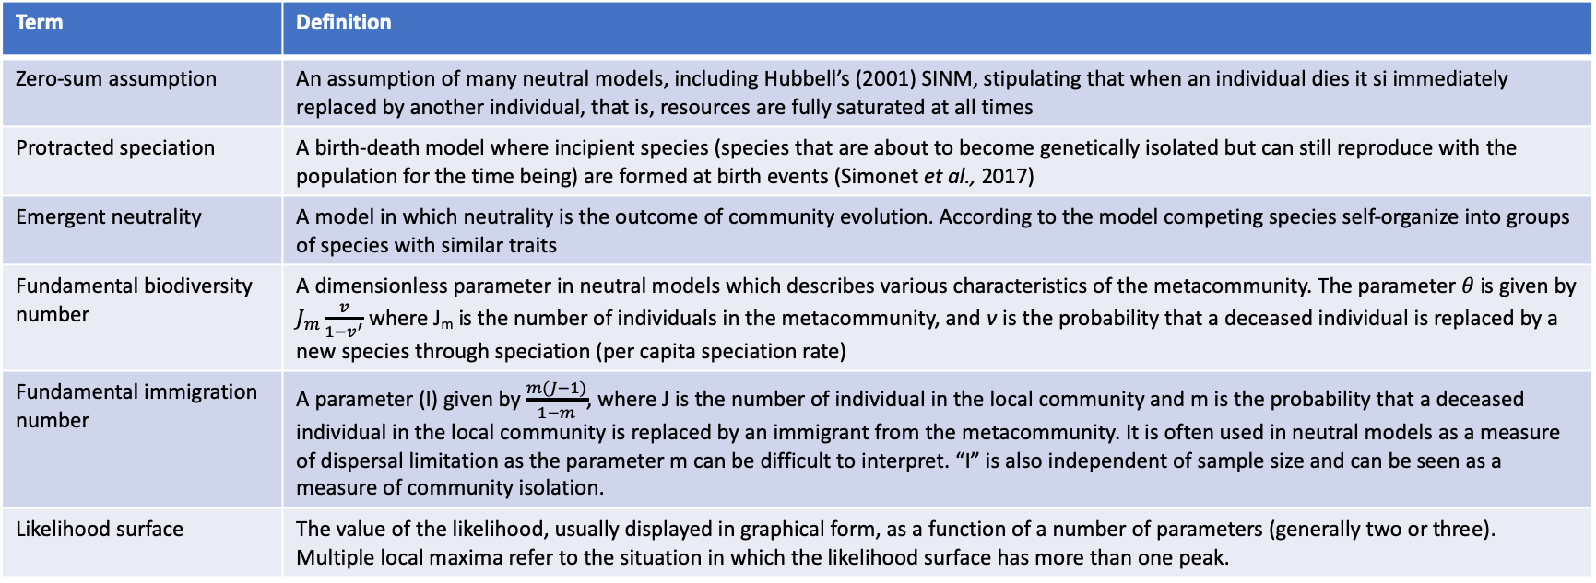
Important Neutral Model Terms (adapted from Matthews & Whittaker, 2014)
Term | Definition
Zero-sum assumption | An assumption of many neutral models, including Hubbell’s (2001) SINM, stipulating that when an individual dies it si immediately replaced by another individual, that is, resources are fully saturated at all times
Protracted speciation | A birth-death model where incipient species (species that are about to become genetically isolated but can still reproduce with the population for the time being) are formed at birth events (Simonet et al., 2017)
Emergent neutrality | A model in which neutrality is the outcome of community evolution. According to the model competing species self-organize into groups of species with similar traits
Fundamental biodiversity number | A dimensionless parameter in neutral models which describes various characteristics of the metacommunity. The parameter $θ$ is given by $J_{m}\frac{v}{1−v^{′}}$ where J_{m} is the number of individuals in the metacommunity, and v is the probability that a deceased individual is replaced by a new species through speciation (per capita speciation rate)
Fundamental immigration number | A parameter (I) given by $\frac{m(J−1)}{1−m}$, where J is the number of individual in the local community and m is the probability that a deceased individual in the local community is replaced by an immigrant from the metacommunity. It is often used in neutral models as a measure of dispersal limitation as the parameter m can be difficult to interpret. “I” is also independent of sample size and can be seen as a measure of community isolation.
Likelihood surface | The value of the likelihood, usually displayed in graphical form, as a function of a number of parameters (generally two or three). Multiple local maxima refer to the situation in which the likelihood surface has more than one peak.

Slide 16
Important Neutral Model Terms (adapted from Matthews & Whittaker, 2014) cont.
Term | Definition
Local community | Generally relates to the local community in Hubbell’s spatially implicit neutral model, in which it is a set of individuals that live in the same smaller sample/island distinct from the larger metacommunity/mainland. A dead individual is immediately replaced either by an offspring of another individual (of any species) in the local community, or by an immigrant from the metacommunity (determined by m; the probability that a deceased individual in the local community is replaced by an immigrant from the metacommunity). As long as m is greater than 0 the local community receives a certain amount of immigrants from the metacommunity. The number of individuals in the local community is predicted to be too small for speciation to occur
Metacommunity | In the context of neutral theory, the metacommunity generally relates to Hubbell’s spatially implicit neutral model, in which it is the source pool of individuals. A dead individual is immediately replaced either by an offspring of another organism in the metacommunity, or by an individual from a new species (speciation). Offspring of individuals may disperse to the local community.
Multimodal species abundance distribution | A species abundance distribution with multiple modal abundance values or octaves. The majority of published SAD models are unimodal, but it has become increasingly apparent that many empirical abundance distributions exhibit multiple modes.
Spatially explicit neutral model (SENM) | A neutral model that incorporates an explicit spatial structure, which enables the model to predict the exact location of each individual in space.
Spatially implicit neutral model (SINM) | A neutral model that incorporates a restricted consideration of spatial structure. Hubbell’s (2001) classic neutral model is spatially implicit as it only focuses on two scales of community organization, that is, the metacommunity and local community.
Speciation mode (with neutral models) | The manner in which speciation is modelled in neutral models. In Hubbell’s classic SINM, speciation occurs via the point mutation mode whereby speciation is an instantaneous process. Neutral models incorporating alternative species modes have since been developed; for instance, whereby speciation is a gradual, drawn out process (see Protracted Speciation).

Slide 17
Important Neutral Model Terms (adapted from Matthews & Whittaker, 2014) cont.
Term | Definition
Species abundance distribution (SAD) | The typical univariate SAD gives the expected frequency of species at each abundance level, either in terms of relative frequencies or simply by the average number of species at each abundance level. The multivariate SAD give the whole multidimensional distribution: the abundance of species observed within a sample of an ecological community.
Species-area relationship (SAR) | The relationship between the area of a sample or island and the number of species in that area.
Stochastic niche theory | A theory of community structure which combined niche apportionment with stochastic processes.
Zero-sum multinomial distribution (ZSM) | The SAD predicted for the local community in Hubbell’s (2001) SINM
Lognormal distribution | A probability distribution of a random variable whose logarithm follows a Gaussian (normal) distribution. In relation to SAD, the lognormal distribution characterizes a sample with relatively few very abundance or very rare species.
Logseries distribution | A probability distribution which results from the Poisson sampling of a gamma distribution after a certain relevant limit is taken, and conditional presence is considered, that is, it gives the conditional probability of attaining a certain abundance level given that the species is present. In relation to SAD, the logseries characterizes a sample in which the most common abundance category is a single individual.

Slide 18
Null Models

Slide 19
Indexes
Jaccard Index – statistic for understanding the similarity between sites (communities)
Bray-Curtis – statistic used for quantifying the compositional dissimilarity between two sites (communities)
UniFrac – phylogenetic beta-diversity measurement to compare environmental samples (used with multivariate analysis like PCoA can indicate which factors are driving differences between communities 10.1038/ismej.2010.133)
Beta nearest taxon index (βNTI) - the difference between observed beta mean nearest taxon distance (βMNTD) and the mean of the null distribution of βMNTD normalized by its standard deviation

Slide 20
Inferring Ecological Determinism
To what extend is biotic and abiotic selection driving community assembly?
Approaches:
Species Sorting Models

Slide 21
References
Etienne, R. S., Alonso, D. & McKane, A. J. (2007) The zero-sum assumption in neutral biodiversity theory. Journal of Theoretical Biology, 248 (3): 522-536.
Matthews, T. J. & Whittaker, R. J. (2014) Neutral theory and the species abundance distribution: recent developments and prospects for unifying niche and neutral perspectives. Ecology and Evolution, 4 (11): 2263-2277.
Simonet, C. Scherrer, R., Rego-Costa, A. & Etienne, R. S. (2017) Robustness of the approximate likelihood of the protracted speciation model. Journal of Evolutionary Biology, 31 (3): 469-479.
Zhou, J. (2017) Stochastic Community Assembly: Does it Matter in Microbial Ecology? Microbiology and Molecular Biology Reviews, 81 (4): 1-32.

