Slide 1
Modelling Neutral and Non-Neutral Mechanisms of Community Assembly
Amy Solman

Slide 2
Inferring Ecological Stochasticity (adapted from Zhou, 2017)
What methods can we use to understand the extent to which dispersal, drift and diversification are driving community assembly?
Multivariate Analysis
Neutral Models
Null Models

Slide 3
Multivariate Analysis Summary
Type I: ﻿Direct comparisons of community structure differences between and within treatments (or different groups of communities in distinct environments) | Type II: ﻿Correlation-type analyses between community structure and environment variables | Type III: Variation-Partitioning Analysis
Permutational multivariate analysis of variance (PERMANOVA) | Mantel test | Raw-data-based direct approach (DIST)
Analysis of similarities | Multiple regression on (dis)similarity matrices (MRM) | Distance- based indirect approach
Permutational analysis of multivariate dispersions (PERNDISP) | Redundancy analysis (RDA)
Principal-coordination analysis (PCoA) | Canonical correspondence analysis (CCA)
Nonmetric multidimensional scaling (NMDS)
Principal-component analysis (PCA)
Detrended correspondence analysis (DCA)
If within treatment communities are very similar and between treatment communities are different = deterministic mechanisms (doesn’t say much for stochastic)
Proportion of structure variation that can be explained by environmental variables through correlation = deterministic, remaining proportion = stochastic
Control geographic distance, find corr between environment/structure = enviro effect. Control environment, find corr between distance/structure = distance effect
Problems: Type I usually applied with null model analysis (observed vs null expectations). Type II different processes (selection/dispersal) could produce similar patterns. Type III distance effect could also be due to other spatial effects or drift and unexplained variation could be due to unmeasured enviro variables, biotic interactions, drift etc + recent simulations shown it fails to make accurate predictions. General issues with unmeasured environmental variables causing distance effect to be over estimated. Use MVA as exploratory tool with neutral and null approaches.

Slide 4
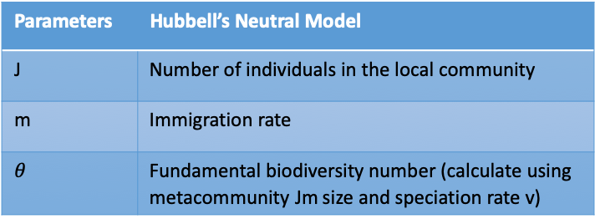
Neutral Model Summary
Spatially Implicit | Spatially Explicit
Hubbell’s Neutral Model | Rosindell et al. (2008, 2013)
 | Sloan et al. (2006, 2007)
Assumptions
The neutrality assumption | Functional equivalence among different species
The point mutation assumption | Speciation takes place by point mutation
The zero-sum assumption | For every death there is a corresponding birth i.e. the community size does not change (some models relax this)
Dispersal only occurs between two distinct spatial scales, from the metacommunity to each local community
Dispersal occurs in multiscale structures, for instance, as migration between cells in a 2D grid
Used For | Fitting Methods
Species-abundance distributions | Sampling theory
Species-area relationships | Derived analytical forms
Distance-decay relationships | Likelihood functions
Abundance-occupancy relationships
Species turnover
Parameters | Hubbell’s Neutral Model
J | Number of individuals in the local community
m | Immigration rate
$$θ$$ | Fundamental biodiversity number (calculate using metacommunity Jm size and speciation rate v)
Problems: Sampling effect = uncertainty due to a small sample size, but neutral models developed specifically for studying microbial communities. Microbial studies give contradicting results, some have shown stochastic processes are dominant while others show deterministic processes dominate. Niche and neutral processes have varying degrees of impact for different functional groups within a community (e.g. phototrophic vs heterotrophic) Solved by quantifying niche and neutral processes over a range of spatial/temporal scales, environmental gradients and/or different functional groups.

Slide 5
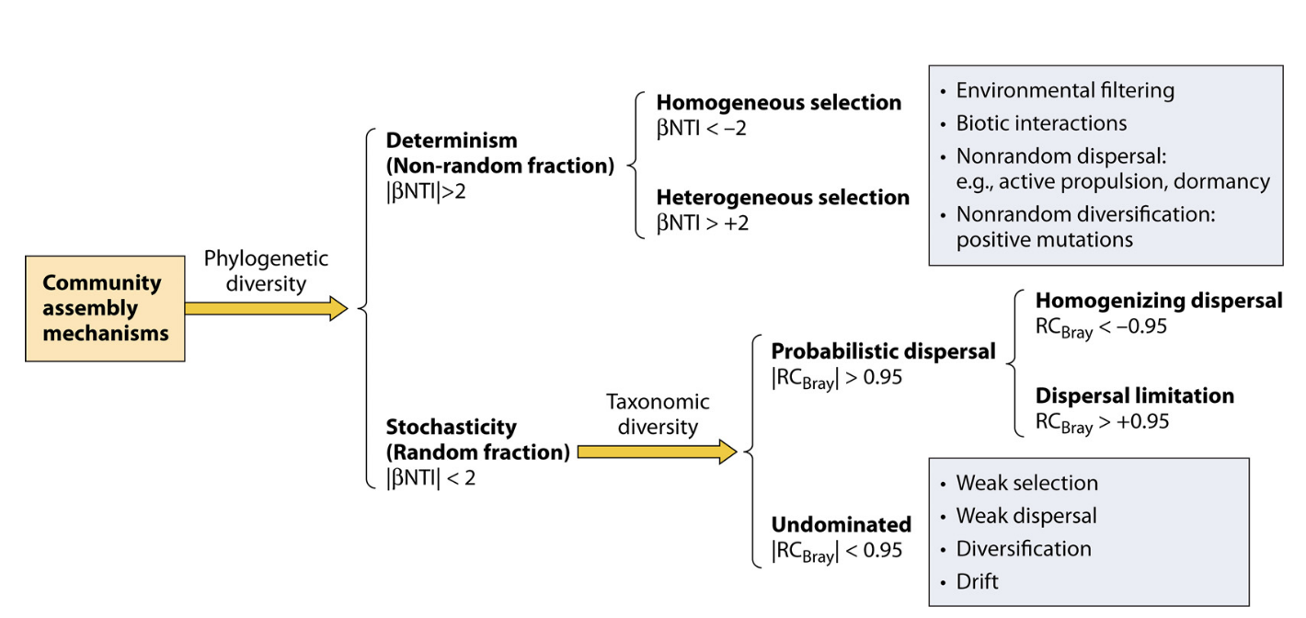
Null Model Summary
Null Model Method
1. How similar/dissimilar are the community structures?
2. While keeping species richness, species abundance and the sum of all taxon occurrence frequencies constant, randomly shuffle community data. If observed patterns are not statistically different from null expectations, the community dynamics are stochastic. Otherwise, they are deterministic
Data Types
Incidence (presence/absence) | Phylogenetic
Abundance | Taxonomic
 | Functional
Problems: Developing randomization algorithms is difficult because results are sensitive to method. Too few constraints = so random that it is easy for the null expectation to be different from the observed pattern. Too many constraints = result could be close to the observed pattern. Null model analysis not well suited for large data sets due to false-positive signiﬁcant pairs and data autocorrelation. The choice of the appropriate regional species pool, should not be too small or too large. The majority of null modeling approaches have been developed based on incidence data. Abundance data contain more information on species associations, they could be more suitable for inferring the underlying community assembly mechanisms. Inclusion of abundance data in null model randomization is complicated. Null model analysis assumes strong interactions = communities that are signiﬁcantly different from null expectations. However, strong interactions, when combined with a variable immigration history, could produce an apparently random community structure.
< Null-model-based quantitative framework for community assembly processes. Used beta-nearest taxon index and Raup-Crick based metric for parsing the influence of deterministic and stochastic processes using phylogenetic and taxonomic data.

