Slide 1
Microbial Biogeography and Community Assembly Mechanisms in the Supraglacial Environment: Influence of activity and abundance
Amy Solman
Notes:
Questions I want to ask:
How does dormancy influence microbial dispersal and community assembly?
How do dispersal and community assembly mechanisms differ at local, regional and global scales?
Does dispersal and community assembly mechanisms change between Spring and Summer seasons?
Why are we interested in community assembly?
Because we want to understand the evolutionary and ecological mechanisms that govern microbial community composition at local scales, thus shaping large scale patterns of microbial biogeography. Community composition affects community function with profound impacts on the wider ecosystem functioning and biodiversity.
This study aims to develop an in-depth understanding of cryoconite community interactions and assembly processes. Particular questions of interest include:
(i) Do cryoconite community exhibit nonrandom co-occurrence patterns?

Slide 2
Hypotheses
Snow, ice and cryoconite substrates exhibit significantly different active and bulk microbial community structure, inclusive of total, abundant and rare sub-communities.
The physio-chemical characteristics of glacial snow, ice and cryoconite are significantly different.
Ice active and bulk community structure, biogeographic patterns and community assembly mechanisms exhibit seasonal variation between spring and summer.
Microbial community composition in the supraglacial environment is explained by both deterministic and stochastic assembly processes.
Total, abundant and rare prokaryotic and eukaryotic sub-communities exhibit distinct biogeographic patterns, driven by distinct community assembly processes, across all substrates.
Active and bulk prokaryotic and eukaryotic sub-communities exhibit distinct biogeographic patterns, driven by distinct community assembly processes, across all substrates.

Slide 3
Analysis Workflow
Statistical/Multivariate Analysis
Neutral Model
Null Model
Network Analysis
Notes:
Why am I using this analysis workflow?
I am combining multiple analytical techniques in order to collect a wide range of evidence pointing towards the drivers of community assembly.
Each method used in isolate may have its caveats, but used in combination we can build a robust picture of the processes at play in our environment of interest.
Multivariate analysis looks primarily at deterministic drivers of community assembly (e.g. environmental factors)
Neutral model looks at how much of the patterns we see can be explained by stochastic processes alone.
Null model takes a phylogenetic approach to look at deviation between our observed communities are what we expect at random to investigate both deterministic and stochastic processes.
Network analysis allows us to explore biotic selection as a deterministic process of community assembly.

Slide 4
Sommers et al., (2020) ﻿Microbial Species–Area Relationships in Antarctic Cryoconite Holes Depend on Productivity
Recently published
Cryoconite communities
Detailed information on sequence processing
ISAR analysis
Includes bacterial and eukaryotic sequence data
Includes data from two glaciers
Notes:
I chose this dataset on which to develop my analysis pipeline because it included recently published cryoconite community data and cryoconite communities are of specific interest to me as they are a hotspot of biological activity on the glacier surface. Also, they act as discrete microcosms which can be measured in terms of area, therefore have the advantage of being used to explore the present of island-species area relationships.
The fact that ISAR had already been investigated in this dataset meant that I could carry out my own analyses and compare the results to ensure that I was analyzing the data correctly.
The paper included information on sequence processing that I was able to use in my first QIIME workflow.
It gave me the opportunity to work with 16S and 18S data (although here I have only analyzed the 16S data)
The data could also be grouped by glacier which was useful for comparative analyses.

Slide 5
QIIME2 & DADA2
Download sequence data and metadata in command line using SRA toolbox
QIIME2: Modify/convert files to QIIME2 formats
QIIME2: Trim primers
DADA2: Denoise data
QIIME2: Use SILVA classifier to classify representative sequences
QIIME2: Generate feature table
QIIME2: Make multiple sequence alignment with MAFFT, construct phylogenetic tree and root.
QIIME2: Export feature table, ASV count table, representative sequences, taxonomy table and rooted phylogenetic tree.
Notes:
In QIIME2 on my local computer I downloaded Sequence Read Archive (SRA) toolbox that allowed me to prefetch the sequence data from the SRA website using the archive umber supplied by the paper, splitting the flies into forward and reverse reads and saving them to my laptop.
I renamed the sequence files and modified the metadata file into formats expected by QIIME2.
Import fastq files and convert them into a format Qiime wants to work with.
Remove primers. I'm getting the primers from https://earthmicrobiome.org/protocols-and-standards/16s/ as described by Sommers et al., (2020)
The primer sequences are :
Updated sequences: 515F (Parada)–806R (Apprill), forward-barcoded:
FWD:GTGYCAGCMGCCGCGGTAA; REV:GGACTACNVGGGTWTCTAAT
Check the quality of trimmed reads and visualise.
Call DADA2. Where are the adaptors? Front or back? Use trim in DADA2 to cut them, in stead of QIIME2 cutadapt
FastQC - look at for adaptor - if adaptor isn't there then don't worry about it! Warning: Not all adaptors are picked up by FastQC.
Denoise data and check results of this step.
Summarise remaining reads after denoising and visualise. Through the sequence table generated below you can click on a representative sequence and BLAST it.
Generate a feature table and visualise.
Download Silva classifier and move to work folder.
Classify representative sequences and visualise.
Make a multiple sequence alignment with MAFFT.
Now mask the alignment.
Construct the phylogenetic tree and root.
Export feature table (Feature table of the remaining sequences after denoising that tells us how many samples we have, how many features (ASVs) we have, how frequent (how many individual cells there are) per sample, how many ASVs we see per sample ) , ASV count table (ASV count table with sample as columns and ASV as row ), representative sequences (The remaining representative sequences after denoising (i.e. a list of all the unique base pair sequences present in the denoised dataset), exported as a fasta file), taxonomy table (Table of feature (ASV) IDs and their taxonomic classifications ) and phylogenetic tree.

Slide 6
Data Prep
Wrangle metadata
Identify and remove contaminant ASVs
Remove singletons
Re-root phylogenetic tree
Remove ambiguous annotations and low abundance phyla
Construct phyloseq object and export
Load in data from QIIME2 step

Slide 7
Abundant and rare taxa
Rarefied phyloseq object to even sampling depth
Get local (within sample) relative abundances
Locally abundant taxa > 1% relative abundance
Locally rare taxa < 0.01% relative abundance
Find the regional (between sample) relative abundances = mean of local relative abundances
Regionally abundant taxa > 0.1% mean relative abundance
Regionally rare taxa < 0.01% mean relative abundance
Li et al., (2021) Active bacterial and archaeal communities in coastal sediments: Biogeography pattern, assembly process and co-occurrence relationship

Slide 8
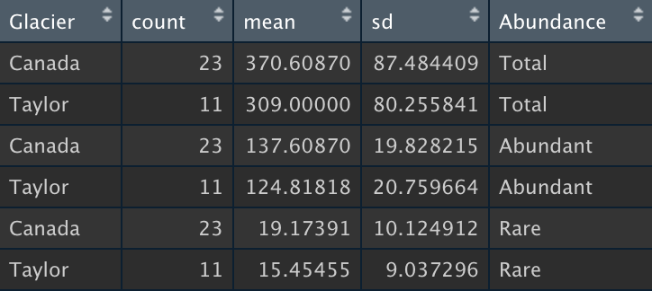
ASV Richness
Comparison of ASV richness between Canada and Taylor glaciers
Total community: Parametric assumptions met. Unpaired two-sample t-test showed no significant difference (t=1.97, df=32, p=0.57)
Abundant community: Parametric assumptions not met. Unpaired two samples Wilcoxon test showed no significant difference (W=179.5, p= 0.053)
Rare community: Parametric assumptions met. Unpaired two-sample t-test showed no significant difference (t=1.04, df=32, p=0.31)

Slide 9
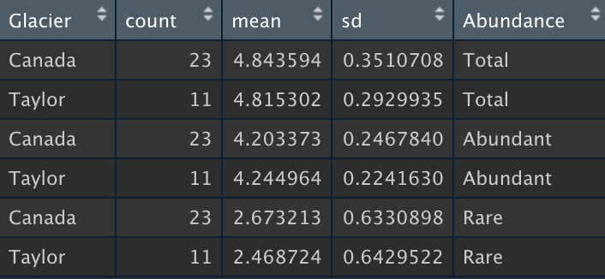
Shannon Diversity
Comparison of Shannon between Canada and Taylor glaciers
Total community: Parametric assumptions not met. Unpaired two samples Wilcoxon test showed no significant difference (W=141, p= 0.61)
Abundant community: Parametric assumptions not met. Unpaired two samples Wilcoxon test showed no significant difference (W=123, p= 0.91)
Rare community: Parametric assumptions met. Unpaired two-sample t-test showed no significant difference (t=0.88, df=32, p=0.39)
Notes:
Faith: Total community = No difference. Abundant community = No difference (significant difference with non-parametric). Rare community = No difference.
Simpson: Total community = No difference. Abundant community = Significant difference (no difference with non-parametric). Rare community = No difference.
Inverse Simpson: Total community = No difference. Abundant community = No difference. Rare community = No difference.
Pilou: Total community = Significant difference. Abundant community = Significant difference. Rare community = No difference.

Slide 10
Beta Diversity & Ordination: Weighted UniFrac
Total Community
Abundant Community
Rare Community
Figure : Beta diversity of rare community, calculated using weighted UniFrac distances, visualized use PCoA (blue is Taylor Glacier and orange is Canada Glacier). This plot shows significant beta diversity variation between glaciers (PERMANOVA: F = 1.50, df=1, P =0.038).
Figure : Beta diversity of total community, calculated using weighted UniFrac distances, visualized use PCoA (blue is Taylor Glacier and orange is Canada Glacier). This plot shows significant beta diversity variation between glaciers (PERMANOVA: F =8.39 , df=1, P =0.001).
Figure : Beta diversity of abundant community, calculated using weighted UniFrac distances, visualized use PCoA (blue is Taylor Glacier and orange is Canada Glacier). This plot shows significant beta diversity variation between glaciers (PERMANOVA: F = 11.11, df=1, P =0.001).

Slide 11
Beta Diversity & Ordination: Unweighted UniFrac
Total Community
Abundant Community
Rare Community
Figure : Beta diversity of rare community, calculated using weighted UniFrac distances, visualized use PCoA (blue is Taylor Glacier and orange is Canada Glacier). This plot shows no significant beta diversity variation between glaciers (PERMANOVA: F = 1.01, df=1, P =0.43).
Figure : Beta diversity of total community, calculated using weighted UniFrac distances, visualized use PCoA (blue is Taylor Glacier and orange is Canada Glacier). This plot shows significant beta diversity variation between glaciers (PERMANOVA: F =4.61 , df=1, P =0.001).
Figure : Beta diversity of abundant community, calculated using weighted UniFrac distances, visualized use PCoA (blue is Taylor Glacier and orange is Canada Glacier). This plot shows significant beta diversity variation between glaciers (PERMANOVA: F = 8.91, df=1, P =0.001).
Notes:
Unweighted unifrac ordination indicates that there is significant variation in beta diversity between abundant sub-communities, but no significant variation between rare communities. This may also be indicative of separate abundant communities established due to selection, while the rare sub-community randomly disperses between the glaciers.

Slide 12

Beta Diversity & Ordination: Bray-Curtis
Figure : Beta diversity of rare community calculated using Bray-Curtis distances, visualized use NMDS plot (blue is Taylor Glacier and orange is Canada Glacier). This plot shows no significant beta diversity variation between glaciers (PERMANOVA: F = 1.06, df=1, P =0.07).
Figure : Beta diversity of total community calculated using Bray-Curtis distances, visualized use NMDS plot (blue is Taylor Glacier and orange is Canada Glacier). This plot shows significant beta diversity variation between glaciers (PERMANOVA: F =8.5 , df=1, P =0.001).
Figure : Beta diversity of abundant community calculated using Bray-Curtis distances, visualized use NMDS plot (blue is Taylor Glacier and orange is Canada Glacier). This plot shows significant beta diversity variation between glaciers (PERMANOVA: F = 10.33, df=1, P =0.001).

Slide 13
Linear Regression Analysis: Are their correlations between ASV richness and any environmental variables?
Correlation test (cor.test) of log transformed data indicated…
Total community ASV richness: Correlation with cryoconite hole depth, cryoconite hole area, DNA per gram of cryoconite, organic matter content of cryoconite
Abundant community ASV richness: Correlation with cryoconite hole area, DNA per gram of cryoconite, organic matter content of cryoconite
Rare community ASV richness: Correlation with cryoconite hole depth, cryoconite hole area
Notes:
Linear regression indicates that abundant sub-community is correlated with hole area, DNA per gram of cryoconite and organic matter content of cryoconite.
Linear regression indicates that rare sub-community is correlated with hole depth and area. Suggests that abundant community may be shaped more by selection, which rare community may be more shaped by stochastic processes.

Slide 14
Multiple predictor variable linear models
lm(formula = logRichness ~ (logArea + logorg_matter + logDepth + logDNA_per_g + logwater_content + Glacier)^2, data = data)
Total ASV Richness minimum adequate model = logRichness ~ logArea + logorg_matter + logDepth + logDNA_per_g + logArea:logorg_matter + logArea:logDepth (F=23.35, df=6,21, p<0.001, adjusted R2 = 0.83)
Abundant ASV Richness minimum adequate model = logRichness ~ logArea + logorg_matter + logDepth + logDNA_per_g + logwater_content + Glacier + logArea:logorg_matter + logArea:logDepth + logArea:logwater_content + logorg_matter:logwater_content + logDepth:logDNA_per_g + logDNA_per_g:logwater_content + logDNA_per_g:Glacier + logwater_content:Glacier (F=36.26, df=14,13, p < 0.0001, adjusted R2 = 0.95)
Rare ASV Richness: = logRichness ~ logArea (F=41.74, df=1,26, p<0.001, adjusted R2=0.60)
Notes:
Using model simplification with interaction, I started with a maximal model that included area, organic matter content, hole depth, DNA per gram, water content and glacier.
The minimum adequate model to explain abundant richness involved a range of environmental parameters.
The minimum adequate model to explain rare community richness was hole area.
Suggests that abundant community may be shaped more by selection, which rare community may be more shaped by stochastic processes.

Slide 15
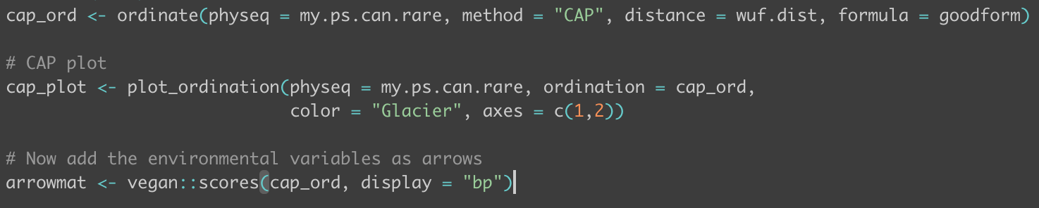
CAP Ordination
< Code from CAP analysis of rare community, vegan::scores(cap_ord, display=“bp”) returned no values – too many zeros in the relative abundances?
Total Community
Abundant Community
Rare Community
Figure : On Taylor glacier cryoconite area explained 29.44% of variation in total community beta diversity (F = 2.92, P=0.02). On Canada glacier, both area and water content explained 33.25% of the variation of variation in community composition (F=4.45, P=0.001)
Figure : On Taylor glacier cryoconite area explained 29.22% of variation in abundant community beta diversity (F = 2.89, P=0.02). On Canada glacier, both area and water content explained 35.41% of variation in community composition (F=4.82, P=0.001)
Figure : On Taylor glacier chlorophyll content explained 18.5% of variation in rare community beta diversity (F = 1.56, P=0.04).
Notes:
CAP ordination shows the correlation between beta diversity and area across both glaciers for abundant taxa, with water content also being correlated for Canada glacier.. Had problems with rare community.

Slide 16
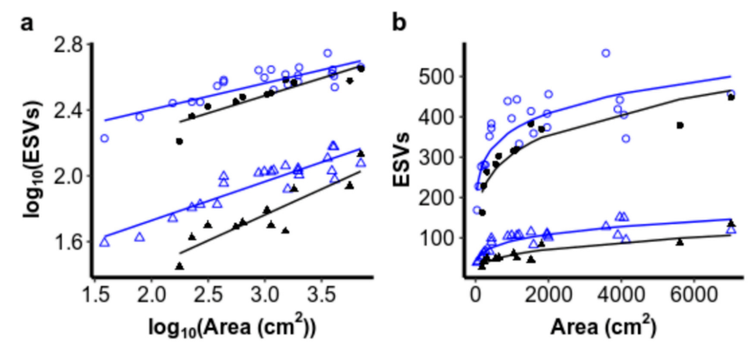
Island Species-Area Relationship (ISAR)
Figure : Non-linear least squares used to fit area to ASV data for abundant community. Canada: intercept = 103.34, slope = 0.04; Taylor: intercept = 51.46, slope = 0.13). Linear regression - log Area explains significant variation in abundant taxa log Richness on Canada Glacier (F=8.7, df=1,19, p = 0.008, adjusted R2 = 0.29) and Taylor Glacier (F=27.92, df=1,5, p=0.003, adjusted R2 = 0.82) shows that species richness increases with hole area (Canada: intercept=1.99, se=0.15; slope=0.05, se=0.02; Taylor: intercept=1.68, se=0.07; slope=0.14, se=0.03).
Figure : Non-linear least squares used to fit area to ASV data for rare community. Canada: intercept = 2.78, slope = 0.27; Taylor: intercept = 1.02, slope = 0.37). Linear regression - log Area explains significant variation in rare taxa log Richness on Canada Glacier (F=24.57, df=1,19, p <0.0001, adjusted R2 = 0.54) and Taylor Glacier (F=16.94, df=1,5, p=0.009, adjusted R2 = 0.73) shows that species richness increases with hole area (Canada: intercept=0.03, se=0.24; slope=0.39, se=0.08; Taylor: intercept=-0.19, se=0.31; slope=0.43, se=0.10).
Figure : Non-linear least squares used to fit area to ASV data for total community. Canada: intercept = 161.5, slope = 0.12; Taylor: intercept = 76.67, slope = 0.19). Linear regression - log Area explains significant variation in total taxa log Richness on Canada Glacier (F=38.23, df=1,19, p < 0.001, adjusted R2 = 0.65) and Taylor Glacier (F=32.06, df=1,5, p=0.002, adjusted R2 = 0.84) shows that species richness increases with hole area (Canada: intercept=2.15, se=0.17; slope=0.14, se=0.02; Taylor: intercept=1.84, se=0.11; slope=0.21, se=0.04).
Notes:
Using linear regression log area explained significant variation in abundant sub-community richness with a slope of 0.05 for Canada and 0.14 for Taylor. These slope coefficients are fairly commonly found for microbes.
Using linear regression log area explained significant variation in rare sub-community richness with a slope of 0.39 for Canada and 0.43 for Taylor. These slope coefficients are extremely high for microbes. Rare community richness increases more quickly with cryoconite area, suggesting that stochastic processes of dispersal are more important than for abundant taxa.

Slide 17
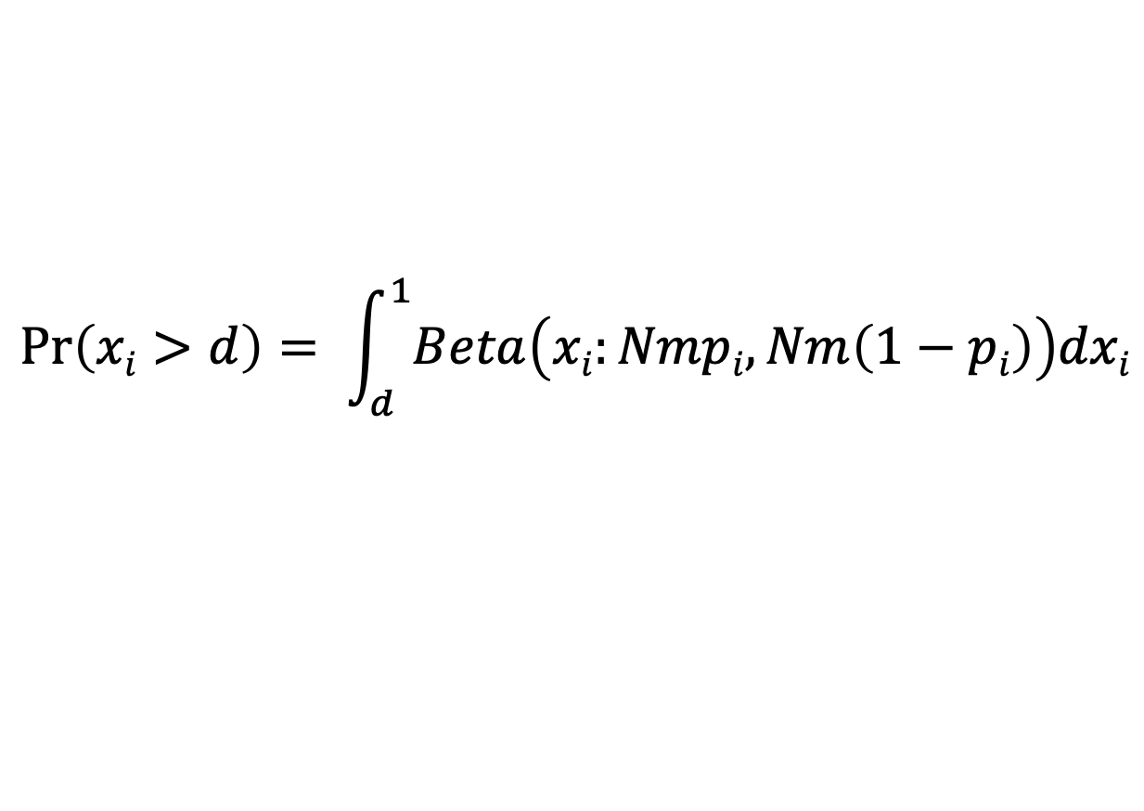
Sloan’s Neutral Community Model
Probability that a dead individual is replaced by dispersing individual
Average sample read count
Relative abundance of species i in the metacommunity
Abundance of species i
$$\operatorname{Pr}\left(xi>d\right)= \int_{d}^{1}{Beta\left(xi:Nmpi, Nm\left(1−pi\right)\right)dxi}$$
Probability
Detection threshold
Beta probability density function
$\operatorname{Pr}\left(xi>d\right)$ is equal to the proportion of samples in which species i is observed
Sloan et al., (2006) Quantifying the roles of immigration and chance in shaping prokaryote community structure
Notes:
Sloan’s Neutral Model states that the probability of species i occurring within a sample at abundance (x_{i}) above a detection threshold (d)
Model results are compared to the observed data. Deviation of observed data from model results is assumed to be evidence of deterministic community assembly.
The abundance of each ASV in the metacommunity (pi) is estimated by averaging it’s relative abundance across all samples.
Why is Sloan's Neutral Model important? (Sloan et al., 2006)
Microbial organisms are essential for life on earth.
The rules that govern their community assembly are poorly understood.
We need mathematical tools to describe these processes.
Typically microbial community structure has been thought to be shaped by deterministic processes (abiotic and biotic selection).
Despite this, the relative abundances and frequencies of taxa observed can be described using a neutral community model.
Sloan’s neutral community model includes stochastic birth-death events (or ecological drift) and immigration.
The neutral community model DOES NOT include any deterministic processes and is not supposed to be a complete description of microbial community assembly processes.
Despite this, the successful application of the model in describing patterns of community structure suggests that stochastic processes of ecological drift and dispersal are important processes in microbial community assembly.
Neutral models allow us to quantify processes which are difficult to directly observe (dispersal) yet that are important to microbial communities.
To test if stochastic processes play a key role in shaping microbial community structure we need:
Evidence of random community assembly
A neutral model for microbes that can deal with large populations
A method for paramaterisation that does not rely on observed species abundance distributions or assumptions about source community patterns
Data that support the model
A model robust to departures from the assumption of neutrality
Explain how Sloan's Neutral Model works.
The community is saturated with Nt individuals. For the assemblage to change an individual must die or leave the system. The rate of change within the system is species independent.
The dead individual is replace with probability m by an immigrant from the metacommunity, or replaced by reproduction of a member of the local community with probability 1-m.
The community changed through a cycle of death, birth and immigration only.

Slide 18
Code
Packages
library(dplyr)
library(tibble)
library(phyloseq)
library(ape)
library(vegan)
library(FSA)
library(eulerr)
library(minpack.lm)
library(Hmisc)
library(stats4)
library(ggplot2)
library(grid)
library(gridExtra)
Extract ASV table from phyloseq object
Calculate N by finding the mean number of reads per sample. We also find the limit of detection (d) = 1/N
Calculate the mean observed relative abundance and occurrence frequency of each ASV
Using non-linear least squares fitting we fit the neutral model to our data to find, finding the probability of dispersal (m)
Using the estimated value of m we calculate predicted occurrence frequencies and plot predictions from the neutral model against observed frequencies
Code developed from Barnett et al., (2020) Soil characteristics and land-use drive bacterial community assembly patterns (https://github.com/seb369/landuse_comm_assembly)
Notes:
Code developed from Barnett et al., (2020) Soil characteristics and land-use drive bacterial community assembly patterns (https://github.com/seb369/landuse_comm_assembly)
So we:
Fit the model to the observed frequency of occurrences of ASVs (in what proportion of the samples is each ASV detected?) and their abundance in the metacommunity (estimated as the mean relative abundance across all samples).
Explain how Sloan's Neutral Model works.
1. Calculate N as the mean read count within samples
2. Calculate the average relative abundance of each ASV across samples
3. Calculate the occurrence frequency of each ASV
4. Calculate the limit of detection
5. Fit the model parameter (m – probability that a dead individual is replaced by an immigrant) using non-linear least squares fitting
6. Use the fitted m parameter to calculate predicted ASV frequencies under stochastic processes.
10. Plot the predicted ASV frequencies (percentage of samples we expect to see an ASV) with the observed ASV frequencies against their mean relative abundance across all samples

Slide 19
Neutral Model
Total Community Abundant Community Rare Community
Notes:
The neutral model performed well for TOTAL community, explaining 77% of variation in ASV detection frequency with an estimated migration factor of 0.017 between sites.
These results suggest that neutral assembly processes can explain the pattern of observed ASV occurrence frequencies
Neutral processes less successful at explaining pattern of abundant community. Suggests intermediate and rare communities may be better explained by neutral processes. Rare community model fitting failed!
This is the result of the model fitting with the Sommers dataset (not reduced).
X axis = log average relative abundances of each ASV across all samples (percent composition of an ASV relative to the total number of ASVs across all samples)
Y axis = mean occurrence frequency of each ASV (in what percentage of samples will each ASV occur)
Points = observed log relative abundances against occurrence frequencies
Solid line = predicted log relative abundances plotted against occurrence frequencies
Dotted lines = 95% confidence intervals
This allows us to assess to what degree observed community structure can be explained by stochastic processes within each sample.
The Sloan neutral model is applied here. This model does not take into account phylogenetic distance.
ASV occurrence frequency is explained as a function of ASV abundance within the metacommunity (i.e. the more abundant an ASV is in the metacommunity, the more frequently it will be detected in the local community by chance).
The neutral model performed well, explaining 77% of variation in ASV detection frequency with an estimated migration factor of 0.017 between sites.
These results suggest that neutral assembly processes can explain the pattern of observed ASV occurrence frequencies and that the the regional species pool is a driving factor in the community composition of these samples.
The deviation of predicted occurrence frequencies from observed occurrence frequencies suggests that there are also deterministic processes driving community composition.
WHAT CAN WE INTERPRET FROM THESE RESULTS?
I have assessed the degree to which stochastic processes explain community assembly within these samples.
This model ignores phylogenetic distance and explains the frequency of ASV detection across samples as a function of their abundance in the metacommunity (the more individuals of ASV i are present in the metacommunity, the more likely you are to find them in any given sample).
The neutral model performed well, explaining 77% of the variation in ASV detection frequency with an estimated migration factor of 0.017 between sites (this means there is ~2% chance of a local death being replaced by an immigrant which is very low – lower than reported for other studies that hover around 16-25%).
These results indicate that, for the majority of ASVs, neutral assembly processes of ecological drift and dispersal can explain their within sample occurrence patterns across an area, and the composition of the species pool of the area drives community assembly.
However, the model is not a perfect fit to the data and beta diversity ordination has shown that communities vary significantly between glaciers, suggesting that deterministic processes also play an important role.
NULL hypothesis: cryoconite bacterial community composition is completely stochastic. Neutral model results (high R2) mean I am unable to reject the null hypothesis. Significant variable in ASV frequency across samples is explained by their relative abundance in the metacommunity. The results suggest that local selection is weak and dispersal is low, indicating that ecological drift is the dominant community assembly process.
Estimates of beta diversity based on phylogenetic dissimilarity show significant variation between glaciers. This supports the results that dispersal is limited. We might suggest that variation in beta diversity is a result of local ecological drift and limited dispersal rather than selection.
The distribution of ASVs across samples (in the metacommunity) followed the basic pattern of more abundant data being widespread – this is consistent with predictions of neutral theory. Despite the good fit of the model and the low m rate, there was significant difference between the communities on each glacier, illustrating the important point that variation among microbial communities does not need to be the result of environmental differences. Neutral processes can generate diversity on their own!
What would I expect to see for abundant/rare, active/bulk communities? What would I infer from this?
I want to repeat this analysis for abundant/rare taxa and active/bulk groups to see if stochastic processes are as important for each group, as well as to see how chance of immigration changes.
Previous studies into soil microbial community assembly processes found:
Neutral model explained more variation in abundant sub-community than rare sub-community.
Neutral model also predicted lower m values for abundant sub-communities than rare sub-communities.
Abundant species likely utilize an array of resources and occupy more broad niches, which rare taxa may occupy more specific niches – we would expect rare sub-communities to be more strongly shaped by deterministic processes.
I predict that the neutral model will describe more variation in the bulk community than the active community as selection will only occur on active species. I also predict that migration rates will be higher for bulk communities because migration requires that an individual successfully transfer to a new habitat – where a dormant individual doesn’t need to worry about selection.

Slide 20
Stegen et al., (2015) Phylogenetic Null Model
βNTI
< -2
> 2
|βNTI| < 2
Homogenizing Selection
Variable Selection
Stochastic Processes
Raup-Crick
< - 0.95
Homogenizing Dispersal
> 0.95
Dispersal Limitation
|Raup-Crip| < 0.95
Ecological Drift or Weak Selection
Stegen et al., (2015) Estimating and mapping ecological processes influencing microbial community assembly
Notes:
For each pair of community we generate the βMNTD is selection was not driving community assembly by randomly shuffling the tips of the phylogeny and recalculating the βMNTD (repeat 999 times to get distribution of null values).
We use the observed βMNTD and the null βMNTD to generate our β-nearest-taxon-index (βNTI).
If the observed βMNTD is significantly less (i.e. βNTI <-2) or greater than the null expectation (i.e. βNTI >2) we would infer that homogenous selection or variable selection is shaping community assembly respectively.
If the absolute value of βNTI is less than 2 we suggest that stochastic processes are predominantly driving community assembly.
Observed bray-Curtis dissimilarities are then compared to the null distribution to get the RCbray value. If the Rcbray value is less than -0.95 then the community is more homogenous than expected at random and this is driven by high dispersal rates. If the Rcbray value is > 0.95 than the communities are more different than expected by random and they are shaped by dispersal limitation. If the absolute value of Rcbray is less than 0.95 then the compositional turnover between a given pair of communities is undominated by selection or dispersal.
Why is Stegen's Phylogenetic Null Model important?
Ecological community assembly is shaped by:
Selection from among-taxa differences in fitness (this can be homogenous or variable)
Dispersal (is a rate that may be limited when there is limited dispersal between communities, or homogenizing dispersal when there is high dispersal between communities)
Ecological drift
The relative importance of these processes varies.
If environmental conditions are homogenous through space there will be constant selective pressure resulting in homogenous selection.
If environmental conditions vary across space, the fitness differences of taxa will vary across space and there will be variable selection.
High dispersal rates between communities lead to homogenous community composition if those dispersal rates overcome selective pressures, leading to homogenizing dispersal.
If selection is weak and dispersal between communities is low, ecological drift can generate significant changes in community composition.
Dispersal limitation is the situation in which low dispersal rates are the primary contributor to high community turnover.
Ecological drift is the situation in which there is a combination of moderate selection and moderate dispersal, neither process dominates so community turnover is a result of a mixture of dispersal and random birth/death events. Essentially this is where community assembly is not dominated by a particular process.
Stochastic processes can produce complex spatial community patterns.
Ecological drift = random birth/death events in a specific area, in the absence of selection. Ecological drift is particularly important when dispersal is limited as illustrated by island biogeography theory.
Dispersal limitation between isolated habitats promotes local extinction and ecological drift which causes initially identical communities to diverge. Ecological drift can cause communities to diverge, even when dispersal is high and selection pressure is low.
Homogenizing dispersal = high dispersal rates leading to similar communities between habitats (overcomes the impact of ecological drift and even deterministic processes)
Deterministic (deterministic processes commonly mean beta diversity varies as a result of environmental characteristics – i.e. communities are more or less different due to the differences or similarities of the environments)
Variable selection – deterministic processes are driving variable composition between communities. Different areas have different environmental characteristics that select for different species.
Homogenizing selection – deterministic processes are driving homogenous composition between communities. Different areas have similar environmental characteristics that select for similar species.
Dispersal limitation – stochastic dispersal limitation is driving variable composition between communities
Homogenizing dispersal – stochastic high dispersal is driving homogenous composition between communities
Ecological drift – stochastic ecological drift is driving variable composition between communities
Explain how Stegen's Null Model works.
This framework uses the phylogenetic differences between communities to infer ecological selection.
Why is phylogenetic signal important?
For this method to work there need to be significant phylogenetic signal – that is, taxa that are more closely phylogenetically related, exhibit ecological similarities/niche similarities. If more closely related taxa are not more ecologically similar then we cannot use their relatedness to infer if selection or stochastic processes are occurring.
The process
To quantify phylogenetic turnover between communities we first calculate the between-community mean-nearest-taxon-distance metric (βMNTD). This quantifies the distance between each species in one community and it’s closest relative in a second community.
For each pair of community we generate the βMNTD is selection was not driving community assembly by randomly shuffling the tips of the phylogeny and recalculating the βMNTD (repeat 999 times to get distribution of null values).
We use the observed βMNTD and the null βMNTD to generate our β-nearest-taxon-index (βNTI).
If the observed βMNTD is significantly less (i.e. βNTI <-2) or greater than the null expectation (i.e. βNTI >2) we would infer that homogenous selection or variable selection is shaping community assembly respectively.
If the absolute value of βNTI is less than 2 we suggest that stochastic processes are predominantly driving community assembly.
To distinguish between homogenizing dispersal, limited dispersal and lack of dominance between selection and dispersal, we use the Raup-Crick metric which incorporates species relative abundances but doesn’t use phylogenetic information.
To generate the RC metric, species are drawn into each sample until the observed species richness of each sample is reached.
Then individuals are draw into each species until the observed abundance is reached. This procedure approximates stochastic community assembly under the assumption of weak selection and random dispersal. Compositional differences are qualified using Bray-Curtis and this is repeated 999 times for each pair of communities to generate a null distribution of dissimilarities.
Observed bray-Curtis dissimilarities are then compared to the null distribution to get the RCbray value. If the Rcbray value is less than -0.95 then the community is more homogenous than expected at random and this is driven by high dispersal rates. If the Rcbray value is > 0.95 than the communities are more different than expected by random and they are shaped by dispersal limitation. If the absolute value of Rcbray is less than 0.95 then the compositional turnover between a given pair of communities is undominated by selection or dispersal.

Slide 21
Phylogenetic Signal
Find phylogenetic distances between ASVs
Plot results of the mantel correlograms against phylogenetic distance classes for each environmental parameter to check for significant relationships
Calculate mantel correlograms for each environmental parameter
Find the weighted mean environmental parameters for each ASV = niche preferences

Slide 22
Phylogenetic Signal
Datasets had to be reduced because they were too big and taking a million years to do my mantel correlograms and killing my laptop!
Total Community Abundant Community Rare Community?!?!?!?
Notes:
Solid and open dots signify significant and non-significant correlations respectively. This related between ASV niche differences and between ASV phylogenetic distances. I used the cryoconite properties of chlorophyll, hole depth, pH and water content to estimate ASV environmental niches. Significant positive correlations indicates that the niche distance between ASVs increases with phylogenetic distance.
The null model may not be appropriate for this data due to lack of significant correlations– however, we must consider that this dataset was drastically reduced to allow the correlograms to process on my local computer. With that in mind, we continue with the null model analysis.
There are multi ways of testing for phylogenetic signal so it’d like to look into them (https://besjournals.onlinelibrary.wiley.com/doi/full/10.1111/j.2041-210X.2012.00196.x)

Slide 23
Phylogenetic Null Model
Total Community Abundant Community Rare Community
Notes:
The abundant community is mostly shaped by dispersal limitation between sites.
The rare community is mainly shaped by drift (no dominat selection process).
Here we see that when I compared the composition of each community to the composition of all other communities, the absolute values of the β-nearest-taxon-index (βNTI) were generally < 2, suggesting that community assembly is predominantly driven by homogenizing dispersal, limiting dispersal or is undominated/a result of drift.
βNTI combined with Rcbray scores indicated that communities on both glaciers were shaped by a combination of dispersal limitation (making the communities less similar than would be expected by chance) and drift (where neither selection or dispersal are particularly strong).
The dominance of stochastic processes is in keeping with the results of my neutral model analysis which suggested a large portion of the variation between communities could be explained by stochastic processes. Moreover, this is consistent with my CAP analysis that suggested cryoconite hole area and water content explained a low level of variation in community composition.
What would I expect to see for abundant/rare, active/bulk communities? What would I infer from this?
Previous studies of community assembly for abundant and rare taxa have found:
Increased homogenous selection for rare taxa.
Increased dispersal limitation and variable selection for abundant taxa.
Other studies have found selection more dominant for abundant taxa and drift more dominant for rare taxa.
These processes very depending on environment. Because as far as I know null modelling with abundant/rare sub-communities hasn’t been applied to the supraglacial environment so it’s s mystery.
I predict that stochastic processes will drive more variation in the bulk community than the active community as selection will only occur on active species. I also predict that Selection will be more important for rare than abundant taxa as abundant taxa may experience higher immigration rates that overcomes selection processes.

Slide 24
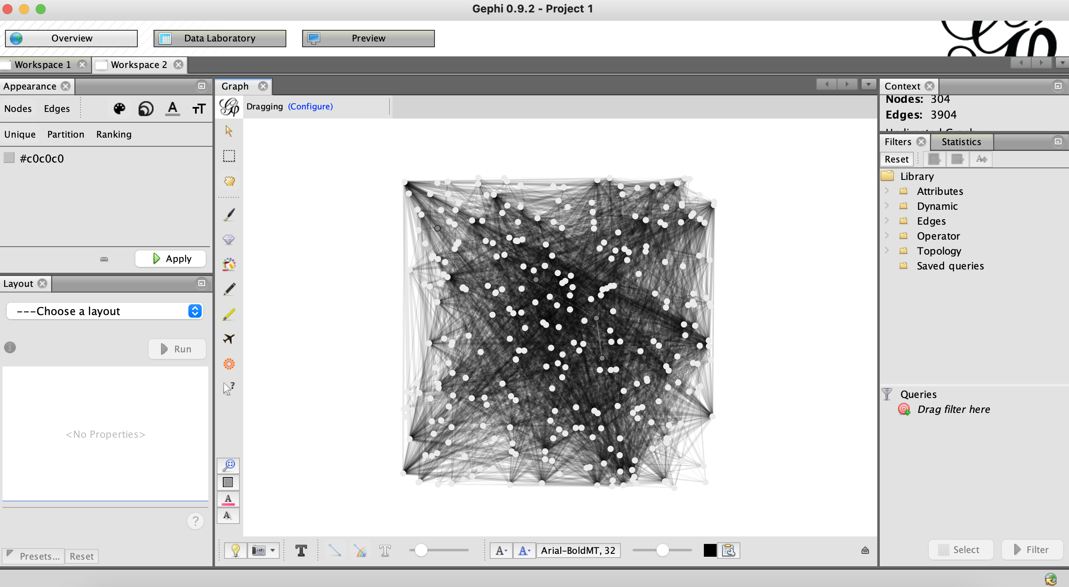
Co-Occurrence Network Analysis
Notes:
Why is network analysis important?
Network analysis allows us to explore biotic selection, that is the interactions between microbial taxa that may drive microbial community assembly.
If we see a low number of significant taxon co-occurrence patterns this may support our theory that community assembly is primarily stochastic. If there are high numbers of significant taxon co-occurrence patterns this may lend support to deterministic processes driving community assembly.

Slide 25
Summary of Results
Microbial community composition in the supraglacial environment is explained by both deterministic and stochastic assembly processes.
Total, abundant and rare prokaryotic and eukaryotic sub-communities exhibit distinct biogeographic patterns, driven by distinct community assembly processes, across all substrates.
Linear regression: Abundant sub-community correlated with a range of environmental variables. Rare sub-community mainly correlated with hole area.
Ordination: Abudant communities distinct between glaciers. Rare community not significantly different.
ISAR: Rare community more strongly shaped by increasing hole area than abundant community. HIGH SLOPE COEFFICIENT!
Neutral model: Seems like neutral model may better explain intermediate/rare communities than abundant communities.
Null: Abundant community shaped by dispersal limitation. Rare community shows no dominant process.
REMEMBER: THESE ANALYSES NEED TO BE RUN ON HPC FOR TRUE RESULT!
Notes:
Linear regression indicates that abundant sub-community is correlated with hole area, DNA per gram of cryoconite and organic matter content of cryoconite.
Linear regression indicates that rare sub-community is correlated with hole depth and area. Suggests that abundant community may be shaped more by selection, which rare community may be more shaped by stochastic processes.
Linear regression with interactions
The minimum adequate model to explain abundant richness involved a range of environmental parameters.
The minimum adequate model to explain rare community richness was hole area.
Suggests that abundant community may be shaped more by selection, which rare community may be more shaped by stochastic processes.
Unweighted unifrac ordination indicates that there is significant variation in beta diversity between abundant sub-communities, but no significant variation between rare communities. This may also be indicative of separate abundant communities established due to selection, while the rare sub-community randomly disperses between the glaciers.
CAP ordination shows the correlation between beta diversity and area across both glaciers for abundant taxa, with water content also being correlated for Canada glacier.. Had problems with rare community.
Using linear regression log area explained significant variation in abundant sub-community richness with a slope of 0.05 for Canada and 0.14 for Taylor. These slope coefficients are fairly commonly found for microbes.
Using linear regression log area explained significant variation in rare sub-community richness with a slope of 0.39 for Canada and 0.43 for Taylor. These slope coefficients are extremely high for microbes. Rare community richness increases more quickly with cryoconite area, suggesting that stochastic processes of dispersal are more important than for abundant taxa.
The neutral model performed well for TOTAL community, explaining 77% of variation in ASV detection frequency with an estimated migration factor of 0.017 between sites.
These results suggest that neutral assembly processes can explain the pattern of observed ASV occurrence frequencies
Neutral processes less successful at explaining pattern of abundant community. Suggests intermediate and rare communities may be better explained by neutral processes. Rare community model fitting failed!
The abundant community is mostly shaped by dispersal limitation between sites.
The rare community is mainly shaped by drift (no dominat selection process).

