Slide 1
Microbial Biogeography and Community Assembly Mechanisms in the Supraglacial Environment: Influence of activity and abundance
Amy Solman
Notes:
Questions I want to ask:
How does dormancy influence microbial dispersal and community assembly?
How do dispersal and community assembly mechanisms differ at local, regional and global scales?
Does dispersal and community assembly mechanisms change between Spring and Summer seasons?
Why are we interested in community assembly?
Because we want to understand the evolutionary and ecological mechanisms that govern microbial community composition at local scales, thus shaping large scale patterns of microbial biogeography. Community composition affects community function with profound impacts on the wider ecosystem functioning and biodiversity.
This study aims to develop an in-depth understanding of cryoconite community interactions and assembly processes. Particular questions of interest include:
(i) Do cryoconite community exhibit nonrandom co-occurrence patterns?

Slide 2
Neutral Theory
Sloan et al., (2006) Quantifying the roles of immigration and chance in shaping prokaryote community structure

Slide 3
Hypotheses
Microbial community composition in the supraglacial environment is explained by both deterministic and stochastic processes.
Abundant and rare prokaryotic and eukaryotic diversity exhibit distinct biogeographic patterns that are driven by different community assembly processes.
Community assembly processes will differ between bulk and active microbial communities. That is, active communities will be more strongly influenced by deterministic processes and bulk communities will be more strongly influenced by stochastic processes.
Biogeographic patterns (ISAR, DDR) will differ between bulk and active communities. That is, active communities will exhibit stronger biogeographic patterns than bulk communities.

Slide 4
Analysis Workflow
Multivariate Analysis
Neutral Model
Null Model
Network Analysis
Notes:
Why am I using this analysis workflow?
I am combining multiple analytical techniques in order to collect a wide range of evidence pointing towards the drivers of community assembly.
Each method used in isolate may have its caveats, but used in combination we can build a robust picture of the processes at play in our environment of interest.
Multivariate analysis looks primarily at deterministic drivers of community assembly (e.g. environmental factors)
Neutral model looks at how much of the patterns we see can be explained by stochastic processes alone.
Null model takes a phylogenetic approach to look at deviation between our observed communities are what we expect at random to investigate both deterministic and stochastic processes.
Network analysis allows us to explore biotic selection as a deterministic process of community assembly.

Slide 5
Sommers et al., (2020) ﻿Microbial Species–Area Relationships in Antarctic Cryoconite Holes Depend on Productivity
Recently published
Cryoconite communities
Detailed information on sequence processing
ISAR analysis
Includes bacterial and eukaryotic sequence data
Includes data from two glaciers
Notes:
I chose this dataset on which to develop my analysis pipeline because it included recently published cryoconite community data and cryoconite communities are of specific interest to me as they are a hotspot of biological activity on the glacier surface. Also, they act as discrete microcosms which can be measured in terms of area, therefore have the advantage of being used to explore the present of island-species area relationships.
The fact that ISAR had already been investigated in this dataset meant that I could carry out my own analyses and compare the results to ensure that I was analyzing the data correctly.
The paper included information on sequence processing that I was able to use in my first QIIME workflow.
It gave me the opportunity to work with 16S and 18S data (although here I have only analyzed the 16S data)
The data could also be grouped by glacier which was useful for comparative analyses.

Slide 6
QIIME2 & DADA2
Download sequence data and metadata in command line using SRA toolbox
QIIME2: Modify/convert files to QIIME2 formats
QIIME2: Trim primers
DADA2: Denoise data
QIIME2: Use SILVA classifier to classify representative sequences
QIIME2: Generate feature table
QIIME2: Make multiple sequence alignment with MAFFT, construct phylogenetic tree and root.
QIIME2: Export feature table, ASV count table, representative sequences, taxonomy table and rooted phylogenetic tree.
Notes:
In QIIME2 on my local computer I downloaded Sequence Read Archive (SRA) toolbox that allowed me to prefetch the sequence data from the SRA website using the archive umber supplied by the paper, splitting the flies into forward and reverse reads and saving them to my laptop.
I renamed the sequence files and modified the metadata file into formats expected by QIIME2.
Import fastq files and convert them into a format Qiime wants to work with.
Remove primers. I'm getting the primers from https://earthmicrobiome.org/protocols-and-standards/16s/ as described by Sommers et al., (2020)
The primer sequences are :
Updated sequences: 515F (Parada)–806R (Apprill), forward-barcoded:
FWD:GTGYCAGCMGCCGCGGTAA; REV:GGACTACNVGGGTWTCTAAT
Check the quality of trimmed reads and visualise.
Call DADA2. Where are the adaptors? Front or back? Use trim in DADA2 to cut them, in stead of QIIME2 cutadapt
FastQC - look at for adaptor - if adaptor isn't there then don't worry about it! Warning: Not all adaptors are picked up by FastQC.
Denoise data and check results of this step.
Summarise remaining reads after denoising and visualise. Through the sequence table generated below you can click on a representative sequence and BLAST it.
Generate a feature table and visualise.
Download Silva classifier and move to work folder.
Classify representative sequences and visualise.
Make a multiple sequence alignment with MAFFT.
Now mask the alignment.
Construct the phylogenetic tree and root.
Export feature table (Feature table of the remaining sequences after denoising that tells us how many samples we have, how many features (ASVs) we have, how frequent (how many individual cells there are) per sample, how many ASVs we see per sample ) , ASV count table (ASV count table with sample as columns and ASV as row ), representative sequences (The remaining representative sequences after denoising (i.e. a list of all the unique base pair sequences present in the denoised dataset), exported as a fasta file), taxonomy table (Table of feature (ASV) IDs and their taxonomic classifications ) and phylogenetic tree.

Slide 7
Data Prep
Wrangle metadata
Identify and remove contaminant ASVs
Remove singletons
Re-root phylogenetic tree
Remove ambiguous annotations and low abundance phyla
Construct phyloseq object and export
Load in data from QIIME2 step

Slide 8
Abundant and rare taxa
Rarefied phyloseq object to even sampling depth
Get local (within sample) relative abundances
Find the regional (between sample) relative abundances = mean of local relative abundances
Locally abundant taxa > 1% relative abundance
Locally rare taxa < 0.01% relative abundance
Regionally abundant taxa > 0.1% mean relative abundance
Regionally rare taxa < 0.01% mean relative abundance
Li et al., (2021) Active bacterial and archaeal communities in coastal sediments: Biogeography pattern, assembly process and co-occurrence relationship

Slide 9
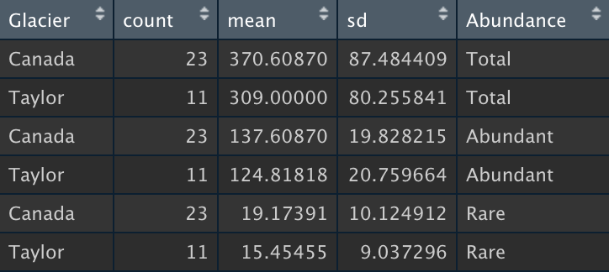
ASV Richness
Comparison of ASV richness between Canada and Taylor glaciers
Total community: Parametric assumptions met. Unpaired two-sample t-test showed no significant difference (t=1.97, df=32, p=0.57)
Abundant community: Parametric assumptions not met. Unpaired two samples Wilcoxon test showed no significant difference (W=179.5, p= 0.053)
Rare community: Parametric assumptions met. Unpaired two-sample t-test showed no significant difference (t=1.04, df=32, p=0.31)

Slide 10
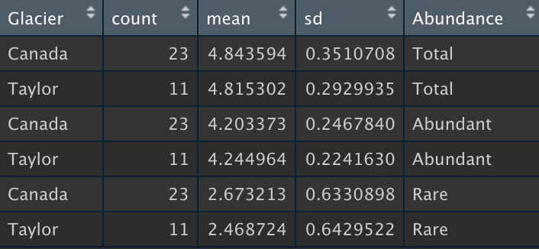
Shannon Diversity
Comparison of Shannon between Canada and Taylor glaciers
Total community: Parametric assumptions not met. Unpaired two samples Wilcoxon test showed no significant difference (W=141, p= 0.61)
Abundant community: Parametric assumptions not met. Unpaired two samples Wilcoxon test showed no significant difference (W=123, p= 0.91)
Rare community: Parametric assumptions met. Unpaired two-sample t-test showed no significant difference (t=0.88, df=32, p=0.39)

Slide 11
Other Diversity Metrics
Faith: Total community = No difference. Abundant community = No difference (significant difference with non-parametric). Rare community = No difference.
Simpson: Total community = No difference. Abundant community = Significant difference (no difference with non-parametric). Rare community = No difference.
Inverse Simpson: Total community = No difference. Abundant community = No difference. Rare community = No difference.
Pilou: Total community = Significant difference. Abundant community = Significant difference. Rare community = No difference.

Slide 12
Linear models with ANOVA
LogRichness ∼ Glacier
Total : Significant model but low explanatory power (F=6.26, df = 1, p=0.02, adj R2 = 0.16)
Abundant: Significant model but low explanatory power (F=5.8, df = 1, p=0.02, adj R2 = 0.15)
Rare: Insignificant model (F=1.142, df=1, p=0.30)

Slide 13
Linear Regression Analysis: Are their correlations between ASV richness and any environmental variables?
Correlation test (cor.test) of log transformed data indicated…
Total community ASV richness: Correlation with cryoconite hole depth, cryoconite hole area, DNA per gram of cryoconite, organic matter content of cryoconite
Abundant community ASV richness: Correlation with cryoconite hole area, DNA per gram of cryoconite, organic matter content of cryoconite
Rare community ASV richness: Correlation with cryoconite hole depth, cryoconite hole area

Slide 14
Linear model of log(Richness) explained by log(Area)
log Area explains significant variation in total taxa log Richness on Canada Glacier (F=38.23, df=1,19, p < 0.001) and Taylor Glacier (F=32.06, df=1,5, p=0.002) shows that species richness increases with hole area (Canada: intercept=4.96, se=0.15; slope=0.14, se=0.02; Taylor: intercept=4.24, se=0.25; slope=0.21, se=0.04).
log Area explains significant variation in abundant taxa log Richness on Canada Glacier (F=8.7, df=1,9, p=0.008) and Taylor Glacier (F=27.92, df=1,5, p=0.003) shows that species richness increases with hole area (Canada: intercept=4.59, se=0.12; slope=0.05, se=0.02, Taylor: intercept=3.87, se=0.18; slope=0.14, se=0.03).
log Area explains significant variation in rare taxa log Richness on Canada Glacier (F=24.57, df=1,19, p<0.001) and Taylor Glacier (F=16.94, df=1,5, p=0.009) shows that species richness increases with hole area (Canada: intercept=0.07, se=0.55; slope=0.39, se=0.08, Taylor: intercept=-0.45, se=0.72, slope=0.43, se=0.1).

Slide 15
Linear model of log(Richness) explained by log(Area)
Total Community Abundant Community Rare Community
Notes:
The same analysis with a range of diversity metrics gave similar results.

Slide 16
Linear model of log(Richness) as a function of log(Area) * Glacier
Significant variation in total taxa log Richness is explained by the main effects area (p < 0.001) and glacier (p < 0.001) but there is no significant interaction between area and glacier (p=0.08)
Significant variation in abundant taxa log Richness is explained by the main effects area (p < 0.001) and glacier (p = 0.002) and there is significant interaction between area and glacier (p=0.008)
Significant variation in rare taxa log Richness is explained by the main effect area (p < 0.001) but not glacier (p = 0.23) but there is no significant interaction between area and glacier (p=0.76)

Slide 17
Linear model of log(Richness) as a function of log(Area) * Glacier
Total Community Abundant Community Rare Community

Slide 18
Multiple predictor variable linear model
lm(formula = logRichness ~ (logArea + logorg_matter + logDepth + logDNA_per_g + logwater_content + Glacier)^2, data = data)
Total ASV Richness minimum adequate model = logRichness ~ logArea + logorg_matter + logDepth + logDNA_per_g + logArea:logorg_matter + logArea:logDepth (F=23.35, df=6,21, p<0.001, adjusted R2 = 0.83)
Abundant ASV Richness minimum adequate model = logRichness ~ logArea + logorg_matter + logDepth + logDNA_per_g + logwater_content + Glacier + logArea:logorg_matter + logArea:logDepth + logArea:logwater_content + logorg_matter:logwater_content + logDepth:logDNA_per_g + logDNA_per_g:logwater_content + logDNA_per_g:Glacier + logwater_content:Glacier (F=36.26, df=14,13, p < 0.0001, adjusted R2 = 0.95)
Rare ASV Richness: = logRichness ~ logArea (F=41.74, df=1,26, p<0.001, adjusted R2=0.60)

Slide 19
Non-linear least squares model fitting of Area to ASV Richness
Total Community Abundant Community Rare Community

Slide 20
Beta Diversity & Ordination: Weighted UniFrac
Figure : Beta diversity of rare community, calculated using weighted UniFrac distances, visualized use PCoA (blue is Taylor Glacier and orange is Canada Glacier). This plot shows significant beta diversity variation between glaciers (PERMANOVA: F = 1.50, df=1, P =0.038).
Figure : Beta diversity of total community, calculated using weighted UniFrac distances, visualized use PCoA (blue is Taylor Glacier and orange is Canada Glacier). This plot shows significant beta diversity variation between glaciers (PERMANOVA: F =8.39 , df=1, P =0.001).
Figure : Beta diversity of abundant community, calculated using weighted UniFrac distances, visualized use PCoA (blue is Taylor Glacier and orange is Canada Glacier). This plot shows significant beta diversity variation between glaciers (PERMANOVA: F = 11.11, df=1, P =0.001).

Slide 21
Beta Diversity & Ordination: Unweighted UniFrac
Figure : Beta diversity of rare community, calculated using weighted UniFrac distances, visualized use PCoA (blue is Taylor Glacier and orange is Canada Glacier). This plot shows no significant beta diversity variation between glaciers (PERMANOVA: F = 1.01, df=1, P =0.43).
Figure : Beta diversity of total community, calculated using weighted UniFrac distances, visualized use PCoA (blue is Taylor Glacier and orange is Canada Glacier). This plot shows significant beta diversity variation between glaciers (PERMANOVA: F =4.61 , df=1, P =0.001).
Figure : Beta diversity of abundant community, calculated using weighted UniFrac distances, visualized use PCoA (blue is Taylor Glacier and orange is Canada Glacier). This plot shows significant beta diversity variation between glaciers (PERMANOVA: F = 8.91, df=1, P =0.001).

Slide 22

Beta Diversity & Ordination: Bray-Curtis
Figure : Beta diversity of rare community calculated using Bray-Curtis distances, visualized use NMDS plot (blue is Taylor Glacier and orange is Canada Glacier). This plot shows no significant beta diversity variation between glaciers (PERMANOVA: F = 1.06, df=1, P =0.07).
Figure : Beta diversity of total community calculated using Bray-Curtis distances, visualized use NMDS plot (blue is Taylor Glacier and orange is Canada Glacier). This plot shows significant beta diversity variation between glaciers (PERMANOVA: F =8.5 , df=1, P =0.001).
Figure : Beta diversity of abundant community calculated using Bray-Curtis distances, visualized use NMDS plot (blue is Taylor Glacier and orange is Canada Glacier). This plot shows significant beta diversity variation between glaciers (PERMANOVA: F = 10.33, df=1, P =0.001).

Slide 23
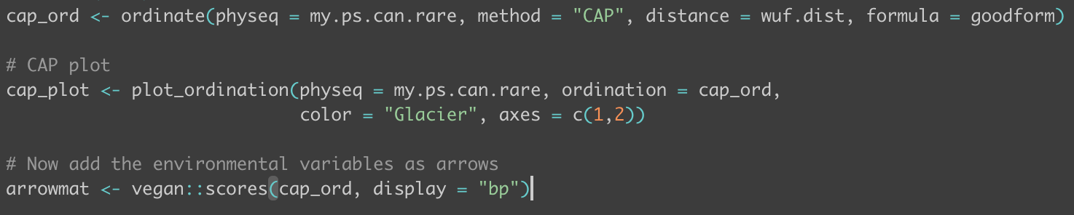
CAP Ordination
< Code from CAP analysis of rare community, vegan::scores(cap_ord, display=“bp”) returned no values – too many zeros in the relative abundances?
Total Community
Abundant Community
Rare Community
Figure : On Taylor glacier cryoconite area explained 29.44% of variation in total community beta diversity (F = 2.92, P=0.02). On Canada glacier, both area and water content explained 33.25% of the variation of variation in community composition (F=4.45, P=0.001)
Figure : On Taylor glacier cryoconite area explained 29.22% of variation in abundant community beta diversity (F = 2.89, P=0.02). On Canada glacier, both area and water content explained 35.41% of variation in community composition (F=4.82, P=0.001)
Figure : On Taylor glacier chlorophyll content explained 18.5% of variation in rare community beta diversity (F = 1.56, P=0.04).

Slide 24
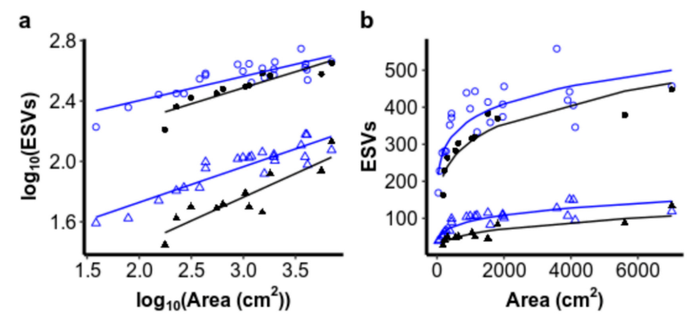
Island Species-Area Relationship (ISAR)
Figure : Non-linear least squares used to fit area to ASV data for abundant community. Canada: intercept = 103.34, slope = 0.04; Taylor: intercept = 51.46, slope = 0.13). Linear regression - log Area explains significant variation in abundant taxa log Richness on Canada Glacier (F=8.7, df=1,19, p = 0.008, adjusted R2 = 0.29) and Taylor Glacier (F=27.92, df=1,5, p=0.003, adjusted R2 = 0.82) shows that species richness increases with hole area (Canada: intercept=1.99, se=0.15; slope=0.05, se=0.02; Taylor: intercept=1.68, se=0.07; slope=0.14, se=0.03).
Figure : Non-linear least squares used to fit area to ASV data for rare community. Canada: intercept = 2.78, slope = 0.27; Taylor: intercept = 1.02, slope = 0.37). Linear regression - log Area explains significant variation in rare taxa log Richness on Canada Glacier (F=24.57, df=1,19, p <0.0001, adjusted R2 = 0.54) and Taylor Glacier (F=16.94, df=1,5, p=0.009, adjusted R2 = 0.73) shows that species richness increases with hole area (Canada: intercept=0.03, se=0.24; slope=0.39, se=0.08; Taylor: intercept=-0.19, se=0.31; slope=0.43, se=0.10).
Figure : Non-linear least squares used to fit area to ASV data for total community. Canada: intercept = 161.5, slope = 0.12; Taylor: intercept = 76.67, slope = 0.19). Linear regression - log Area explains significant variation in total taxa log Richness on Canada Glacier (F=38.23, df=1,19, p < 0.001, adjusted R2 = 0.65) and Taylor Glacier (F=32.06, df=1,5, p=0.002, adjusted R2 = 0.84) shows that species richness increases with hole area (Canada: intercept=2.15, se=0.17; slope=0.14, se=0.02; Taylor: intercept=1.84, se=0.11; slope=0.21, se=0.04).
Notes:
Non-linear regression does not use p-values or R2 values but we can use R2 values to compare model fittings

Slide 25
Neutral Model
Total Community Abundant Community Rare Community

Slide 26
Phylogenetic Signal
Total and rare dataset reduced to only ASVs found in >20 samples and <20 samples respectively because the datasets were too big and taking a million years to do my mantel correlograms and killing my laptop!
Total Community Abundant Community Rare Community
Notes:
Solid and open dots signify significant and non-significant correlations respectively. This related between ASV niche differences and between ASV phylogenetic distances. I used the cryoconite properties of chlorophyll, hole depth, pH and water content to estimate ASV environmental niches. Significant positive correlations indicates that the niche distance between ASVs increases with phylogenetic distance.
Here there is only one significant relationship between phylogenetic distance and environmental variable – so the null model may not be appropriate for this data – however, we must consider that this dataset was drastically reduced to allow the correlograms to process on my local computer. With that in mind, we continue with the null model analysis.
There are multi ways of testing for phylogenetic signal so it’d like to look into them (https://besjournals.onlinelibrary.wiley.com/doi/full/10.1111/j.2041-210X.2012.00196.x)

Slide 27
Phylogenetic Null Model
Total Community Abundant Community Rare Community

Slide 28
Summary of Results
Remember, Taylor glacier is only represented by 11 samples. Canada is represented by 23 samples.

Slide 29
Multivariate Analysis
Alpha Diversity
Beta Diversity & Ordination
ISAR and DDR

Slide 30
Alpha Diversity
Figure : Plots of ASV richness (A) and Shannon Diversity Index (B) for each glacier (richness: t = 2.0202, df = 32, p=0.0518, Shannon: W = 142, p=0.5808)
Notes:
Calculated ASV richness and Shannon Diversity Index for each Glacier
Used Two Samples T-Test to compare ASV richness between glaciers (as count data was normally distributed)
Result: No significant difference between ASV richness (p=0.052)
Used Two Samples Wilcoxon Test to compare Shannon Diversity Index for each glacier (as index data was not normally distribute)
Result: No significant difference between Shannon Diversity (p=0.581)

Slide 31
Beta Diversity & Ordination: Weighted UniFrac
Figure : Beta diversity calculated using weighted UniFrac distances, visualized use PCoA (blue is Taylor Glacier and orange is Canada Glacier). This plot shows significant beta diversity variation between glaciers (PERMANOVA: F = 12.539, df=1, P = 0.0001).
Notes:
I calculated the beta diversity between glaciers using weighted unifrac distances used the distance function in phyloseq package.
I used permutational multivariate analysis of variance (PERMANOVA) to find if community composition significantly varied between glaciers using 999 permutations
Estimates of beta diversity based on phylogenetic dissimilarity show significant variation between glaciers.

Slide 32
Beta Diversity & Ordination: Unweighted UniFrac
Figure : Beta diversity calculated using unweighted UniFrac distances, visualized use PCoA (blue is Taylor Glacier and orange is Canada Glacier). This plot shows significant beta diversity variation between glaciers (PERMANOVA: F =4.1016 , df=1, P =0.001).

Slide 33
Beta Diversity & Ordination: Bray-Curtis
Figure : Beta diversity calculated using Bray-Curtis distances, visualized use NMDS plot (blue is Taylor Glacier and orange is Canada Glacier). This plot shows significant beta diversity variation between glaciers (PERMANOVA: F =8.3412 , df=1, P =0.001).

Slide 34
All Environmental Plots
Notes:
Wilcoxon test used to compare cryoconite hole area (cm2) between glaciers. No significant difference detected (W = 134, p=0.7966).
Wilcoxon test used to compare chlorophyll between glaciers. No significant difference detected (W = 160, p=0.141).
Wilcoxon test used to compare DNA content between glaciers. Significant difference detected (W = 251, p<0.05).
Wilcoxon test used to compare organic matter content between glaciers. Significant difference detected (W = 220, p<0.05).
Welch Two Sample T-Test used to compare pH between glaciers. Significant difference detected (t=2.193, df=11.766, p=0.0492).
Wilcoxon test used to compare water content between glaciers. Significant difference detected (W = 220, p<0.05).

Slide 35
CAP Analysis
Figure : Most of the variation in beta diversity within each glacier explained by cryoconite area. On Taylor glacier cryoconite area explained 34.8% of variation in community composition (F = 3.734, P=0.002). On Canada glacier, both area and water content explained 29.7% of variation in community composition (F=5.124, P=0.001)
Notes:
I have used canonical analysis of principal coordinates (CAP) to explore how differences in community composition are explained by environmental variables

Slide 36
Island Species-Area Relationship (ISAR)
Figure. Results graphs taken from Sommers et al., (2020)
Figure. Left: log10 cryoconite area plotted against log10 ASV richness, Right: Cryoconite hole area plotted against ASV richness (Canada
Notes:
I fit the power-law model to cryoconite area and ASV richness data using non-linear least squares. I did this primarily to build my ISAR code and to check if my results mirrored those of Sommers et al., (2020) to make sure my earlier QIIME2/DADA2/Data prep processes had been carried out correctly.
Sloan et al., (2006)
‘The microbial world is hard to observe. It is only recently
that the techniques in microbial ecology have advanced
to the point that patterns such as species area curves
have been reported for prokaryotic communities (Green
et al
., 2004; Horner-Devine
et al
., 2004), at least 83 years
after the observation was ﬁrst made in communities of
arger organisms. Species area curves led directly to the
development of the ﬁrst theories of community assembly
(MacArthur and Wilson, 1967). ‘

Slide 37
Distance-Decay Relationship (DDR)
Notes:
DDR doesn’t work for this dataset as most of the holes are reported to have the same long lat coordinates.
https://www.sciencedirect.com/science/article/pii/S0048969720326334?casa_token=_OIfwvA-tuAAAAAA:9hcvTlrLPzo2zS9fFqlKOsVuy2eRuJk32-nf2n04KnadJqfNsY8j35g-cCJR6uBYcm1dJ-HvpQ
Previous investigations have found a greater rate of turnover for rare taxa over geographic distance.
Abundant taxa exhibited lower rates of turnover over geographic distance.
Might expect this as low abundance taxa may be less likely by chance to disperse due to their lower numbers.

Slide 38
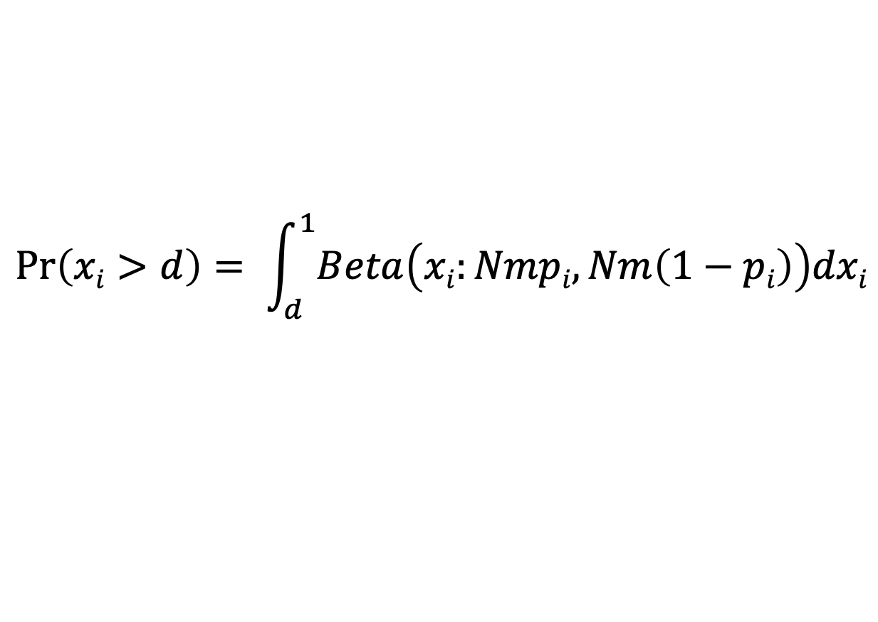
Sloan’s Neutral Community Model
Probability that a dead individual is replaced by dispersing individual
Average sample read count
Relative abundance of species i in the metacommunity
Abundance of species i
$$\operatorname{Pr}\left(xi>d\right)= \int_{d}^{1}{Beta\left(xi:Nmpi, Nm\left(1−pi\right)\right)dxi}$$
Probability
Detection threshold
Beta probability density function
$\operatorname{Pr}\left(xi>d\right)$ is equal to the proportion of samples in which species i is observed
Sloan et al., (2006) Quantifying the roles of immigration and chance in shaping prokaryote community structure
Notes:
Sloan’s Neutral Model states that the probability of species i occurring within a sample at abundance (x_{i}) above a detection threshold (d)
Model results are compared to the observed data. Deviation of observed data from model results is assumed to be evidence of deterministic community assembly.
The abundance of each ASV in the metacommunity (pi) is estimated by averaging it’s relative abundance across all samples.
Why is Sloan's Neutral Model important? (Sloan et al., 2006)
Microbial organisms are essential for life on earth.
The rules that govern their community assembly are poorly understood.
We need mathematical tools to describe these processes.
Typically microbial community structure has been thought to be shaped by deterministic processes (abiotic and biotic selection).
Despite this, the relative abundances and frequencies of taxa observed can be described using a neutral community model.
Sloan’s neutral community model includes stochastic birth-death events (or ecological drift) and immigration.
The neutral community model DOES NOT include any deterministic processes and is not supposed to be a complete description of microbial community assembly processes.
Despite this, the successful application of the model in describing patterns of community structure suggests that stochastic processes of ecological drift and dispersal are important processes in microbial community assembly.
Neutral models allow us to quantify processes which are difficult to directly observe (dispersal) yet that are important to microbial communities.
To test if stochastic processes play a key role in shaping microbial community structure we need:
Evidence of random community assembly
A neutral model for microbes that can deal with large populations
A method for paramaterisation that does not rely on observed species abundance distributions or assumptions about source community patterns
Data that support the model
A model robust to departures from the assumption of neutrality
Explain how Sloan's Neutral Model works.
The community is saturated with Nt individuals. For the assemblage to change an individual must die or leave the system. The rate of change within the system is species independent.
The dead individual is replace with probability m by an immigrant from the metacommunity, or replaced by reproduction of a member of the local community with probability 1-m.
The community changed through a cycle of death, birth and immigration only.

Slide 39
Code
Packages
library(dplyr)
library(tibble)
library(phyloseq)
library(ape)
library(vegan)
library(FSA)
library(eulerr)
library(minpack.lm)
library(Hmisc)
library(stats4)
library(ggplot2)
library(grid)
library(gridExtra)
Extract ASV table from phyloseq object
Calculate N by finding the mean number of reads per sample. We also find the limit of detection (d) = 1/N
Calculate the mean observed relative abundance and occurrence frequency of each ASV
Using non-linear least squares fitting we fit the neutral model to our data to find, finding the probability of dispersal (m)
Using the estimated value of m we calculate predicted occurrence frequencies and plot predictions from the neutral model against observed frequencies
Code developed from Barnett et al., (2020) Soil characteristics and land-use drive bacterial community assembly patterns (https://github.com/seb369/landuse_comm_assembly)
Notes:
Code developed from Barnett et al., (2020) Soil characteristics and land-use drive bacterial community assembly patterns (https://github.com/seb369/landuse_comm_assembly)
So we:
Fit the model to the observed frequency of occurrences of ASVs (in what proportion of the samples is each ASV detected?) and their abundance in the metacommunity (estimated as the mean relative abundance across all samples).
Explain how Sloan's Neutral Model works.
1. Calculate N as the mean read count within samples
2. Calculate the average relative abundance of each ASV across samples
3. Calculate the occurrence frequency of each ASV
4. Calculate the limit of detection
5. Fit the model parameter (m – probability that a dead individual is replaced by an immigrant) using non-linear least squares fitting
6. Use the fitted m parameter to calculate predicted ASV frequencies under stochastic processes.
10. Plot the predicted ASV frequencies (percentage of samples we expect to see an ASV) with the observed ASV frequencies against their mean relative abundance across all samples

Slide 40
Results
Notes:
This is the result of the model fitting with the Sommers dataset (not reduced).
X axis = log average relative abundances of each ASV across all samples (percent composition of an ASV relative to the total number of ASVs across all samples)
Y axis = mean occurrence frequency of each ASV (in what percentage of samples will each ASV occur)
Points = observed log relative abundances against occurrence frequencies
Solid line = predicted log relative abundances plotted against occurrence frequencies
Dotted lines = 95% confidence intervals
This allows us to assess to what degree observed community structure can be explained by stochastic processes within each sample.
The Sloan neutral model is applied here. This model does not take into account phylogenetic distance.
ASV occurrence frequency is explained as a function of ASV abundance within the metacommunity (i.e. the more abundant an ASV is in the metacommunity, the more frequently it will be detected in the local community by chance).
The neutral model performed well, explaining 77% of variation in ASV detection frequency with an estimated migration factor of 0.02 between sites.
These results suggest that neutral assembly processes can explain the pattern of observed ASV occurrence frequencies and that the the regional species pool is a driving factor in the community composition of these samples.
The deviation of predicted occurrence frequencies from observed occurrence frequencies suggests that there are also deterministic processes driving community composition.
WHAT CAN WE INTERPRET FROM THESE RESULTS?
I have assessed the degree to which stochastic processes explain community assembly within these samples.
This model ignores phylogenetic distance and explains the frequency of ASV detection across samples as a function of their abundance in the metacommunity (the more individuals of ASV i are present in the metacommunity, the more likely you are to find them in any given sample).
The neutral model performed well, explaining 77% of the variation in ASV detection frequency with an estimated migration factor of 0.017 between sites (this means there is ~2% chance of a local death being replaced by an immigrant which is very low – lower than reported for other studies that hover around 16-25%).
These results indicate that, for the majority of ASVs, neutral assembly processes of ecological drift and dispersal can explain their within sample occurrence patterns across an area, and the composition of the species pool of the area drives community assembly.
However, the model is not a perfect fit to the data and beta diversity ordination has shown that communities vary significantly between glaciers, suggesting that deterministic processes also play an important role.
NULL hypothesis: cryoconite bacterial community composition is completely stochastic. Neutral model results (high R2) mean I am unable to reject the null hypothesis. Significant variable in ASV frequency across samples is explained by their relative abundance in the metacommunity. The results suggest that local selection is weak and dispersal is low, indicating that ecological drift is the dominant community assembly process.
Estimates of beta diversity based on phylogenetic dissimilarity show significant variation between glaciers. This supports the results that dispersal is limited. We might suggest that variation in beta diversity is a result of local ecological drift and limited dispersal rather than selection.
The distribution of ASVs across samples (in the metacommunity) followed the basic pattern of more abundant data being widespread – this is consistent with predictions of neutral theory. Despite the good fit of the model and the low m rate, there was significant difference between the communities on each glacier, illustrating the important point that variation among microbial communities does not need to be the result of environmental differences. Neutral processes can generate diversity on their own!
What would I expect to see for abundant/rare, active/bulk communities? What would I infer from this?
I want to repeat this analysis for abundant/rare taxa and active/bulk groups to see if stochastic processes are as important for each group, as well as to see how chance of immigration changes.
Previous studies into soil microbial community assembly processes found:
Neutral model explained more variation in abundant sub-community than rare sub-community.
Neutral model also predicted lower m values for abundant sub-communities than rare sub-communities.
Abundant species likely utilize an array of resources and occupy more broad niches, which rare taxa may occupy more specific niches – we would expect rare sub-communities to be more strongly shaped by deterministic processes.
I predict that the neutral model will describe more variation in the bulk community than the active community as selection will only occur on active species. I also predict that migration rates will be higher for bulk communities because migration requires that an individual successfully transfer to a new habitat – where a dormant individual doesn’t need to worry about selection.

Slide 41
Stegen et al., (2015) Phylogenetic Null Model
βNTI
< -2
> 2
|βNTI| < 2
Homogenizing Selection
Variable Selection
Stochastic Processes
Raup-Crick
< - 0.95
Homogenizing Dispersal
> 0.95
Dispersal Limitation
|Raup-Crip| < 0.95
Ecological Drift or Weak Selection
Stegen et al., (2015) Estimating and mapping ecological processes influencing microbial community assembly
Notes:
Why is Stegen's Phylogenetic Null Model important?
Ecological community assembly is shaped by:
Selection from among-taxa differences in fitness (this can be homogenous or variable)
Dispersal (is a rate that may be limited when there is limited dispersal between communities, or homogenizing dispersal when there is high dispersal between communities)
Ecological drift
The relative importance of these processes varies.
If environmental conditions are homogenous through space there will be constant selective pressure resulting in homogenous selection.
If environmental conditions vary across space, the fitness differences of taxa will vary across space and there will be variable selection.
High dispersal rates between communities lead to homogenous community composition if those dispersal rates overcome selective pressures, leading to homogenizing dispersal.
If selection is weak and dispersal between communities is low, ecological drift can generate significant changes in community composition.
Dispersal limitation is the situation in which low dispersal rates are the primary contributor to high community turnover.
Ecological drift is the situation in which there is a combination of moderate selection and moderate dispersal, neither process dominates so community turnover is a result of a mixture of dispersal and random birth/death events. Essentially this is where community assembly is not dominated by a particular process.
Stochastic processes can produce complex spatial community patterns.
Ecological drift = random birth/death events in a specific area, in the absence of selection. Ecological drift is particularly important when dispersal is limited as illustrated by island biogeography theory.
Dispersal limitation between isolated habitats promotes local extinction and ecological drift which causes initially identical communities to diverge. Ecological drift can cause communities to diverge, even when dispersal is high and selection pressure is low.
Homogenizing dispersal = high dispersal rates leading to similar communities between habitats (overcomes the impact of ecological drift and even deterministic processes)
Deterministic (deterministic processes commonly mean beta diversity varies as a result of environmental characteristics – i.e. communities are more or less different due to the differences or similarities of the environments)
Variable selection – deterministic processes are driving variable composition between communities. Different areas have different environmental characteristics that select for different species.
Homogenizing selection – deterministic processes are driving homogenous composition between communities. Different areas have similar environmental characteristics that select for similar species.
Dispersal limitation – stochastic dispersal limitation is driving variable composition between communities
Homogenizing dispersal – stochastic high dispersal is driving homogenous composition between communities
Ecological drift – stochastic ecological drift is driving variable composition between communities
Explain how Stegen's Null Model works.
This framework uses the phylogenetic differences between communities to infer ecological selection.
Why is phylogenetic signal important?
For this method to work there need to be significant phylogenetic signal – that is, taxa that are more closely phylogenetically related, exhibit ecological similarities/niche similarities. If more closely related taxa are not more ecologically similar then we cannot use their relatedness to infer if selection or stochastic processes are occurring.
The process
To quantify phylogenetic turnover between communities we first calculate the between-community mean-nearest-taxon-distance metric (βMNTD). This quantifies the distance between each species in one community and it’s closest relative in a second community.
For each pair of community we generate the βMNTD is selection was not driving community assembly by randomly shuffling the tips of the phylogeny and recalculating the βMNTD (repeat 999 times to get distribution of null values).
We use the observed βMNTD and the null βMNTD to generate our β-nearest-taxon-index (βNTI).
If the observed βMNTD is significantly less (i.e. βNTI <-2) or greater than the null expectation (i.e. βNTI >2) we would infer that homogenous selection or variable selection is shaping community assembly respectively.
If the absolute value of βNTI is less than 2 we suggest that stochastic processes are predominantly driving community assembly.
To distinguish between homogenizing dispersal, limited dispersal and lack of dominance between selection and dispersal, we use the Raup-Crick metric which incorporates species relative abundances but doesn’t use phylogenetic information.
To generate the RC metric, species are drawn into each sample until the observed species richness of each sample is reached.
Then individuals are draw into each species until the observed abundance is reached. This procedure approximates stochastic community assembly under the assumption of weak selection and random dispersal. Compositional differences are qualified using Bray-Curtis and this is repeated 999 times for each pair of communities to generate a null distribution of dissimilarities.
Observed bray-Curtis dissimilarities are then compared to the null distribution to get the RCbray value. If the Rcbray value is less than -0.95 then the community is more homogenous than expected at random and this is driven by high dispersal rates. If the Rcbray value is > 0.95 than the communities are more different than expected by random and they are shaped by dispersal limitation. If the absolute value of Rcbray is less than 0.95 then the compositional turnover between a given pair of communities is undominated by selection or dispersal.

Slide 42
Phylogenetic Signal
Find phylogenetic distances between ASVs
Plot results of the mantel correlograms against phylogenetic distance classes for each environmental parameter to check for significant relationships
Calculate mantel correlograms for each environmental parameter
Find the weighted mean environmental parameters for each ASV = niche preferences

Slide 43
Phylogenetic Signal
Notes:
Solid and open dots signify significant and non-significant correlations respectively. This related between ASV niche differences and between ASV phylogenetic distances. I used the cryoconite properties of chlorophyll, hole depth, pH and water content to estimate ASV environmental niches. Significant positive correlations indicates that the niche distance between ASVs increases with phylogenetic distance.
Here there is only one significant relationship between phylogenetic distance and environmental variable – so the null model may not be appropriate for this data – however, we must consider that this dataset was drastically reduced to allow the correlograms to process on my local computer. With that in mind, we continue with the null model analysis.
There are multi ways of testing for phylogenetic signal so it’d like to look into them (https://besjournals.onlinelibrary.wiley.com/doi/full/10.1111/j.2041-210X.2012.00196.x)

Slide 44
Phylogenetic Null Model
Notes:
Here we see that when I compared the composition of each community to the composition of all other communities, the absolute values of the β-nearest-taxon-index (βNTI) were generally < 2, suggesting that community assembly is predominantly driven by homogenizing dispersal, limiting dispersal or is undominated/a result of drift.
βNTI combined with Rcbray scores indicated that communities on both glaciers were shaped by a combination of dispersal limitation (making the communities less similar than would be expected by chance) and drift (where neither selection or dispersal are particularly strong).
The dominance of stochastic processes is in keeping with the results of my neutral model analysis which suggested a large portion of the variation between communities could be explained by stochastic processes. Moreover, this is consistent with my CAP analysis that suggested cryoconite hole area and water content explained a low level of variation in community composition.
What would I expect to see for abundant/rare, active/bulk communities? What would I infer from this?
Previous studies of community assembly for abundant and rare taxa have found:
Increased homogenous selection for rare taxa.
Increased dispersal limitation and variable selection for abundant taxa.
Other studies have found selection more dominant for abundant taxa and drift more dominant for rare taxa.
These processes very depending on environment. Because as far as I know null modelling with abundant/rare sub-communities hasn’t been applied to the supraglacial environment so it’s s mystery.
I predict that stochastic processes will drive more variation in the bulk community than the active community as selection will only occur on active species. I also predict that Selection will be more important for rare than abundant taxa as abundant taxa may experience higher immigration rates that overcomes selection processes.

Slide 45
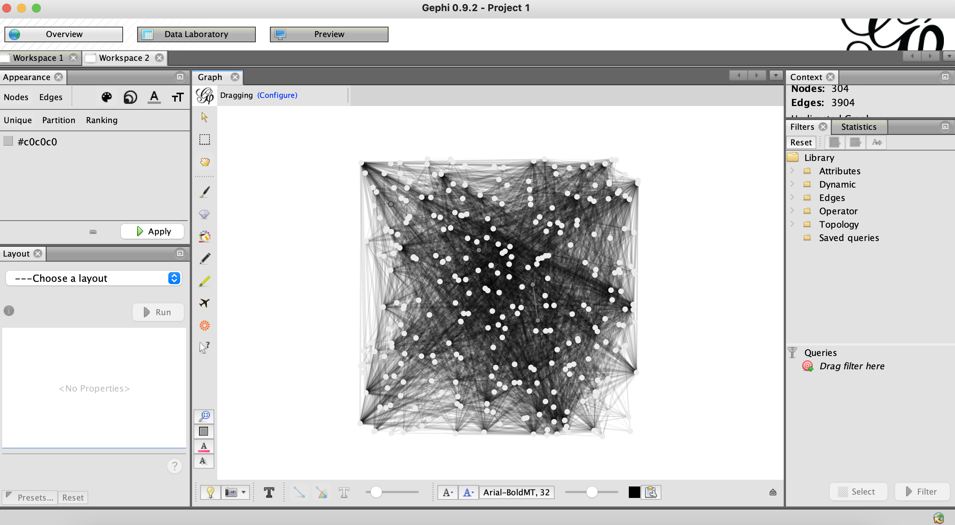
Co-Occurrence Network Analysis
Notes:
Why is network analysis important?
Network analysis allows us to explore biotic selection, that is the interactions between microbial taxa that may drive microbial community assembly.
If we see a low number of significant taxon co-occurrence patterns this may support our theory that community assembly is primarily stochastic. If there are high numbers of significant taxon co-occurrence patterns this may lend support to deterministic processes driving community assembly.

Slide 46
Co-Occurrence Network Analysis
Notes:
Whilst multivariate analysis can assist us in investigating abiotic selection, microbial community assembly is also shaped by biotic selection.
Biotic interactions may include top-down control through viral lysis and grazing, as well as microbe-microbe interactions.
Due to technological restrictions, investigations of microbe-microbe interactions have typically been limited. With access to high-throughout sequencing, we can now construct co-occurrence networks in an attempt to decipher intra- and inter-specific interactions within communities.
Previous research has indicated that microbial communities exhibit non-random co-occurrence patterns and module structures, suggesting that biotic selection plays a strong role in shaping community assembly.
Communities may even centre around keystone species, that maintain the functioning of the community as a whole.

Slide 47
Centrality and Clustering
Degree Centrality
Closeness Centrality
Betweenness Centrality
Clustering coefficient
Notes:
Centrality – how close is a node to the network as a whole
Degree Centrality – number of links connected to a node (who has the most friends?)
Closeness Centrality - average length of the shortest path between the node and all other nodes in the graph (how long does it take me on average to reach another node)
Betweenness Centrality – the number of times a node is crossed by each of the shortest routes between nodes (between any two nodes there is a shortest distance to travel. How many shortest distances is the node of interest within?)
Clustering
What groups are within the network?
Clustering coefficient – how many connections are there to other nodes, compared to the POTENTIAL number of connections to other nodes within the group?
Clustering coefficient = 1 means there is a clique, so all nodes are connected to each other in a group

Slide 48
Results
Notes:
Based on correlation analysis, for the positive co-occurrence network, 6526 edges, which depict significant and strong pairwise correlations between species (Spearman's ρ ≥ 0.6, P < 0.01), were captured between 554 nodes (i.e. ASVs).
Based on correlation analysis, for the negative co-occurrence network, 1780 edges, which depict significant and strong pairwise correlations between species (Spearman's ρ ≥ 0.6, P < 0.01), were captured between 299 nodes (i.e. ASVs).

Slide 49
Hu et al., (2017) Strong impact of anthropogenic contamination on the co‐occurrence patterns of a riverine microbial community
Notes:
Packages:
Vegan
Igraph
Hmisc
1) Defines functions for co-occurrence network analysis. Function needs a matrix with samples as columns and ASVs as rows, as well as the cutoffs for clustering coefficient and cut off for FDR-adjusted P-value.
2)

Slide 50
Transpose asv table (asv = rows, samples = columns) and compute a matrix of Spearman’s rho rank correlation coefficients for all possible pairs of columns (asvs).

