Slide 1
Microbial Biogeography and Community Assembly Mechanisms in the Supraglacial Environment: Influence of activity and abundance
Amy Solman
Notes:
Questions I want to ask:
How does dormancy influence microbial dispersal and community assembly?
How do dispersal and community assembly mechanisms differ at local, regional and global scales?
Does dispersal and community assembly mechanisms change between Spring and Summer seasons?
Why are we interested in community assembly?
Because we want to understand the evolutionary and ecological mechanisms that govern microbial community composition at local scales, thus shaping large scale patterns of microbial biogeography. Community composition affects community function with profound impacts on the wider ecosystem functioning and biodiversity.
This study aims to develop an in-depth understanding of cryoconite community interactions and assembly processes. Particular questions of interest include:
(i) Do cryoconite community exhibit nonrandom co-occurrence patterns?

Slide 2
Why are they different? Why should we care?
Community 1
Community 2

Slide 3
Community Assembly Processes
Selection
Dispersal
Ecological Drift
Notes:
Spatial turnover in community composition (that is, the difference in abundance and diversity of biological communities between locations) is shaped by ecological drift, selection and dispersal
Community assembly processes can be stochastic or deterministic.
Stochastic processes are random birth, death and dispersal events .
Deterministic processes arise from fitness differences between species, that drive their habitat preferences.
Adaptive traits (e.g. tolerance to low temperatures) define fitness differences (e.g. the greater reproductive success of one species in a cold habitat as compared to another, less reproductively successful species) and may be phylogenetically conserved (e.g. present in species with closer evolutionarily relationships – two species that have a more recent common ancestor may share tolerance to low temperatures that gives both greater reproductive success as compared to a third organism that has a more distance evolutionary relationship).
Closely evolutionarily related species will share adaptive traits that define their fitness differences and drive habitat preferences. So, the environmental constraints of habitat A may facilitate species with close evolutionary histories, while the community of habitat B may share close evolutionary histories with each other while the beta diversity (the change in community composition between habitat A and B) is driven deterministically by those environmental constrains.
Both stochastic (birth, death) and deterministic (fitness difference) processes are influenced by dispersal rates.
Dispersal = the replacement of a dead individual in the local community with a random individual from the regional species pool.
We don’t know much about the ecological factors influencing bacterial dispersal rates.
Stochastic processes can produce complex spatial community patterns.
Ecological drift = random birth/death events in a specific area, in the absence of selection. Ecological drift is particularly important when dispersal is limited as illustrated by island biogeography theory.
Dispersal limitation between isolated habitats promotes local extinction and ecological drift which causes initially identical communities to diverge. Ecological drift can cause communities to diverge, even when dispersal is high and selection pressure is low.
Homogenizing dispersal = high dispersal rates leading to similar communities between habitats (overcomes the impact of ecological drift and even deterministic processes)

Slide 4
Supraglacial deterministic processes

Slide 5
Supraglacial stochastic processes

Slide 6
Hypotheses
Microbial community composition in the supraglacial environment is explained by both deterministic and stochastic processes.
Community assembly processes will differ between abundant and rare taxa.
Biogeographic patterns (ISAR, DDR) will differ between abundant and rare taxa.
Community assembly processes will differ between bulk and active microbial communities. That is, active communities will be more strongly influenced by deterministic processes and bulk communities will be more strongly influenced by stochastic processes.
Biogeographic patterns (ISAR, DDR) will differ between bulk and active communities. That is, active communities will exhibit stronger biogeographic patterns than bulk communities.

Slide 7
Analysis Workflow
Multivariate Analysis
Neutral Model
Null Model
Network Analysis

Slide 8
Sommers et al., (2020) ﻿Microbial Species–Area Relationships in Antarctic Cryoconite Holes Depend on Productivity
Recently published
Cryoconite communities
Detailed information on sequence processing
ISAR analysis
Includes bacterial and eukaryotic sequence data
Includes data from two glaciers
Notes:
I chose this dataset on which to develop my analysis pipeline because it included recently published cryoconite community data and cryoconite communities are of specific interest to me as they are a hotspot of biological activity on the glacier surface. Also, they act as discrete microcosms which can be measured in terms of area, therefore have the advantage of being used to explore the present of island-species area relationships.
The fact that ISAR had already been investigated in this dataset meant that I could carry out my own analyses and compare the results to ensure that I was analyzing the data correctly.
The paper included information on sequence processing that I was able to use in my first QIIME workflow.
It gave me the opportunity to work with 16S and 18S data (although here I have only analyzed the 16S data)
The data could also be grouped by glacier which was useful for comparative analyses.

Slide 9
QIIME2 & DADA2
Download sequence data and metadata in command line using SRA toolbox
QIIME2: Modify/convert files to QIIME2 formats
QIIME2: Trim primers
DADA2: Denoise data
QIIME2: Use SILVA classifier to classify representative sequences
QIIME2: Generate feature table
QIIME2: Make multiple sequence alignment with MAFFT, construct phylogenetic tree and root.
QIIME2: Export feature table, ASV count table, representative sequences, taxonomy table and rooted phylogenetic tree.
Notes:
In QIIME2 on my local computer I downloaded Sequence Read Archive (SRA) toolbox that allowed me to prefetch the sequence data from the SRA website using the archive umber supplied by the paper, splitting the flies into forward and reverse reads and saving them to my laptop.
I renamed the sequence files and modified the metadata file into formats expected by QIIME2.
Import fastq files and convert them into a format Qiime wants to work with.
Remove primers. I'm getting the primers from https://earthmicrobiome.org/protocols-and-standards/16s/ as described by Sommers et al., (2020)
The primer sequences are :
Updated sequences: 515F (Parada)–806R (Apprill), forward-barcoded:
FWD:GTGYCAGCMGCCGCGGTAA; REV:GGACTACNVGGGTWTCTAAT
Check the quality of trimmed reads and visualise.
Call DADA2. Where are the adaptors? Front or back? Use trim in DADA2 to cut them, in stead of QIIME2 cutadapt
FastQC - look at for adaptor - if adaptor isn't there then don't worry about it! Warning: Not all adaptors are picked up by FastQC.
Denoise data and check results of this step.
Summarise remaining reads after denoising and visualise. Through the sequence table generated below you can click on a representative sequence and BLAST it.
Generate a feature table and visualise.
Download Silva classifier and move to work folder.
Classify representative sequences and visualise.
Make a multiple sequence alignment with MAFFT.
Now mask the alignment.
Construct the phylogenetic tree and root.
Export feature table (Feature table of the remaining sequences after denoising that tells us how many samples we have, how many features (ASVs) we have, how frequent (how many individual cells there are) per sample, how many ASVs we see per sample ) , ASV count table (ASV count table with sample as columns and ASV as row ), representative sequences (The remaining representative sequences after denoising (i.e. a list of all the unique base pair sequences present in the denoised dataset), exported as a fasta file), taxonomy table (Table of feature (ASV) IDs and their taxonomic classifications ) and phylogenetic tree.

Slide 10
Data Prep
Wrangle metadata
Identify and remove contaminant ASVs
Remove singletons
Re-root phylogenetic tree
Remove ambiguous annotations and low abundance phyla
Construct phyloseq object and export
Load in data from QIIME2 step

Slide 11
Multivariate Analysis
Alpha Diversity
Beta Diversity & Ordination
Linear Models (including ISAR and DDR)

Slide 12
Alpha Diversity
Figure : Plots of ASV richness (A) and Shannon Diversity Index (B) for each glacier (richness: t = 2.0202, df = 32, p=0.0518, Shannon: W = 142, p=0.5808)
Notes:
Calculated ASV richness and Shannon Diversity Index for each Glacier
Used Two Samples T-Test to compare ASV richness between glaciers (as count data was normally distributed)
Result: No significant difference between ASV richness (p=0.052)
Used Two Samples Wilcoxon Test to compare Shannon Diversity Index for each glacier (as index data was not normally distribute)
Result: No significant difference between Shannon Diversity (p=0.581)

Slide 13
Beta Diversity & Ordination: Weighted UniFrac
Figure : Beta diversity calculated using weighted UniFrac distances, visualized use PCoA (blue is Taylor Glacier and orange is Canada Glacier). This plot shows significant beta diversity variation between glaciers (PERMANOVA: F = 12.539, df=1, P = 0.0001).
Notes:
I calculated the beta diversity between glaciers using weighted unifrac distances used the distance function in phyloseq package.
I used permutational multivariate analysis of variance (PERMANOVA) to find if community composition significantly varied between glaciers using 999 permutations

Slide 14
Beta Diversity & Ordination: Unweighted UniFrac
Figure : Beta diversity calculated using unweighted UniFrac distances, visualized use PCoA (blue is Taylor Glacier and orange is Canada Glacier). This plot shows significant beta diversity variation between glaciers (PERMANOVA: F =4.1016 , df=1, P =0.001).

Slide 15
Beta Diversity & Ordination: Bray-Curtis
Figure : Beta diversity calculated using Bray-Curtis distances, visualized use NMDS plot (blue is Taylor Glacier and orange is Canada Glacier). This plot shows significant beta diversity variation between glaciers (PERMANOVA: F =8.3412 , df=1, P =0.001).

Slide 16
All Environmental Plots
Notes:
Wilcoxon test used to compare cryoconite hole area (cm2) between glaciers. No significant difference detected (W = 134, p=0.7966).
Wilcoxon test used to compare chlorophyll between glaciers. No significant difference detected (W = 160, p=0.141).
Wilcoxon test used to compare DNA content between glaciers. Significant difference detected (W = 251, p<0.05).
Wilcoxon test used to compare organic matter content between glaciers. Significant difference detected (W = 220, p<0.05).
Welch Two Sample T-Test used to compare pH between glaciers. Significant difference detected (t=2.193, df=11.766, p=0.0492).
Wilcoxon test used to compare water content between glaciers. Significant difference detected (W = 220, p<0.05).

Slide 17
CAP Analysis
Figure : Most of the variation in beta diversity within each glacier explained by cryoconite area. On Taylor glacier cryoconite area explained 34.8% of variation in community composition (F = 3.734, P=0.002). On Canada glacier, both area and water content explained 29.7% of variation in community composition (F=5.124, P=0.001)
Notes:
I have used canonical analysis of principal coordinates (CAP) to explore how differences in community composition are explained by environmental variables

Slide 18
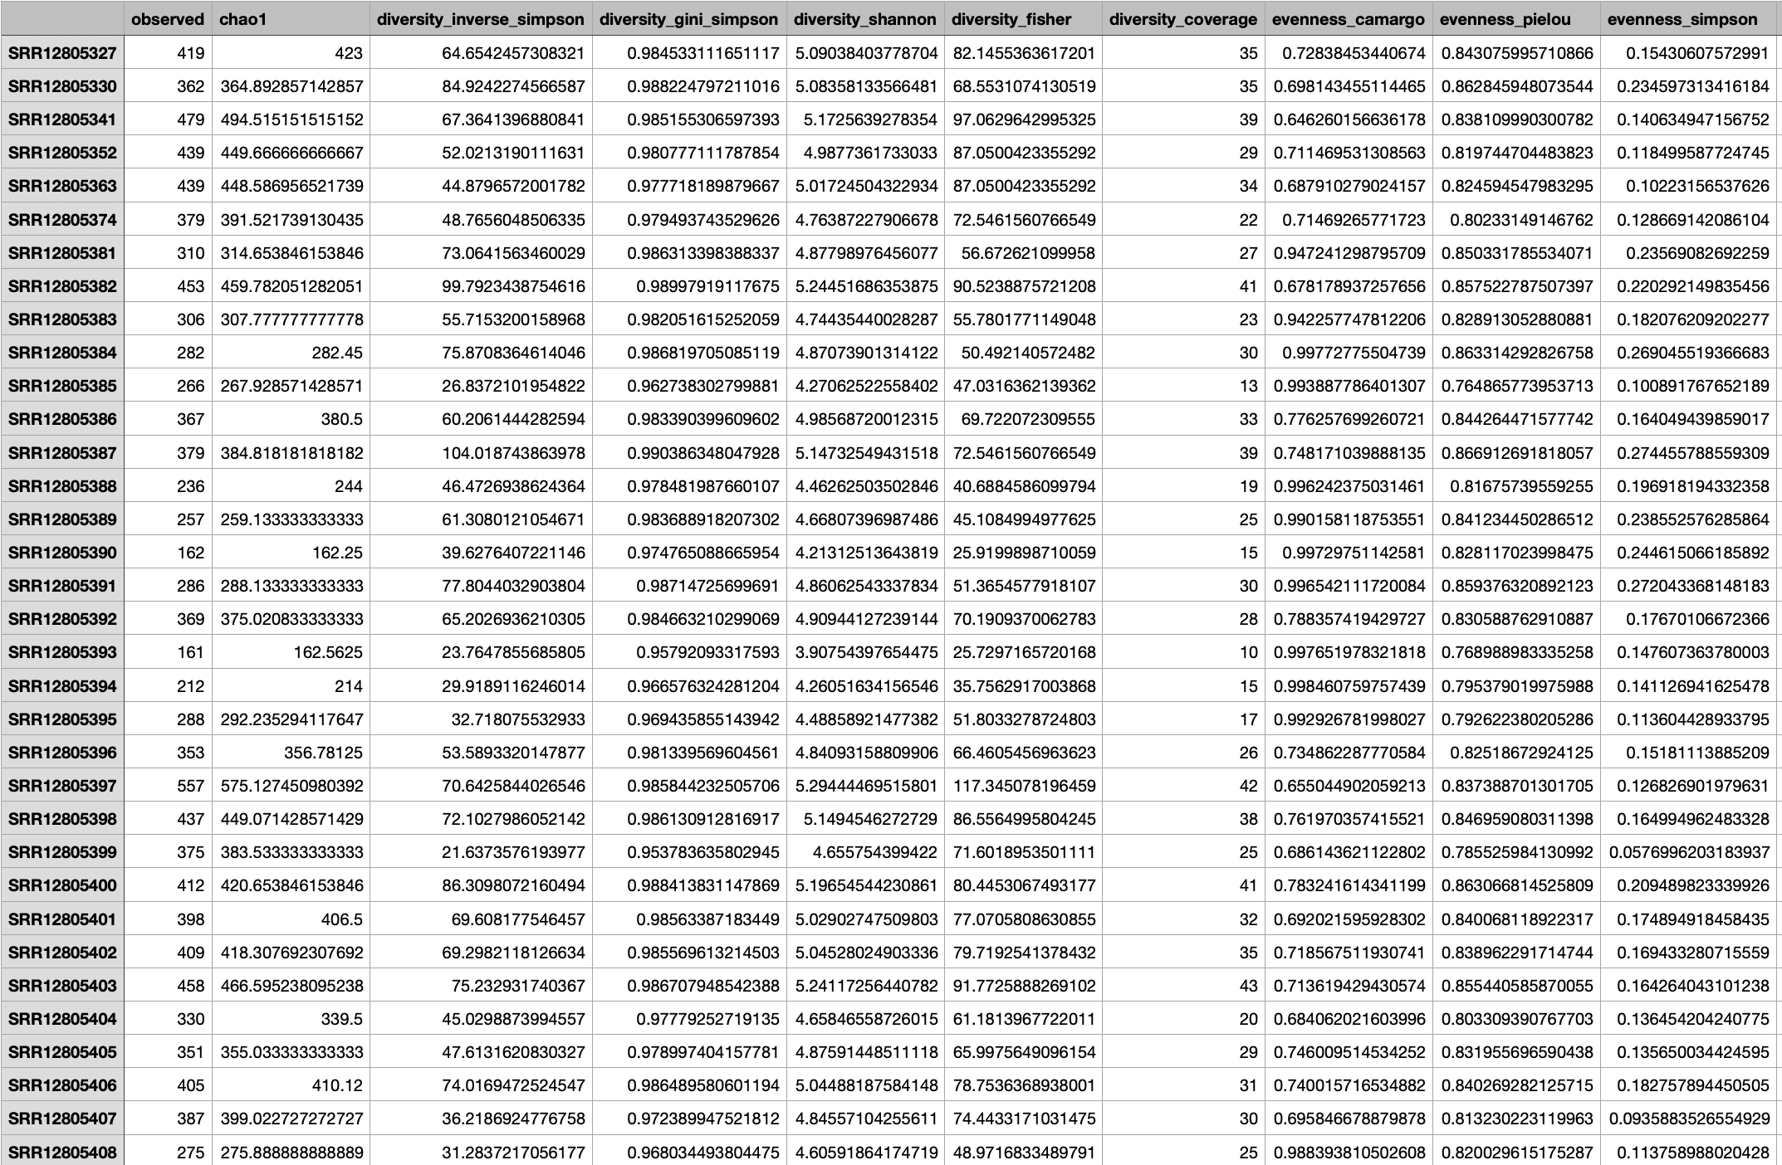
Alpha Non-Phylogenetic Diversity
ASV richness
Shannon Diversity
Simpsons Diversity
Inverted Simpsons Diversity
Pilou Evenness
Notes:
Used ‘vegan’ package to get Shannon, Simpsons, Inverted Simpsons Diversity Indexes of count data in each sample. Also Pilou evenness and Faith’s phylogenetic diversity.
Alternatively use alpha() function from microbiome package to calculate all indices at one!
Here we have boxplots comparing the diversity indices of the two glaciers

Slide 19
Alpha Phylogenetic Diversity
Notes:
Comparison of phylogenetic diversities of the two glaciers

Slide 20
Absolute Abundance Bar Plots
Figure 1. Bar chart of Hellinger transformed ASV data with agglomerated Phyla

Slide 21
Relative Abundance Bar Plots
Notes:
Relative abundance plots, agglomerated by Class

Slide 22
Beta Phylogenetic Diversity & Ordination
Figure 3. Unweighted UniFrac PCoA, scaled by eigenvalues
Figure 4. Weighted UniFrac PCoA, scaled by eigenvalues
Figure. Unweighted UniFrac PCoA with filtered data, not scaled by eigenvalues (using microbiome package)
Figure. Unweighted UniFrac PCoA with unfiltered data, not scaled by eigenvalues (using microbiome package)
Figure. Weighted UniFrac PCoA with unfiltered data, not scaled by eigenvalues (using microbiome package)
Notes:
#Unweighted unifrac is based on presence/absence not abundance - but it is sensitive to sequencing depth. So if a sample is of greater depth than other reads it may have more low abundance taxa and therefore effect the unifrac metric

Slide 23
Beta Non-Phylogenetic Diversity & Ordination
Figure. Bray-Curtis NMDS plot
Figure 2. Bray-Curtis PCoA, scaled by eigenvalues
Figure 5. Bray-Curtis NMDS plot

Slide 24
Beta Non-Phylogenetic Diversity & Ordination
Figure 6. Bar plot of Principal Component Analysis on Log-Ratio Transformed Data
Figure 8. Log-Ratio PCoA screenplot using Jaccard variances
Figure 7. Log-Ratio PCA ordination of 16S sequence data
Figure 9. Log-Ratio PCoA screenplot using Euclidean variances
Figure 10. Euclidean NMDS plot
Figure 11. Jaccard NMDS plot
Notes:
1) Looked for evidence of compositionality. By multiplying ASV table by itself we can look for evidence of covariance.
#We then find the determinant of the covariance matrix and if the answer is 0 we have evidence of compositionality in the data – the result was 0 so the data is compositional.
2) Because out data are compositional we then need to transform them for downstream analysis
#Step Four: Perform a Log-Ratio trasnformation
#This will normalise the ASV data within each sample
3) Look at the difference the log-ratio transformation has made to the covariance of the data
4) Figure 6: Perform Principal Component Analysis on Log-Ratio Transformed Data, Create visual representation of PCA and plot
5) Figure 7: Visualise and plot the pca
6) Computed the jaccard distance metric

Slide 25
Linear Models
Figures 12-16: Boxplots showing medians, 25th, 75th percentiles and outlying data points for ASV richness, hole area, hole depth, chlorophyll and DNA content, between the two glaciers
Figures 17-21: Boxplots showing medians, 25th, 75th percentiles and outlying data points for Shannon, Simpson, Inverse Simpson Diversity, Pilou Evenness and Faith’s PD, between the two glaciers
Notes:
I performed linear regressions between the explanatory variables (glaciers) and response variables (richness, depth, area, chlorophyll, dna per gram, diversity indices).
I then constructed ANOVA tables of the linear regression models to gauge their statistical significance.
#Analysis of Variance (ANOVA), a linear model analysis. We want to ask: is the ASV richness/chlorophyll/hole size/hole depth/DNA per gram between glaciers significantly different? Plot the data divided into glacier groups
#ANOVA quantifies the signal to noise ratio. How different are our groups in ratio to how spread out the data are? ANOVA will tell us how confident we can be that we are not being fooled by a type I error (a false positive difference between the groups)
#ANOVA will: 1) quantify the overall variability of the dataset. 2) Divide that variability into the variability between and within groups. More signal = more condifent. More noise = less confident.
The ANOVA tables showed there was significant difference between the glaciers in terms of ASV richness, cryoconite hole depth, the dna per gram of cryoconite and faith’s pd.

Slide 26
General Statistics: Linear Regression Analysis
Figure 22: Linear regression plot of ASV richness against cryoconite hole area
Notes:
Linear Regression Analysis
#We use linear regression analysis if our explanatory variable is continuous

Slide 27
Multivariate Analysis
Canonical Analysis of Principal Coordinates (CAP) used to identify the variation in community composition explained by pH, cryoconite hole area, cryoconite hole depth, water content and chlorophyll
Notes:
Multivariate analysis can allow us to look at the relationship between community composition and environmental characteristics – these are deterministic, non-random processes. Investiagation into deterministic processes of community assembly (e.g. relationship between community composition and environmental characteristics) dominate most studies of microbial community assembly, howeber, it is likely both deterministic and stochastic processes contribute to community assembly. This is why I combine multivariate and network analysis (deterministic) with phylogenetic null modelling (deterministic and stochastic) and neutral modelling (stochastic).
It has been suggested that initial community assembly is driven by stochastic processes, and deterministic processes shape the community through time.
What do we already know about deterministic processes on glaciers?
What do we already know about stochastic processes on glaciers?

Slide 28
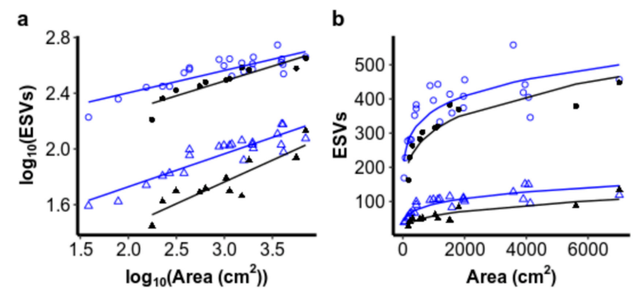
Island Species-Area Relationship (ISAR)
Figure. Results graphs taken from Sommers et al., (2020)
Figure. Results graphs from my analyses (16S only)

Slide 29
Distance-Decay Relationship (DDR)
Notes:
DDR doesn’t work for this dataset as most of the holes are reported to have the same long lat coordinates.

Slide 30
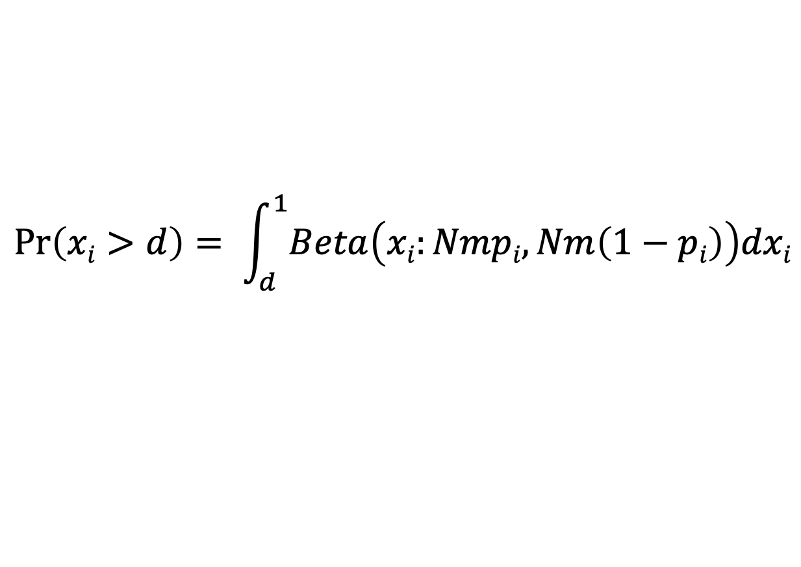
Sloan’s Neutral Model
Probability that a dead individual is replaced by dispersing individual
Relative abundance of species i in the metacommunity
Average sample read count
Abundance of species i
$$\operatorname{Pr}\left(xi>d\right)= \int_{d}^{1}{Beta\left(xi:Nmpi, Nm\left(1−pi\right)\right)dxi}$$
Probability
Detection threshold
Beta probability density function
$\operatorname{Pr}\left(xi>d\right)$ is equal to the proportion of samples in which species i is observed
Notes:
Sloan’s Neutral Model states that the probability of species i occurring within a sample at abundance (x_{i}) above a detection threshold (d)
Model results are compared to the observed data. Deviation of observed data from model results is assumed to be evidence of deterministic community assembly.
The abundance of each ASV in the metacommunity (pi) is estimated by averaging it’s relative abundance across all samples.

Slide 31
Code
Extract ASV table from phyloseq object
Calculate the size of the metacommunity (N) by finding the mean number of reads per sample. We also find the limit of detection (d) = 1/N
Calculate the mean observed relative abundance and occurrence frequency of each ASV
Using non-linear least squares fitting we fit the neutral model to our data to find, finding the probability of dispersal (m)
Using the estimated value of m we calculate predicted occurrence frequencies and plot predictions from the neutral model against observed frequencies
Packages
library(dplyr)
library(tibble)
library(phyloseq)
library(ape)
library(vegan)
library(FSA)
library(eulerr)
library(minpack.lm)
library(Hmisc)
library(stats4)
library(ggplot2)
library(grid)
library(gridExtra)
Code developed from Barnett et al., (2020) Soil characteristics and land-use drive bacterial community assembly patterns (https://github.com/seb369/landuse_comm_assembly)
Notes:
Code developed from Barnett et al., (2020) Soil characteristics and land-use drive bacterial community assembly patterns (https://github.com/seb369/landuse_comm_assembly)

Slide 32
Results
Notes:
This is the result of the model fitting with the Sommers dataset (not reduced).
X axis = log mean relative abundances of each ASV
Y axis = mean occurrence frequency of each ASV
Points = observed log relative abundances against occurrence frequencies
Solid line = predicted log relative abundances plotted against occurrence frequencies
Dotted lines = 95% confidence intervals
This allows us to assess to what degree observed community structure can be explained by stochastic processes within each sample.
The Sloan neutral model is applied here. This model does not take into account phylogenetic distance.
ASV occurrence frequency is explained as a function of ASV abundance within the metacommunity (i.e. the more abundant an ASV is in the metacommunity, the more frequently it will be detected in the local community by chance).
The neutral model performed well, explaining 77% of variation in ASV detection frequency with an estimated migration factor of 0.02 between sites.
These results suggest that neutral assembly processes can explain the pattern of observed ASV occurrence frequencies and that the the regional species pool is a driving factor in the community composition of these samples.
The deviation of predicted occurrence frequencies from observed occurrence frequencies suggests that there are also deterministic processes driving community composition.

Slide 33
Phylogenetic Signal
Find phylogenetic distances between ASVs
Plot results of the mantel correlograms against phylogenetic distance classes for each environmental parameter to check for significant relationships
Calculate mantel correlograms for each environmental parameter
Find the weighted mean environmental parameters for each ASV = niche preferences

Slide 34
Phylogenetic Signal
Notes:
Here there is only one significant relationship between phylogenetic distance and environmental variable – so the null model may not be appropriate for this data – however, we must consider that this dataset was drastically reduced to allow the correlograms to process on my local computer. With that in mind, we continue with the null model analysis.

Slide 35
Stegen et al., (2013) Phylogenetic Null Model
βNTI
< -2
> 2
|βNTI| < 2
Homogenizing Selection
Variable Selection
Stochastic Processes
Raup-Crick
< - 0.95
Homogenizing Dispersal
> 0.95
Dispersal Limitation
|Raup-Crip| < 0.95
Ecological Drift or Weak Selection
Notes:
Stochastic processes can produce complex spatial community patterns.
Ecological drift = random birth/death events in a specific area, in the absence of selection. Ecological drift is particularly important when dispersal is limited as illustrated by island biogeography theory.
Dispersal limitation between isolated habitats promotes local extinction and ecological drift which causes initially identical communities to diverge. Ecological drift can cause communities to diverge, even when dispersal is high and selection pressure is low.
Homogenizing dispersal = high dispersal rates leading to similar communities between habitats (overcomes the impact of ecological drift and even deterministic processes)
Deterministic (deterministic processes commonly mean beta diversity varies as a result of environmental characteristics – i.e. communities are more or less different due to the differences or similarities of the environments)
Variable selection – deterministic processes are driving variable composition between communities. Different areas have different environmental characteristics that select for different species.
Homogenizing selection – deterministic processes are driving homogenous composition between communities. Different areas have similar environmental characteristics that select for similar species.
Dispersal limitation – stochastic dispersal limitation is driving variable composition between communities
Homogenizing dispersal – stochastic high dispersal is driving homogenous composition between communities
Ecological drift – stochastic ecological drift is driving variable composition between communities

Slide 36
Phylogenetic Null Model

Slide 37
Co-Occurrence Network Analysis
Notes:
Whilst multivariate analysis can assist us in investigating abiotic selection, microbial community assembly is also shaped by biotic selection.
Biotic interactions may include top-down control through viral lysis and grazing, as well as microbe-microbe interactions.
Due to technological restrictions, investigations of microbe-microbe interactions have typically been limited. With access to high-throughout sequencing, we can now construct co-occurrence networks in an attempt to decipher intra- and inter-specific interactions within communities.
Previous research has indicated that microbial communities exhibit non-random co-occurrence patterns and module structures, suggesting that biotic selection plays a strong role in shaping community assembly.
Communities may even centre around keystone species, that maintain the functioning of the community as a whole.

Slide 38
Centrality and Clustering
Degree Centrality
Closeness Centrality
Betweenness Centrality
Clustering coefficient
Notes:
Centrality – how close is a node to the network as a whole
Degree Centrality – number of links connected to a node (who has the most friends?)
Closeness Centrality - average length of the shortest path between the node and all other nodes in the graph (how long does it take me on average to reach another node)
Betweenness Centrality – the number of times a node is crossed by each of the shortest routes between nodes (between any two nodes there is a shortest distance to travel. How many shortest distances is the node of interest within?)
Clustering
What groups are within the network?
Clustering coefficient – how many connections are there to other nodes, compared to the POTENTIAL number of connections to other nodes within the group?
Clustering coefficient = 1 means there is a clique, so all nodes are connected to each other in a group

Slide 39
Results
Notes:
Based on correlation analysis, for the positive co-occurrence network, 6526 edges, which depict significant and strong pairwise correlations between species (Spearman's ρ ≥ 0.6, P < 0.01), were captured between 554 nodes (i.e. ASVs).
Based on correlation analysis, for the negative co-occurrence network, 1780 edges, which depict significant and strong pairwise correlations between species (Spearman's ρ ≥ 0.6, P < 0.01), were captured between 299 nodes (i.e. ASVs).

Slide 40
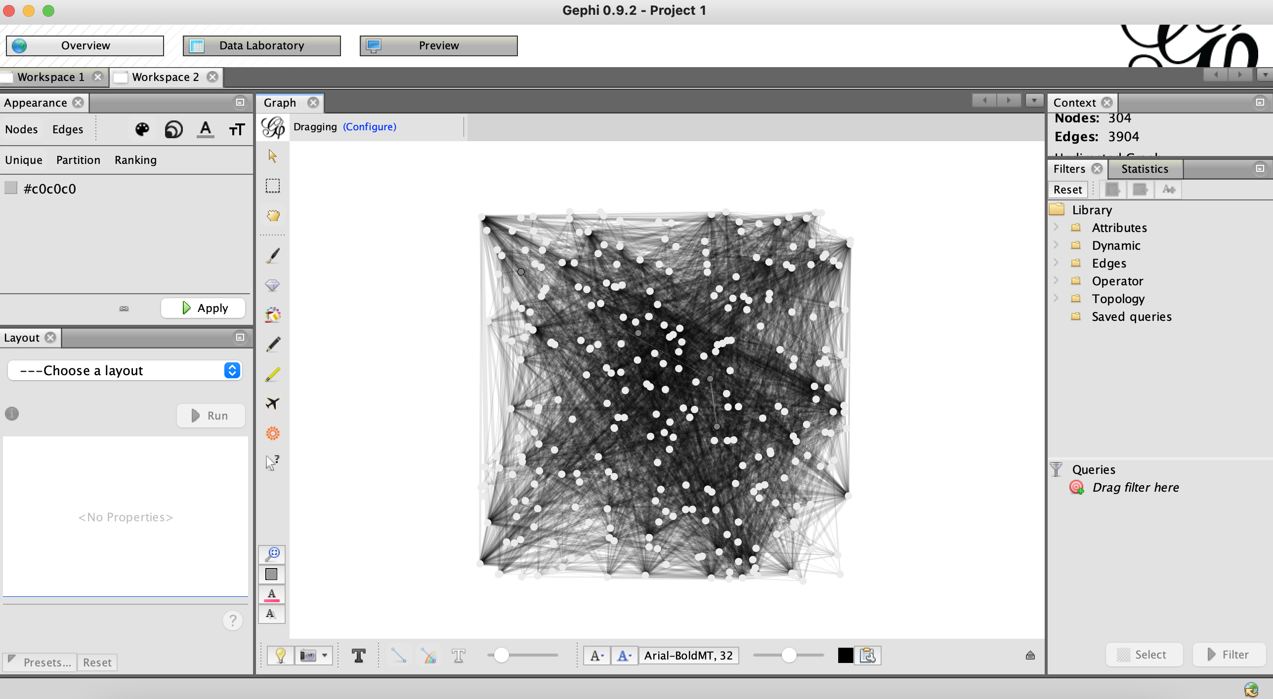
Gephi

Slide 41
Hu et al., (2017) Strong impact of anthropogenic contamination on the co‐occurrence patterns of a riverine microbial community
Notes:
Packages:
Vegan
Igraph
Hmisc
1) Defines functions for co-occurrence network analysis. Function needs a matrix with samples as columns and ASVs as rows, as well as the cutoffs for clustering coefficient and cut off for FDR-adjusted P-value.
2)

Slide 42
Transpose asv table (asv = rows, samples = columns) and compute a matrix of Spearman’s rho rank correlation coefficients for all possible pairs of columns (asvs).

