Slide 1
Project 1: Data Analysis of Restaurants in Washington DC
Amy Sylla & Oluwatobi Akinsanya
September 8, 2020

Slide 2
Outline:
A client wants to open a restaurant in Washington DC. What type of restaurant should they open and where in DC ?
Our Analysis will answer 4 questions:
What is the most competitive restaurant type in each DC Quadrant?
What is the average restaurant quality for restaurant types in each DC Quadrant?
What are the best graded restaurants in DC ? Do they reflect their demographics ?
Food trucks vs Restaurants, what to pick ?

Slide 3

What is the most competitive restaurant type in each DC Quadrant?
This data will help us find out which restaurant type may have been exhausted in DC and which restaurant types have the opportunity to grow

Slide 4

What is the average/best restaurant quality for restaurant types in each DC Quadrant?
This data will help identify if there is a particular restaurant type that may be associated with lower food quality. If so, this may present an opportunity to stand out.

Slide 5

Do ethnic groups in DC impact restaurant types in each DC Quadrant?
With this question, we can identify any trends that may be related to DC's ethnicity. This will help us understand if a particular group of people impact the amount of a restaurant type in DC. If there is a trend, the new restaurant may have to serve those groups of people in some way with the new restaurant.

Slide 6
Understanding the problem: Methods used
What is needed?
How do we find that?
Treatment + Analysis
Total number of restaurants in DC
Ratings of Restaurants type ratings
Description of ethnic groups in DC
Find a good data source
Determine quadrants
Zip codes/Coordinates
Loading data
Combining data
Plot data
Analyze

Slide 7
Sources of Informations

Slide 8

Retrieving data:
Food
Yelp
Pros:
Cons:
Detailed
Developer friendly
Includes both Api and CSV files
No format
Only allows 1000 data maximum per entry

Slide 9

Retrieving data:
Population
United States Census
Pros:
Cons:
Very detailed
Trusted
Cryptic Api calls
Time consuming
Does not include good coordinates for lower state level

Slide 10

Retrieving data:
Population
DC Health
Very detailed
Trusted
CSV files included
Not as broad as Census
“Messy”

Slide 11
Processing data

Slide 12
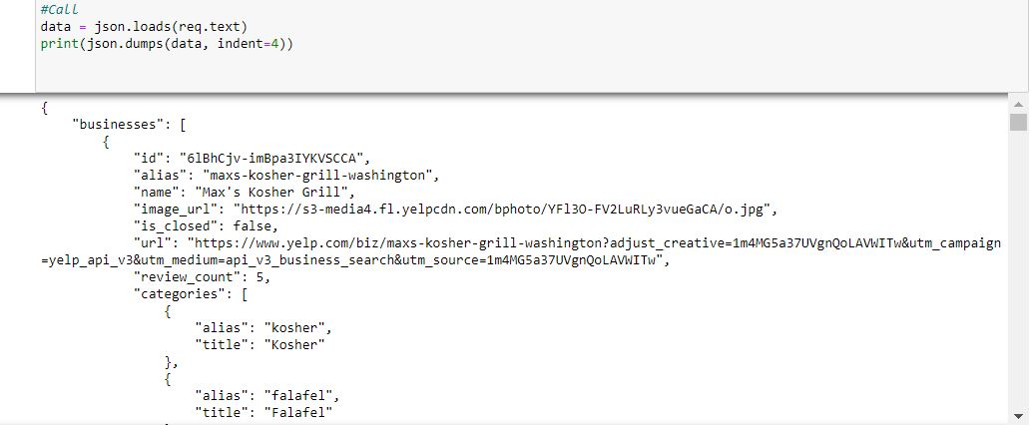
Loading data: Json and CSV
Json

Slide 13
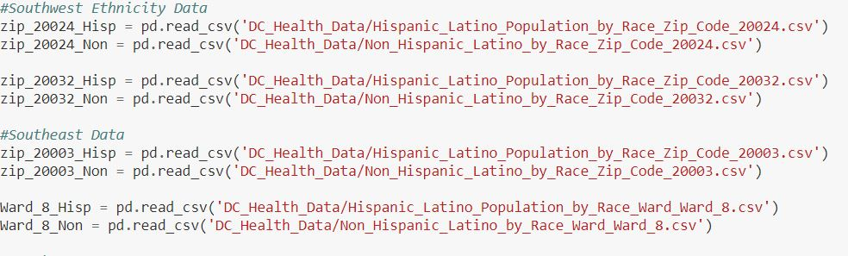
Loading data: Json and CSV
CSV

Slide 14
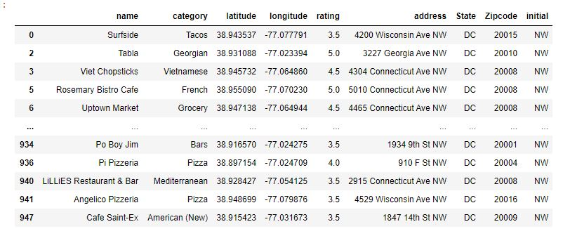
Framing the data: Pandas

Slide 15
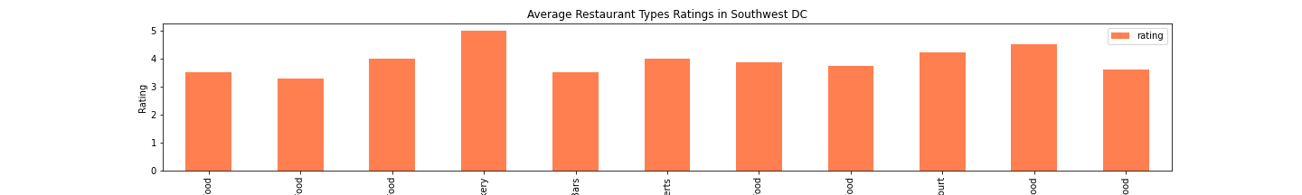
Plotting Data:

Slide 16
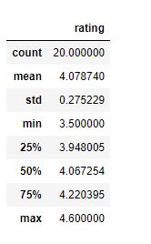
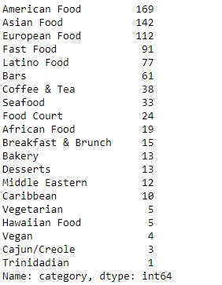
Analysis: Pandas, logic and a lot of courage

Slide 17
Results

Slide 18
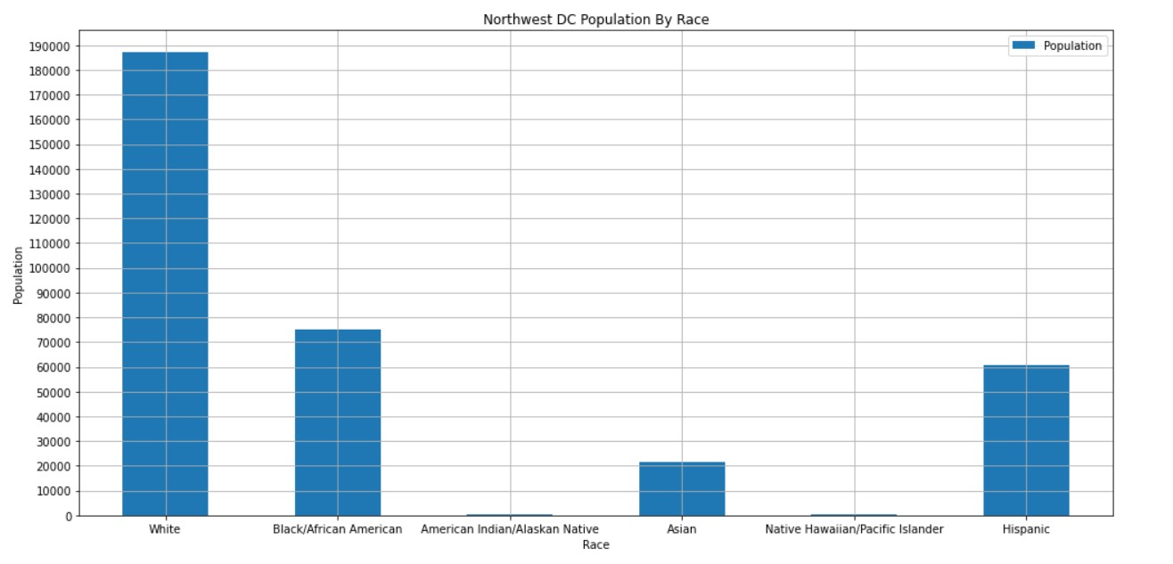
Northwest

Slide 19
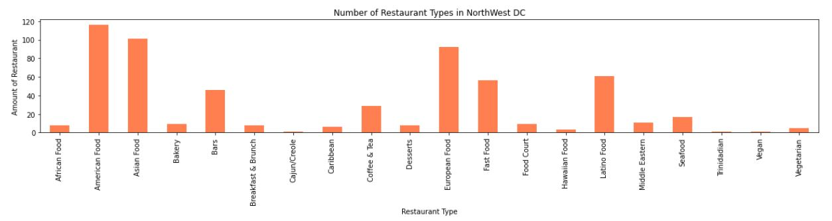
Northwest

Slide 20
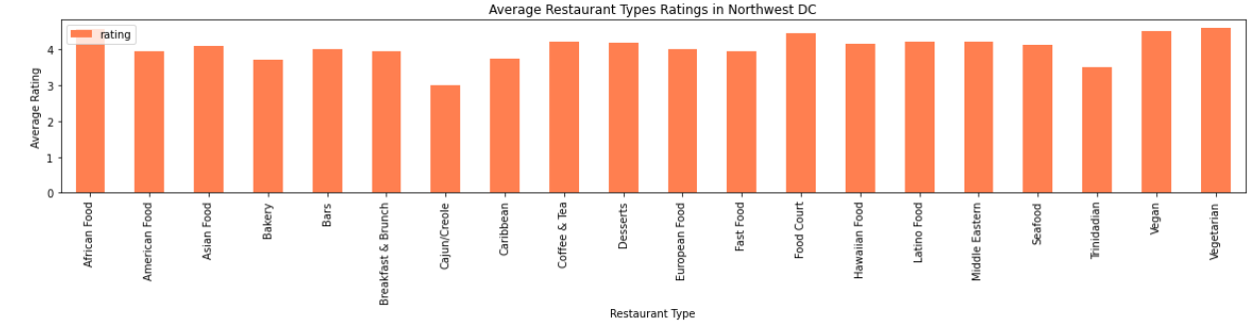
Northwest

Slide 21
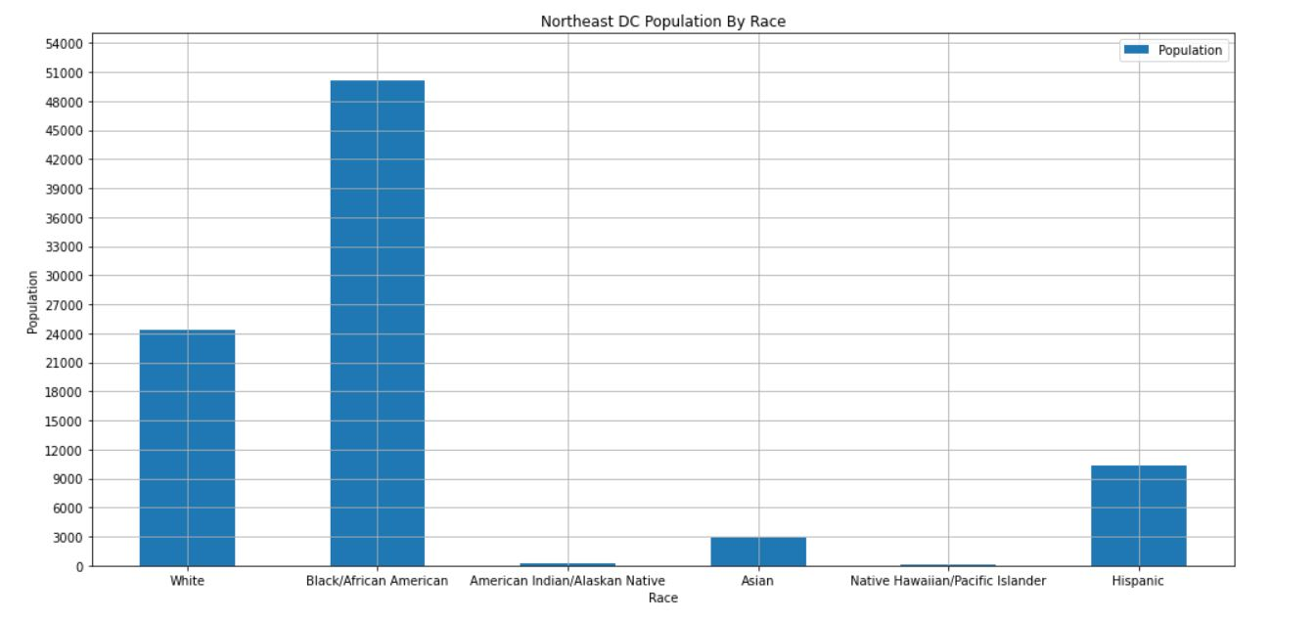
Northeast

Slide 22
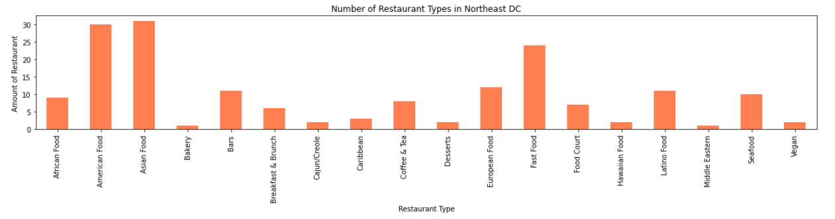
Northeast

Slide 23
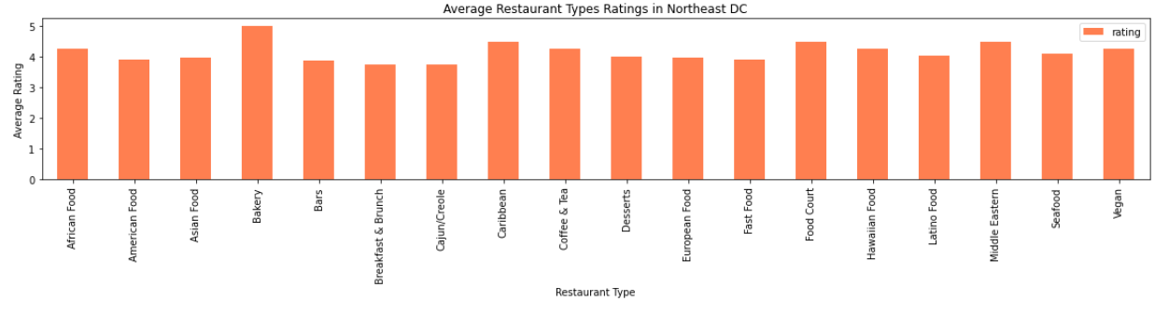
Northeast

Slide 24
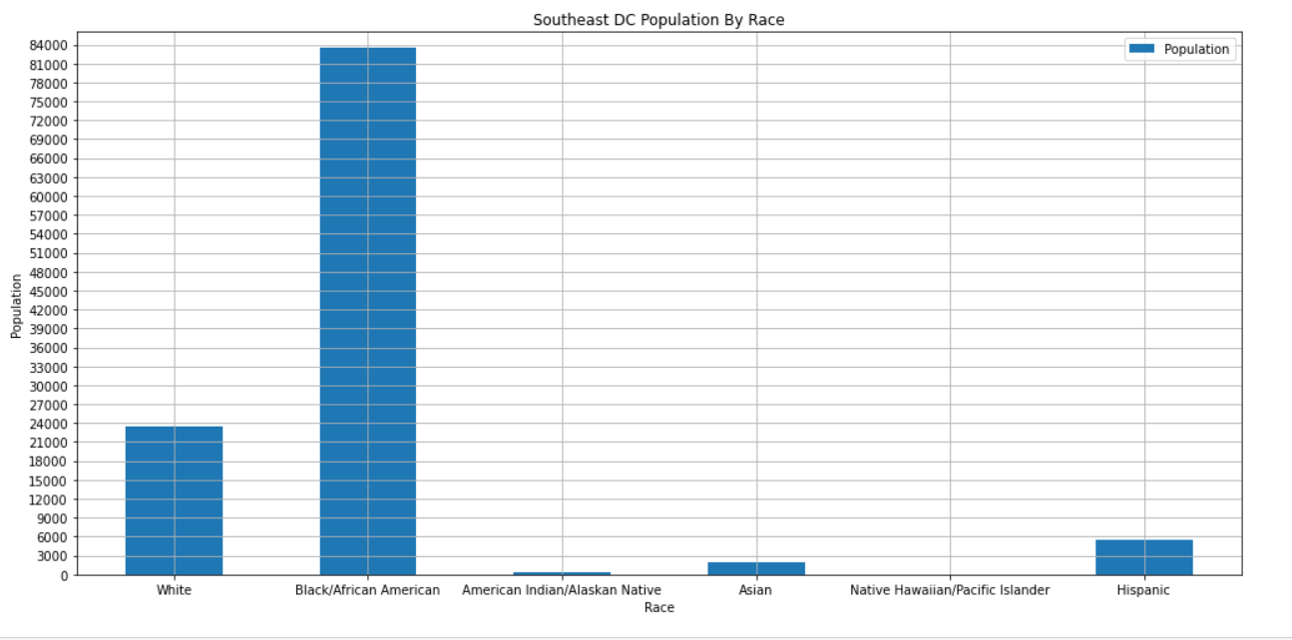
Southeast

Slide 25
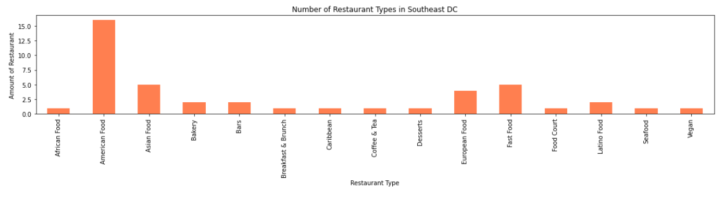
Southeast

Slide 26
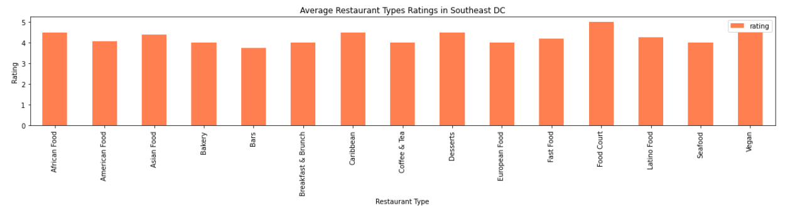
Southeast

Slide 27
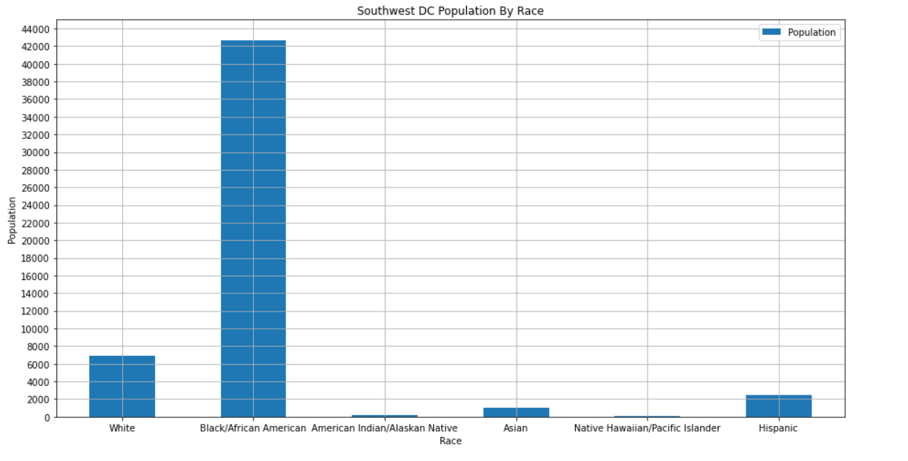
Southwest

Slide 28
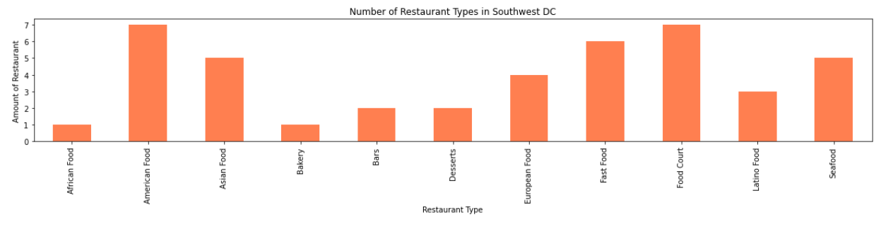
Southwest

Slide 29
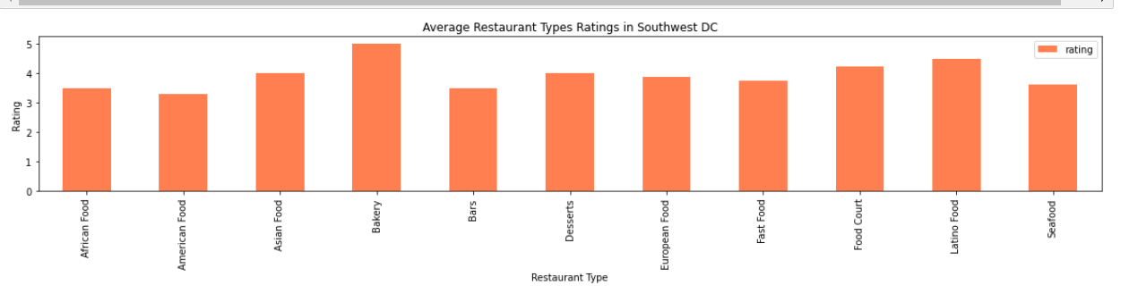
Southwest

Slide 30
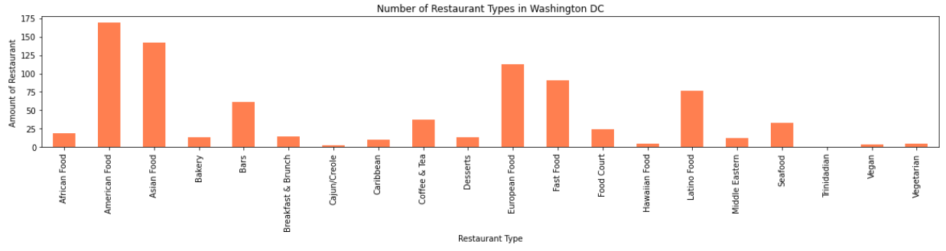
Washington DC

Slide 31
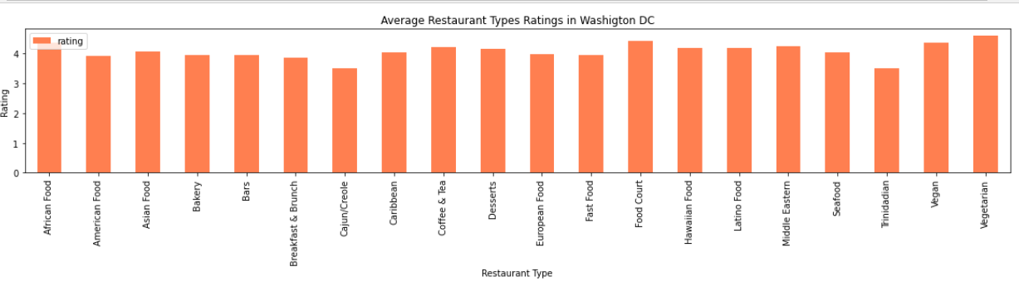
Washington DC

Slide 32
Trend analysis
Average Rating
Findings
-The most competitive restaurant types across each quadrant are American and Asian restaurants.
- The least competitive market for restaurant types are foreign and niche restaurants.
- All restaurant types have an average rating of 3 stars or more but the restaurant types in Southwest DC have lower average ratings than any other quadrant.
- Despite the competitive nature of Asian restaurants, few Asians are living in DC compared to White or African American. African Americans are the majority in every DC quadrant except in Northwest DC which is majority white. In Northwest DC, there were more European restaurants than any other quadrant.
Number of restaurants
1
3.92
2
3
4.08
169
3.99
4
142
3.93
112
91
Fast Food
Asian
Food
American Food
European Food

Slide 33
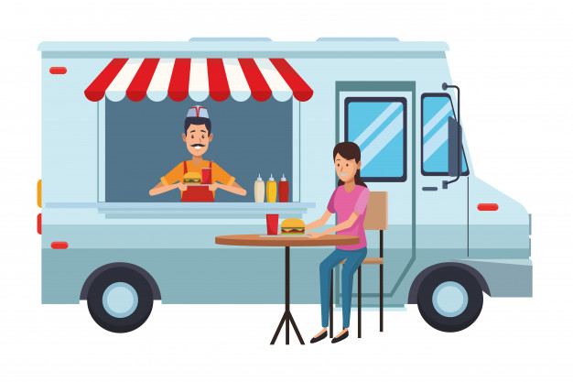
Food Trucks
Food trucks do not have a fixed location
Can sell everywhere and attract tourists !
Higher average rating than all restaurants with a 4.34 out of 5 !

Slide 34
And the winner is....

Slide 35
A niche restaurant in Southeast !
A niche restaurant in SOUTHEAST DC or a Food Truck are the best options in terms of ratings and competition.

Slide 36

Insights:
There is more research to be done to build a stronger recommendation.
We didn't anticipate African Americans being the majority in every quadrant of DC except Northwest
An interesting find is that Asian food is just as competitive as American restaurants
Another find is that Southeast DC is the only location without much diversity in restaurant types but yet as the highest amount of African Americans.

Slide 37

Problems encountered:
The Ethnicity Data was only limited to Zip codes and Wards which made it difficult to get a very accurate representation of the four quadrants. Some wards and zip code spanned across multiple quadrants.
Troubleshooting our code was quite a challenge !
Retrieving Data

Slide 38

Future improvements:
If we had more time, we would:
Collect more data from different database
Plot restaurants in a map for better visualization
Cleaning more of the data (create sub-categories)
Diving more into the categories

Slide 39
Questions ?

Slide 40
Thank you for listening!

