Slide 1

Using Reddit API for Classification Tools:
Can a Bot distinguish Jokes vs. Questions?
Amy Taylor; DSI-6
12/21/18

Slide 2

Overview
Why do we care about classifying jokes or questions?
Subreddit case study: Dad Jokes and ELI5
Data collection methods
Model Evaluation
- Baseline processing parameters
- Log regression
- Random forest (Extra trees)
5. Results: log regression = most accurate classifier

Slide 3
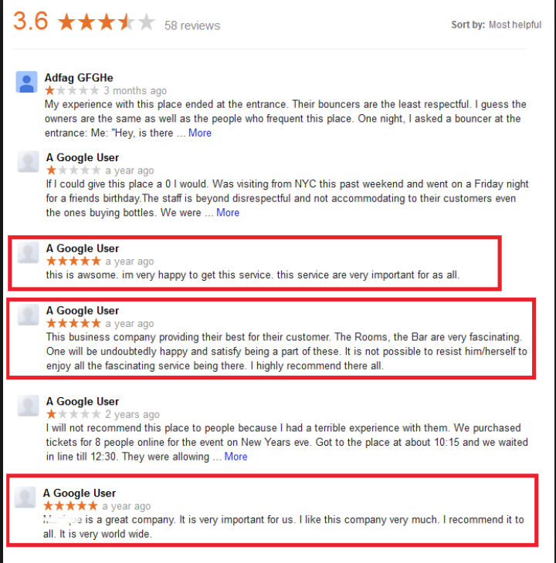

Joke or question... Why do we care?
We want bots to ....
Do my job for me... So I can Interact with redditor humans LESS
Answer REAL questions more quickly
Disregard fake, or nonsense questions
Filter through the sarcastic comments (i.e. yelp)
Be funny!

Slide 4

Two Subreddits as Case Study
Dad Jokes = make you laugh and cringe in equal measure”
1.3m Subscribers

Slide 5
Dad Jokes = make you laugh and cringe in equal measure”
My son wanted some girl advice, so I told him, “If you are intimidated by a date, remember one thing...”
They are just big raisins.
1.3m Subscribers

Slide 6

Different Intentions
Dad Jokes = make you laugh and cringe in equal measure”
ELI5 = explain like I’m 5 years old
My son wanted some girl advice, so I told him, “If you are intimidated by a date, remember one thing...”
They are just big raisins.
Layman-friendly explanations (not actually 5 yr)
Must be FACTUAL INFO, not opinions
Must be nice (so no sarcasm)
1.3m Subscribers
16.3m Subscribers

Slide 7
but Similar Structure...
Dad Jokes
What kind of exercise do lazy people do? Diddly squats
Why did the snowman name his dog Frost? Because sometimes Frost bites!

Slide 8
but Similar Structure...
Dad Jokes | ELI5
What kind of exercise do lazy people do? Diddly squats | Why don’t you hear about the history of Africa before colonialism?
Why did the snowman name his dog Frost? Because sometimes Frost bites! | Why do animals seem to have a hard time seeing themselves in a mirror?

Slide 9
but Similar Structure...
Dad Jokes | ELI5
What kind of exercise do lazy people do? Diddly squats | Why don’t you hear about the history of Africa before colonialism?
Why did the snowman name his dog Frost? Because sometimes Frost bites! | Why do animals seem to have a hard time seeing themselves in a mirror?
How many drugs did Charlie Sheen do? Enough to kill two and a half men.
What's the difference between a depression and a recession? A recession is when you lose your job, a depression is what happens when I lose mine.

Slide 10
but Similar Structure...
Dad Jokes | ELI5
What kind of exercise do lazy people do? Diddly squats | Why don’t you hear about the history of Africa before colonialism?
Why did the snowman name his dog Frost? Because sometimes Frost bites! | Why do animals seem to have a hard time seeing themselves in a mirror?
How many drugs did Charlie Sheen do? Enough to kill two and a half men. | Why was New York City so dangerous in the 70s + 80s and how did it get that way?
What's the difference between a depression and a recession? A recession is when you lose your job, a depression is what happens when I lose mine. | What is the difference between movies and films? Also directors and filmmakers?

Slide 11
but Similar Structure...
Dad Jokes | ELI5
What kind of exercise do lazy people do? Diddly squats | Why don’t you hear about the history of Africa before colonialism?
Why did the snowman name his dog Frost? Because sometimes Frost bites! | Why do animals seem to have a hard time seeing themselves in a mirror?
How many drugs did Charlie Sheen do? Enough to kill two and a half men. | Why was New York City so dangerous in the 70s + 80s and how did it get that way?
What's the difference between a depression and a recession? A recession is when you lose your job, a depression is what happens when I lose mine. | What is the difference between movies and films? Also directors and filmmakers?
Harry, you are a Unit of Power! I‘m a Watt? | How can sound BE turned into digital?
A ghost either is or is not resting against a wall. boolean | Gamma regression and when it should be used.
What do you call it when the Indian restaurant forgets your bread? It’s a naan issue. | Why is the body able to regrow the liver and not any other organs?

Slide 12
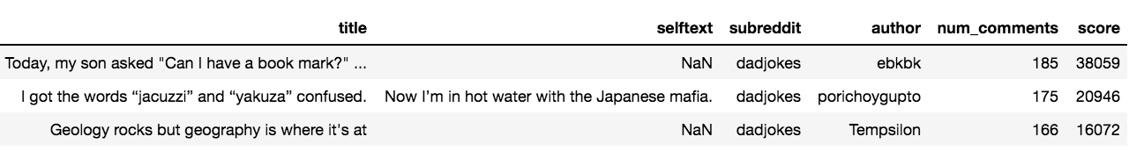
Data Collection/Cleaning
3260 unique posts (53/47 split)
https://www.reddit.com/r/dadjokes/top.json?t=month
https://www.reddit.com/r/dadjokes/new/.json
https://www.reddit.com/r/explainlikeimfive.json
https://www.reddit.com/r/explainlikeimfive/controversial/.json
Joke = 0
Five = 1

Slide 13
Model Baseline:
Preprocessing needed before modeling?
Lemmatize or not?
Remove: > HTML? Stop/words?
> Punctuation/digits?

Slide 14
Model Baseline (logreg):
Preprocessing needed before modeling?
Log reg accuracy = 93.6%
- stopwords included
- n_grams = (1,2)
2. Matrix Generator = Countvectorizer
3. Classifier = logistic regression (sklearn)
Train score = 0.99 (all)
n = # of features
Stopwords necessary!
Don’t need to lemmatize
No filters works just fine

Slide 15
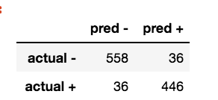
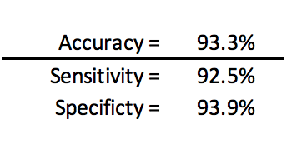
Model Baseline (logreg):
Metric Evaluation
Type I errors = Type II errors
Slightly better at classifying posts as jokes over questions

Slide 16
Decision Tree Classifiers
Default hyperparameters
Grid search optimized hyperparameters
Model | Test Score | Train S | Test
ExtraTreesClassifier() | 0.875 | 1.0 | 0.921
RandomForestClassifier | 0.864 | 1.0 | 0.917
BaggingClassifier() | 0.877 | 1.0 | 0.906
AdaBoostClassifier() | 0.854 | 0.92 | 0.892

Slide 17
Decision Tree Classifiers
Default hyperparameters
Grid search optimized hyperparameters
Model | Test Score | Train S | Test
ExtraTreesClassifier() | 0.875 | 1.0 | 0.921
RandomForestClassifier | 0.864 | 1.0 | 0.917
BaggingClassifier() | 0.877 | 1.0 | 0.906
AdaBoostClassifier() | 0.854 | 0.92 | 0.892
Most important parameter = # of trees
Final Result:
LogReg scored the overall highest accuracy, however... Score did not improve w/ hyperparameter optimization
For decision trees, the classifiers that introduced more randomness improved accuracy the most
Help reduce variance in the overfit models
Next Steps:
Create custom stopwords
Eliminate features to help with overfitting
Re-try processing parameters with decision tree classifiers

Slide 18
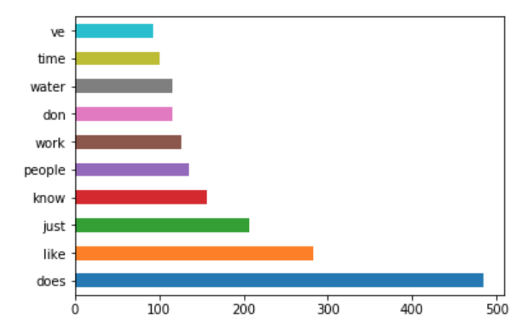
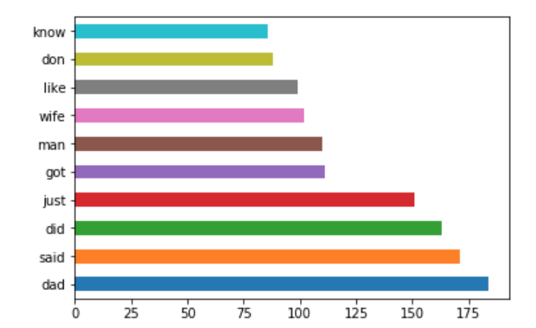
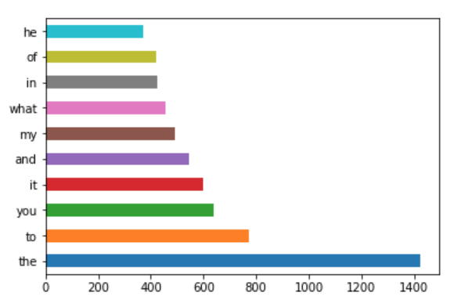
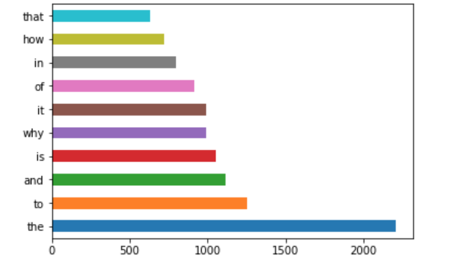
Dad Jokes
ELI5
Stop words removed
Stop words left in

