Slide 1

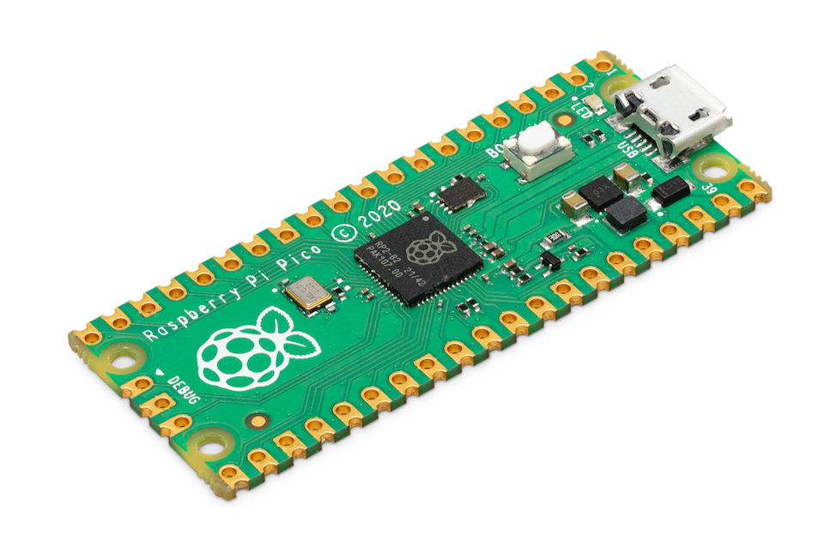




PICO
microcontroller
beginner workshop
Instructor: Amytis Saghafi

Slide 2
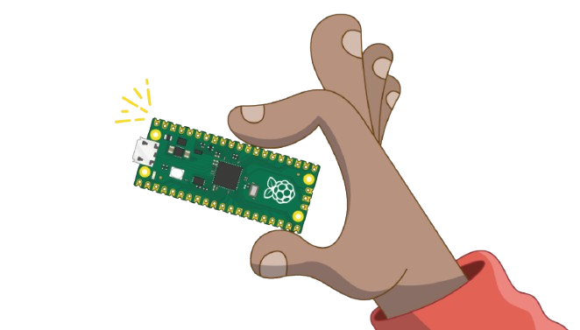
Agenda
What is a Microcontroller?
Microcontroller vs. Single Board Computers
The variety of boards
MicroPython vs C
Software Setup
Electronic Basics
Hands-on Tutorials
blinking an LED
Using a Button
possibly: PWM and ADC

Slide 3
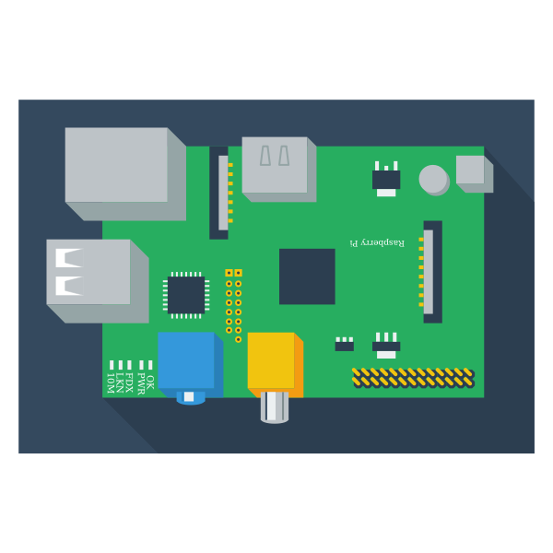
What is a Microcontroller?
a small computer on a single integrated circuit, designed for embedded applications.

Slide 4
Components of a Microcontroller
RAM
ADC
ROM
Central Processing Unit
DAC
I/O Peripherals
Serial Port

Slide 5
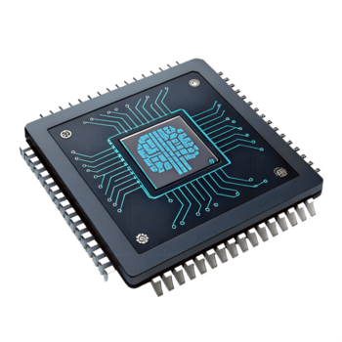
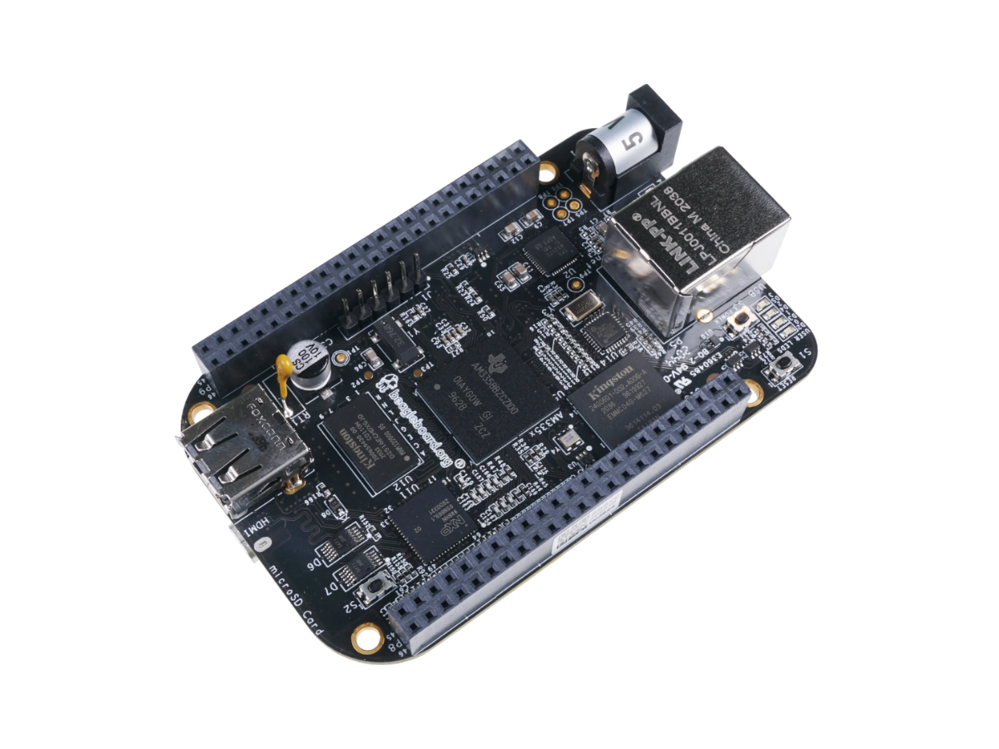
Microcontroller vs. Single Board Computer
Single Board Computers
(SBC)
Microprocessors
(MPUs)
Microcontrollers
(MCUs)

Slide 6
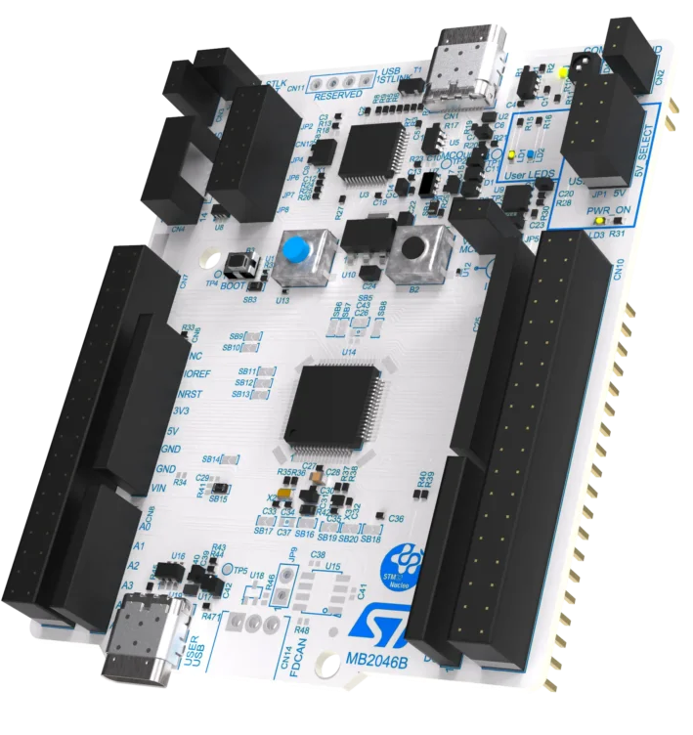
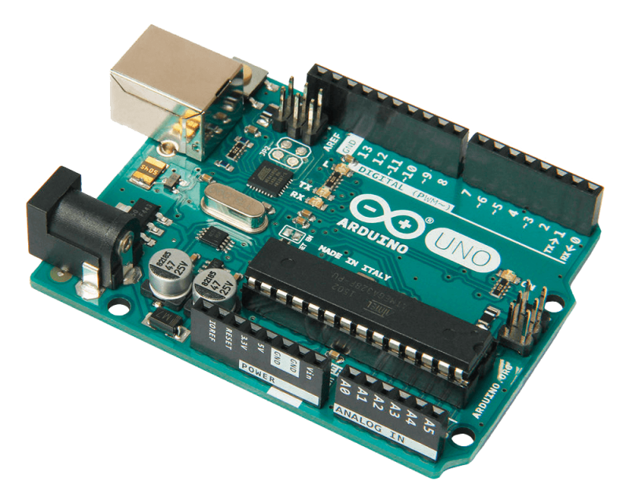
Variety of Boards
Arduino
Raspberry Pi Pico
STM 32

Slide 7
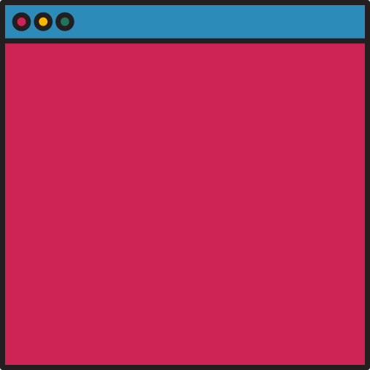
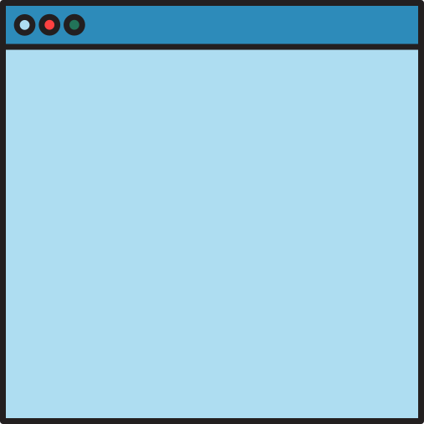
MicroPython
C/ C++ (Pico SDK)
Ease of Use: Moderate (requires compilation)
Setup Time: Slower (CMake and toolchain setup)
Performance: Max performance (up to ~250× faster)
Control: Direct register and hardware access
Debugging: SWD, debug probes, and GDB
Ease of use: Easy
Setup: Drag-drop UF2
Performance: Good enough
Hardware access: High-level Abstraction
Debugging: REPL / print
VS

Slide 8
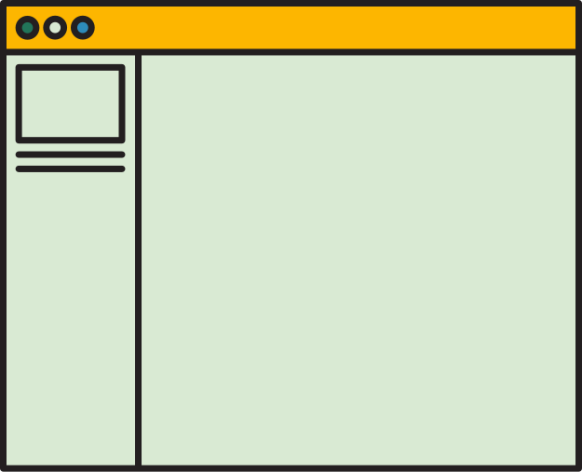
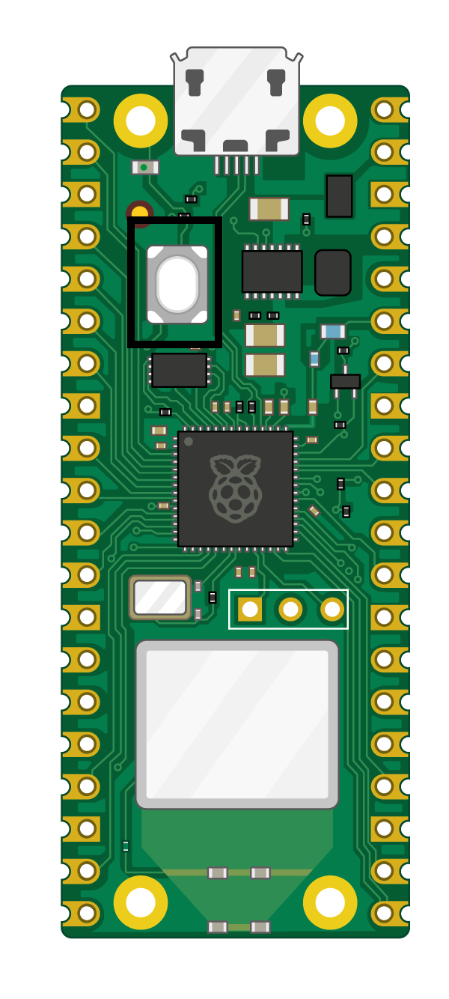
Why Raspberry Pi Pico?
Powerful Hardware
Dual-core ARM Cortex-M0+
Up to 133 MHz
264 KB RAM
Lots of Feature
26 GPIO pins
ADC, PWM, I²C, SPI, UART
Programmable I/O (PIO)
Raspberry Pi Pico
Easy development
Supports MicroPython and C/C++
Simple setup with Thonny

Slide 9

Software Setup
Install Thonny IDE from: https://thonny.org/
Open Thonny, go to tools→ options → Interpreter
Change “Local Python 3” to “MicroPython (Raspberry Pi Pico)”
Select Micropython (Raspberry Pi Pico)
Hold the BOOTSEL button
Plug the Pico into USB.
Flash Pico (Instructions coming in the next few slides)
BOOTSEL

Slide 10
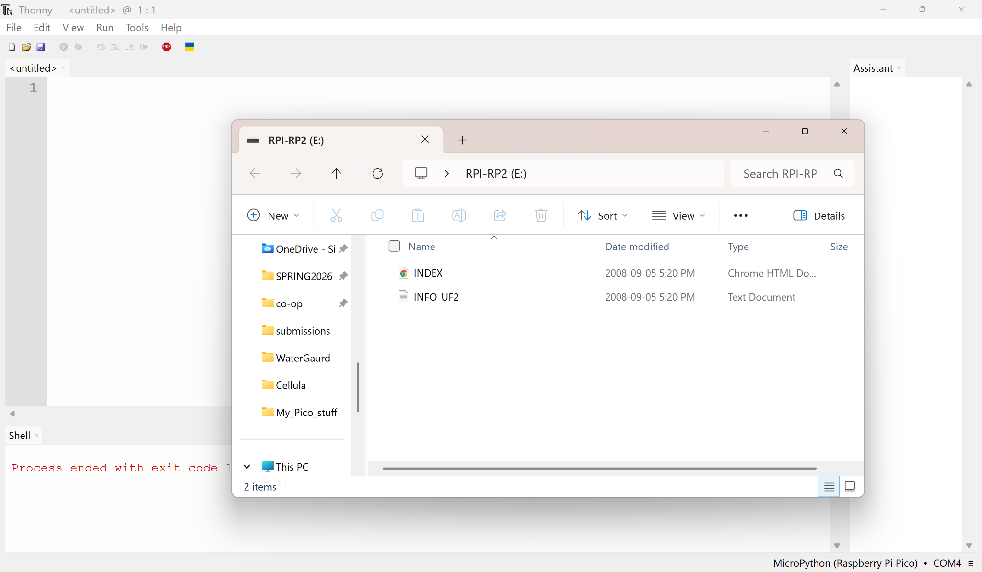
Once Pico is plugged into USB it should show up as a flashdrive!

Slide 11
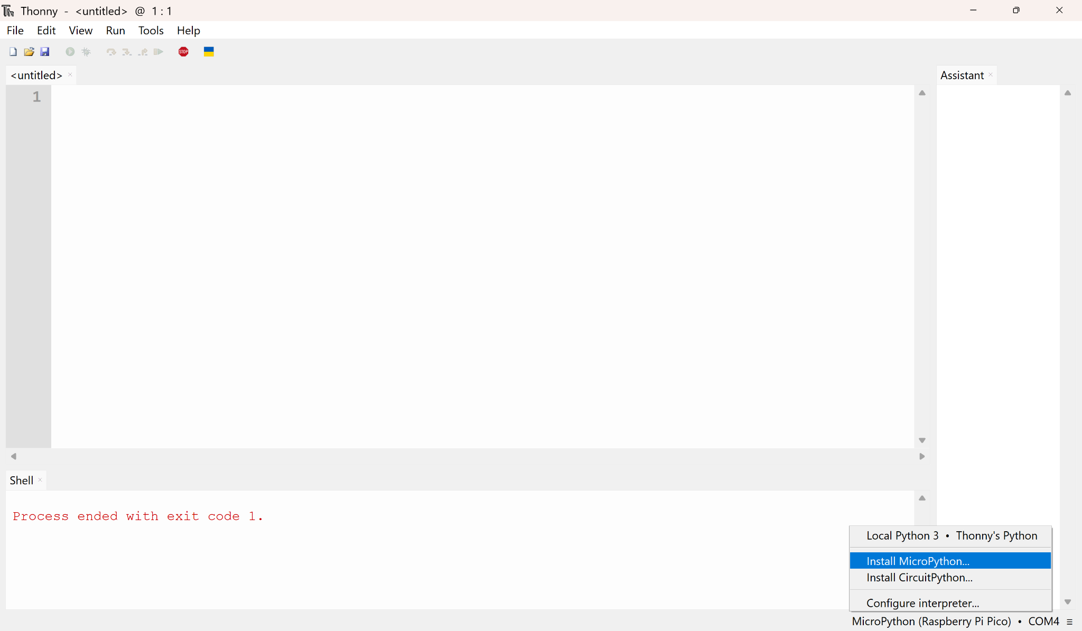
Then Open Thonny and Click on the backend in the bottom right corner, then select “Install MicroPython”

Slide 12
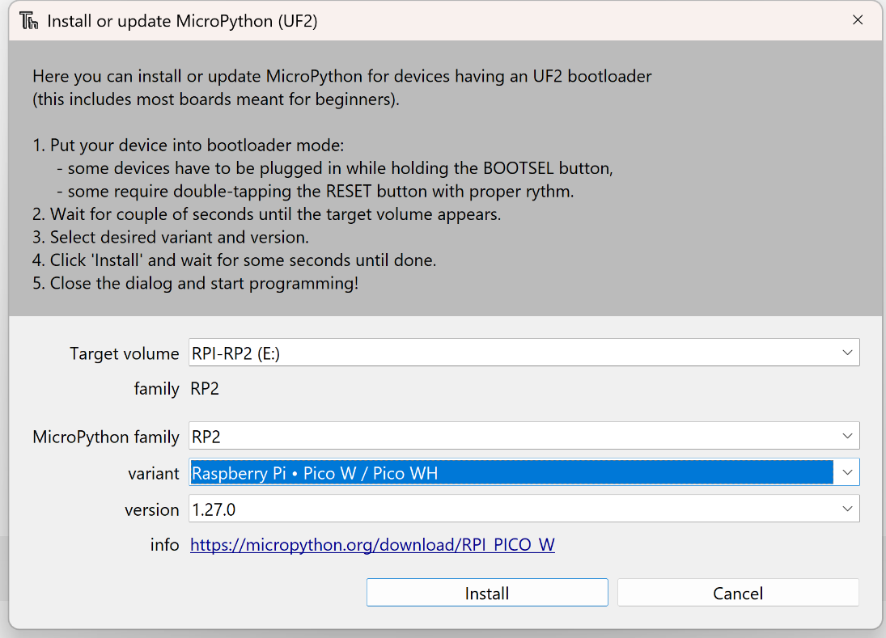
Choose the name that showed up as a drive as target Volume
and Pico W/WH as the variant and install
Wait for the pico to reboot! (no need to unplug)
Once rebooted you should be able to select it as a backend with a communication port attached to it.
Note: If this process doesn’t work, you can download the file directly from the Raspberry Pi Pico website and drag it on to the flashdrive. This will automatically reboot the pico and should work as normal.

Slide 13
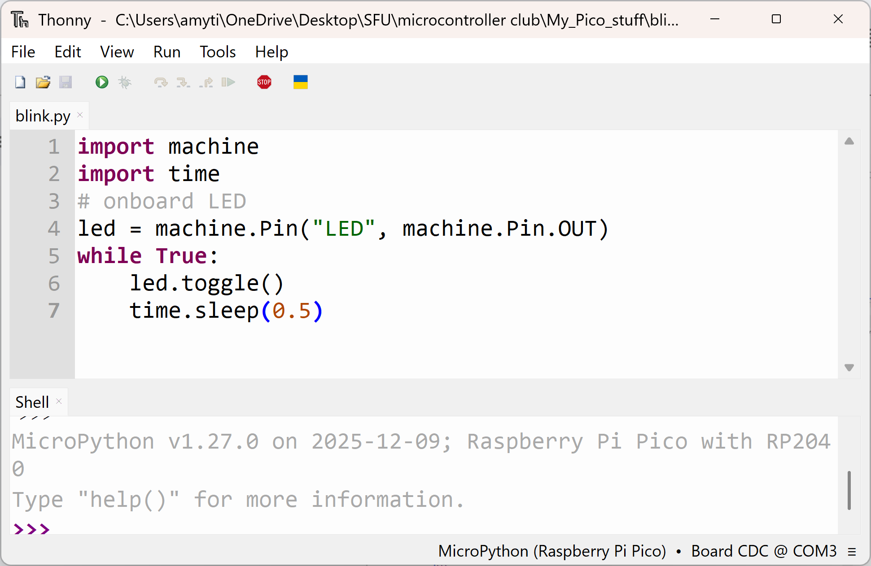
Blink onboard LED
Onboard LED
Pin Access
Timing Functions

Slide 14
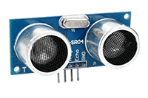
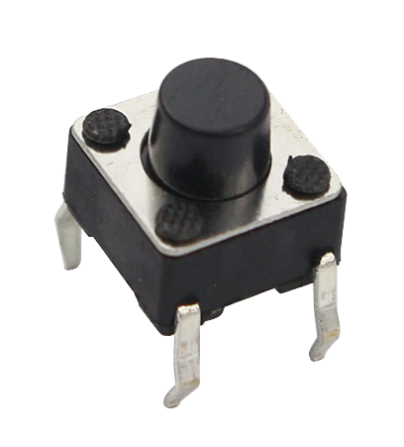
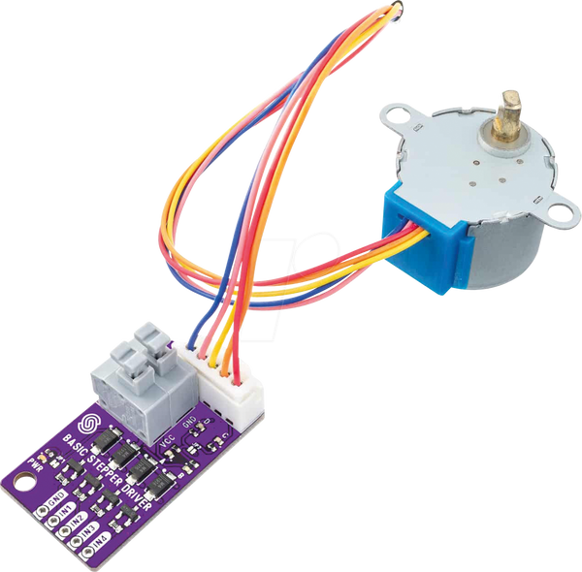
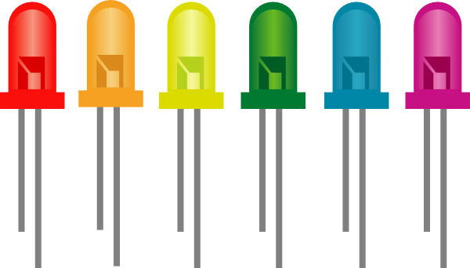
What is GPIO?
GPIO = General Purpose Input/ Output
Uses digital input (1 and 0)
As input, peripheral requires external power
As output, typically provides peripheral with some sort of power
note: sometimes external power is still required

Slide 15
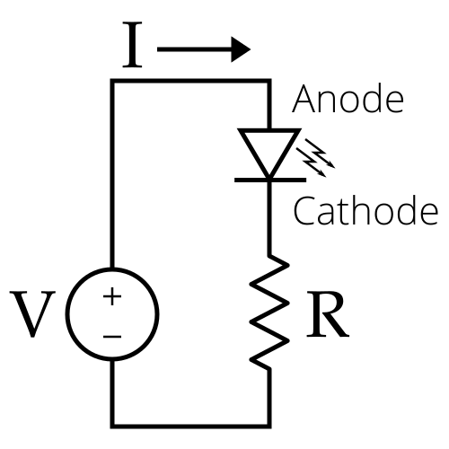
Electronics Basics
OHM’S LAW: V=IR
Pico GPIO pin voltage: 3.3 V
LED voltage drop: 2.0 V
Safe LED Current: 10-30 mA
3.3 V - 2.0 V
R=
= 65 Ω
Choose closest value available!
0.02 A
(I used 220 Ω)

Slide 16



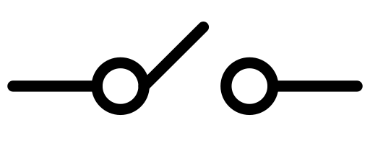
Hands-On Tutorials
Blink LED
Set-up button
Wire up an LED to a GPIO pin
Write MicroPython Program to Blink the LED
Play with Blink timing
What are pull-up and pull-down resistors? (look it up and we will discuss later!)
Wire up a Button to a GPIO pin
See if you can output a message when button status changes!
Write a program that uses the button to control the LED
You can add more buttons and LEDs and play around with the functionality!
LED
R
(220 Ω)
GPIO Pin
3V3(OUT)
Pull-UP
Resistor
(10 kΩ)
3V3(OUT)
Pull-Down
Resistor
(10 kΩ)
GPIO Pin
GPIO Pin
(Default: 1)
(Default: 0)

Slide 17
CHALLENGE: Reaction Timer Game
Write program that:
Waits random delay
Turns on LED
Records how fast button was pushed after LED turns on
Prints reaction time in console
Keeps track of best reaction time of the session

Slide 18
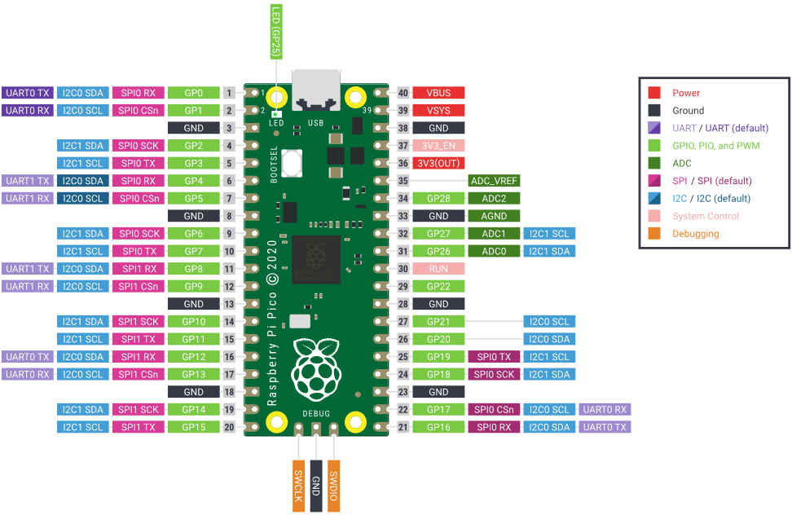
PICO PINOUT

Slide 19
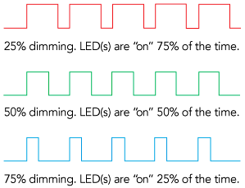
What is PWM?
PWM = Pulse Width Modulation
This is how we control brightness!

Slide 20
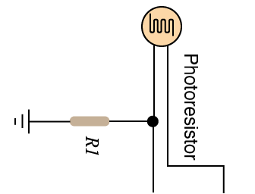
What is ADC and how is it used?
ADC = Analog to digital converter
reads voltage as an 16-bit number (0 -65536)
Photoresistor
R1
10 kΩ
ADC Pin
3V3(OUT)

Slide 21
CHALLENGE: Automatic Light Control
Wire up a photoresistor to an ADC pin. (use a voltage divider)
Write a program that:
  Reads light levels from the photoresistor using the ADC pin
  Adjusts the brightness of the LED using PWM based on light level readings
  (BONUS) play around with a manual button override!

Slide 22
Thanks for coming!
Any Questions?
Please return your kits the way you found the :)

