Slide 1
Analysis of VA SOL Scores
A look into pre and post COVID elementary student pass rates
-Amy Ward

Slide 2

About Me
Data Analyst
Veteran Teacher
Proponent of Data Driven Decision Making
Always searching for improvement and efficiency!

Slide 3
Overview
Methods
Collection and Cleaning
Statistics
Findings
Divisions
Schools
Next Steps
Further Data
Practices

Slide 4
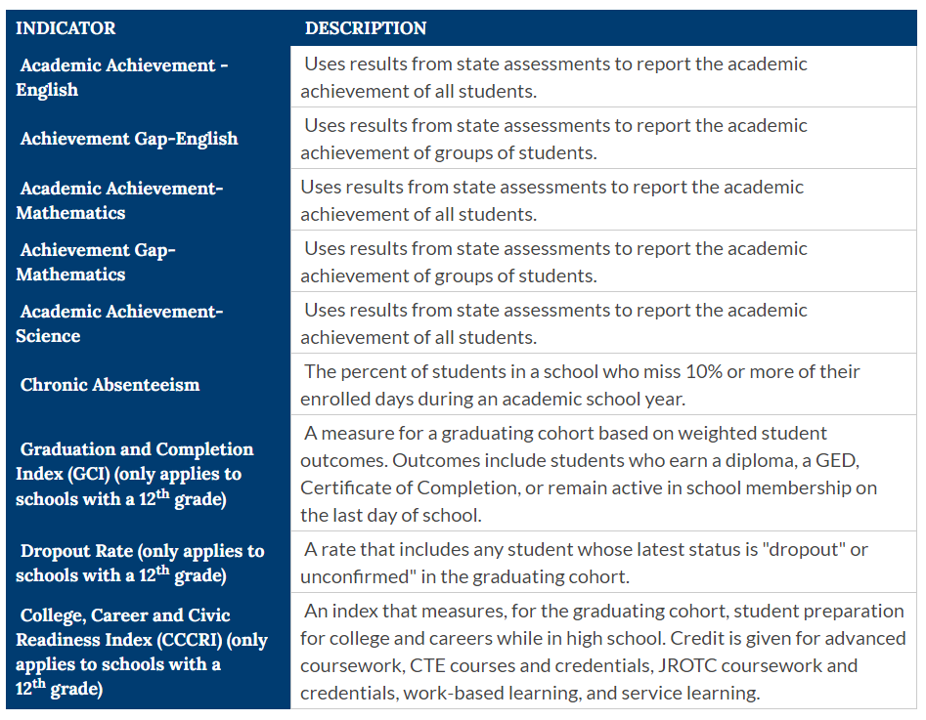

KPIs
School Quality Indicators
Accreditation
From VDOE

Slide 5
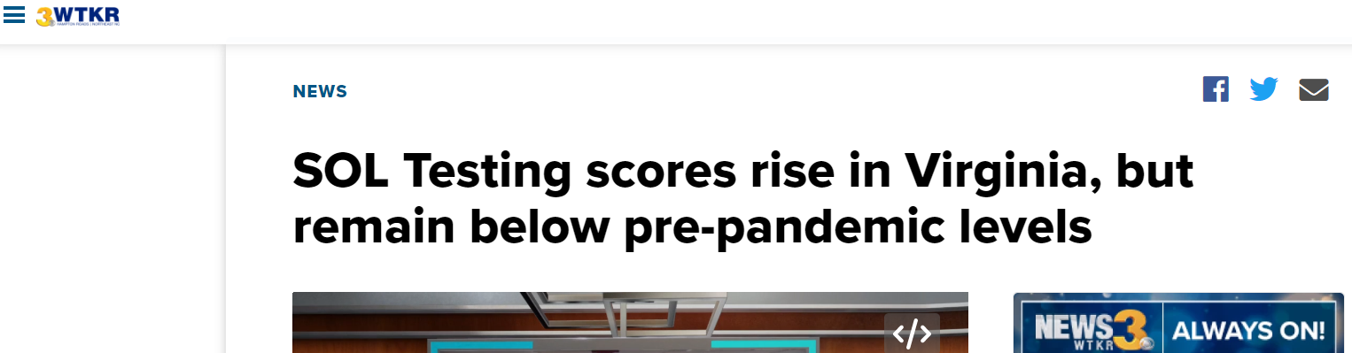
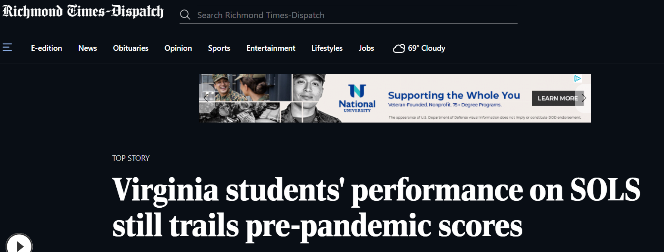
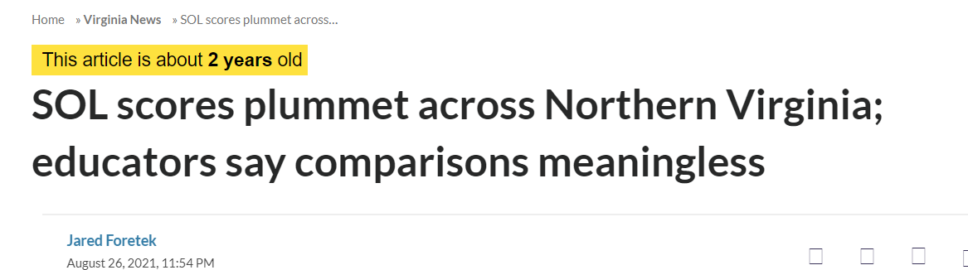
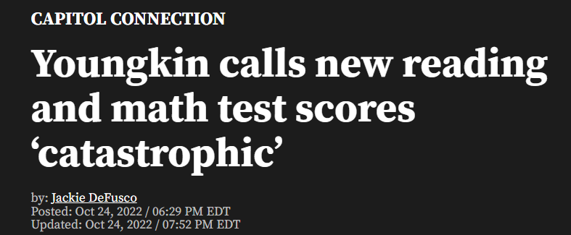
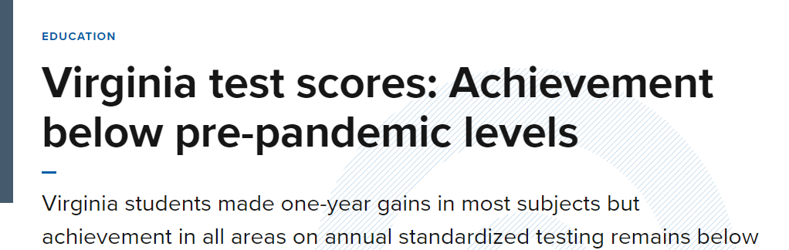
In the News

Slide 6
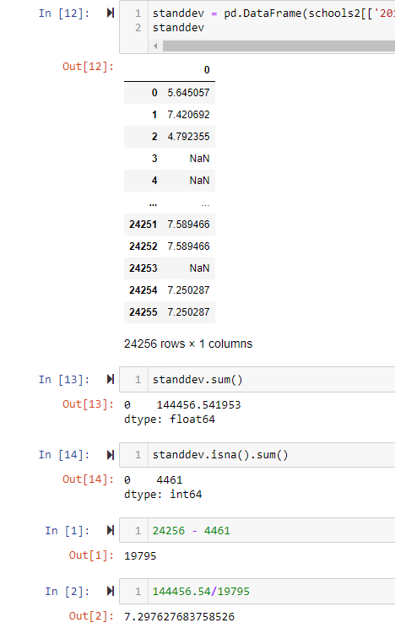
Determining Success
Standard Deviation for each District and School between 2013-2019
Gave normal range of variation from the mean translating to average rise and fall of test scores year to year
Some variance in these numbers
Averaged the standard deviations to create a typical range of expected outcomes

Slide 7
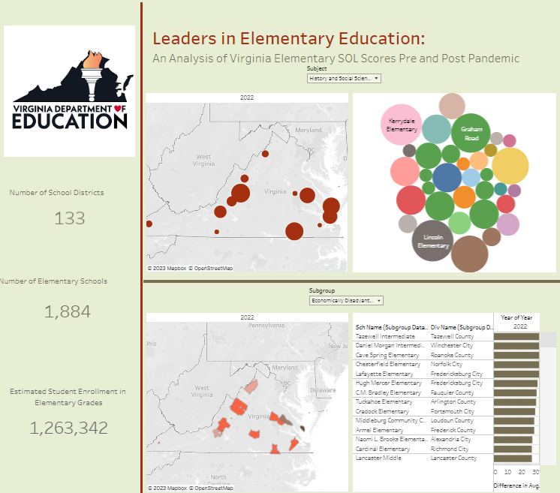
Findings
Tableau Analysis

Slide 8

Review and Next Steps
Many divisions were within one average standard deviation of test score differences between 2019 and 2022.
Two districts have shown growth overall.
Many individual schools have increased their SOL test scores since 2019.
Much could be learned from these districts and schools moving forward:
Analysis of school demographics
Data collection on curriculum taught
Data collection on management practices
Data collection on class size/grouping/student teacher ratio
Data collection on scheduling and minutes of instruction
Analysis of VDOE school climate survey
Determine what these schools are doing correctly and attempt to replicate it in lower performing areas.

Slide 9

Questions

