Slide 1
Intro to Html/CSS workshop
Make sure to have a text editor (like Atom)
and a Github account.

Slide 2
What is HTML?
Stands for HyperText Markup Language
Describes the structure of a web page
Consists of a series of tags that tell your web browser how to display content
Web browsers (like Chrome, Safari, Firefox, etc) will read HTML documents and display them

Slide 3
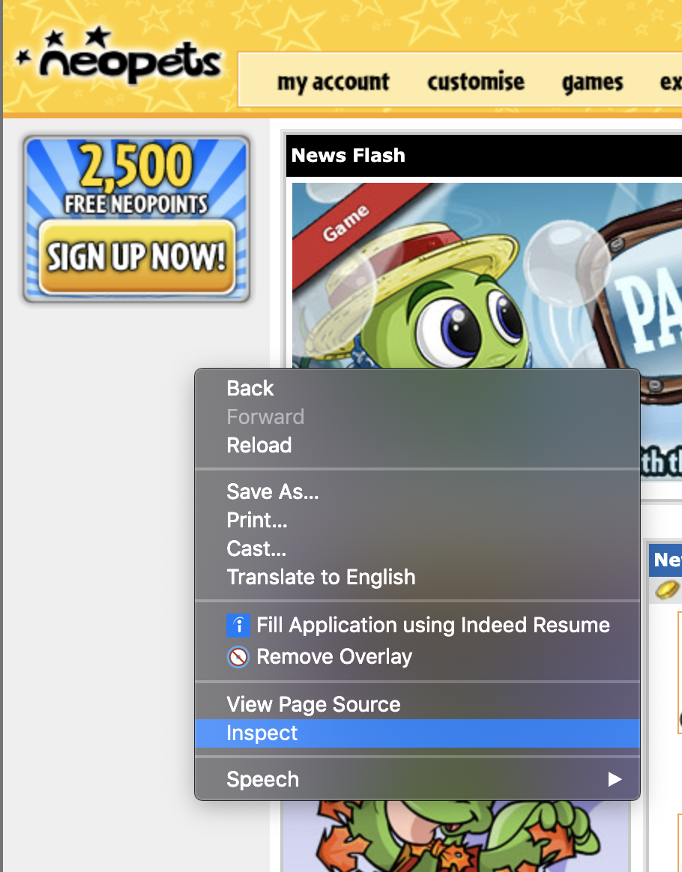
Inspect Element
Right click → “Inspect” or “View Page Source” on a webpage and you will be able to see

Slide 4
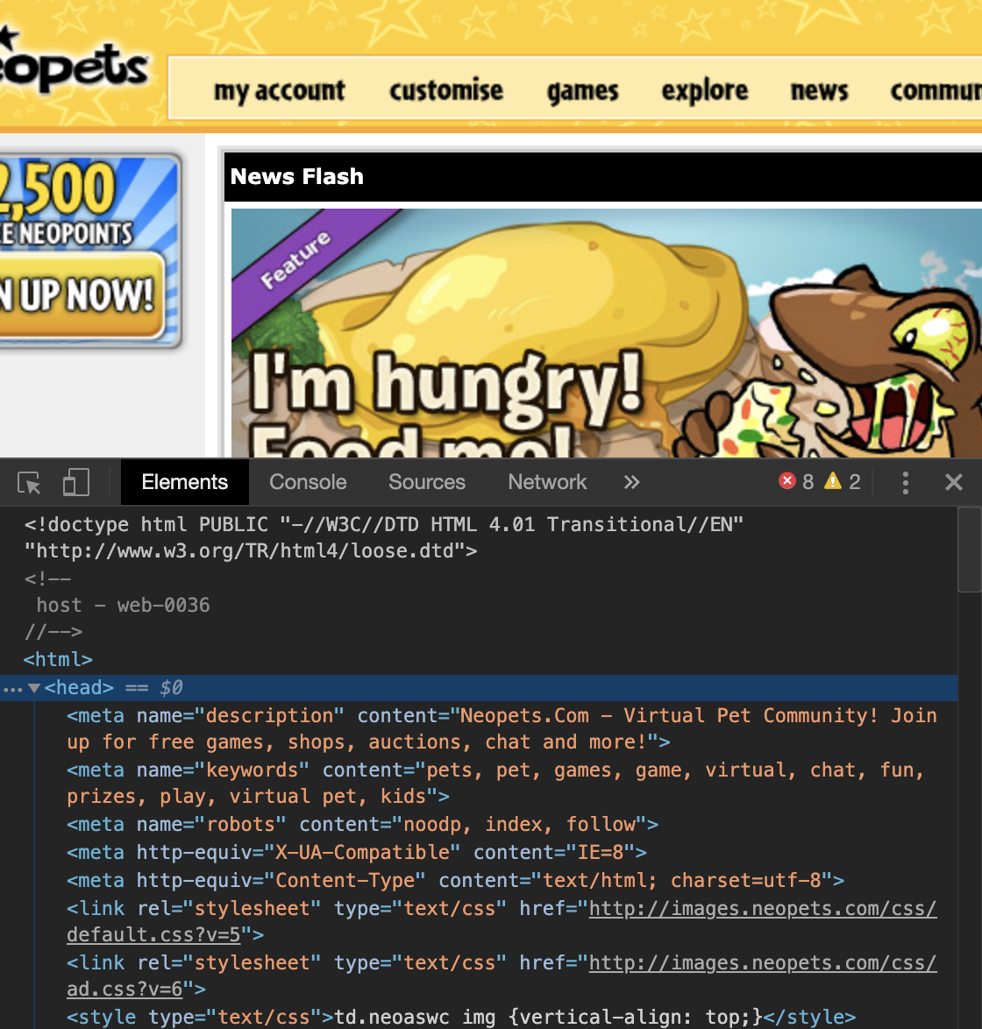

Slide 5
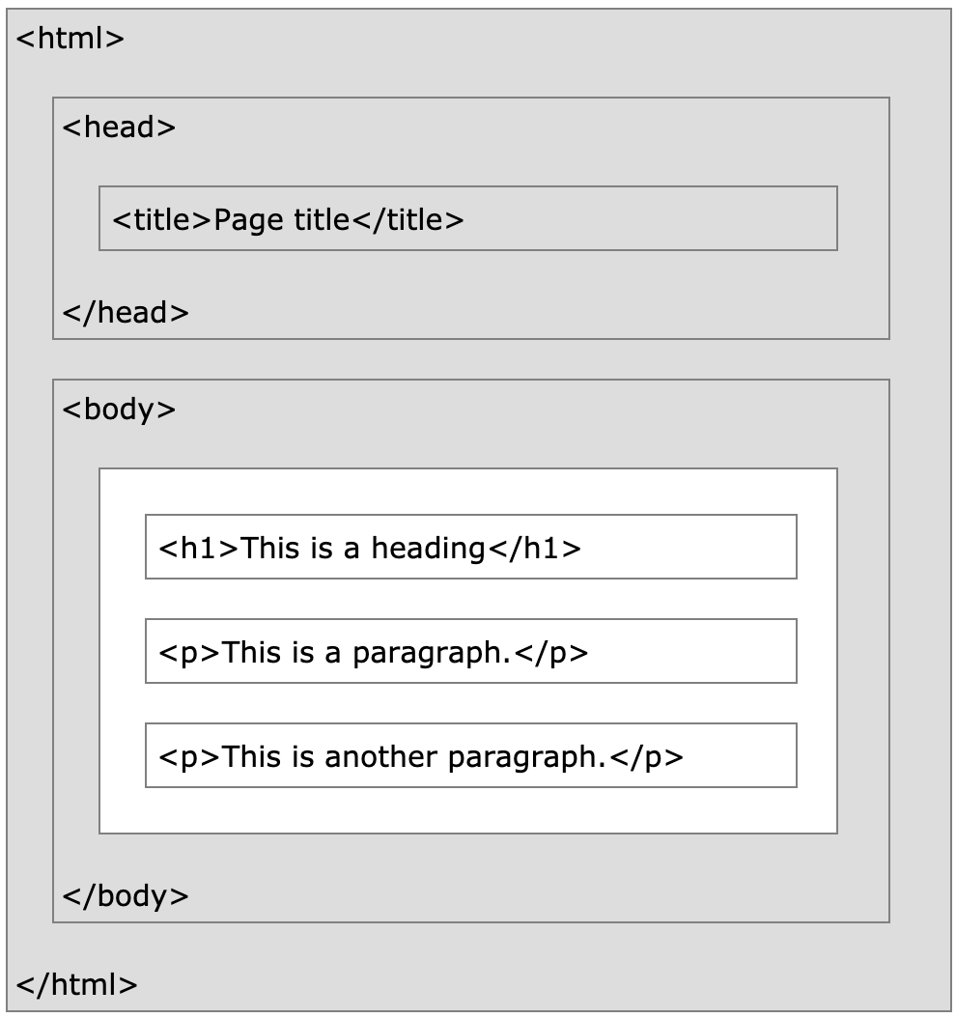
HTML Page Structure
HTML uses a parent-child hierarchy
<!DOCTYPE html>
<html>
<head> </head>
<body>
<h1>This is a heading</h1>
<p>This is a paragraph.</p>
</body>
</html>

Slide 6
What Goes Where
<head>
Title of page
Links to CSS and JS files
Links to fonts
Author(s) of page
Sets up the page
</head>
<body>
Everything else
</body>

Slide 7
Useful Tags
Divider: <div> </div>
Creates a box to put anything in
Serves as a division or section for your HTML code
Links: <a href=“[link here]”> [text here] </a>
Creates a hyperlink when you click on the text enclosed within the tag
Images: <img src=[path to image] alt=[alt.name]>
Path to image might be “/file/image.png”

Slide 8
List Tags
Unordered Lists
Ordered Lists
<ul>
<li>Coffee</li>
<li>Tea</li>
<li>Milk</li>
</ul>
Coffee
Tea
Milk
<ol>
<li>Coffee</li>
<li>Tea</li> →
<li>Milk</li>
</ol>
1. Coffee
2. Tea
3. Milk

