Slide 1
You will complete a total of 14 trials.
On each trial, you will be presented with four different versions of an image, arranged like below.
VERSION 1
VERSION 2
VERSION 3
VERSION 4

Slide 2
You will complete a total of 14 trials.
On each trial, you will be presented with four different versions of an image, arranged like below.
VERSION 1
VERSION 2
VERSION 3
VERSION 4
These images are designed to help people understand the side effect associated with this COVID-19 vaccine.

Slide 3


On each trial, you will be asked to make judgements about the different image versions.
You will answer two sets of 3 questions for each trial. Here is an example of one of the sets:
VERSION 1
VERSION 2
VERSION 3
VERSION 4
In terms of helping you evaluate the risks of seeking this vaccine, which version is…
Easiest to understand?
The second easiest to understand?
The most difficult to understand?

Slide 4
On each trial, you will be asked to make judgements about the different image versions.
You will answer two sets of 3 questions for each trial. Here is an example of one of the sets:
VERSION 1
VERSION 2
VERSION 3
VERSION 4
The four image versions will differ between each trial, so please pay attention.

Slide 5
[Attention check questions]

Slide 6

Well done, you have passed the attention check questions.
When you are ready, click the button below to start the game.

Slide 7
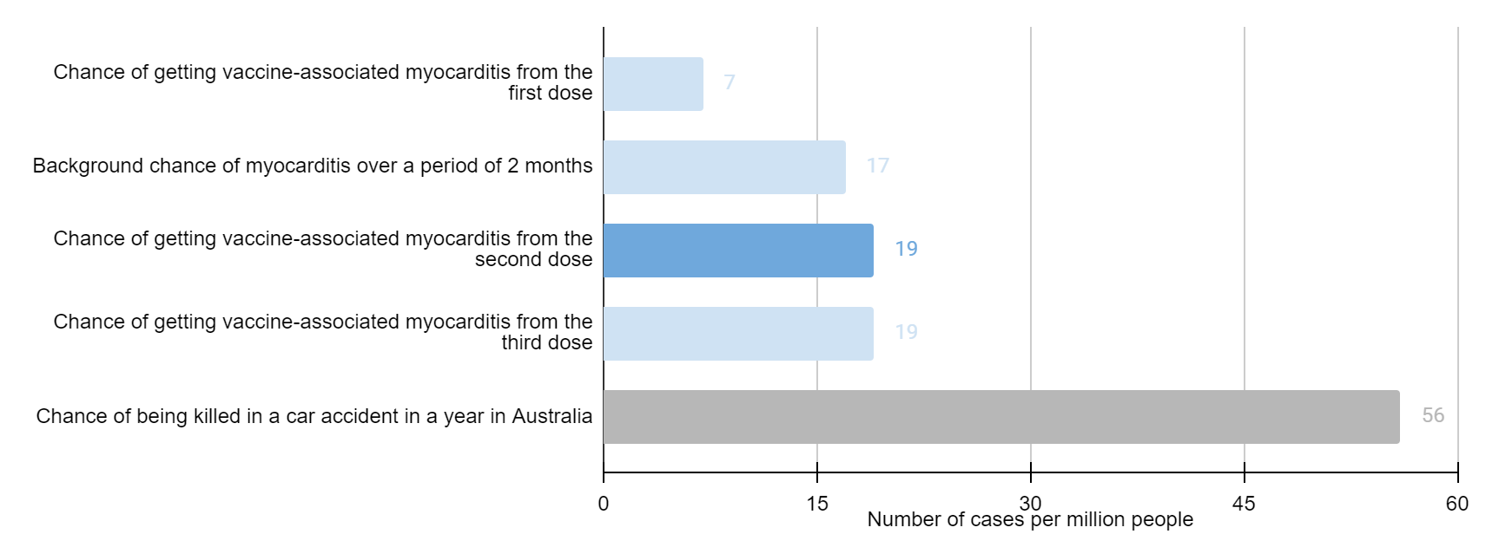

Version 1
Version 2
Chance of getting vaccine-associated myocarditis from the first dose: 7 per million
Background chance of myocarditis over a period of 2 months: 17 per million
Chance of getting vaccine-associated myocarditis from the second dose: 19 per million
Chance of getting vaccine-associated myocarditis from the third dose: 19 per million
Chance of being killed in a car accident in a year in Australia: 56 per million
Version 3
Version 4
Chance of getting vaccine-associated myocarditis from the first dose: 7 per million
Background chance of myocarditis over a period of 2 months: 17 per million
Chance of getting vaccine-associated myocarditis from the second dose: 19 per million
Chance of getting vaccine-associated myocarditis from the third dose: 19 per million
In terms of helping you evaluate the risks of getting this vaccine, which version is…
Easiest to understand?
The second easiest to understand?
The most difficult to understand?

Slide 8
500ms blank screen

Slide 9
Version 1
Version 2
Chance of getting vaccine-associated myocarditis from the first dose: 7 per million
Background chance of myocarditis over a period of 2 months: 17 per million
Chance of getting vaccine-associated myocarditis from the second dose: 19 per million
Chance of getting vaccine-associated myocarditis from the third dose: 19 per million
Chance of being killed in a car accident in a year in Australia: 56 per million
Version 3
Version 4
Chance of getting vaccine-associated myocarditis from the first dose: 7 per million
Background chance of myocarditis over a period of 2 months: 17 per million
Chance of getting vaccine-associated myocarditis from the second dose: 19 per million
Chance of getting vaccine-associated myocarditis from the third dose: 19 per million
Which version would lead you to be…
Most likely to seek the vaccine?
Second most likely to seek the vaccine?
Least likely to seek the vaccine?

Slide 10
Loading next images…
2s delay

Slide 11
Version 1
Version 2
Chance of getting vaccine-associated myocarditis from the first dose: 7 per million
Background chance of myocarditis over a period of 2 months: 17 per million
Chance of getting vaccine-associated myocarditis from the second dose: 19 per million
Chance of getting vaccine-associated myocarditis from the third dose: 19 per million
Chance of being killed in a car accident in a year in Australia: 56 per million
Version 3
Version 4
Chance of getting vaccine-associated myocarditis from the first dose: 7 per million
Background chance of myocarditis over a period of 2 months: 17 per million
Chance of getting vaccine-associated myocarditis from the second dose: 19 per million
Chance of getting vaccine-associated myocarditis from the third dose: 19 per million
(The four versions are supposed to be different here & will be replaced for the actual task.)
In terms of helping you evaluate the risks of getting this vaccine, which version is…
Easiest to understand?
The second easiest to understand?
The most difficult to understand?
Notes:
(The four versions are supposed to be different here)

Slide 12
500ms blank screen

Slide 13
Version 1
Version 2
Chance of getting vaccine-associated myocarditis from the first dose: 7 per million
Background chance of myocarditis over a period of 2 months: 17 per million
Chance of getting vaccine-associated myocarditis from the second dose: 19 per million
Chance of getting vaccine-associated myocarditis from the third dose: 19 per million
Chance of being killed in a car accident in a year in Australia: 56 per million
Version 3
Version 4
Chance of getting vaccine-associated myocarditis from the first dose: 7 per million
Background chance of myocarditis over a period of 2 months: 17 per million
Chance of getting vaccine-associated myocarditis from the second dose: 19 per million
Chance of getting vaccine-associated myocarditis from the third dose: 19 per million
Which version would lead you to be…
Most likely to seek the vaccine?
Second most likely to seek the vaccine?
Least likely to seek the vaccine?

Slide 14
Loading next images…
… etc for 13 more trials

Slide 15
MATERIALS

Slide 16
Your chance of myocarditis after the first shot of vaccine will increase by: | 0.2 cases per 100,000 people
Chance of having myocarditis in 2 months even you haven’t had any vaccine and haven’t had COVID-19 (infection) | 1.7 cases per 100,000 people
Your chance of myocarditis after the second shot of vaccine will increase by | 2 cases per 100,000 people
Chance of having myocarditis after COVID-19 (infection) | 2,400 cases per 100,000 people
Notes:
opt1_base0_comp0_bar0_eval0

Slide 17
Your chance of myocarditis after the first shot of vaccine will increase by: | 0.2 cases per 100,000 people
Chance of having myocarditis in 2 months even you haven’t had any vaccine and haven’t had COVID-19 (infection) | 1.7 cases per 100,000 people
Your chance of myocarditis after the second shot of vaccine will increase by | 2 cases per 100,000 people
Chance of having myocarditis after COVID-19 (infection) | 2,400 cases per 100,000 people
Chance of dying in a car crash in a year in Australia | 5.6 cases per 100,000 people
Notes:
opt3_base0_comp1_bar0_eval1

Slide 18
Your chance of myocarditis after the first shot of vaccine will increase by: | 2 cases per 1,000,000 people
Chance of having myocarditis in 2 months even you haven’t had any vaccine and haven’t had COVID-19 (infection) | 17 cases per 1,000,000 people
Your chance of myocarditis after the second shot of vaccine will increase by | 20 cases per 1,000,000 people
Chance of having myocarditis after COVID-19 (infection) | 24,000 cases per 1,000,000 people
Notes:
opt5_base1_comp0_bar0_eval1

Slide 19
Your chance of myocarditis after the first shot of vaccine will increase by: | 2 cases per 1,000,000 people
Chance of having myocarditis in 2 months even you haven’t had any vaccine and haven’t had COVID-19 (infection) | 17 cases per 1,000,000 people
Your chance of myocarditis after the second shot of vaccine will increase by | 20 cases per 1,000,000 people
Chance of having myocarditis after COVID-19 (infection) | 24,000 cases per 1,000,000 people
Chance of dying in a car crash in a year in Australia | 56 cases per 1,000,000 people
Notes:
opt7_base1_comp1_bar0_eval0

