Slide 1
Save environment

Slide 2


Slide 3
environment
The circumstances or conditions that surround one; surroundings.
The totality of circumstances surrounding an organism or group of organisms, especially:
The combination of external physical conditions that affect and influence the growth, development, and survival of organisms: "We shall never understand the natural environment until we see it as a living organism" (Paul Brooks).
The complex of social and cultural conditions affecting the nature of an individual or community

Slide 4

.
.

Slide 5
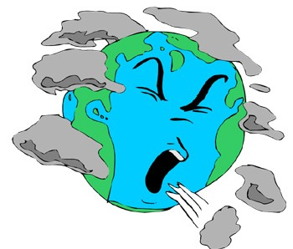
Environmental problems

Slide 6
Environmental problems
With the growing population even the problems are increasing and of late they have taken a demonic size, which is commanding expert attention to be solved. There are problems like Air Pollution, Drinking water pollution, Global warming, Hazardous Waste, Ozone Depletion and many others, which makes the list endless. As globalization paves its way across the world these problems no longer remain local problems but become international issues and there are numerous causes of these problems, some of which are created by man and can also be controlled by man. So here we would discuss some of these environmental problems, their causes and effects.

Slide 7
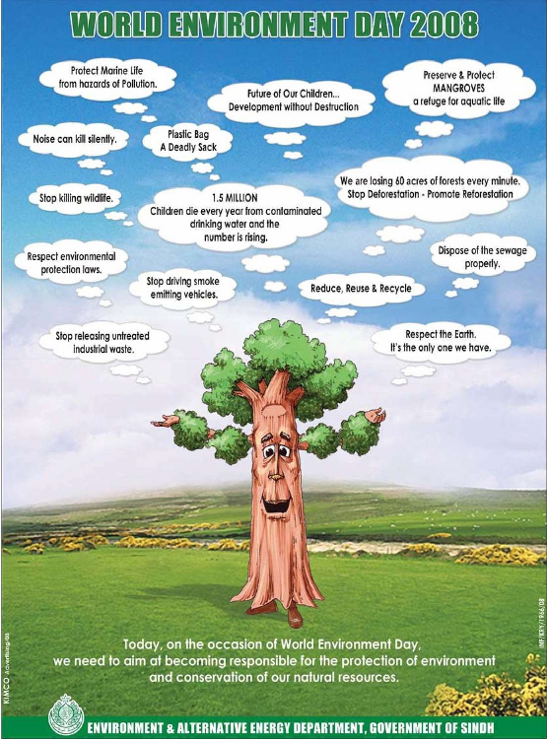

Slide 8
Environmental problems
Air Pollution- Air Pollution is one of the problems that seem to have no solution at all. Air carries contaminants like poisonous gases and dust particles which when inhaled lead to a number of lung disorders. The sources of air pollution are innumerable which are as follows:
Industries
Agriculture
Traffic
As all of these causes consist of one or the other process of combustion they emit gases that pollute the atmospheric air. Here can be large-scale pollutants like the Volatile Organic Compounds as well as minor dust particles. Nitrogen emissions come out mainly from agriculture mainly during the process of denitrification. The pesticides used for agricultural purposes can also be a cause of Air Pollution. Air Pollution can cause many heart and lung disorders like Bronchitis, Lung Cancer and diseases of the like.

Slide 9
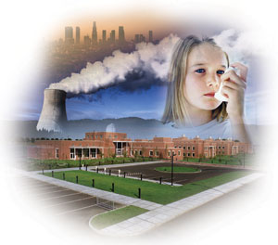

Slide 10
Environmental problems
Acid Rain- Acid rain is caused by the numerous acidic pollutants, which have potential to damage earth’s environment in a drastic way. Acid rain is caused due to the presence of chemicals like Sulfur Dioxide and Nitrogen Oxides in the atmosphere. These chemicals are introduced in the atmosphere as a result of the industrial processes. Sulfur Dioxide is emitted out of those industries that use coal as their fuel. Automobiles all around the world emit one third of the nitrogen oxide that is present in the atmosphere of earth. Natural causes like fire, volcanic eruptions and bacterial decomposition are also responsible for the increase in the amount of Nitrogen Oxide in the atmospheric air. Acid rain chokes the pores in the plant leaves, which leads to the death of plants and a large number of plants in a short span of time. The brick walls and stones are also corroded and the soil composition is changed leading to the death of plants again. Acid rain also leads to the destruction of aquatic life.

Slide 11
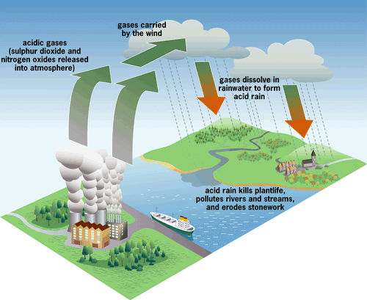

Slide 12
Environmental problems
Global Warming- Global warming which leads to the Greenhouse effect is also a kind of environmental problem that is due to overpopulation and pollution. Large number of people are creating grater amount of garbage. Emissions form your refrigerator and also from the industries produce a large amount of heat, which fails to go out of the earth’s atmosphere unlike before when earth radiated out half of the heat back. This is leading towards climate change, rise in sea levels due to melting of glaciers and consequently a threat that some of the landmass might just go beneath the increasing water and therefore cease to exist.

Slide 13
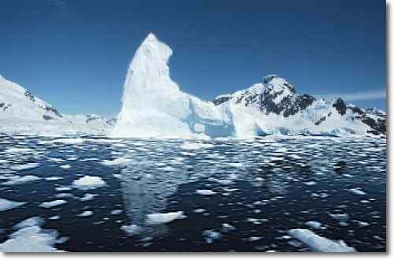

Slide 14
How to save environment
Ways to Save Our Environment
With global warming on the rise, it's no news that this has been an age old concern for us all. No one stopped to really do anything about it, so now we step in to set an example and be that change. So here's how to save our environment, by being of help when it comes to land/air pollution, water pollution and noise pollution.

Slide 15
Ways to Save Our Environment
Make Use of Garbage Disposals
You see those big dumpsters dotting street corners, and those trash cans lined up against side walks? They're not there to put up a show, but for you to notice them and drop in your waste. It's sad when someone litters a place that is clean, without the thought of 'let me hold on to this until I spot a trash can'. We need to consciously tell ourselves - that what little we do, does count. So the next time you get that urge to toss that gum or chocolate wrapper out the car window, or 'accidentally' drop it as you walk down the street - ask yourself how much waste you've been contributing to the environment with that bad habit of yours going on for years. Look into environmental pollution facts, for a clearer perspective on just how bad the situation is.

Slide 16
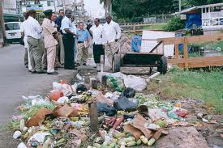

Slide 17
Ways to Save Our Environment
Go Easy on the Honking/Loud Music
Patience is a virtue not many people have and sometimes those who do can lose their minds at some point over traffic. Try and wait for a couple of seconds for the person in front of you to make a move, and don't join in with the herd of impatient drivers, that start to honk incessantly. We all know that loud music is justified when the weekend comes around. Try being a little sympathetic when it comes to your neighbors, and even to people across the street. Go by the curfew time, or make sure to turn it down at least when it's 11 pm. Not everyone will be a fan of your music, or noise that late, so try and be a little understanding.

Slide 18
Ways to Save Our Environment
Don't Waste/Pollute Water Sources
When it comes to how to save the environment at home, the first thing to do is to avoid letting water run continuously or leave taps partially open. Make sure that taps are not leaky, or left unattended without use. This would help greatly in water conservation. Another helpful gesture, is to use CFL bulbs, since it's not only energy saving, but cuts down on electricity costs as well.

Slide 19


Slide 20
Ways to Save Our Environment
Set an Example to Kids
As grown adults, it is your responsibility to pass on the message of simple ways to save the environment, and instill it in kids, until they get older. When it comes to ways on how to save the environment for kids, it is important to teach them ways on how to get rid of waste, how not to litter play areas, streets and school grounds, how to advice someone on not littering if he/she were to witness an act, help them make environment issue related projects (planting trees, science projects on how to save the planet, street clean up sessions and so on) to help others in the class understand how important it is to cater to the planet, as well as get parents involved in helping them out. Starting this with kids is a good way of spreading the message early in the lives, in the hope that they carry it forward as they grow older.

Slide 21
Recycling
Recycling is a method of transforming back items that can be reusable once they're disposed off by the public. This means that whatever is throw out, like paper, tins, cardboard and so on, can be put through the process of reproducing them, to make new products. Not all plastic is recyclable, and must be avoided as much as possible. The environment cannot degrade plastic, so these are left to scatter and collect in places. Don't waste anything, and try to come up with ways on things you can use again. Like say old magazines, newspapers and art paper and can be used for projects. Try turning something you don't need anymore into a work of art and use it for another purpose instead. Be creative when it comes to things that you don't want that is in good condition, or sell them off, or better yet, give it away to charity. These are helpful, and simple ways on how to save the environment by recycling. Here are some interesting recycling facts for kids.

Slide 22
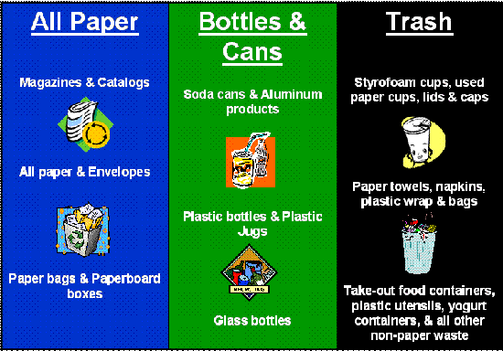

Slide 23
With these environmental ethics in mind, we should be able to do what we can, for it to have a bigger impact on the planet at large. Don't think that by being environmental conscious, you are being a sissy in some way, if you were to point it out to someone who's hard headed when it comes to how to save the environment. As long as you do your part, and try to pass on that knowledge, the world is a small step closer to being saved.
        Think green!

Slide 24


