Slide 1
Java Threads
By
Dr Sumana M

Slide 2
Multithreading
Java is a multi-threaded programming language which means we can develop multi-threaded program using Java.
A multi-threaded program contains two or more parts that can run concurrently.
each part can handle a different task at the same time making optimal use of the available resources specially when your computer has multiple CPUs.
multitasking is when multiple processes share common processing resources such as a CPU.
Multi-threading extends the idea of multitasking into applications where you can subdivide specific operations within a single application into individual threads.
Each of the threads can run in parallel.

Slide 3
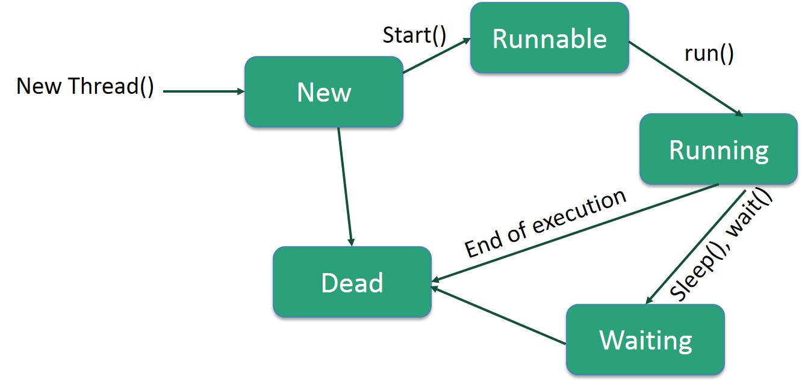
Life Cycle of a Thread

Slide 4
Following are the stages of the life cycle −
New − A new thread begins its life cycle in the new state. It remains in this state until the program starts the thread. It is also referred to as a born thread.
Runnable − After a newly born thread is started, the thread becomes runnable. A thread in this state is considered to be executing its task.
Waiting − Sometimes, a thread transitions to the waiting state while the thread waits for another thread to perform a task. A thread transitions back to the runnable state only when another thread signals the waiting thread to continue executing.
Timed Waiting − A runnable thread can enter the timed waiting state for a specified interval of time. A thread in this state transitions back to the runnable state when that time interval expires or when the event it is waiting for occurs.
Terminated (Dead) − A runnable thread enters the terminated state when it completes its task or otherwise terminates.

Slide 5
Thread Creation In Java
Threads can be created by using two mechanisms : 1. Extending the Thread class 2. Implementing the Runnable Interface
Implementing the Runnable Interface
class RunnableDemo implements Runnable {
private Thread t;
private String threadName;
RunnableDemo( String name) {
threadName = name;
System.out.println("Creating " + threadName );
}

Slide 6
public void run() {
System.out.println("Running " + threadName );
try {
for(int i = 4; i > 0; i--) {
System.out.println("Thread: " + threadName + ", " + i);
// Let the thread sleep for a while.
Thread.sleep(50);
}
} catch (InterruptedException e) {
System.out.println("Thread " + threadName + " interrupted.");
}
System.out.println("Thread " + threadName + " exiting.");
}
public void start () {
System.out.println("Starting " + threadName );
if (t == null) {
t = new Thread (this, threadName);
t.start ();
}
}
}

Slide 7
public class TestThread {
public static void main(String args[]) {
RunnableDemo R1 = new RunnableDemo( "Thread-1");
R1.start();
RunnableDemo R2 = new RunnableDemo( "Thread-2");
R2.start();
}
}

Slide 8
Create a Thread by Extending a Thread Class
class ThreadDemo extends Thread {
private Thread t;
private String threadName;
ThreadDemo( String name) {
threadName = name;
System.out.println("Creating " + threadName );
}
public void run() {
System.out.println("Running " + threadName );
try {
for(int i = 4; i > 0; i--) {
System.out.println("Thread: " + threadName + ", " + i);
// Let the thread sleep for a while.
Thread.sleep(50);
}
} catch (InterruptedException e) {
System.out.println("Thread " + threadName + " interrupted."); }
System.out.println("Thread " + threadName + " exiting."); }

Slide 9
public void start () {
System.out.println("Starting " + threadName );
if (t == null) {
t = new Thread (this, threadName);
t.start ();
} } }
public class TestThread {
public static void main(String args[]) {
ThreadDemo T1 = new ThreadDemo( "Thread-1");
T1.start();
ThreadDemo T2 = new ThreadDemo( "Thread-2");
T2.start();
}
}

Slide 10
Thread Methods
public void start()
Starts the thread in a separate path of execution, then invokes the run() method on this Thread object.
public void run()
If this Thread object was instantiated using a separate Runnable target, the run() method is invoked on that Runnable object.
public final void setName(String name)
Changes the name of the Thread object. There is also a getName() method for retrieving the name.
public final void setPriority(int priority)
Sets the priority of this Thread object. The possible values are between 1 and 10.

Slide 11
public final void join(long millisec)
The current thread invokes this method on a second thread, causing the current thread to block until the second thread terminates or the specified number of milliseconds passes.
public void interrupt()
Interrupts this thread, causing it to continue execution if it was blocked for any reason.
public final boolean isAlive()
Returns true if the thread is alive, which is any time after the thread has been started but before it runs to completion.

Slide 12
Static Thread methods
public static void yield()
Causes the currently running thread to yield to any other threads of the same priority that are waiting to be scheduled.
public static void sleep(long millisec)
Causes the currently running thread to block for at least the specified number of milliseconds.
public static Thread currentThread()
Returns a reference to the currently running thread, which is the thread that invokes this method.

Slide 13
Write a Java Program that creates two threads object of Thread class. Where one thread asks the user to enter a number not less than four digits. Split the digits of the number and display in words the value of the number. Ex: 1 – One. Second thread finding the number of vowels in a word. Ex: JAVA – Vowel - A, Count – 2.

