Slide 1
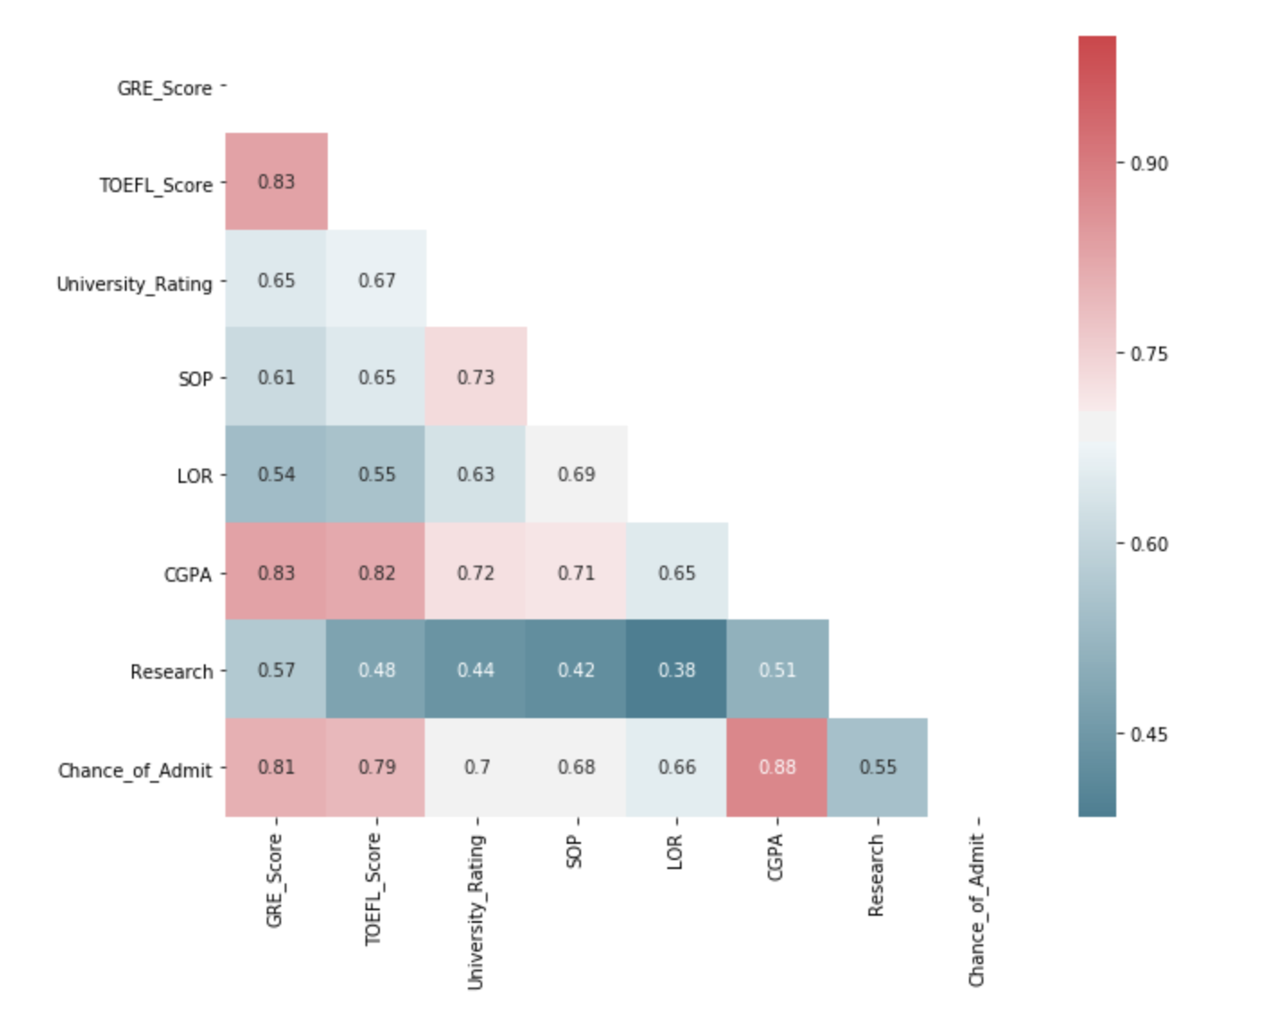
co
Introduction
This project mainly focuses on what parameters are important for a student to get into UCLA graduate school, and how these factors are interrelated among themselves. It will also help predict candidates' chances of admission given the variables.
Correlations between different columns
The 3 most important features for admission to the Master: CGPA, GRE SCORE, and TOEFL SCORE
The 3 least important features for admission to the Master: Research, LOR, and SOP

Slide 2
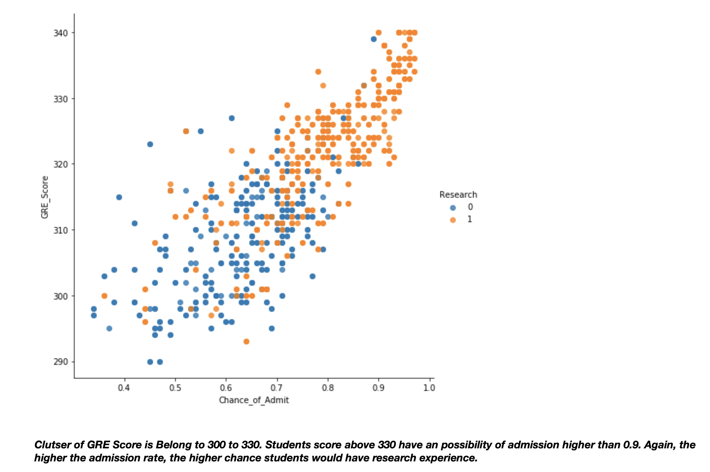
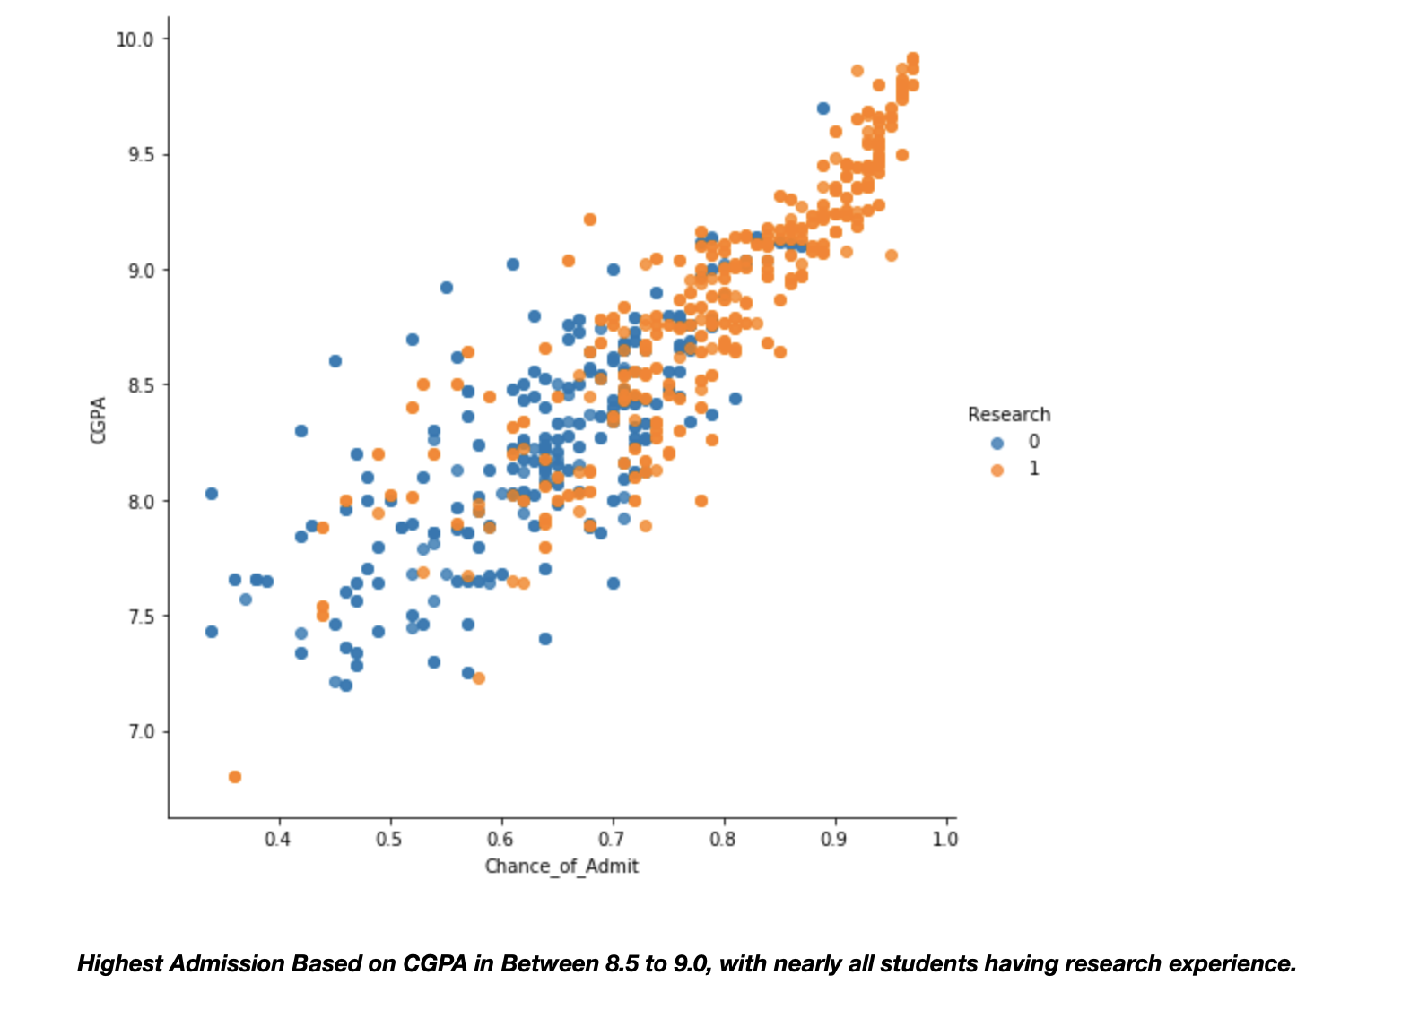
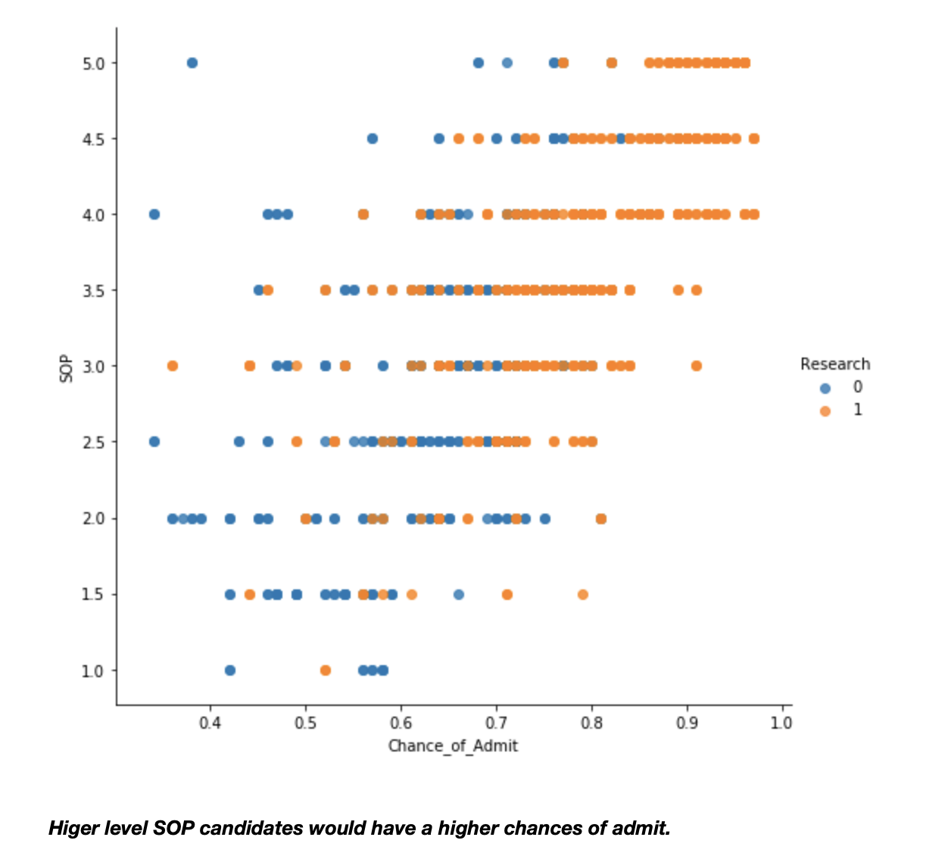
Relationships of different variables

Slide 3
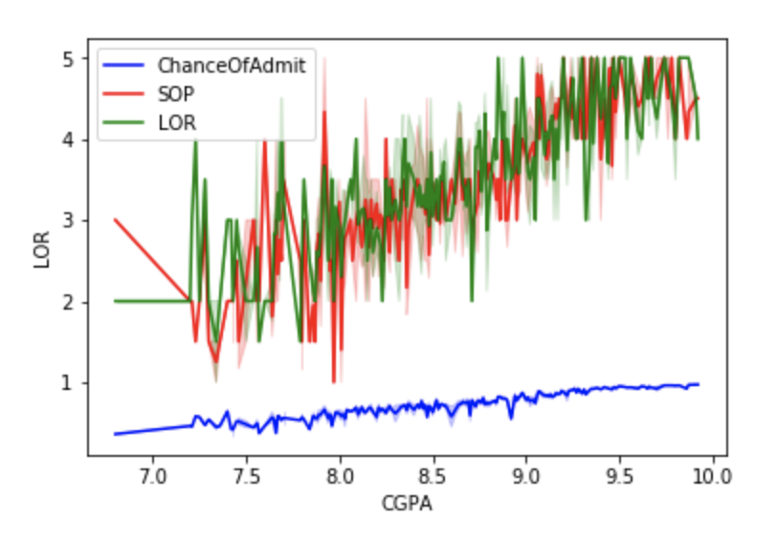
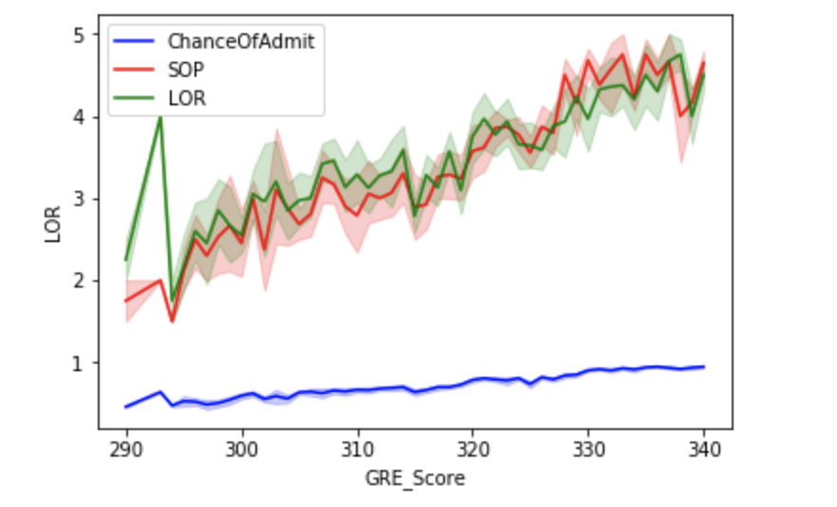
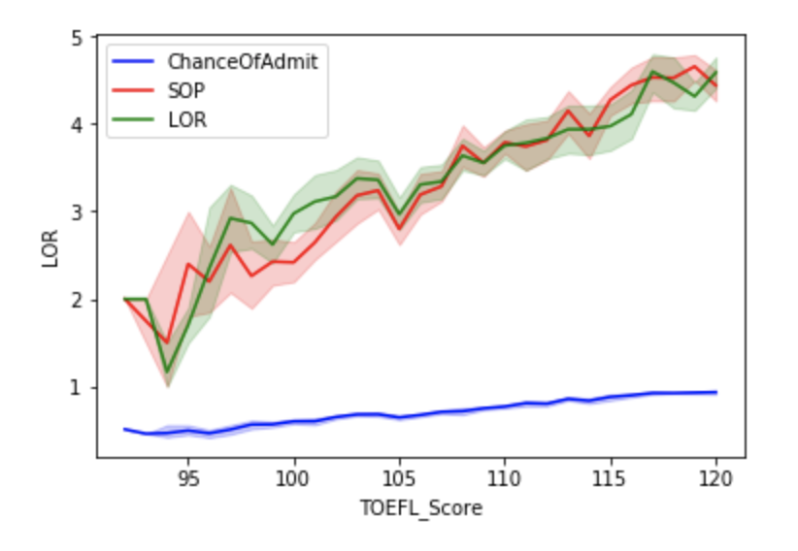
From the data exploration and visualization above, we can see that student's GRE score, TOEFL score, and CPA having more significant impact on whether they can be admitted or not; while university rating, statement of purpose, letter of recommendation show a weaker influence. Finally, students with higher admission rate usually have research experience. That is to say, research experience, though shows a relatively low correlation, weighs a lot in the admission process.

Slide 4
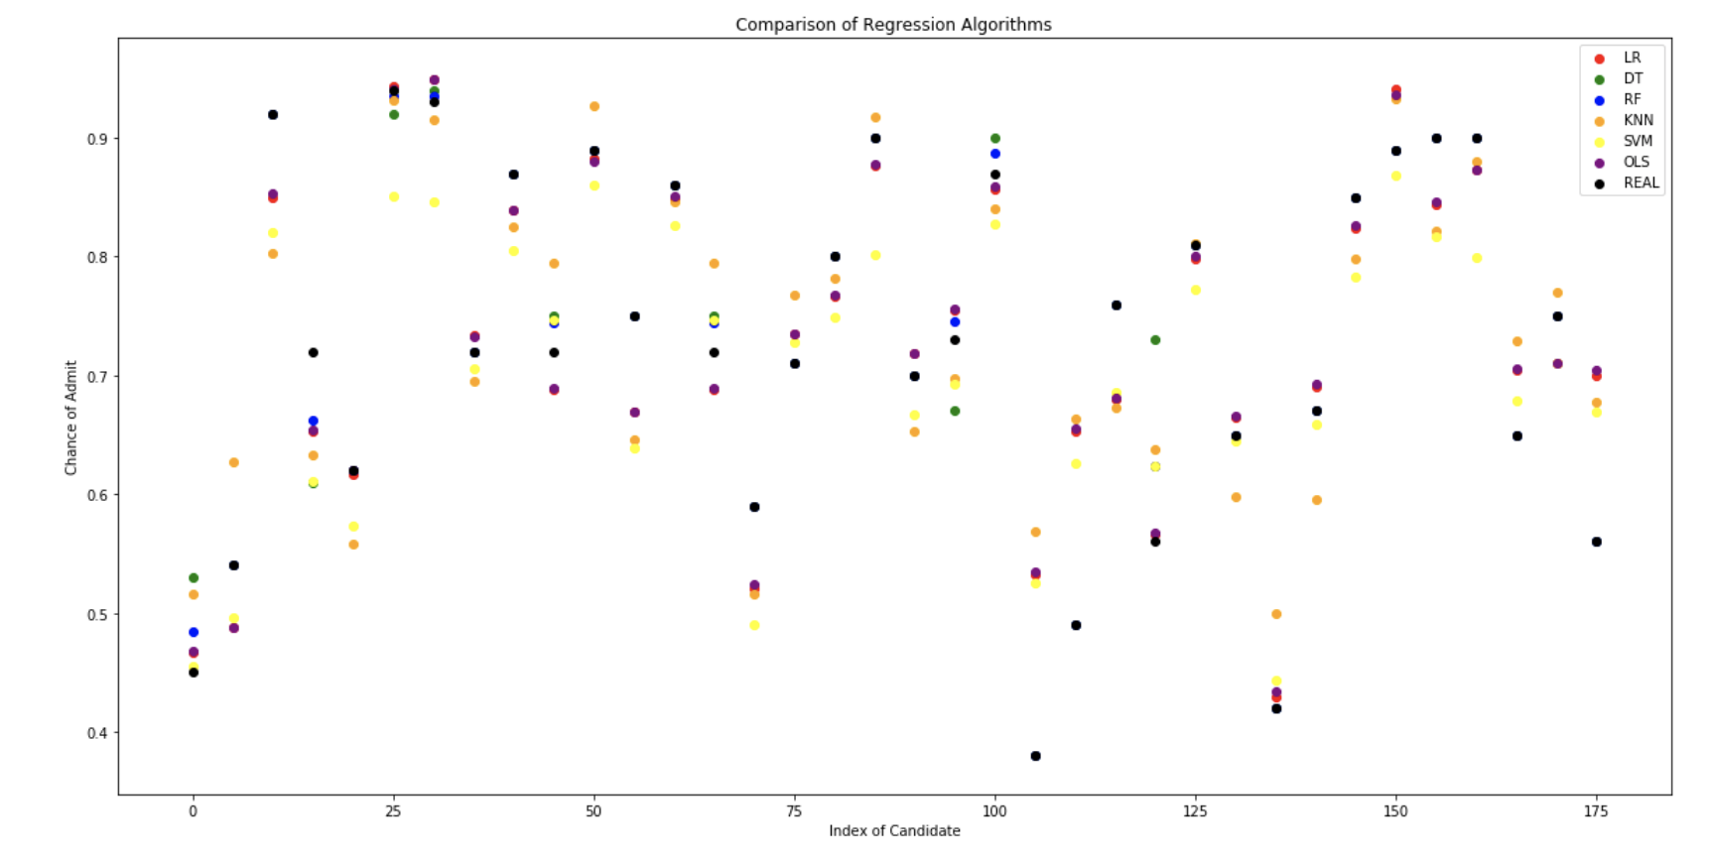
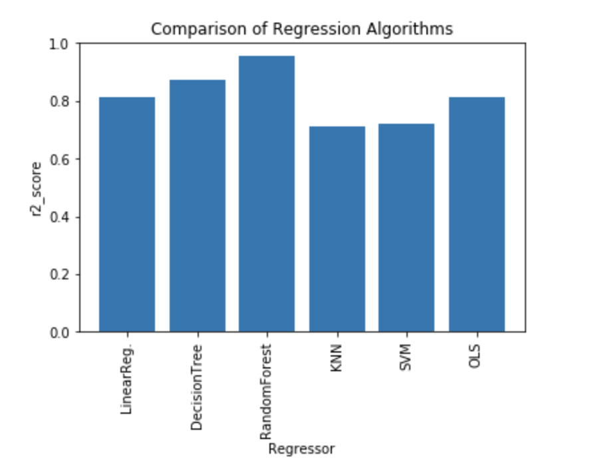
By compared R2 of different models, the best model is Random Forest which has the highest R2 score ( 0.96 )

Slide 5
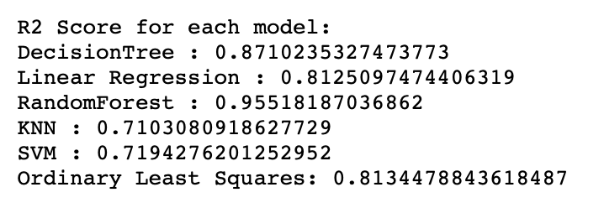
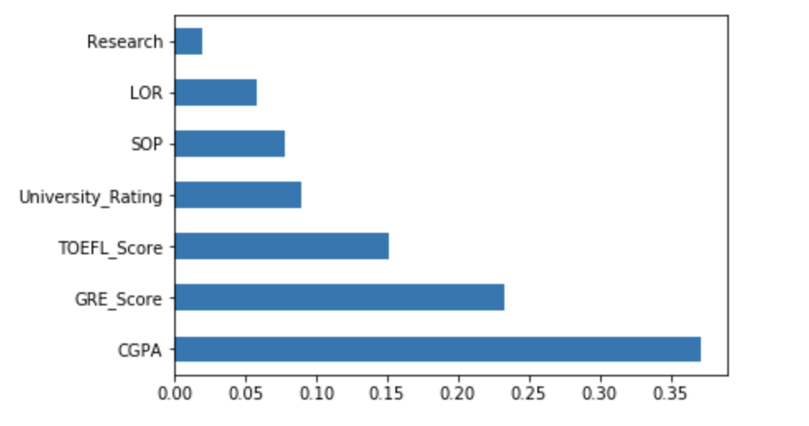
R2 Score and Importance of different Models
The most important parameter is CGPA The model is 98% accurate to predict admission status of a candidate

