Slide 1
SNT
All detailed instructions can be found here: https://imagej.net/plugins/snt/
Brief documentation by Phoebe and Joe – Last edited 04/15/22

Slide 2
Goal of using SNT
Goal: Use SNT to semi-autotrace branches in order to get the xyz coordinates of traced branch
Additional goals:
Get branch order information
Get information about distance from soma and from nearest proximal/distal branch points
Workflow: Trace all branches in a neuron → Save measurements (i.e. branch order information) → Run Phoebe’s python code to generate xyz coordinates for each branch

Slide 3
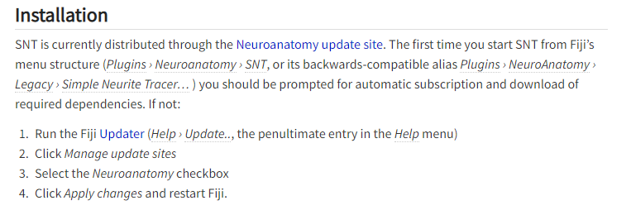
Installation
Go to https://imagej.net/plugins/snt/ and follow instructions on “Installation” section

Slide 4

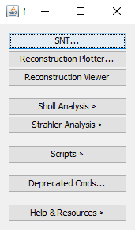
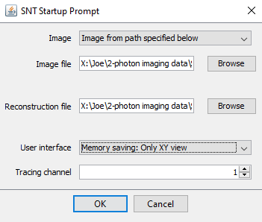
Starting SNT
Click SNT
Click SNT
Browse to image
Can also load .traces file as reconstruction file if you’ve already started tracing
Tracing channel should be cell fill

Slide 5
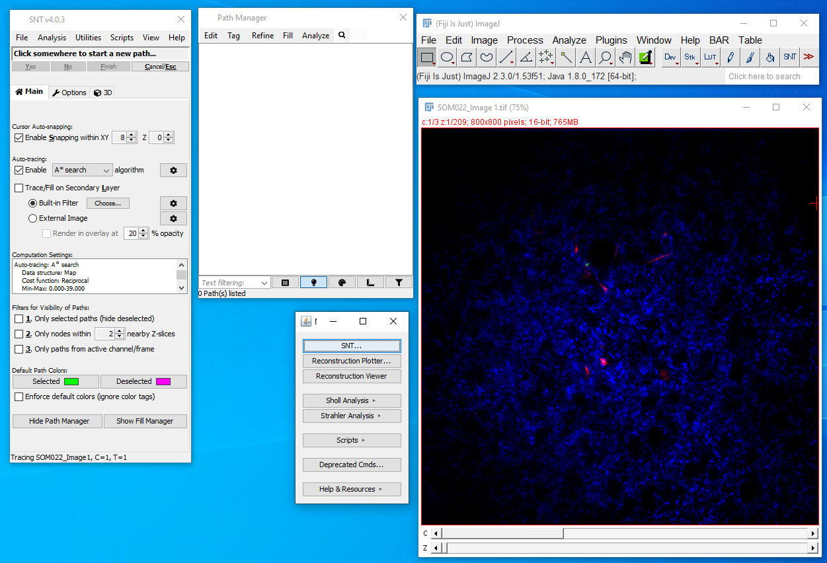
Settings: this is a screenshot of Phoebe’s settings
Change this to 2 if you want to place markers closer to where your cursor is instead of snapping to dendrite
Checking this box is helpful when scrolling through during tracing

Slide 6
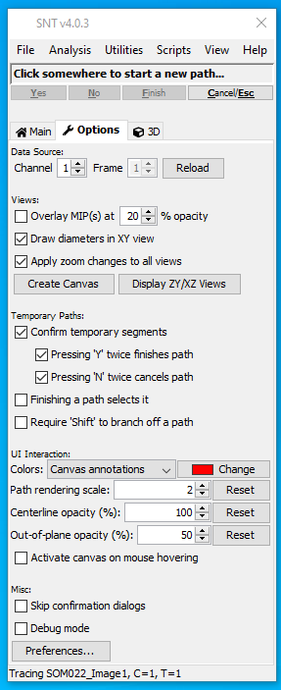
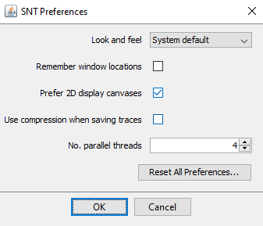
Additional Settings
Go to “Options” → “Preferences” → Make sure that “Use compression when saving traces” is unclicked.
If this is clicked, the saved .traces file is compressed and cannot be read easily.
If this is unclicked, the saved .traces file can be easily opened (i.e. with NotePad)

Slide 7
Tracing shortcuts
If you want to trace branch by placing two nodes at start and end of branch:
Click start of branch → Click end of branch → Press “F” (for Finalized)
The branch should be automatically traced by brightness and “Path(n)” will appear in the Path Manager
If you want to manually place more nodes:
Click start of branch → Click next branch point → Press “Y” (for Yes)→…→ Press “F” at end of branch
If you made a mistake, just press “N”
To select traced branch:
Type “G” while hovering cursor near the branch you want to select on the image
To edit branch:
Select branch to edit in Path Manager → Right click on image → Edit Path
Or press shift E while branch is highlighted
Press shift E again to exit edit mode
To draw/connect a child branch, press G or select parent branch → Press Alt-shift to get Fork Point → Trace child branch

Slide 8
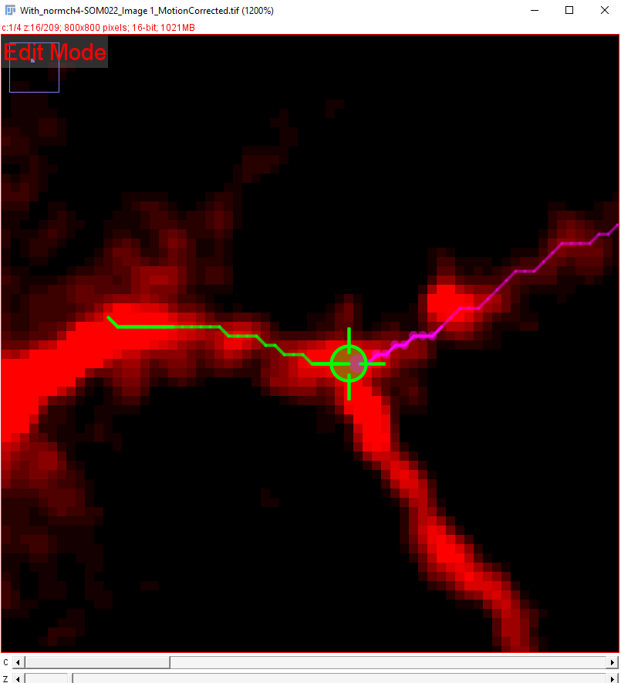
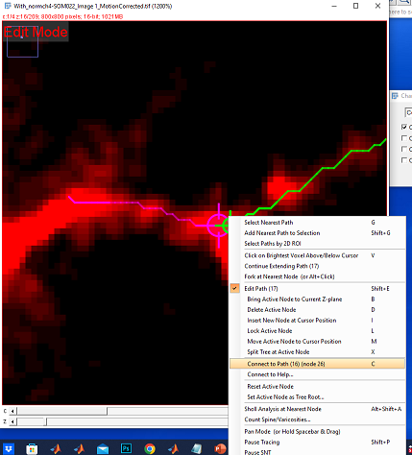
Tracing shortcuts: connecting branches that were already traced
To connect previously traced branches as parent/child (e.g. if you need to edit/add a parent branch after children are already traced, where “parent” refers to the branch closer to the soma and “child” refers to the higher-order branch farther from the soma)
Make sure the parent branch ends on the beginning of the child branch, because this connection step will not create a bunch of nodes between the end of the parent and the beginning of the child branch
Type “G” while hovering cursor near the parent branch to select it
Type shift E to enter edit mode
Hover cursor over the end of the parent branch (the pixel that you want connected to the beginning of the child branch), the pixel you hovered over should appear as a large target shape to show that it’s the active node
Type “G” again to select child branch
Hover cursor over the beginning of the child branch (the pixel you want connected to the end of the parent branch), the pixel you hovered over should appear as a large target shape to show that it’s the active node
Right click and select “connect to Path (n) (node n)”
Check the path manager to make sure the branches are showing up as parent/child the way you expect

Slide 9
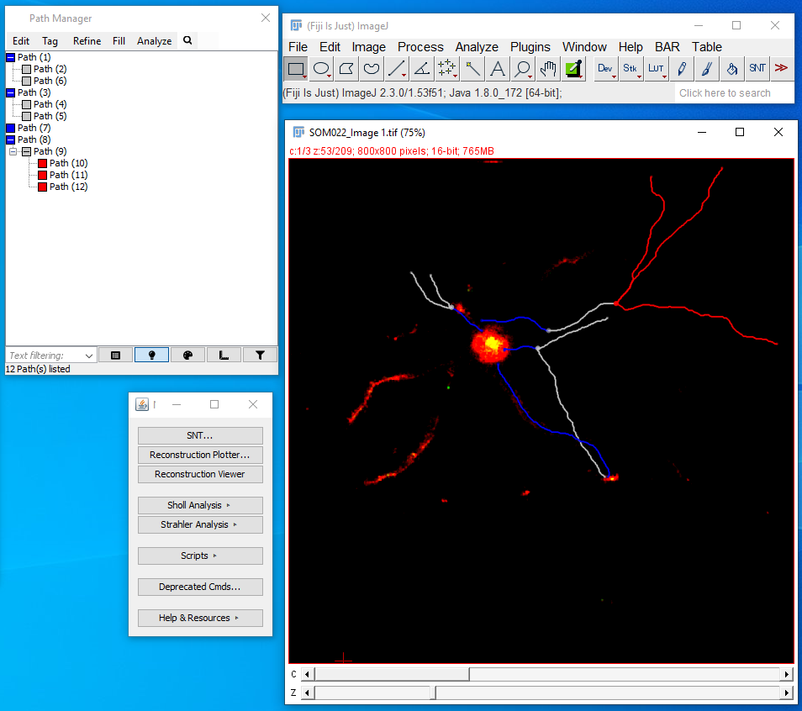
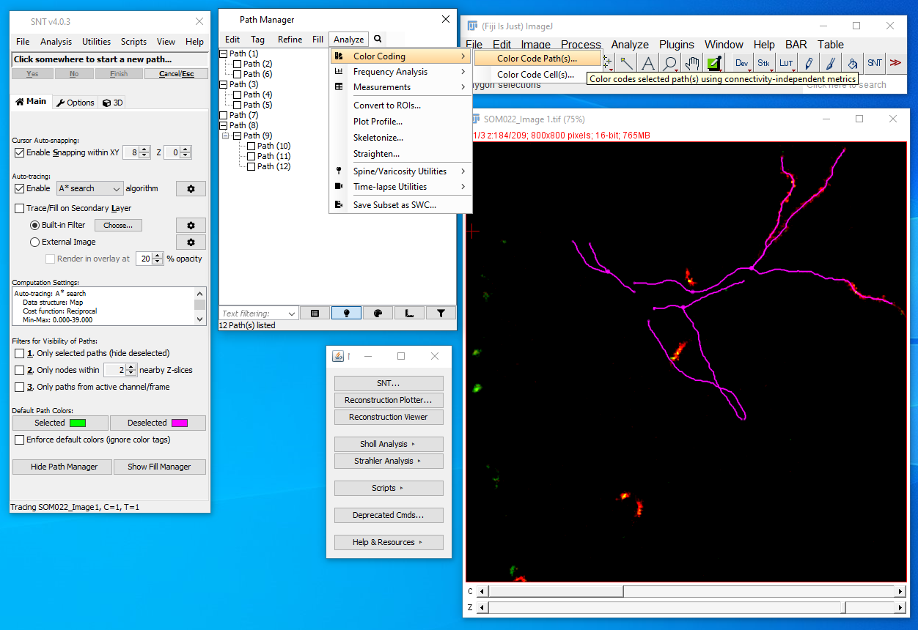
Additional Setting/Preferences
You can change color of branches based on Path Order. This is just for your own visual preferences:
“Path Manager” → “Analyze” → “Color Coding” → “Color Code Path(s)…” → Choose Color by “Path order”

Slide 10
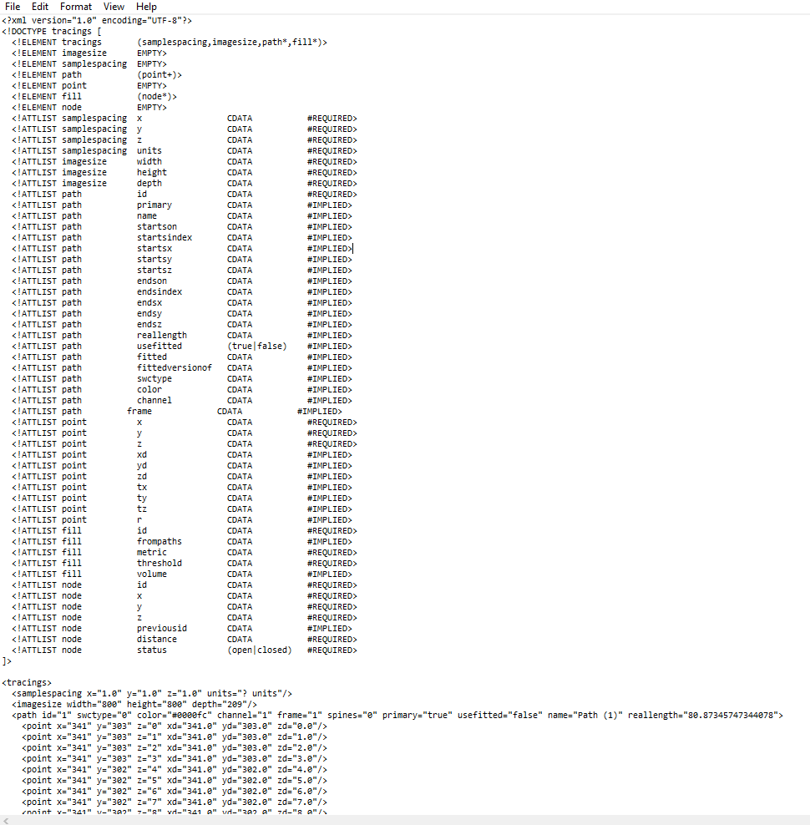
After tracing, save the following:
Measurements to save:
“Path Manager” → “Analyze” → “Measurements” → “Measure Path(s)…” → A window will appear → Click “File” in SNT menu → “Save Tables & Analysis Plots…” to save table as .csv
This gives you length, # of nodes, highest path order, width, height, depth
In SNT menu, click “Analysis” → “Path Properties: Export CSV…”
This gives us more detailed information about branch order (i.e. ConnectedPathIDs and ChildPathIDs)
Save traced branch(es) or entire traced arbor as .traces
“File” → “Export As” → “TRACES…”
You should get a .traces file that looks like the image to the right:

Slide 11
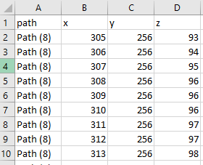
Get XYZ coordinates of traced branch(es)
Once you have the .traces file saved for the traced branch(es), run “xyz_coordinates_along_path_FINALIZED.py”
Output of code: a .csv file with the xyz coordinate for each traced branch.
This is what the output of the .csv should look like:

Slide 12
Next steps
Repeat the same steps for ALL the images from the same neuron.
Keep the branch path IDs the same. In other words, trace the branches in the same order and make sure they have the same IDs
Alternatively, branches can be renamed after tracing by right clicking on the branch in the path manager and using the “rename” option
You can either keep the default Path (#) name or change it to “b#” (i.e. Path (1) or b1)
Might need to modify the python code accordingly.
Could potentially plot the individual branches across all the images as a sanity check or to double check that they are approximately the same.
Output:
A “_xyzCoordinates.csv” file for each imaging timepoint, where the .csv file contains xyz info on ENTIRE dendritic arbor (i.e. ALL branches)
Further steps:
Feed the .csv files into the computational python code to have it extract the branch information and the xyz coordinates from the .csv

