Slide 1
Predicting earthquake building damage
Amy Kim
18th May 2022

Slide 2
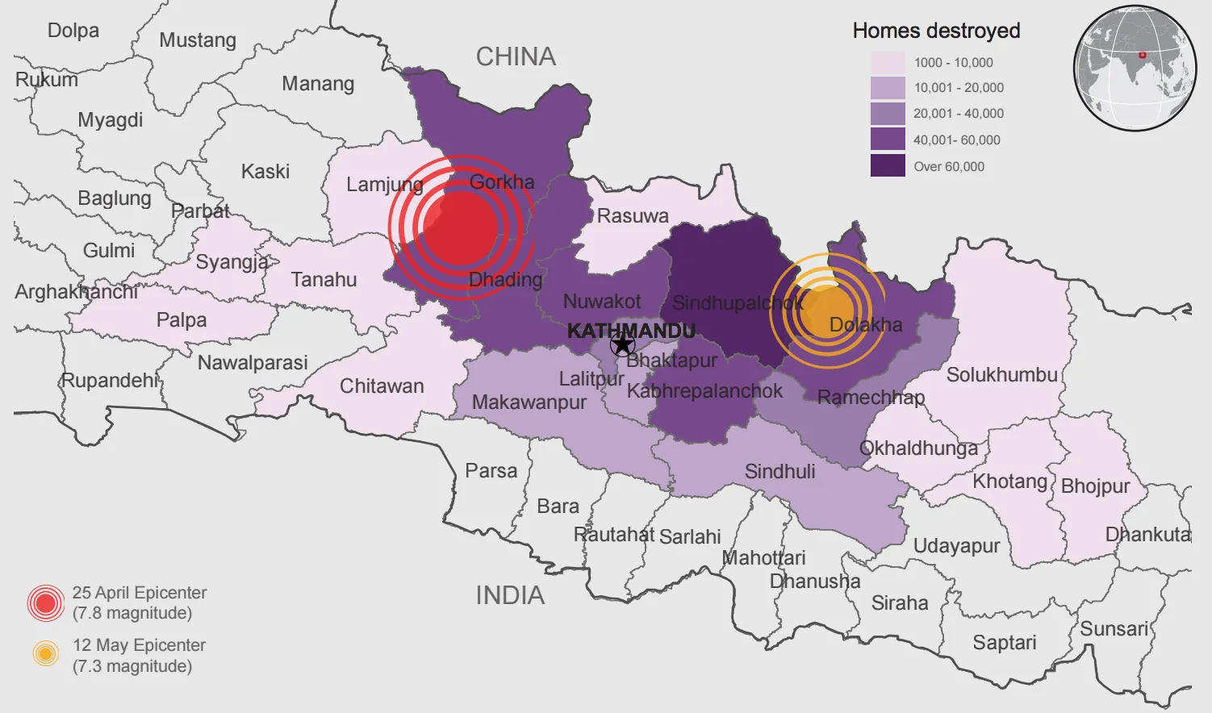
Motivation
In 2015 a 7.8 Mw Gorkha Earthquake occurred on April 25, 2015 in Nepal
Economic cost = $10 billion nearly half of its GDP of $19billion
9,000 lives lost
Goal:
Use machine learning classification to predict building damage

Slide 3
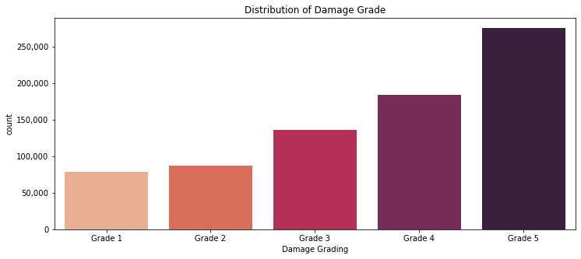
Data
Nepal carried out a household survey for 11 severely affected districts to assess building damage.
750k +rows , 42 features
Target: Damage Grade
Features: Building data
Examples:
Year built
Construction material
Building height & floor area
Land surface
Grade 1 | Thin cracks in plaster
Grade 2 | Cracks in many walls
Grade 3 | Large and extensive cracks
Grade 4 | Walls collapse, failure of roof/floor
Grade 5 | Total or near collapse

Slide 4
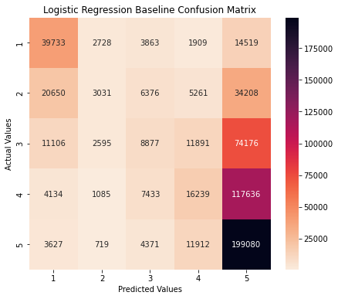
Baseline model
Logistic Regression
Log loss score: 1.32

Slide 5
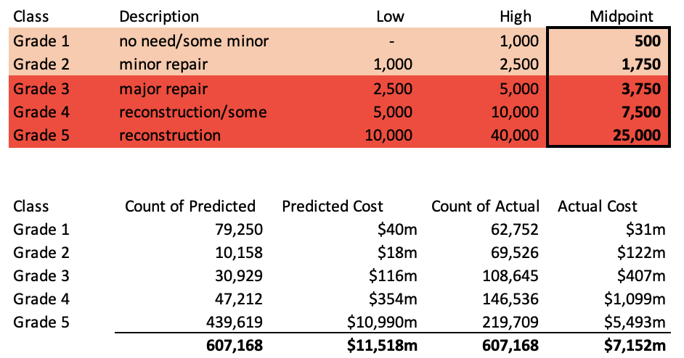
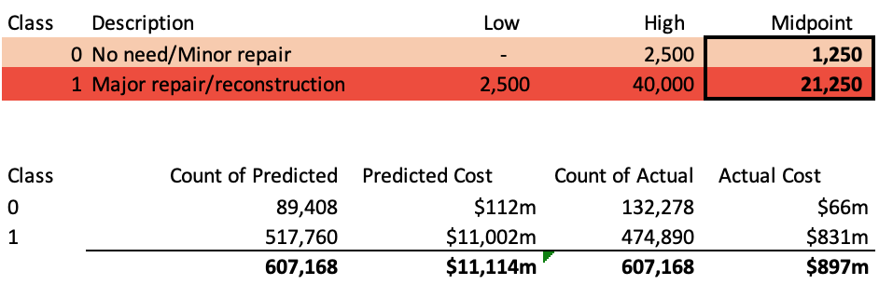
Binary
Should we consider Binary model?
Multiclass
Model miss:
$10 billion
(11.4x)
Model miss: $4 billion
(0.6x)

Slide 6
Comparison stage 1
Classifiers
Regressors
 | Log loss score
Logistic Regression (baseline) | 1.32
Logistic Regression (One v Rest) | 1.31
Random Forest Classifier (SMOTE) | 1.24
XG Boost Classifier (SMOTE) | 1.27
 | RMSE
Linear Regression (baseline) | 1.12
Random Forest Regressor (SMOTE) | 0.99
XG Boost Regressor (SMOTE) | 1.02

Slide 7
Comparison stage 2
Classifiers
Regressors
 | F1 score (micro)
Random Forest Classifier (SMOTE) | 0.54
 | F1 score (micro)
Random Forest Regressor (SMOTE) | 0.43
 | F1 score (micro)
RF Regressor (SMOTE) RF Classifier (SMOTE) XGB Regressors (SMOTE) XGB Classifier (SMOTE) | 0.45
Ensemble
Random Forest Classifier
F1 score on final holdout : 0.45

Slide 8
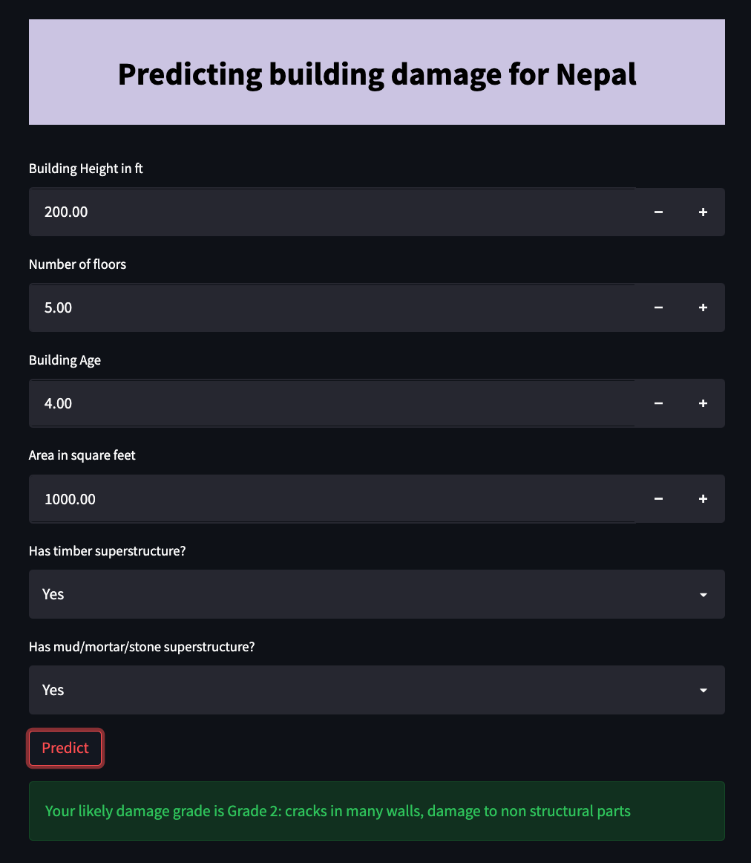
Model Deployment
Top 6 features were used to deploy a simple proof of concept model
Please visit at : https://share.streamlit.io/amyyunekim/course_4_classification/main/app/app.py

Slide 9
Future development
Further tuning of hyperparameters
Use cloud computing for faster processing on large data sets

Slide 10
Discussion
Overfitting problem training score was higher than test score.
CV only included 3 folds
Use cloud computing for faster processing on large data sets
Further tuning of hyperparameters

Slide 11
Thanks!
Do you have any questions?
amyyunekim@gmail.com

