Slide 1


Introduction to reference based RNA-seq
Roberts, Erin M.
BIO 594: Using genomic techniques to examine the evolution of populations
April 4th, 2018
Notes:
distinguish this from non-reference based methods

Slide 2
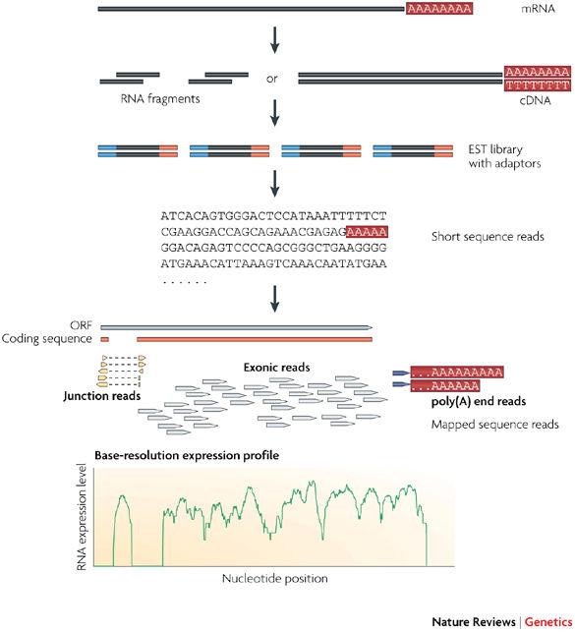
What are the goals of RNA-seq?
Identify transcripts and quantify gene expression
Obtain “transcriptome”: snapshot of expression of all genes a time point
Conesa et al., 2016; Wang et al., 2009
Notes:
use reverse transcriptase enzyme

Slide 3
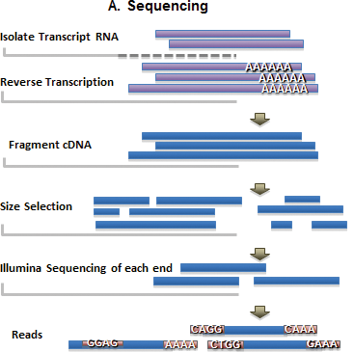
Zhao 2016

Slide 4
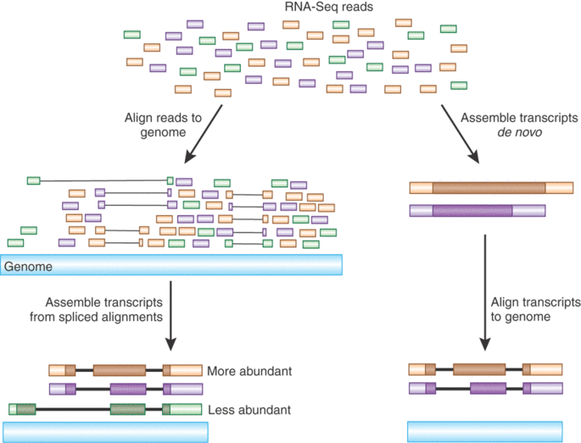
Reference-based RNA-seq
When you either have a reference genome or a reference transcriptome
Is my reference reliable?
Haas, 2010
Notes:
-some considerations about using a reference genome include thinking about the reliability of the reference.
-reference bias
-mapping to a reference genome or transcriptome allows for novel genes and transcripts to be identified

Slide 5
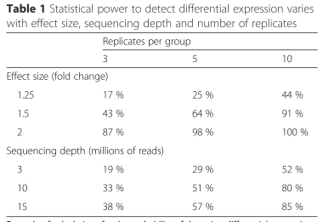
Experimental Design
Sequencing depth: number of sequenced reads for a given sample
Deeper sequencing (20X vs. 40X) will allow for better transcript detection and read quantification
Optimal library size can depend on complexity of transcriptome.
Number of replicates
Conesa, et al. 2016
Notes:
-library size is the number of sequenced reads for a single sample
-﻿Moreover, optimal library size depends on the complexity of the targeted transcriptome. Experimental results suggest that deep sequencing improves quantification and identification but might also result in the detection of transcriptional noise and off-target transcripts [10].
-number of samples sequenced depends both on biological variability of your system in question and technical variability in your RNA seq protocols
-some of this noise can be taken care of during analysis, where you will filter out genes expressed at low levels prior to calculating differential gene expression
-but increased depth can increase your ability to detect lowly expressed genes
-typically three replicates is a minimum you can use

Slide 6
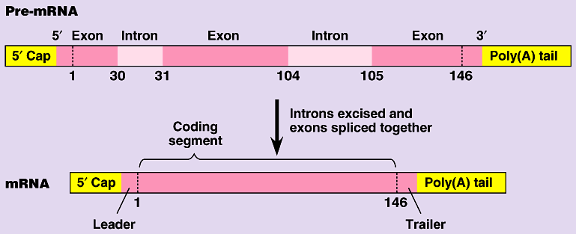
RNA Extraction Protocol Considerations
RNA-extraction protocol considerations
remove highly abundant rRNA (leaving only mRNA)
Can enrich for mRNA with Poly(A) selection
requires high proportion of mRNA of high quality
Notes:
over 90% of total RNA in the cell is rRNA
-for bacterial sequences mRNA is not polyadenylated so you would have to rRNA depletion..can use a nucleic acid binding probe

Slide 7
General RNA-seq Analysis Pipeline
Sequence reads
Read Pre-Processing
Align Reads to Reference Genome or Transcriptome
Count
Assemble and Quantify Reads
Read Normalization
Statistical Testing
Notes:
----- Meeting Notes (4/4/18 13:26) -----
Maybe need less coverage if you have a good reference

Slide 8
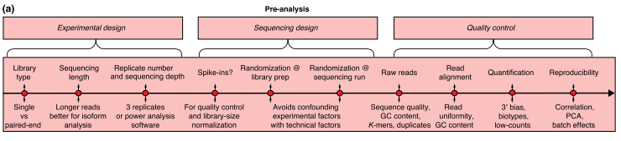
Pre-Analysis Steps

Slide 9
Step 1: Read Preprocessing and Quality Control
Check the md5 checksum
Trim adapters
Trim low quality score sequences (usually based on PHRED score), set cutoff between 10-20
Measure GC content of reads
Trim low quality ends of reads
Tools:
Trimmomatic
Cutadapt
BBTools
FastQC
Leek
Notes:
Read quality typically decreases toward the 3’ end of reads
----- Meeting Notes (4/4/18 13:26) -----
Check Sum files. MD5 raw reads CheckSum file. Check if it matches the check sum from the facility. Make sure you provide the checksum file whenever you send it to someone else. CheckSum, MD5 Sum wildcard.gz

Slide 10
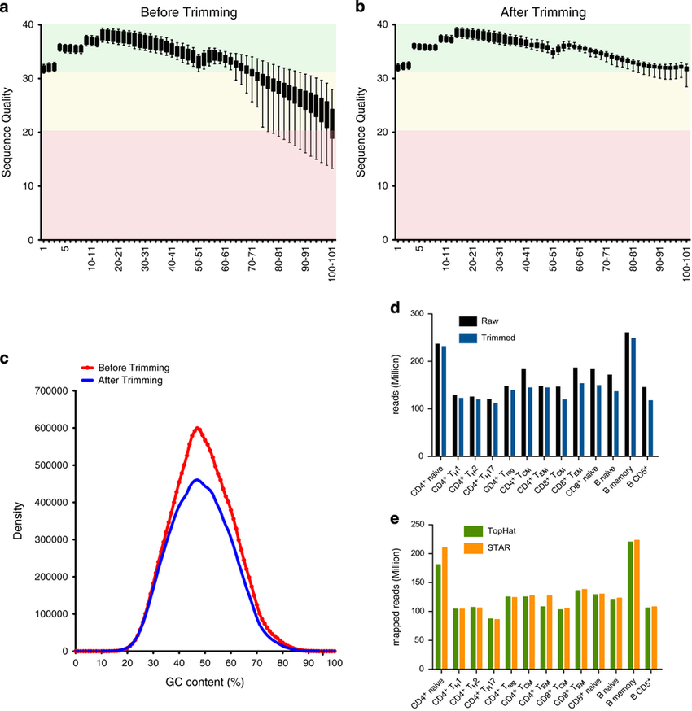
RNA-seq quality by read position
Bonnal et al., 2015
Notes:
(a) Phred quality score of the average distribution over all reads across all samples in each base before and (b) after trimming. (c) %GC content before and after trimming. (d) Detailed overview of the human lymphocyte subsets profiled: raw reads (black), the reads trimmed and filtered by quality (blue), and (e) the comparison of the mapped reads using TopHat (light green) and STAR (light orange).

Slide 11
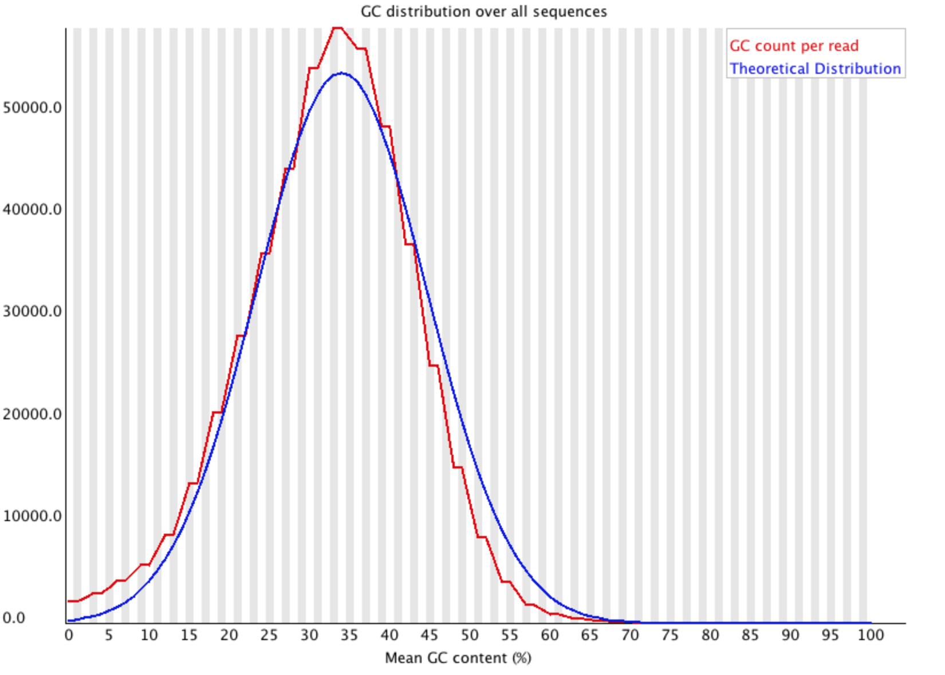
GC content
Expect to see roughly normal distribution of GC content, central peak corresponding
Unusual shape could indicate library contamination
https://www.bioinformatics.babraham.ac.uk/projects/fastqc/Help/3%20Analysis%20Modules/5%20Per%20Sequence%20GC%20Content.html
Notes:
Risso 2011- However, raw counts are neither directly comparable between genes within a lane, nor between replicate lanes (i.e., lanes assaying the same library) for a given gene, and normalization of the counts is needed to allow accurate inference of differences in transcript levels. Indeed, by virtue of the assay, one expects the read count for a given gene to be roughly proportional to both the gene's length and its transcript abundance. The read count will also vary between replicate lanes as a result of differences in sequencing depth, i.e., total number of reads produced in a given lane.
Risso 2011-Furthermore, as detailed in the literature review below, previous studies have reported selection biases related to the sequencing efficiency of genomic regions, whereby read counts depend not only on length but also on sequence features such as GC-content and mappability (i.e., uniqueness of a particular sequence compared to the rest of the genome) [3, 6, 7, 8, 9, 10, 11, 12, 13, 14, 15, 16, 17, 18, 19, 20]. For instance, GC-rich and GC-poor fragments tend to be under-represented in RNA-Seq, so that, within a lane, read counts are not directly comparable between genes. Additionally, GC-content effects tend to be lane-specific, so that the read counts for a given gene are not directly comparable between lanes. Biases related to length and GC-content confound differential expression (DE) results as well as downstream analyses, such as those involving Gene Ontology (GO). As GC-content varies throughout the genome and is often associated with functionality, it may be difficult to infer true expression levels from biased read count measures. Proper normalization of read counts is therefore crucial to allow accurate inference of differences in expression levels.

Slide 12
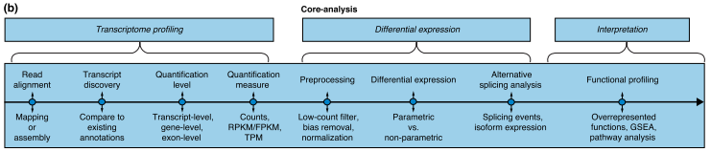
Core Analysis Steps

Slide 13
Step 2: Alignment to genome or transcriptome
Align reads to the genome or transcriptome
Important parameters: % mapped reads, GC content of mapped
Challenge is to identify splice junctions correctly
Aligners
HISAT2: align to either genome or transcriptome¹
STAR (Spliced Alignment to Reference) aligner²
very fast
can identify novel splice junctions
¹Daehwan, 2015; ²Dobin 2015, Conesa et al.2016
Notes:
----- Meeting Notes (4/4/18 13:42) -----
PE better for de novo, SE can be okay for non reference

Slide 14
HISAT2: Hierarchical Indexing for Spliced Alignment of Transcripts
Uses new hierarchcial indexing scheme based on Burrows-Wheeler transform and the FM index
(1) one global FM index representing the whole genome
(2) many separate local FM indexes for small regions collectively covering the genome.
Non gapped alignment
Handles reads involving indels and supports PE reads

Slide 15
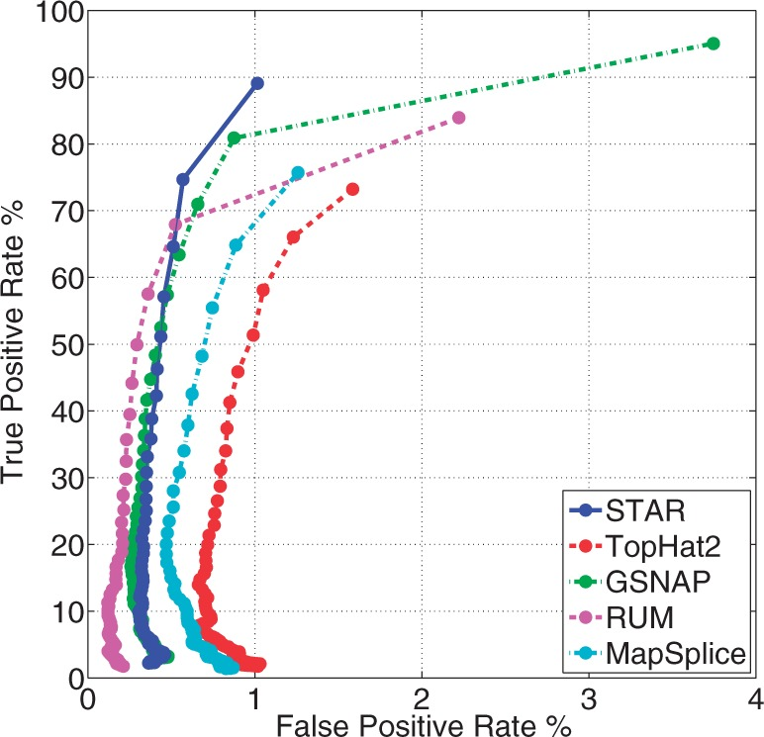
STAR:
very fast
can identify novel splice junctions
Dobin et al., 2013

Slide 16
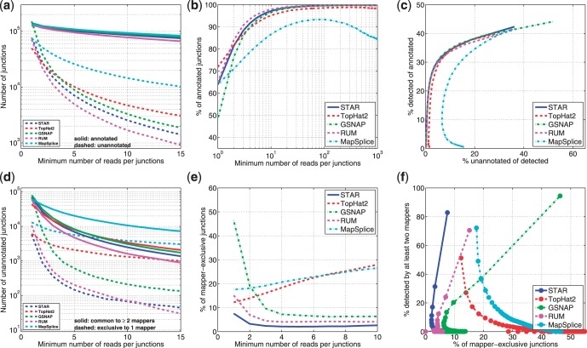
Splice-junction detection
Various accuracy metrics for splice junction detection in the experimental RNA-seq data (Dobin et al., 2013)

Slide 17

Step 3: Counts
HTSeq (Anders, 2015) – a python framework for working with high-throughput sequencing data
htseq-count preprocesses RNA-Seq data for differential expression analysis by counting the overlap of reads with genes
featureCounts: ultrafast and accurate read summarization program (Liao et al., 2014)
“featureCounts is a highly efficient general-purpose read summarization program that counts mapped reads for genomic features such as genes, exons, promoter, gene bodies, genomic bins and chromosomal locations. It can be used to count both RNA-seq and genomic DNA-seq reads”
Notes:
----- Meeting Notes (4/4/18 13:42) -----
mRNA has low

Slide 18

Alternate 2: Skipping the traditional mapping step
Quantify counts with reference transcrtipome
Kallisto: pseudoalignment to quantify reads, very fast (Bray, 2016). Quantifies abundances of transcripts
Salmon: quantify expression of transcripts, uses quasi-mapping approach (Patro, 2017)
RSEM (RNA-seq by Expectation-Maximization) (Li and Deweq, 2011)
with a reference or without (can quantify following use of de novo transcript assembler). Quantify gene and isoform abundance
Notes:
these methods skip through the definitive mapping step

Slide 19
Step 3: Assemble and quantify
StringTie^{1:} is a fast and highly efficient assembler of RNA-Seq alignments into potential transcripts. Estimates transcript expression based on mapping to genome
Can identify novel transcripts and incorporate existing isoforms from annotations
Trinity: de novo assembly of reads²
¹Daehwan et al., 2015; Haas et al., 2013 ³Li 2012

Slide 20
Intro to Differential Gene Expression Analysis
Used to analyze gene expression differences between conditions
How is data generated?
High throughput sequencing of transcriptomes
What are in the inputs?
Count data tables, listing expression of genes in each sample
RPKM, TPM, FPKM, raw counts
What is the output?
Log fold change estimates for each gene (comparing difference between control and challenge)
Significance is determined using adjusted p-values (BH method)

Slide 21
What’s with all the KM’s?
Goal: normalize the read counts by gene length and sequencing depth to minimize bias
RPKM: Reads per Kilobase Million (originally for single end reads)
Count up the total reads in a sample and divide that number by 1,000,000 – this is our “per million” scaling factor.
Divide the read counts by the “per million” scaling factor. This normalizes for sequencing depth, giving you reads per million (RPM)
Divide the RPM values by the length of the gene, in kilobases. This gives you RPKM.
FPKM: Fragments per Kilobase Million (for paired end reads)
Different order of operations
In paired end seq, FPKM takes into account that two reads can map to one fragment (and so it doesn’t count this fragment twice).
TPM: Transcripts per Kilobase Million
Sum of all TPMs in a sample are the same
CPM: Counts per Millions

Slide 22
Steps 4 and 5: Tools for Normalization and differential expression analysis
Ballgown
DESeq2/edgeR
Notes:
Differential sequence analysis with DESeq uses a generalized linear model, where counts for a gene in a sample are modeled with a negative binomial distribution with fitted mean and a gene specific dispersion parameter. The fitted mean is calculated by multiplying sample specific size factors and a parameter proportional to the "expected true concentrations of fragments". Dispersions are estimated from expected mean values from the maximum likelihood estimate of log2 fold changes.
- Main steps of the DESeq2 function: 1. estimation of size factors (s) by estimateSizeFactors 2. estimation of dispersion (a) by estimateDispersions 3. negative binomial GLM fitting for (B) and Wald statistics by nbinomWaldTest

Slide 23
General Steps in Analysis
Data filtering for low count reads:
ex. 100 or greater counts per million for at least two samples
Data normalization
Estimate dispersions
Negative binomial modeling
Notes:
normalize data for counts
## estimating size factors
## estimating dispersions
## gene-wise dispersion estimates
## mean-dispersion relationship
## final dispersion estimates
## fitting model and testing
Both methods are good for gene-level DE analysis, often find overlapping gene sets. For small experiments (n<6) DESeq2 may be more appropriate than edgeR. For very large experiments (n>100) limma-voom may be a more appropriate option.

Slide 24
Functional Enrichment/GSEA
Gene Ontology Terms
molecular function, biological process,and cellular component
Each gene can be described (annotated) with multiple terms.
R packages for functional enrichment:
topGO
Notes:
molecular function (describing the molecular activity of a gene), biological process (describing the larger cellular or physiological role carried out by the gene, coordinated with other genes) and cellular component (describing the location in the cellwhere the gene product executes its function). Each gene can be described (annotated) with multiple terms.
-Can classify if certain gene ontology terms are over represented

Slide 25
Transcriptome Analysis Pipeline
Transcriptome Raw Reads
SRA-toolkit
Gather reads from NCBI
BBTools
Trimming: Adapters, low quality
HISAT2
Stats and File Conversion
SAM Tools
Read alignment to genome
https://github.com/erinroberts/apoptosis_data_pipeline
StringTie
Assembly to Reference annotation
DESeq2
Differential expression analysis
Processing
Isolate Genes of Interest
Gene set enrichment
Notes:
Figure caption (from one of my previous presentations): Workflow visualization for multi-transcriptome analysis (Alexa and Rahnenfuhrer 2016; Leinonen et al., 2011; SRA-Toolkit, NCBI; Bushnell, 2014; Langmead et al., 2012; Trapnell et al., 2012, Love et al., 2014, Altschul et al., 1990; Langfelder et al., 2007; Langfelder and Horvath 2008; Pertea et al., 2016; Shannon, 2003; Yang, Yang et al., 2014; Amrine et al., 2015; Langfelder et al. 2011; Jha et al., 2016) (Figure author Roberts, 2017)
----- Meeting Notes (4/4/18 13:48) -----
EMBL

Slide 26
Citations
Anders S, Pyl PT, Huber W. HTSeq—a Python framework to work with high-throughput sequencing data. Bioinformatics. 2015;31(2):166-169. doi:10.1093/bioinformatics/btu638.
Bushnell, B. "BBTools software package." URL http://sourceforge. net/projects/bbmap (2017).
Bonnal, Raoul JP, et al. "De novo transcriptome profiling of highly purified human lymphocytes primary cells." Scientific data 2 (2015): 150051.
Bray, Nicolas L., et al. "Near-optimal probabilistic RNA-seq quantification." Nature biotechnology 34.5 (2016): 525.
Eddy, Sean. 2010. “HMMER user guide”. http://hmmer.org.
Dobin, Alexander, et al. "STAR: ultrafast universal RNA-seq aligner." Bioinformatics 29.1 (2013): 15-21.
Finn, Robert, D. et al. (2017). InterPro in 2017 — beyond protein family and domain annotations. Nucleic Acids Research, Jan 2017; doi: 10.1093/nar/gkw1107.
Francis et al. 2016. “Functional Annotation: Background and Strategy”.
Haas, Brian J., et al. "De novo transcript sequence reconstruction from RNA-seq using the Trinity platform for reference generation and analysis." Nature protocols 8.8 (2013): 1494.
Haas, Brian J., and Michael C. Zody. "Advancing RNA-seq analysis." Nature biotechnology 28.5 (2010): 421.
Anders, Simon, Paul Theodor Pyl, and Wolfgang Huber. "HTSeq—a Python framework to work with high-throughput sequencing data." Bioinformatics 31.2 (2015): 166-169.
Jones, Philip et al. (2014). InterProScan 5: genome-scale protein function classification. Bioinformatics, Jan 2014; doi:10.1093/bioinformatics/btu031.
Kim, Daehwan, Ben Langmead, and Steven L. Salzberg. "HISAT: a fast spliced aligner with low memory requirements." Nature methods 12.4 (2015): 357.
Li, Bo, and Colin N. Dewey. "RSEM: accurate transcript quantification from RNA-Seq data with or without a reference genome." BMC bioinformatics 12.1 (2011): 323.
Liao Y, Smyth GK and Shi W (2014). featureCounts: an efficient general purpose program for assigning sequence reads to genomic features. Bioinformatics, 30(7):923-30.
Love, Michael I., Wolfgang Huber, and Simon Anders. "Moderated estimation of fold change and dispersion for RNA-seq data with DESeq2." Genome biology 15.12 (2014): 550.
McClean, Phil. 2004. “BLAST: Basic Local Alignment Search Tool”.
Notredame C, Higgins DG, Heringa J: T-coffee: a novelmethod for fast and accurate multiple sequence alignment. J Mol Biol 2000, 302(1):205–217.
Patro, R., Duggal, G., Love, M. I., Irizarry, R. A., & Kingsford, C. (2017). Salmon provides fast and bias-aware quantification of transcript expression. Nature Methods.
Przytycka, Teresa. “Lecture 5: Multiple sequence alignment”. Introduction to Computational Biology.
Julie D. Thompson, Desmond G. Higgins and Toby J. Gibson. “CLUSTAL W: improving the sensitivity of progressive multiple sequence alignment through sequence weighting, position-specific gap penalties and weight matrix choice” *Nucleic Acids Research, 1994, Vol. 22, No. 22 4673-4680.
Edgar, R. C. 2004. MUSCLE: Multiple sequence alignment with high accuracy and high throughput. Nucleic Acids Res. 32:1792–1797.
Pais, F. S.-M., P. de C. Ruy, G. Oliveira, and R. S. Coimbra. 2014. Assessing the efficiency of multiple sequence alignment programs. Algorithms Mol. Biol. 9:4. Zhang, Ying. “Pairwise sequence alignment”. Intro to Molecular Sequence Analysis. 2018.
Wang, Zhong, Mark Gerstein, and Michael Snyder. "RNA-Seq: a revolutionary tool for transcriptomics." Nature reviews genetics 10.1 (2009): 57.

