Slide 1
Refactoring
Improving the Design of Existing Code

Slide 2
What is Refactoring?
Refactoring is the process of changing a software system in such a way that it does not alter the external behavior of the code yet improves its internal structure.
Improving the design of the code after it has been written.

Slide 3
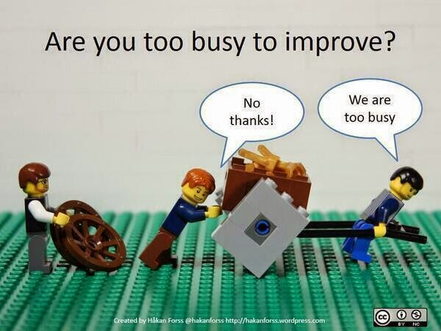
Why Should You Refactor?
Refactoring improves the design of software.
Refactoring makes software easier to understand.
Refactoring helps you find bugs.
Refactoring helps you program faster.
Notes:
As people change code, the code loses its structure.

Slide 4
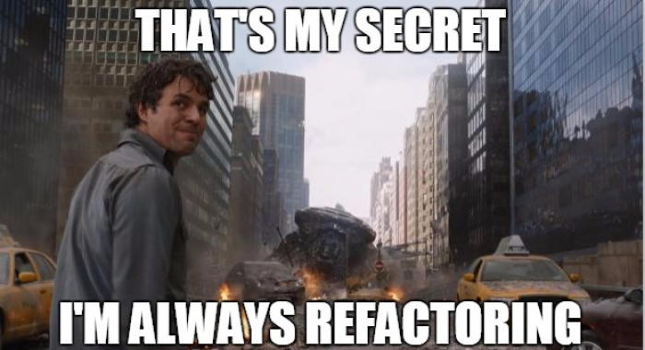
When Should You Refactor?
Refactor when you add function.
Refactor when you need to fix a bug.
Refactor as you do a code review.
Notes:
Boy Scout Rule
Two hat

Slide 5

When Should You Refactor?
The Two Hats
Adding Features
Refactoring
When you add features, you shouldn’t be changing existing code; you are adding new capabilities.
When you refactor, you make a point of not adding function; you only restructure the code.
Notes:
Boy Scout Rule
Two hat

Slide 6

When Should You Refactor?
Refactoring reduces duplication
The Rule of Three
The first time you do something, you just do it.
The second time you do something similar, you wince at the duplication, but you do the duplicate thing anyway.
The third time you do something similar, you refactor.
Notes:
Boy Scout Rule
Two hat

Slide 7
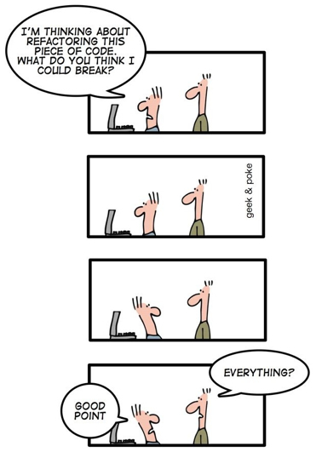
When Shouldn’t You Refactor?
When you are close to a deadline or release.
When the code just doesn’t work and would be easier to rewrite from scratch.

Slide 8
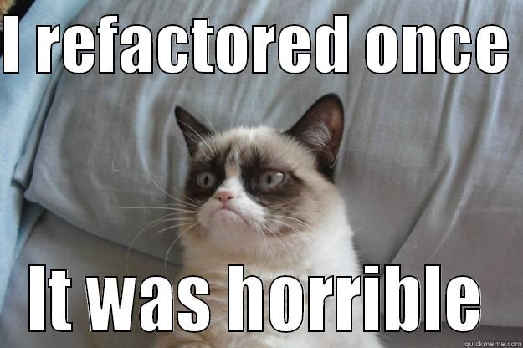
Code smells
Refactoring

Slide 9
Bad Smells In Code
Deciding when to start refactoring, and when to stop, is just as important to refactoring as knowing how to operate the mechanics of refactoring.
Code smells give you indications that there is trouble that can be solved by refactoring.

Slide 10
Bad Smells In Code
Long Method
Duplicated Code
Large Class
Long Parameter List
Comments

Slide 11
Bad Smells In Code
Improper Naming
Data Clumps
Switch Statements
Dead Code
Lack of Unit Tests

Slide 12
Refactoring Methods
Refactoring

Slide 13
A Simple Example
void printOwing(double amount) { printBanner(); //print details System.out.println ("name:" + _name); System.out.println ("amount" + amount); }
void printOwing(double amount) { printBanner(); printDetails(amount); } void printDetails(double amount) { System.out.println("name:" + _name); System.out.println("amount" + amount); }

Slide 14
Extract Method
You have a code fragment that can be grouped together.
Turn the fragment into a method whose name explains the purpose of the method.

Slide 15
Extract Method
Motivation
Extract method is one of the most common refactorings you should do.
Look for a method that is too long or look for code that needs a comment to understand its purpose.
Then turn that fragment of code into its own method.

Slide 16
Extract Method
Motivation
Short, well-named methods are preferred for several reasons.
First, it increases the chance that other methods can use a method when it is finely grained.
Second, it allows higher level methods to read more like a series of comments.

Slide 17
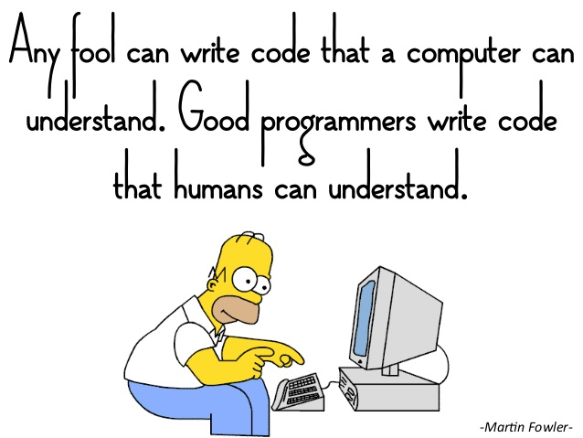

Slide 18
Meaningful Names
This code is very simple, but what does it actually do?
Looking at it we can’t tell what it is actually doing.
public List<int[]> getList()
{
List<int[]> list1 = new ArrayList<int[]>();
foreach (int[] x in theList)
{
if (x[0] == 4)
{
list1.add(x);
}
}
return list1;
}

Slide 19
Meaningful Names
Is this code any better?
public List<int[]> getFlaggedCells()
{
List<int[]> flaggedCells = new ArrayList<int[]>();
foreach (int[] cell in grid)
{
if (cell[STATUS_VALUE] == FLAGGED)
{
flaggedCells.add(x);
}
}
return flaggedCells;
}

Slide 20
Meaningful Names
What about this?
public List<Cell> getFlaggedCells()
{
List<Cell> flaggedCells = new ArrayList<Cell>();
foreach (Cell cell in grid)
{
if (cell.isFlagged())
{
flaggedCells.add(cell);
}
}
return flaggedCells;
}

Slide 21
Meaningful Names
What have we done?
Used intention revealing names
flaggedCells rather than list1
Replaced magic numbers with methods
cell.isFlagged() rather than x[0] == 4
Created an appropriate abstract data type
Cell cell rather than int[] cell

Slide 22
Meaningful Names (ARIA Example)
string behaviorCd = string.Empty;
// Build the cell type string
if (!this.m_PtCncrDtls.MorphCd.Equals(string.Empty) &&
!this.m_PtCncrDtls.BehaviorCd.Equals(string.Empty) &&
!this.m_PtCncrDtls.MorphCdSeq.Equals(0))
{
behaviorCd = this.m_PtCncrDtls.BehaviorCd;
if (this.m_PtCncrDtls.BehaviorCd.Equals("6"))
this.m_OrigCellTyp = this.m_PtCncrDtls.MorphCd + "3" +
this.m_PtCncrDtls.MorphCdSeq.ToString();
else
this.m_OrigCellTyp = this.m_PtCncrDtls.MorphCd + behaviorCd +
this.m_PtCncrDtls.MorphCdSeq.ToString();
}

Slide 23
Meaningful Names
Another example
What is d? Days? Diameter?
int d;

Slide 24
Meaningful Names
Is this any better?
int d; // elapsed time in days

Slide 25
Meaningful Names
What about this?
int elapsedTimeInDays;

Slide 26
Introduce Explaining Variable
You have a complicated expression.
Put the result of the expression, or parts of the expression, in a temporary variable with a name that explains the purpose.

Slide 27
Introduce Explaining Variable
Motivation
Expressions can become very complex and hard to read.
In such situations, temporary variables can be helpful to break down the expression into something manageable.
Introduce explaining variable is particularly valuable with conditional logic.
Consider extract method as an alternative.

Slide 28
Introduce Explaining Variable (Example)
if ((platform.toUpperCase().indexOf("MAC") > -1) &&
(browser.toUpperCase().indexOf("IE") > -1) &&
wasInitialized() && resize > 0)
{
// do something
}
const boolean isMacOs = platform.toUpperCase().indexOf("MAC") > -1;
const boolean isIE = browser.toUpperCase().indexOf("IE") > -1;
const boolean wasResized = resize > 0;
if (isMacOs && isIE && wasInitialized() && wasResized)
{
// do something
}

Slide 29
Replace Magic Number with Symbolic Constant
You have a literal number with a particular meaning.
Create a constant, name it after the meaning, and replace the number with it.

Slide 30
Replace Magic Number with Symbolic Constant
Motivation
Magic numbers are numbers with special values that are not obvious.
Magic numbers are really nasty when you need to reference the same logical number in more than one place.
If the numbers might ever change, making the change is a nightmare.

Slide 31
Replace Magic Number with Symbolic Constant (Example)
double potentialEnergy(double mass, double height)
{
return mass * 9.81 * height;
}
const double GRAVITATIONAL_CONSTANT = 9.81;
double potentialEnergy(double mass, double height)
{
return mass * GRAVITATIONAL_CONSTANT * height;
}

Slide 32
Do One Thing
How many things is this function doing?
public bool isEdible()
{
if (this.ExpirationDate > DateTime.Now &&
this.ApprovedForConsumption == true &&
this.InspectorId != null)
{
return true;
}
else
{
return false;
}
}

Slide 33
Do One Thing
How many things is this function doing?
public bool isEdible()
{
if (this.ExpirationDate > DateTime.Now &&
this.ApprovedForConsumption == true &&
this.InspectorId != null)
{
return true;
}
else
{
return false;
}
}
Check expiration
Check approval
Check inspection
Return result

Slide 34
Do One Thing
Now the function is doing one thing.
If we need to change what isEdible means, we can easily add another condition.
public bool isEdible()
{
return isFresh() &&
isApproved() &&
isInspected();
}

Slide 35
Don’t mix levels of abstraction
Which one is easier to read and understand?
public void doTheChores()
{
takeOutTheTrash();
walkTheDog();
foreach (Dish dish in dirtyDishes)
{
sink.washDish(dish);
towel.dryDish(dish);
}
}
public void doTheChores()
{
takeOutTheTrash();
walkTheDog();
doTheDishes();
}

Slide 36
Explain Yourself
Which one is clearer?
// Check to see if the employee is eligible for full benefits
if ((employee.flags & HOURLY_FLAG) && (employee.age > 65))
if (employee.isEligibleForFullBenefits())

Slide 37
Comments
Good Comments
API Documentation
Explain intent
Clarification
Bad Comments
Redundant
Obsolete
Code commented out
Notes:
If you feel the need to write a comment to make the code more understandable, you should be refactoring.

Slide 38
Visual Studio
Refactoring Tools
Code Analysis
Rename
Extract Method

Slide 39
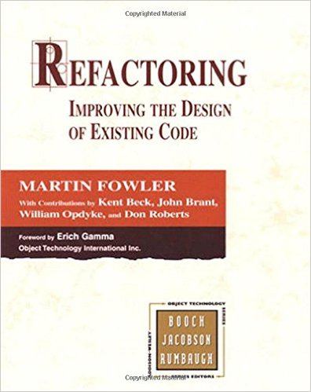
References
Refactoring: Improving the design of existing code – Martin Fowler
http://refactoring.com/catalog/
http://blog.codinghorror.com/code-smells/

Slide 40
Fun Read
How to Write Unmaintainable Code

