Slide 1

Deep Hierarchical Encoder For Detecting Incongruity Between News Headline and Body Text
M.Tech Dissertation
Presentation By: Under the supervision of:
Mohd Amzad Prof. Dr. Bashir Alam
M.Tech 4’th sem Dept. Computer Engg, JMI

Slide 2
Contents:
Introduction
Aim Of The Project
Problem Definition
Literature Survey
Dataset Description
Methodology
Experiment
Results
Analysis of Results
Conclusion and Future Scope
References

Slide 3
Introduction
With the rapid development of the internet over the past few years, a lot of online news websites and social applications come up with attractive and catchy ways to present news to their readers.
The growth of online journalism brings with it issues such as inaccuracy, unfairness, and subjectivity.
So, the headlines decide the viral potential of news stories on social sites. In today's digital world under information overload, people are less likely to read or click on the whole content but just read news headlines.
Therefore, if a news headline is incongruent with its body text it could mislead readers to access false information, which then becomes hard to revoke.

Slide 4
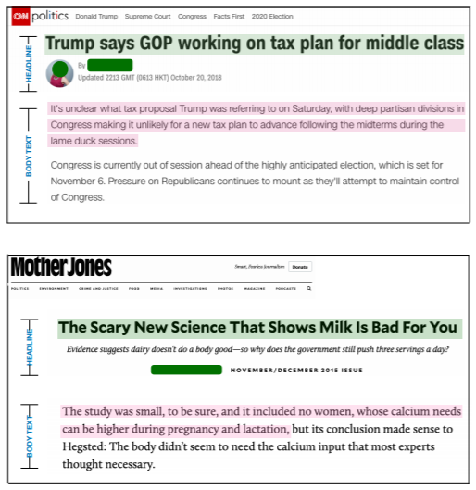
The majority of prior research addressing this issue has attempted to identify incongruity in news headlines by examining either the linguistic features of news headlines (Blom and Hansen 2015; Chen, Conroy, and Rubin 2015) or the textual similarities between news headlines and body content (Ferreira and Vlachos 2016; Wang, Hamza, and Florian 2017).
We propose deep learning approaches for learning the complex textual relationship between the news headline and the full news content, which has proven critical for classifying incongruent headlines.
Figure 1: A news article example of the incongruent headline. (Ref.:ppr=MuSeM: Detecting Incongruent News Headlines using Mutual Attentive Semantic Matching)

Slide 5
2. Aim of the Project
To use a large-scale dataset for the incongruent headline problem, which covers almost all important news articles over a period of two years.
To propose a deep hierarchical models that encode the full news article from a word-level to a paragraph-level. Also to present a data augmentation method that splits news paragraphs and annotates each of them separately.
To train and test our models with real data.
To design the model with fewer parameters.
To study and compare the result obtained with many other baseline models.

Slide 6
3. Problem Definition
News headlines are divided into the three categories listed below from the viewpoint of journalism and communication. They are:
Accurate Headlines
Ambiguous Headlines
Misleading Headlines

Slide 7

Figure 2 demonstrates a representative example of such misinformation and includes both headline and its body.
Such incongruent headlines not only provide the wrong impression to readers, but they also make things worse when they're shared on social media, where most people share without reading the content.
Our basic goal is to predict whether the news headline is congruent or incongruent with the body text.
Figure 2: A news article example of the incongruent headline(Ref ppr.: 2).

Slide 8
4. Literature Survey
Author & Year | Paper title | Short Description
Eugenio Tacchini, Gabriele Ballarin, Marco L. Della Vedova, Stefano Moret, and Luca de Alfaro(2017) | Some Like it Hoax : Automated Fake News Detection in Social Networks | They present two classification techniques, one based on logistic regression, the other on a novel adaptation of boolean crowdsourcing algorithms.
Federico Monti, Fabrizio Frasca, Davide Eynard, Damon Mannion(2019) | Fake News Detection on Social Media using Geometric Deep Learning | The model was trained and tested on news stories, verified by professional fact-checking organizations, that were spread on Twitter.
Rowan Zellers , Ari Holtzman , Hannah Rashkin, Yonatan Bisk, Ali Farhadi, Franziska Roesner(2020) | Defending Against Neural Fake News | This paper investigates the threats posed by adversaries seeking to spread disinformation.A controllable language model named Grover – suggests that these threats are real and dangerous.
Yi-Ju Lu, Cheng-Te Li(2020) | GCAN: Graph-aware Co-Attention Networks for Explainable Fake News Detection on Social Media | Extensive experiments conducted on real tweet datasets exhibit that GCAN can significantly outperform state-of-the-art methods by 16% in accuracy on average. In addition, the case studies also show that GCAN can produce reasonable explanations.

Slide 9
Tanik Saikh,Arkadipta De, Asif Ekbal,Pushpak Bhattacharyya (2020) | A Deep Learning Approach for Automatic Detection of Fake News | The proposed systems yield encouraging performance, outperforming the current handcrafted feature engineering based state-of-the art system with a significant margin of 3.08% and 9.3% by the two models, respectively.
Chunyuan Yuan, Qianwen Ma, Wei Zhou, Jizhong Han and Songlin Hu(2020) | Early Detection of Fake News by Utilizing the Credibility of News, Publishers, and Users Based on Weakly Supervised Learning | They propose a novel Structure-aware Multi-head Attention Network (SMAN), which combines the news content, publishing, and reposting relations of publishers and users, to jointly optimize the fake news detection and credibility prediction tasks.
Seunghyun Yoon, Kunwoo Park, Minwoo Lee, Taegyun kim, Meeyoung Cha, And Kyomin Jung(2021) | Learning to Detect Incongruence in News Headline and Body Text via a Graph Neural Network | The model, called the graph-based hierarchical dual encoder (GHDE), utilizes a graph neural network to efficiently learn the content similarity between news headlines and long body paragraphs. This paper also releases a million-item-scale dataset of incongruity labels that can be used for training.
Rahul Mishra, Piyush Yadav, Remi Calizzano, Markus Leippold(2020) | MuSeM: Detecting Incongruent News Headlines using Mutual Attentive Semantic Matching | This paper proposes a method that uses inter-mutual attention-based semantic matching between the original and synthetically generated headlines, which utilizes the difference between all pairs of word embeddings of words involved.
Wei Wei and Xiaojun Wan(2017) | Learning to Identify Ambiguous and Misleading News Headlines | For the identification of misleading headlines, they extract features based on the congruence between headlines and bodies.Then they use classifiers to detect inaccurate headlines crawled from different sources and conduct a data analysis.

Slide 10
5 .Dataset Description
We have downloaded the ‘Fake News Detection’ dataset from kaggle. This is a high-quality dataset with labeled attributes.
To overcome the limitations related to noise in datasets, this Fake News Detection dataset for headline incongruence problem is collected from many news websites.
To cover a wide range of news, they crawled a total of 40 000 articles in six different domains (domestic, world, society, entertainment, sports, and technology) from major news sites.
About the dataset file
Each record has four characteristics:
Headline: the news article's headline.
Body: contains the body of the news article.
Article_link(URLs): Here's a link to the original news article.
Label: If the record is sarcastic/incongruent its value is 1, otherwise it is 0.

Slide 11
Table 1: Examples of statements and side information in the dataset .
URls: http://www.bbc.com/news/world-us-canada-41419190 Headline: Four ways Bob Corker skewered Donald Trump Body: Image copyright Getty Images On Sunday morning, Donald Trump went off on a Twitter tirade against a ... Label: 1
URLs: https://www.reuters.com/article/us-filmfestival-london-lastflagflying/linklaters-war-veteran-comedy-... Headline: Linklater's war veteran comedy speaks to modern America, says star Body: LONDON (Reuters) - “Last Flag Flying”, a comedy-drama about Vietnam war veterans, will resonate with… Label: 1
URLs: https://www.activistpost.com/2017/09/war-cash-backfires-indias-economy.html Headline: War on Cash Backfires on India’s Economy Body: By Clint Siegner Indian Prime Minister Narendra Modi launched a surprise attack on cash in late 2016... Label: 0

Slide 12
6. Methodology
Given a {headline} and {body text} pair, our goal is to determine whether a news article contains an incongruent headline.
I.Baseline approaches
We present some baseline approaches that have been used to solve the headline incongruence problem. Feature-based ensemble algorithms are frequently utilized due to their simplicity and effectiveness.
XGB
XGBoost, which implements gradient boosted decision trees, is a well-recognized and fast algorithm for classification tasks .
Using an incongruity label instead, we extract a feature set consisting of TF-IDF vectors based on word occurrences.
Singular values decomposed from these vectors indicate word-vector similarities between a {headline} and its corresponding {body text}.

Slide 13
2. Recurrent Dual Encoder (RDE)
To compute the similarity between two text inputs, a recurrent dual encoder composed of dual RNNs was used.
Using the final hidden state of each headline and body text RNN, the probability of having an incongruent headline is calculated after the encoding step. In the training objective, the incongruence score is as follows:
P(label) = σ((hd^{H}_{th} )^{T} M hd^{B}_{tb} + b), ….eq(1)
Z = − log𝜫^{N}_{n=1}P(label_{n}|hd^{H}_{n,th} , hd^{B}_{n,tb} ) ....eq(2)

Slide 14
3. Convolution Dual Encoder (CDE)
Taking the word sequence of {headline} and {body text} as input to the convolutional layer, we obtained a vector representation
V = {V_{i} |i = 1, · · · , k}
For each part of the article through the max-over-time pooling after computing convolution with k filters as follows:
V_{i} = G(f_{i}(W)), ….eq(3)
We use dual CNNs to encode the {headline} and the {body text} into vector representations.

Slide 15
II.Proposed Models
The recurrent neural network used in RDE, for example, is bad at recalling information from the distant past.
While CDE learns local word dependencies, the model's normal convolutional filter length prevents it from catching any relationship between words in different places.
Attentive Hierarchical Recurrent Dual Encoder (AHRDE)
Using a two-level hierarchy of RNN architecture, this model divides the text into a list of paragraphs and encodes the complete text input from the word level to the paragraph level.
We use bi-directional RNNs to utilize information from the past and future.

Slide 16
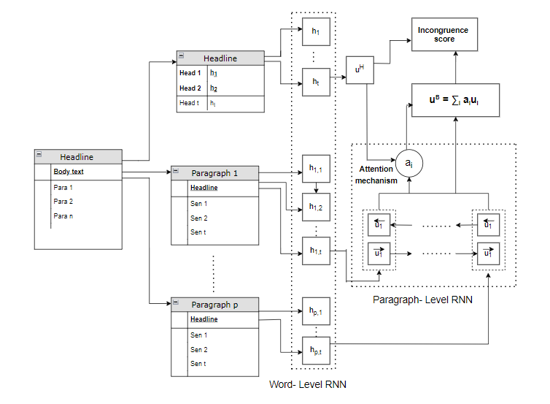
The word-level RNN encodes the word sequences wd_{p} = {wd_{p,1:t}} to hd_{p} = {hd_{p,1:t}} for each paragraph.
The hidden states of hierarchical RNNs are as follows: hd_{p,t} = F_{θ}(hd_{p,t-1}, wd_{p,t}), …..eq(4)
u_{p} = G_{θ}(u_{p-1}, hd_{p}). …..eq(5)
Then, each u_{p} of {body text} is aggregated according to its correspondence with the {headline} as follows: S_{p} = V^{T} tanh(WB^{B}_{u} u^{B}_{p} + WH^{H}_{u} u ^{H}).eq(6)
a_{i} = exp(S_{i})/ ∑_{p} exp(S_{p}), ……..eq(7)
u^{B} = ∑_{i} a_{i,}u_{i}^{B} …...eq(8)
We use the same training objective as the RDE model, and the incongruence score is calculated as follows:
P(label) = σ((u^{H}) |M u^{B} + b) ……..eq(9)
Figure 3: A diagram of the AHRDE model.

Slide 17
2 Embedding Recurrent Encoder (ERE)
The AHRDE model encodes text from the word level to the paragraph level using two hierarchical RNNs.
AHRDE calculates h_{p} in equation (4) by averaging the word embedding among the words in paragraph p,
hd_{p} = ∑_{i} embedding(w_{i}), w_{i} ⊂ p-th paragraph. …….eq(10)
The embedding procedure is constructed as follows for a given input sequence x = {x_{1:t}} with these K vectors:
p_{k} = softmax((x)^{T} m_{k}),
x_{K} = ∑^{K}_{k=1} p_{k}m_{k},
e = concat{x, x_{k}} ….eq(11)
Then, using the paragraph-encoded sequence input, a paragraph-level RNN is used to retrieve the final encoding vector for the entire body text.

Slide 18
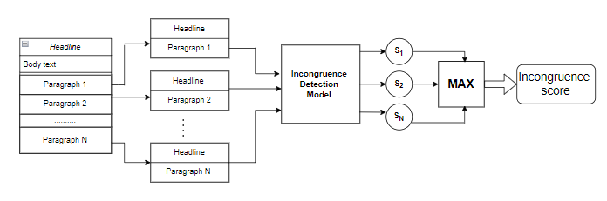
Figure 4: Diagram of the independent training method.
3.Independent Training
(IT) Method
The final incongruence score for the pair of {headline} and {body text} is calculated as follows :
P(label) = max(s_{1:p}) ….eq(12)
We utilize the paragraph dataset to train models with the IT approach, and incongruence scores are obtained as follows:
XGB with IT
RDE/CDE with IT
AHRDE with IT
ERE with IT

Slide 19
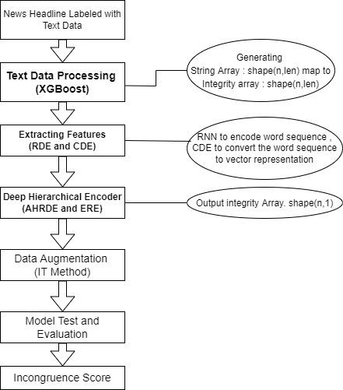
Figure 5: flowchart showing the various modules of the Deep Hierarchical Encoder

Slide 20
7. Experiment
Case Study:
Table 2
Headline | Body | URL | Label
The Amish Brotherhood Has endorsed Donald Trump for president | The Amish, who are direct descendents of the protestant reformation sect known as the Anabaptists, have typically stayed out of politics in the past. As a general rule, they don’t vote, serve in the military, or engage in any other displays of patriotism. This year, however,the AAM has said that it is imperative that they get involved in the democratic process. | http://cnn.com.de/mews/amish-ccommit-vote-donald-trump-now-lockpresidency/ | 1
Wikileaks Gives Hillary An Ultimatum: OUIT, Or We Dump Something Life-Destroying | On Sunday,Wikileaks gave Hillary Clinton less than a 24-hour window to drop out of the race or they will dump something that will destroy her completely. Recently, Julian Assange confirmed that WikiLeaks was not working with the Russian government, but in the pursuit of justice, they are obligated to release anything that they can to bring light to a corrupt system and who could possibly be more corrupt than crooked Hillary? | http://thelastlineofdefense.org/wikileaks-gives-hillary-an-ultimatum-quitor-we-dump-sometning-life-destroying/ | 1

Slide 21
2. Preprocessing
Prior to training models, we perform the following pre-processing steps:
Filtering headlines:-We remove all non-alphanumeric characters from the text, but we keep all stop words because our model trains the sequence of words in a text directly.
We replace all user mentions and hashtags with a blank space and skip images , flags from the posts.
We replace the URLs with the string ‘http‘. And define max features.
Vectorize & Convert text for input.
Splitting data to train & test.

Slide 22
3. Experimental setup
All the experiments were performed using Python and some modules are build and trained in google colab.
Optimization was done using Adam and sigmoid as an activation function.
We trained each classifier model with a batch size of 32. In all the approaches, we used only the first token output provided by each model as input to classifier layer.
To measure the combined performance of 4 individual baseline models together, we have used weighted fine-grained f1 score as the metric, where the weights for the scores of individual classes are the fraction of their positive examples.
We apply IT data augmentation method to all four models and that gives an increase in performance.

Slide 23
8 Result
Table 3: deep hierarchical encoder accuracy
Among the deep learning models, the newly proposed AHRDE achieved the best performance with regard to accuracy (0.97 ).
Experiment Results
Methods | Accuracy | Precision | Recall | F-Score
Without IT-Method | 0.84 | 0.82 | 0.81 | 0.82
With IT-Method | 0.97 | 0.96 | 0.97 | 0.96

Slide 24
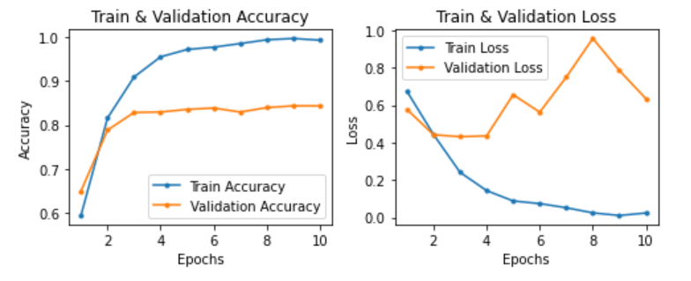
B. Model Accuracy And Loss
I. Without IT Method
(a) Model Accuracy and Loss without IT
(a) Model Accuracy and Loss without IT
(a) Model Accuracy and Loss without IT
Figure 6: Model Accuracy and loss Without IT method.

Slide 25
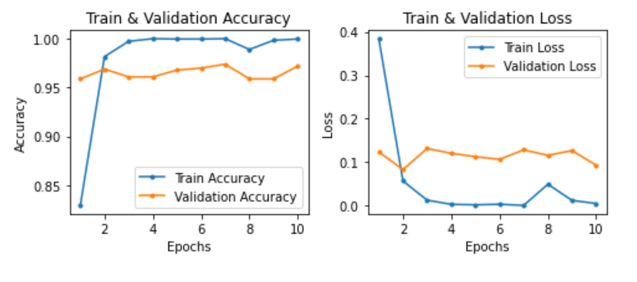
II. With IT Method
Figure 7: Model accuracy and loss With IT

Slide 26
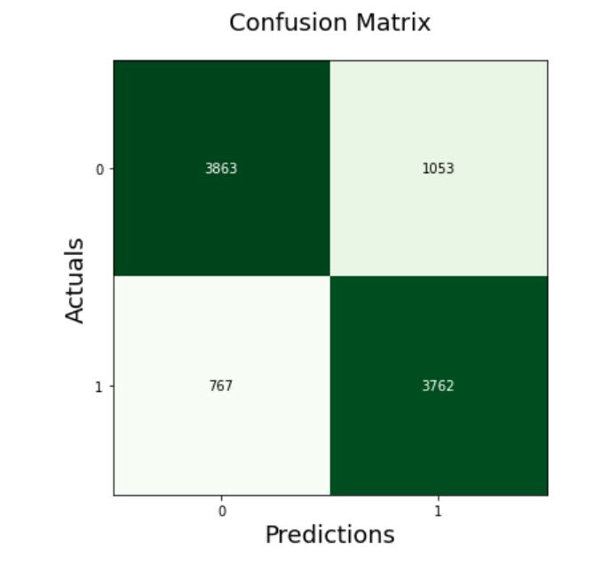
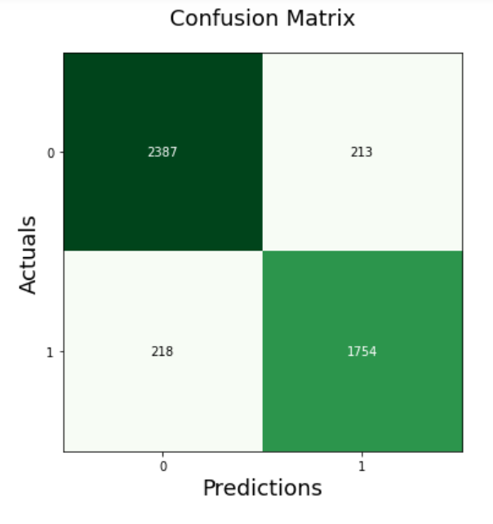
Figure 8: Confusion matrix of our best model (AHRDE and ERE) before and after applying the data augmentation methods.

Slide 27
C. Performance Comparison
Table 4: Model performance (top-2 scores marked as bold).
With an accuracy of 0.907, CDE outscored the other single models. The AHRDE model was the most accurate among deep learning models, with an accuracy of 0.975.
Model | Accuracy Without DA | Accuracy With DA
SVM XGB CDE RDE | 0.660 0.718 0.793 0.741 | 0.770 0.773 0.907 0.823
AHRDE And ERE | 0.843 | 0.975

Slide 28
9. Analysis of Results
Three observations are made here:
First, among the deep learning models, the newly proposed AHRDE achieved the best performance with regard to accuracy (0.97 ).
Second, when the IT method was used, prediction performance improved significantly.
Third, when we looked at the top 250 articles, the AHRDE model with IT had a precision of 0.82, which is high enough to be used for detection in real news sites.

Slide 29
10 Conclusion and Future work
Conclusion
We employed a fake news dataset designed to recognize news stories whose body text contradicts the headline. We also present two neural networks that use a hierarchical recurrent design to efficiently learn the textual link between headline and body text. The experiments show that models trained on our available corpus perform well on both synthetic and real-world datasets. Furthermore, we present Independent Training, a data augmentation strategy that creates headline-paragraph combinations by splitting the entire body text into independent paragraphs, improving the models' performance.
Future Work
This research could be expanded to measure the inconsistency of title and content in other categories of online content in the future. Automatically identifying such incongruent titles of diverse items will benefit individuals in being happier, similar to the incongruent headline problem.

Slide 30
11. References
[1] Chen, Yimin, Niall J. Conroy, and Victoria L. Rubin. "Misleading online content: recognizing clickbait as" false news"." Proceedings of the 2015 ACM on workshop on multimodal deception detection. 2015.
[2] Chesney, Sophie, et al. "Incongruent headlines: Yet another way to mislead your readers." Proceedings of the 2017 EMNLP Workshop: Natural Language Processing meets Journalism. 2017.
[3] Ecker, Ullrich KH, et al. "The effects of subtle misinformation in news headlines." Journal of experimental psychology: applied 20.4 (2014): 323.
[4] Gabielkov, Maksym, et al. "Social clicks: What and who gets read on Twitter?." Proceedings of the 2016 ACM SIGMETRICS international conference on measurement and modeling of computer science. 2016.
[5] Normala, Che Eembi Jamil, et al. "Fakeheader: A tool to detect deceptive online news based on misleading news headlines and contents." Turkish Journal of Computer and Mathematics Education 12.3 (2021): 2217-2223.
[6] Park, Kunwoo, et al. "BaitWatcher: A lightweight web interface for the detection of incongruent news headlines." Disinformation, Misinformation, and Fake News in Social Media. Springer, Cham, 2020. 229-252.
[7] Tacchini, Eugenio, et al. "Some like it hoax: Automated fake news detection in social networks." arXiv preprint arXiv:1704.07506 (2017).
[8] Yoon, S., Park, K., Lee, M., Kim, T., Cha, M., & Jung, K. (2021). Learning to Detect Incongruence in News Headline and Body Text via a Graph Neural Network. IEEE Access, 9, 36195-36206.

Slide 31
[9] Monti, Federico, et al. "Fake news detection on social media using geometric deep learning." arXiv preprint arXiv:1902.06673 (2019).
[10] Zellers, Rowan, et al. "Defending against neural fake news." arXiv preprint arXiv:1905.12616 (2019).
[11] Lu, Yi-Ju, and Cheng-Te Li. "GCAN: Graph-aware co-attention networks for explainable fake news detection on social media." arXiv preprint arXiv:2004.11648 (2020).
[12] Saikh, Tanik, et al. "A deep learning approach for automatic detection of fake news." arXiv preprint arXiv:2005.04938 (2020).
[13] Yuan, Chunyuan, et al. "Early Detection of Fake News by Utilizing the Credibility of News, Publishers, and Users Based on Weakly Supervised Learning." arXiv preprint arXiv:2012.04233 (2020).
[14] Kamal, Ojasv, Adarsh Kumar, and Tejas Vaidhya. "Hostility Detection in Hindi leveraging Pre-Trained Language Models." arXiv preprint arXiv:2101.05494 (2021).
[15] Bhatt, Gaurav, et al. "On the benefit of combining neural, statistical and external features for fake news identification." arXiv preprint arXiv:1712.03935 (2017).
[16] Yang, Yang, et al. "TI-CNN: Convolutional neural networks for fake news detection." arXiv preprint arXiv:1806.00749 (2018).
[17] Nguyen, Duc Minh, et al. "Fake news detection using deep markov random fields." Proceedings of the 2019 Conference of the North American Chapter of the Association for Computational Linguistics: Human Language Technologies, Volume 1 (Long and Short Papers). (2019).
[18] Saikh, Tanik, et al. "A Deep Learning Approach for Automatic Detection of Fake News." arXiv preprint arXiv:2005.04938 (2020).
[19] Umer, Muhammad, et al. "Fake news stance detection using deep learning architecture (cnn-lstm)." IEEE Access 8 (2020): 156695-156706.
[20] Cui, Limeng, et al. "defend: A system for explainable fake news detection." Proceedings of the 28th ACM International Conference on Information and Knowledge Management (2019).
[21] Girgis, Sherry, Eslam Amer, and Mahmoud Gadallah. "Deep learning algorithms for detecting fake news in online text." 2018 13th International Conference on Computer Engineering and Systems (ICCES). IEEE (2018).

Slide 32
[22] Thota, Aswini, et al. "Fake news detection: a deep learning approach." SMU Data Science Review 1.3 (2018):
[23] Sahoo, Somya Ranjan, and B. B. Gupta. "Multiple features based approach for automatic fake news detection on social networks using deep learning." Applied Soft Computing 100 (2021): 106983.
[24] Girgis, Sherry, Eslam Amer, and Mahmoud Gadallah. "Deep learning algorithms for detecting fake news in online text." 2018 13th International Conference on Computer Engineering and Systems (ICCES). IEEE (2018).
[25] Zhang, Jiawei, et al. "Fake news detection with deep diffusive network model." arXiv preprint arXiv:1805.08751 (2018).
[26] Wei, Wei, and Xiaojun Wan. "Learning to identify ambiguous and misleading news headlines." arXiv preprint arXiv:1705.06031 (2017).
[27] Mishra, Rahul, et al. "MuSeM: Detecting incongruent news headlines using mutual attentive semantic matching." 2020 19th IEEE International Conference on Machine Learning and Applications (ICMLA). IEEE (2020).
[28] Chen, Y.; Conroy, N. J.; and Rubin, V. L. 2015. Misleading online content: Recognizing clickbait as false news. In Proceedings of the ACM Workshop on Multimodal Deception Detection (2015)
[29] Chesney, S.; Liakata, M.; Poesio, M.; and Purver, M. 2017. Incongruent Headlines: Yet Another Way to Mislead Your Readers. In Proceedings of the EMNLP Workshop: Natural Language Processing meets Journalism, 56–61 (2017)
[30] Chopra, S.; Jain, S.; and Sholar, J. M. 2017. Towards Automatic Identification of Fake News: Headline-Article Stance Detection with LSTM Attention Models (2017).
[31] Ecker, U. K.; Lewandowsky, S.; Chang, E. P.; and Pillai, R. 2014. The effects of subtle misinformation in news headlines. Journal of experimental psychology: applied 20(4):323 (2014).
[32] "https://rishabhmisra.github.io/publications/"
[33] https://en.wikipedia.org/wiki/Biological_neural_network
[34] Bourgonje, Peter, Julian Moreno Schneider, and Georg Rehm. "From clickbait to fake news detection: an approach based on detecting the stance of headlines to articles." Proceedings of the 2017 EMNLP workshop: natural language processing meets journalism. 2017.

Slide 33
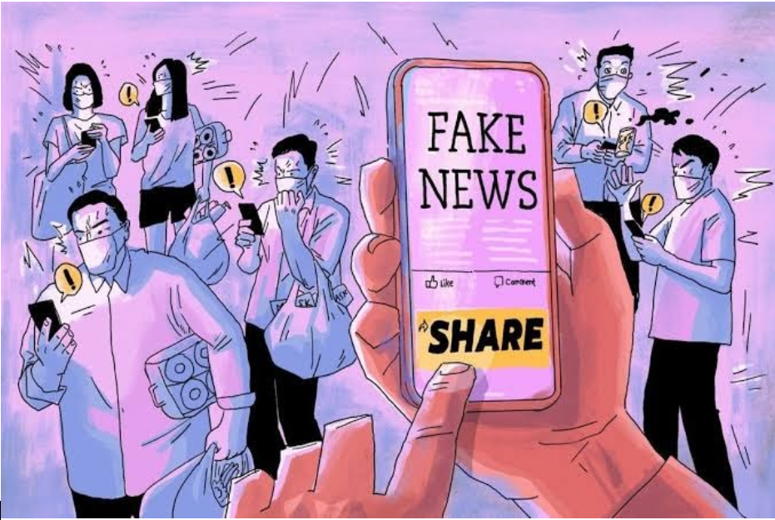
Thank You

