Slide 1
Installing, Configuring & Customizing KFS
Mike Criswell (Michigan State University)
Warren Liang (University of California, Irvine)

Slide 2
Minimum Requirements
Java 1.5
Ant 1.6.5
Oracle 10.1+ or MySQL 5.0.5+
Servlet 2.4 container (e.g. Apache Tomcat)
https://test.kuali.org/confluence/x/IoTI

Slide 3
Other Tools
Development & Testing
Production
IDE, e.g. Eclipse 3.2+
KFS test framework based on Junit 3.8.1
Continuous Integration, e.g. Anthill Pro 2.50+
Application Server, e.g. Tomcat 5.5.16+
Web Server, e.g. Apache 2.0.55+
Load Balancer, Zeus ZXTM-lb

Slide 4
Selected KFS Terminology
Business Objects (BOs)
  Java classes, instances of which represent a DB row in table
OJB, for Object Relational Mapping
  Configured using XML files
Data Dictionary
  Configured using XML files
Spring, for Service and Transactional Management
  Configured using XML files

Slide 5
Evaluation: Database Setup
Install appropriate version of a supported database (currently MySQL and Oracle)
Install JDBC drivers
Configure database import/export tool via ~/impex-build.properties
Perform initial setup steps
Run bootstrap target
Import demo data set
https://test.kuali.org/confluence/x/YvY

Slide 6
Evaluation: Environment Setup
Configure build process via kuali-build.properties
Set up java, ant, tomcat, and optionally Eclipse
Run ant target “dist-local” (and “make-source”, if no IDE)
Start tomcat
https://test.kuali.org/confluence/x/X-Y

Slide 7


Build Files
User properties (“~/kuali-build.properties”)
Institution shared properties
Project build.properties
build.xml
build directory
  external
  project
https://test.kuali.org/confluence/x/Y-Y

Slide 8
Configuration & Customization: build.properties
Deployment
Database platform
Batch
User Maintenance
Authentication
Spring Files
User Interface
User Messages

Slide 9
Functional Implementation Questions
Should we use workflow for other applications
Will our security office frown on the encryption strategy
  The default implementation for KFS is demonstration grade, meaning that it should not be used with real sensitive data.

Slide 10
Functional Implementation Questions
How will we source institutional user data
How and when will our batch schedule run
Should our static content (e.g. images, help pages, etc.) be release independent and who will maintain it

Slide 11
Functional Implementation Questions
What will our chart and organization hierarchy look like
Will we use flexible offsets
Do we have additional attributes that we need to represent and use in KFS
How can we change workflow to meet our approval process

Slide 12
Configuration & Customization: Spring: Bean Overrides
User Service
Authentication Service
Mail Service
Encryption Service (should be overridden)
Modules
Any other service

Slide 13
Spring: Module Definition
Provides definitions and directory locations for the following:
  Users
  Authorization
  Data Dictionary
  Database/OJB mappings
  Batch
  DWR (AJAX) configuration files
  Module metadata

Slide 14
Example Spring Module Definition
<bean id="purapModule" class="org.kuali.core.KualiModule">
<property name="moduleId" value="purap" />
<property name="moduleName" value="Purchasing/Accounts
Payable" />
<property name="moduleCode" value="PA" />
<property name="initializeDataDictionary" value="true"/>
<property name="moduleUserService"
ref="purapUserService" />
Represents module metadata, and most of these probably won’t be overridden

Slide 15
Example Spring Module Definition (cont.)
<property name="moduleAuthorizer">
<bean
class="org.kuali.kfs.authorization.
KfsModuleAuthorizerBase">
<property name="packagePrefixes">
<list>
<value>org.kuali.module.purap.</value>
</list>
</property>
</bean>
</property>
Which java package(s) belong in the module?

Slide 16
Example Spring Module Definition (cont.)
<property name="moduleUserRule">
<null />
</property>
<property name="moduleUserPreRules">
<null />
</property>
<property name="dataDictionaryPackages">
<list>
<value>org/kuali/module/purap/datadictionary</value>
</list>
</property>
Location(s) of data dictionary files

Slide 17
Example Spring Module Definition (cont.)
<property name="databaseRepositoryFilePaths">
<list>
<value>org/kuali/module/purap/OJB-repository-
purap.xml</value>
</list>
</property>
<property name="jobNames">
<list>
<value>
purchasingPreDisbursementImmediatesExtractJob
</value>
</list>
</property>
Location(s) of OJB files
Batch job(s) associated with the module (name of job Spring beans)

Slide 18
Example Spring Module Definition (cont.)
<property name="triggerNames">
<value>purchasingPreDisbursementImmediates
ExtractJobTrigger</value>
</property>
</bean>
Trigger(s) (i.e. invoker of jobs at a given time), if necessary, for batch jobs in module (name of trigger Spring beans)

Slide 19
Configuration & Customization: Spring Module Definition
To override/add OJB mappings, data dictionary entries, packages, jobs, etc., the module bean must be overridden.

Slide 20
Configuration & Customization: Spring Module Definition
Create a new Spring bean file
Copy the original Spring module bean and paste it to the new Spring file
Make desired changes (e.g. add OJB file)
Remember that overriding Spring beans (by adding new Spring files to the application) must be done by adding the path/name of the new files to the “spring.source.files” build property

Slide 21
Data Dictionary
The data dictionary is one of KFS/Rice’s repository for metadata about business objects, attributes, and documents.
Specified with XML files located within the project structure.
https://test.kuali.org/confluence/x/r4HgAQ

Slide 22
Data Dictionary
The DD defines the following:
  Labels
  Presence & Order of Fields
  Custom Fields
  Inquiry Association
  Authorization
  Maintainables
  Business Rules

Slide 23
Configuration & Customization: Data Dictionary
Copy and modify an existing DD file or create a new one in the module’s institutional DD directory under work/src
Override Spring module to include the new institutional DD directory at end of list.
<property name="dataDictionaryPackages">
<list>
<value>org/kuali/module/purap/datadictionary</value>
</list>
</property>
<value>edu/mySchool/module/purap/datadictionary</value>

Slide 24
Extended Attributes
Institutions will probably need to add additional attributes to the tables shipped with KFS.
KFS comes with a mechanism to do this in a minimally invasive and standardized way.
Extended Attributes reduce the pain of upgrading KFS.
https://test.kuali.org/confluence/x/goERAQ

Slide 25
Extended Attributes: Example
Institutions may decide to add additional attributes for the Account table.
They create a secondary table to store the extended attributes with the same primary keys as the account table.
Using an equi-join/natural join, the framework can access both the built-in and extended attributes from the Account Business Object.

Slide 26
Configuration & Customization: Extended Attributes
Module Spring bean override
Database object(s) (i.e. DB tables, etc.)
Extension class descriptor & base descriptor override in OJB
Extension Business Object & rule override
Extension BO DD entry, base BO and maintenance document DD override
Optional control values & AJAX

Slide 27
Extended Attributes: Example
After an extended attribute is created, we can easily implement lookups and inquiries with the extended attribute(s), as well as create/modify maintenance documents to use those extended attributes.

Slide 28
System Parameters
Allow institutions to customize out of the box business rules based on their own policies
Controlled by functional users via maintenance documents
Externalize constants out of the code
Maintained in System Parameters Tables
Convenient service and evaluator methods are provided for developers to access and use the constant values in business rules validations
https://test.kuali.org/confluence/x/3IDS
Notes:
Parameters allow users to control the aspects of the application's behavior that they should be responsible for and which should be able to change independently of application releases.

Slide 29
Configuration & Customization: Parameters
Configuration
  Exception mailing lists
  Authorized groups
  Derivations
Validation: simple and compound constraints
Relative help URLs

Slide 30
Configuration & Customization: Parameters
Review each parameter to determine whether it needs to be changed
Write a SQL script, or modify the XML database data manually

Slide 31
Business Rules Class
Pluggable through Data Dictionary
Since written in Java, they are much more expressive than just matching
Has access to all Kuali Spring-based services
Extensive code reuse through inheritance and services
https://test.kuali.org/confluence/x/poDS

Slide 32
Plugging Business Rules Class
Specify the fully qualified class name of the business rule class with the <businessRuleClass> tag in the document's data dictionary file.

Slide 33
Plugging Business Rules Class
  Example, PaymentRequestDocument.xml:
  <documentClass>
  org.kuali.module.purap.document.PaymentRequestDocument
  </documentClass>
  <businessRulesClass>
  org.kuali.module.purap.rules.PaymentRequestDocumentRule
  </businessRulesClass>

Slide 34
Document Authorizer Framework
Determines who can initiate a document
  Initiator workgroup in Doc DD XML
How document fields are rendered
What buttons are displayed
https://test.kuali.org/confluence/x/goAUAQ

Slide 35
Plugging Authorizer Class
<documentClass>
org.kuali.module.purap.document.PaymentRequestDocument
</documentClass>
<documentAuthorizerClass>
org.kuali.module.purap.document.PaymentRequestDocumentAuthorizer
</documentAuthorizerClass>
<authorizations>
<authorization action="initiate">
<workgroups>
<workgroup>
KUALI_PURAP_ACCOUNTS_PAYABLE
</workgroup>
</workgroups>
</authorization>
</authorizations>
Document Authorizer class implementation
Document initiator workgroup

Slide 36
Configuration & Customization: web.xml
Workflow Servlet Mappings
CAS Servlet Mappings
Filters
Listeners

Slide 37
Configuration & Customization: Workflow
Document Types
  Exception, blanket approval, etc. workgroups
  Route nodes / path
  Search configuration
Rules / Searching
  Add rule templates / modify existing templates
  Modify / add XML attribute definitions
  Extend and customize java attributes
https://test.kuali.org/confluence/x/agAEAQ

Slide 38
Implementation
Database Setup
  Import bootstrap data set
  Review data setup page for delivered data description and dependency information
  Determine what you will load through UI vs other
  Use the post-data load encryption process as needed for data not loaded through UI
Environment Setup
  Revisit build properties
  Wrap or replace KFS build

Slide 39
Maintaining Customizations
Additions should reside outside the org.kuali package
Do not modify delivered files (data dictionary, OJB, spring) – override them
When you need to modify delivered files, use the keyword: INSTITUTIONAL CUSTOMIZATION (in comment appropriate for file type)
Track modifications to delivered document types, parameters, workgroups
Version control or other comparison tool to assist with merge of modifications to delivered files

Slide 40
Upgrade Process
Get distribution, point at your prior version, run delivered code upgrade process
Use delivered process to generate database upgrade script, review & execute
Branch your current development version, replace custom code with the distribution
Sync and reapply changes

Slide 41
KFS Installation/Configuration and Customization at MSU

Slide 42
Installation/Configuration and Customization at MSU
MSU and KFS
Approach
Technical environment
Distribution: What do you get ?
Goals/Objectives
MSU load process
How did it go?
Next steps
Recommendations

Slide 43
MSU and KFS
3 technical staff, 4 KFS developers, 14 functional staff. Continuing with staff additions
Four sandbox environments running KFS 2
Review, learn, and provide input on installation efforts

Slide 44
MSU’s Approach
Create sandboxes using MSU data
Become familiar with the application prior to implementation
For bootstrap version much attention was given to data, setup and configuration
Prior to installation functional/technical staff reviewed process from KFS release 1 and developed plan for KFS release 2

Slide 45
Technical Environment
 | MSU Sandboxes | MSU CVS/Dev/Test
Hardware | Application Server: Dell PowerEdge 2850, 2 Dual Processors, 8 Gig RAM, (2) 60 GB Drives, Red Hat Enterprise RHEL 5-32 - Linux (64 bit OS), 4 instances of KFS for various functional groups to play in Database Server: Dell Dual Processor, 8 GIG RAM, Red Hat Enterprise RHEL 5-32 - Linux (64 bit OS), 400GB Local RAID5 storage | Application Server: Dell PowerEdge 2950 III, 2 Quad Processors, 32 Gig RAM, VMWare 6, CVS, Dev and Test on different VM guests, CVS on Win2003, Red Hat Enterprise RHEL 5-32 - Linux (64 bit OS), SAN-based storage Database Server: Dell PowerEdge 2950 III, Quad Processors, 32 Gig RAM, VMWare 6, Dev and Test DBs on different VM guests, Red Hat Enterprise RHEL 5-32 - Linux (64 bit OS), SAN-based storage
Database | Oracle 10g Standard Edition for Linux (64 bit edition) | Oracle 10g Enterprise Edition for Linux (64 bit edition)
Download | Source Code Distribution | Source Code Distribution
Dataset | KULBOOTSTRAP + MSU Data | KULBOOTSTRAP + MSU Data

Slide 46
Distribution: What do you get?
Kuali Financial System w/embedded Rice
Database Import/Export Tool
  Demo Data Set
  Bootstrap Data Set
Kuali Rice Source

Slide 47
Goals/Objectives (MSU)
Build the application from source
Populate system with MSU data
Test ability to make institutional enhancements
  Change color scheme
  Replace CAS Authentication with MSU’s home-grown authentication.
  Test extended attribute feature.
  Build Lookup and Maintenance eDoc to support added attributes
  Create a custom business rule.
  Configure KEW routing rules for certain eDocs
  Create new KEW Rule Attribute, Rule Template and Rule based on an extended attribute

Slide 48
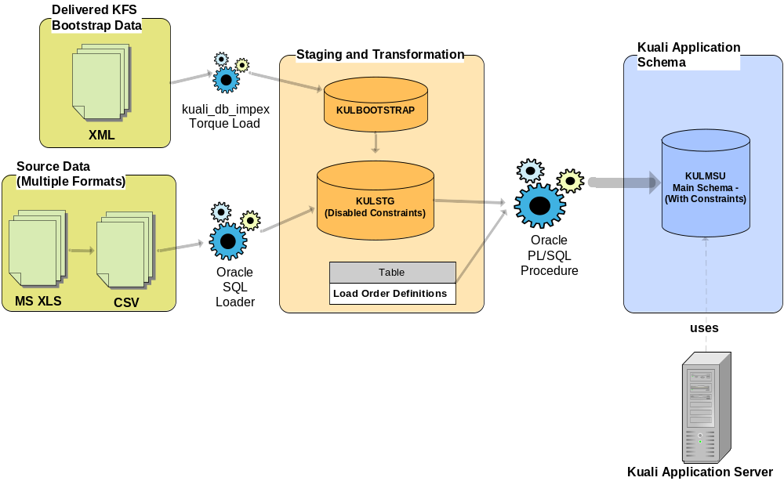
MSU Load Process

Slide 49
How did it go? (MSU)
Installation went well (some expected challenges)
  Performance issues initially but addressed by Foundation developers in 2.2 (significant improvement)
Referential integrity constraints helped ensure proper data load.
  MSU created Entity Relationship Diagrams (ERD) to help understand data model. Used both DB constraints and reverse-engineered OJB repository files to build ERD
Documentation continues to improve
Experience with installing prior releases and improving load process is making upgrades easier.

Slide 50
Next Steps for MSU
Prepare infrastructure for dev and test environments
Upgrade to KFS 2.2
Streamline upgrade process for future releases
Test KFS with standalone RICE KEW/Server
  Goal: central workflow server for KFS and KRA
Continue to identify gaps
MSU KFS implementation will likely be phased with P1 late summer 2009 and P2 following six months later
KRA First Release – Create first KRA sandbox

Slide 51
Recommendations
Start with kualitestdrive site (http://kualitestdrive.org/)
Begin with demo data and delivered configuration values
Technical and Functional staff collaboration is key
Analyze KFS and Rice data model. Focus on Chart/Org/GL modules before trying to build with bootstrap and institutional data
Create a sandbox environment and begin with minimal set of institutional data

Slide 52
Questions?
kualitestdrive@oncourse.iu.edu

