Slide 1
Wavelet and spectral analysis of heart sound for automated diagnosis of cardiac disorders

Slide 2
Contents
Introduction
Background Study
Objectives
Implementation
Data collection
Data processing
Features extraction
Result & Discussion
Future Works
References

Slide 3
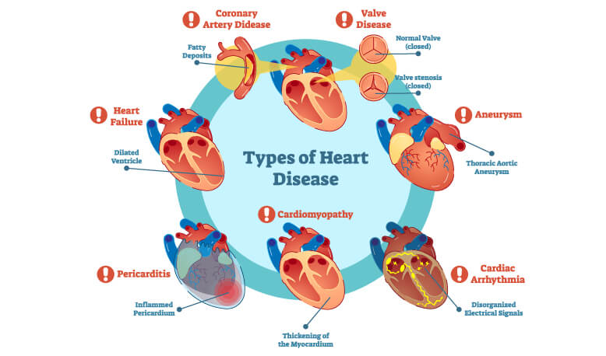
Introduction
Heart Disease Categories
Electrical
Atrial Fibrillation
Atrial Flutter
Sick Sinus Syndrome (SSS)
Sinus Tachycardia
Ventricular Tachycardia (VT)
Ventricular Fibrillation (VF)
Heart Block
Syncope
Circulatory
Heart Attack (Myocardial Infarction)
Stroke
Structural
Heart Failure
Heart Valve Problems

Slide 4
Background Study
papers | Findings
Blind Monaural Source Separation on Heart and Lung Sounds Based on Periodic-Coded Deep Auto encoder [1] | Proposed a novel periodicity-coded deep auto- encoder (PC-DAE) approach to separate mixed heart-lung sounds.
Detection and classification of abnormities of first heart sound using empirical wavelet transform [2] | Applied Empirical Wavelet Transform (EWT) to decompose S1 and extracted the instantaneous frequency (IF) of mitral component (M1) and tricuspid component (T1) by using Hilbert Transform.
Algorithms for automatic analysis and classification of heart sounds–a systematic review [3] | Provided an in-depth systematic review and critical analysis of all existing approaches for automatic identification and classification of heart sounds.
A noise reduction technique based on nonlinear kernel function for heart sound analysis [4] | Proposed a novel heart sound de-noising technique has been introduced based on a combined framework of wavelet packet transform (WPT) and singular value decomposition (SVD).
[1] Tsai, Kun-Hsi, Wei-Chien Wang, Chui-Hsuan Cheng, Chan-Yen Tsai, Jou-Kou Wang, Tzu-Hao Lin, Shih-Hau Fang, Li-Chin Chen, and Yu Tsao. "Blind Monaural Source Separation on Heart and Lung Sounds Based on Periodic-Coded Deep Autoencoder." IEEE Journal of Biomedical and Health Informatics 24, no. 11 (2020): 3203-3214.
[2] Li, Haixia, Yongfeng Ren, Guojun Zhang, Renxin Wang, Jiangong Cui, and Wendong Zhang. "Detection and classification of abnormities of first heart sound using empirical wavelet transform." IEEE Access 7 (2019): 139643-139652.
[3] Dwivedi, Amit Krishna, Syed Anas Imtiaz, and Esther Rodriguez-Villegas. "Algorithms for automatic analysis and classification of heart sounds–a systematic review." IEEE Access 7 (2018): 8316-8345.
[4] Mondal, Ashok, Ishan Saxena, Hong Tang, and Poulami Banerjee. "A noise reduction technique based on nonlinear kernel function for heart sound analysis." IEEE journal of biomedical and health informatics 22, no. 3 (2017): 775-784.

Slide 5
Objectives
Collect heart sound data from the person lives far from medical facility zone
Spectral analysis of heart sound
Wavelet analysis of heart sound
Find out whether a person healthy or unhealthy by his heart sound

Slide 6
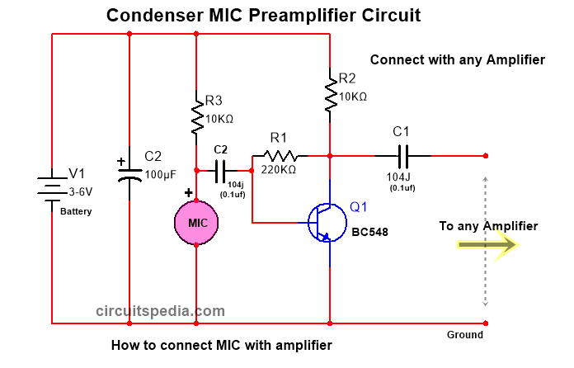
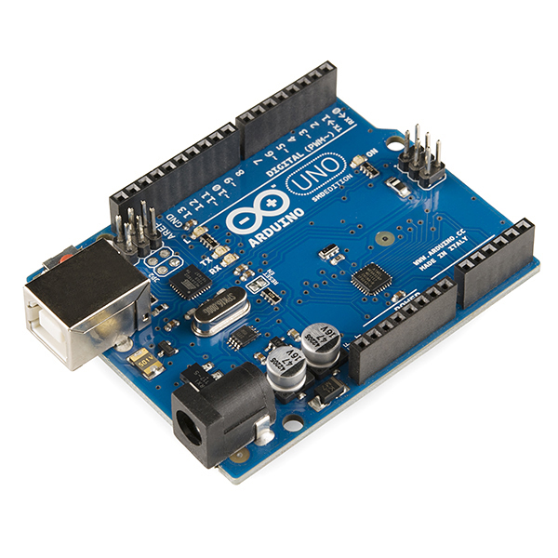
Data Acquisition
Used stethoscope combining with condenser microphone for acquiring data.
PLX-DAQ Tool: PLX-DAQ is an add-on data acquisition tool for Microsoft Excel for the Parallax microcontroller.
Arduino Uno is an open-source microcontroller board based on a microchip ATmega328P microcontroller developed by Arduino.
MATLAB is the high-performance technical computing language.

Slide 7
Data processing
Signal
This figure shows us the healthy and unhealthy subjects with comparison between them. Healthy person’s electrical signal shows much higher amplitude than unhealthy samples.
Healthy
Unhealthy

Slide 8
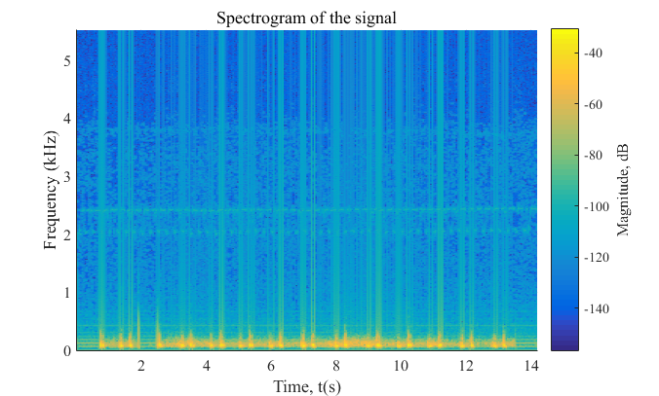
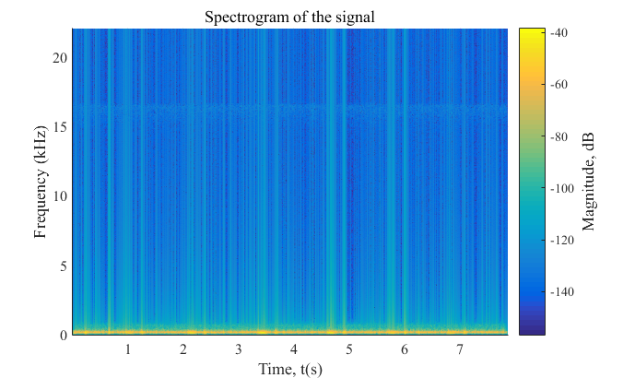
Data processing(Cont’d)
Spectrogram:
Spectrogram of heart sound recorded from healthy subjects.
Spectrogram of heart sounds recorded from unhealthy subject.
Figure shows the intensity of the frequency content of the signal and higher magnitude with constant variation as time progresses.
This figure is more consistent with magnitude and small in value. We have seen lower magnitude value all around the spectrogram. Clear indication of differences between these two figure is noticeable.

Slide 9
Data processing(Cont’d)
Normal distribution
Probability distribution of heart sound recorded from healthy subject.
Probability distribution of heart sound recorded from unhealthy subject.
The area that falls under the curve between two points on a probability distribution plot indicates the probability that a value will fall within that interval. Normal distribution here is determined by two parameters the mean and the variance of the signal. Mean and median here is zero. Most of the parameters falls in standard deviation +1 to -1 which is almost 68.26%. Density level is different for healthy and unhealthy subjects.

Slide 10
Data processing(Cont’d)
Mean Value Comparison
Figure shows the mean value comparison between healthy and unhealthy subjects. Recorded sound signal from healthy and unhealthy person shows wide variant of mean value. Although we have successfully found a threshold value ranges as isolation line between healthy and unhealthy subjects. Mean values variation is found due to different gender, age, body structure etc. So, when we collect the heart sound data through the data acquisition technique described earlier then by finding out the mean value of recorded sound signal we can tell whether the person is healthy or unhealthy.
Mean value of healthy and unhealthy subject.

Slide 11
Discrimination Table
Table: Range of Threshold to Separate Healthy and Unhealthy Heart Sounds for Automated Diagnosis of Cardiac Disorders.
Features | Max. value of unhealthy samples for threshold selection | Min value of Healthy samples for threshold selection | Range for threshold | Feature considered for separation of healthy and unhealthy heart sounds
Absolute mean: Signal Amplitude | 0.07 Yes | 0.09 | 0.07 to 0.09 | Yes
Energy of DWT | 2e-08 | 0.5e-05 | 2e-08 to 0.5e-05 | Yes
If a person’s heart sound signal absolute mean value is above 0.09 then the person is healthy and when it is below 0.07 then the person is unhealthy. If energy of a frequency band of a signal is below 2e-08 the person is unhealthy when it is above 0.5e-05 the person is healthy.

Slide 12
Detailed coefficient for healthy and unhealthy subject
De-noised detailed coefficient using sym4 level4 of healthy subject.
De-noised detailed coefficient using sym4 level4 of unhealthy subject.
Firstly healthy heart sound signal is made noise free using symlet wavelet family. This de-noised signal’s detailed coefficient is shown above.
Unhealthy heart sound sample is de-noised, then using symlet wavelet family we can have different decomposition level de-noised heart sound signal ready to be analyzed further. Detailed coefficient is determined here.
Figure 4.13. De-noised detailed coefficient using sym4 level4 of unhealthy subject.

Slide 13
Approximation coefficient of healthy and unhealthy subject
De-noised approx. coefficient using sym4 level4 of healthy subject.
De-noised approx. coefficient using sym4 level4 of unhealthy subject.
Approximation coefficient of heart sound signal is used for differentiating between healthy and unhealthy subject. Symlet level 4 decomposition is shown here.
Unhealthy heart sound sample is de-noised, then using symlet wavelet family we can have different decomposition level de-noised heart sound signal ready to be analyzed further. Detailed coefficient is determined here.
Figure 4.19. De-noised approximation coefficient using sym4 level4 of unhealthy subject.

Slide 14
Detailed coefficient changes with different decomposition level
4 Level of wavelet coefficient before de-noising:
4 Level of wavelet coefficient after de-noising:
Detailed Coefficient before de-noising the signal of healthy subject.
Detailed coefficient after de-noising the signal of healthy subject.

Slide 15
Energy of DWT co-efficient
Zoomed version of unhealthy subjects:
:
Wavelet energy provides information on the relative energy associated with different frequency bands and can be regarded as the density of the time scale. Healthy signals energy is much higher than unhealthy samples. So, wavelet energy of a signal is discriminatory enough to tell us is the desired sample healthy or unhealthy. Zoomed version of energy of DWT wavelet coefficient is also shown above.

Slide 16
Result and Discussion
The results of the experiment showed adequate discrimination between the characteristics of heart sounds for automatic screening of cardiac problems using signal processing from healthy/unhealthy heart sounds.
Mean Threshold level is found about (0.06-0.09). Above this threshold value the subject is considered as healthy and below the threshold value is that is unhealthy subject.
To derive discriminatory features from wavelet heart sound coefficients, the heart sound signal was converted into the wavelet domain.

Slide 17
Future Work
An IOT based system can be improved so that the data collected from far area can easily transferred to the server to do the analysis. Then update information about the health condition could be supplied to a person. If we found any abnormality we can check it earlier before it’s getting worse.
Artificial intelligence can also be used is this sector for better output and discriminatory features.
Machine learning can also be used for accurate diagnosis of cardiac diseases from heart sound.
Many transform technique can be used for further extraction of different features in the biomedical field.

Slide 18
THE END

