Slide 1
BOOST
By
Ahmad Awan

Slide 2
WHAT IS IT?
A set of libraries.
Eighty individual Libraries.
Can be used with both free and proprietary software projects.
Useful for any C++ developer.

Slide 3
WHAT CAN IT DO
provide support for:
Multithreading
Image processing
Regular expressions
Unit testing
Linear Algebra
Number generation

Slide 4
WHY YOU SHOULD CONSIDER
Provide wide range of support.
Many of Boost's founders are on the C++ standards committee.
Several libraries have been incorporated into C++11 standard.

Slide 5
C++ 11
Smart pointers
Tuples
Threads
Regex

Slide 6
C+++ 18
A file system library based on boost::filesystem

Slide 7
Installation
Link: https://www.boost.org/users/download/
UNIX:
tar --bzip2 -xf /path/to/boost_1_66_0.tar.bz2 tar --gz -xf /path/to/boost_1_66_0.tar.gz
cd path/to/boost_1_66_0
./bootstrap.sh
./b2 install

Slide 8
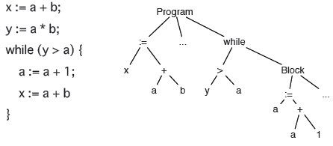
Parsing
Parsing is the problem of transforming a linear sequence of characters into a syntax tree.
more easily interpreted, managed, or transmitted by a computer.

