Slide 1
Demistifying Hacking

Slide 2
PRELUDE
The species with the more advance technology wipes out the inferior one.
Wars were once won with most advance weapons technology.
World War II was won by intelligence and computers.
Alan Turing broke the Enigma Code and allowed the British to decode all secret German communication.
His work shortened the war by more than two years and saved over millions of lives.

Slide 3
WHAT IS HACKING
To modify (a computer program or electronic device) or write (a program) in a skillful or clever way.
Dictionary.com
To circumvent security and break into (a network, computer, file, etc.), usually with malicios intent.
Dictionary.com

Slide 4
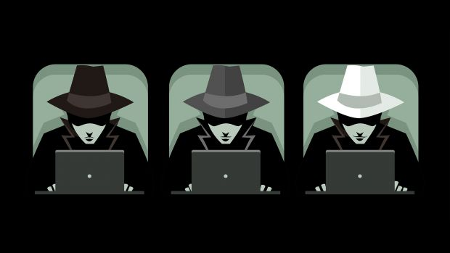
ETHICS
White Hat.
Black/Red Hat.
Grey Hat.

Slide 5
WHITE HAT HACKERS
Use their knowledge for good.
Inform companies of security flaws.
Usually hired by companies to check vulnarabilities.
Are awarded prizes or “bounty”.

Slide 6
BLACK HAT HACKER
Use their knowledge for evil or personal gain.
Focused on by news and social media.
Finds zero-day exploits or other security hole.
Illegal use for other systems.

Slide 7
GREY HAT HACKERS
Between a black hat and a white hat.
Find security flaws and may inform others.
Might not ask the organization for permission which is illegal.
May inform the organization secretely or publicly.

Slide 8
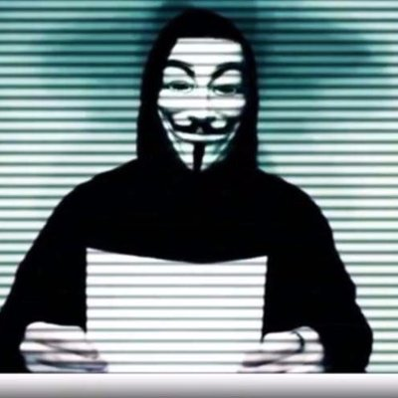
EXAMPLE

Slide 9
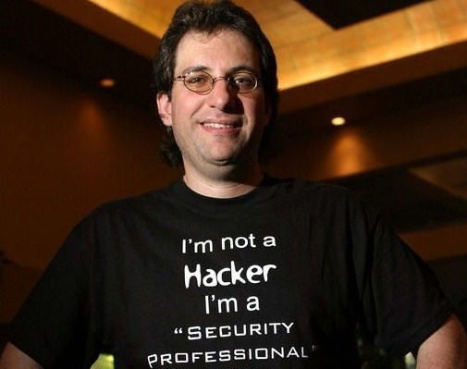
EXAMPLE
Kevin Mitnick, most notorious hacker.
High-profile 1995 arrest and later five years in prison, and in Solitary Confinement.
Allegedly, the Judge was convinced that Mitnick could start a nuclear war by whistling into a pay phone.

Slide 10
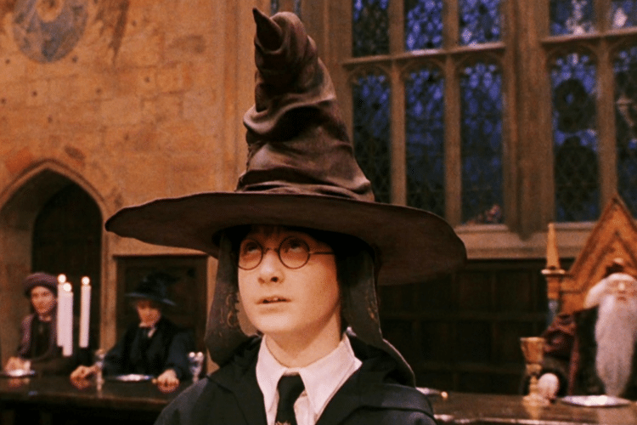
Example

Slide 11
POPULARIZED HACKING
Hollywood popularized hackers.
A few key strokes and they are in.
Can gain access to a nuclear power plant or a secure military or company network in a few minutes.
Every computer user knows how to hack.

Slide 12
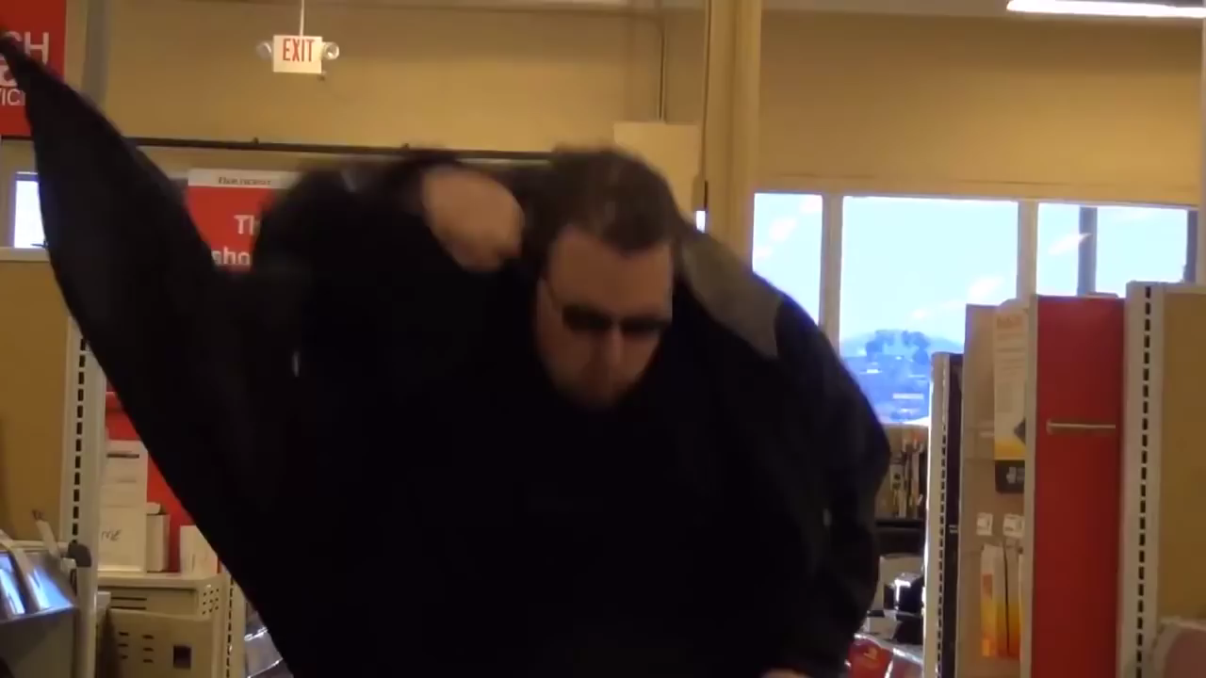

Slide 13
WHAT ACTUALLY HAPPENS
Sitting. Checking. Waiting. Thinking.
Hackers can be also called security experts.
Indepth knowledge needed on the target.
Can take hours.

Slide 14
COMMON HACKS
Keylogger.
Denial of Service (DoS\DDoS).
Phishing.
Virus\Trojan.
Social Engineering.
Eavesdropping

Slide 15
KEY LOGGERS
Listen and record each and every key stroke.
Send the record to an email after a specified time.
Maybe visible in task manager but may assume the name of a system task such as “svchost.exe”.

Slide 16
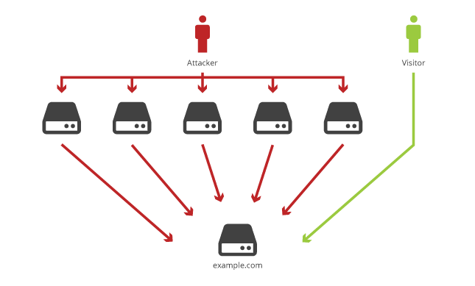
DENIAL OF SERVICE
Not a hack but is harmful.
Simple premise.
Send so many request to the server to overwhelm it.

Slide 17
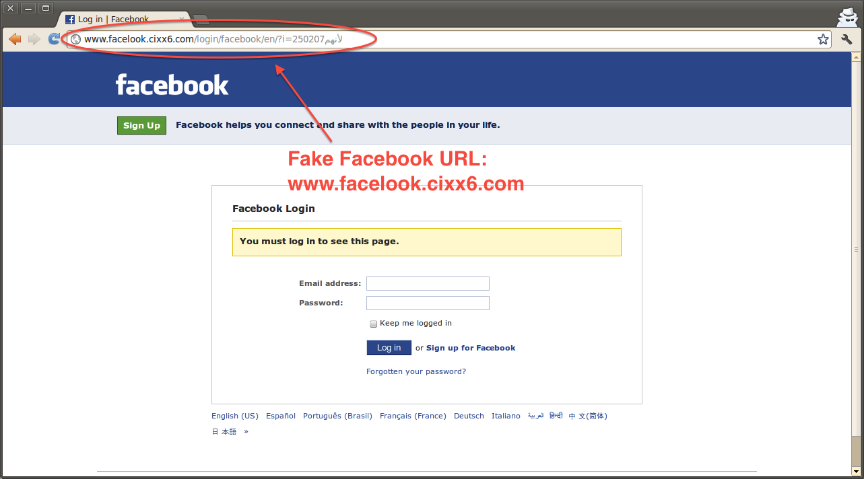
PHISHING

Slide 18
SOCIAL ENGINEERING
The biggest flaw in any system is the human aspect.
Security can be made stronger but humans are still stupid.
Social engineering included phishing attacks, rubber duckies or baiting.
Even the Africian officer offering you a million dollars email is a crafty social engineering attack.

Slide 19
WORMS
Self replicating virus.
Uses a computer network or emails to spread.
Does nothing but take up resources.
ILOVEYOU virus costed about $15 billion dollars in damages.
In 1999, Melissa virus caused $1.2 billion in damages.

Slide 20
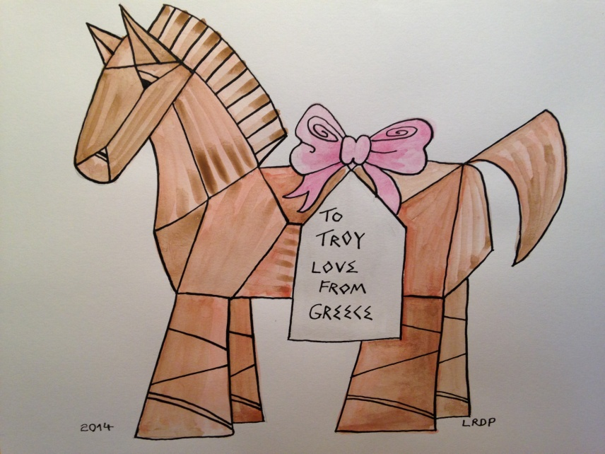
TROJAN
Just as Troy fell for the fake wooden horse.
Trojan virus are programs that hide their true purpose.
May install backdoor or ransomeware.
Gives access to affected
computer.
Do not self spread

Slide 21
RANSOMWARE
A virus that encrypts certain random documents.
Will decrypt or provide key if a payment is made.
Bitcoin is being used as a payment currency
Typically carried out using a Trojan.
In 2017, Wannacry affected more than 200,000 computers across 150 countries, with total damages ranging from hundreds of millions to billions of dollars.

Slide 22
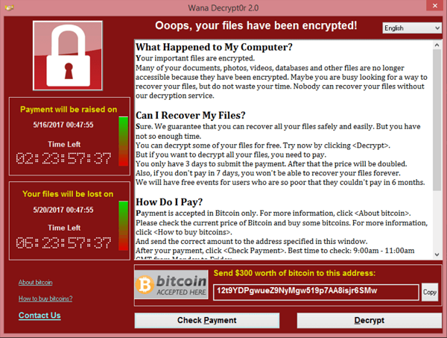

Slide 23
EAVESDROPPING
Key logger is similar eavesdropping.
Packet sniffing and fake open wifi networks are used.
Even real public wifi such as in restaurants can be eavesdropped.
The traffic and its contents are read.
Login credentials and banking info can be stolen.

Slide 24

SQL Injection
Website did not prepare for sql attack
Inserting a partial sql command in an input field can change the result.
Putting a comment in the input field can be used.

Slide 25
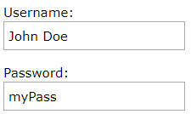
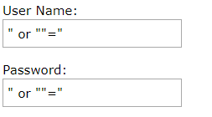

Slide 26
MySQL comment is double dash - -
If the input field is
We can insert another query of our own after the inverted comma and before the semicolon.
Union will be used for the new query.
‘ ; --

Slide 27
PREVENTION
Passwords.
Browsing.
In Real Life.

Slide 28
PASSWORDS
Almost all passwords are bad which includes all of us.
Adding a number or symbol wont magically secure them.
Why are most password bad?
Because the bases for secure passwords are mostly outdated.
Most passwords can be broken by dictionary attacks or brute force using AirCrack.

Slide 29
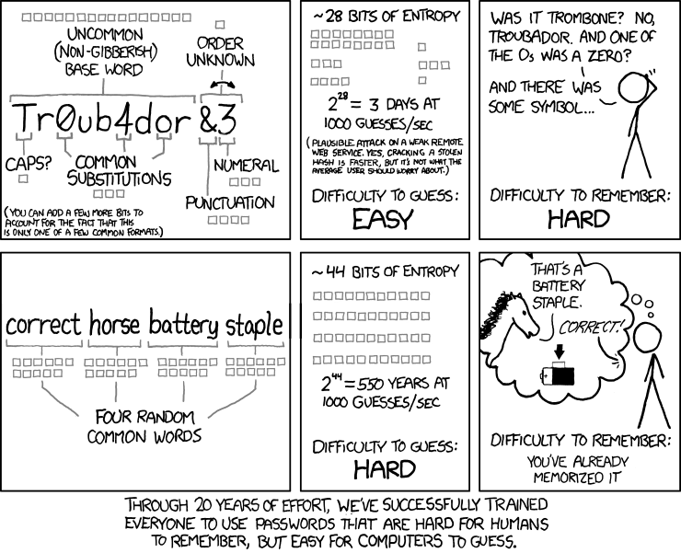

Slide 30
Passwords should never be saved as a plain text in the database.
A hashing algorithm should be applied.
A salting technique can increase security.

Slide 31
BROWSING
DO NOT give away any info online
Do NOT visit unknown sites.
Do NOT download from unknown sites.
Do NOT click the “free ipad banner”.
DO check file to be downloaded.
DO check if the download button takes you do another site by hovering.

Slide 32
IN REAL LIFE
Do NOT use disk given to you by a stranger.
Do NOT pick up a stray usb stick.
Do NOT give away your login info even to call agents.

Slide 33
WHY DO HACKS HAPPEN?
Because of security exploits or holes.
Code injection can occur due to buffer overflow or other attacks.
One person was able to change the game Super Mario Bros to Flappy Bird using code injection and various vulnerabilities in the game code.

Slide 34
ZERO DAY EXPLOIT
A weakness in a system.
Allows a virus to control the machine undetected.
Its called zero day because 0 days have been spent on fixing the security flaw.
They are extremely rare.
A zero day can be sould on the black market for hundreds of thousands of dollars.
One zero day is enough to affect millions of machines.

Slide 35
THREAT
US Government publishes a document called the “World Threat Assessment”.
In 2007 report, cyber warefare wasn’t included.
In 2011, cyber warefare was at the bottom on the list.
From 2013, cyber warefare was the top threat.

Slide 36
STORY TIME
STUXNET: The Worlds First Digital Weapon
Experts called it the greatest rootkit ever created.
Affected computers in almost every country.
STUXNET had seven methods of spreading.
It is unheard of a virus having more than one zero day. STUXNET had four different zero days.
Amount of money spent meant that only a powerful organization was behind it.

Slide 37
It did nothing, stayed dormant.
Its target: NATANZ Uranium Enrichment Plant in Iran. Their PLC units and centrifuges.
After infecting the target, it was recording data from centrifuge for 13 days.
Afterwards, STUXNET increased and decreased the centrifge speed for 15 minutes each.
It used to recorded data to override the output data so it would seem that nothings wrong.

Slide 38
Even disabled the manual emergency off switch.
The spin speed would be changed every 27 days.
It destroyed over a thousand centrifuges.
Anonymous NSA sources, confirmed that “Olympic Games”, was a multimillion dollar joint effort by the NSA, GCHQ in UK and UNIT 8200 in Israel.

