Slide 1
PASSWORDS

Slide 2
ALL YOUR PASSWORDS ARE BAD

Slide 3
PASSWORDS
Combination of characters:
Letters
Numbers
Symbols
Their job is to protect something, give access only to authorized users.

Slide 4
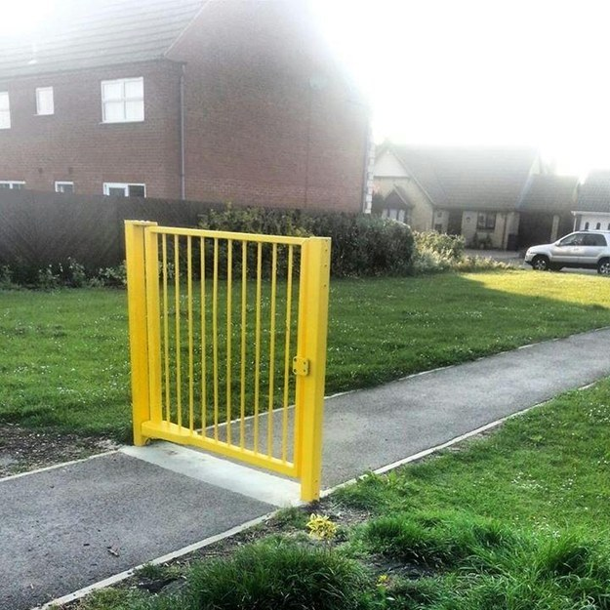

Slide 5
POPULAR PASSWORDS
Birthday date
12345678
87654321
qwerty
password
1password

Slide 6
THESE ARE ALL BAD

Slide 7
WHYYYYYY?

Slide 8
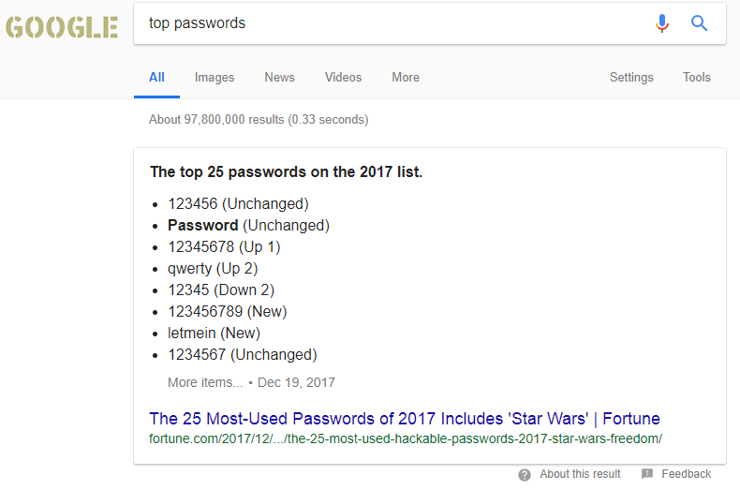

Slide 9
PROBLEMS
Too popular.
Too common.
Too simple.
Five second passwords.

Slide 10
POSSIBLE SOLUTIONS
Make it longer.
More numbers.
Add symbols
Maybe swap characters
Maybe change letters to similar numbers or symbols.

Slide 11
PROBLEM WITH SOLUTION
Longer passwords are hard to remember.
Symbols or numbers may be forgotten.
Swaps may be harder to remember.
1337 SPEAK

Slide 12
COMMON THEME?

Slide 13
I FORGOT

Slide 14
HOW DOES A COMPUTER GUESS MY PASSWORD?

Slide 15
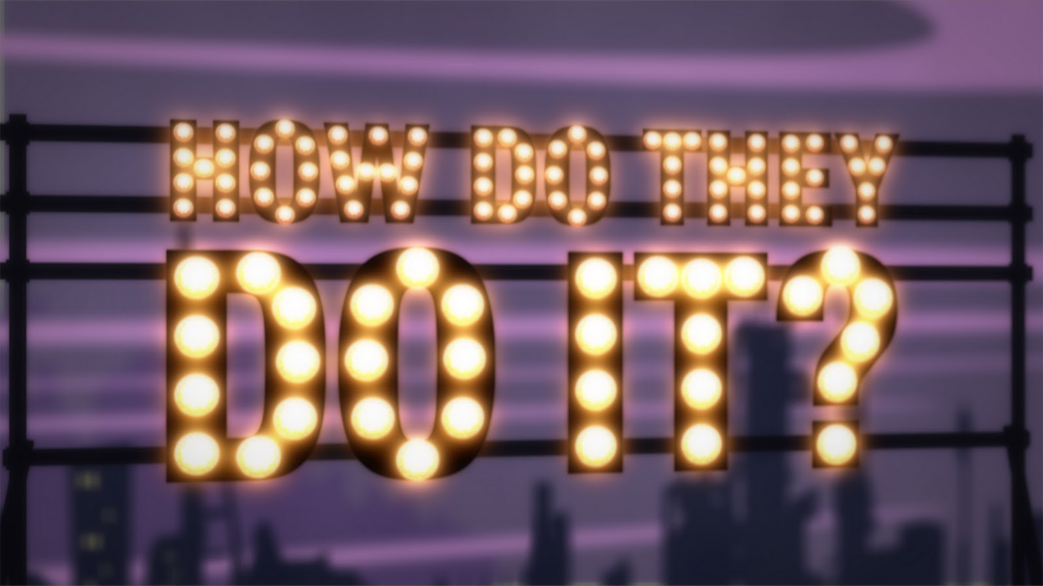

Slide 16
1 GigaHerz Means they can do 10^9 or 1 BILLION calculations per second.
They guess your passwords one by one.
They have a list of passwords to check against.
Even your 4 digit pin code is a chew toy for computers.

Slide 17
1 GigaHerz Means they can do 10^9 or 1 BILLION calculations per second.
They guess your passwords one by one.
They have a list of passwords to check against.
Even your 4 digit pin code is a chew toy for computers.
https://howsecureismypassword.net/

Slide 18
WHY ARE PASSWORDS STILL WEAK?
People don’t care about their passwords.
“I AM RIGHT. YOU ARE WRONG”.

Slide 19
HOW DO I KNOW?

Slide 20
“BEST” KOREA HAD AN OOPSIE
Their version of Facebook was hacked by teenagers.
They forgot to change their default password.

Slide 21
SO WHAT DID WE LEARN?

Slide 22
Almost all your passwords are bad.
People don’t think about their passwords.
People don’t see the threat.
Even if you have nothing, it is still troubling.
People tend to forget.

Slide 23
LETS TRY TO FIX THAT

Slide 24
FIX?
Longer passwords are the key.
But people forget.

Slide 25
SOLUTION
More meaningful passwords.
OR a passphrase
Even 3-4 random words joined together is a long password.
And easy to remember.

Slide 26
OTHER SOLUTIONS?
Use passphrase generation techniques like Diceware.
Even Google “Passphrase generator”.
https://www.useapassphrase.com/
correcthorsebatterystaple is a better password than Tr0ub4dor&3.
But again, its too popular, but you get the point.

Slide 27
BUT BUT BUT BUT BUT BUT BUT BUT

Slide 28
I OWN A WEBSITE. WHAT IF I AM HACKED AND THEY GET MY DATABASE.

Slide 29
YOU SHOULD HAVE ATTENDED MY LAST PRESENTATION

Slide 30
ARE YOU STORING PLAIN TEXT PASSWORDS?

Slide 31
BUT I STILL HAVE GOOD NEW FOR YOU

Slide 32
HASHING

Slide 33
Hashing is a one way algorithm.
Techniques like SHA256, MD5
It converts a password to a particular string.
You can’t get a password from a hash.
You need the password to get the hash.
If you store the hashes, you don’t have the passwords.
NO ONE CAN STEAL THEM

Slide 34
BUUUUUUUT
Since people are negligent.
AND hashing always gives a particular string.
People will use the popular passwords.
AND people have made a list of the hashes of all those popular passwods.

Slide 35
SOLUTION

Slide 36
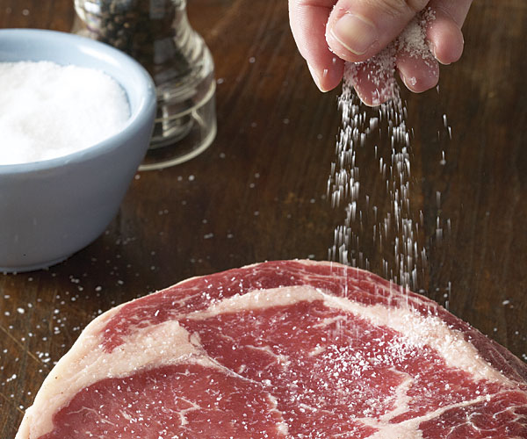

Slide 37
SALTING
Add salt to the meat so it lasts longer.
We add randomness to passwords.
Like adding 1@a to the start and end of a password before hashing. Everyone is using it.

Slide 38
WAIT, IT WORKS?

Slide 39
YES

Slide 40
HOW?
Since salts are random, everyone has their own special salt.
Unless the attacker knows the salt, he can’t ever guess it.
Even if I gave him my password and the hash function, without the salt, it’s a different password.

Slide 41
EXAMPLE 256HASH
PASSWORD
HASH
password
5e884898da28047151d0e56f8dc6292773603d0d6aabbdd62a11ef721d1542d8
1@apassword1@a
fcd402a1ebef92720c47d37da0e63bd81e5d1976b5a2e26b3bb8138c87d72486

Slide 42
I MADE THIS PRESENTATION ALL BY MYSELF

Slide 43
WHY?

Slide 44
Internet of Things are becoming a pain to deal with

Slide 45
IoT
Are IoT’s getting worse.
Probably Not.
Soooo What’s WRONG…
They are increasing.
More ways to get into our life.
More ways to mess with our lives.

Slide 46
TIP BEFORE YOU GO
Rethink you passwords.
Change your router login password.
Change your online webcam login passwords.

