Slide 1
Discriminant Analysis, Classification and Regression Trees, and Indicator Species Analysis
Jacob Weverka (with major help from the UMASS Landscape Ecology Lab)

Slide 2
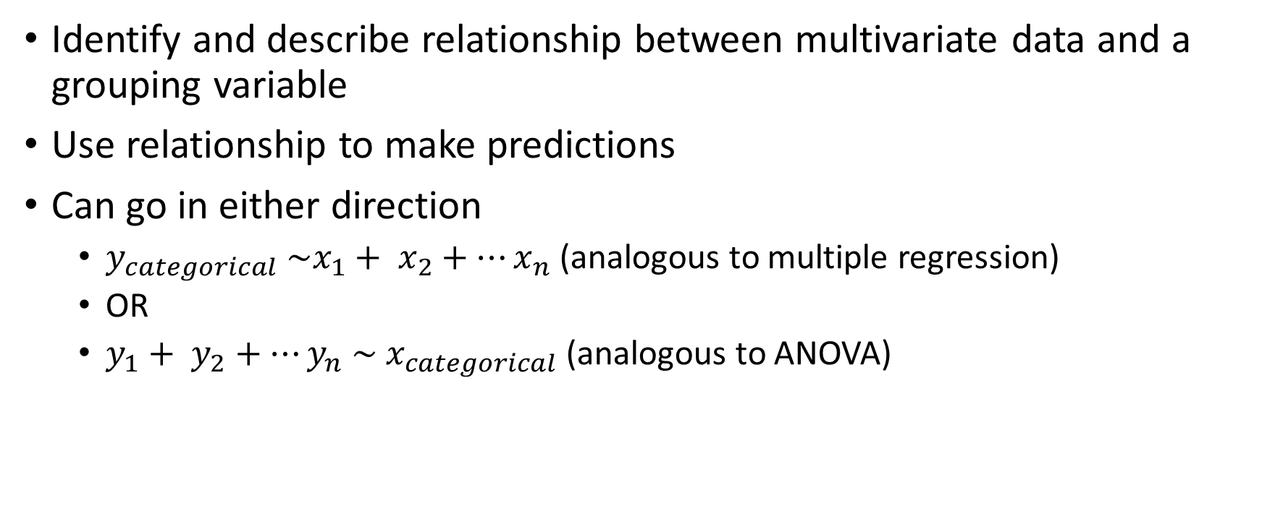
Discriminant Analysis

Slide 3
Can I use DA?
1 categorical variable and 2 or more discriminating variables (continuous, categorical, or count)
Groups must be mutually exclusive
No missing data
Don’t need equal sample size, but similar size is preferable
At least 2 samples per group, and at least 2 more samples than number of variables

Slide 4
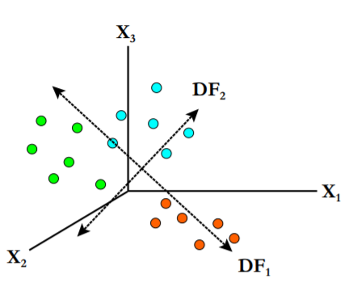
Canonical Analysis of Discriminance
Objective: test and describe difference between 2 or more pre-defined groups using 2 or more discriminating variables
Method: Create linear combinations of discriminating variables that best distinguish between groups (canonical functions)
Each sample gets a ‘canonical score’ for each axis
Each group has a centroid of canonical scores
Look for separation between groups
Ideally look for ecological interpretation

Slide 5
Classification
Use canonical functions to classify samples
Several parametric and non-parametric methods
Parametric
Linear discriminant functions (LDA) – assumes equal multivariate normal distributions for all groups
Quadratic discriminant functions – assumes unequal multivariate normal distribution for all groups
Non-parametric
Kernal – estimate group-specific densities and classify using highest local density
K nearest neighbor – classifies by using groups based on which has the nearest neighbor

Slide 6
DA Assumptions
Inferential use of DA requires assumptions
Equal variance-covariance matrices between groups
Look for univariate variance homogeneity for discriminating variables (e.g. Fligner-Killeen nonparametric), visually inspect
Multivariate normality within groups
Look for univariate normality in groups, try a multivariate normality test (e.g Energy test)
Collinearity & Multicollinearity: No 2 variables are perfectly correlated, no variable can be calculated by combination of other variables
If assumption broken, drop one of the variables from the analysis
Samples are independent

Slide 7
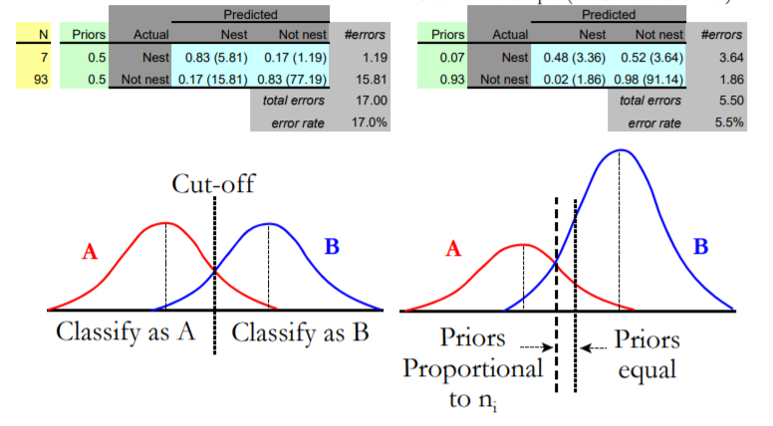
DA Assumptions Continued
Prior probabilities of group membership identifiable
Not necessarily equal
Linearity – variables change linearly along gradients

Slide 8
If Assumptions are Violated
Procedure is moderately robust to violations
Calculate canonical functions – do they have ecological meaning?
Try nonparametric methods or CART (see later)
Variable Selection for DA
If you have to many discriminators or are trying to identify the most useful from a large set of discriminators
Forward variable selection using variable that minimizes Wilk’s lambda statistic

Slide 9
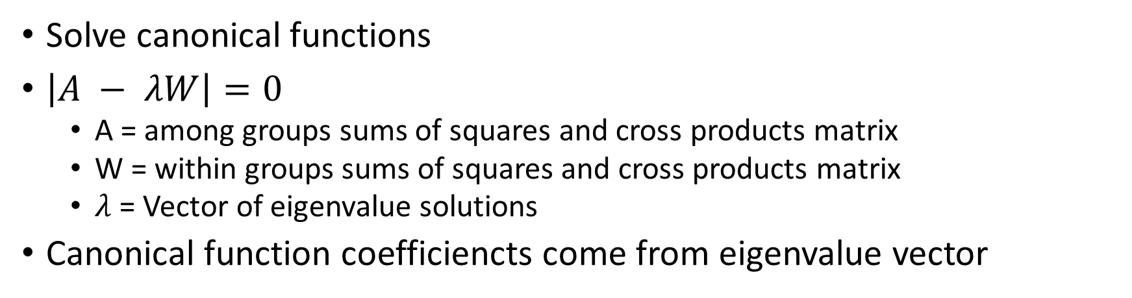
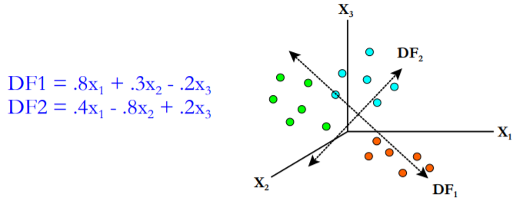
How it works

Slide 10
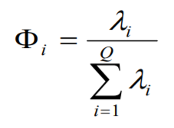
Assessing Canonical Functions Importance
Is a canonical function significant, and how many should be used?
Multiple methods
Relative percent variance
Relative value of coefficients
Shows how much variation is associated with each axis
Canonical Correlation
Correlate canonical functions to groups
Significance test
Graph and evaluate
Test classification accuracy (chance-corrected)
Are they ecologically interpretable?

Slide 11
Interpreting Canonical Functions
Multiple methods
Standardized canonical scores
Weights of standardized variables, use to describe variable importance
Total Structure coefficients
Correlation between variable and canonical functions
Covariance controlled partial F
Ranks partial F ratios of all variable contribution to model
Potency index
% of discriminating power of retained canonical functions associated with each variable

Slide 12
Canonical function validation
Results only reliable if mean and dispersion estimates are also reliable (larger sample size is preferable)
Split-sample validation
Training and testing datasets
How well does model from training dataset fit results from testing dataset?

Slide 13
Other DA considerations
Different philosophies on interpreting canonical functions – performance measures vs. ecological meaning
Validation of model is important
May be limited by parametric assumptions

Slide 14
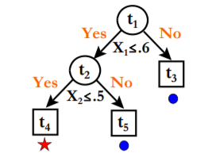
Classification and Regression Trees (CART)
Nonparametric procedure for description of data
Recursive partitioning of data into smaller groups
Can take numeric and categorical variable
Can handle missing data, robust to outliers
Good for non-homogenous relationships, complex data, mixed data
Relatively interpretable
Automatic variable selection

Slide 15
CART Elements
A set of questions: is x_{m} > c
Or linear combinations of continuous variable/Boolean combinations of categorical variables
A rule for selecting best split at a node
A rule for the size of the tree (when to stop splitting)

Slide 16
How it works
At each node, calculate the best split point for each potential variable
Choose the variable with the best split
Continue doing this for each node until every node is terminal

Slide 17
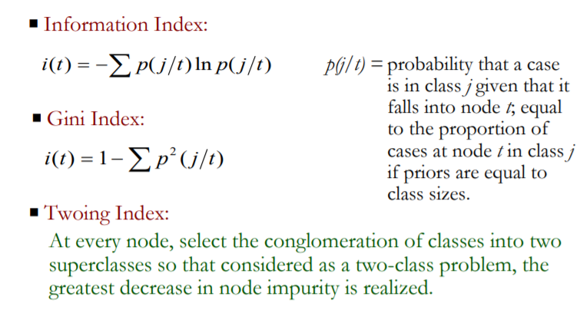
Splitting Criteria
Node impurity: mixing of classes within a node
At each node, select split that reduces impurity the most
If regression tree, minimize variance
Can also specify prior probabilities for each class, which affect the tree’s classification
Or misclassification cost

Slide 18
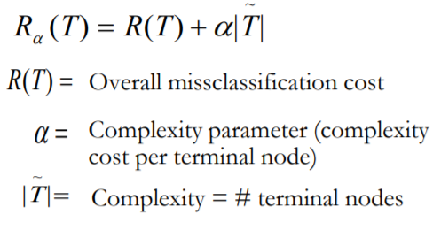
How big to make a tree?
More splits = better fit
More splits = greater risk of overfitting
Method – grow tree to largest extent possible, then prune back to an appropriate size
V-fold cross validation
Divide data into V subsets, drop each subset and make a tree on remaining data, validate on dropped subset
Tree with minimum estimated error rate chosen
Smallest tree within 1 SE of minimum error rate

Slide 19
CART Variable Importance
Measured by sum of decrease in impurity cause by variable at each node
Mainly reported as relative magnitude

Slide 20
Random Forest
Machine Learning method based on CART
Bootstrap approach containing several CARTs
Each tree built on 2/3 of data
Random subset of explanatory variables tried at each node
No pruning
Classification error rate for each tree determined by making prediction for “out-of-bag” sample
RF prediction determined by prediction of majority of trees

Slide 21
Random Forest – variable importance
Determined by permuting each variable and measuring increase in prediction error
Higher increase in error = more important variable
Or determine by mean decrease in impurity for each variable
Otherwise RF is a bit of a black box

Slide 22
CART Limitations and Considerations
Could be computationally complex
May bias toward variables with more possible splits
Results not based on underlying theoretical model
Blessing and a curse

Slide 23
Indicator Species Analysis
Nonparametric procedure for distinguishing groups based on species compositional data
Compute index of relative abundance of a species within each group
Compute relative frequency of a species within each group
Indicator value is product of these two numbers
Indicator value of 1 = perfect indicator, 0 = not an indicator

