Slide 2
Two main ways to treat stable isotopes
Trophic position: How high on the food chain?
Niche space: What resources are they using?

Slide 3
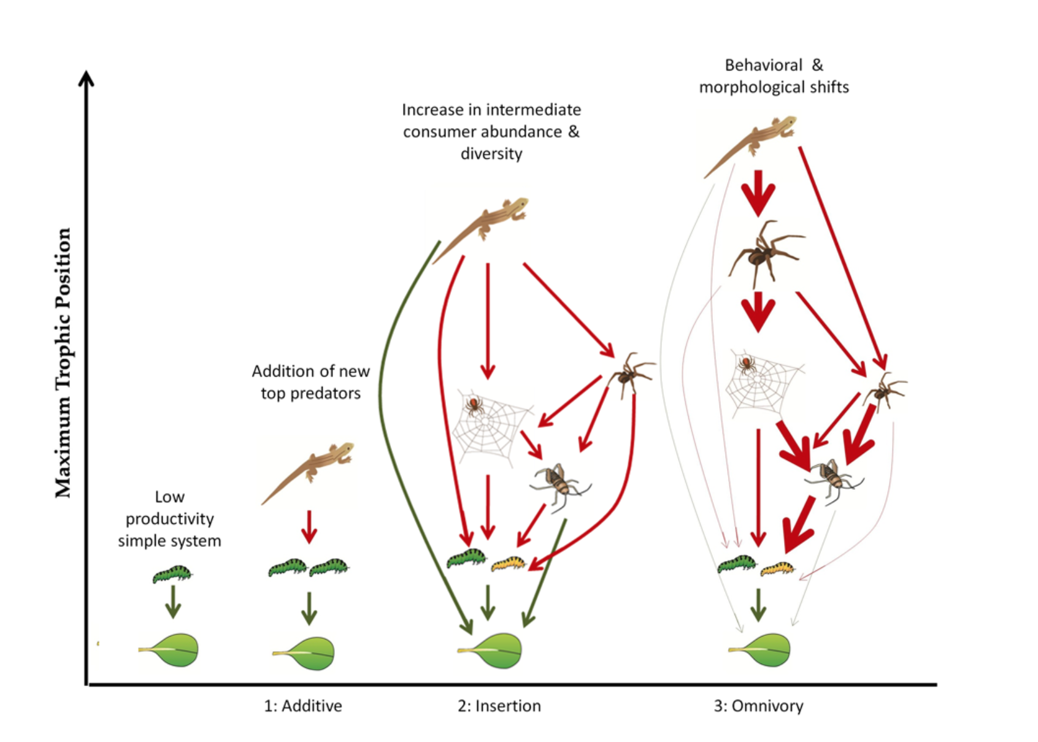
How high on the food chain?

Slide 4
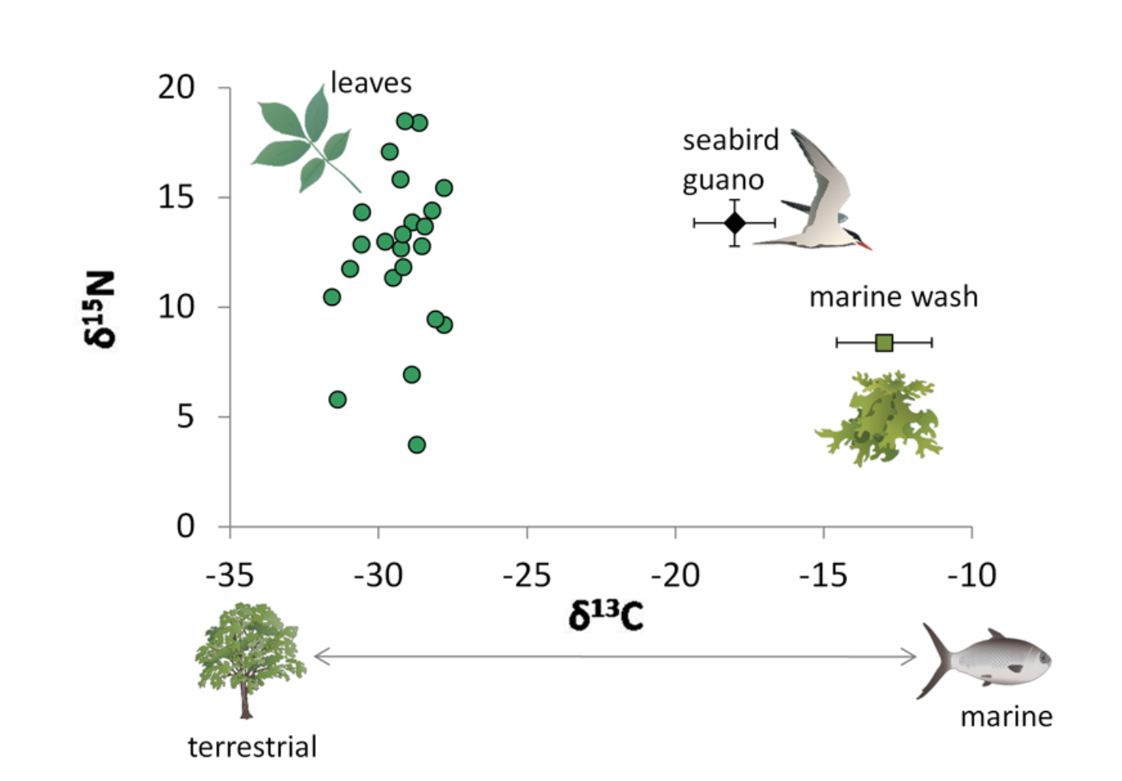
Where are resources coming from?

Slide 5
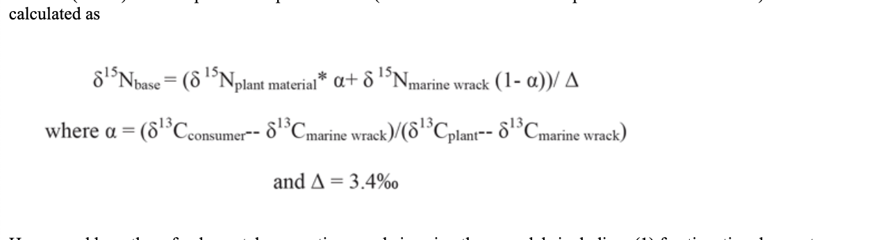
MATH for trophic position

Slide 6
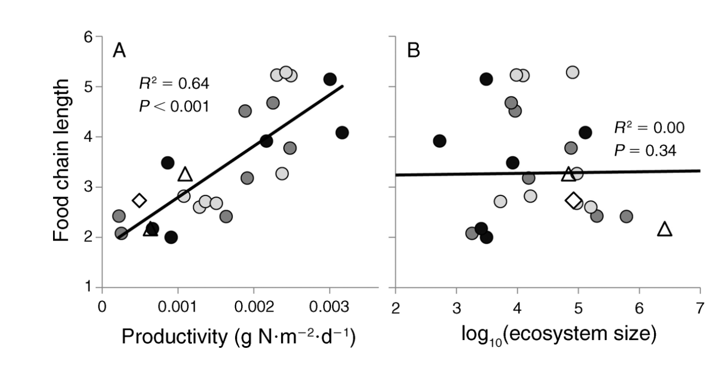
Trophic position varies by island on Palmyra

Slide 7
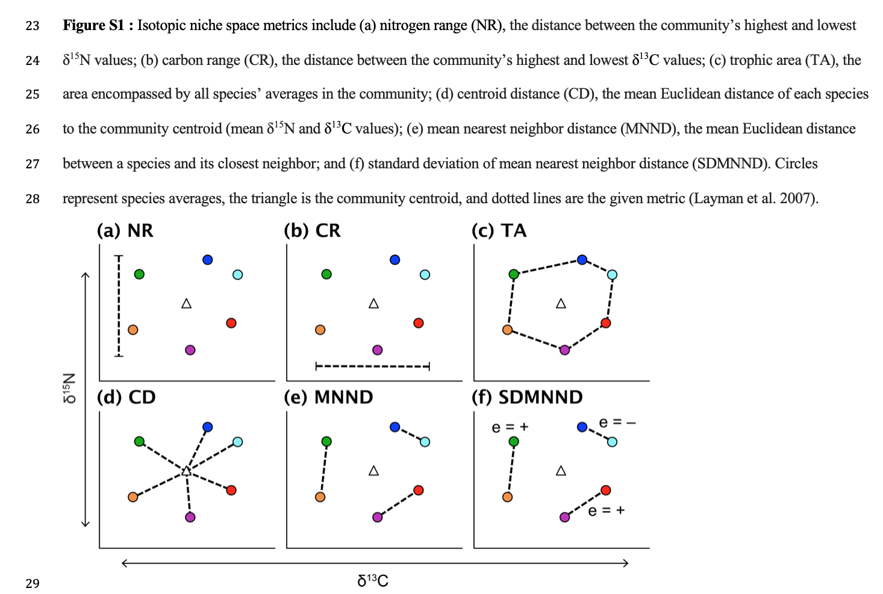
What resources are they using?

Slide 8
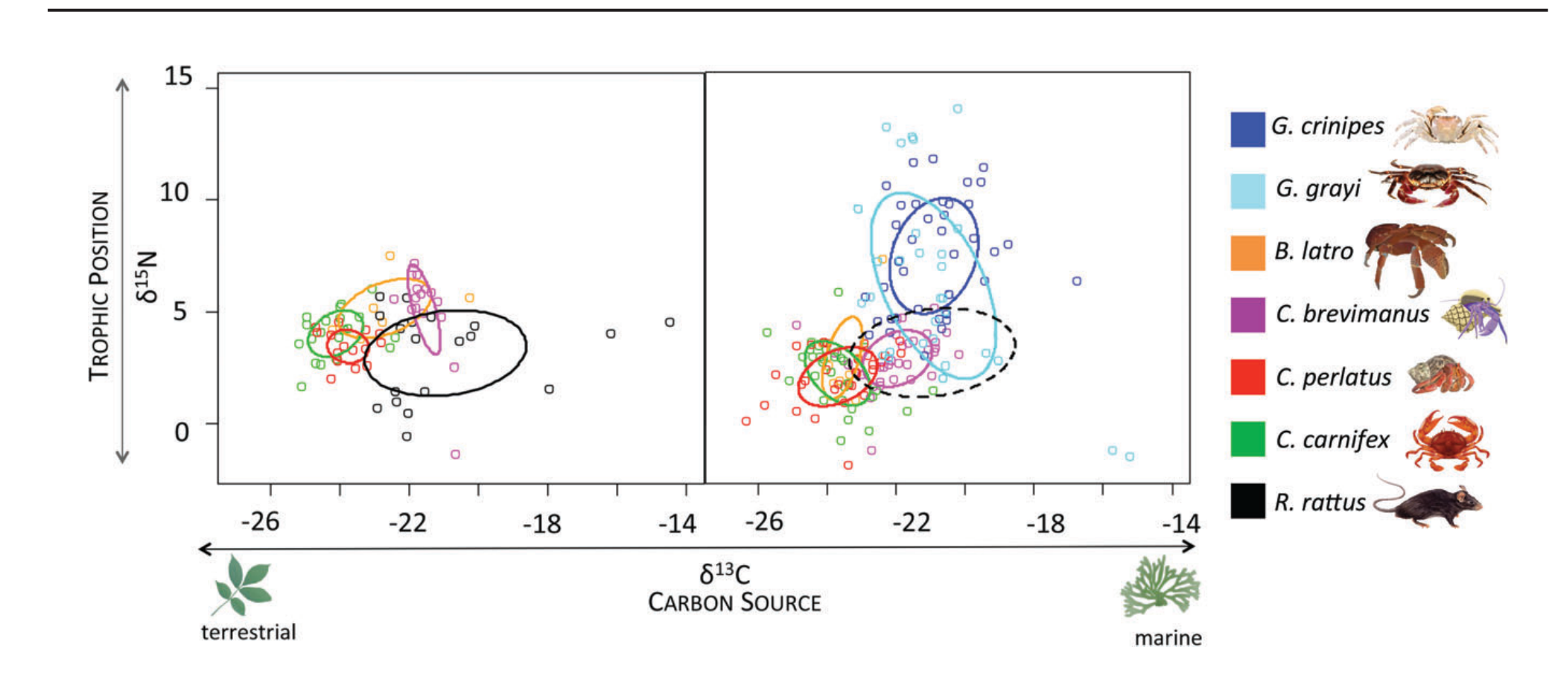
Niche space of crabs on Palmyra

Slide 9

DNA metabarcoding
Bead cleaned DNA @ 10 ng/uL
COI Primer +
Illumina Tag
PCR1:
Bead cleaned PCR1 (0.8x)
Tag + Index + P5/P7
PCR2:
Pooled at 5nM
Bead cleaned PCR2 (0.7x)
PCR2 Product:

Slide 10
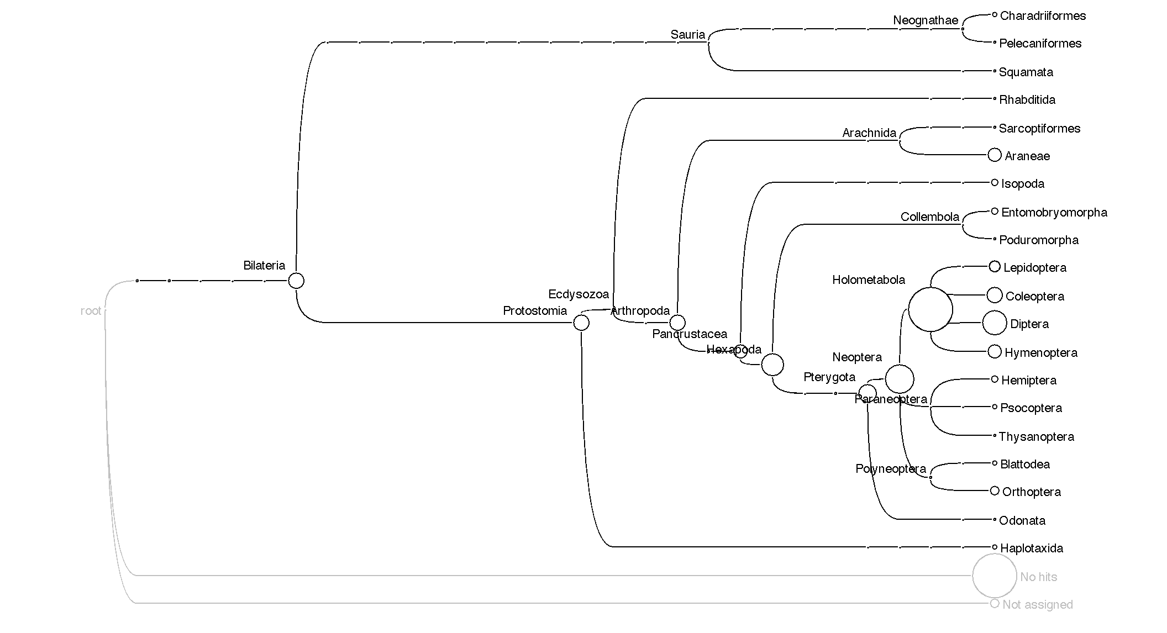
Taxonomic tree

