Slide 1
CG Invader
Team 낙지탕탕이 (Korean Traditional Food)

Slide 2
Overview
About the feature of game
Story
Game play
Implementation
Structure
In game play

Slide 3
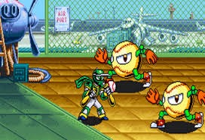
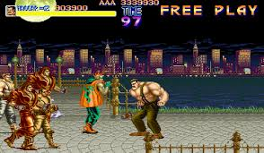
Objective
Imitating the existing retro game with a simple story
Therefore, character vs character fight was included in original plan
<1993. Ninja Baseball Bat man
, Irem>
<1989. Final Fight, Capcom>

Slide 4
Game - Stage
There exist stage 0 and stage 1
Stage 0 stays for simple intro story
In stage 1 real game playing precedes – popping bubble
Score is decided by timer in stage 1

Slide 5
Game - story
Episode 0
CG Invader
The 4th grade student, who want to graduate in 2020, came to CG class after hearing some rumors …

Slide 6
Implementation - Structure
primitives
quad.h
circle.h
wall.h
light.h
texture.h
player, creatures,
background, map
(initialize, update, render)
irrKlang.h
game_object.h
simple_math.h
Functions for interaction between game objects
game_level.h
text.cpp
state_render.h
Game stage, game condition, control
main

Slide 7



Implementation – In Game Play
Animation of character
The textures of character change within characters states, that are wait, move and hit
Characters states change according to keyboard inputs and time

Slide 8
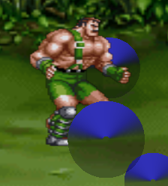
Implementation – In Game Play
Z-axis with depth test
Because the character moves only x-axis and y-axis, there is no need for z-axis
However, z-axis is combined with y-axis
The bubbles move according to A1 cg-circle
Disappearing bubbles are behind the background in a moment
It will appear after x or y window collision
Originally, I didn’t intend, but it makes game more fun or annoying

Slide 9
Summary
Originally, I want to make a game imitating retro in console
However, the result is much simpler like flash game when I played in young ages

Slide 10
More feature
Stage 2
Game is so simple to play, little fun
Rendering texts sequentially with time delay

Slide 11
Resource
Main character Haggar from final fight 3 -Tomisaurus
Text Windows - Jackester

