Slide 1
The Relationship Between CO₂ Emissions and GNI
Anna Maria Thum

Slide 2
Dataset(s)
The World Development Indicators Dataset was used for the analysis . This dataset is the World Bank’s prime compilation of international statistics on global development. It contains over thousand annual indicators of economic development from all 189 World Bank member countries as well as 28 other economies with population of more than 30,000.
For this poject, Indicators.csv was the file that was used of this dataset.

Slide 3
Motivation
Climate change and income inequality pose two major problems of the 21st century. As these two issues require complex solutions, this paper will be visualising the influence different income levels have on CO₂ emissions.
Since the climate crisis concerns all of us, this question might be interesting to everyone.

Slide 4
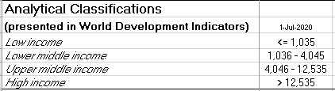
Research Question(s)
Following questions were tried to be answered in this presentation:
How did the CO₂ emissions differ regarding varying income levels from 1960 to 2011?
Do CO₂ emissions and GNI emissions correlate?
How differently did the income levels combust fuel 2011?
Countries in the World Development Indicators database are classified as low, lower-middle, middle, upper-middle and high income. The level of a country was determined by using national income (GNI) per capita, in U.S. dollars. To measure CO₂ emissions the indicator “CO2 emissions (metric tons per capita)” was used in this analysis.
World Bank GNI per capita Classification, retrieved October 31st, 2020 from databank.worldbank.org/data/download/site-content/OGHIST.xls

Slide 5
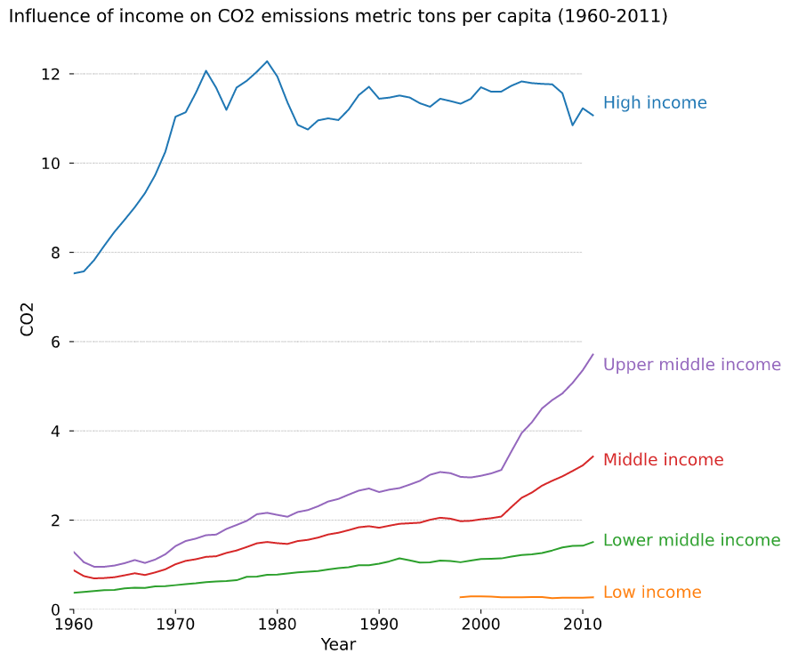
Findings
From 1960 to 2011 countries with high income caused the most CO₂ emissions.
The CO₂ emissions from the middle and the upper middle income countries increased drastically.
Data from countries with low income were only registered since 1998.

Slide 6
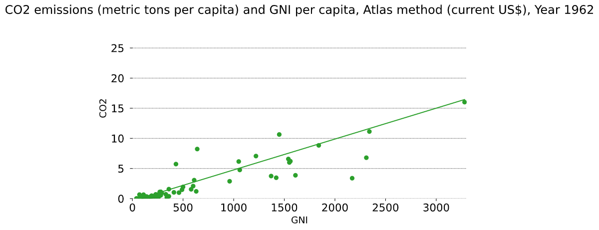
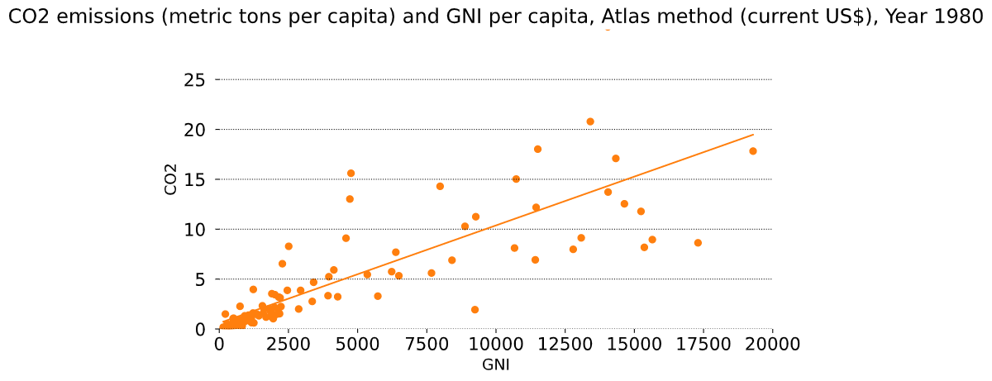
Findings
Pearson correlation coefficient
 | CO2_emissions | GNI
CO2_emissions | 1.000000 | 0.685654
GNI | 0.685654 | 1.00000
Pearson correlation coefficient
 | CO2_emissions | GNI
CO2_emissions | 1.000000 | 0.748708
GNI | 0.748708 | 1.00000

Slide 7
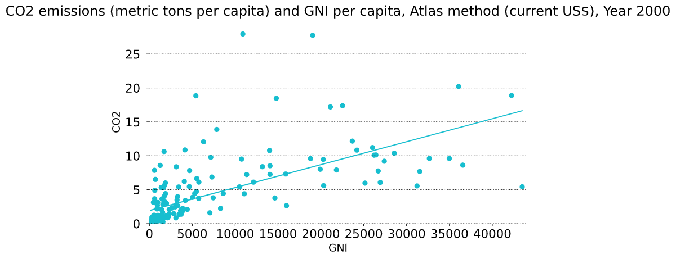
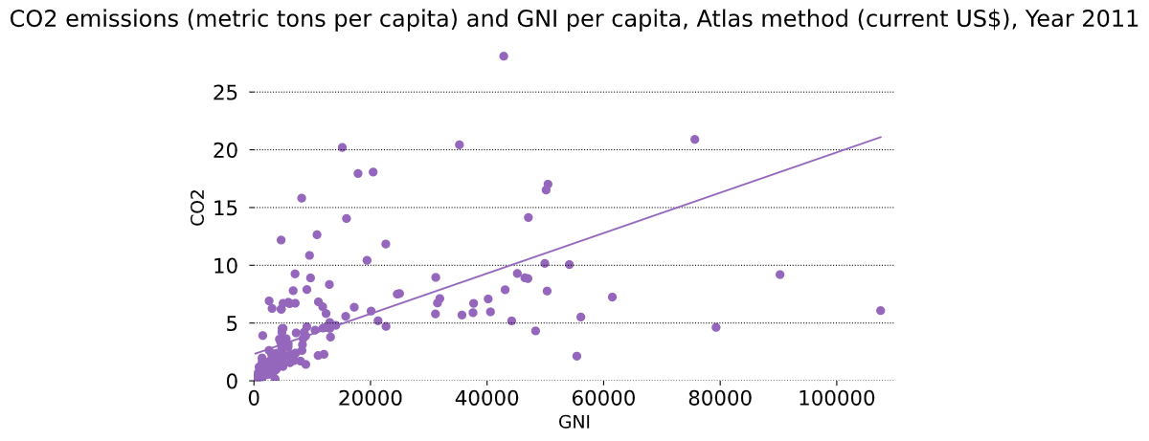
Findings
Pearson correlation coefficient
 | CO2_emissions | GNI
CO2_emissions | 1.000000 | 0.64927
GNI | 0.64927 | 1.00000
Pearson correlation coefficient
 | CO2_emissions | GNI
CO2_emissions | 1.000000 | 0.545036
GNI | 0.545036 | 1.00000

Slide 8
Findings
1962: Pearson-Coefficient 0.685654
1980: Pearson-Coefficient 0.748708
2000: Pearson-Coefficient 0.64927
2011: Pearson-Coefficient 0.545036
Since all Pearson-Coefficients lay between 0.54 and 0.75 the hypothesis of a linear relationship between CO2 emissions and GNI is supported.

Slide 9
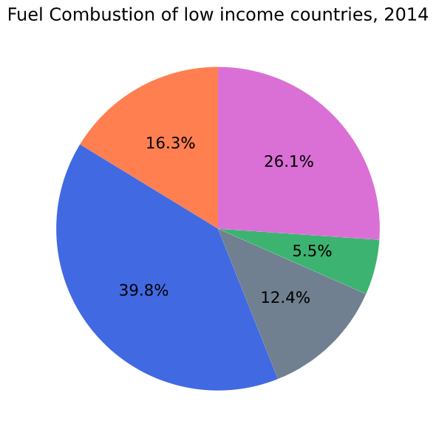
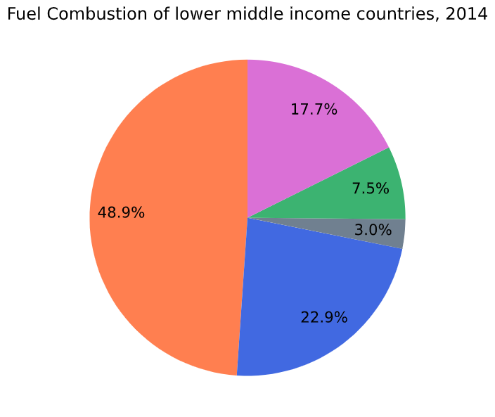
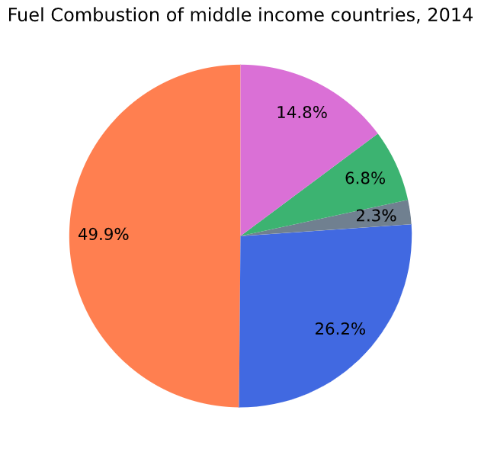
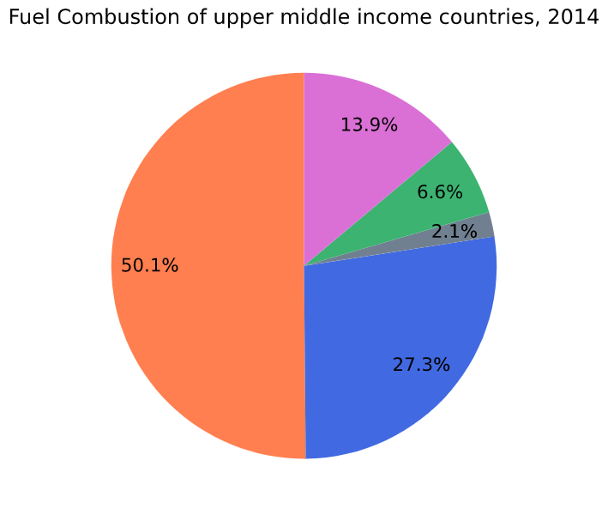
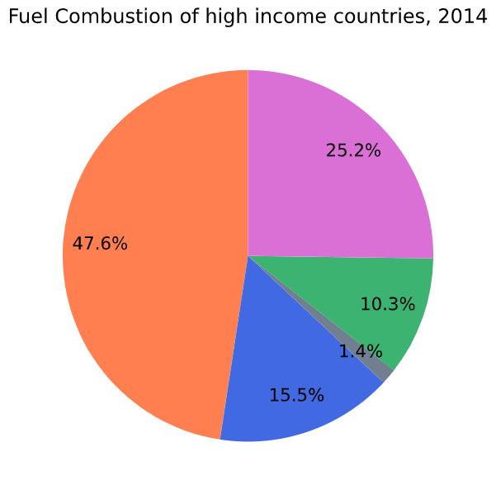
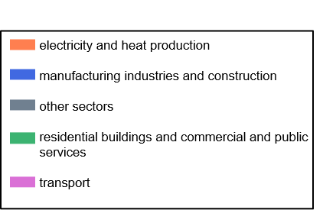
Findings

Slide 10
Findings
As the income increases, the combustion of fuel for electricity and heat production rises. Whereat countries with upper middle income require the most (50.1%).
Low income countries have the biggest need for fuel for manufacturing industries and construction at 39.8%. After that the usage is between 27.3% (upper middle income) and 15.5% (high income).
Countries with high income use the most fuel in sector “residential buildings and commercial and public services” (25.2%). The lowest fuel combustion for this sector have countries with high middle income have (13.9%).
The biggest fuel combustion for transport have high income countries (10.3%), followed by lower middle income countries (7.5%). Countries with low income require the least at 5.5%.
Only countries with low income need for other sectors 12.4%. The other levels are in this sector between 3.0% (middle income) and 1.4% (high income).

Slide 11
Acknowledgements
This analysis was made by me and I received no feedback for this work.

Slide 12
References
https://www.kaggle.com/worldbank/world-development-indicators, 31.10.2020
https://datahelpdesk.worldbank.org/knowledgebase/articles/378834-how-does-the-world-bank-classify-countries
databank.worldbank.org/data/download/site-content/OGHIST.xls, 24.10.2020
Fahrmeir, Kneib, Lang. 2009. Regression: Modelle, Methoden und Anwendungen. 2nd Edition. Springer
https://databank.worldbank.org/home, 10.10.2020

