Slide 1
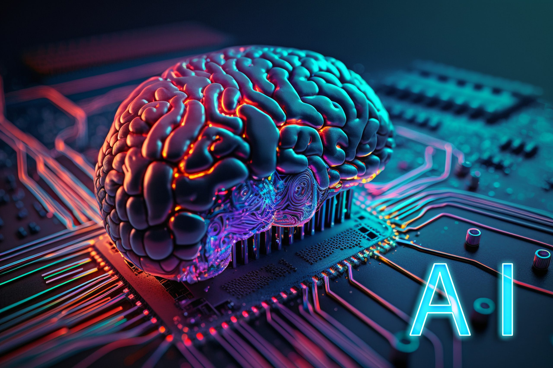


 |  |  | VRISHANK WARRIER EXCP 16014022096 Honors - MAI
Mat Bot
Mathematical
Problem-solving
Intelligent Agent

Slide 2
PROJECT DESCRIPTION:
Mat bot will be powered by advanced AI algorithms which will adapts to various mathematical domains and provides efficient solutions.
It will use text recognition software to get the mathematical equations, word problems etc. which may ranges from basic arithmetic to complex calculus problems.
It then preform mathematical analysis on then given problem.
Machine learning will allow AI to improve and learn from experience, becoming more proficient over time to enhance efficiency, accuracy, and speed in tackling complex mathematical tasks.
Mat Bot will interact with users through a user-friendly interface

Slide 3
PROJECT DESCRIPTION:
Real-world Applications:
Mathematical problem-solving is crucial for solving real-world problems in physics, economics, engineering, and more.
Many industries rely on mathematical models for decision-making and optimization.

Slide 4
OBJECTIVES:
• Develop a rule-based system capable of solving basic mathematical problems.
• Implement machine learning algorithms for adapting to new mathematical problem-solving challenges.
• Tune the agent’s algorithms based on experimental results to enhance efficiency and accuracy.
• Demonstrate adaptability and learning capabilities of MatBot through mathematical problem scenarios.

Slide 5
HARDWARE REQUIREMENTS:
Processor Unit (CPU):
Random Access Memory (RAM):
Storage:
Graphics Processing Unit (GPU):
Network Interface:
Input Devices:

Slide 6
SOFTWARE REQUIREMENTS:
Operating System:
Development Environment:
Mathematical Libraries:
Machine Learning Libraries (if applicable):
User Interface (UI):
Communication Protocols:
Version Control:
Database (if applicable):

Slide 7
Performance Measure, Environment, Actuators, and Sensors. :
P: accuracy and efficiency of its solutions to mathematical problems.
E: digital environment varying in complexity
A: graphical user interface
S: gather information from the environment

Slide 8
LITERATURE SURVEY :
Automated Theorem Proving (ATP):
Symbolic Computation:
Constraint Satisfaction:
Machine Learning for Pattern Recognition:
Natural Language Processing (NLP):

Slide 9
LITERATURE SURVEY :
Fun Search – set-inspired problem
AI:R Math – homework helper
Socratic – educational tech company

Slide 10
REFERENCES:
https://www.scientificamerican.com/article/ai-beats-humans-on-unsolved-math-problem/
https://slashdot.org/software/p/AIR-MATH/#:~:text=AIR%20MATH%20uses%20AI%20recognition,step%2Dby%2Dstep%20answers.
https://ieeexplore.ieee.org/abstract/document/6758619
https://www.cs.cmu.edu/~fp/courses/atp/handouts/atp.pdf
https://www.geeksforgeeks.org/what-is-symbolic-computation-in-sympy/

Slide 11
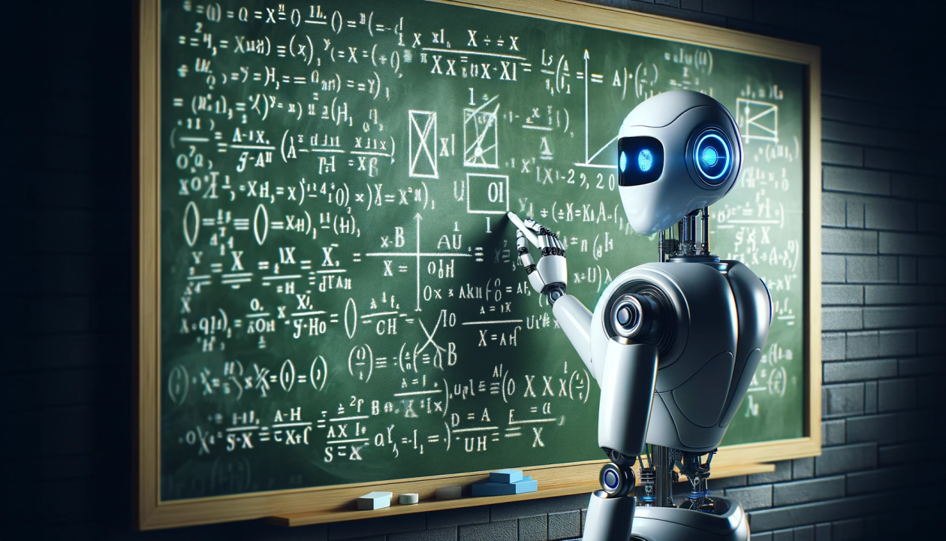
THANK YOU

