Slide 1

BEAUTYCARE
GROUP 1 – AP146
Ngo Thien An
Vo Van Duc
Nguyen Dinh Minh Duc
Nguyen Thanh Kien
Doan Thanh Nhan

Slide 2
1
Practical basis
2
Introduce
3
Feature of Website
Content
4
Website Interface
5
Advantages And Disadvantages
6
Development

Slide 3
1. CƠ SỞ THỰC TIỄN
Need
Supply
Pioneers
Team
Derived from shopping needs for sunglasses and fashion glasses

Slide 4
2. INTRODUCE
Convenience for customers.
Variety of code samples
Connect to the internet → Buy from anywhere
Sign up for information
Product Reviews
Customer members

Slide 5
3. FEATURE OF WEBSITE
1
Detail product
2
Contact
3
Product Comparison
4
Sigin , Registration

Slide 6
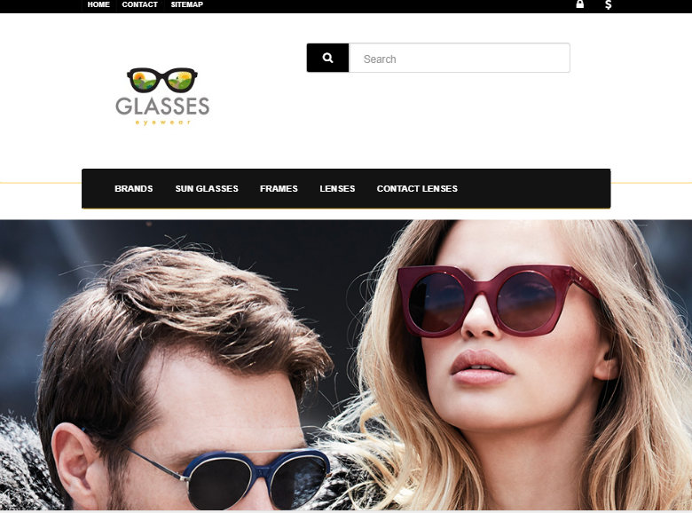
4. Website Interface
Trang chủ

Slide 7
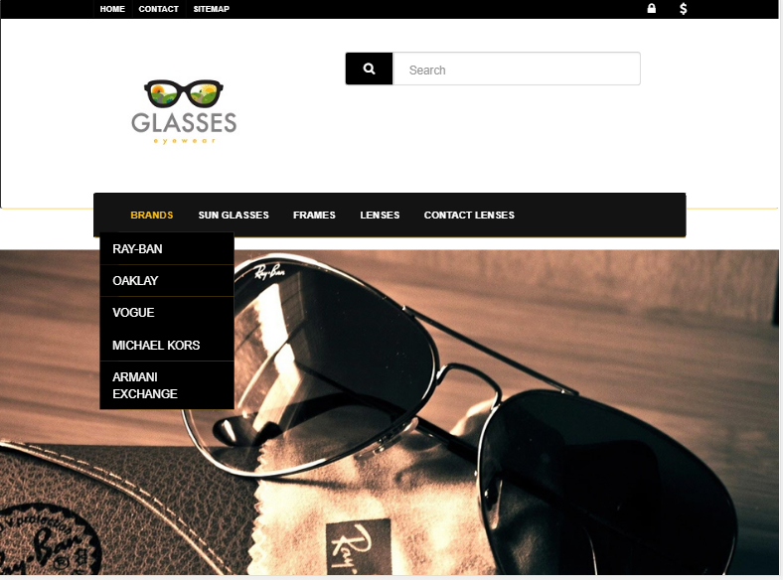
Danh mục sản phẩm

Slide 8
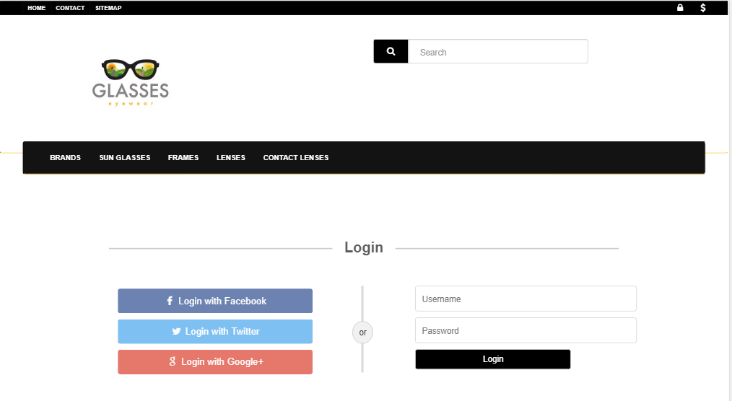
Page Sigin

Slide 9
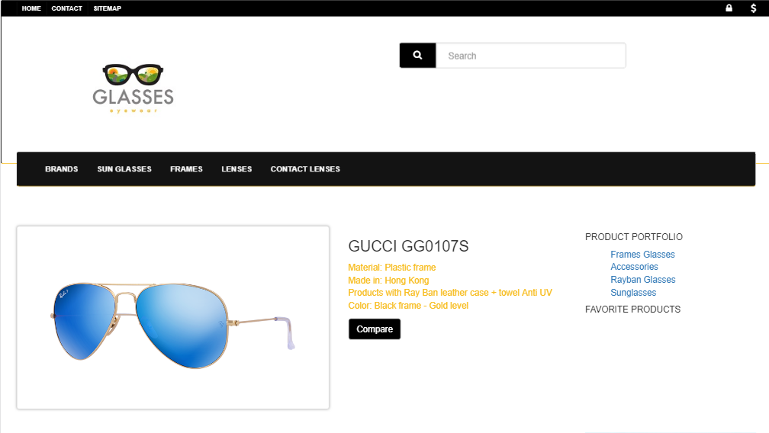
Detail Product

Slide 10
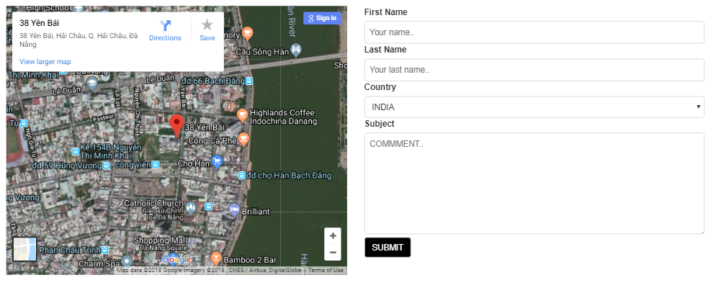
Contact

Slide 11
5. ƯU ĐIỂM
A
D
A
V
A
T
A
G
E
S
Provide information - Product images
Compare Product
Website được kết nối với facebook và các trang mạng xã hội phổ biến khác, giúp cho việc chia sẻ được dễ dàng hơn

Slide 12
5. NHƯỢC ĐIỂM
D
I
S
A
V
A
N
T
A
G
E
S
Due to limited time and knowledge, the current website only performs some basic features, not a "dynamic" website, just stopped at the "static" website.
Later on when the knowledge of e-commerce team will develop more web site

Slide 13
6. HƯỚNG PHÁT TRIỂN
In the future, learning more about back-end groups will try to make the site more website-driven and become a bustling online shopping destination to serve the needs of all.

Slide 14


