Slide 1

Microbiome Analyst
Marker Data Profiling
(Tutorial 3)

Slide 2
3-part overview
15-20 minute presentation
Background info – Stephan (5-6 minutes)
(including some lecture notes and general overview of Marker Data Profiling)
Step-by-step how the website works ( 5 minutes)
Explain outputs (graphs) and give it some human meaning, why is this important? – Ayaz (7-10 minutes)

Slide 3
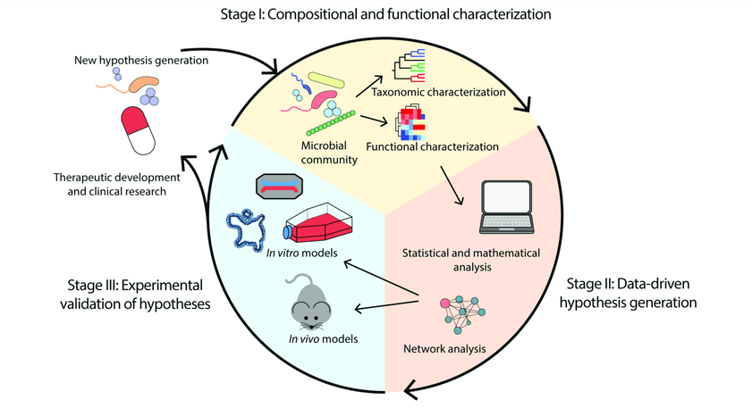
Introduction
What is microbiome Analyst?
Give overview of Microbiome Analyst and then discuss what is Marker Data Profiling, since this is what our tutorial is about

Slide 4
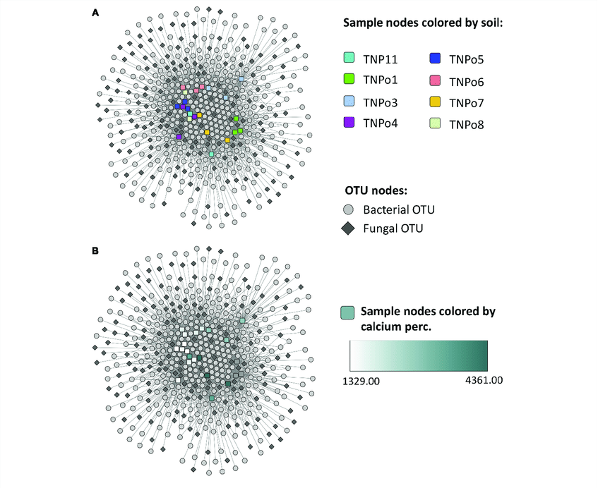
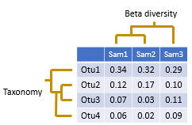
Background Information
Connect lecture slides to what we will be discussing
Operational Taxonomic Units (OTUs)??
What is a OTUs Matrix table?
How are these things used in the Marker Data Profiling Analyst website

Slide 5

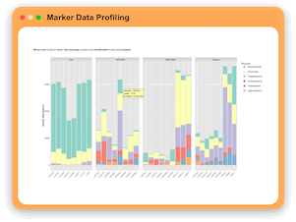
Marker Data Profiling
A set of computational methods and tools used for analyzing and interpreting marker gene data, specifically in the context of microbial communities.

Slide 6
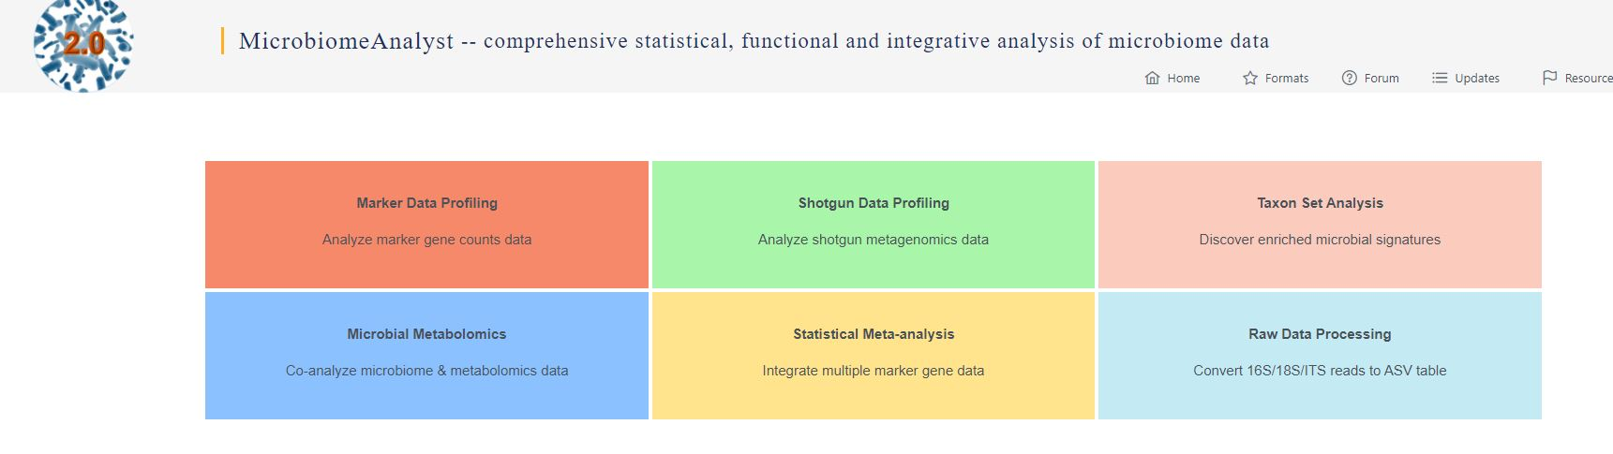
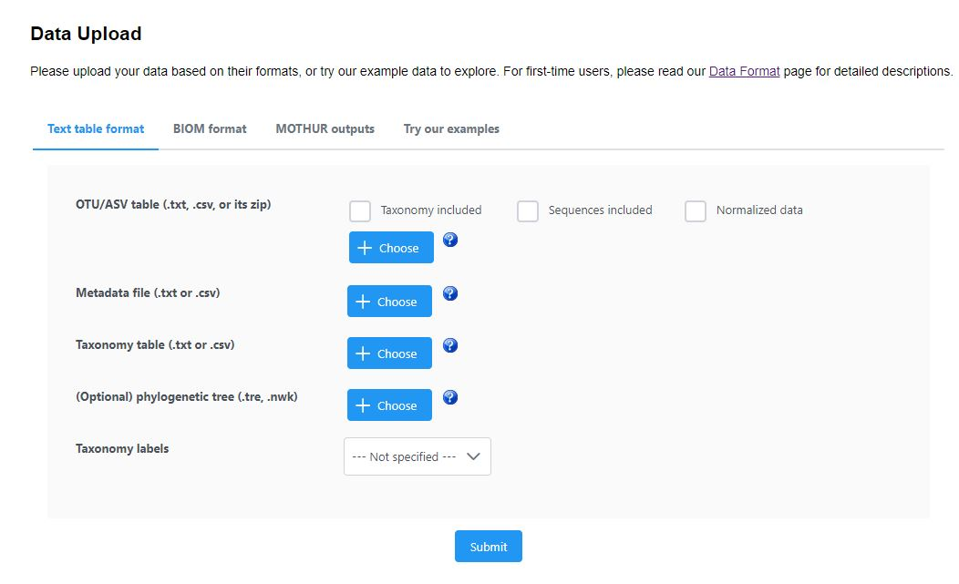
Data Upload
First, we select appropriate Modules to work on. Modules can be selected depending on the data types.
For the purpose of this tutorial, we HAVE selected MDP
MDP
We are using these example Data for Demonstration
Input Data:
We can upload 16S rRNA Data in multiple formats:
Tab-delimited text file (abundance, taxonomy and metadata file)
BIOM format (containing at least abundance and taxonomy information)
Mothur output files.
Check these if any of these applies to out OTU data
Upload OTU and Metadata Files
upload if taxonomy information is not included in OTU table
Upload phylogenetic tree for phylogenetic distance based analysis (Optional)
Specify taxonomic labels which database for the OTU table annotation

Slide 7
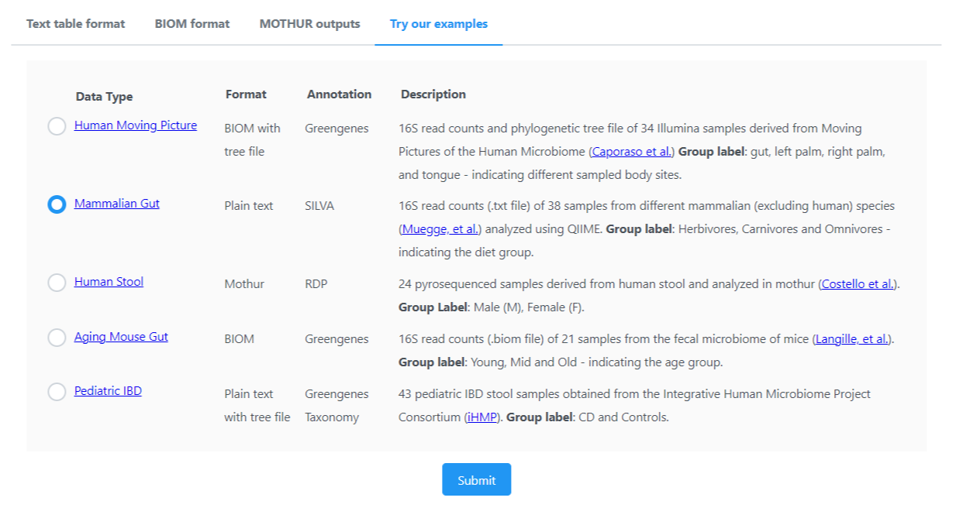
For demonstration, we are using the example datasets in the Microbiome Analyst – Mammalian Gut
Experimental Factor

Slide 8
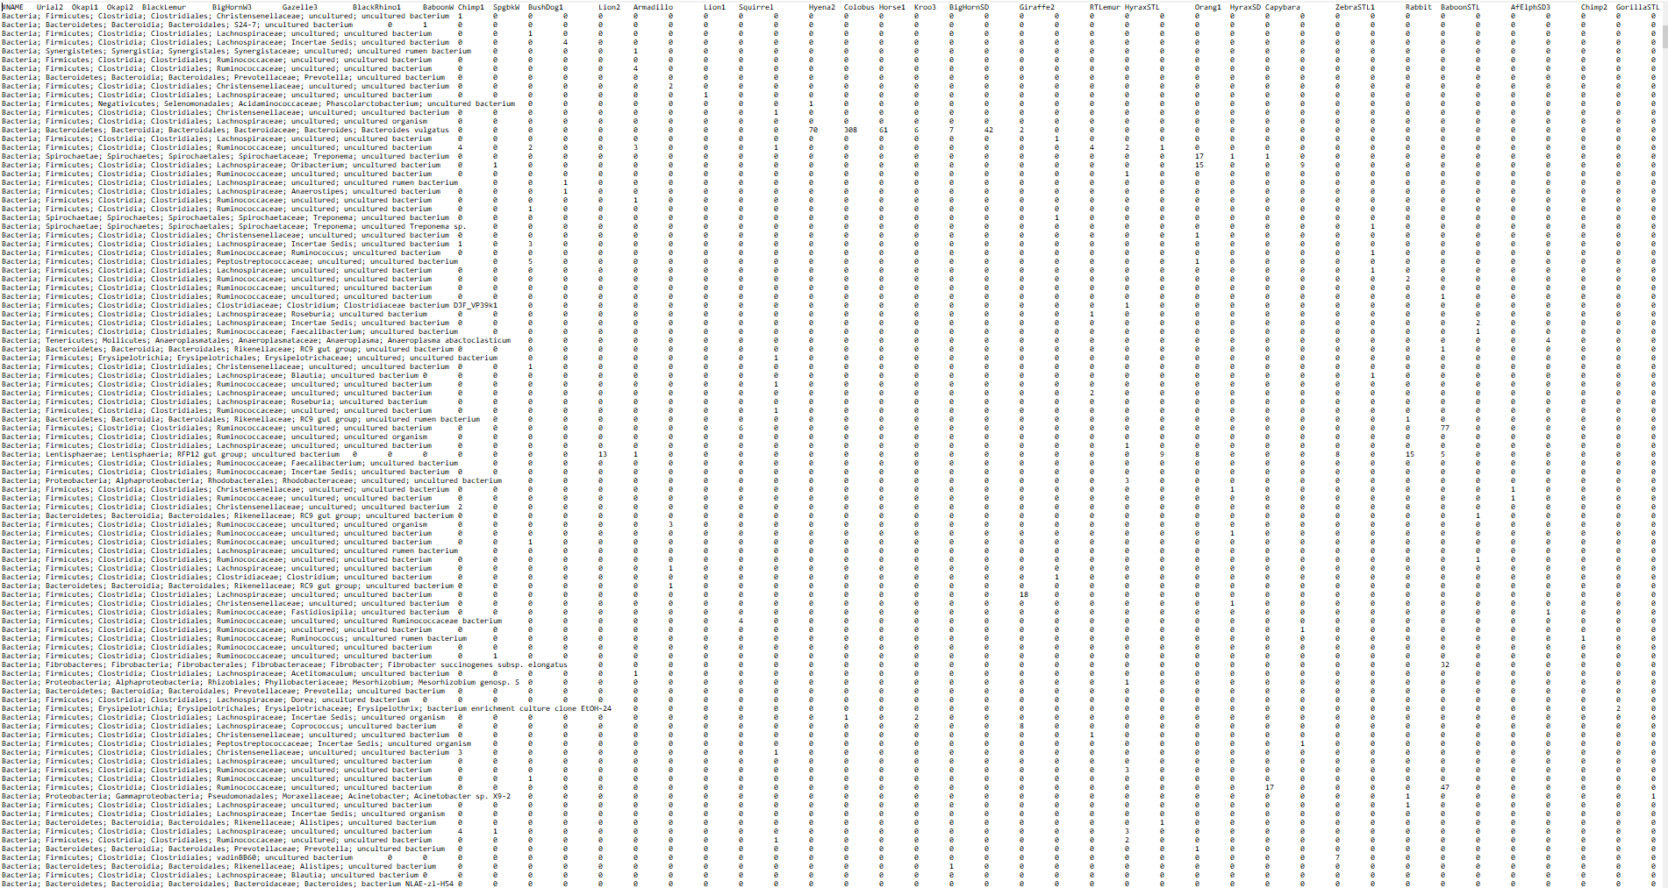
This is how an OTU Table looks like, Let's zoom IN

Slide 9
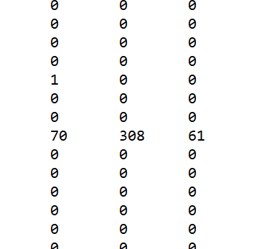


Slide 10
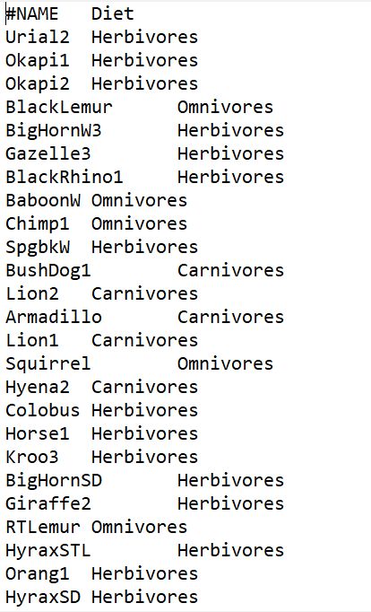
Metadata File

Slide 11
Data Formatting
Also known as Tab-separated files (.txt) or (.csv) files containing a data table. Rows represent features (OTUs), and columns represent samples.
Manipulates data heading from spreadsheet program like MS Excel
The first line must contain sample names, starting with "#NAME". (row)
First Column should contain taxon names*, #TAXONOMY(column) [From domains to species]
Unrecognized Terms can also be included in the taxonomic profile
Non-specific names (e.g., Otu0001) allowed in the first column. Accompanying taxonomy mapping file may be required.
Terms like "uncultured" or strain identifiers can be included without impacting the taxonomic profile.
Cells should indicate read count, proportions, or percentages of taxa in each sample.
Tab-Delimted Text File
*Taxon names are the valid taxonomic identifiers annotated via greengenes or SILVA databases and such labels must include data ranging from domains to species, separated by semicolons (;).

Slide 12
Data Formatting
Tab-Delimited Text File
Notes when Formatting the Data
Sample and feature names must be unique, using English letters, underscores, and numbers. Avoid Latin/Greek letters.
Ensure sample and feature names are consistent in all related files (abundance table, taxonomy table, meta-data file, phylogenetic tree file).
Only numeric and positive values. Empty cells or cells with NA values will be auto-replaced with zero.
Blank cells or "NA" (without quotes) are acceptable in the taxonomy table and denote the maximum taxonomic resolution obtained for each OTU or feature.
Metadata should not be included in the abundance tables (e.g., do not add rows like #CLASS following #NAME).

Slide 13
DATA FORMATTING
2. BIOM Files
Serves as a standard format for biological sample by observation contingency tables.
Explore more: https://biom-format.org/
Compatible with QIIME and mothur for output generation.
Essential contents: Abundance and taxonomy information. Metadata file is optional and separate.
3. Mothur Output File
Requires two specific files: a consensus taxonomy file and a .shared file for abundance data.
Option to upload a separate metadata file.
For comprehensive details, refer https://mothur.org/wiki/

Slide 14
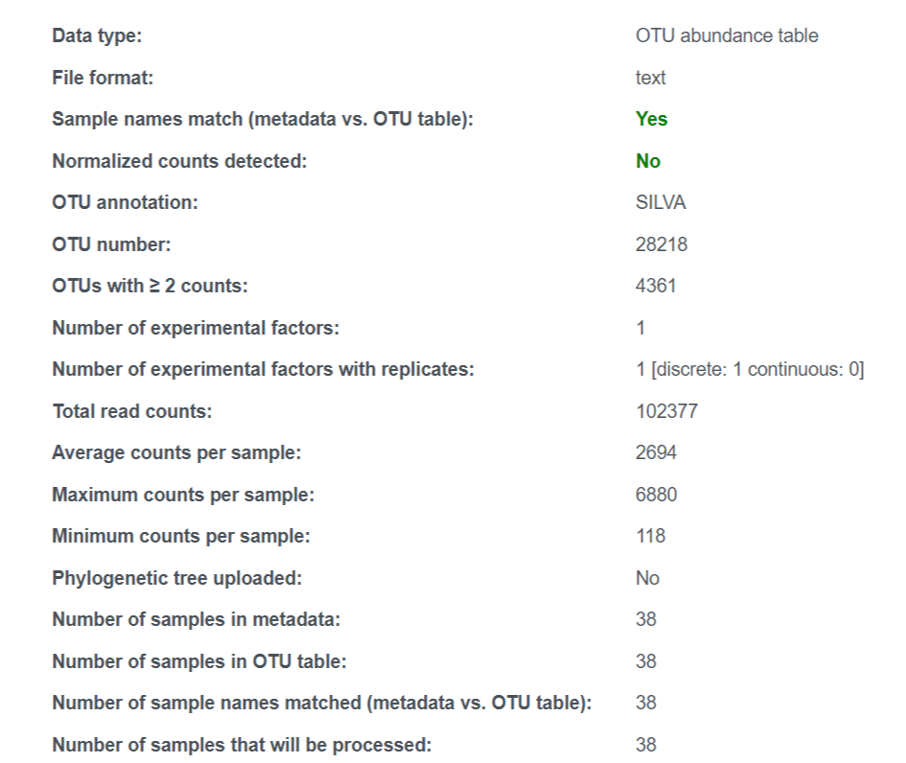
Data Integrity Check
A reference database used for annotating and classifying microbial sequences, particularly ribosomal RNA (rRNA) gene sequences (small and large subunits).
Once we submit the data, we move to the page one. Here we get the Text Summary of the uploaded files.
Pay attention here, as only the matched samples will be processed.
Following slide contains the explanation for each of these checkpoints

Slide 15
Dataset] represents abundance table using OTUS
Data is stored in Text format
Sample names in the metadata and the OTU table match- consistency in sample
Normalized counts, which adjust for differences in sequencing depth, have not been applied to this dataset.
The OTUs have been annotated using the SILVA database, which provides information about the taxonomy of microorganisms.
There are a total of 28,218 OTUs identified in this dataset
Out of the 28,218 OTUs, 4361 have at least 2 counts, indicating their presence in the samples.
There is no experimental factor considered in this dataset
There is one experimental with replicas, and it is of discrete nature (not continuous)
The total number of sequencing reads in the datasets is 102,377
On average, each sample has 2,694 sequencing counts
The sample with the highest sequencing count is 6880 counts
A phylogenetic tree, often used for analyzing evolutionary relationships b/w microbes, has not been uploaded for this dataset
There are 38 samples included in the metadata of this dataset
The OTU table contains 38 samples – indicates inconsistency
All the 38 sample names in the metadata match with the sample names in the OTU table
All 38 samples will be processed for analysis

Slide 16
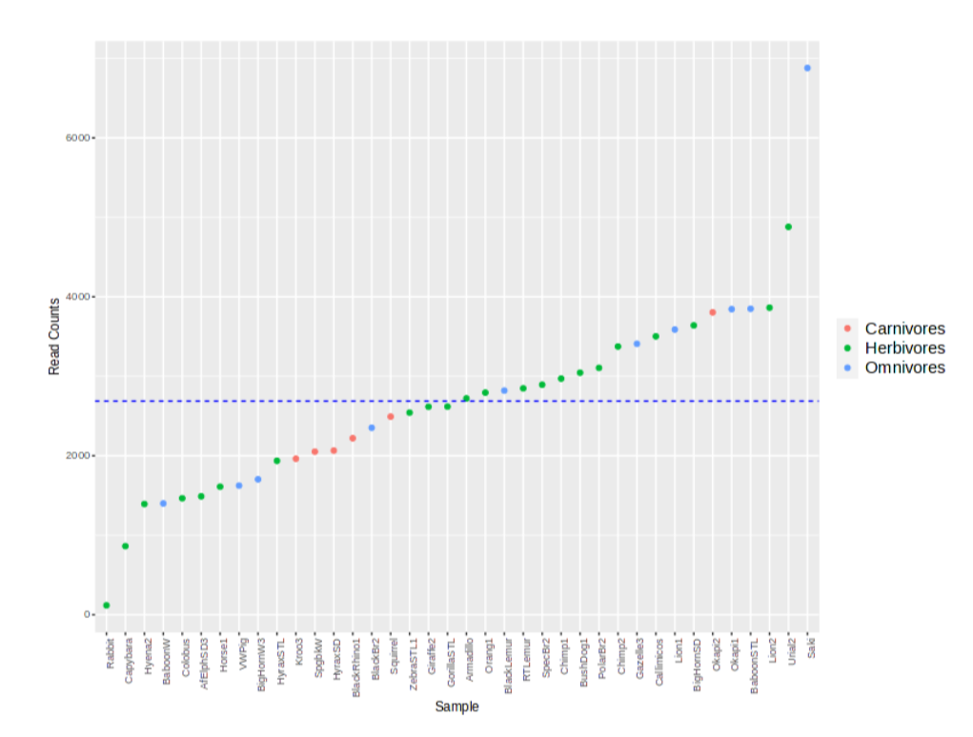
Library Size Overview
Graphically describes the read counts providing information about the library size or all read counts present in each sample.
Helps identifying potential outliers due to oversampling or sequencing error
Average read counts per sample
Notes:
Spread of the data – Variability of in the data obtained - herbivore
Average number of reads

Slide 17
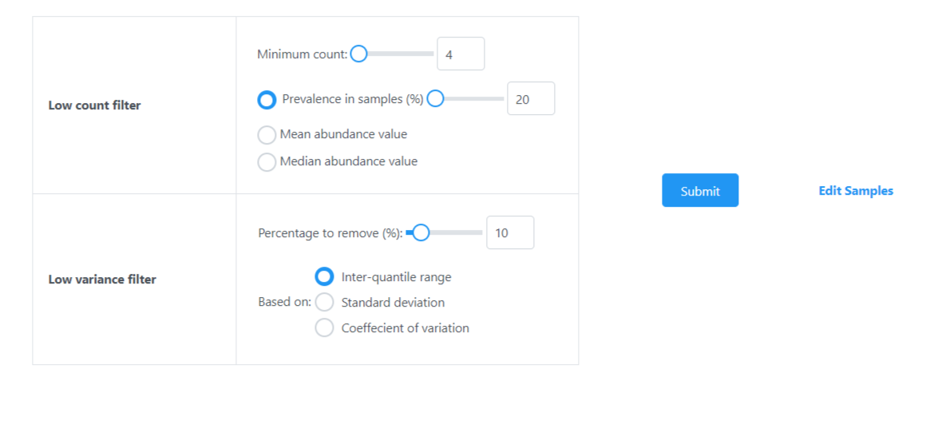
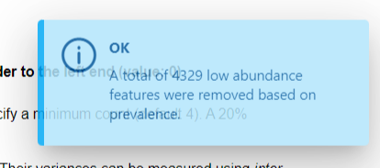
Data Filtering
Detailed explanation in the following slide
Default Settings
After submitting the filters, A message will appear in the upper-right corner, indicating the results of the data filtering steps

Slide 18
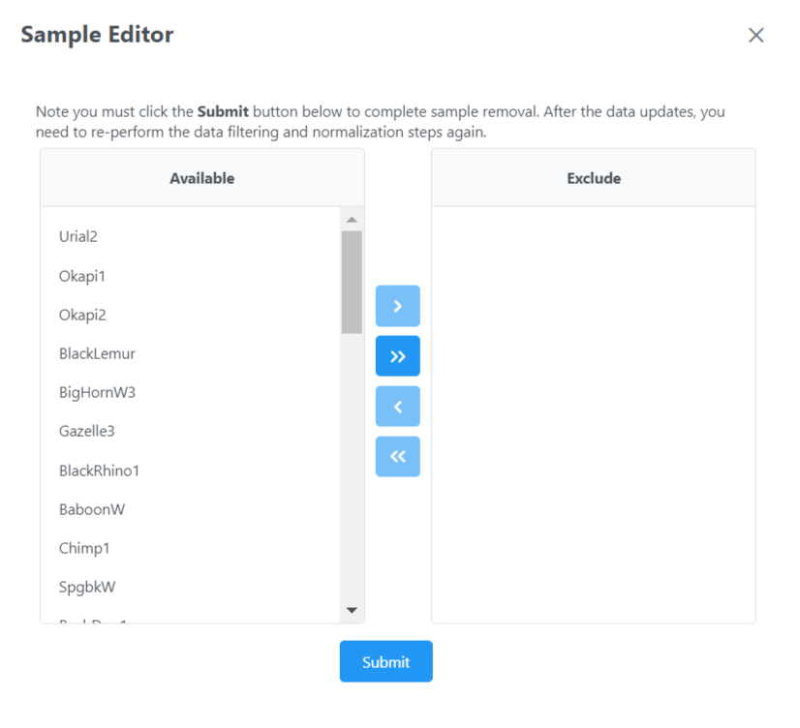
We can remove samples that are detected as outlier via results from graphical summary or rarefaction curve analysis.
These samples will be excluded from downstream analysis (e.g. alpha- , beta- diversity analysis)

Slide 19
Data Filtering
To remove low-quality or uninformative data and enhance the quality of downstream statistical analysis
Notes :
Exclude features with zero counts across all samples
Remove features appearing in only one sample, likely artifacts – Low Count Filtering
Discard features with counts that may arise from errors or minor contamination
Eliminate features with minimal variation across samples, indicating low association with experimental conditions – Low Variance
Minimal filtering is mandatory for all types of analysis
Low count and low variance filters are optional but recommended for comparative studies
Not applied for alpha diversity to retain within sample diversity data
Low count and low variance filters – ensures data reliability in comparative analysis
We can employ six distinct methos based on the abundance or stat measures – Mean, Median, S.D, C.V, IQR(describes the spread of the 50% dataset).
Notes:
For reference

Slide 20
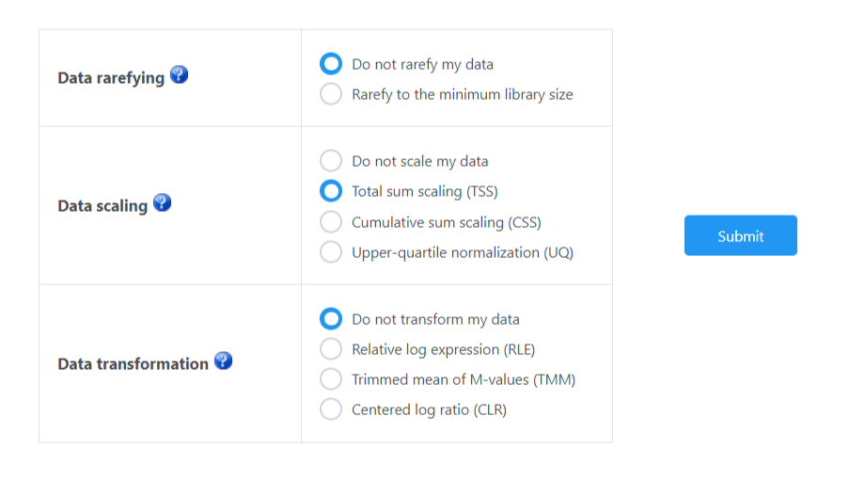
Data Normalization
Option to either not rarefy their data or to rarefy it to the minimum library size.
TSS- Scales the read counts in each sample to the total number of reads, allowing for comparison across samples.
CSS- scales the data based on thE cumulative sum, which can be robust to the presence of highly abundant features.
UQ- Normalizes the data based on the upper quartile, potentially providing a more balanced view when high abundance features dominate the data.
RLE- Useful for stabilizing variance when comparing samples.
TMM- trims the data to reduce the impact of outliers and averages, often used in differential expression analysis.
CLR- Transforms the data to account for compositional nature, a common characteristic of microbiome data.

Slide 21
Data Normalization
Standardize data for accurate comparative analysis.
Compensates for inconsistencies like varying sequencing depth and data sparsity.
Rarefying:
Addresses uneven library sizes through random subsampling.
Suitable for small (<1,000 reads/sample) or highly uneven library sizes.
Criticized for potential information loss, yet valuable for beta diversity.
Scaling (Total Sum Scaling by default):
Adjusts feature counts for sequencing depth, converting to relative abundances.
Total Sum Scaling divides counts by total reads per sample.
Critiques include bias from abundant features and no correction for feature variance heteroskedasticity.
Alternatives like upper quantitative and cumulative sum scaling are proposed for specific issues.
Data Transformation:
Stabilizes variance with methods like Centered Log Ratio (CLR).
CLR and its variants RLE and TMM are highly effective for microbiome data.
Essential for identifying differentially abundant features.
Procedure:
Maintain default settings (Data scaling set to Total Sum Scaling).
Click ‘Submit’ and proceed to the ‘Analysis Overview’ page.
Notes:
For reference

Slide 22


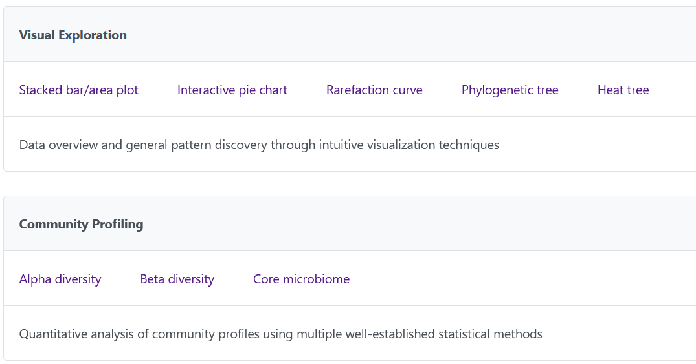
Analysis Overview

Slide 23
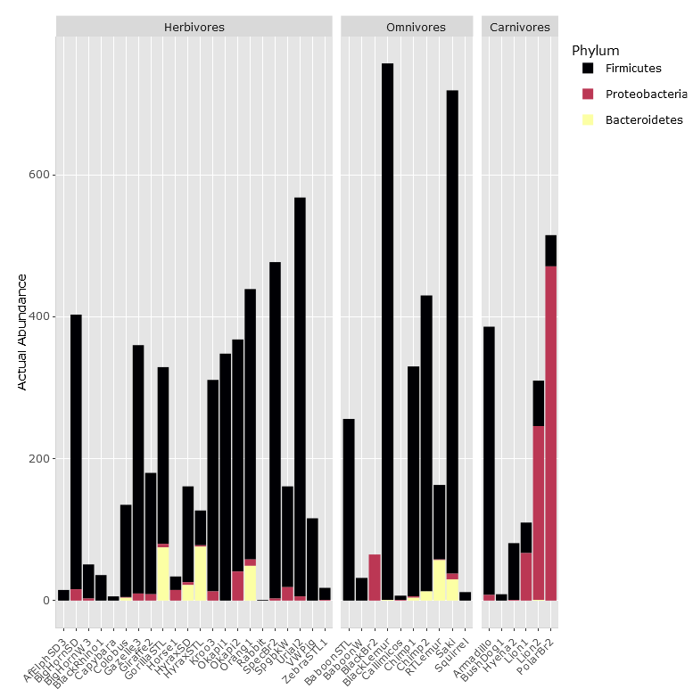
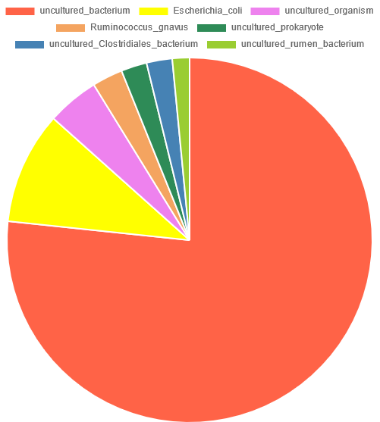
Visual Exploration
Stacked Bar/Area Plot
Shows composition of microbes in each sample
Helps visualize relative abundance of different taxa in each sample, and compare across multiple samples
Provides immediate visual summary of data
Interactive Pie Chart
Displays proportion of each taxon within individual samples
Offers quick, intuitive way to understand composition of a microbiome
Has interactive element where you can click on chart to change it

Slide 24
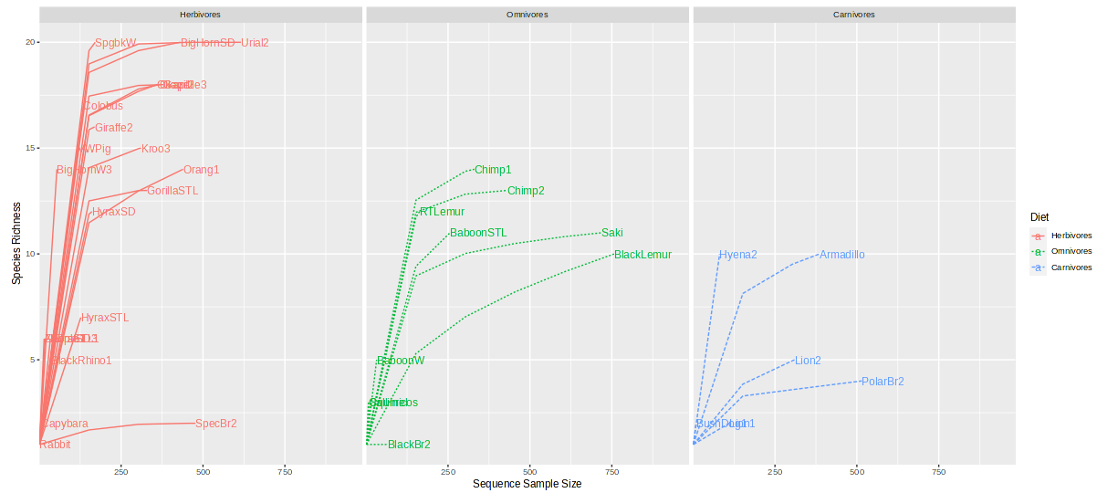
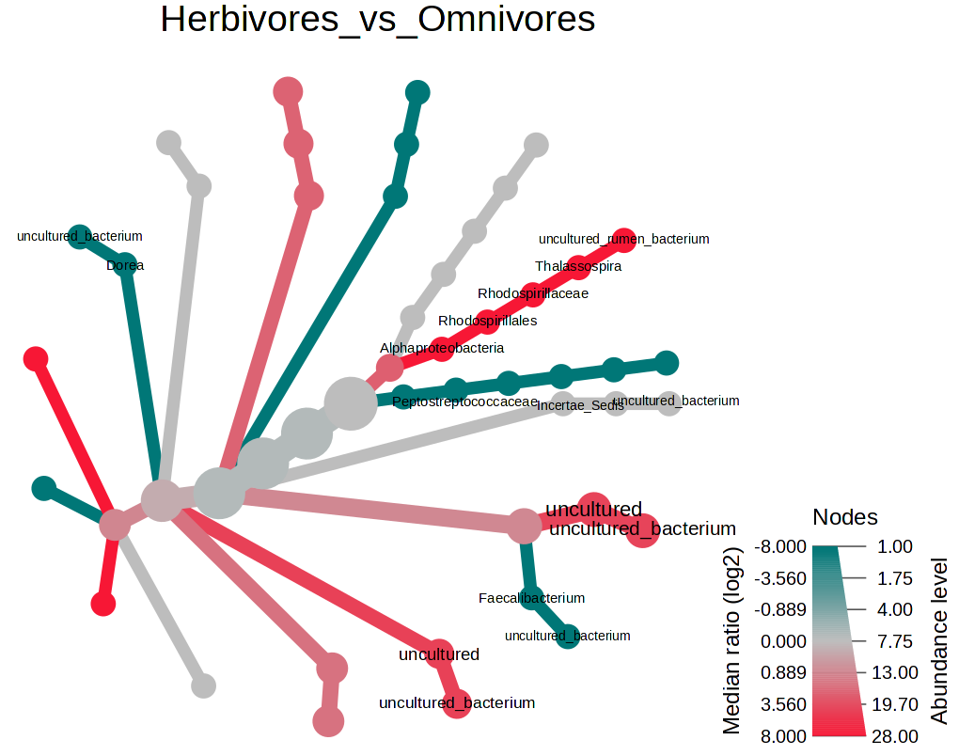
Visual Exploration
Rarefaction Curve
Used to assess species richness as a function of number of sequences obtained
Taxa which are close together share similar genetic markers
Helps to determine if additional sequencing might reveal more diversity
Heat Tree Analysis
Shows hierarchy (relationships) between groups
Shows abundance: larger nodes means more of that taxa (abundance)
Color code: represents “intensity” of taxa according to a specific metric

Slide 25
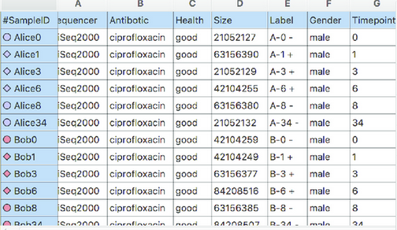
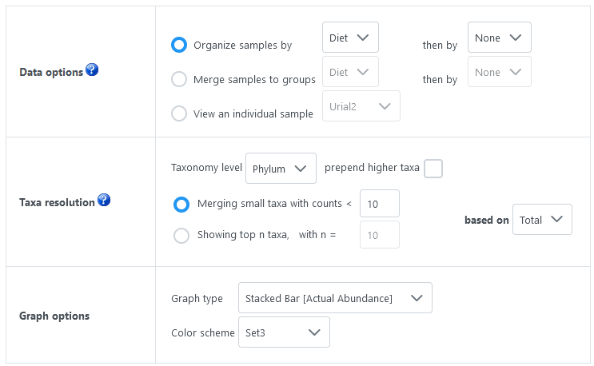
Visual Exploration
Data Options
Organize samples by: lets you sort/group according to certain criteria
Merge Samples to groups: combine multiple samples into single groups based on criterion (i.e. all herbavores grouped as one)
View individual sample: focus on just one microbiome sample in detail
Taxa Resolution
Represents the “level” of how deep you want to go
Phylum is highest level
Species is lowest level
Merging Small Taxa: group together the microorganisms with counts lower than threshold
Focus on more abundant microbes
Showing top n Taxa: Focus on most abundant taxa
An “Others” category will be made containing all the less abundant taxa
Graph Options
Customize the look of your slide for visual aesthetics

Slide 26
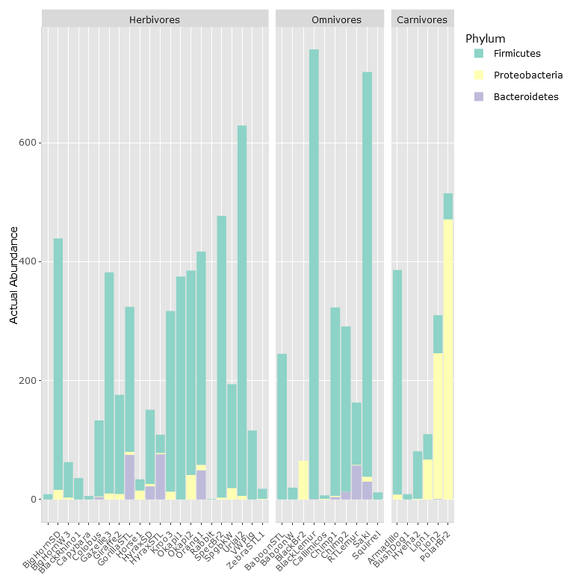
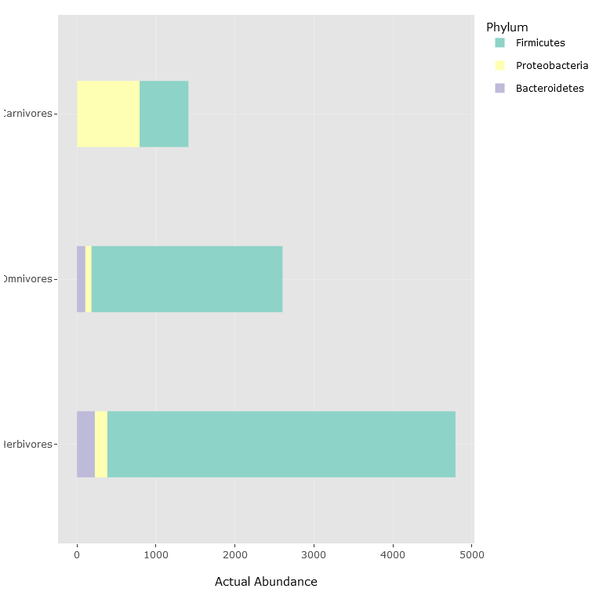
Visual Exploration
Data Options
Organize Samples by Diet
Merge Samples to Groups - Diet

Slide 27
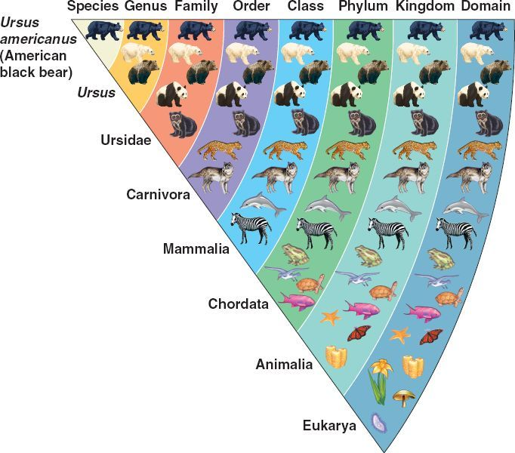
Visual Exploration
Data Options
Organize samples by: lets you sort/group according to certain criteria
Merge Samples to groups: combine multiple samples into single groups based on criterion (i.e. all herbivores grouped as one)
View individual sample: focus on just one microbiome sample in detail
Taxa Resolution
Represents the “level” of how deep you want to go
Phylum is highest level
Species is lowest level
Merging Small Taxa: group together the microorganisms with counts lower than threshold
Focus on more abundant microbes
Showing top n Taxa: Focus on most abundant taxa
An “Others” category will be made containing all the less abundant taxa
Graph Options
Customize the look of your slide for visual aesthetics

Slide 28
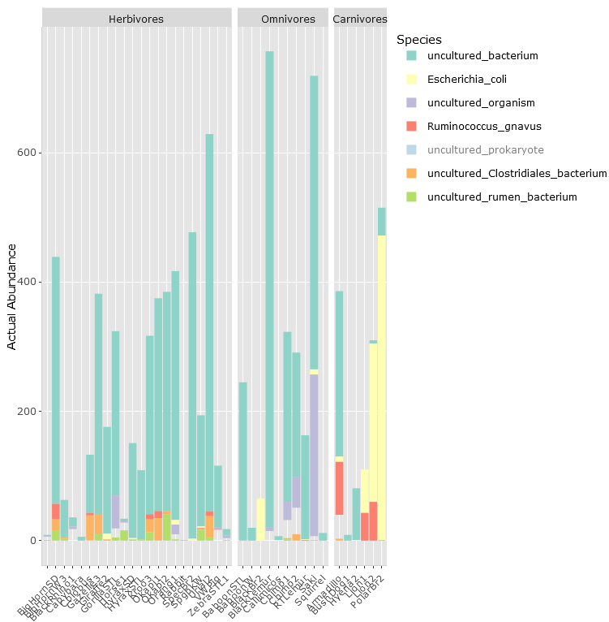
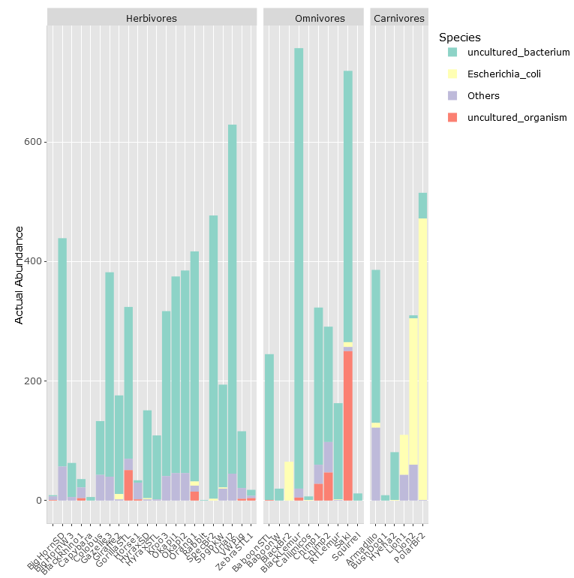
Visual Exploration
Taxa Resolution
Organize Samples by Phylum
Organize Samples by Species
Showing top “n” taxa with n = 3

Slide 29
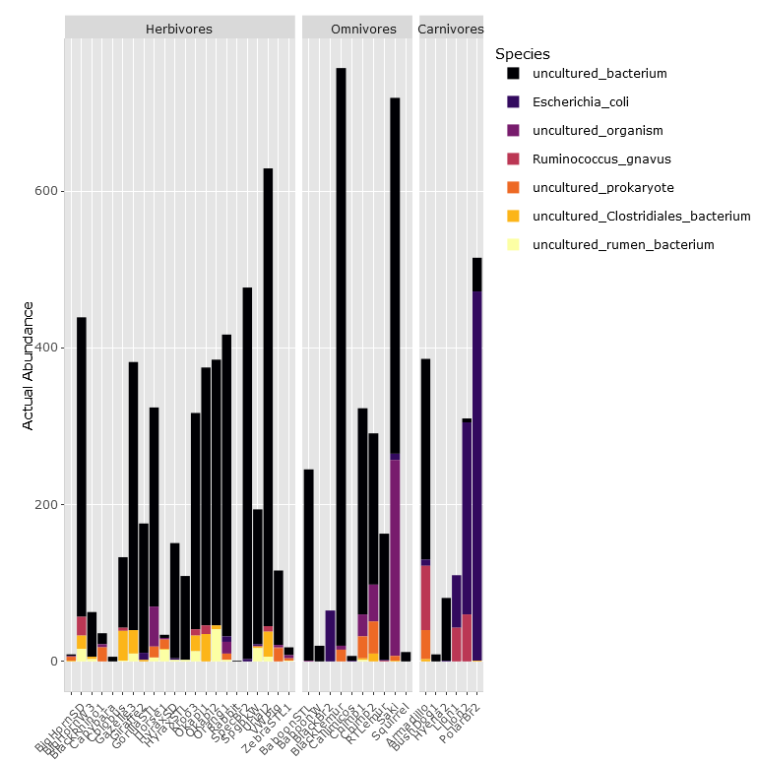
Visual Exploration
Data Options
Organize samples by: lets you sort/group according to certain criteria
Merge Samples to groups: combine multiple samples into single groups based on criterion (i.e. all herbavores grouped as one)
View individual sample: focus on just one microbiome sample in detail
Taxa Resolution
Represents the “level” of how deep you want to go
Phylum is highest level
Species is lowest level
Merging Small Taxa: group together the microorganisms with counts lower than threshold
Focus on more abundant microbes
Showing top n Taxa: Focus on most abundant taxa
An “Others” category will be made containing all the less abundant taxa
Graph Options
Customize the look of your slide for visual aesthetics
“Inferno” Color Scheme

Slide 30
Community Profiling
Alpha Diversity
Single microbial community diversity measure
Beta Diversity
Measures diversity change between environments
Core Microbiome
Refers to set of microbes common in most samples
Richness – different microbe types
Evenness – distribution of microbes
Useful for comparing different ecosystems
These organisms considered fundamental

Slide 31
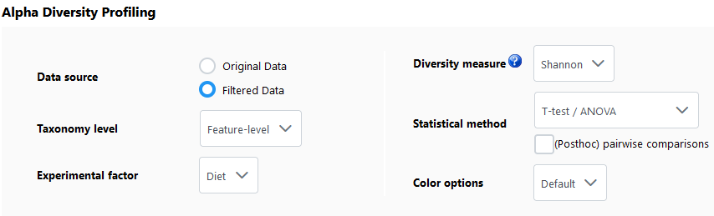
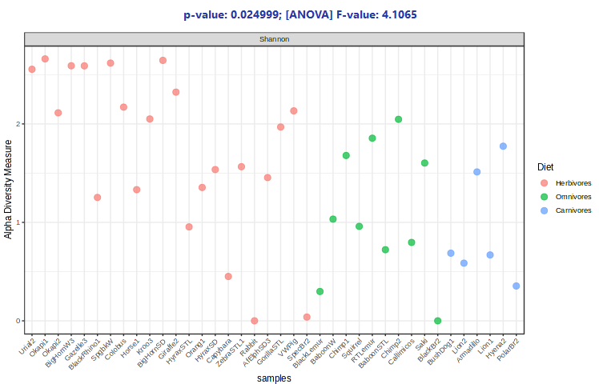
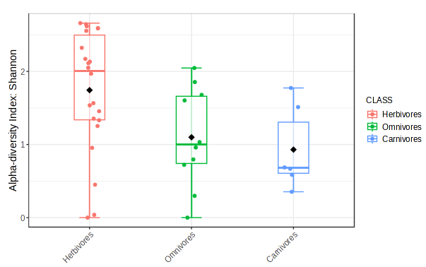
Alpha Diversity
Looks at how many different types of microorganisms present in a sample/environment
Diversity Measure
Shannon: accounts for richness and evenness
Simpson index: gives more weight to most abundant species – dominant species stands out
Chao1: estimates richness, but focuses on rare species
Statistical Method(s)
T-test/ANOVA: used to compare 2 or more groups (i.e. heights of men vs women)
Individual Samples Plot (left graph)
Each dot represents Shannon Diversity of one sample
Y-axis shows Shannon Diversity index, higher value means more diversity
Box & Whiskers Plot (right graph)
Each boxplot corresponds to one dietary group
Central line is median diversity of group
Dots inside the box are individual samples that fall within middle 50% of data
Dots outside the box typically considered outliers

Slide 32
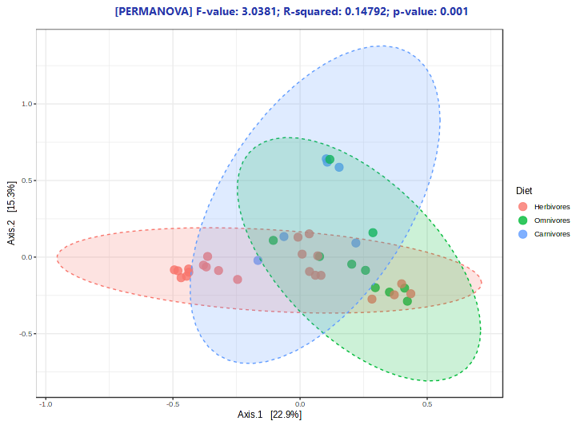
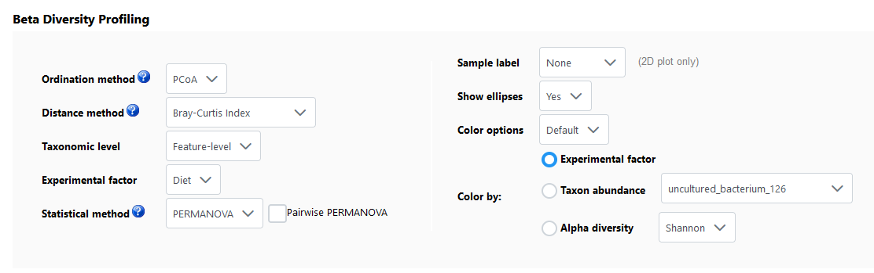
Beta Diversity
Compares diversity between different communities or samples to see how similar or dissimilar they are
Distance Method
Bray-Curtis Index: looks at abundance of each species to see similar or different two communities are
Jenson-Shannon Divergence: measures similarity between two probability distributions
Measures help quantify differences between the microbes in two communities
Beta diversity graph
Each dot represents a sample based on their microbial community
Samples that are close to each other have similar microbes
Ellipses around the dots show how tightly grouped samples are within each category
X-axis and y-axis are percentage variations between samples

Slide 33
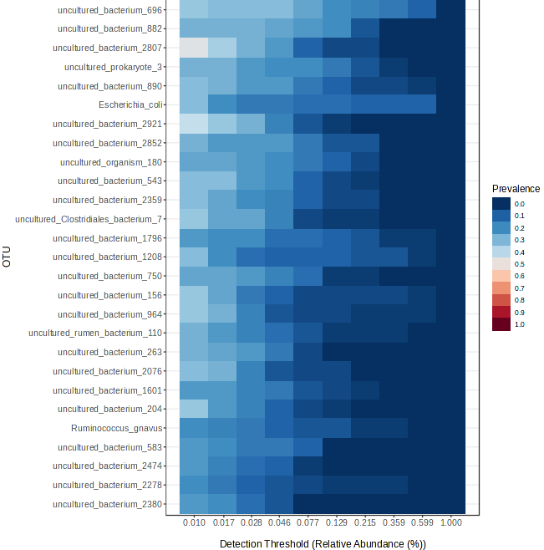
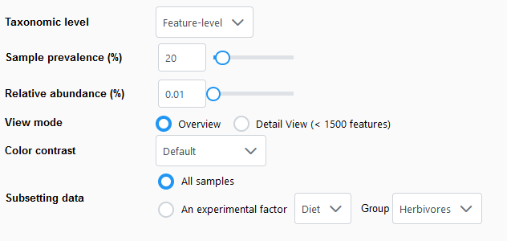
Core Microbiome
Refers to set of microbes that are commonly found across most or all samples in a study
These organisms considered fundamental
Core Microbiome Analysis Graph
Each square represents a different microorganism (OTU) across various samples/conditions
Color of each square represents how common each microorganism is
Darker means more prevalent/abundant in samples
Ligher means lower abundance
X-axis is detection threshold, or relative abundance of that microorganism across the samples

Slide 34
References
Nucleic Acids Research site:
MicrobiomeAnalyst 2.0: comprehensive statistical, functional and integrative analysis of microbiome data | Nucleic Acids Research | Oxford Academic (oup.com)
National Laboratory of Medicine site:
MicrobiomeAnalyst: a web-based tool for comprehensive statistical, visual and meta-analysis of microbiome data - PMC (nih.gov)
Operational Taxonomic Unit (OUT) and OUT Clustering site:
https://www.cd-genomics.com/microbioseq/operational-taxonomic-unit-otu-and-otu-clustering.html

Slide 35
Goal of the Tutorial
To perform comprehensive analysis on data from 16S rRNA marker gene data, which includes:
Compositional and structural analysis
Biodiversity (Alpha and Beta) Analysis
Comparative Analysis
Predictions of Metabolic Potentials

Slide 36
Overview of Microbiome Analyst
Version 2.0

Slide 37
Challenges in Microbiota Studies
Large Data,computational

Slide 38
Key Features of Microbiome Analyst
• Support for a wide array of common as well as advanced methods for taxonomic diversity analysis, functional pro- filing, visualization and significance testing
• Comprehensive support for various data filtering and transformation methods coupled with well-established as well as more recent algorithms for differential abundance analysis

Slide 39
Cont'd..
A powerful, fully-featured metabolic network visualization framework for intuitive exploration of results from functional profiling
Support for meta-analysis with compatible public datasets for context reference and pattern discovery using 3D visual analytics
Enrichment analysis based on >300 taxon sets manually collected from literature and public databases

Slide 40
Four Modules of Microbiome Analyst
(i) Markergene Data Profiling (MDP) - dedicated to the analysis of marker-gene survey data
(ii) Shotgun Data Profiling (SDP) - for the analysis of shotgun metagenomics or metatranscriptomics data
(iii) Projection to Public Data (PPD) - for visual comparison of users’ marker-gene data with a compatible public dataset available in Microbiome Analyst
(iv) Taxon Set Enrichment Analysis (TSEA) - used to test whether certain predefined groups of taxa (taxon sets) are statistically overrepresented in a list of taxa submitted by users

Slide 41
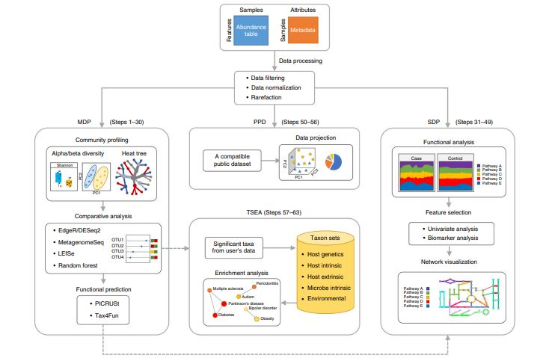
Microbiome Analyst Workflow
The four modules share the same general workflow—data preparation, followed by data analysis and visual exploration.
In this tutorial, we are dealing with this part

Slide 42
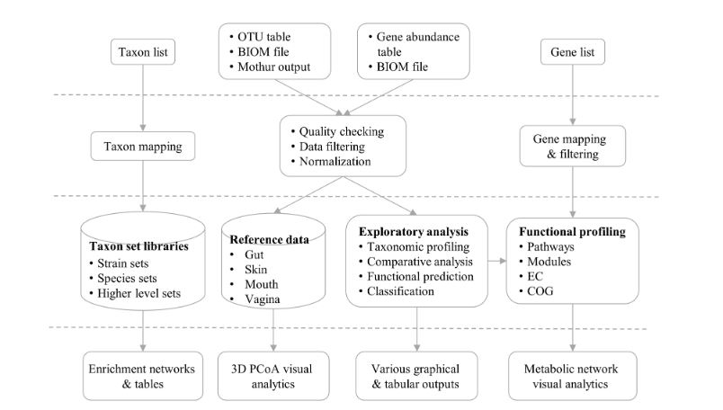
General Workflow
Data Inputs
Data Processing
Data Analysis
Result Exploration

