Slide 1




Abhishek Nath
Dept. of Physics and Astronomy, PI, Uni Heidelberg

Slide 2
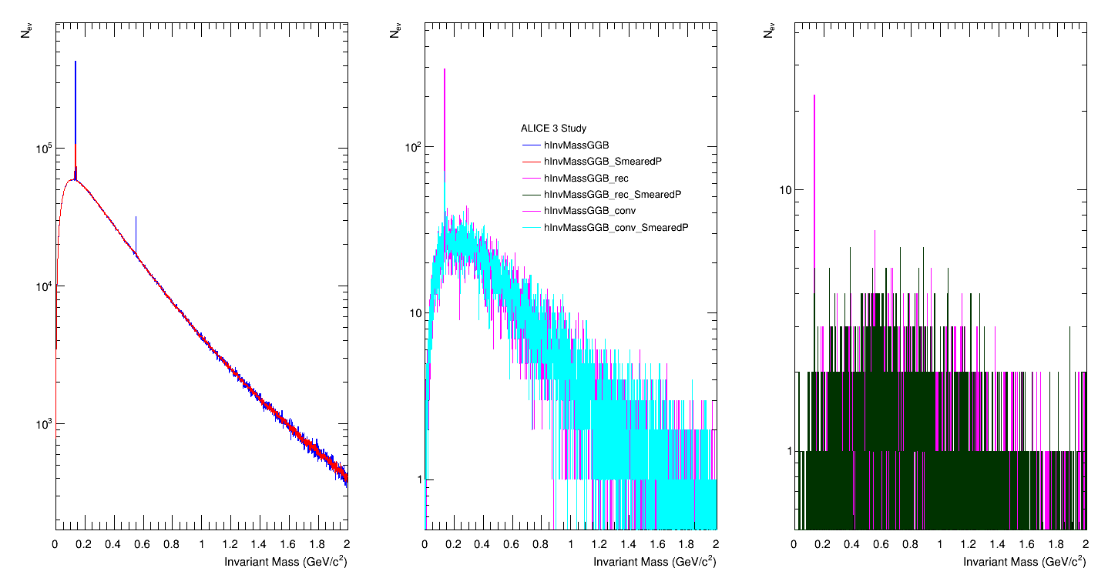
Invariant mass yield at barrel region
1
1

Slide 3
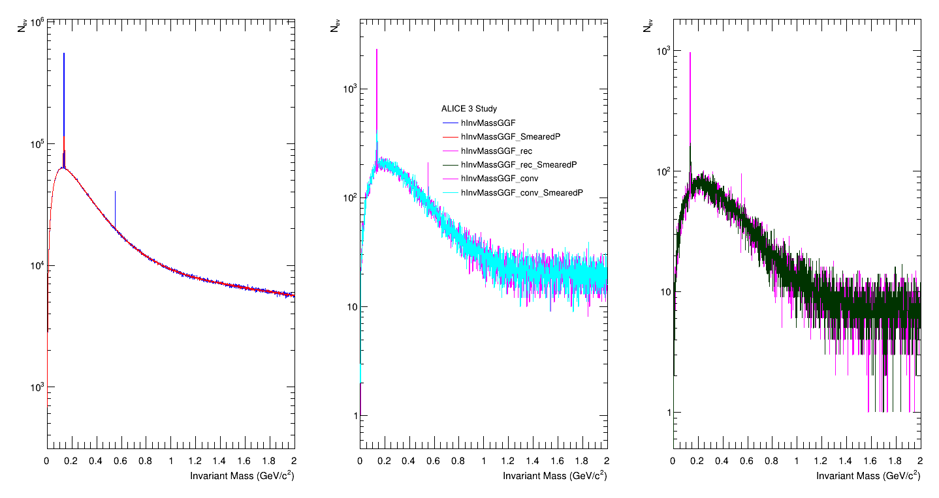
Invariant mass yield at forward region
2

Slide 4
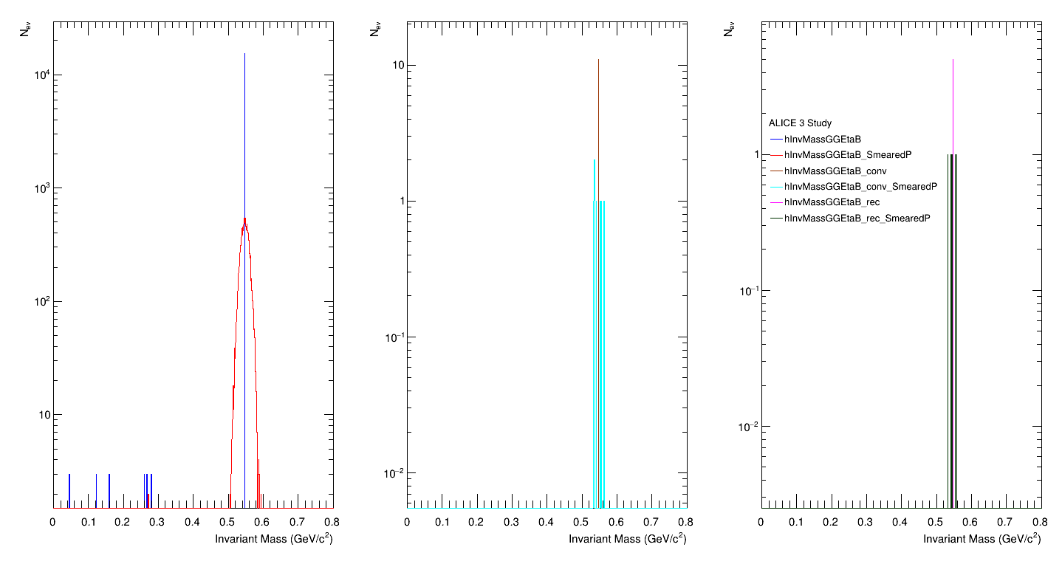
Eta Invariant mass yield at barrel region
3

Slide 5
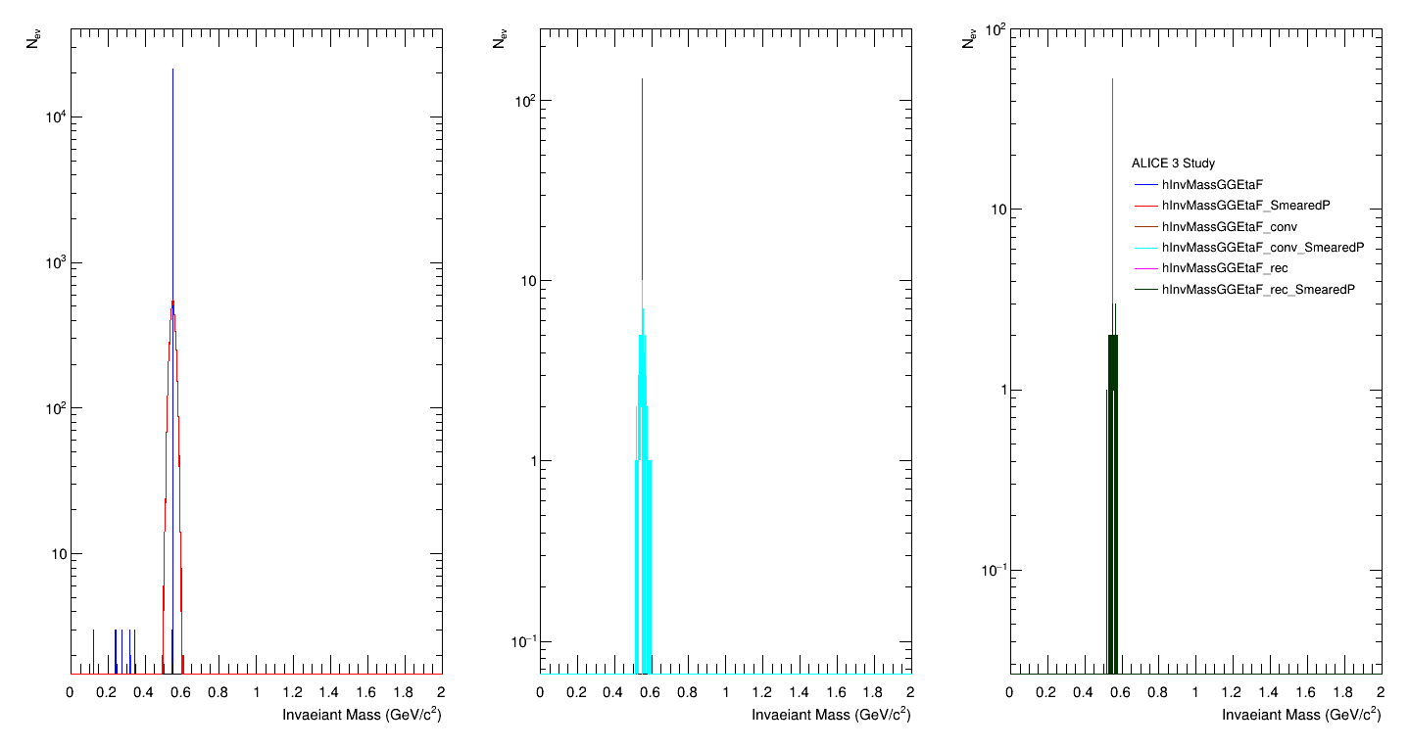
Eta Invariant mass yield at forward region
4

Slide 6
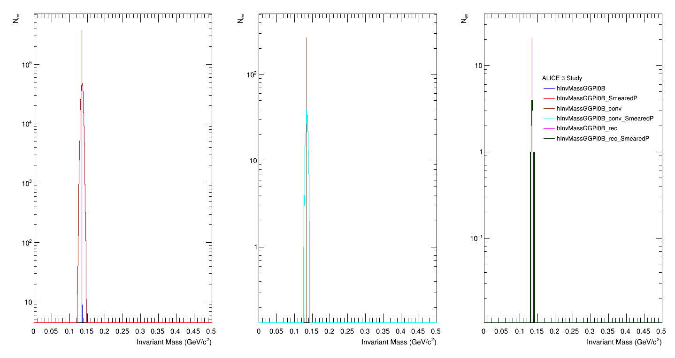
Pi0 Invariant mass yield at barrel region
5

Slide 7
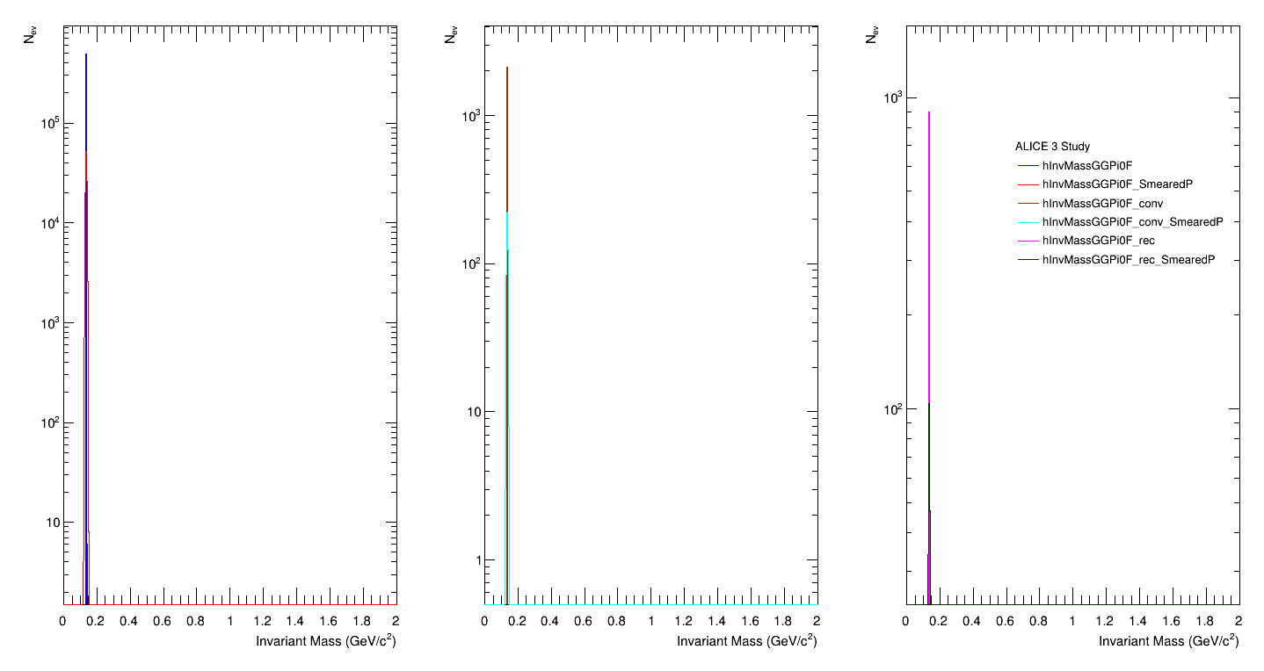
Pi0 Invariant mass yield at forward region
6

Slide 8
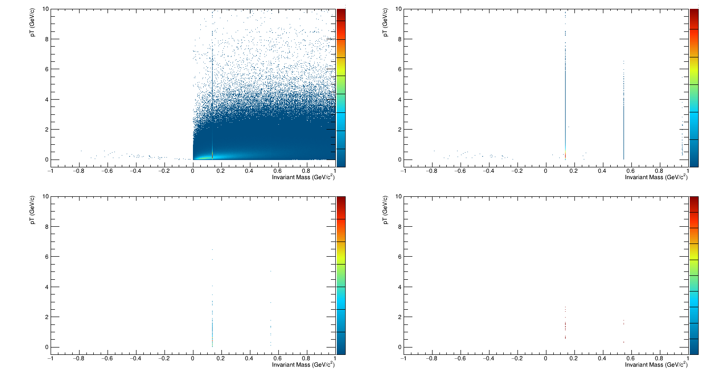
Invariant mass vs pT distribution for Same mother photon pair in barrel region
7

Slide 9
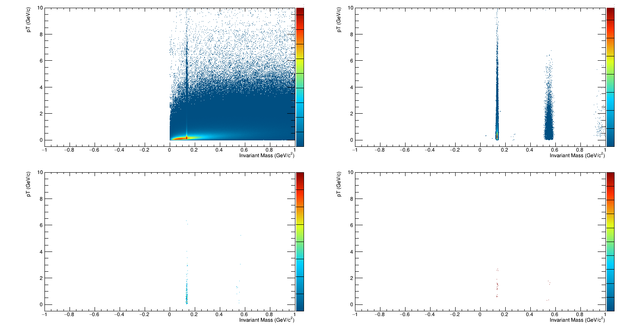
Invariant mass vs pT distribution for Same mother photon pair in barrel region with smeared P
8

Slide 10
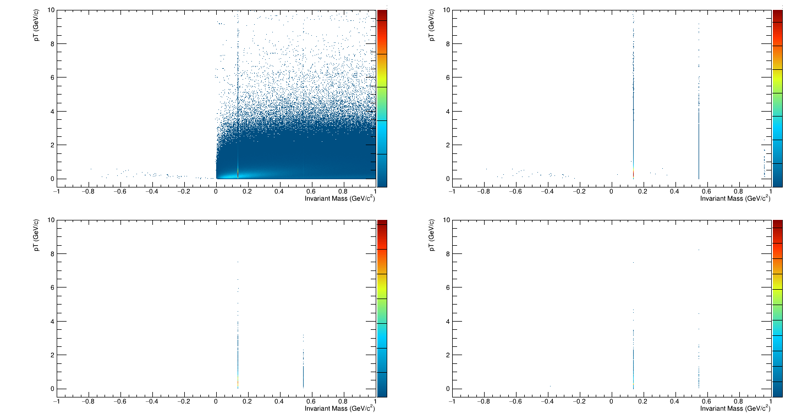
Invariant mass vs pT distribution for Same mother photon pair in forward region
9

Slide 11
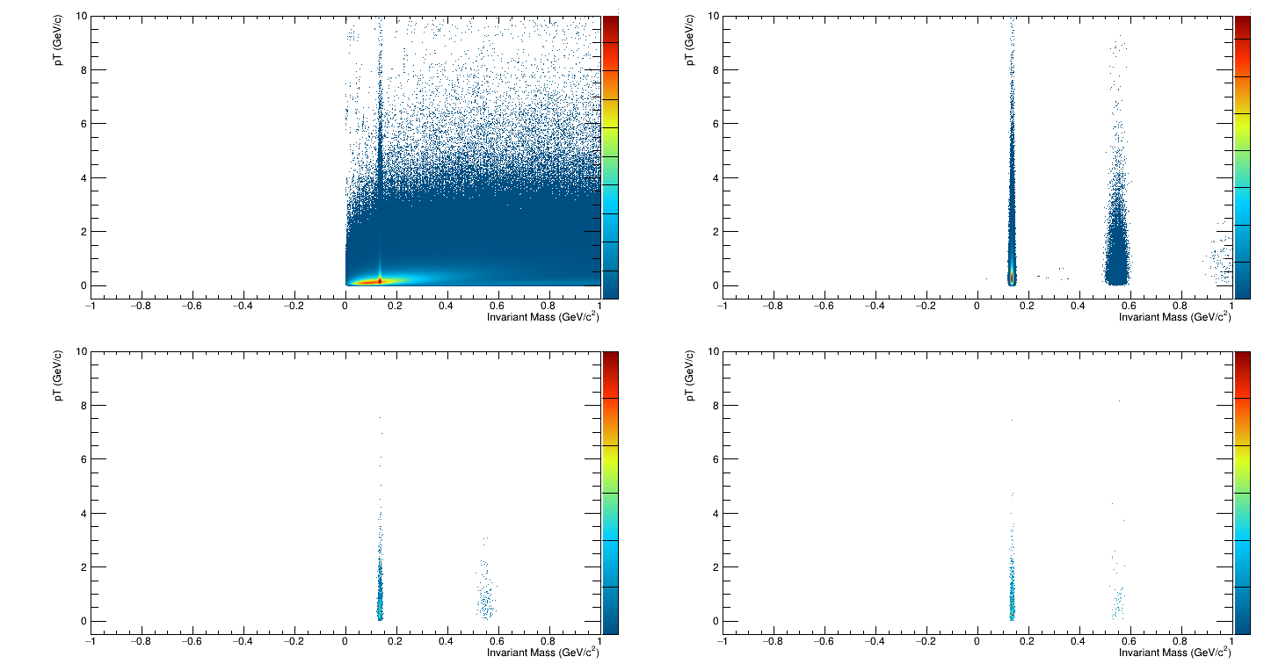
Invariant mass vs pT distribution for Same mother photon pair in forward region with smeared P
10

Slide 12
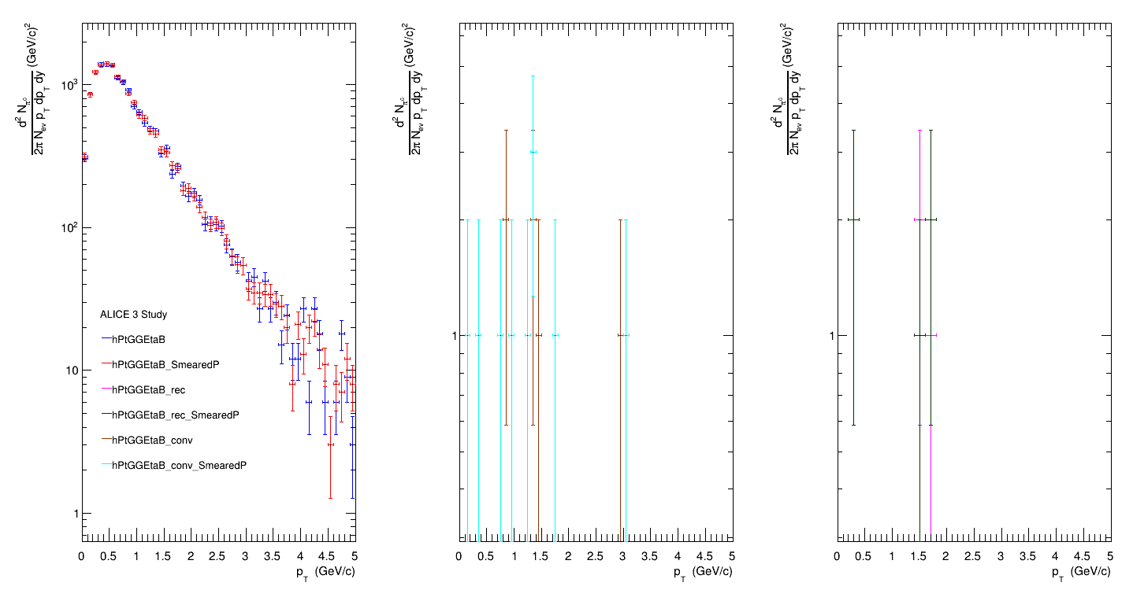
pT spectra of Eta at barrel region
11

Slide 13
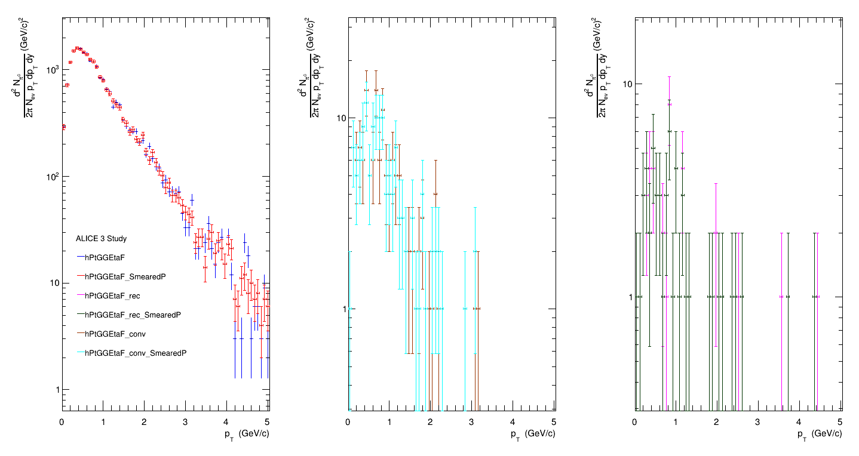
pT spectra of Eta at forward region
12

Slide 14
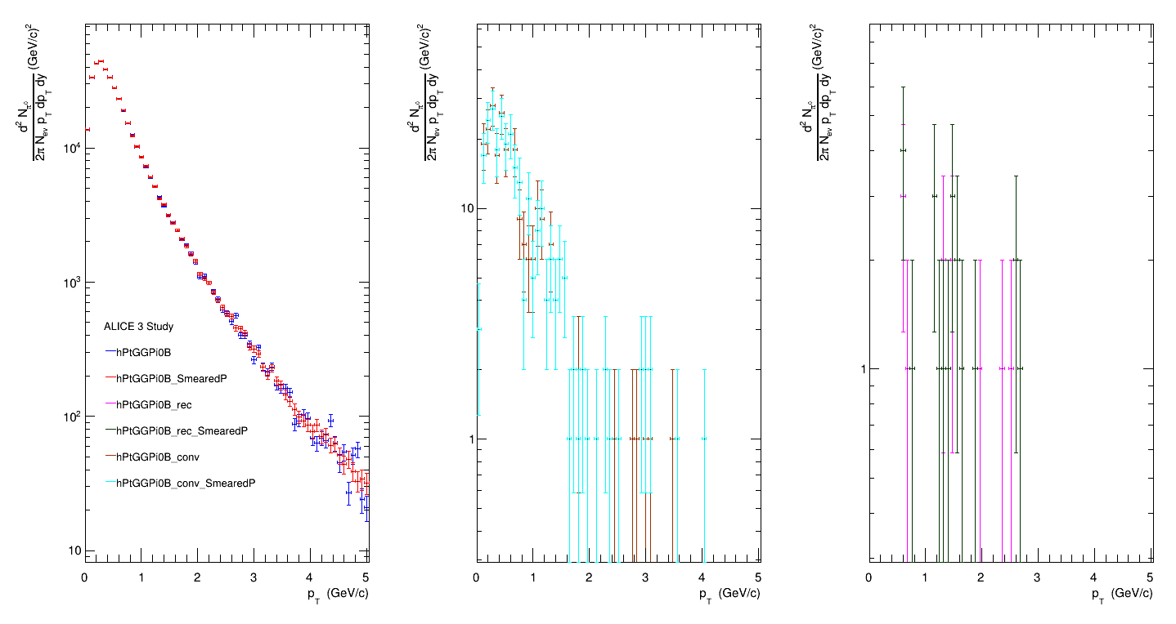
pT spectra of Pi0 at barrel region
13

Slide 15
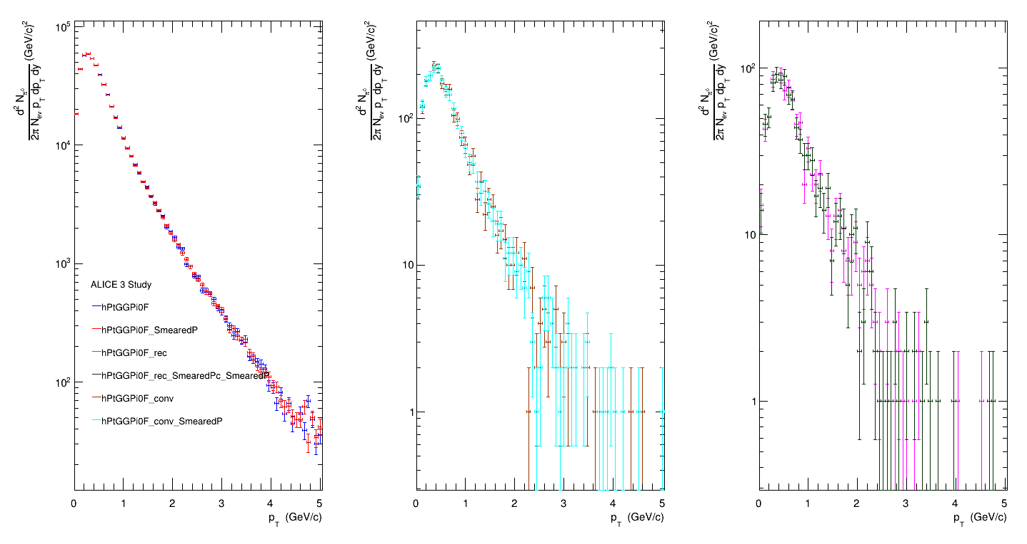
pT spectra of Pi0 at forward region
14

Slide 16
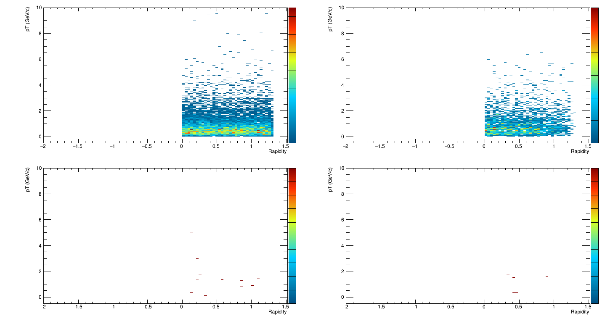
Invariant mass vs pT distribution for Same mother (Eta) photon pair in barrel region
15

Slide 17
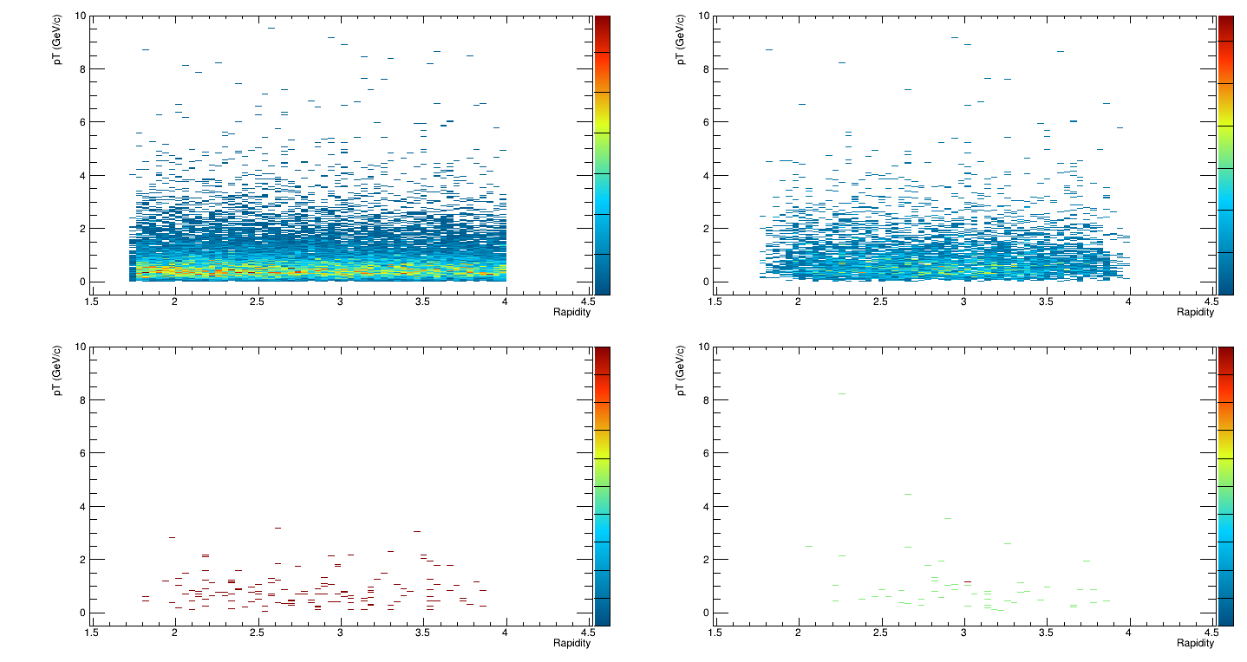
Invariant mass vs pT distribution for Same mother (Eta) photon pair in forward region
16

Slide 18
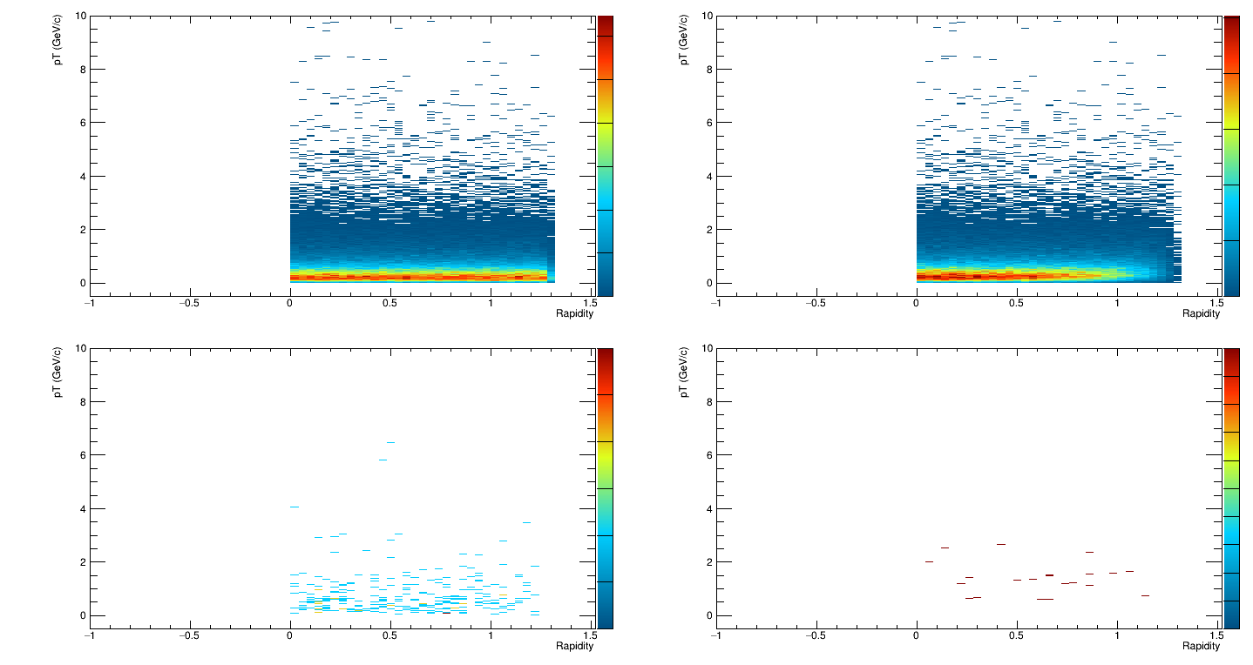
Invariant mass vs pT distribution for Same mother (Pi0) photon pair in forward region
17

Slide 19
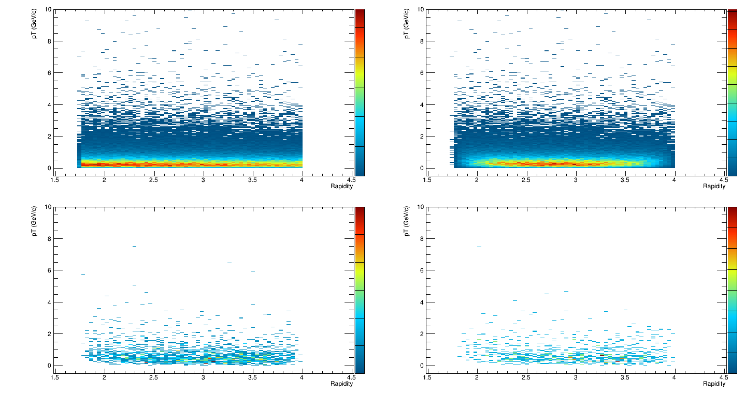
Invariant mass vs pT distribution for Same mother (Pi0) photon pair in forward region with smeared P
18

Slide 20
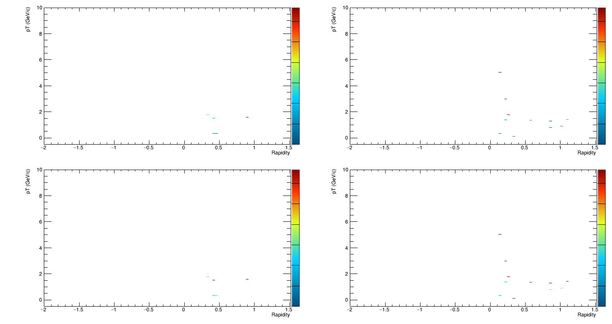
Rapidity-pT Eta-ratio in barrel region
19

Slide 21
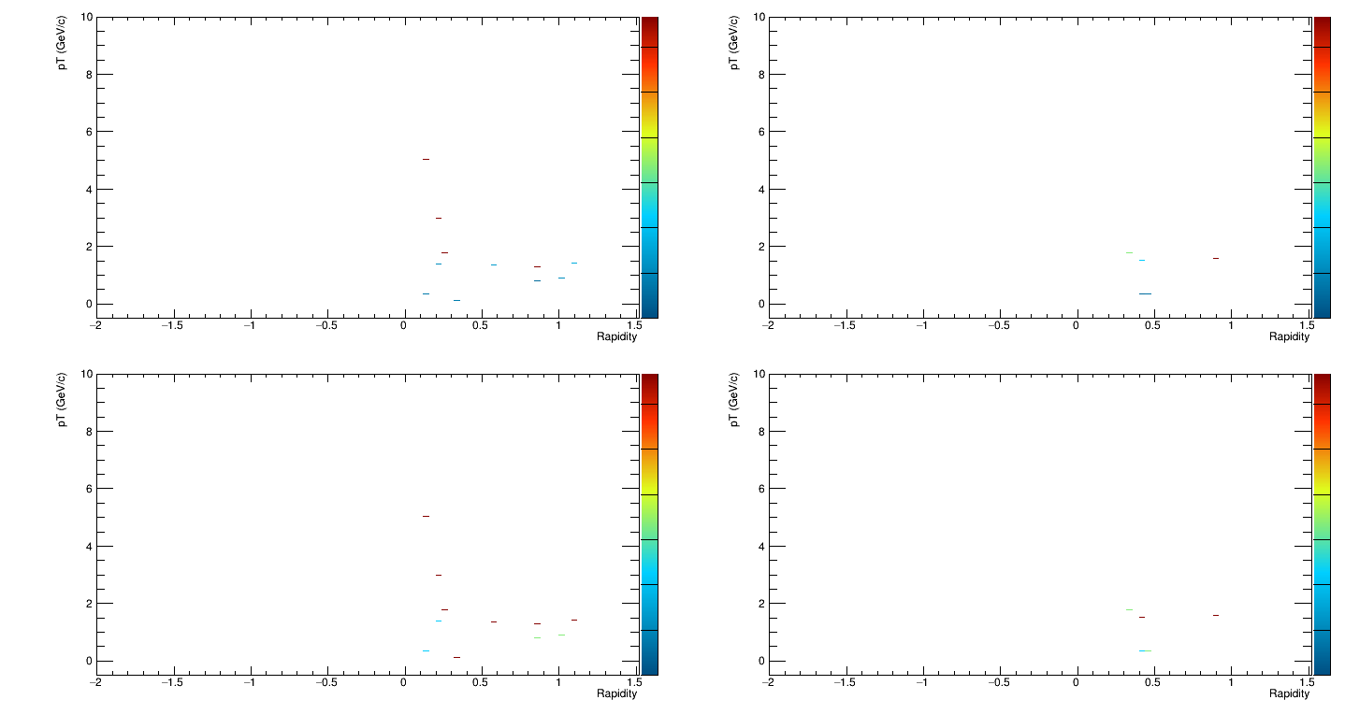
Rapidity-pT Eta-ratio in barrel region with smeared P
20

Slide 22
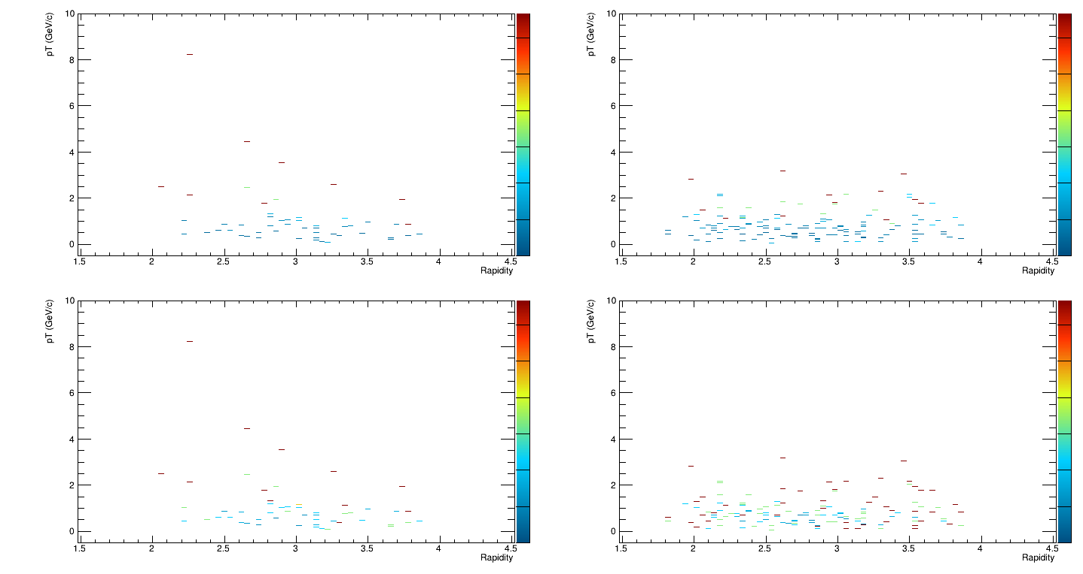
Rapidity-pT Eta-ratio in forward region
21

Slide 23
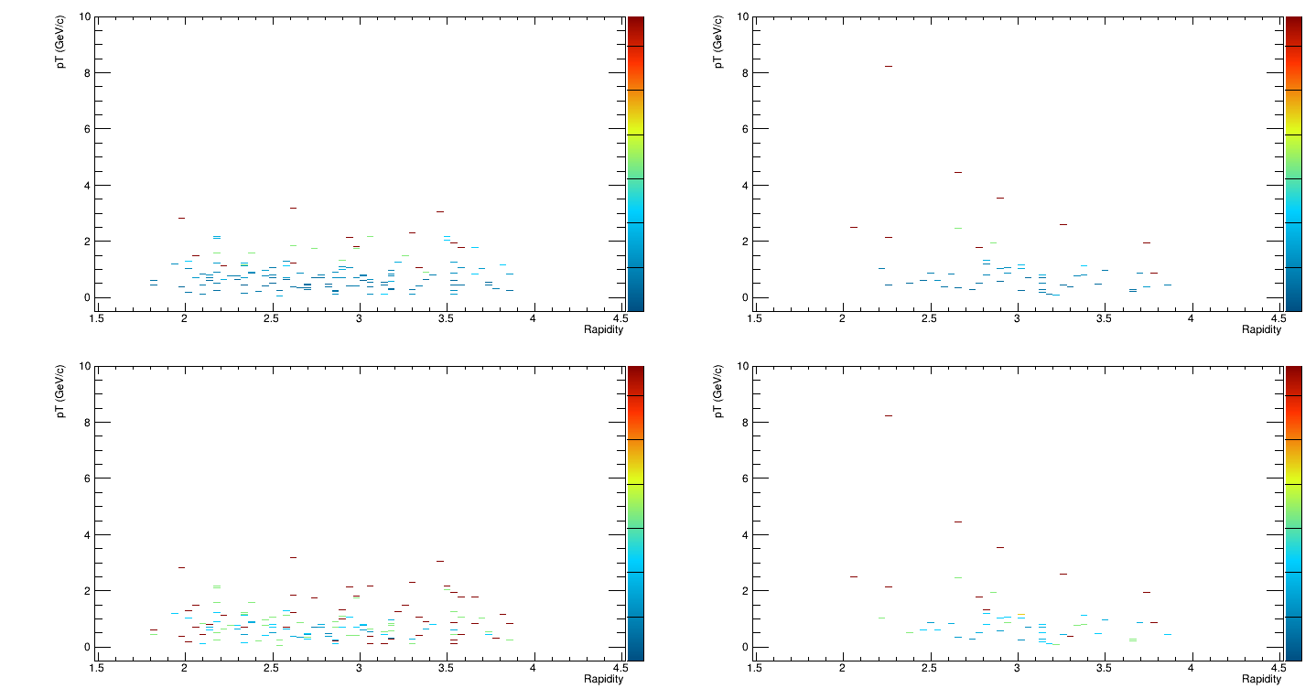
Rapidity-pT Eta-ratio in forward region with smeared P
22

Slide 24
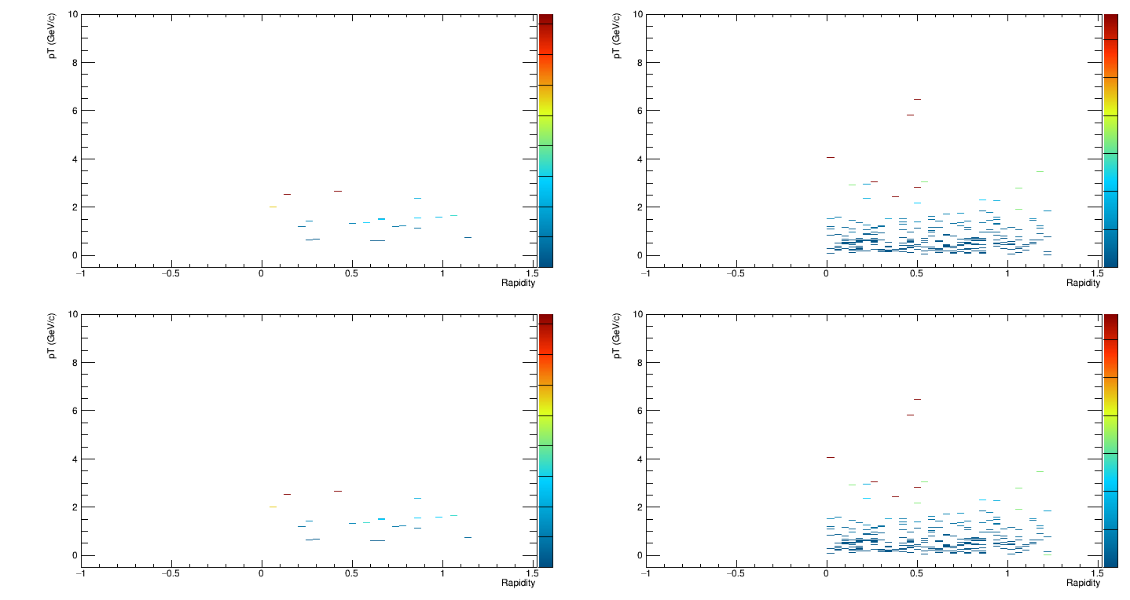
Rapidity-pT Pi0-ratio in barrel region
23

Slide 25
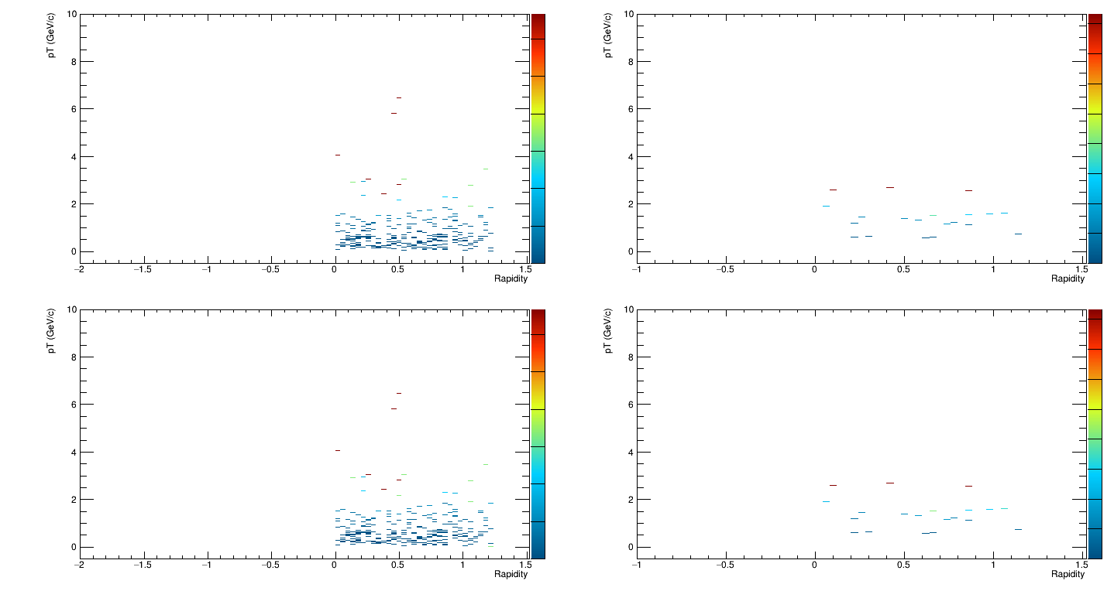
Rapidity-pT Pi0-ratio in barrel region with smeared P
24

Slide 26
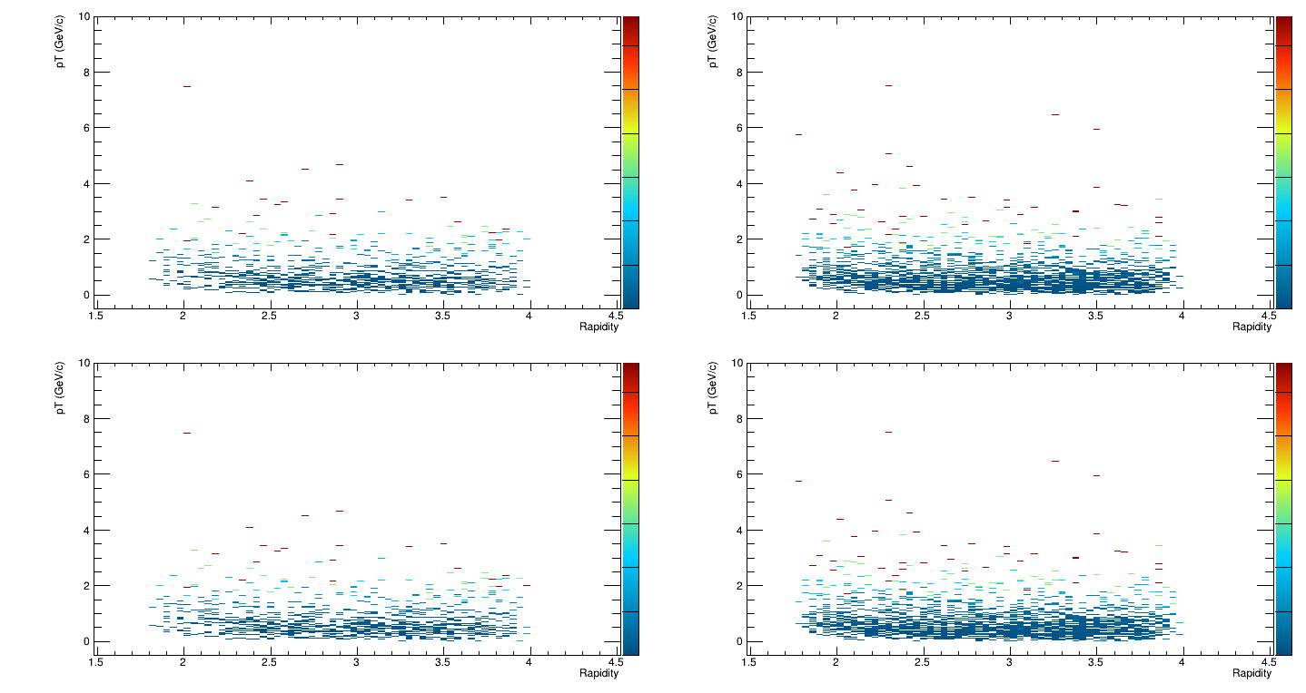
Rapidity-pT Pi0-ratio in forward region
25

Slide 27
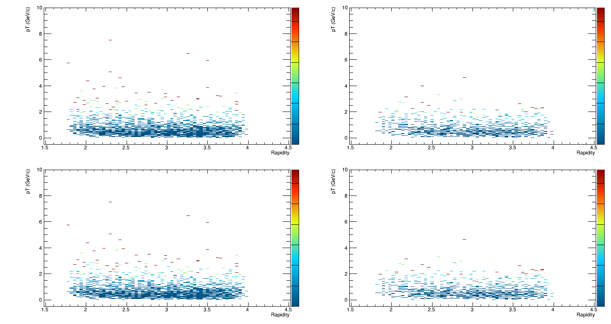
Rapidity-pT Pi0-ratio in forward region with smeared P
26

Slide 28
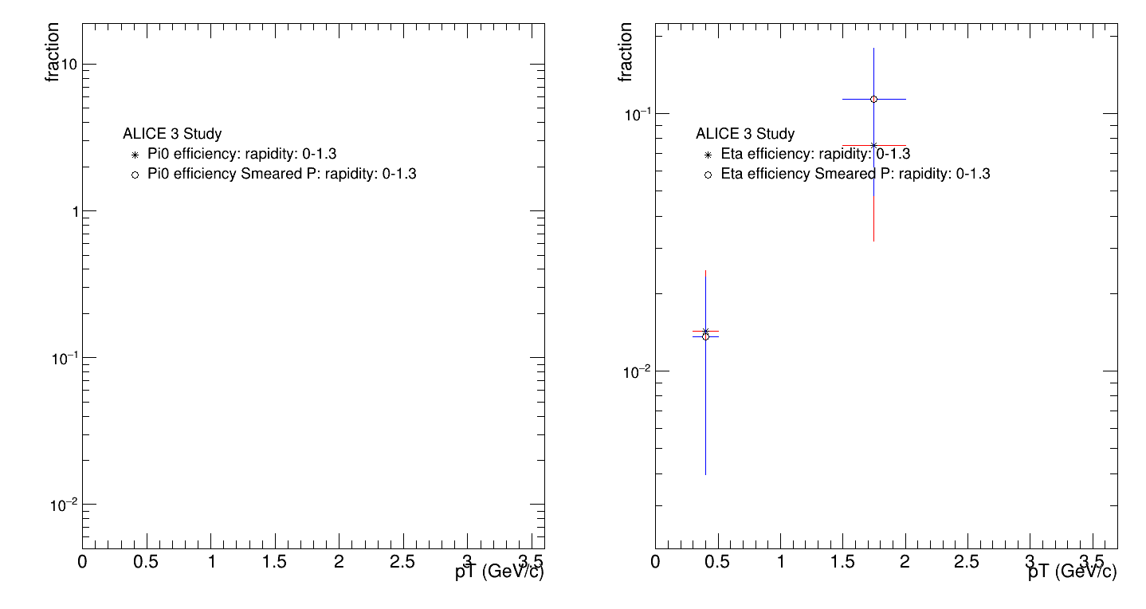
Pi0 and Eta efficiency at barrel region for photon p cut = 0.1 Gev
27

Slide 29
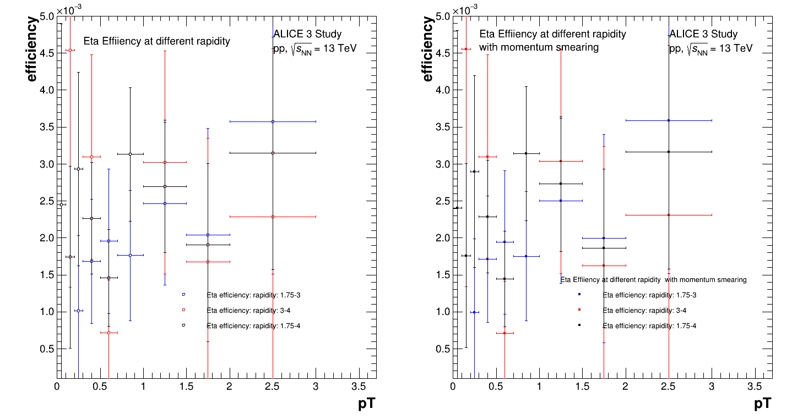
Eta efficiency at forward region for photon p cut = 0.1 GeV
28

Slide 30
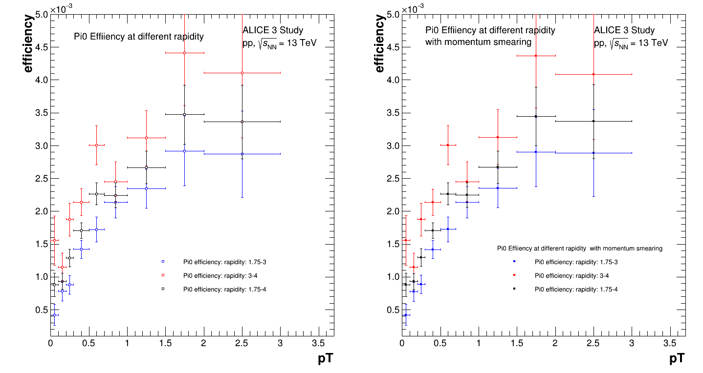
Pi0 efficiency at forward region for photon p cut = 0.1 GeV
29

Slide 31
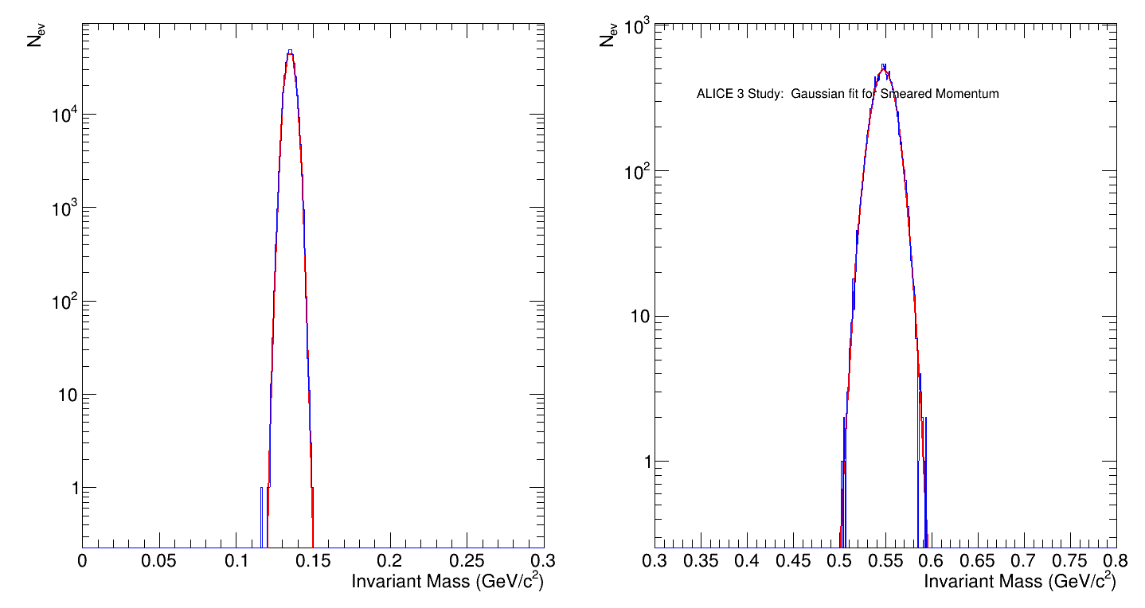
Invariant mass in barrel region with Gaussian Fit
30

Slide 32
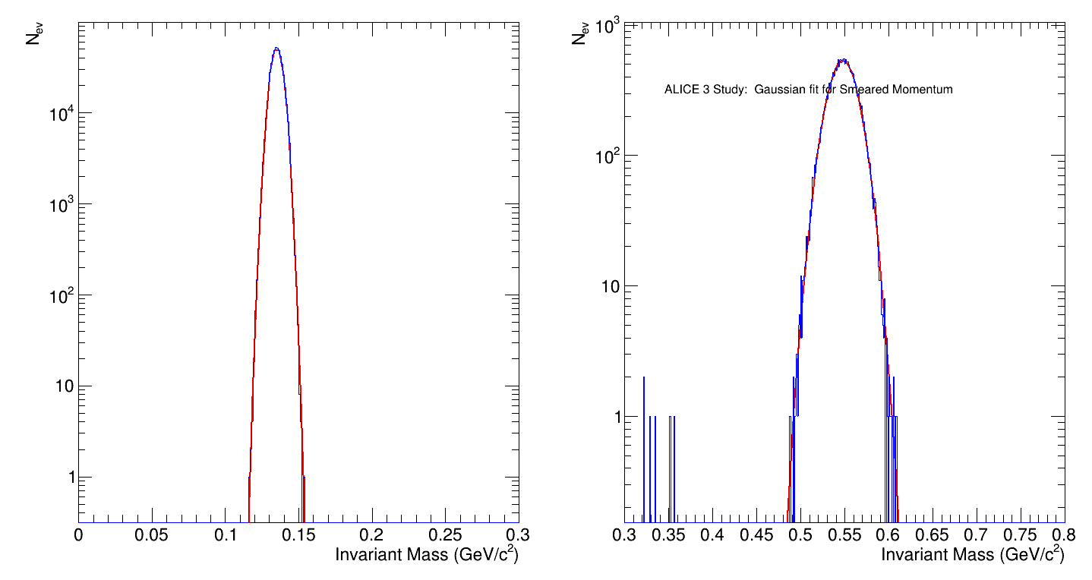
Invariant mass in forward region with Gaussian Fit
31

