Slide 1




ALICE 3 light meson update
Abhishek Nath
Dept. of Physics and Astronomy
PI, Uni Heidelberg
18th Nov 2022 : Update on Systematic studies

Slide 2
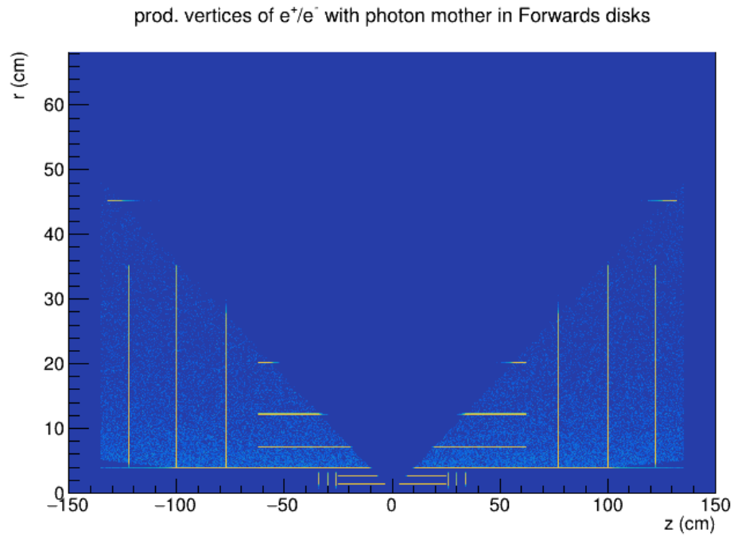
Neutral meson Monte-Carlo performance studies using PCM
Event Generator
Photon Performance
Meson Performance
Full simulations
Fast simulations
 | Barrel | Forward
Rapidity | 0<|y|<1.3 | 1.75<|y|<4
Conversion | R<22 cm | 0<Z<135 cm
Reconstruction | 5 layers 22<R<100 cm | 5 disks 135<|Z|<200 cm
- Full simulations of pp √s = 14 and PbPb √s = 5.52 TeV using PYTHIA 8.2
- pp: 9.6∗10^6 ; PbPb: 19k events
1

Slide 3
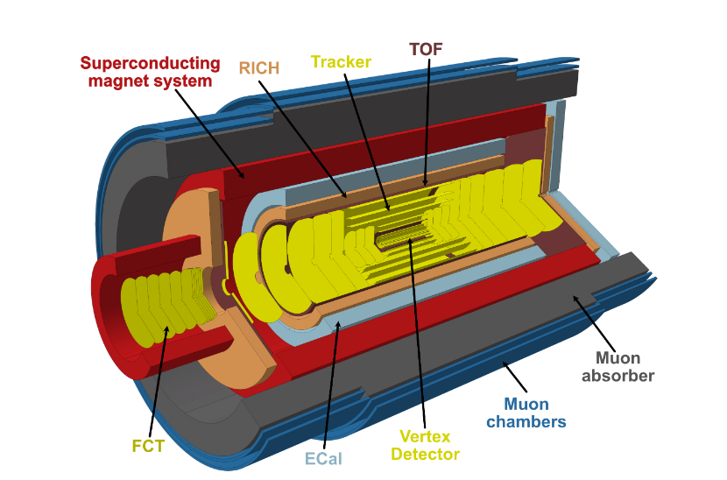
ALICE 3 and recent developments
- ALICE 3: An ultra-light silicon wafer based detector system with very low momentum tracking capabilities for high luminosity collisions
- High-resolution vertex detector, PID over large acceptance
- Photons (1 MeV/c - 50 GeV/c), wide rapidity range (|y | < 4) : → ECAL → FCT → PCM

Slide 4
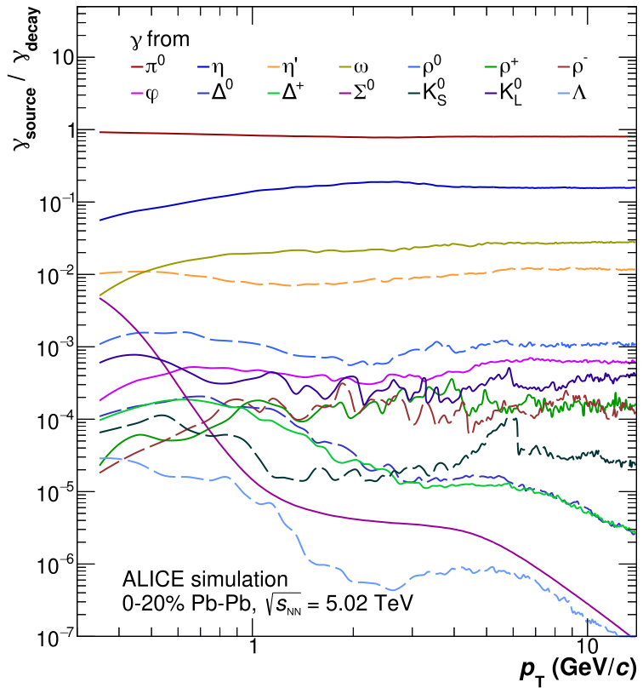
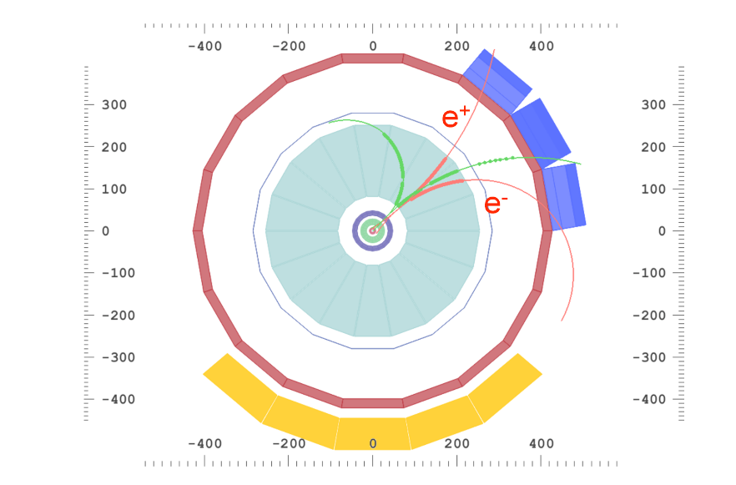
PCM & Direct Photons
- PCM :Converted photons measured by reconstructing e+e− pairs using a V0 algorithm.
- Photon momentum resolution linked to charged particle momentum resolution.
- Good measurement at low p_{T}
- π0 and η are reconstructed in their respective 2γ decay channel
- Can escape QCD medium without being affected
- Carry information on medium’s space-time expansion and temperature: hadron matter phase diagram
- High precision decay photon measurement necessary. Main contributions from π0 and η mesons

Slide 5
PbPb results

Slide 6
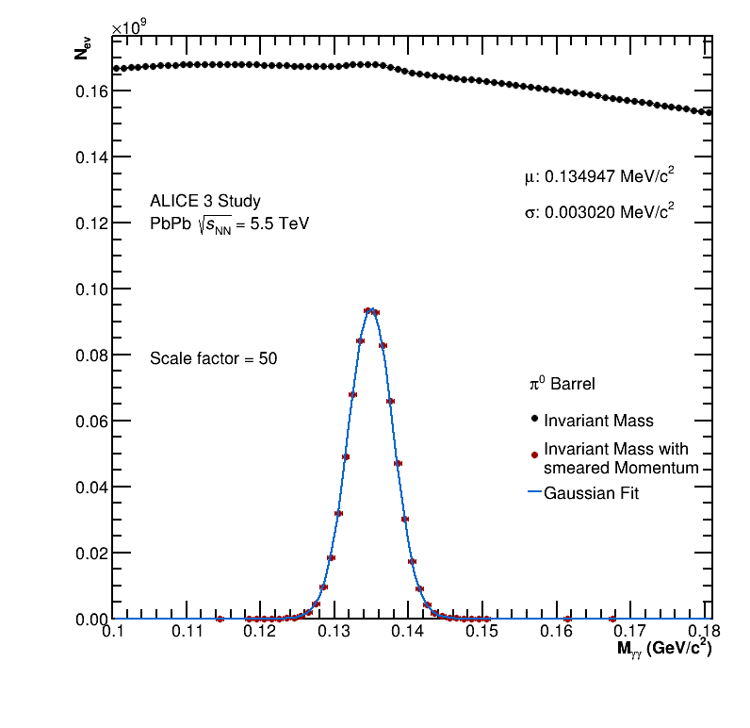
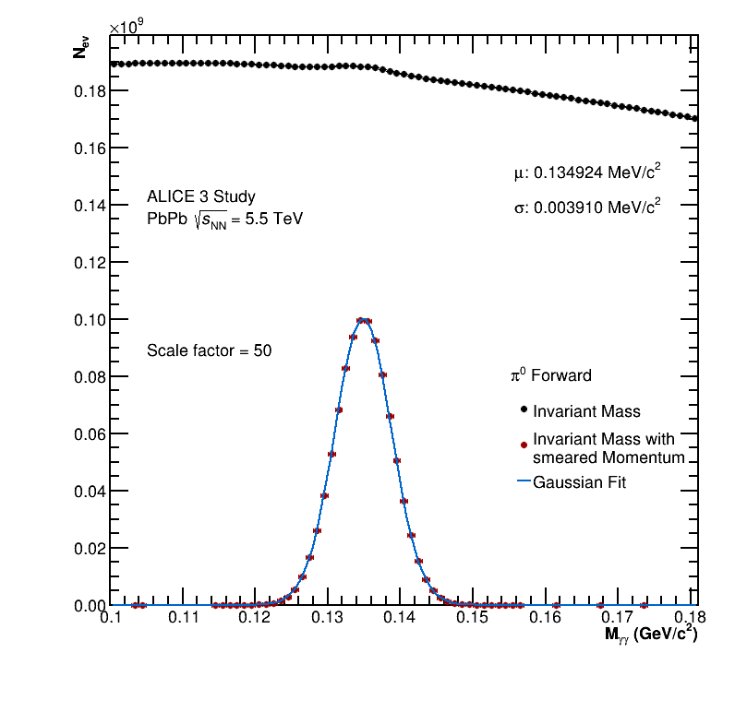
PbPb Results: Mass resolution Pi0
5

Slide 7
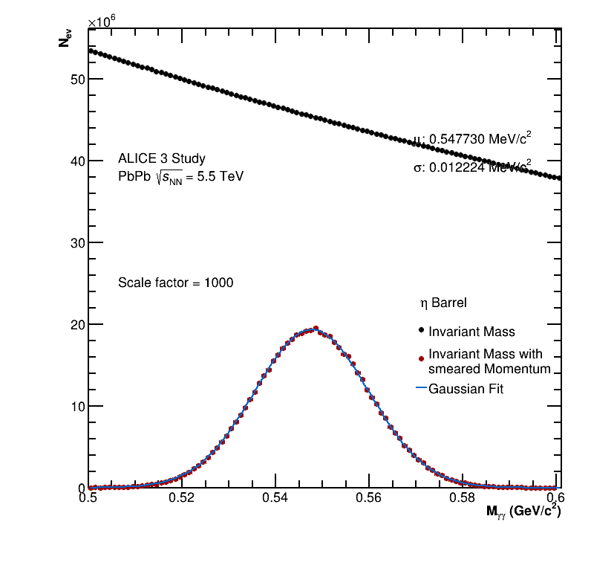
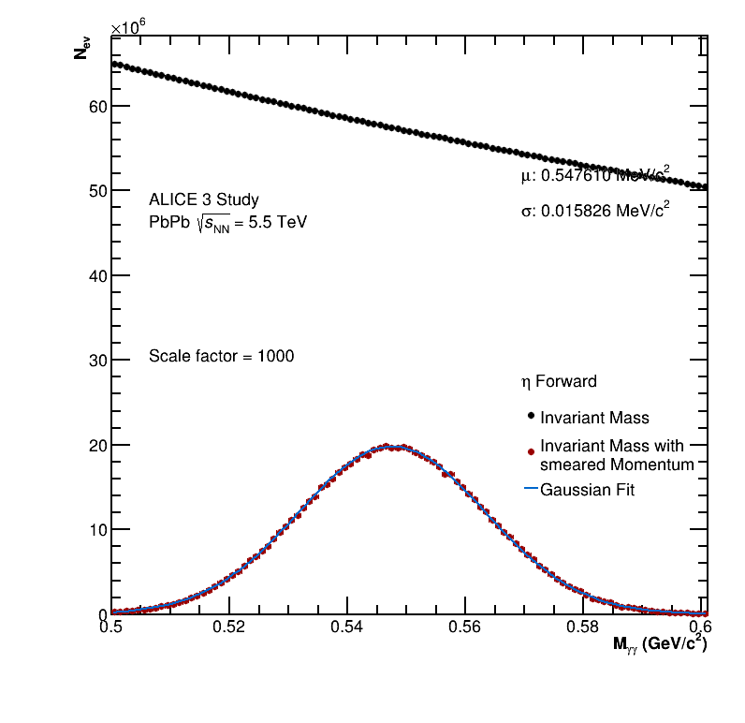
PbPb Results: Mass resolution Eta
6

Slide 8
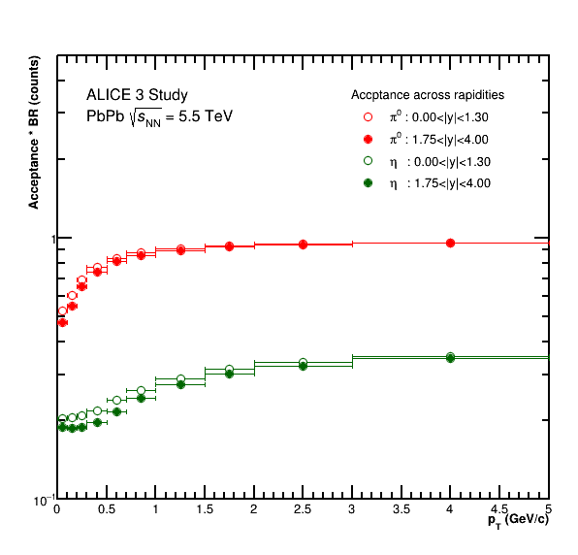
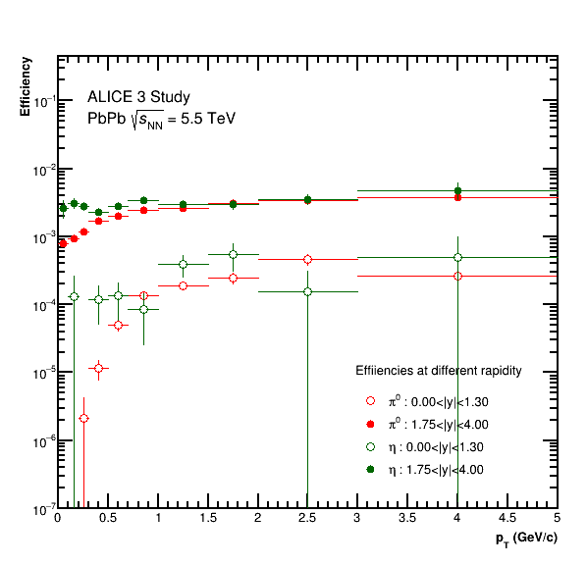
PbPb Results: Acceptance and Efficiency
7

Slide 9
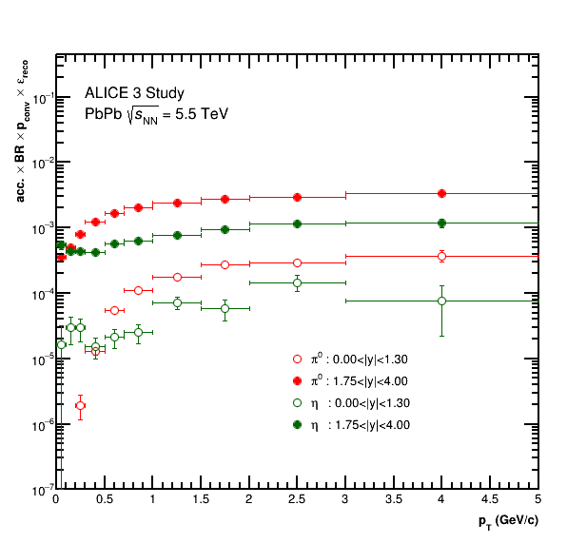
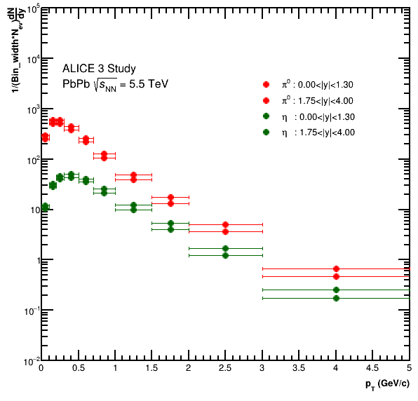
PbPb Results: Net Efficiency and PYTHIA dN/dy
8

Slide 10
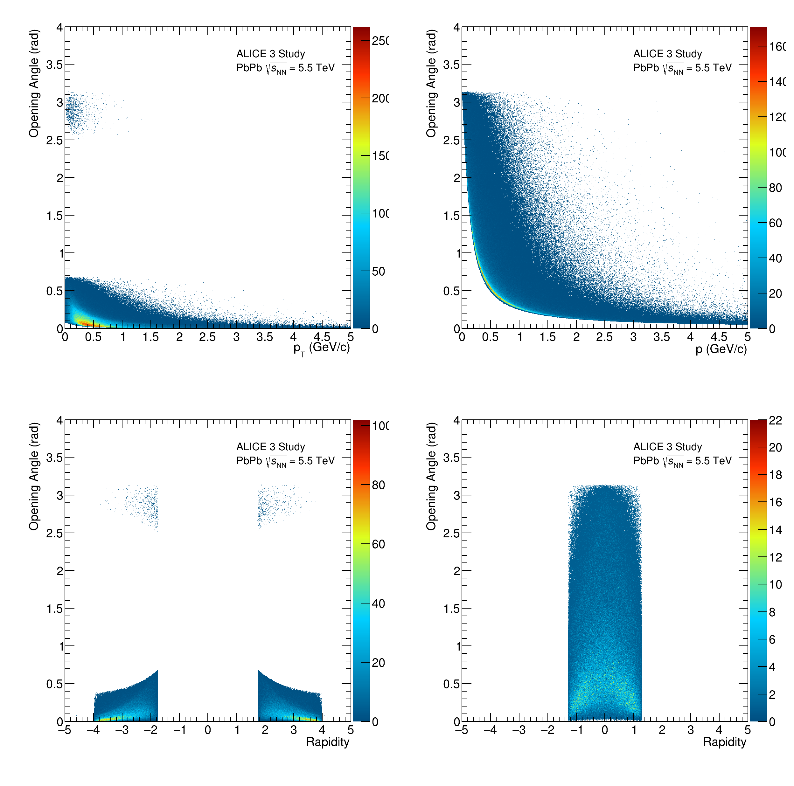
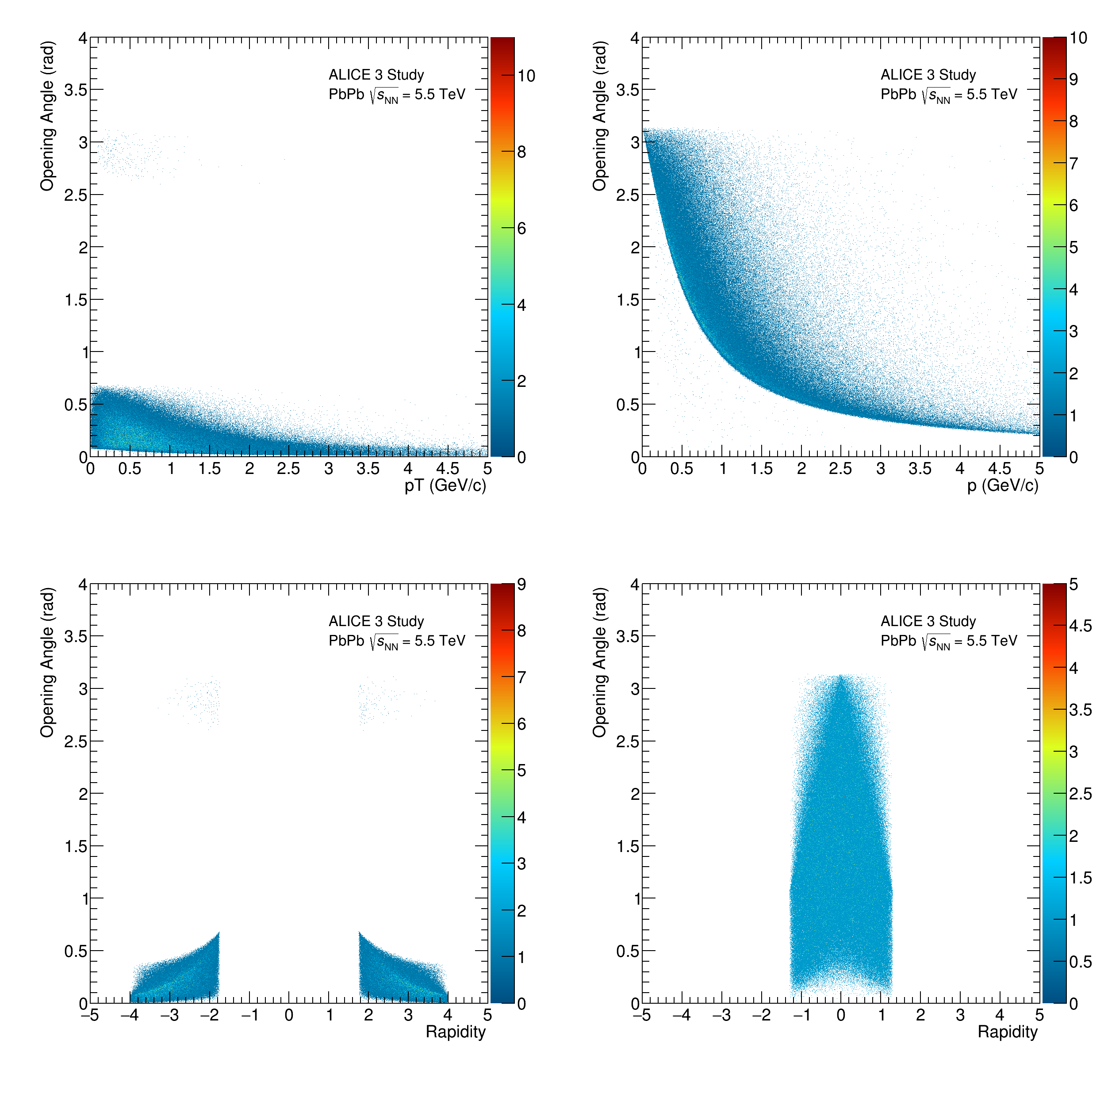
PbPb Results: Opening angle
9

Slide 11
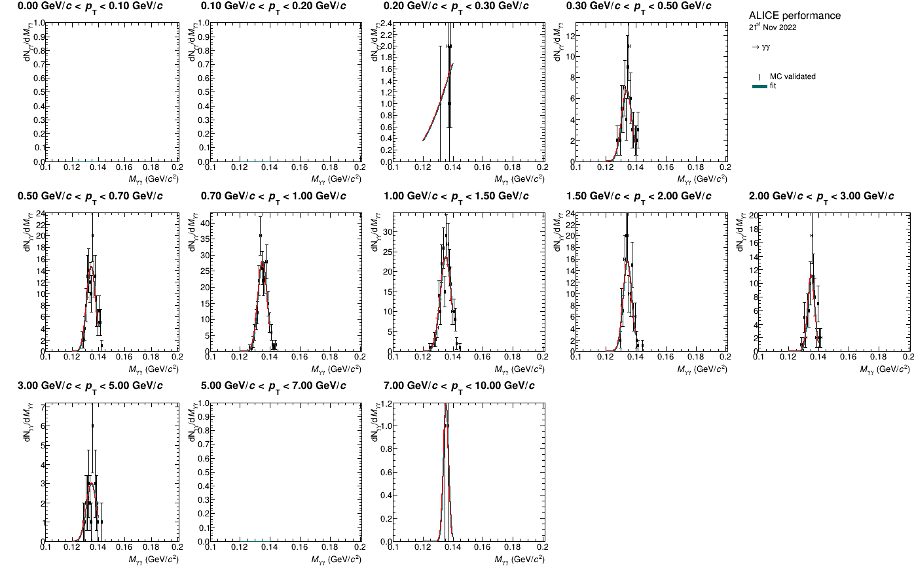
PbPb Results: Signal Fit Pi0 B
10

Slide 12
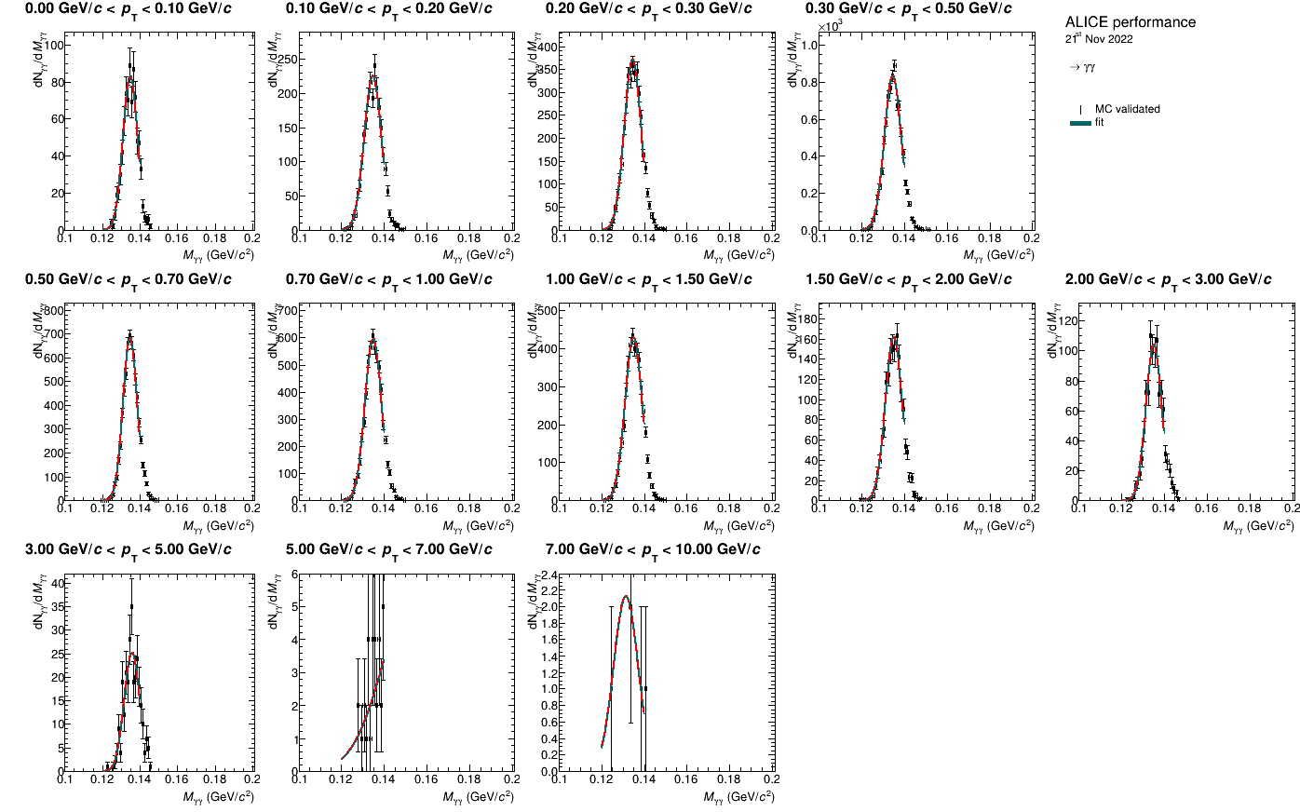
PbPb Results: Signal Fit Pi0 F
11

Slide 13
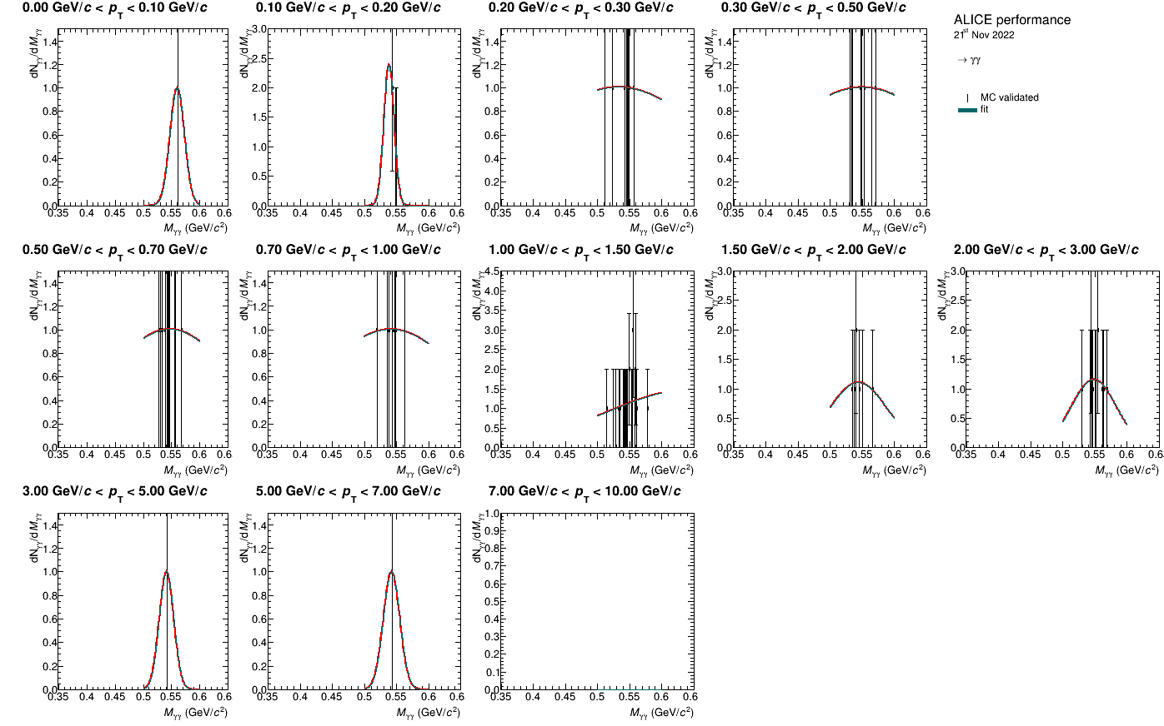
PbPb Results: Signal Fit Eta B
12

Slide 14
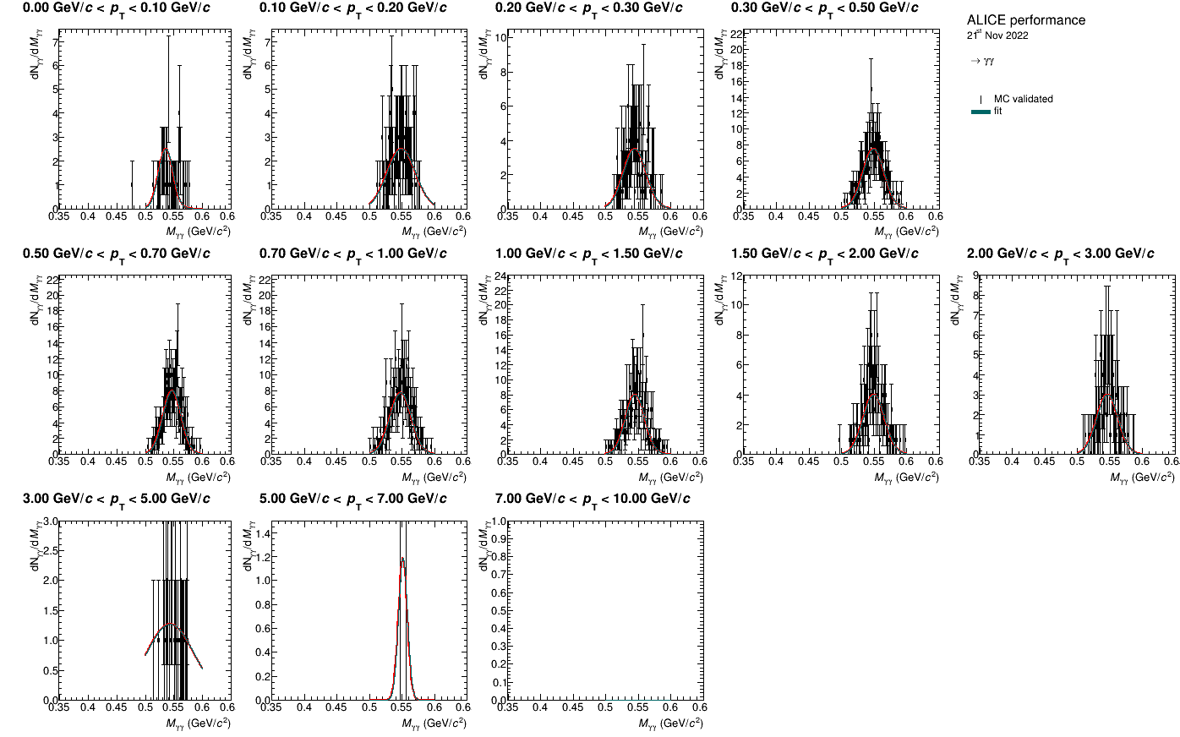
PbPb Results: Signal Fit Eta F
13

Slide 15
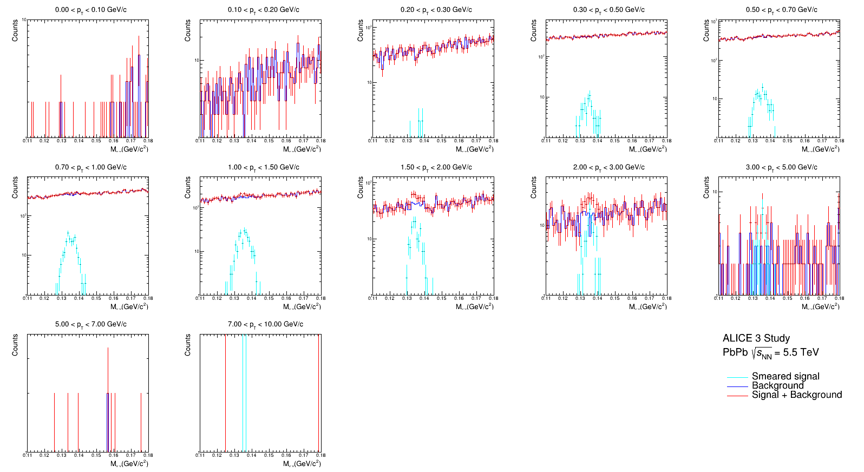
PbPb Results Pi0 B: Signal and Background comparison
14

Slide 16
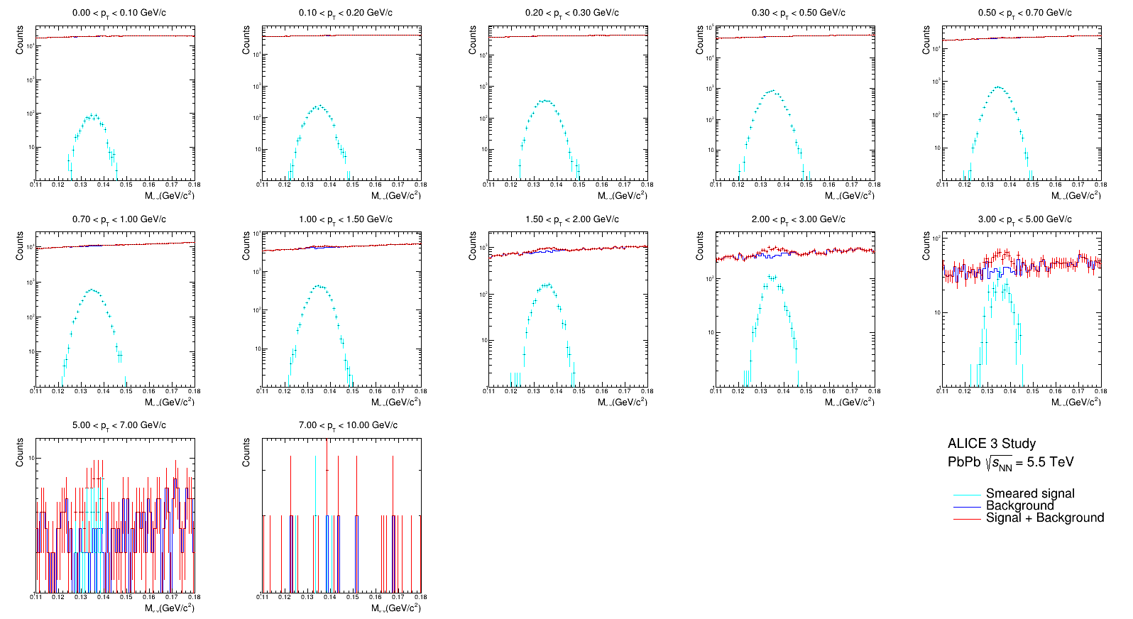
PbPb Results Pi0 F: Signal and Background comparison
15

Slide 17
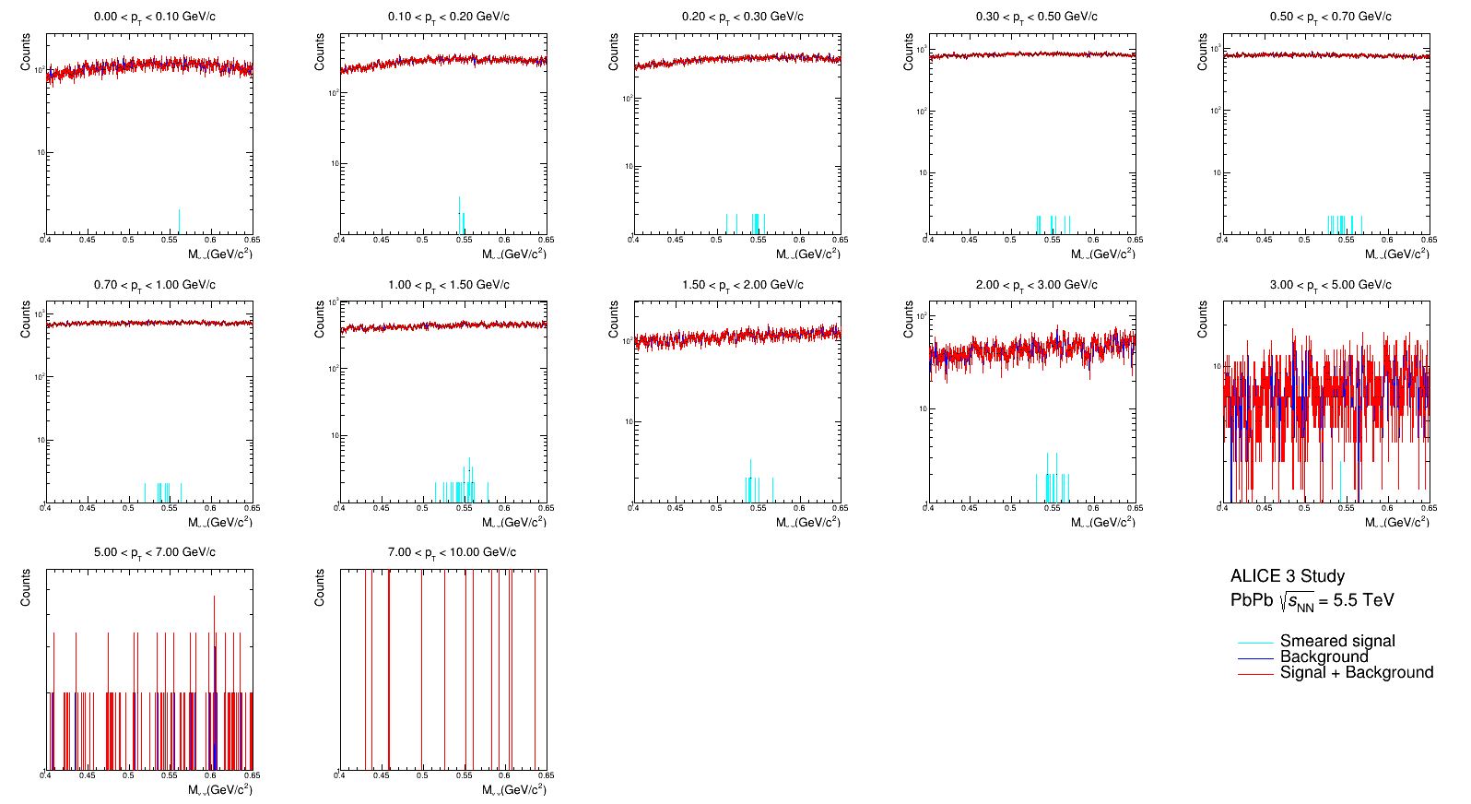
PbPb Results Eta B: Signal and Background comparison
16

Slide 18
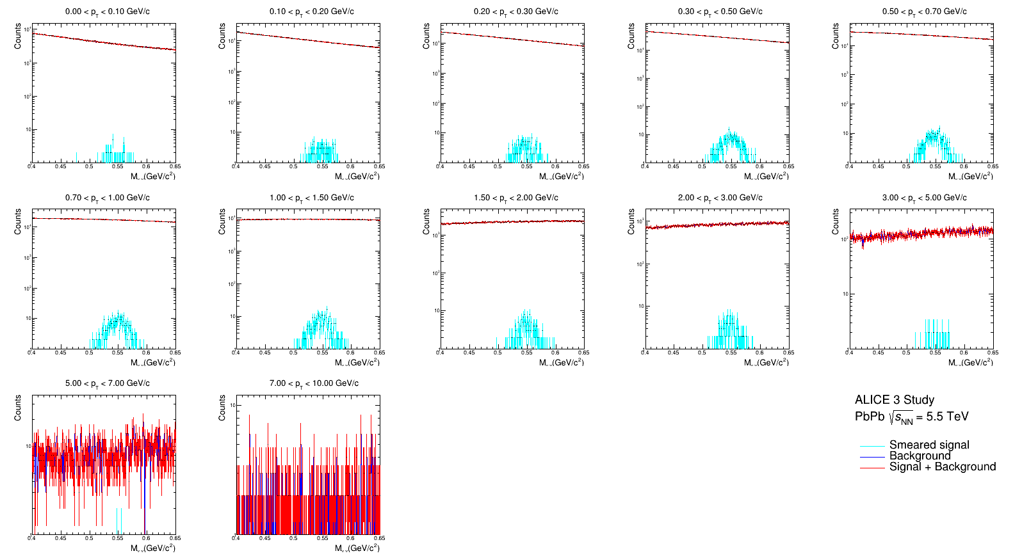
PbPb Results Eta F: Signal and Background comparison
17

Slide 19
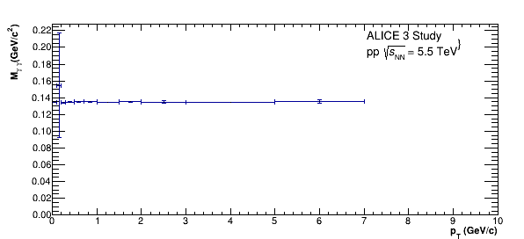
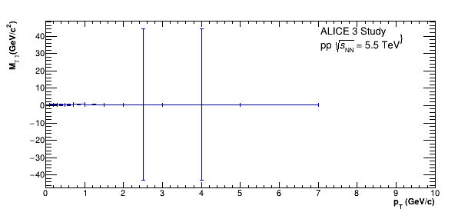
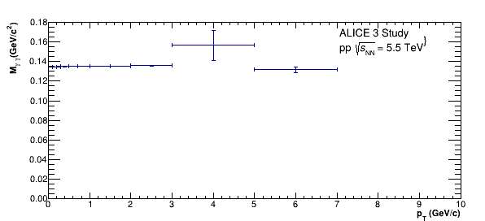
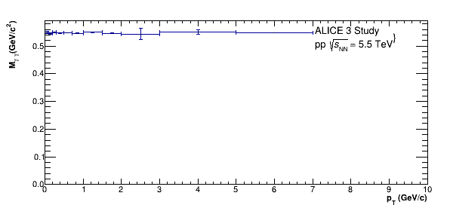
PbPb Results: Gaussian fitted mass
18

Slide 20
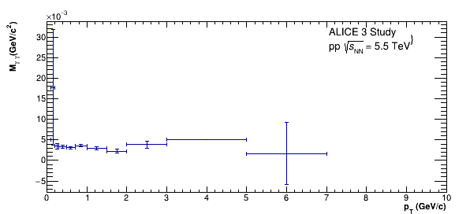
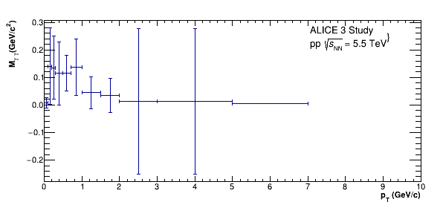
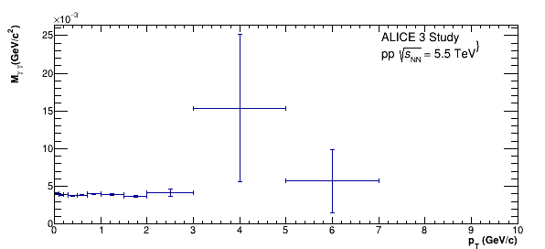
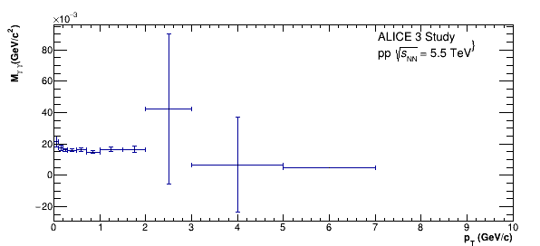
PbPb Results: Gaussian fitted sigma
19

Slide 21
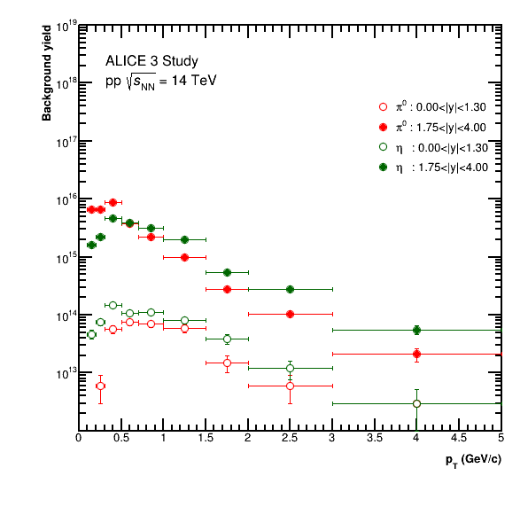
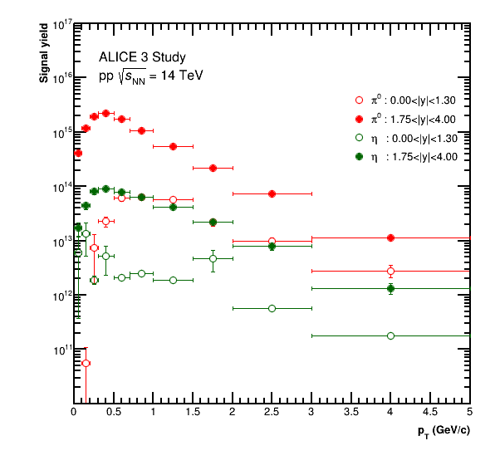
PbPb Results: Net Background and Net Signal
20

Slide 22
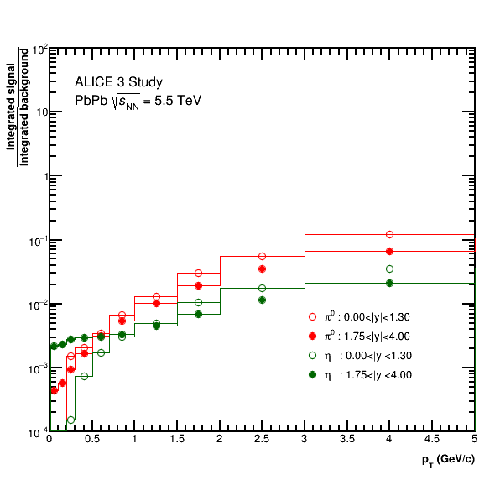
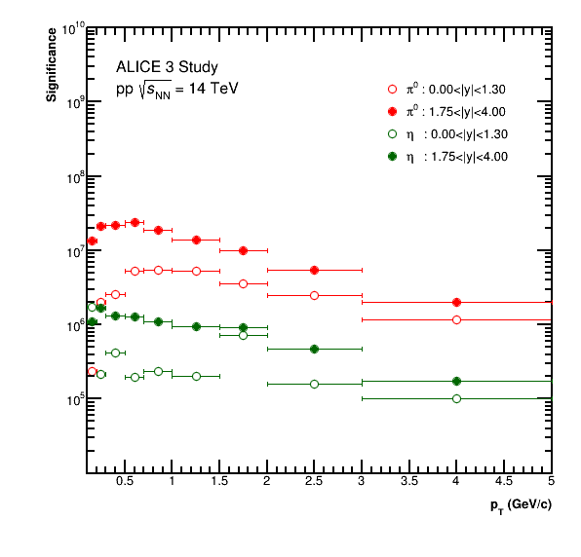
PbPb Results: signal to background ratio and Significance
21

Slide 23
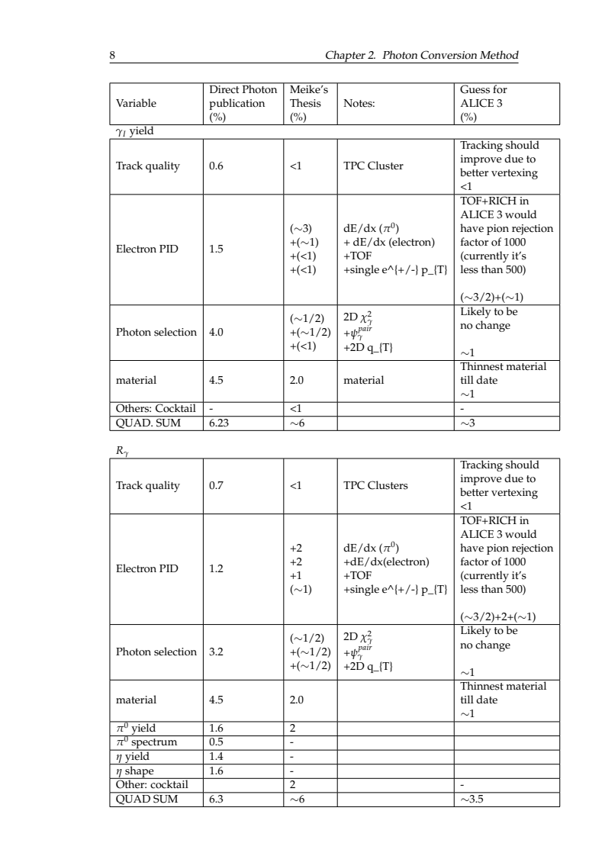
Systematic error : assumptions
A probably reduction from ~6% to ~3% (3.5%) for both Inclusion photon yield (and Double ratio)
Currently working through the systematic error on theory curves (https://arxiv.org/abs/2106.11216) using two different systematic error estimates at low and high pT
<number>

Slide 24
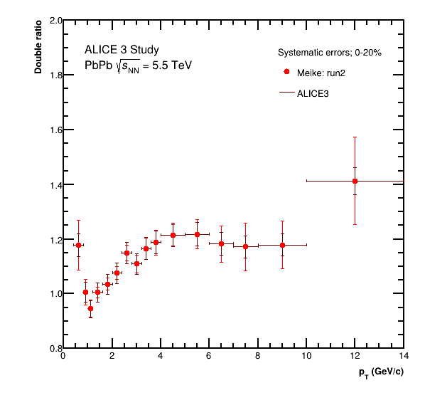
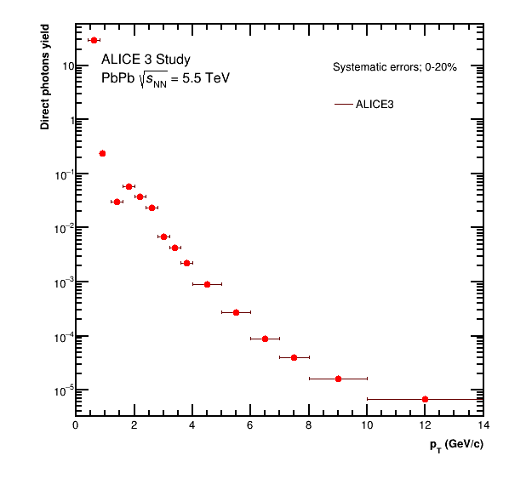
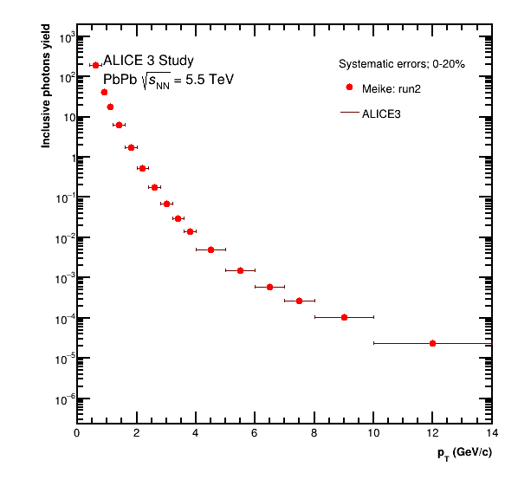
Currently used low pT estimate for all pT range
Double ratio
Direct Photon Yield
Inclusive photons yield

Slide 25
pp results

Slide 26
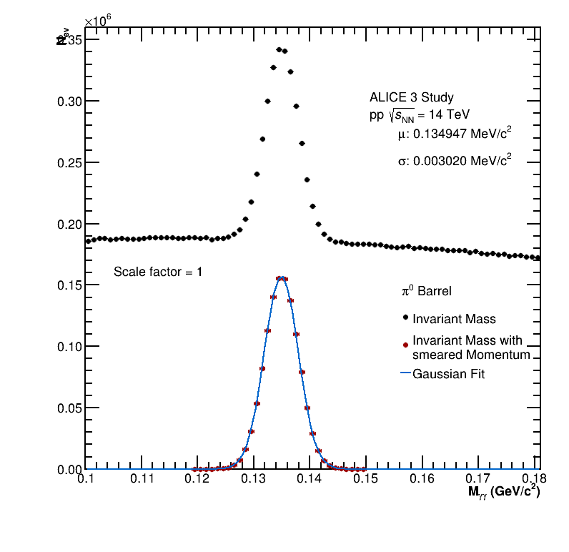
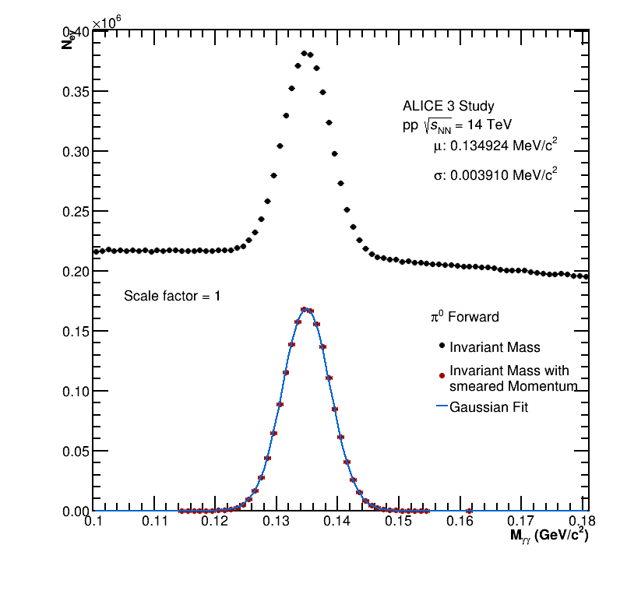
pp Results: Mass resolution Pi0
23

Slide 27
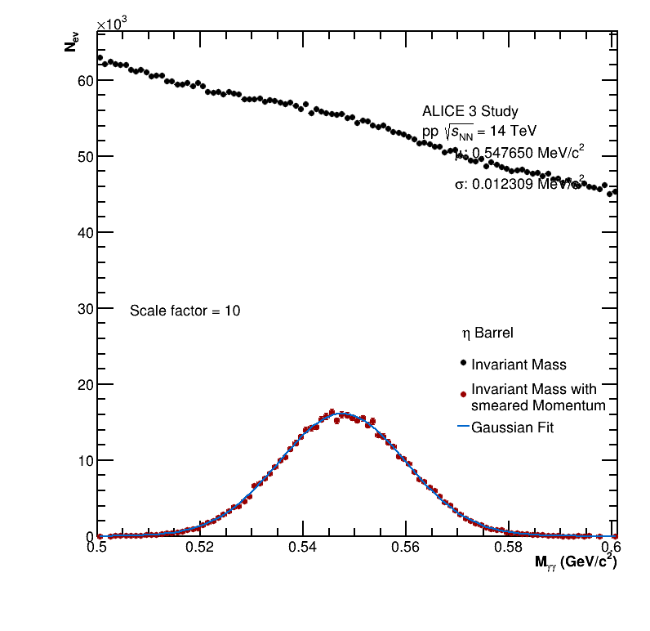
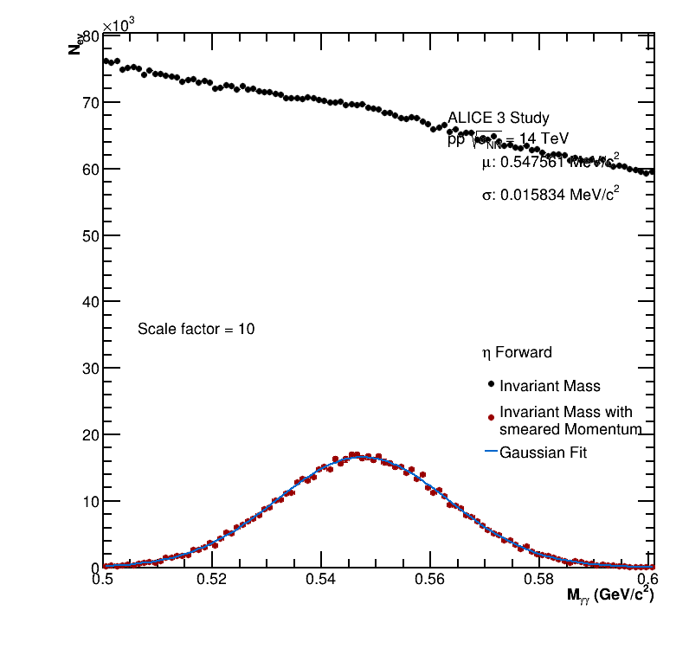
pp Results: Mass resolution Eta
24

Slide 28
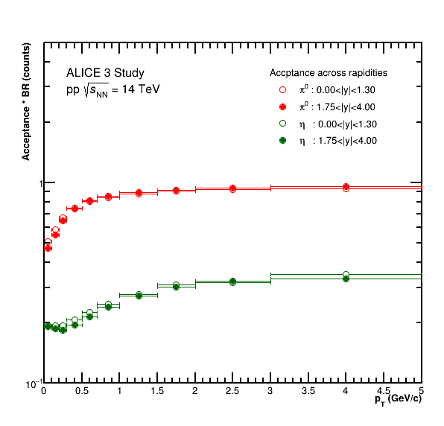
pp Results: Acceptance and Efficiency
25

Slide 29
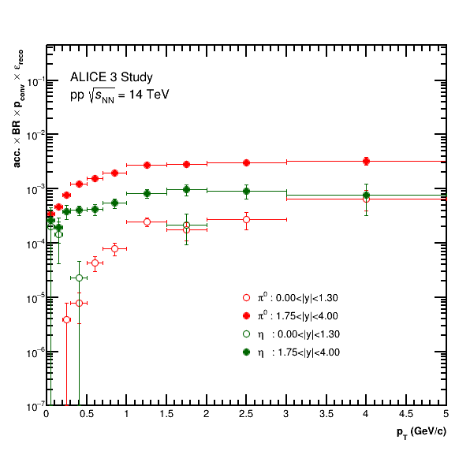
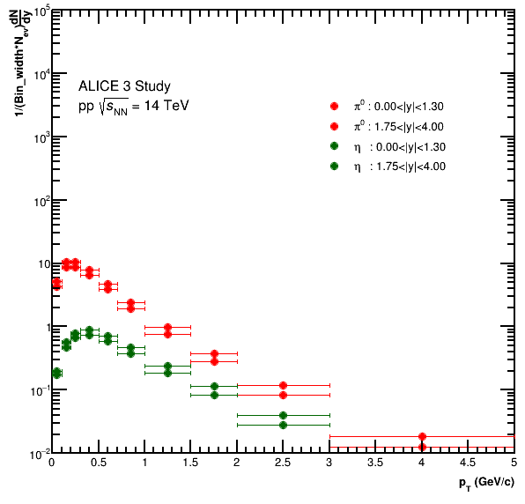
pp Results: Net Efficiency and PYTHIA dN/dy
26

Slide 30
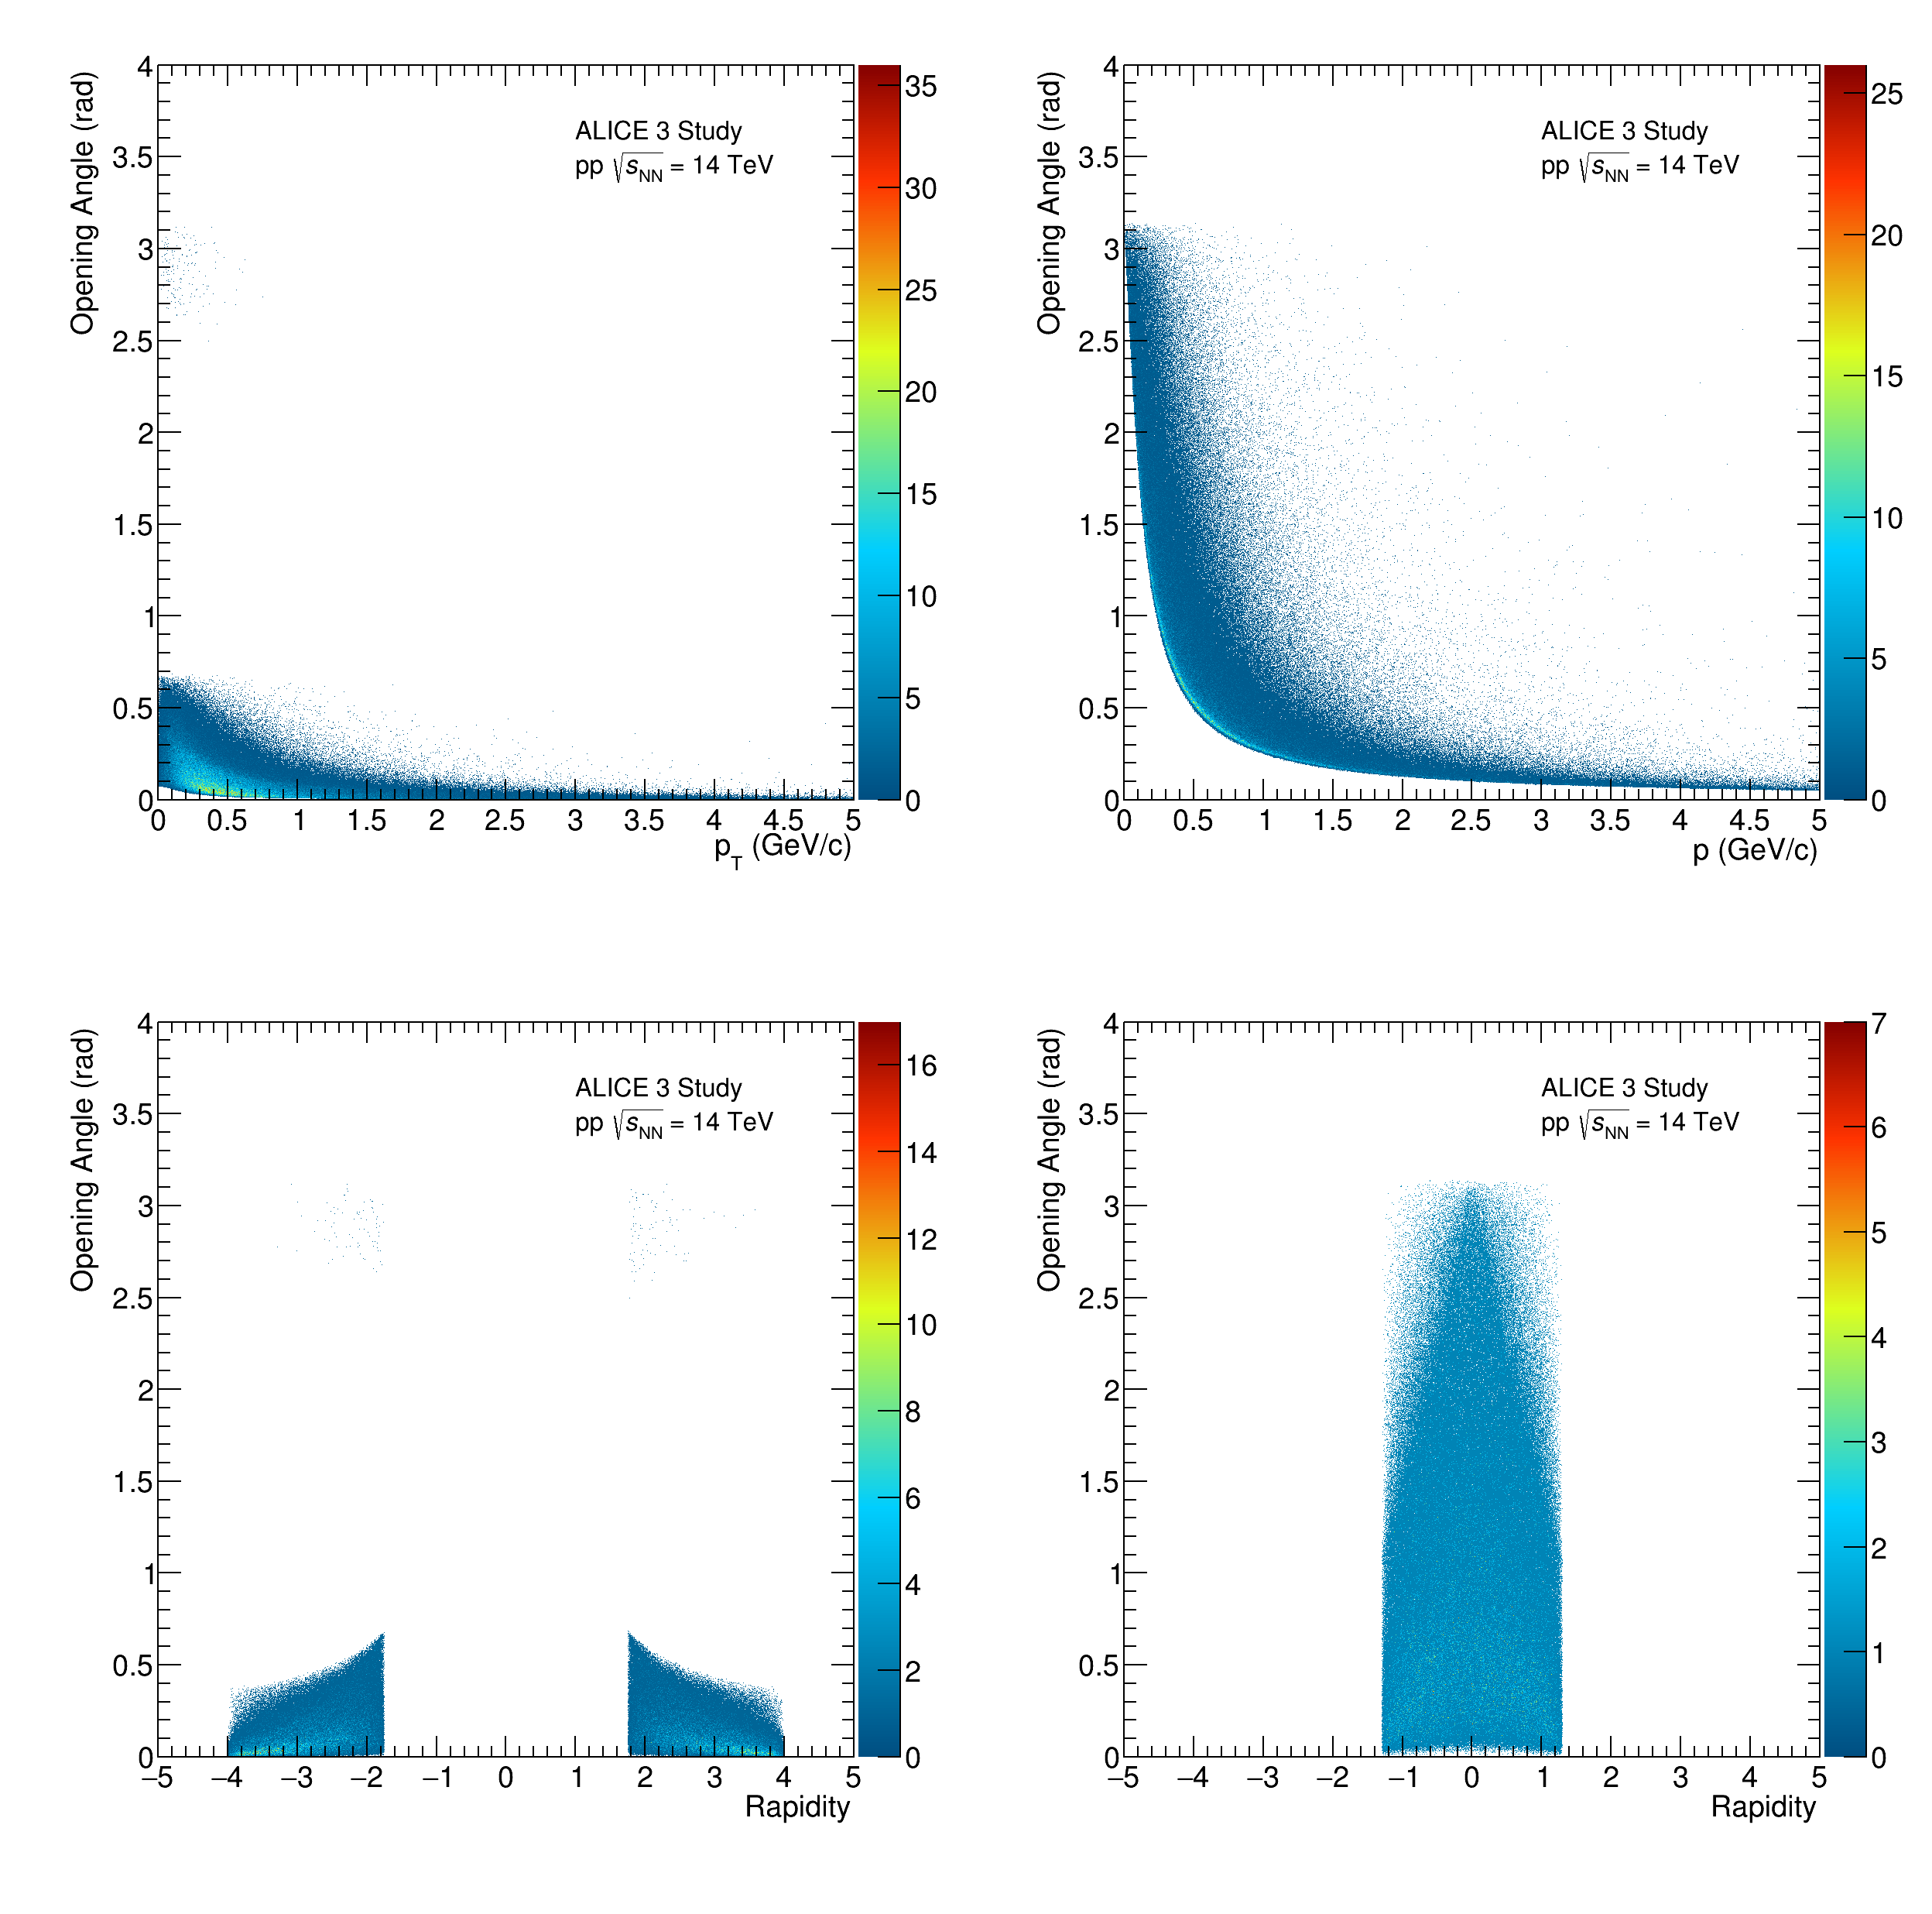
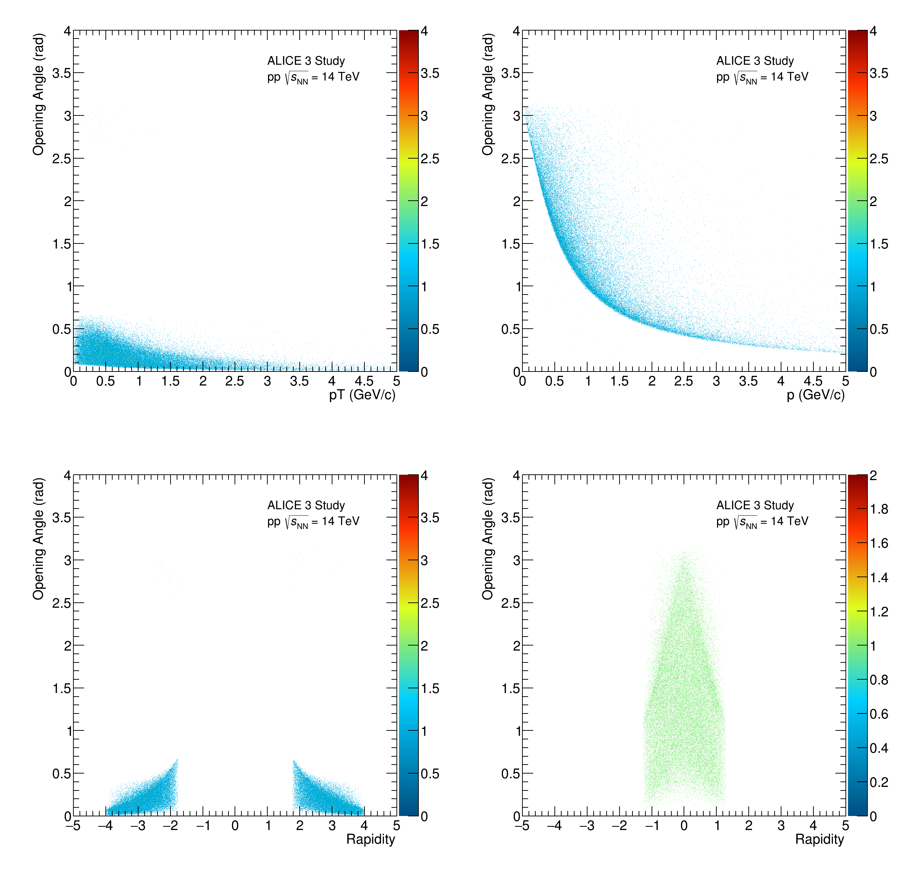
pp Results: Opening angle
27

Slide 31
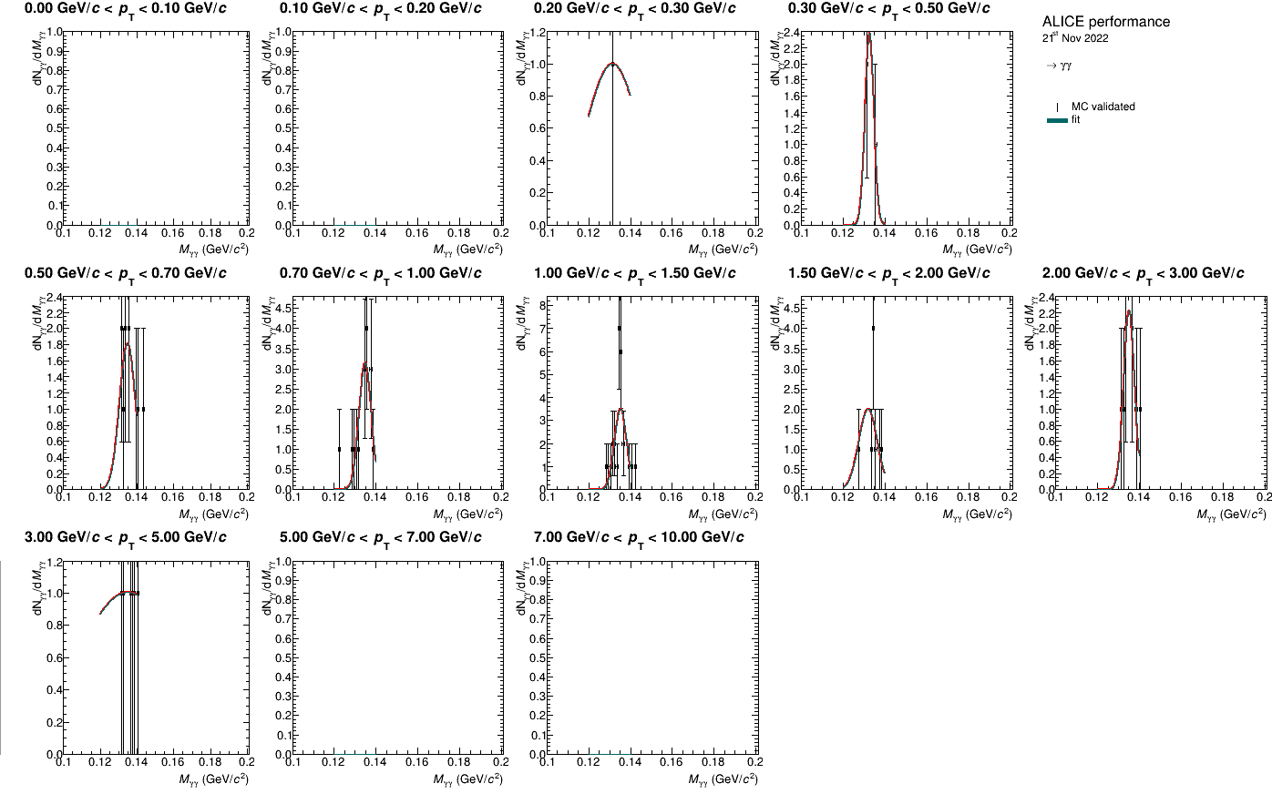
pp Results: Signal Fit Pi0 B
28

Slide 32
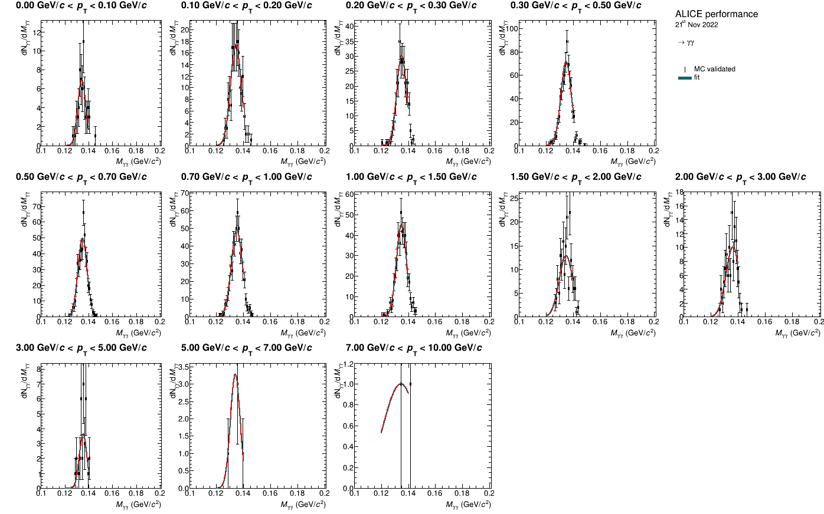
pp Results: Signal Fit Pi0 F
29

Slide 33
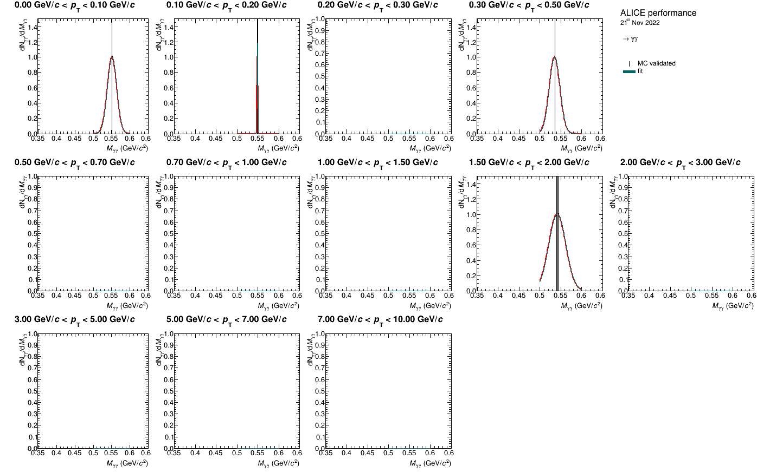
pp Results: Signal Fit Eta B
30

Slide 34

pp Results: Signal Fit Eta F
31

Slide 35

pp Results Pi0 B: Signal and Background comparison
32

Slide 36

pp Results Pi0 F: Signal and Background comparison
33

Slide 37

pp Results Eta B: Signal and Background comparison
34

Slide 38

pp Results Eta F: Signal and Background comparison
35

Slide 39




pp Results: Gaussian fitted mass
36

Slide 40




pp Results: Gaussian fitted sigma
37

Slide 41
pp Results: Net Background and Net Signal
38

Slide 42

pp Results: signal to background ratio and Significance
39

