Slide 1




Abhishek Nath
Dept. of Physics and Astronomy, PI, Uni Heidelberg

Slide 2
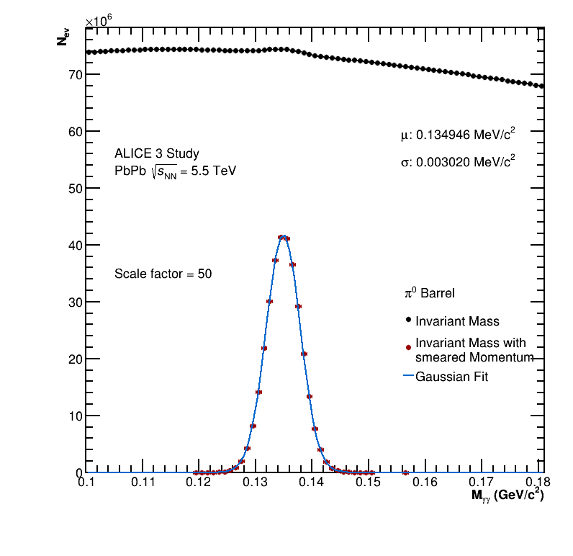
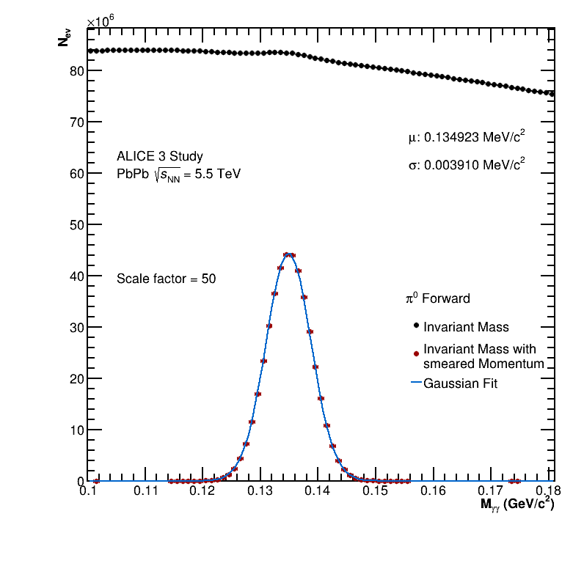
PbPb Results:
1
1

Slide 3
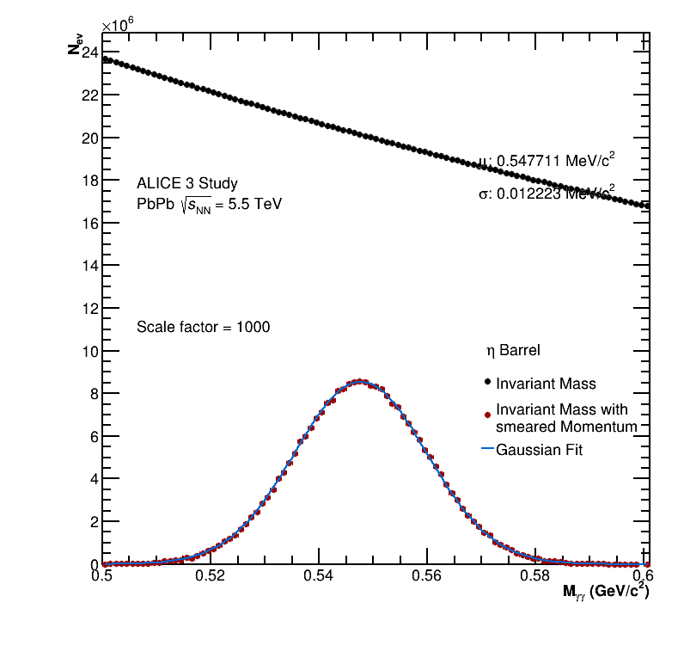
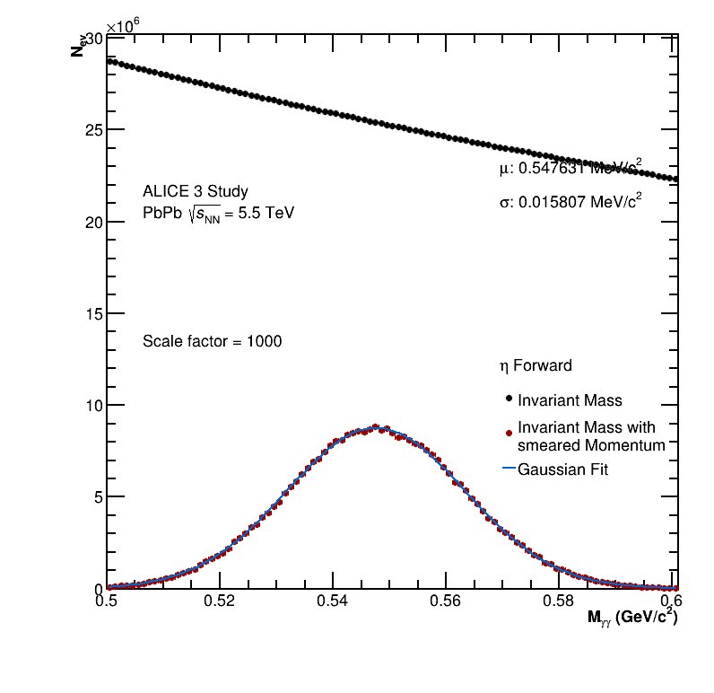
PbPb Results:
2

Slide 4
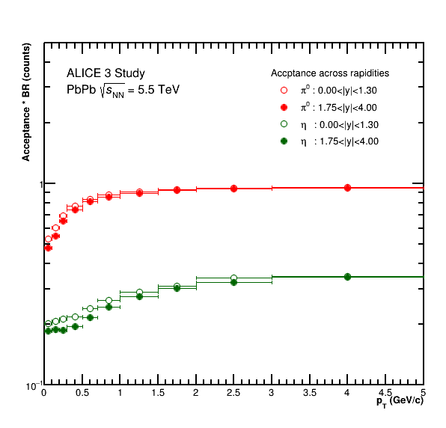
PbPb Results:
3

Slide 5
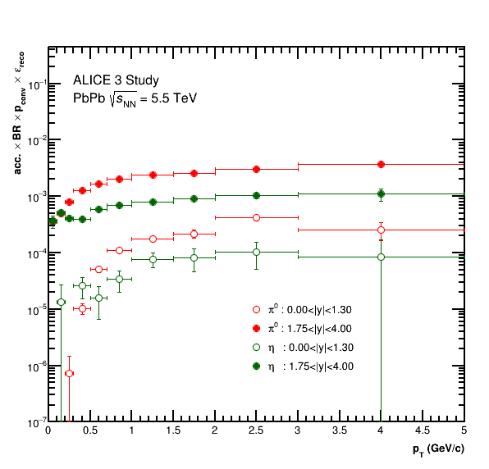
PbPb Results:
4

Slide 6
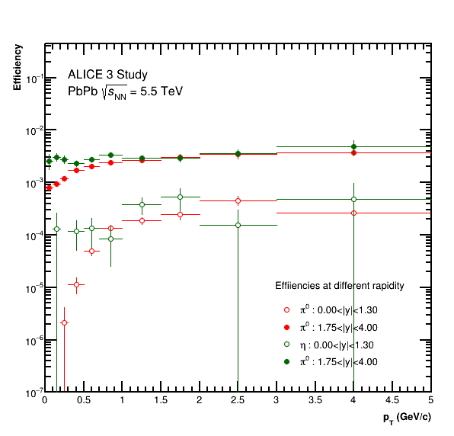
PbPb Results:
5

Slide 7
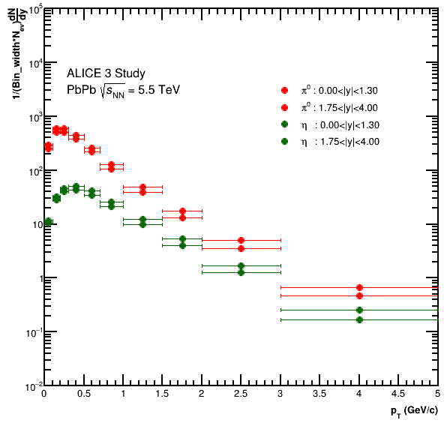
PbPb Results:
6

Slide 8
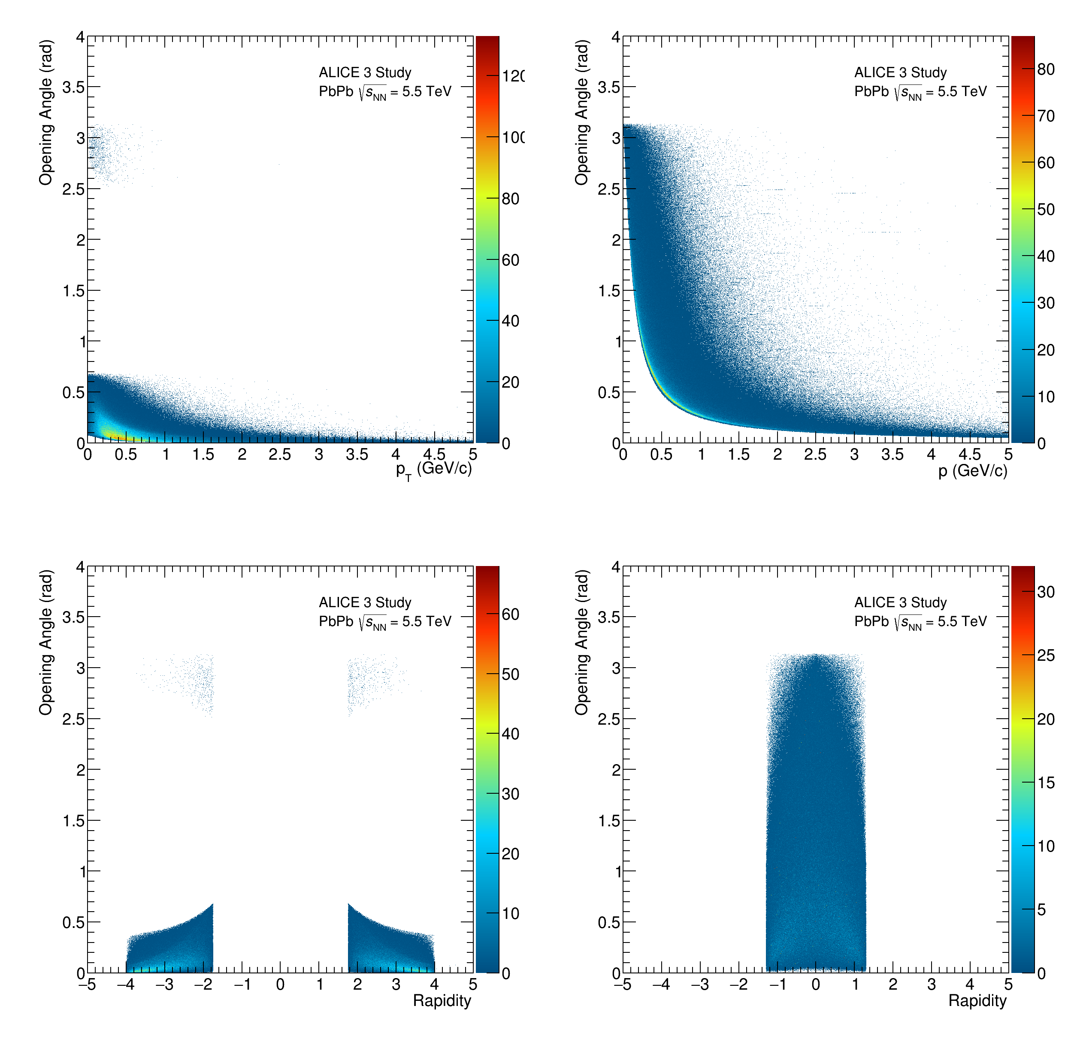
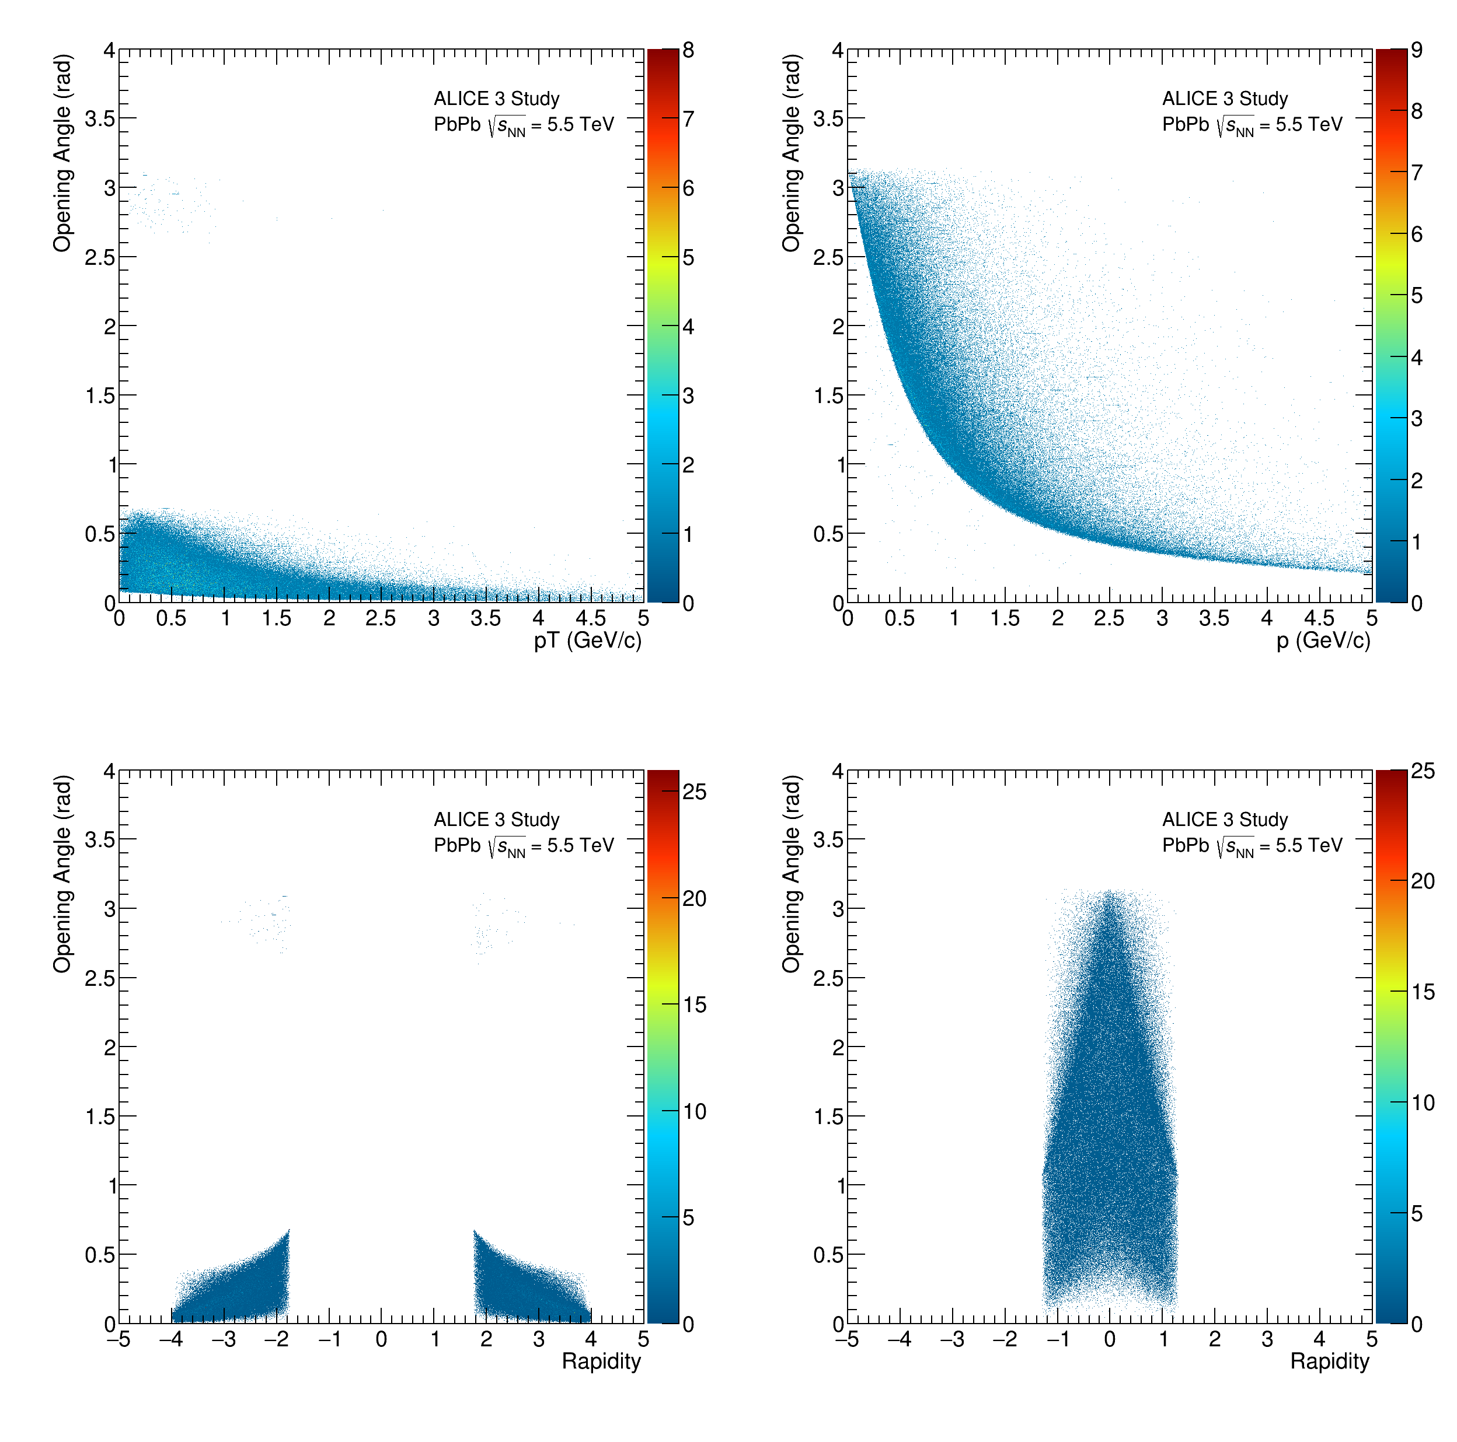
PbPb Results:
7

