Slide 1
Conference Management System
SE Mini Project Group-1

Slide 2
Group Members
Rudranks Chandra Sarma IIB2020003
Khush Kanjani IIB2020007
Aniruddh Sharma IIB2020502
Sahil Pote IIT2020240

Slide 3
Abstract
‘International Conference Management System’ is a web based application that can be used to host any conference. It offers several services and roles.

Slide 4
Objective
To provide a platform to better manage the conferences.

Slide 5
Requirements
Hardware requirements :
Can run on any browser both on Mobile and PC devices.
Software requirements:
Supported on web browsers Chrome v51, Firefox v52, Edge v14, Safari v10, Opera v38 and above.

Slide 6
Roles
Chairs: create new conferences, accept or reject submitted abstracts, etc.
Authors: upload abstracts and papers and submit them, etc.
Reviewers: review abstracts and papers, etc.

Slide 7
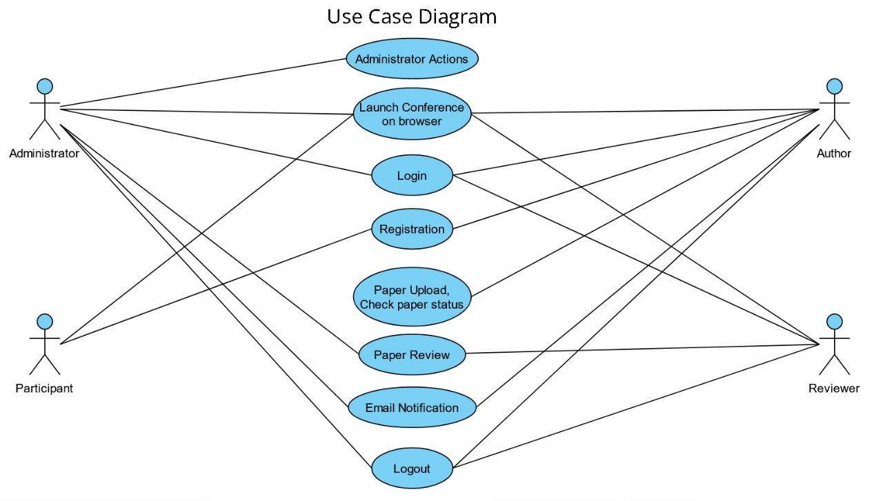
Use Case Diagram

Slide 8
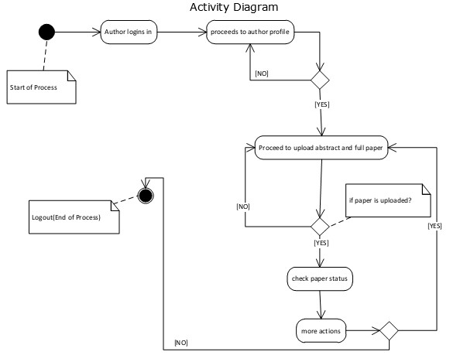
Activity Diagram

Slide 9
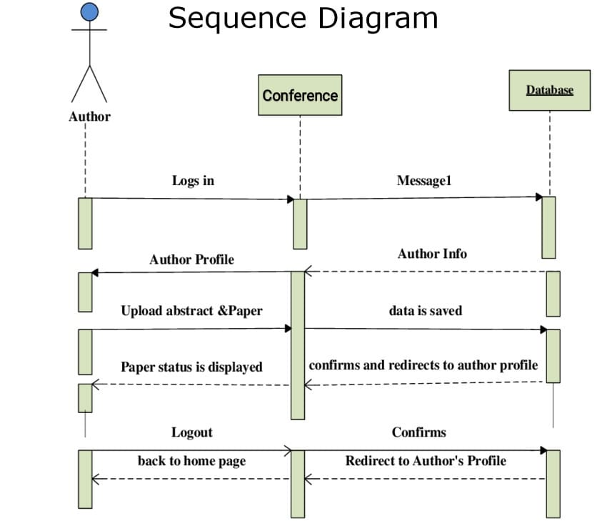
Sequence Diagram

Slide 10
Thank You!

