Slide 1

 | AirSense-AI
Indian Institute of Technology Guwahati BSc. (Hons.) Data Science & Artificial Intelligence Online Degree Programme
 | Student Name : Student ID : Email ID : Programme : Course Code : Course Name : Trimester : |  | Anirudh S 23035010660 anirudh.s@op.iitg.ac.in BSc. (Hons.) Data Science & AI DA 379 Term Project-3 IX
INTERNSHIP/TERM PROJECT

Slide 2

IIT GUWAHATI · B.SC. (HONOURS) DATA SCIENCE & AI
AirSense-AI
Machine Learning-Based Air Quality Prediction & Historical AQI Analysis
Presented by: Anirudh S

Slide 3
Agenda
01
02
Introduction
Problem Statement
Understanding Air Quality and AQI
Challenges in Air Quality Prediction
03
04
Project Objectives
Dataset & Technology Stack
Goals of AirSense-AI
Tools, Libraries, and Historical Dataset
05
06
Machine Learning Pipeline
AQI Prediction System
Data Preprocessing and Model Training
How AirSense-AI Predicts AQI
07
08
Results & Dashboard
Conclusion & Future Scope
Model Performance and Streamlit Application
Project Outcomes and Improvements

Slide 4
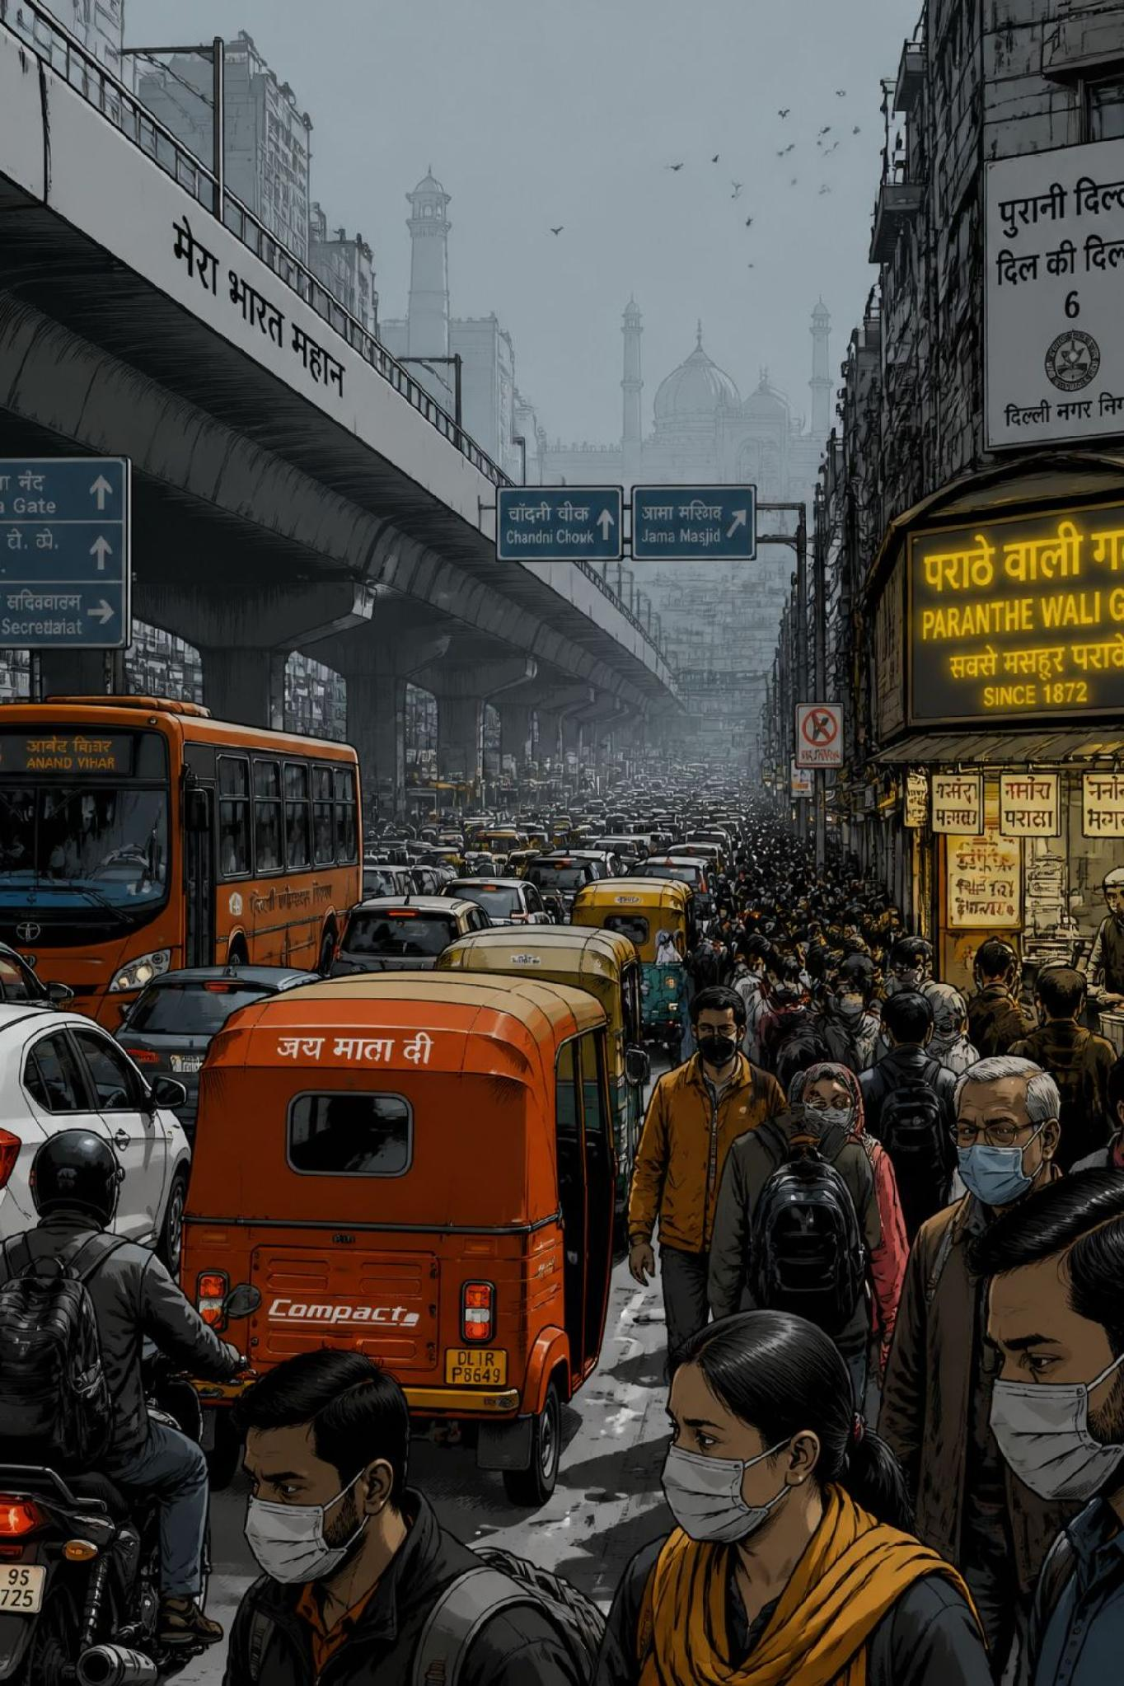

The Importance of Air Quality Monitoring
Air Pollution & Public Health
Air pollution is one of the leading environmental challenges affecting millions worldwide, with direct links to respiratory and cardiovascular disease.
Air Quality Index (AQI)
AQI is a standardized measure indicating pollution levels based on multiple atmospheric pollutants — a single number that communicates complex data.
Why AQI Prediction Matters
Supports environmental awareness, helps citizens understand pollution levels, and assists authorities in monitoring urban air quality.
Project Goal
Develop an intelligent ML application to predict AQI and visualize historical pollution trends for major Indian cities.

Slide 5
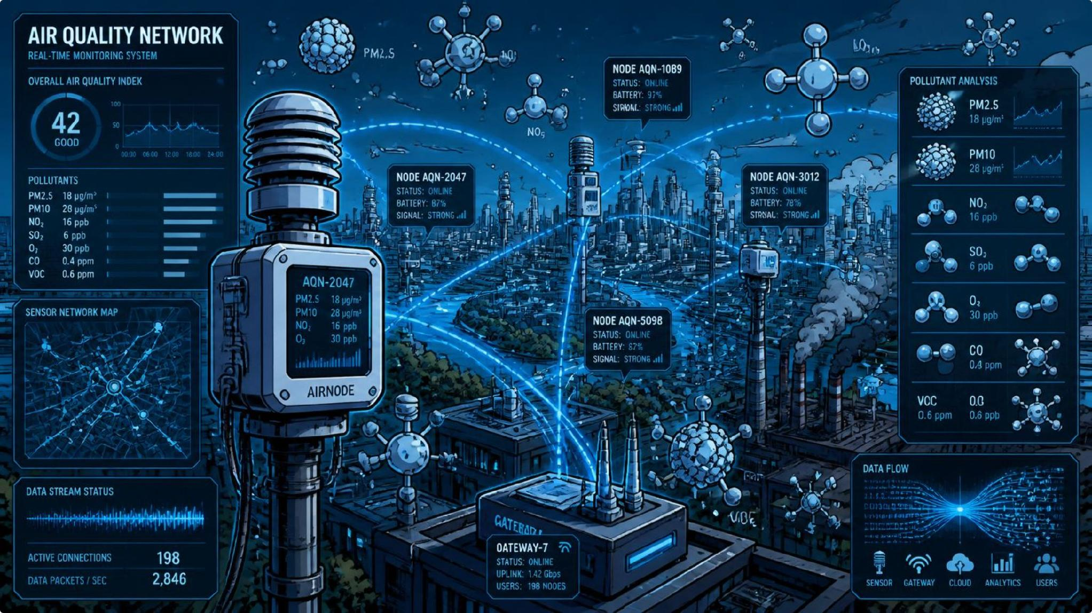

Challenges in Air Quality Prediction
Multiple Pollutants
AQI depends on several pollutants including PM2.5, PM10, CO, NO₂, SO₂, and O₃ — each contributing differently to the overall index.
Complex Relationships
The contribution of each pollutant varies, making manual estimation difficult and error-prone.
Historical Data Analysis
Large volumes of air quality data require automated analysis and visualization.
Proposed Solution: A machine learning system that predicts AQI from pollutant values while providing historical city-wise comparisons through an interactive dashboard.

Slide 6




Objectives of AirSense-AI
Historical Data Analysis
Machine Learning Prediction
Analyze AQI data from four Indian metropolitan cities — Delhi, Mumbai, Chennai, and Kolkata — collected during 2025.
Train regression models capable of accurately predicting AQI from pollutant concentration inputs.
Model Comparison
Interactive Dashboard
Evaluate multiple ML algorithms — Linear Regression, Random Forest, XGBoost — to identify the best-performing model.
Build a Streamlit app featuring AQI prediction, historical analysis, city comparison, pollutant trends, and health advisory.

Slide 7
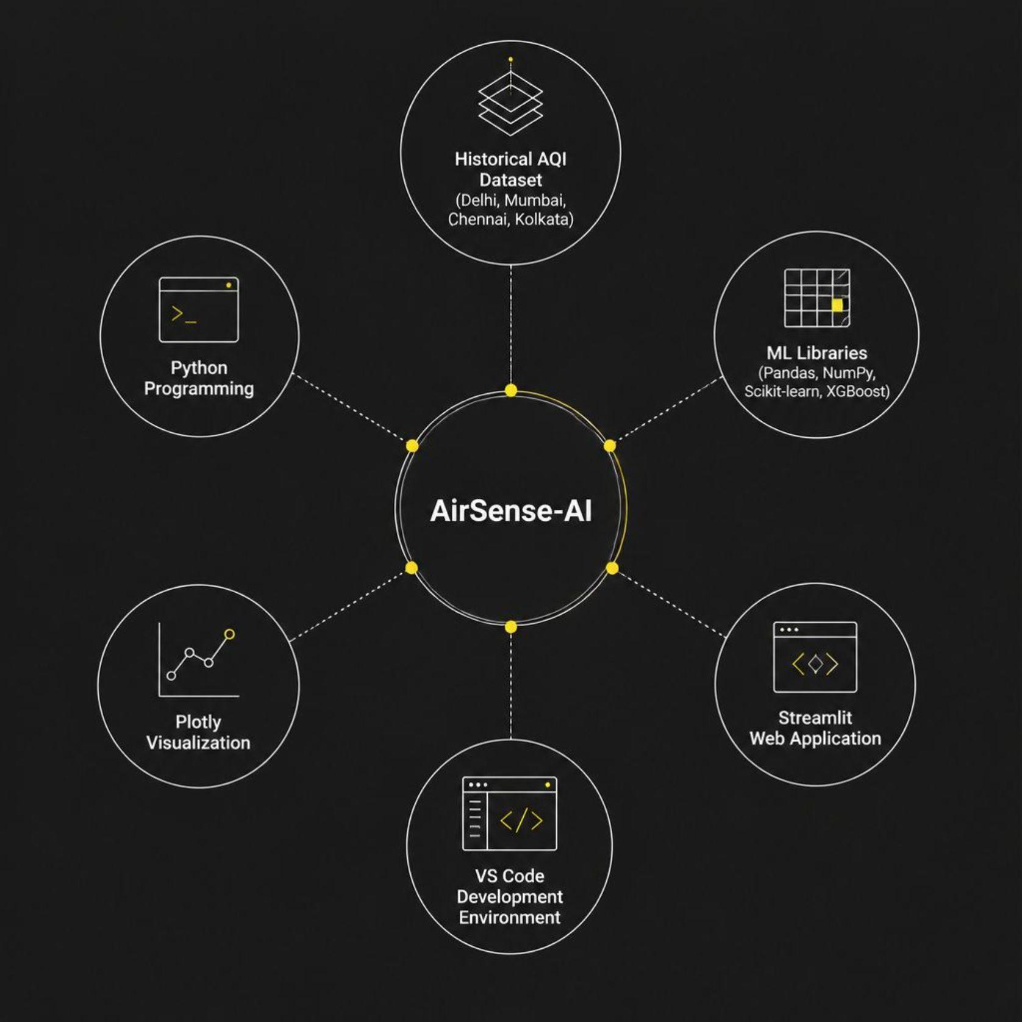
Dataset & Technology Stack
Historical AQI Dataset (2025)
Cities: Delhi, Mumbai, Chennai, Kolkata
Input Features: PM2.5, PM10, CO, NO₂, SO₂, O₃
Target Variable: Air Quality Index (AQI)
Technology Stack
Language: Python
ML Libraries: Pandas, NumPy, Scikit-learn, XGBoost, Joblib
Visualization: Plotly
Web App: Streamlit, Streamlit Option Menu
IDE: Visual Studio Code

Slide 8

How AirSense-AI Works
Load & Clean
Train Models
Import historical AQI data
Linear Reg, RF, XGBoost
Evaluate & Deploy
Feature Prep
Compare results and deploy to Streamlit
Select features and preprocess
The pipeline moves from raw historical data through preprocessing and model training to final deployment — ensuring a reproducible, end-to-end workflow for AQI prediction.

Slide 9

AQI Prediction System
User Inputs
Users enter pollutant concentrations — PM2.5, PM10, CO, NO₂, SO₂, O₃ — into the Streamlit interface.
Machine Learning Model
The Random Forest Regressor processes inputs and predicts the AQI value in real time.
Application Output
The dashboard displays the Predicted AQI, its AQI Category (e.g., Good, Moderate, Poor), and a personalized Health Advisory — making air quality insights accessible to all users.

Slide 10
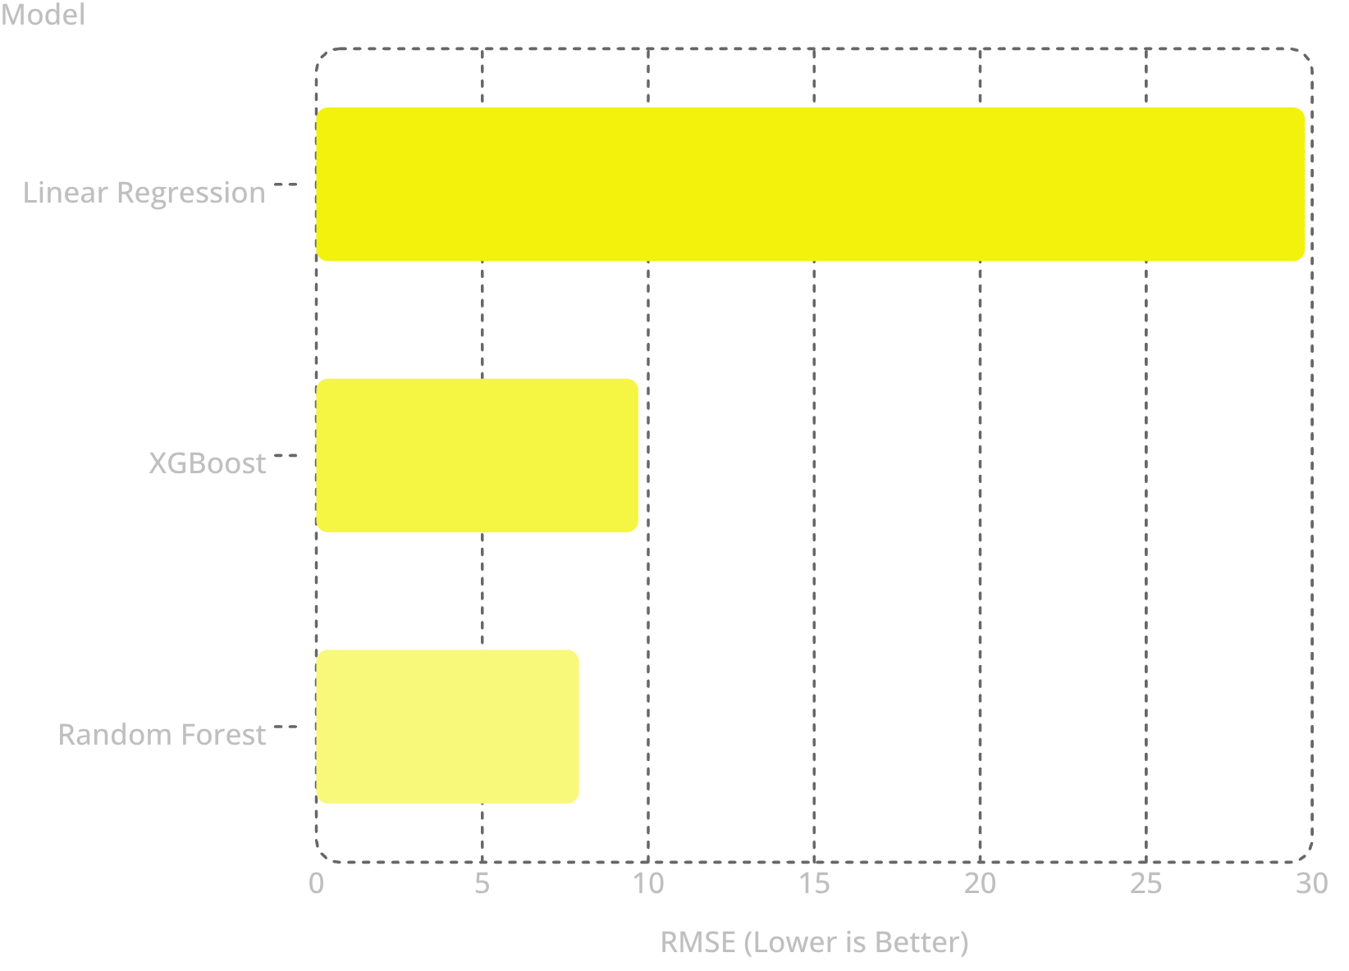
Model Performance & Key Findings
Best Model: Random Forest
Random Forest achieved the lowest prediction error (RMSE: 7.91) and the highest accuracy (R²: 0.9936), significantly outperforming both Linear Regression and XGBoost.
Top Feature Importance
PM2.5, PM10, and O₃ were the most influential pollutants driving AQI predictions in the trained model.
Dashboard Features
AQI Prediction & Category Display
Historical AQI Analysis
City-wise AQI Comparison
Pollutant Trend Visualization
Health Advisory Recommendations

Slide 11

Conclusion & Future Scope
Project Outcomes
Future Scope
Successfully developed an ML-based AQI prediction system, compared three models, and deployed an interactive Streamlit dashboard for prediction, historical analysis, city comparison, and health advisory.
Integrate real-time AQI data via public APIs
Expand dataset to more cities and years
Incorporate meteorological variables (temperature, humidity)
Explore deep learning and time-series forecasting models

Slide 12
Thank You
Anirudh S
https://github.com/an1rudhks/AirSense-AI

