Slide 1

Introduction to Flutter
Tanzilur Rahman

Slide 2
What exactly is Flutter? and what it isn’t
Based on Dart
Cross Platform – Android, iOS, Web, Desktop
Compiles to Native code
Under rapid developement
Google’s brainchild

Slide 3
Cross Compilation Into Native Code?
Compiles Dart code within the flutter app into Native Android and iOS Code
Ionic, another hybrid framework instead renders a webpage and displays programmed app as a webpage

Slide 4
Why Flutter?
Easier learning curve – Dart (close to JS and Java)
Hot Reload – espcially with UI
Lots of issues on Github (around 4k)
Hello World (app) is fatter compared to ionic or react native

Slide 5
How Flutter works?
Widgets
Everything is a widget
The homescreen? Widget
The AppBar? Widget
The Text? You guessed it, also a widget.
Anything that shows is a widget
Also the whole app is a widget in its own, lol

Slide 6
Widget Tree
Flutter maintains a Widget tree
The widget tree is a hierarchy of widget nested within each other
The widgets are displayed accordingly on screen
If theres a change, the widget tree gets rebuilt

Slide 7
Types of Widgets in Flutter
Stateless Widget
Stateful Widget

Slide 8
Stateless Widget
Static content UI
Once drawn on screen, cannot be changed
Static within the widget tree

Slide 9
Stateful Widget
Changes UI when there’s a change
Rebuild child in widget tree
Dynamic UI

Slide 10
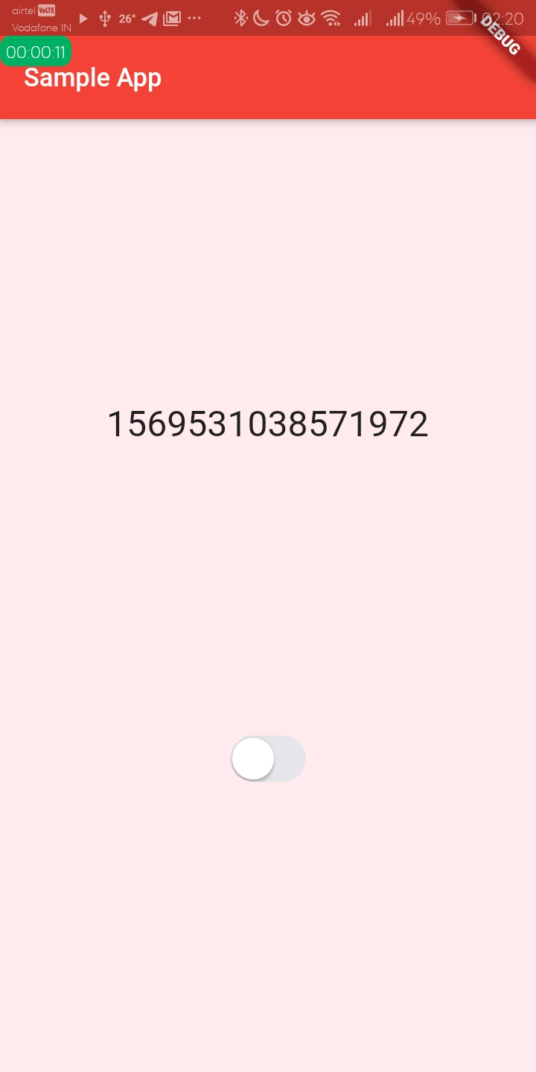
AppBar
My App
Text
Page 1
Timer
Page 3
Switch
Column
AppBar
Text
Switch

Slide 11
GitHub
github.com/an7agon1st/flutter-session-iiitd

Slide 12
Flutter Setup
Workshop Session

Slide 13
Firebase
NoSQL data base Firestore
Can store Media files as well at Firebase Storage
Firebase Cloud Messaging – push notifications
Perfect for personal or small level businesses without having to buy a dedicated server
Its free

Slide 14
Deploying Your App to a Store
Register with Apple ( $100 pa ) / Google play ($25)
Signing the app
Renaming, screenshots, icon, such and so
Deploy!

