Slide 2

ITSS Software Development
Internet Media Store

Slide 3
Instructor: Dr. Nguyễn Thị Thu Trang
Students: Nguyễn Hoàng Anh
Mai Đức An
Nguyễn Quốc Anh
Vũ Đức An
Nguyễn Hải Anh

Slide 4
Contents
01
INTRODUCTION
02
TECHNOLOGY & FRAMEWORK
03
SYSTEM ARCHITECTURE & ARCHITECTURE DESIGN
04
DETAILED DESIGN
05
DATA MODELING
06
DESIGN CONSIDERATIONS
07
DEMO

Slide 5

Introduction to AIMS: An Internet Media Store
Objective
AIMS provides a robust, user-friendly platform for buying and selling physical media products, ensuring seamless operation and high reliability.
Scope
24/7 Operation: Serves up to 1,000 customers and runs for 300 hours continuously.
Product Management: Efficiently add, edit, and delete books, CDs, LP records, and DVDs.
User Management: Administrators manage user accounts, roles, and security.
Customer Experience: Easy product search, viewing, and purchasing with secure VNPay payments.
Order Management: Smooth order placement, payment, and delivery, including rush delivery options.
Performance & Reliability: Quick response times and rapid incident recovery.
Security & Compliance: Strict security measures and pricing regulation compliance.
AIMS is a comprehensive and reliable e-commerce solution for media products.

Slide 6




TECHNOLOGY AND FRAMEWORK
MongoDB
Java
Spring Boot
ReactJS
….

Slide 7
SYSTEM ARCHITECTURE & ARCHITECTURE DESIGN

Slide 8
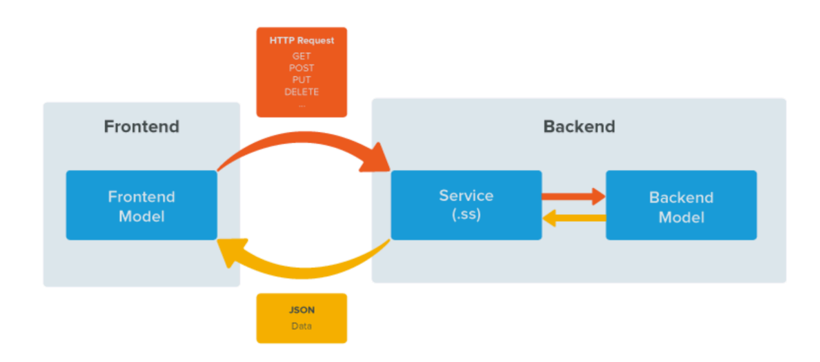
System Architecture and Architecture Design
Architecture Patterns

Slide 9
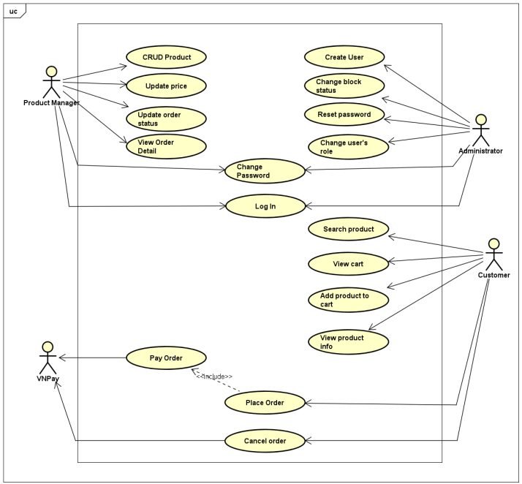
System Architecture and Architecture Design
Use case Diagram

Slide 10
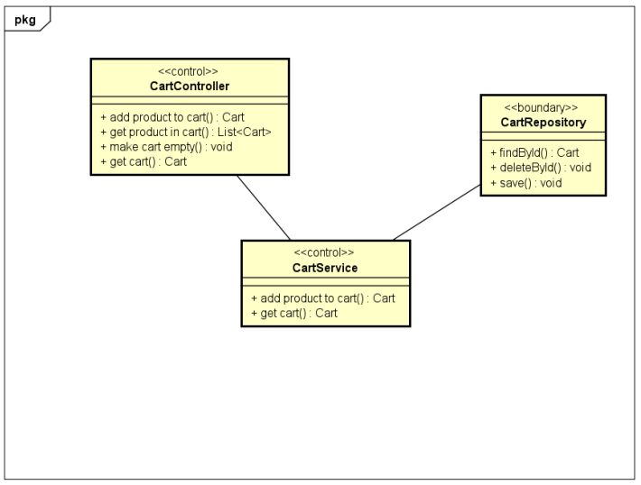
System Architecture and Architecture Design
Cart Analysis Class Diagram

Slide 11
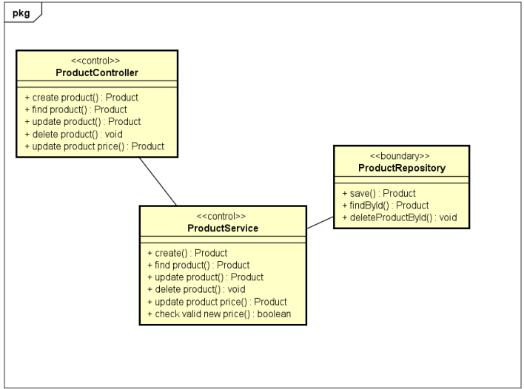
System Architecture and Architecture Design
Product Analysis Class Diagram

Slide 12
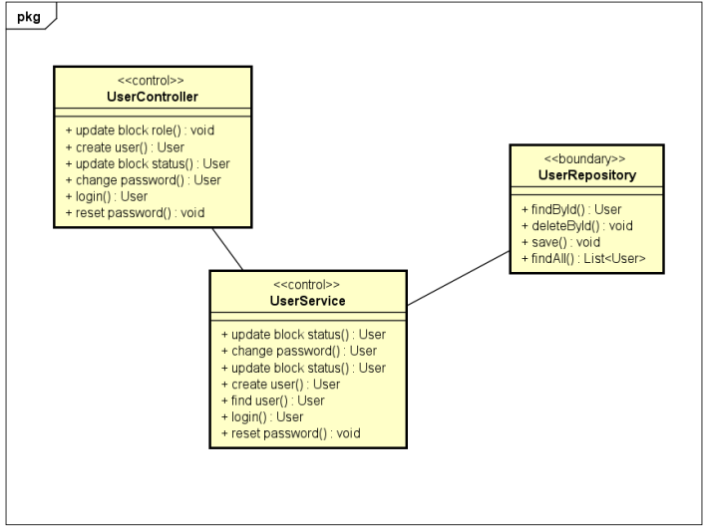
System Architecture and Architecture Design
User Analysis Class Diagram

Slide 13
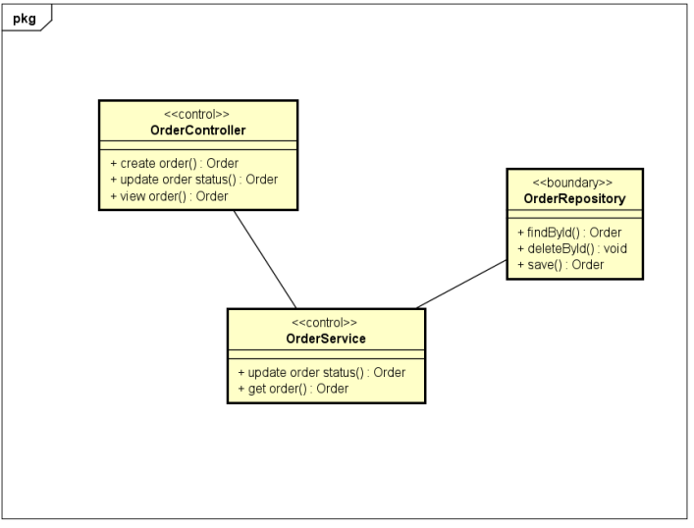
System Architecture and Architecture Design
Order Analysis Class Diagram

Slide 14
DETAILED DESIGN

Slide 15
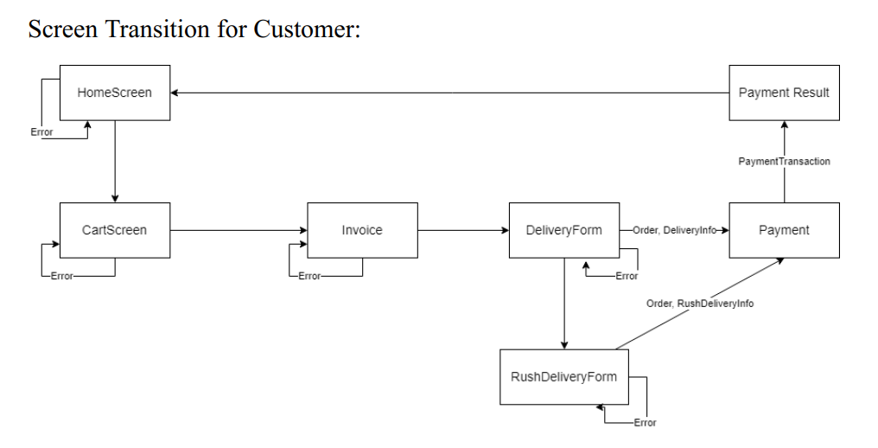
Detailed Design

Slide 16
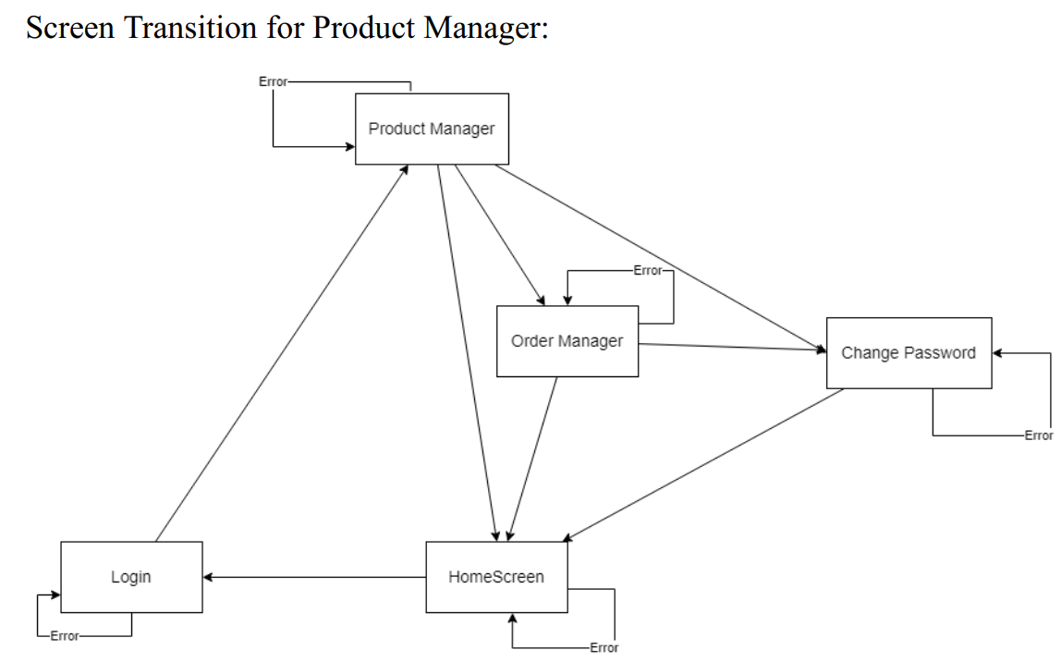
Detailed Design

Slide 17
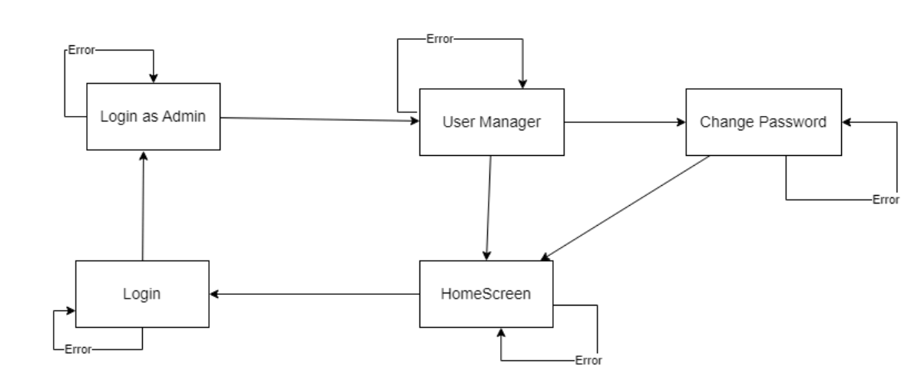
Detailed Design
Screen transition for Admin:

Slide 18
DATA MODELING

Slide 19
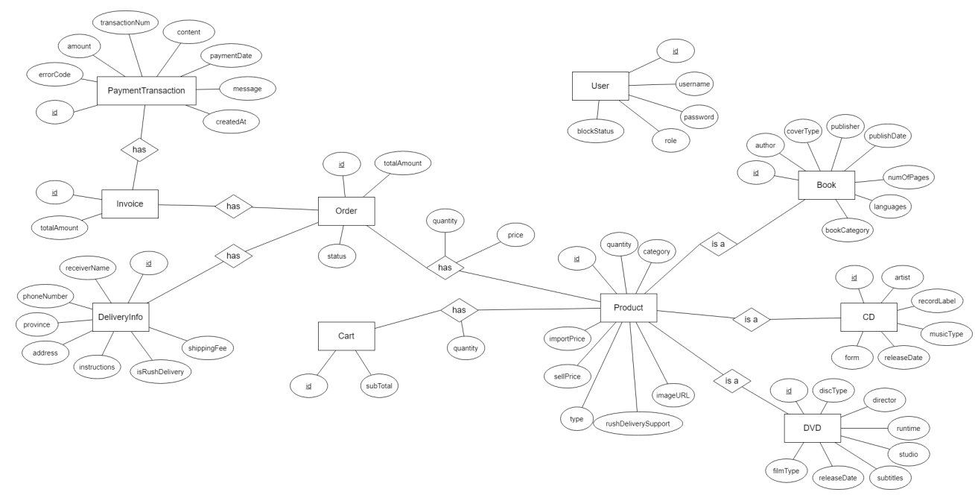
Data Modeling

Slide 20
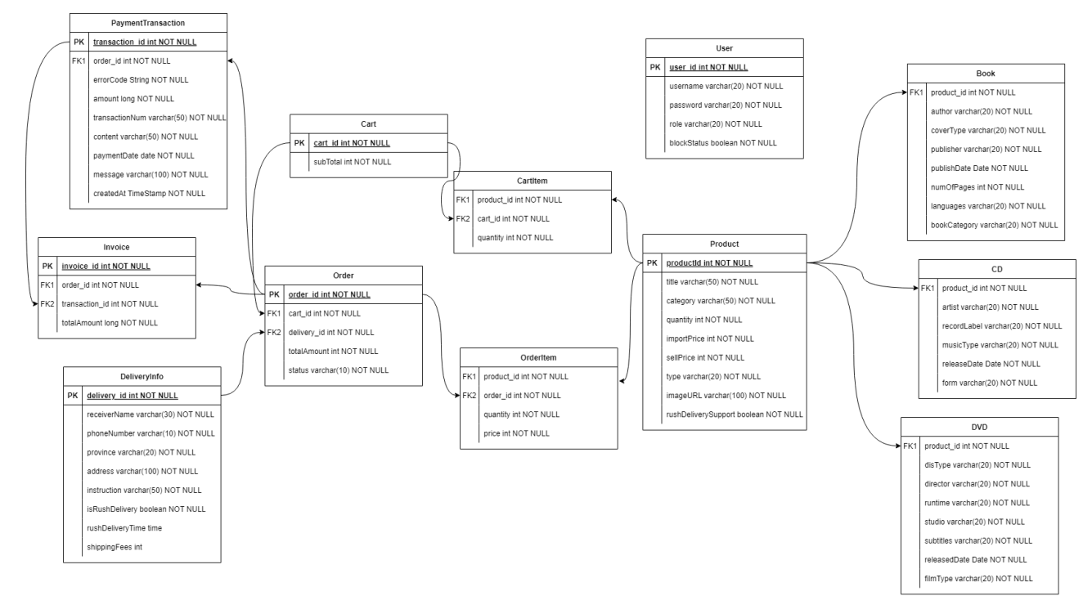
Data Modeling

Slide 21
DESIGN CONSIDERATIONS

Slide 22
Design Considerations
Goals and Guidelines
User-Friendly UI Design
Ease of Use: Intuitive UI for easy task completion with clear prompts.
Error Handling: Immediate, clear notifications with corrective actions.
Backend Design
Request Handling: Robust design to detect and handle bad requests early, ensuring system stability.

Slide 23
Design Considerations
Architectural Strategies
Backend: Spring Boot
Java framework for creating stand-alone, production-grade applications with minimal configuration.
Promotes microservices architecture for easy scaling and modular development.
Frontend: React.js
JavaScript library for dynamic and responsive UIs.
Component-based architecture for maintainable and scalable codebase.
Database: MongoDB
NoSQL database for flexibility and scalability.
Schema-less design for easy data storage and retrieval, ideal for unstructured data.
Integration
Using Spring Boot, React.js, and MongoDB to build a robust, scalable, and user-friendly Media Store online system.

Slide 24
Design Considerations
Coupling and Cohesion
Coupling
Spring Boot: Promotes loose coupling with distinct modules (controllers, services, repositories).
Advantages: Error isolation and easy extensibility.
Request Flow in Spring Boot
Controller Layer: Validates input data.
Service Layer: Handles business logic.
Repository Layer: Manages data access.
Exception Handling: Directed using annotations.
Cohesion
Communication Cohesion: Service layer functions perform a series of actions for specific business goals.
Sequential Cohesion: Functions build on the results of previous ones, maintaining a logical flow.

Slide 25
Design Considerations
Design Principles
SOLID Principles
SRP: Divides project into packages with specific roles for easier maintenance.
OCP: Classes are extendable without modifying existing code.
LSP: Child classes replace parent classes without affecting functionality.
ISP: Interfaces include only necessary methods.
DIP: Dependencies are abstracted, with high-level modules depending on interfaces.
New Issues and Considerations
Media Types: Adjustments for new media types.
Delivery Calculations: Easy redefinition of delivery methods and pricing.

Slide 26
Design Considerations
Design Patterns
Strategy Pattern
Defines a family of algorithms, encapsulates each, and makes them interchangeable.
Implementation:
- Create ‘PaymentStrategy’ interface.
- Integrate strategies within payment service.
- Use ‘VNPayService’ to retrieve appropriate payment strategy.

Slide 27
DEMO

Slide 28
THANK YOU !

