Slide 1



LightGBM
A Highly Efficient Gradient Boosting Decision Tree
NeurIPS | 2016
Microsoft Research

Slide 2

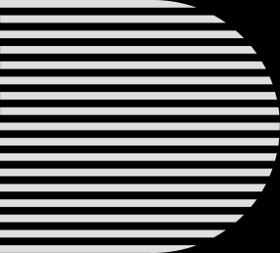
contributions
• Gradient-based One-Side Sampling (GOSS).
• Exclude a significant proportion of data instances with small gradients, and only use the rest to estimate the information gain.
• Exclusive Feature Bundling (EFB).
•Bundle mutually exclusive features, to reduce the number of features.

Slide 3
Related Work
• Scikit-learn and gbm in R implements the presorted algorithm
• PGBRT implements the histogram-based algorithm.
• XGBoost supports both the pre-sorted algorithm and histogram-based algorithm.
• Data instances are filtered if their weights are smaller than a fixed threshold.
• SGB uses a random subset to train the weak learners in every iteration.
• SGB can be applied to GBDT, but AdaBoost cannot.

Slide 4
Related Work
• Filter weak features by principle component analysis
• Filter weak features by projection pursuit
• GBDT with the pre-sorted algorithm can reduce the training cost by ignoring the features with zero values.
• GBDT with the histogram-based algorithm does not have efficient sparse optimization solutions.

Slide 5
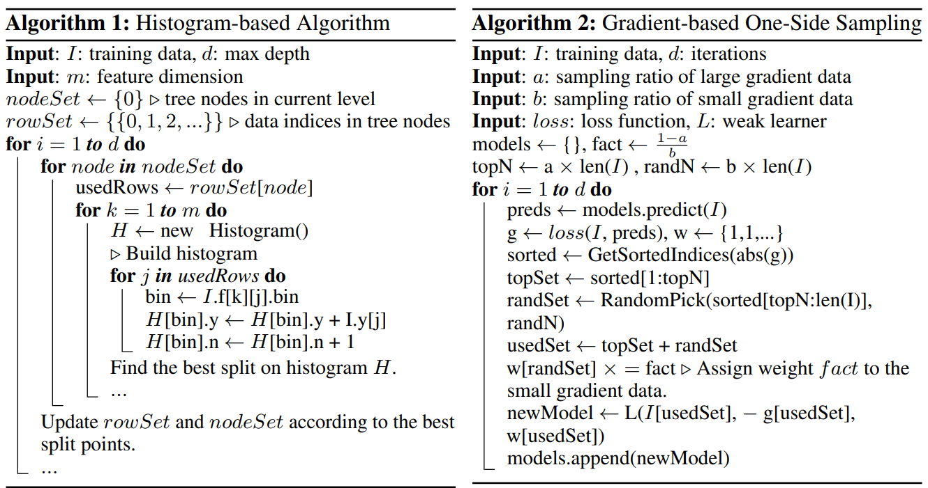
GOSS
• Keeps all the instances with large gradients.
• Random sampling on the instances with small gradients.

Slide 6


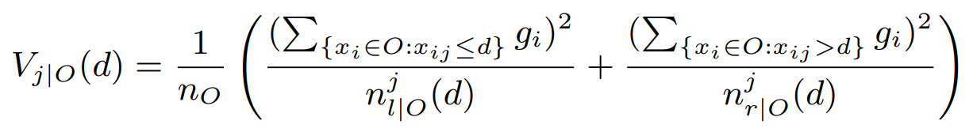



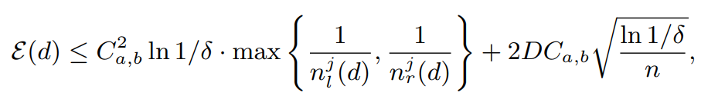
GOSS (Math)
• dataset
• gradients
• variance gain of splitting feature
• keep
• sample
• variance gain of splitting feature
• approximation error
• probability
• one-side gradian
• approximation error

Slide 7
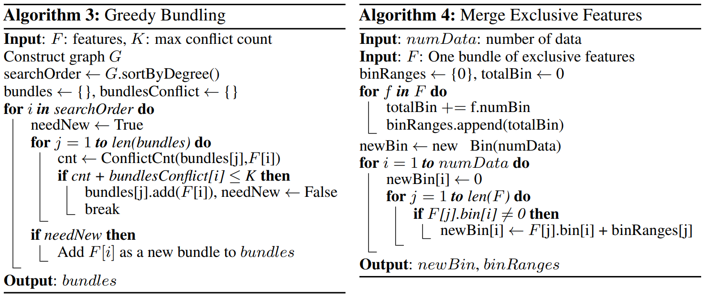
Exclusive Feature Bundling

Slide 8
Pros and cons
• 速度更快
• 遍歷直方圖、單邊梯度、 Leaf-wise
• 內存更小
• 直方圖、互斥特徵捆綁
• 產生過度擬合
• 長出較深的決策樹、對雜訊較為敏感

