Slide 1
Confluence to VSTS migration
Andrzej Kowol – 19.03.2018

Slide 2
Problems to handle
Exporting the content with assets ( images and attachments )
Getting rid of markup from Confluence
Import assets to wiki
Import content to wiki

Slide 3
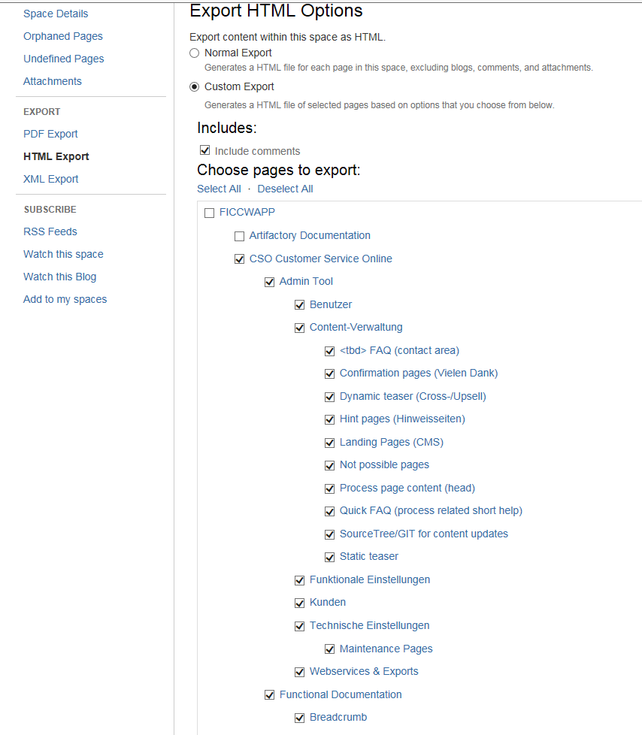
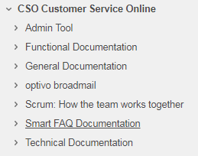
Exporting the confluence content
Contact:
Loudiyi Mohamed
Pradeep Deepti
NARAYANAN Nishanth
The export path:
\\eur.corp.vattenfall.com\vg\_temp\mohamed_temp

Slide 4
Markdown of all html export files
Download pandoc.exe
I wrote the script for going through the files inside the folder, markdown and store it in ./output folder:
echo Click to start
pause
@echo off
for /f %%f in ('dir /b .') do (
echo.%%f|findstr /C:".html" >nul 2>&1 && (
echo Found %%~nf
pandoc.exe -f html -t markdown %%f -o %%~nf.md
) || echo Not found %%f.
)
pause

Slide 5
The VSTS repo
It is based on git, need to checkout the KSO.wiki ( Playground.wiki in my case)
Add any article with some attachment so the folder .attachment will be created ( with some repo id)
Copy all exported attachment to this folder and push it to git.

Slide 6
Problems of new md files
The internal link won’t work ( should be without .htm extension )
Attachments won’t work ( should be with referenced folder: .attachments instead of attachment)
The styles are different and need to be adjusted manually.
Plenty of confluence markup garbage left.

Slide 7
The Java tool for change the content
List<File> filesInFolder = Files.walk(Paths.get("C:\\tmp\\Confluence-space-export-092005-81.html\\EXPORT"))
.filter(Files::isRegularFile).map(Path::toFile).collect(Collectors.toList());
for (File f : filesInFolder) {
System.out.println(f.getName() + " changing");
String content = new String(Files.readAllBytes(Paths.get(f.getPath())));
if (content.contains("(attachments")) {
content = content.replaceAll("\\(attachments", "\\(\\.attachments");
};if (content.contains("(images/icons/")) {
content = content.replaceAll("\\(images\\/icons\\/", "\\(\\.attachments\\/images\\/icons\\/");
};if (content.contains("(download/temp/")) {
content = content.replaceAll("\\(download\\/temp\\/", "\\(\\.attachments\\/download\\/temp\\/");
}; content = content.replaceAll("(\\()([A-Za-z0-9_-]*)(.html)(\\))", "$1$2$4");
content = content.replaceAll(":::(.)*\\{(.)*\\}", "").replaceAll(":::","");
Files.write(Paths.get(f.getParent() + "\\output\\" + f.getName()), content.getBytes());
}

Slide 8
What’s left
{# … } – garbage like this
Broken tables – manual migration ?
Sometimes missing assets in the export.
Establishing the scope of migration and the date.
Manual fixes of the articles by the Team.

Slide 9
Example
https://vfitonlineplatform.visualstudio.com/Playground-Scrum/_wiki/wikis/Playground-Scrum.wiki?wikiVersion=GBwikiMaster&pagePath=%2FSPIKE---Angular-Proof-of-Concept-for-KSO-project_17966729

