Slide 1


A robotic arm-based portrait drawing system
Yue Yiyao Wang Yexiang Shi Yongqi Fan Hangrui

Slide 2
1 Background & Application
2 Image processing
CONTENTS
3 Path planning
4 Control & Drawing
5 Result

Slide 3
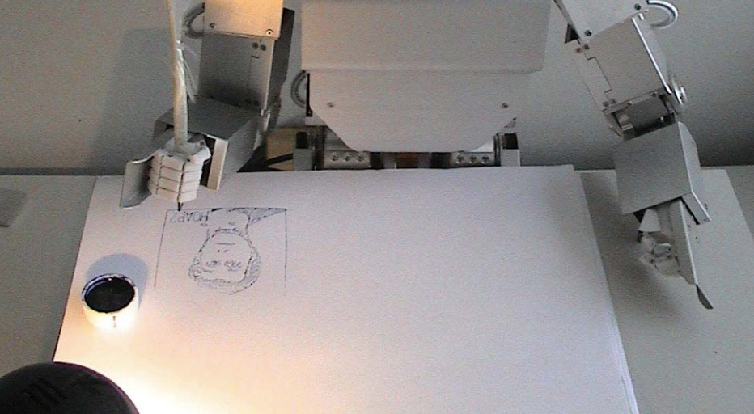
1. Background & Application
Art teaching
Efficiency improvement
New generation art creation

Slide 4
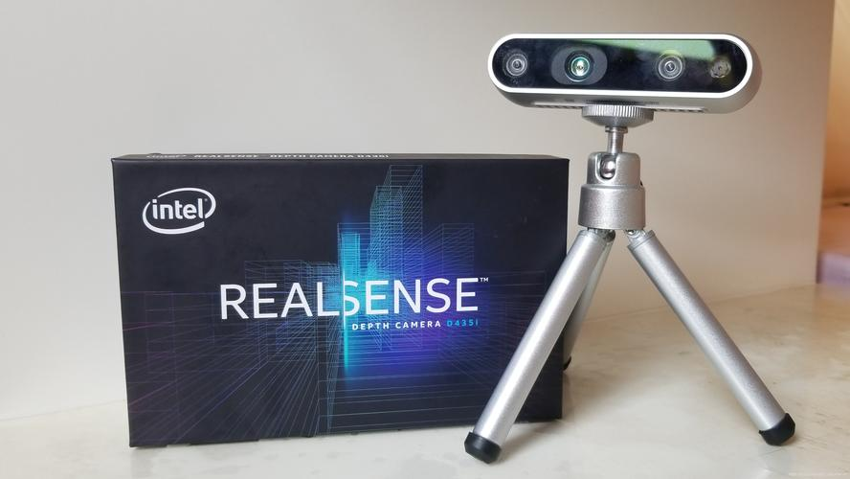
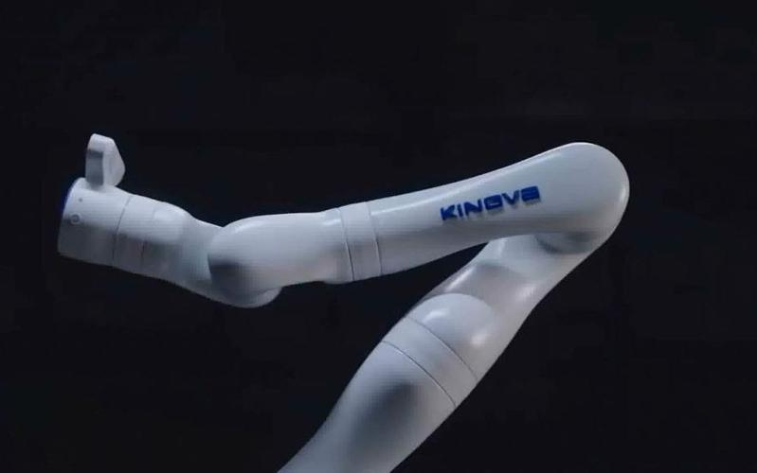
1. Background & Application
Steps
Camara
Capture
Image processing
Path planning
Drawing

Slide 5
2. Image processing
Steps
Graying
Dilate
&
Erode
Gaussian
blurred
Edge extraction
Notes:
触觉传感器数据采集，需要用到的外设

Slide 6
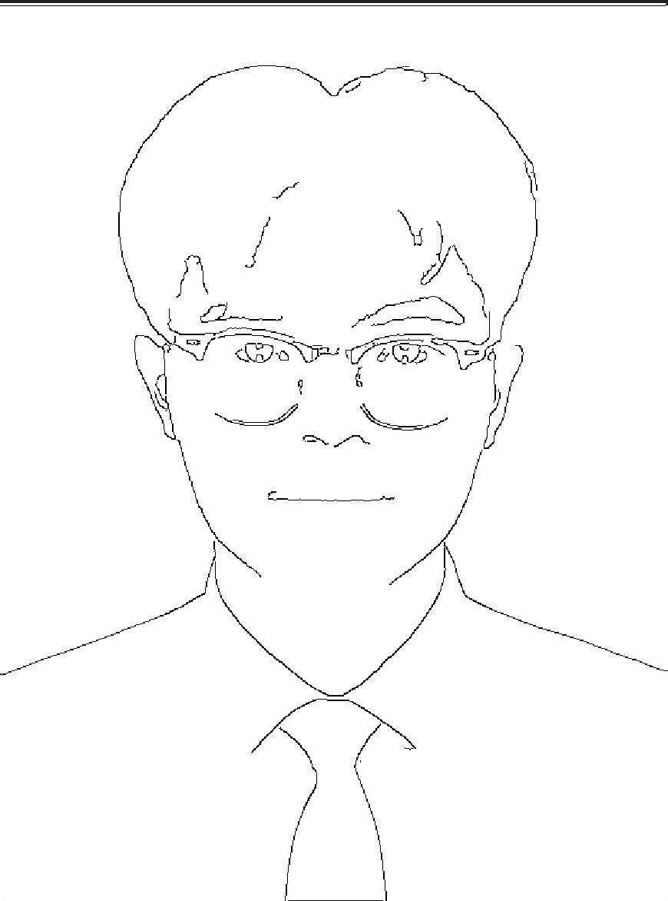
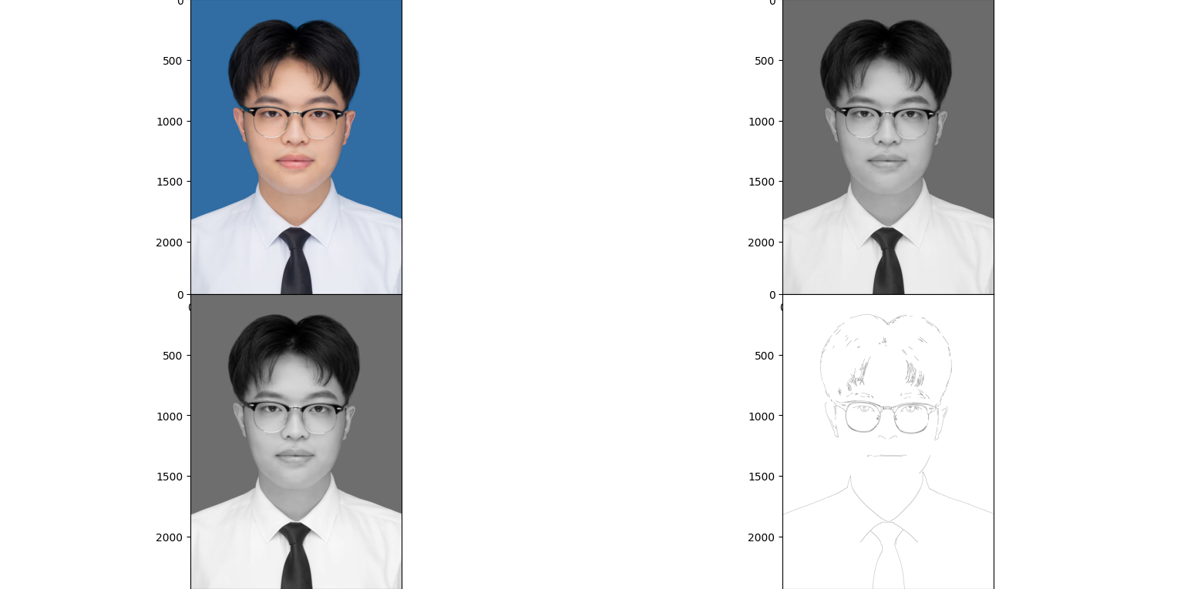
2. Image processing
Input
Output
Notes:
触觉传感器数据采集，需要用到的外设

Slide 7
3. Path planning

Slide 8
3. Path planning

Slide 9
4. Control & Drawing

Slide 10
4. Control & Drawing

Slide 11
5. Result

Slide 12
References
[1] Childers, D. G., and Larar, J. N. (1984). “Electroglottography for laryngeal function assessment and speech analysis,” IEEE Trans. Biomed. Eng. BME-31, 807-817.
[2] Coleman, R. O. (1973a). "A comparison of the contributions of two vocal characteristics to the perception of the maleness and femaleness in the voice," Paper presented at the Annual Convention of the American Speech and Heating Association, Detroit.
[3] Flanagan, J. L. (1972). Speech/lnalysis, Synthesis and Perception (Springer-Verlag, New York), 2nd ed.
[4] Klatt, D. H., and Klatt, L. C. (1990). "Analysis, synthesis and perception of voice quality variations among female and male talkers," J. Acoust. Soc. Am. 80, 820-857.
[5] Schwartz, M. F. (1968). "Identification of speaker sex from isolated, voiceless fricatives," J. Acoust. Soc. Am. 43, 1178-1179.
······

Slide 13
Thanks for listening

