Slide 1
Using robot arm to draw human portraits
Yue Yiyao, Wang Yexiang, Shi Yongqi

Slide 2
Some Products in Market
uArm Swift Pro
AxiDraw
Line-us

Slide 3
S. Calinon, J. Epiney and A. Billard, "A humanoid robot drawing human portraits," 5th IEEERAS International Conference on Humanoid Robots, 2005., Tsukuba, Japan, 2005, pp. 161-166, doi: 10.1109/ICHR.2005.1573562.

Slide 4
Preliminary Design Scheme
Control system of the robotic arm: Gen3_lite
Facial recognition technology:
Drawing techniques: Using pen,
Algorithm and programming design: Edge Detection, Path Planning, Inverse Kinematics

Slide 5
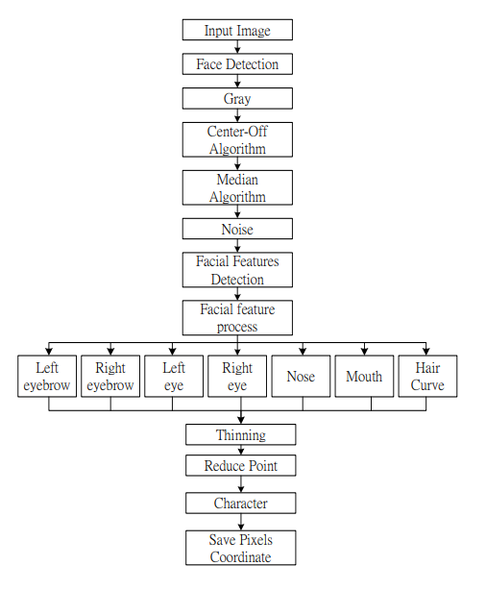
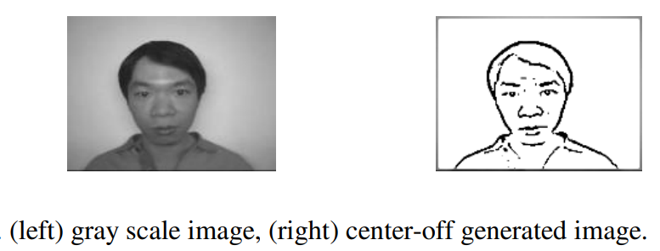
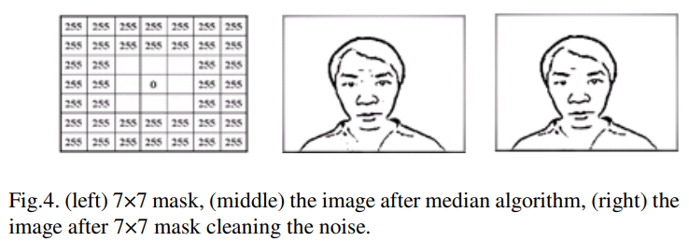

Slide 6
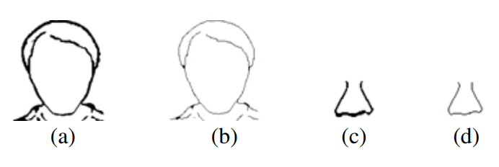
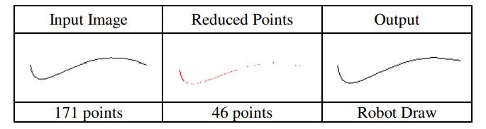

Slide 7
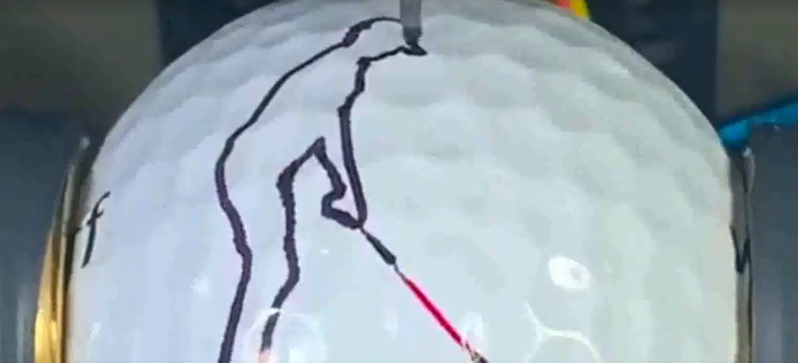
Draw on a non flat surface

