Slide 1

A Robot Manipulation Framework of Novel Objects for Elementary Household Tasks
PhD. Thesis Proposal
Ana C. Huamán Quispe
Reading Committee
Prof. Dr. Henrik I. Christensen, (advisor) Georgia Tech
Prof. Dr. C. Karen Liu, Georgia Tech
Prof. Dr. Charles Kemp, Georgia Tech
Prof. Dr. Andrea L. Thomaz, Georgia Tech
Prof. Dr. Peter K. Allen, Columbia University
----
Prof. Dr. Mike Stilman, Georgia Tech
Institute for Robotics and Intelligent Machines
Georgia Institute of Technology, USA
October 13th, 2015

Slide 2
Motivation

Slide 3
Motivation
Bicentennial Man (1999) Robot & Frank (2012)

Slide 4
Motivation
SERVICE ROBOTICS
“Those robotics systems that assist people in their daily lives at work, in their house, for leisure and as part of assistance to the handicapped and elderly.”
A Roadmap for US robotics, 2013

Slide 5
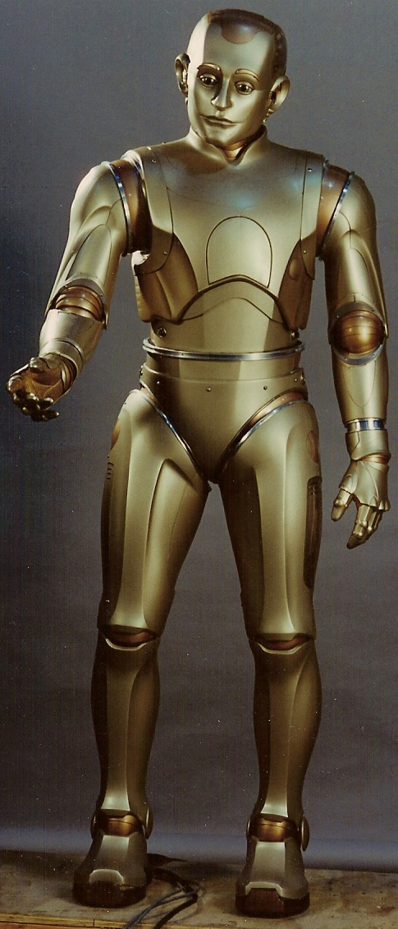
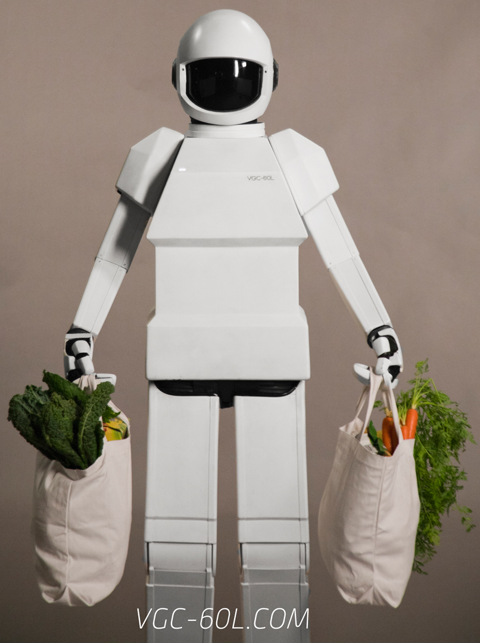
Motivation
SERVICE ROBOTICS
Many skills needed
1. Locomotion
2. Navigation
3. Manipulation
4. Task planning
5. Human-Robot Interaction
6. Many others...

Slide 6
Motivation
SERVICE ROBOTICS
Many skills needed
1. Locomotion
2. Navigation
3. Manipulation
4. Task planning
5. Human-Robot Interaction
6. Many etc.

Slide 7
Motivation
SERVICE ROBOTICS
Ideally your robot would look like...

Slide 8

Motivation
But...

Slide 9
Motivation
In reality:
Humanoid torso
2 arms with 7-DOF each
2 hands with 3 fingers
A head with a RGBD camera
Crichton – Bimanual manipulator
Speed: 8x

Slide 10
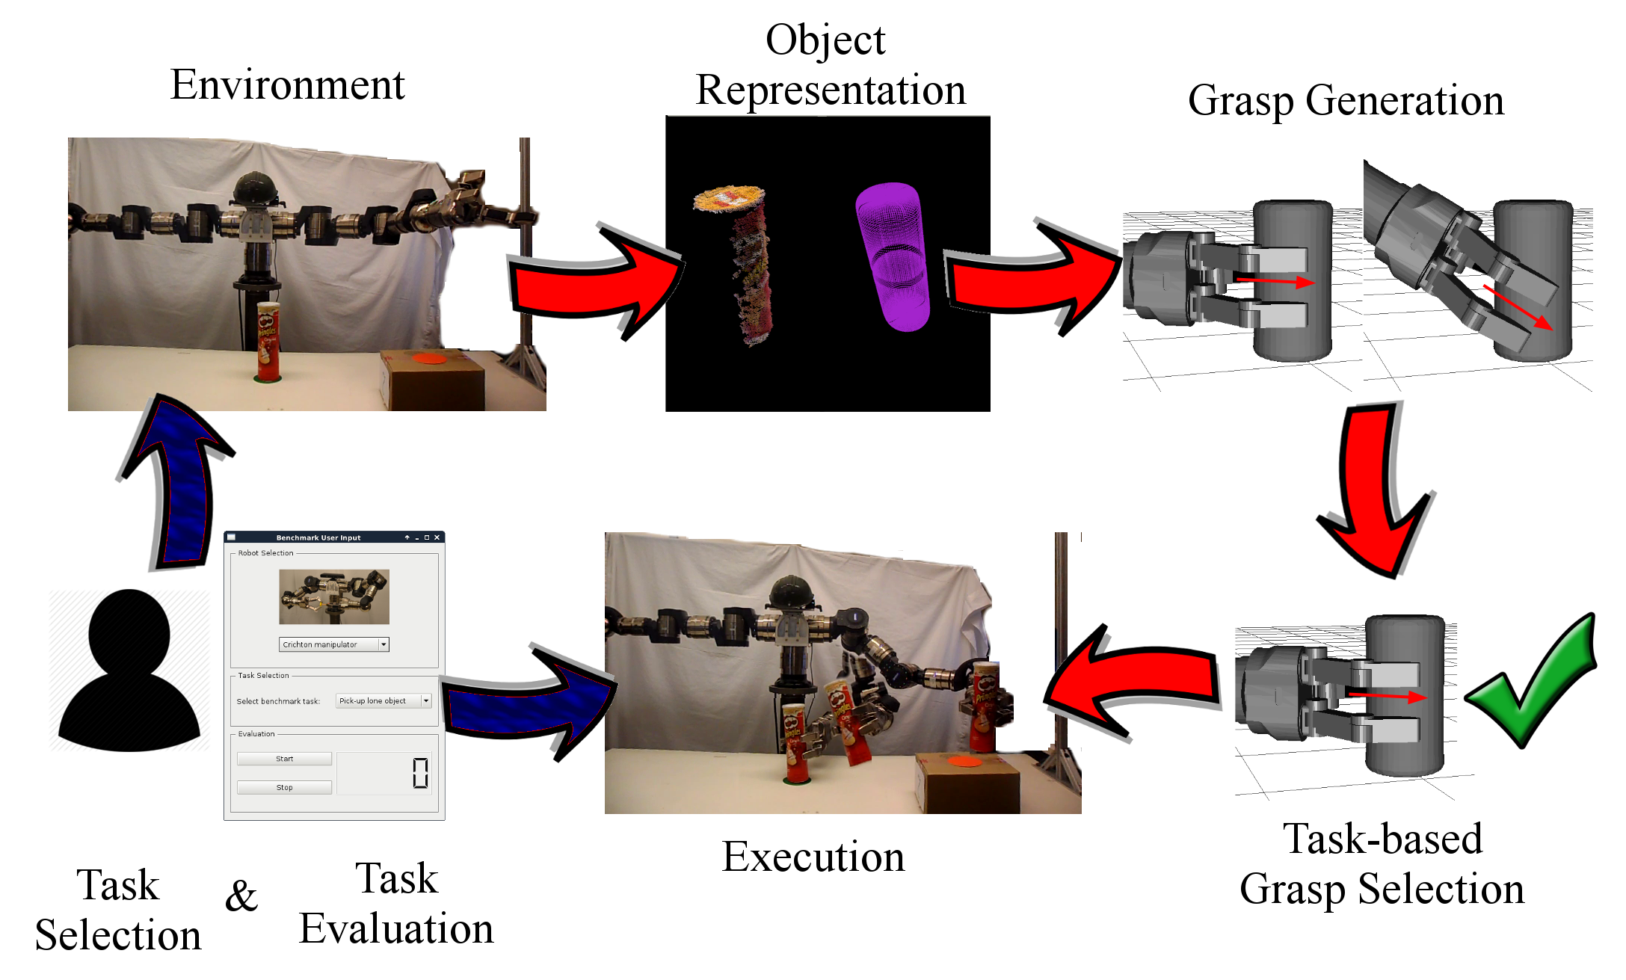
This research: Efficiently performing simple manipulation tasks

Slide 11
Thesis Statement
Compact parametric models facilitate consistent and efficient grasp modeling and execution.

Slide 12
Outline
1. Object representation
2. Grasp generation
3. Grasp selection
4. Handover interaction
5. Benchmark design
6. Proposed work

Slide 13
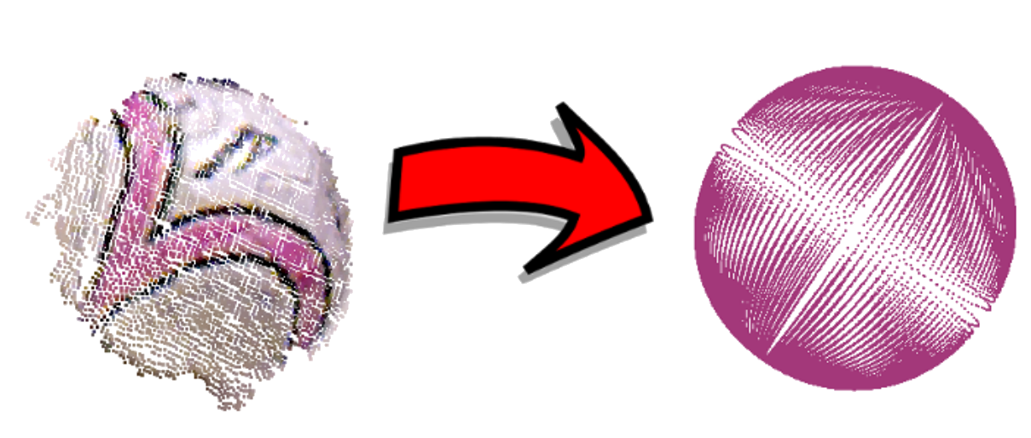
Outline
1. Object representation
2. Grasp generation
3. Grasp selection
4. Handover interaction
5. Benchmark design
* Proposed work

Slide 14
1. Object Representation
“Exploiting Symmetries and Extrusions for Grasping Household Objects”
A. Huaman Quispe, B. Milville, M. Gutierrez, C. Erdogan, M. Stilman, H.I.Christensen and H.Ben Amor
IEEE International Conference on Robotics and Automation, 2015
“Practical Considerations for Fitting Superquadrics to real data for robot manipulation”
A. Huaman Quispe
(Submitted) IEEE International Conference on Robotics and Automation, 2016

Slide 15
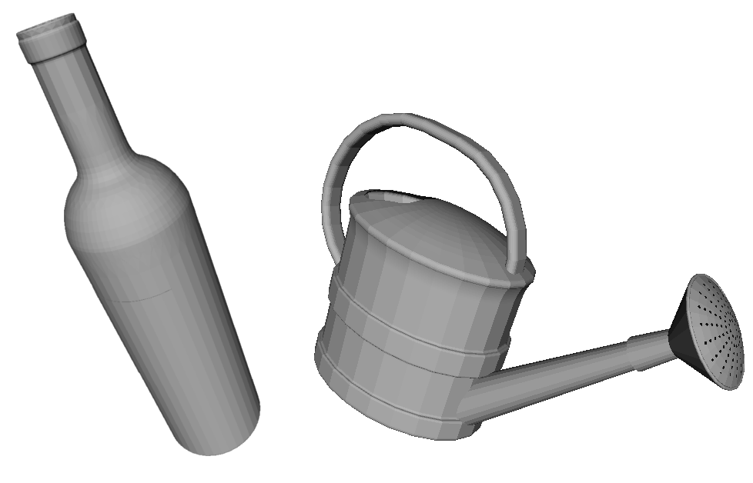
1.1. Related work in object representation
3D MODELS
The KIT object models database: An object model database for object recognition, localization and manipulation in service robotics.
(International Journal of Robotics Research,
A. Kasper, Z. Xue and R. Dillman, 2012)
BigBIRD: A Large-Scale 3D Database of Object Instances
(IEEE Int. Conf. On Robotics and Automation,
A. Singh, J. Sha, K.S. Narayan, T.Achim and P. Abbeel, 2014)
Benchmarking in Manipulation Research: The YCB
Object and Model Set and Benchmarking Protocols
(IEEE Robotics and Automation Magazine,
B. Calli et al, 2015)

Slide 16
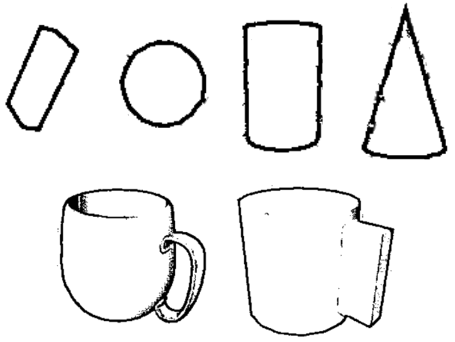
1.1. Related work in object representation
Primitives
Shape-Primitive Based Object
Recognition and Grasping
(7th German Conference on Robotics,
M. Nieuwenhuisen et al, 2012)
Automatic Grasp Planning using Shape Primitives
(IEEE Int. Conf. on Robotics and Automation,
A.T. Miller, S. Knoop, H.I. Christensen and P.K.Allen, 2003)

Slide 17
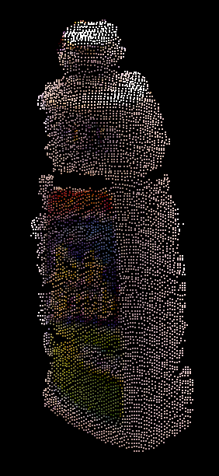
1.1. Related work in object representation
Raw pointclouds
Contact-reactive grasping of objects with partial shape information
(IEEE Intl. Conf. on Robotics and Automation,
K. Hsiao, S. Chitta, Ciocarlie, M. and G. Jones,
2010)

Slide 18
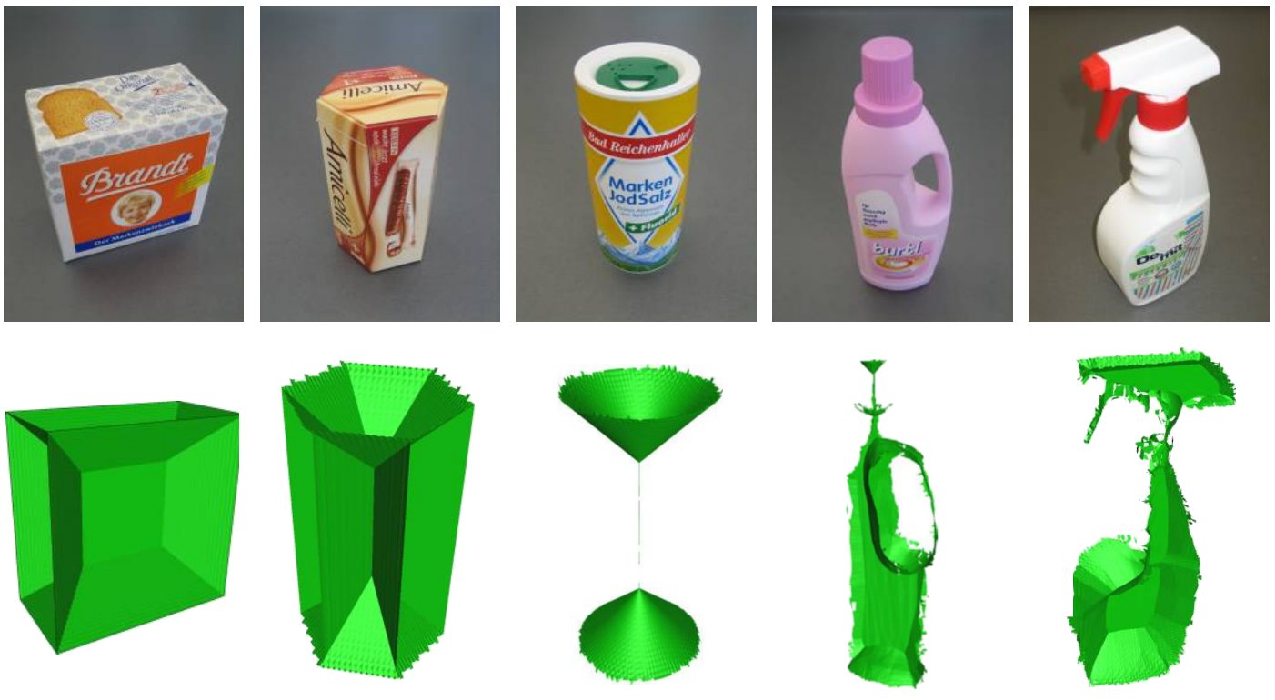
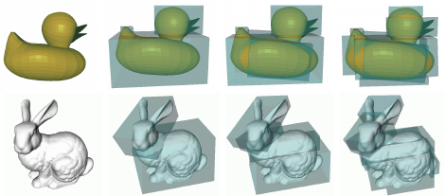
1.1. Related work in object representation
Simplified representations
Unions of balls for shape approximation in robot grasping
(IEEE Intl. Conf. on Robotics and Automation,
M. Przybylski, T. Asfour and D. Dillmann, 2010)
Minimum volume bounding box decomposition for shape approximation in robot grasping
(IEEE Int. Conf. On Robotics and Automation,
K. Huebner, S. Ruhotto and D. Kragic, 2008)

Slide 19

1.2. Superquadrics
Family of geometrical shapes that can represent different types of simple objects.

Slide 20
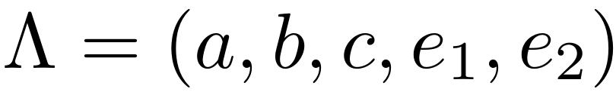
1.2. Superquadrics
With only 5 parameters:

Slide 21
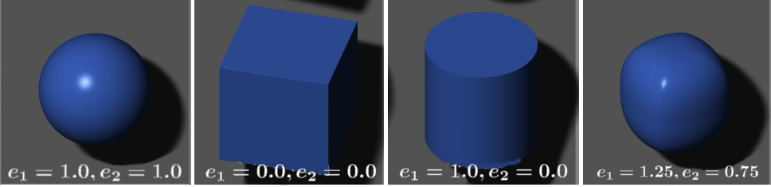
1.2. Superquadrics
With only 5 parameters:
Source: Wikipedia – Superquadrics samples
Source: Wikipedia – Superquadrics samples

Slide 22
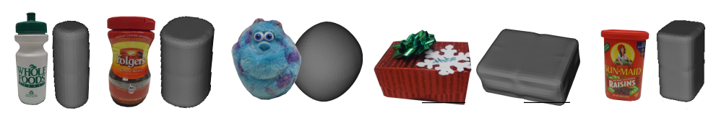
1.2. Superquadrics
With only 5 parameters:
+ 6 additional parameters for rotation and translation: 11 parameters

Slide 23
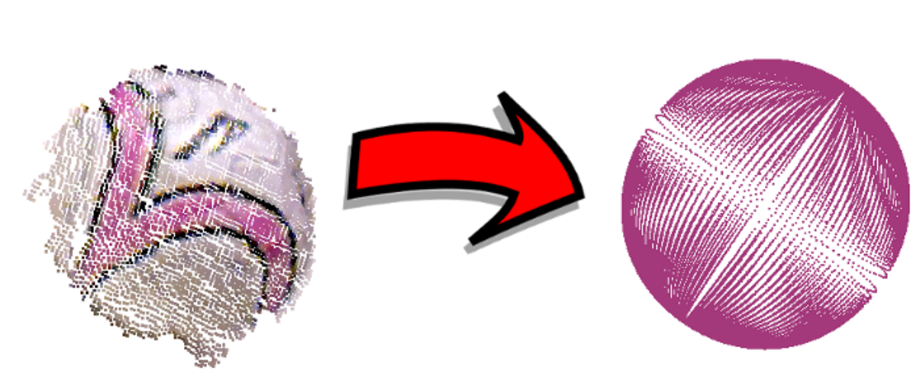
1.3. Input-Output
Dense Parameterized
One-view Pointcloud Representation

Slide 24
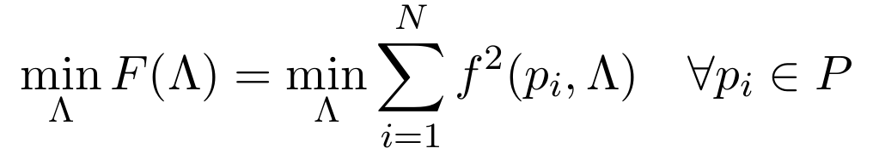
1.3. Input-Output
Use Levenberg-Marquadt to minimize the highly non-linear equation
(11 parameters):

Slide 25
1.3. Input-Output
3 IMPROVEMENTS:
Fast computation (in a few seconds or less)
as to run it on-line in the robot

Slide 26
1.3. Input-Output
3 THINGS TO MAKE THE
MINIMIZATION EASIER

Slide 27
1.3. Minimization
IMPROVEMENTS 1 & 2:
Mirror the segmented pointclouds [1].
Use a hierarchical minimization approach [2].
[1] Mind the Gap: Robotic Grasping under incomplete observation
IEEE Int. Conf. on Robotics and Automation, 2010
J. Bohg, M. Johnson-Roberson, B. Leon, J. Felip, X.Gratal et al.
[2] Multi-scale superquadric fitting for efficient shape and pose recovery of unknown objects
IEEE Int. Conf. on Robotics and Automation, 2013
K. Duncan, S. Sarkar, R. Alqasemi and R. Dubey

Slide 28
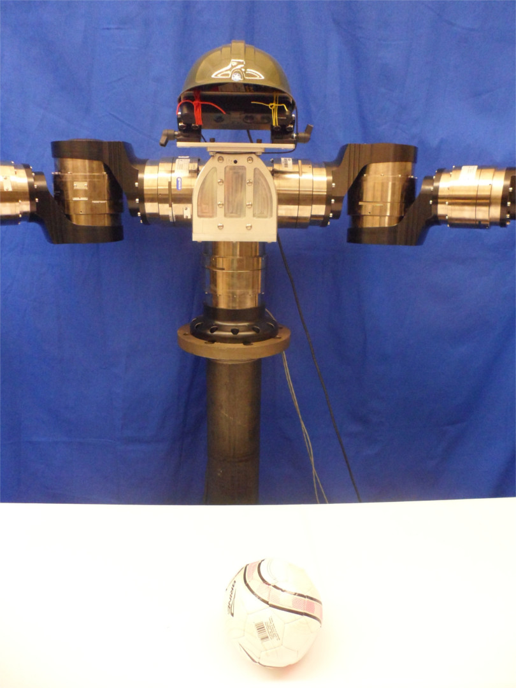
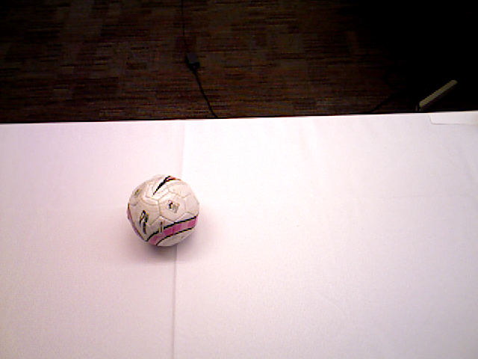
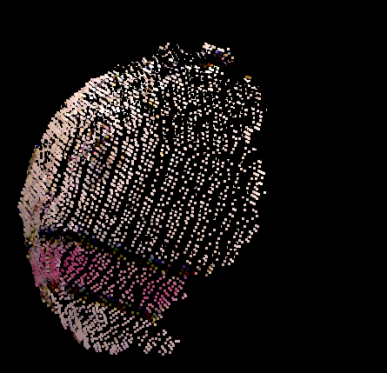

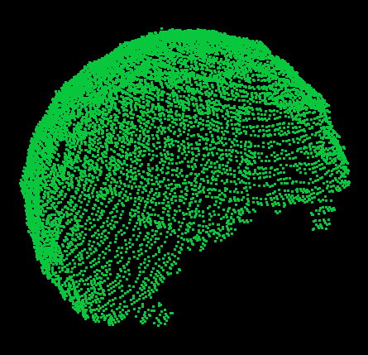
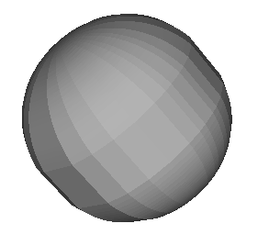
1.3. Superquadric fitting workflow
Input acquisition
Tabletop segmentation
11
PARAMETERS
Pointcloud mirroring
Minimization

Slide 29
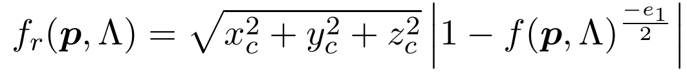
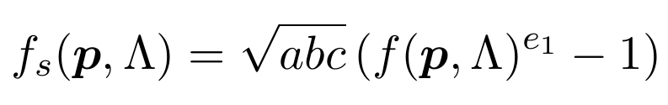
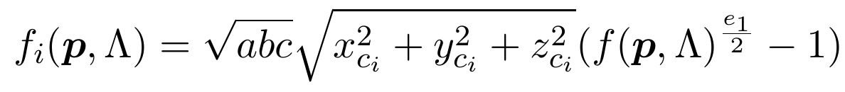
1.3. Minimization
Which function is the best for our purposes?
1. Radial Function:
2. Solina Function:
3. Chevalier Function:
4. Ichim Function:
5. Alternative Function 5:

Slide 30
1.3. Minimization
Which function is the best for our purposes?
1. Radial Function:
2. Solina Function:
3. Chevalier Function:
4. Ichim Function:
5. Alternative Function 5:
EXCEPTION: Experimental Comparison of superquadric fitting objective functions
In Pattern Recognition Letters 24.14 (2003), Y.Zhang

Slide 31
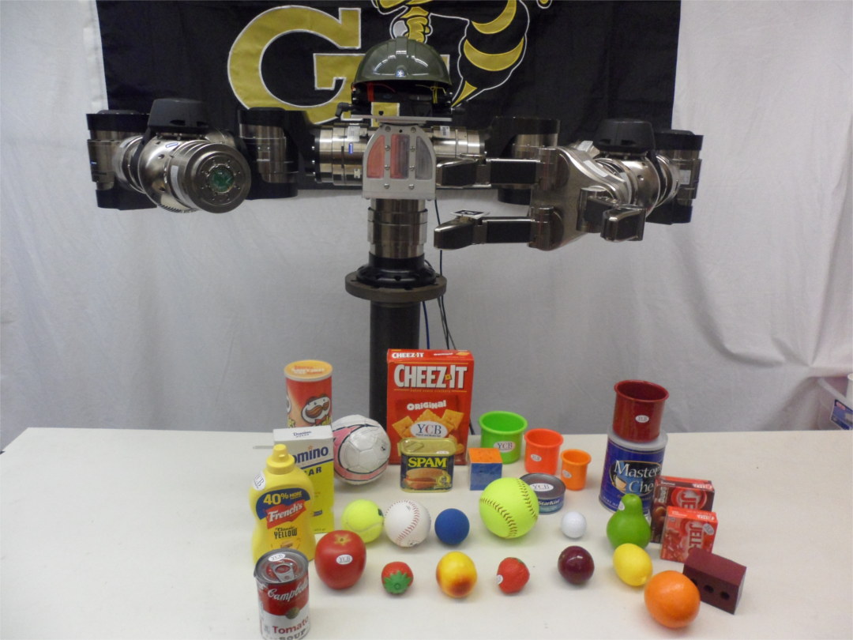
1.4. Superquadric fitting evaluation
Evaluate our SQ fitting
procedure with a subset of the YCB object dataset [3]
(31 objects including food and shape-varied items + 10
extra objects of our own)
[3] The YCB object and model set: Towards common benchmarks for manipulation research
Advanced Robotics, 2015. B. Calli et al.

Slide 32
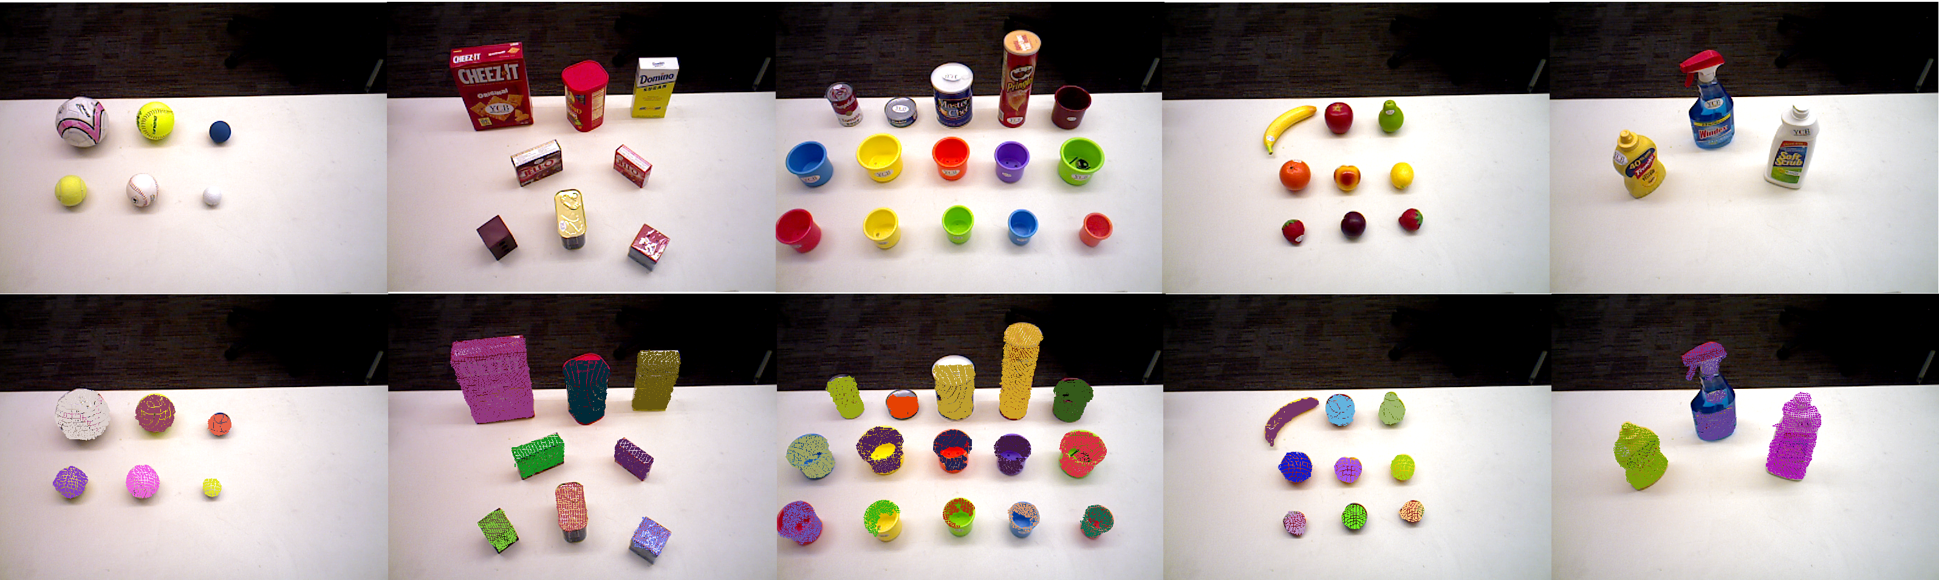
1.4. Superquadric fitting evaluation:
5 groups: Spheres, boxes, cylinders, fruits and non-standard shapes

Slide 33
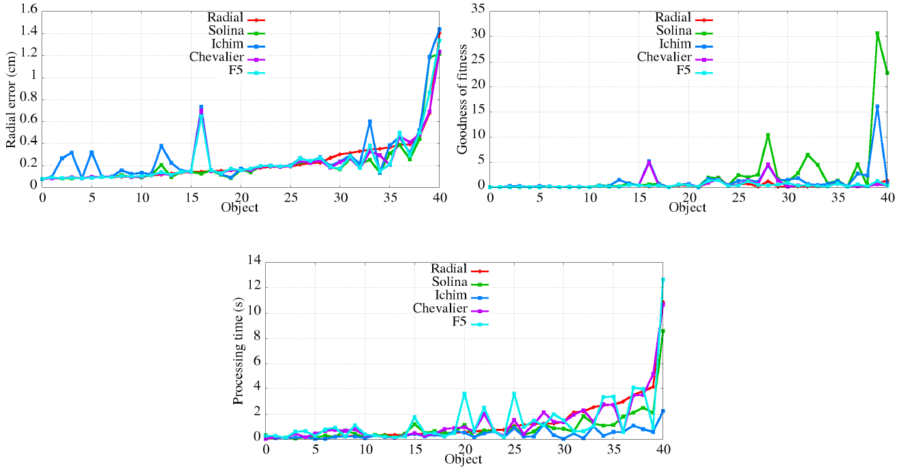
1.4. Superquadric fitting evaluation

Slide 34
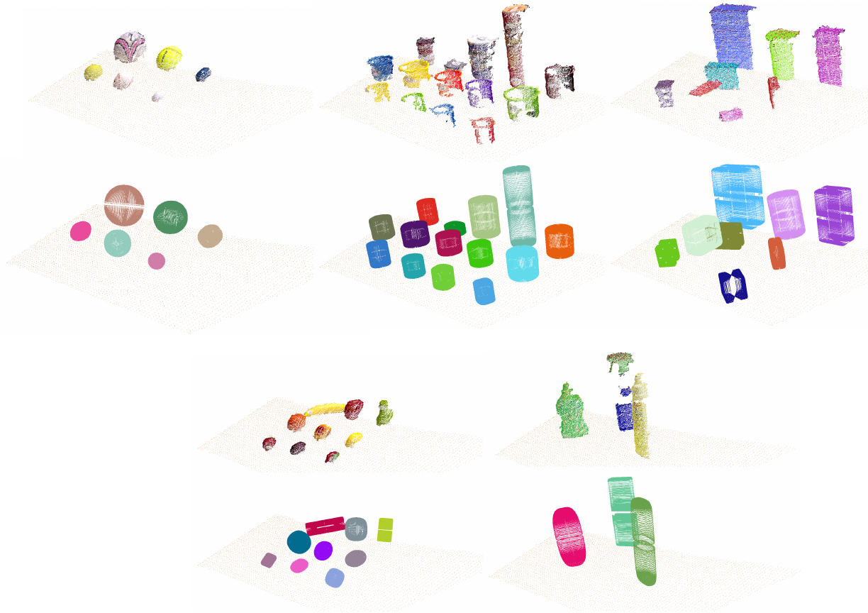
1.4. Superquadric fitting evaluation
Results using the Ichim function:

Slide 35
1.4. Superquadric fitting evaluation
Time results
Avg. time per object:
~2 seconds
Including mirroring + fitting
Getting some individual data
Speed: 2x

Slide 36
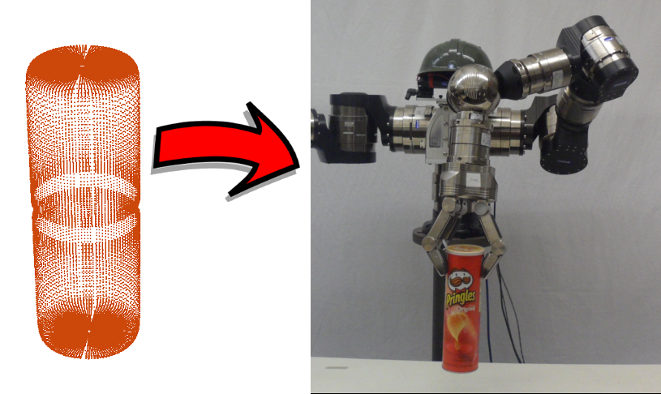
Outline
1. Object representation
2. Grasp generation
3. Grasp selection
4. Benchmark design
5. Handover interaction
* Proposed work

Slide 37
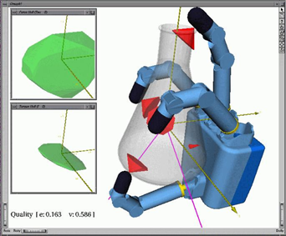
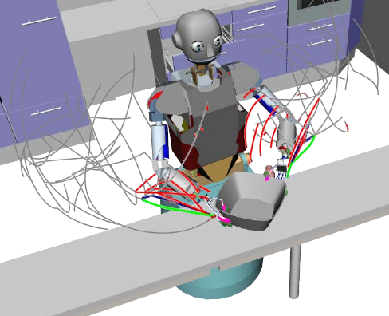
2. Grasp Generation
RELATED WORK:
OpenRave: A Planning Architecture for
Autonomous Robotics
(Technical Report, Carnegie Mellon University,
R. Diankov, 2008
GraspIt! A versatile simulator for robotic grasping
(IEEE Robotics and Automation Magazine,
A.Miller and P.K.Allen, 2004)
Integrated Grasp and Motion Planning
(IEEE, Int. Conf. On Robotics and Automation
N. Vahrenkamp, M. Do, T. Asfour and R. Dillmann, 2010)

Slide 38
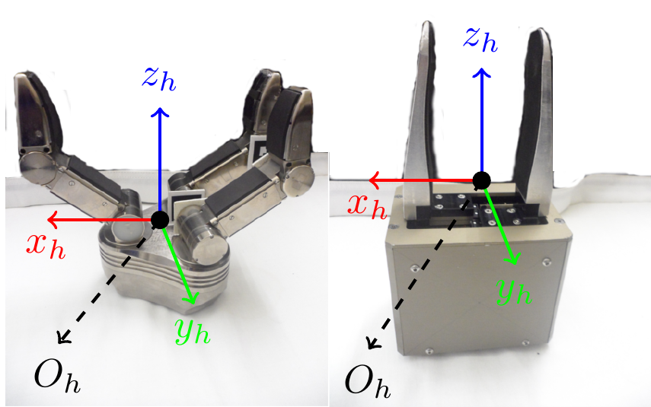
2. Grasp Generation
We define a fixed hand pre-shape:
1. Z axis: Approach direction
2. X axis: Fingers direction
3. Y axis: Right-handed system

Slide 39
2. Grasp Generation
We define a fixed hand pre-shape:
1. Z axis: Approach direction
2. X axis: Fingers direction
3. Y axis: Right-handed system
Output:
1. Finger joints (closed
configuration)
2. Hand pose with respect
to object

Slide 40
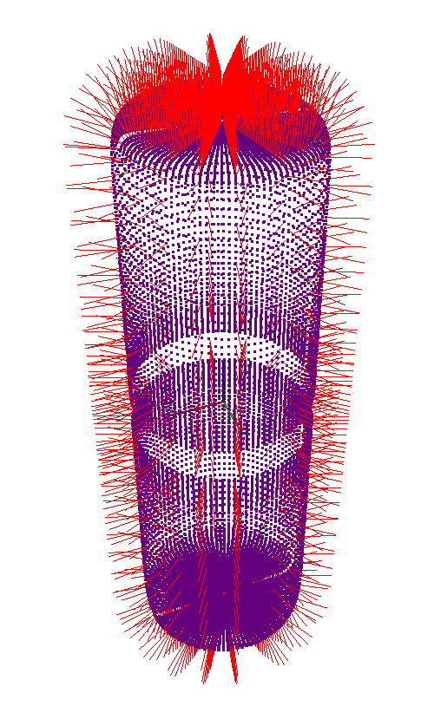
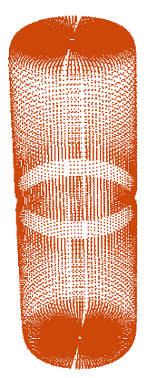
2. Grasp Generation

Slide 41
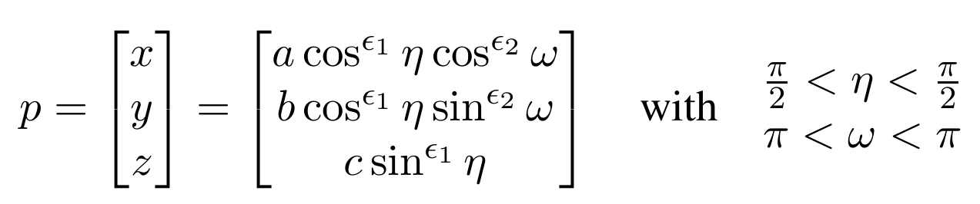
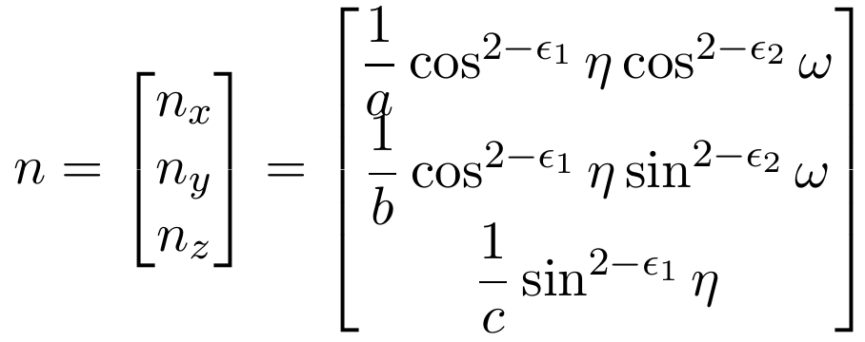
2. Grasp Generation

Slide 42
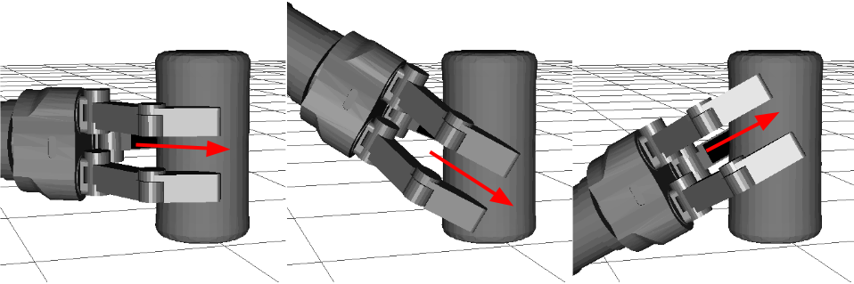
2. Grasp Generation
We add two additional inclinations (45 degrees) to each grasp
produced with a normal.

Slide 43
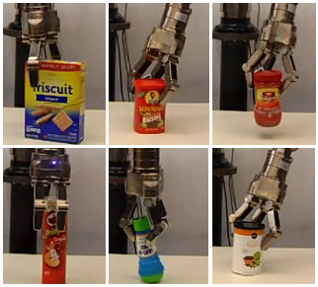
2. Grasp Generation

Slide 44
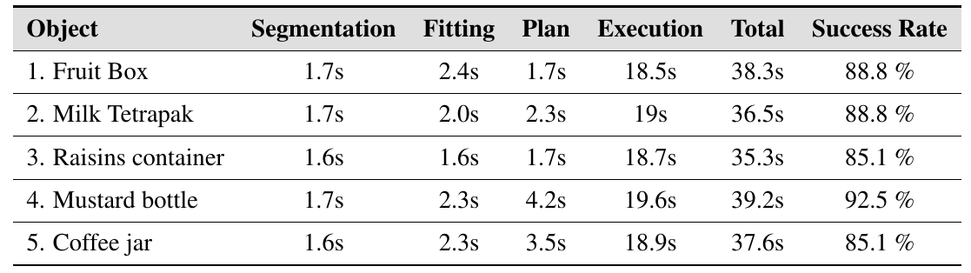
2. Grasp Generation
Results from experimenting with the objects shown:
Success rate evaluated over a number of trials

Slide 45
2. Grasp Generation
Observations:
1. Success rate dependent not only
on grasp generation approach, but
also on diverse factors: Camera
calibration, motion control
performance and movement
accuracy.
2. Results shown were ran in open
loop.
Video speed: 8x

Slide 46
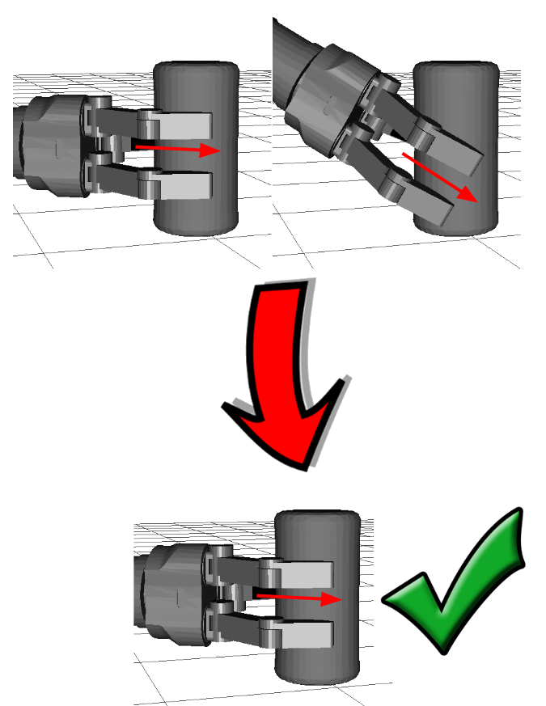
Outline
1. Object representation
2. Grasp generation
3. Grasp selection
4. Handover interaction
5. Benchmark design
6. Proposed work

Slide 47
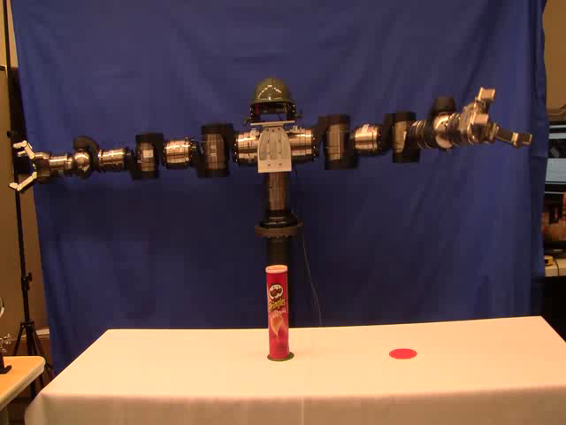
3. Grasp Selection
One robot
One object
A simple pick-and-place task

Slide 48
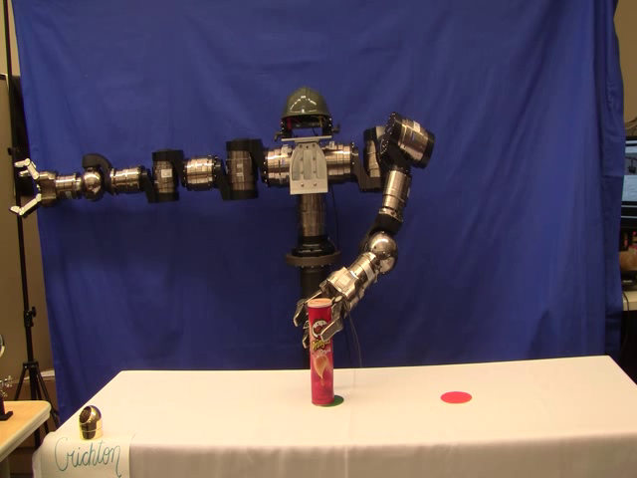
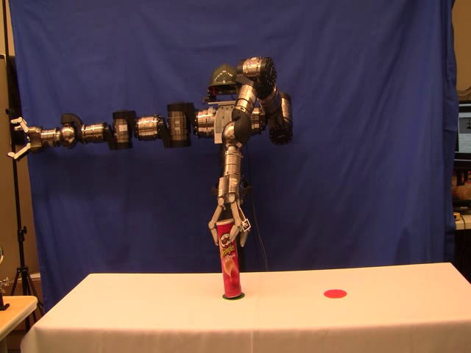
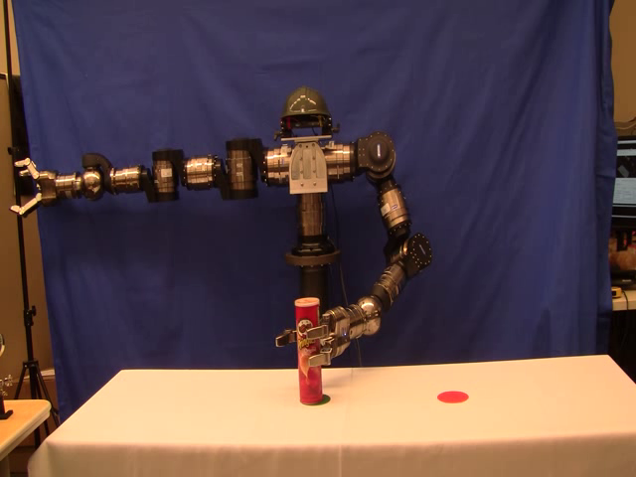
3. Grasp Selection
Many possible grasps to choose from!
Grasp 7/33 Grasp 13/33 Grasp 16/33
For this particular problem, our standard planner found 33 possible grasps.

Slide 49
3. Grasp Selection
Given a pick-and-place task and a number of
candidate grasps: Which grasp should be tried first?

Slide 50
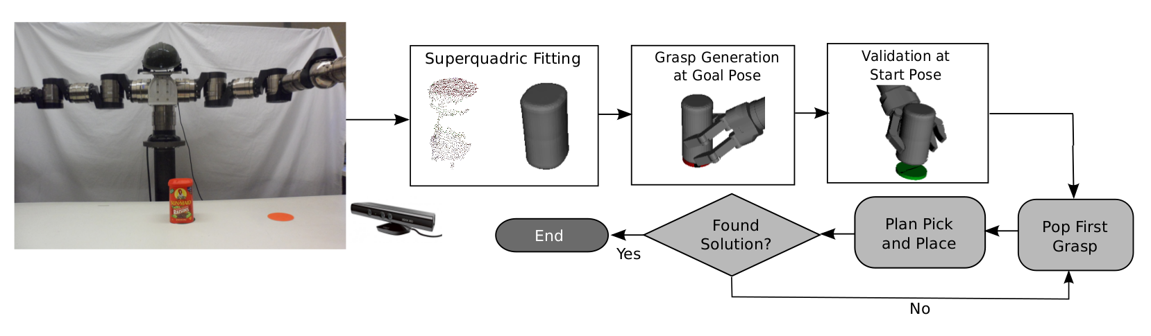
3. Grasp Selection
Given a pick-and-place task and a number of
candidate grasps: Which grasp should be tried first?

Slide 51
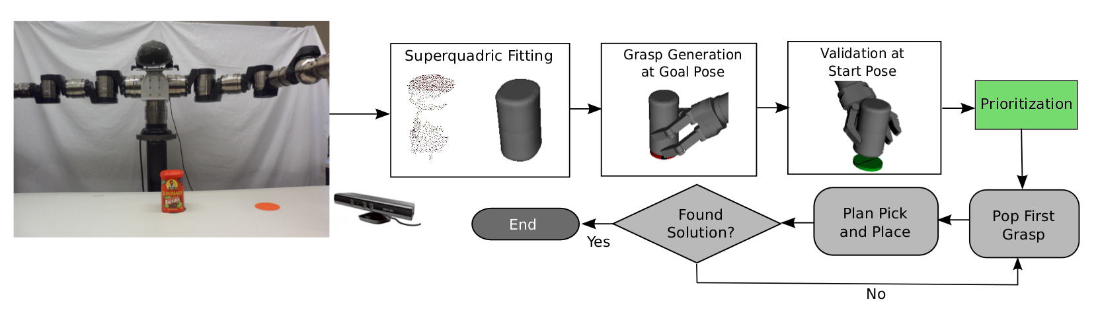
3. Grasp Selection
Given a pick-and-place task and a number of
candidate grasps: Which grasp should be tried first?

Slide 52
3. Grasp Selection
What metric to use to prioritize grasps?
IDEA: We want to select grasps that can be easy to execute.

Slide 53
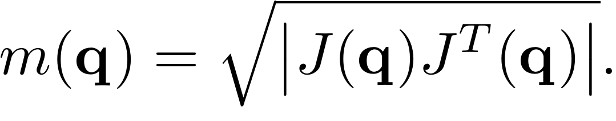
3. Grasp Selection
What metric to use to prioritize grasps?
IDEA: We want to select grasps that can be easy to execute.
MANIPULABILITY (m)
Measurement of
how dexterous the
end-effector of a robotic
arm is at a given
joint configuration q.

Slide 54
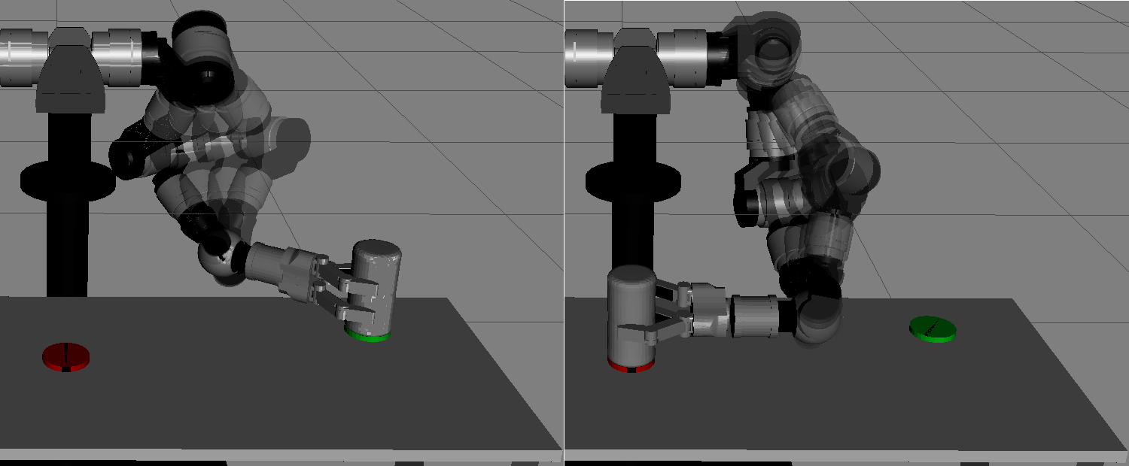
3. Grasp Selection
We proposed:
Situated grasp manipulability (m_g)
Measurement of
how dexterous the
end-effector of a robotic
arm is (in average)
when executing a grasp
g on an object at a given
pose (Ts or Tg).

Slide 55
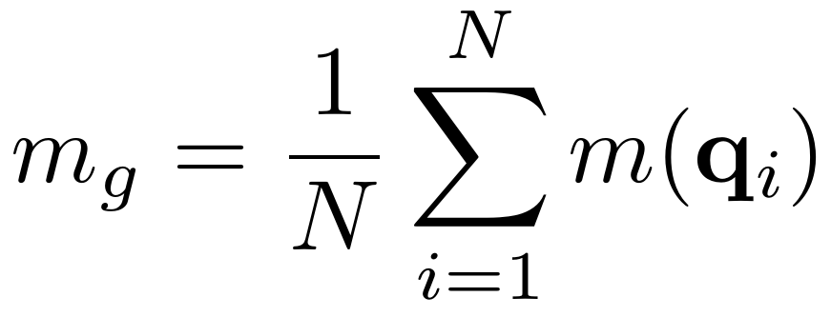
3. Grasp Selection
We proposed:
Situated grasp manipulability (m_g)

Slide 56
3. Grasp Selection
Situated grasp manipulability (m_g)
Should we care more for comfort at the beginning of the
pick-and-place task? Or the comfort at the goal pose is more
important?

Slide 57
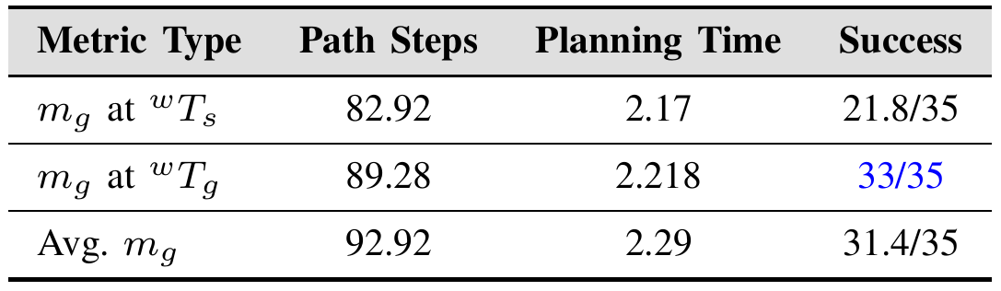
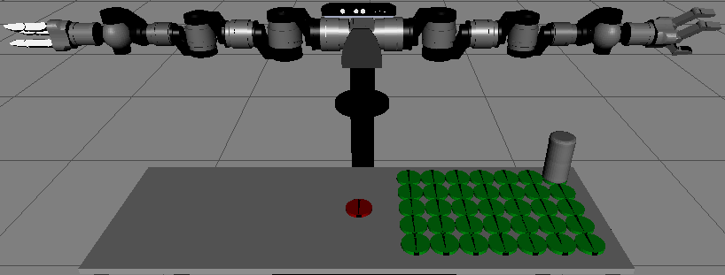
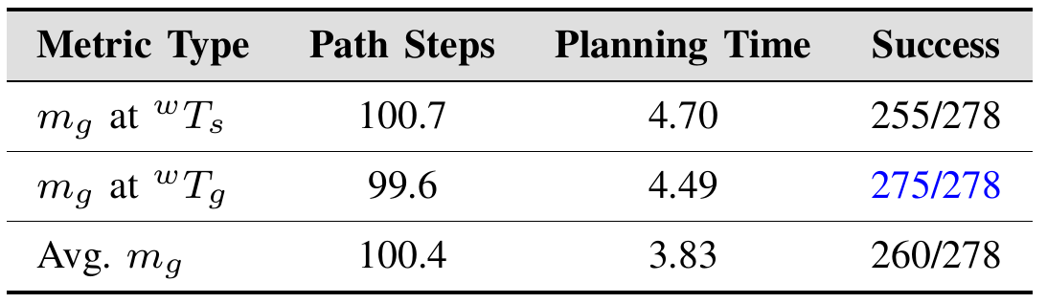
3. Grasp Selection
Situated grasp manipulability (m_g)
Should we care more for comfort at the beginning of the
pick-and-place task? Or the comfort at the goal pose is more
important?

Slide 58
3. Grasp Selection

Slide 59

Outline
1. Object representation
2. Grasp generation
3. Grasp selection
4. Handover interaction
5. Benchmark design
* Proposed work

Slide 60

4.2. Robot-human handover
“Handover Planning for Every Occassion”
A. Huaman Quispe, H. Ben Amor and M. Stilman
IEEE-RAS International Conference on Humanoid Robots 2014

Slide 61
4.2. Robot-human handover
Related Work:
Human Preferences for Robot-Human Handover configurations
IEEE/RSJ Int. Conf. On Intelligent Robots and Systems, 2011
M. Cakmak, S.S. Srnivasa, M.K.Lee, J. Forlizzi and S. Kiesler
Sharing Efforts in planning human-robot handover tasks
Int. Symposium on Robot and Human Interactive Comm., 2012
J.Mainprice, M. Gharbi, T. Simeon, R. Alami
Towards planning human-robot interactive manipulation tasks:
Task dependent and human oriented autonomous selection of grasp
and placement
IEEE/RAS Int. Conf. On Biomedical Robotics and Biomechatronics, 2012
A. Kumar, J. Saut, D. Sidobre and R. Alami,

Slide 62
4.2. Robot-human handover
Some observations:
Common assumption 1:
Robot is facing the human.
Common assumption 2:
Object is already in the hand.
Common assumption 3:
Robot / human can move.

Slide 63

4.2. Robot-human handover
Problem Description:

Slide 64

4.2. Robot-human handover
Problem Description:

Slide 65

4.2. Robot-human handover
Problem Expected Output:

Slide 66

4.2. Robot-human handover
Proposed Solution:
STEP 1: Generate feasible grasps for receiver humanoid

Slide 67

4.2. Robot-human handover
Proposed Solution:
STEP 2: Generate feasible grasps for giver robot

Slide 68
4.2. Robot-human handover
Proposed Solution:
STEP 3: Calculating feasible handover poses
The position of the object must be constrained to
the common workspace between the robot and the humanoid.
Virtually there is an infinite number of poses the
object can assume.
We use two heuristics to search the possible rotation for the object:
1. Humans usually don't rotate an object unless it is necessary.
2. Whenever possible, our wrist is in a rest position.

Slide 69

4.2. Robot-human handover
STEP 3: HEURISTICS
1. Humans usually don't rotate
an object unless it is necessary.
2. Whenever possible, our wrist
is in a rest position.

Slide 70

4.2. Robot-human handover
STEP 3: HEURISTICS
1. Humans usually don't rotate
an object unless it is necessary.
2. Whenever possible, our wrist
is in a rest position.

Slide 71

4.2. Robot-human handover
EXPERIMENTS: 1. BUTLER SCENARIO

Slide 72



4.2. Robot-human handover
EXPERIMENTS: 1. BUTLER SCENARIO

Slide 73

4.2. Robot-human handover
EXPERIMENTS: 2. STOOL SCENARIO

Slide 74



4.2. Robot-human handover
EXPERIMENTS: 2. STOOL SCENARIO

Slide 75

4.2. Robot-human handover
EXPERIMENTS: 3. KNEELING SCENARIO

Slide 76



4.2. Robot-human handover
EXPERIMENTS: 3. KNEELING SCENARIO

Slide 77

Outline
1. Object representation
2. Grasp generation
3. Grasp selection
4. Handover interaction
5. Benchmark design
6. Proposed work

Slide 78
5. Benchmark Design
“A Taxonomy of Benchmark Tasks for Bimanual manipulators”
A. Huaman Quispe, H. Ben Amor and H.I.Christensen
International Symposium of Robotics Research (ISRR) 2015

Slide 79
5. Benchmark Design
What tasks should we use to
evaluate our robot?

Slide 80

5. Benchmark Design
There are many!

Slide 81
5. Benchmark Design
Related work:
Towards a Comprehensive Chore List for Domestic Robots
ACM/IEEE Int. Conf. On Human-Robot Interaction, 2013
M. Cakmak and L. Takayama
Domestic Robots for Older Adults: Attitudes, Preferences and Potential
International Journal on Social Robotics, 2014
C.A. Smarr, T. Mitzner, J.Beer, A. Prakash, T.Chen, C.Kemp, W. Rogers.

Slide 82

5. Benchmark Design
Our work:
A review of related fields:
BENCHMARKING
IN
ROBOTICS
PERFORMANCE
EVALUATION
IN HUMANS

Slide 83

5. Benchmark Design
Our work:
A review of related fields:
BENCHMARKING
IN
ROBOTICS
PERFORMANCE
EVALUATION
IN HUMANS
BENCHMARK
DESIGN
GUIDELINES
+
TAXONOMY

Slide 84

5.1. Benchmarking in Robotics
Mostly through the use of competitions:

Slide 85
5.1. Benchmarking in Robotics
Mostly through the use of competitions:
DARPA Robotics Challenge (2015)
Amazon Picking Challenge (2015)

Slide 86


5.1. Benchmarking in Robotics
Some lessons learned:
1. There is the risk of
over-specialization.
2. A lack of guidelines
and expectations
can render unexpected
results.

Slide 87

5.2. Benchmarking in Humans: Dexterity Tests

Slide 88


5.2. Benchmarking in Humans:
Physical tests
Grip and pinch strength Kapandji test (1985)
evaluation (1984)

Slide 89


5.2. Benchmarking in humans: Starting to use objects
Box and Block test (1986) Purdue Pegboard test (1985)

Slide 90



5.2. Benchmarking in humans:
What does the person cares for?
Chedoke Arm and Hand Activity Itinerary (2005)

Slide 91



5.2. Revising human tests:
We have two arms so...
Sollerman Hand Function Test (1995)

Slide 92
5.2. Revising human tests:
Lessons learned
Metrics must be relevant to the end-users.
Tests should happen several times.
Baseline results are 100% needed.

Slide 93

5.2. What we propose: Benchmark taxonomy

Slide 94
Outline
1. Object representation
2. Grasp generation
3. Grasp selection
4. Handover interaction
5. Benchmark design
6. Proposed work

Slide 95
6. Proposed Work
1. Implementation of 3 sample benchmark experiments. Ideally
One of them should involve a human handover.
2. Extension of grasp prioritization approach to handle
soft constraints.
3. [DESIRED] Transfer both of my proposed approaches to arm
Planning (ICHR 2012, IROS 2013) in the physical robot platform.

Slide 96
6. Timeline

