Slide 1

A Robot Manipulation Framework of Novel Objects for Elementary Household Tasks
PhD. Thesis Defense
Ana C. Huamán Quispe
Reading Committee
Prof. Dr. Henrik I. Christensen, (advisor) Georgia Tech
Prof. Dr. C. Karen Liu, Georgia Tech
Prof. Dr. Charles Kemp, Georgia Tech
Prof. Dr. Andrea L. Thomaz, Georgia Tech
Prof. Dr. Peter K. Allen, Columbia University
----
Prof. Dr. Mike Stilman, Georgia Tech
Institute for Robotics and Intelligent Machines
Georgia Institute of Technology, USA
May 13th, 2016

Slide 2
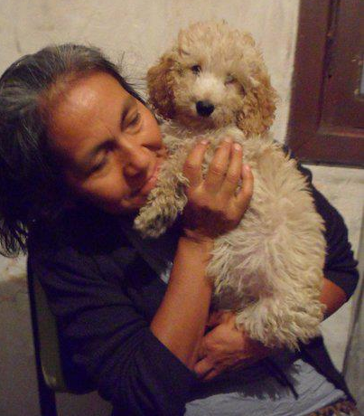
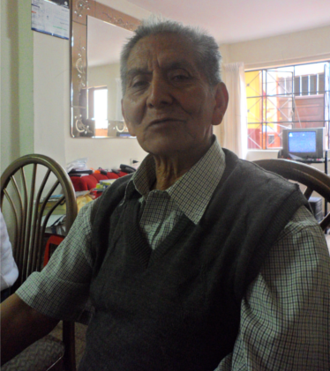

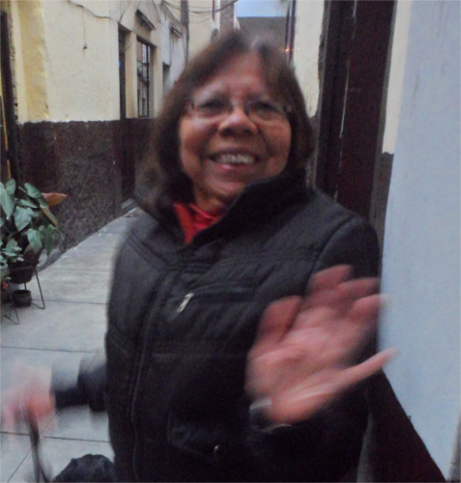
Motivation
Make robots useful to everyday people

Slide 3
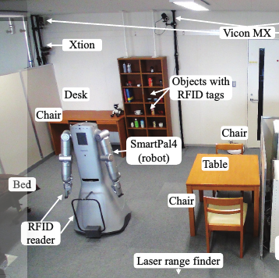
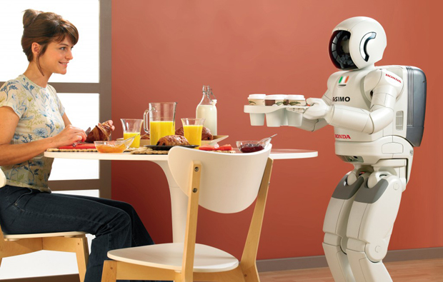
Motivation
Structured
Environments
Generalized
Environments

Slide 4
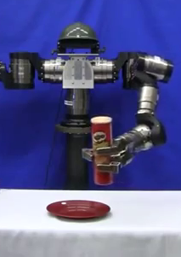
Motivation
Manipulation Tasks

Slide 5
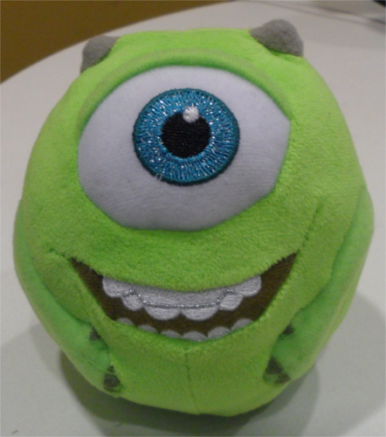
Manipulation Tasks in Generalized Environments: Challenges
Generalized
Environments
1. Robot will encounter objects it has not seen before.

Slide 6
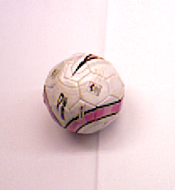
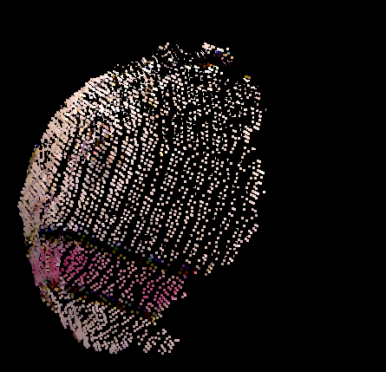

Motivation
Generalized
Environments
1. Robot will encounter objects it has not seen before.
2. Perceptual information is incomplete and noisy.

Slide 7

Motivation
Generalized
Environments
1. Robot will encounter objects it has not seen before.
2. Perceptual information is incomplete and noisy.
3. People has not patience: Planning must be done online.

Slide 8
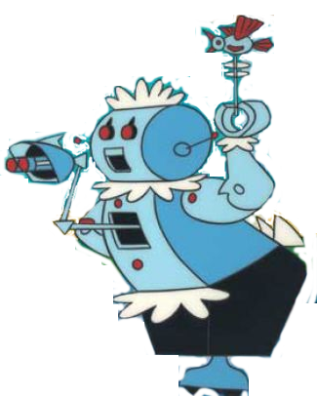
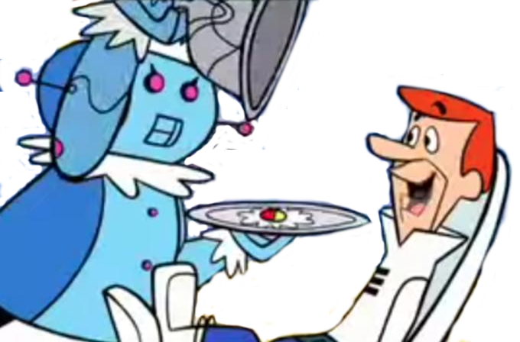
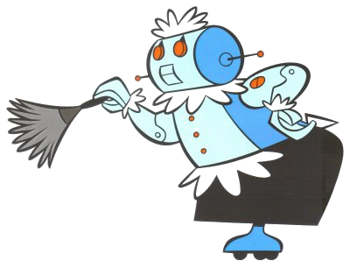
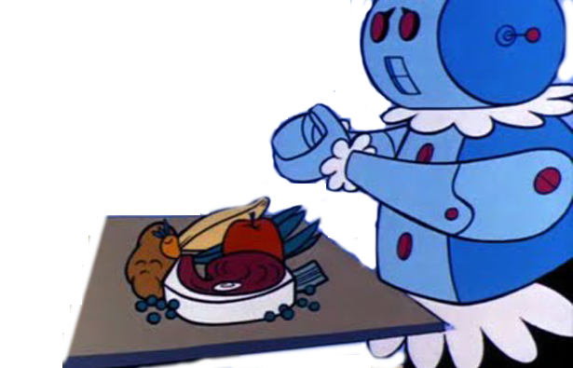
Motivation
Generalized
Environments
1. Robot will encounter objects it has not seen before.
2. Perceptual information is incomplete and noisy.
3. People has not patience: Planning must be done online.
4. People are demanding: Many multiple tasks.

Slide 9

Motivation
Generalized
Environments
1. Robot will encounter objects it has not seen before.
2. Perceptual information is incomplete and noisy.
3. People has not patience: Planning must be done online.
4. People are demanding: Many multiple tasks.
5. We like predictability: Use human heuristics?

Slide 10
Thesis Statement
Using a parameter-based object representation enables the efficient development of grasp-selection and planning strategies for elementary manipulation tasks.

Slide 11
Tasks explored in this thesis
Pick-up tasks
Pick-and-place tasks
Pouring tasks

Slide 12
Contributions
(1) We demonstrate that superquadrics are useful primitive shapes suitable to represent
on-the-fly a considerable number of convex household objects; their parametric
nature (3 axis and 2 shape parameters) is shown to be helpful to represent simple
semantic labels for objects (i.e. for a pouring task) useful for grasp and motion plan-
Ning. [SECTION 1]
(2) We introduce a hand-and-arm metric that considers both grasp robustness
and arm end-comfort to select grasps for simple pick-up tasks. We show with real and
simulation results that considering both hand and arm aspects of the manipulation
task helps to select grasps that are easier to execute in real environments without
sacrificing grasp stability on the process. [SECTION 3]
(3) We present grasp selection and planning strategies that exploit task constraints
to select the more appropriate grasp to carry out a manipulation task in an online
and efficient manner (in terms of planning and execution time. [SECTION 4 & 5 ]

Slide 13
Publications
A Taxonomy of Benchmark Tasks for Robot Manipulation
A. Huamán Quispe, H. Ben Amor and H.I. Christensen. International Symposium on Robotics Research (ISRR 2015)
Efficient Manipulation Planning with basic primitives
A. Huamán Quispe, B. Melville, C. Erdogan, H. Ben Amor, H. Christensen and M. Stilman
Proceedings of IEEE International Conference on Robotics and Automation (ICRA 2015 )
Handover Planning for Every Occasion
A. Huamán Quispe, Heni Ben Amor and M. Stilman
Proceedings of 2014 IEEE-RSJ International Conference on Humanoid Robots (Humanoids)
Grasping for a Purpose: Using Task Goals for Efficient Manipulation Planning
A. Huamán Quispe, H. Ben Amor, H.I. Christensen and M. Stilman
Computing Research Repository - http://arxiv.org/abs/1603.04338
(Submitted) Combining arm and grasp metrics for sensible grasp selection
A. Huamán Quispe, H. Ben Amor, H.I. Christensen
12th Conference on Automation, Science and Engineering (CASE 2016)
(Submitted) Exploiting Human Heuristics and shape-embedded semantic information to efficiently perform simple manipulation tasks
International Symposium of Experimental Robotics (ISER 2016)

Slide 14
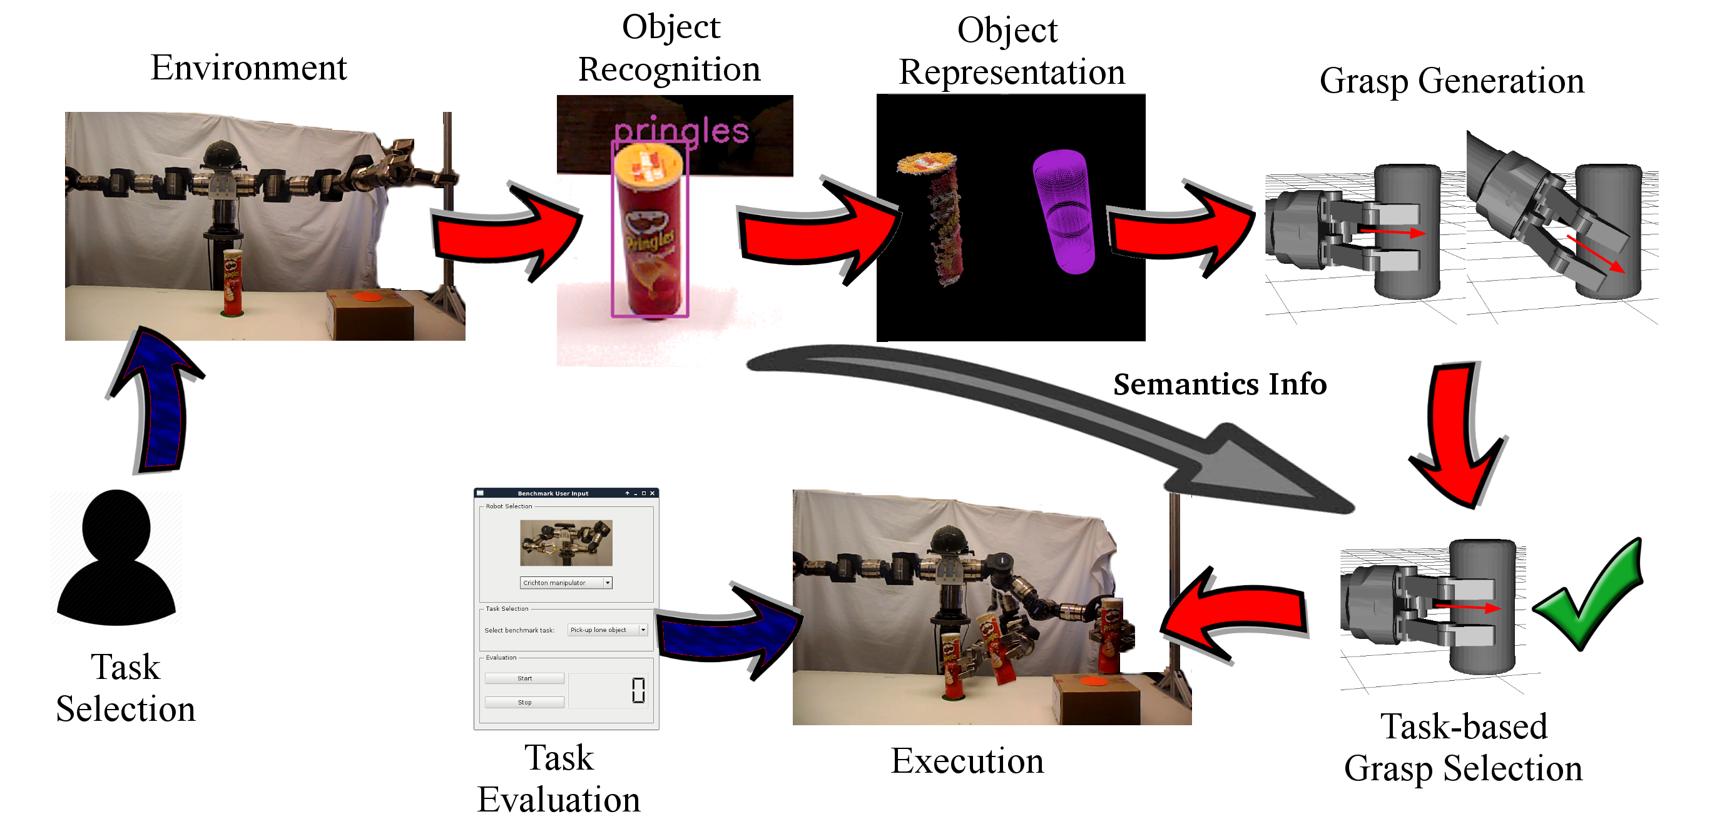
Outline

Slide 15
Outline

Slide 16
Outline
Object Representation
Grasp generation
Pick-up Tasks
Pick-and-place Tasks
Pouring Tasks
Summary

Slide 17
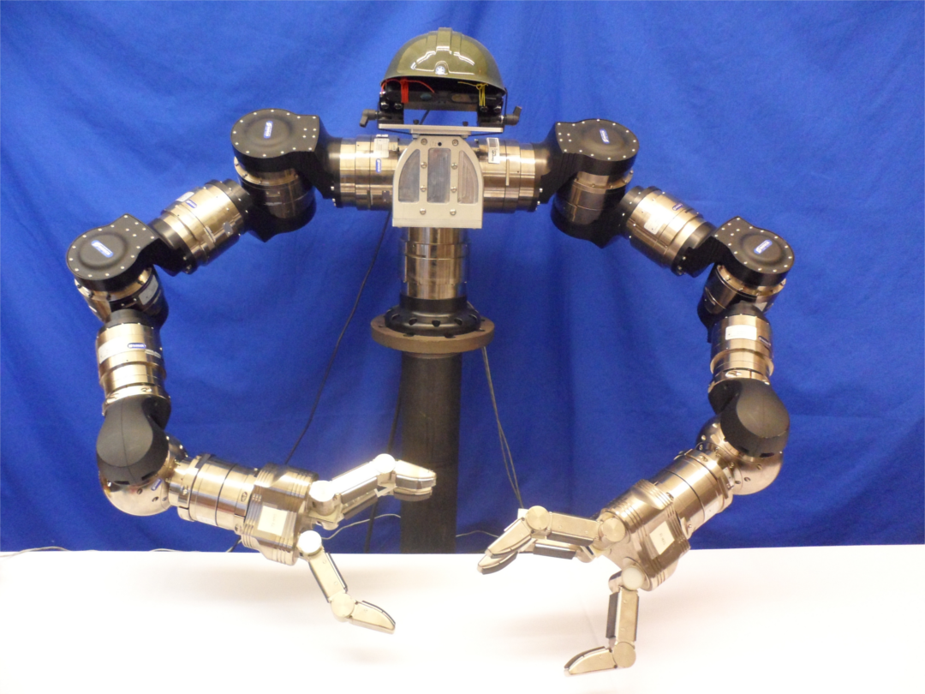
The Robot
PrimeSense
RGB-D sensor
7 DOF arm
(LWA4-Schunk)
3-fingered
Hand (SDH)
No use of ROS

Slide 18
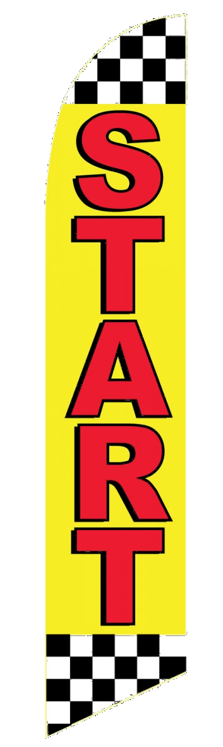
Let's start!

Slide 19
You are here

Slide 20
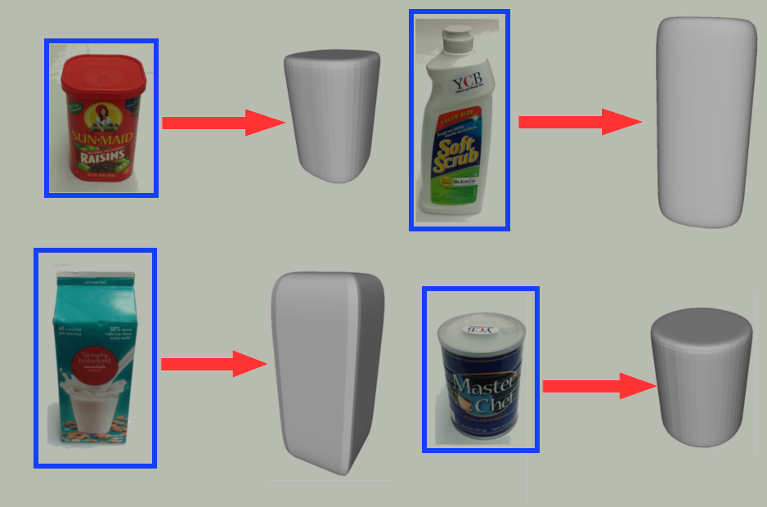
1. Object Representation

Slide 21
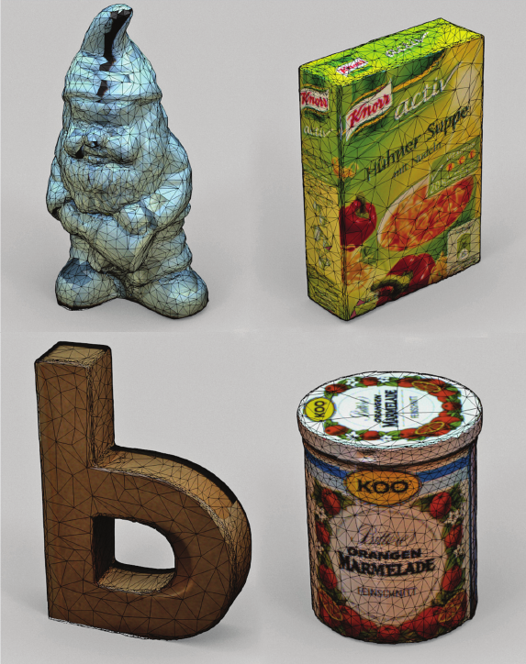
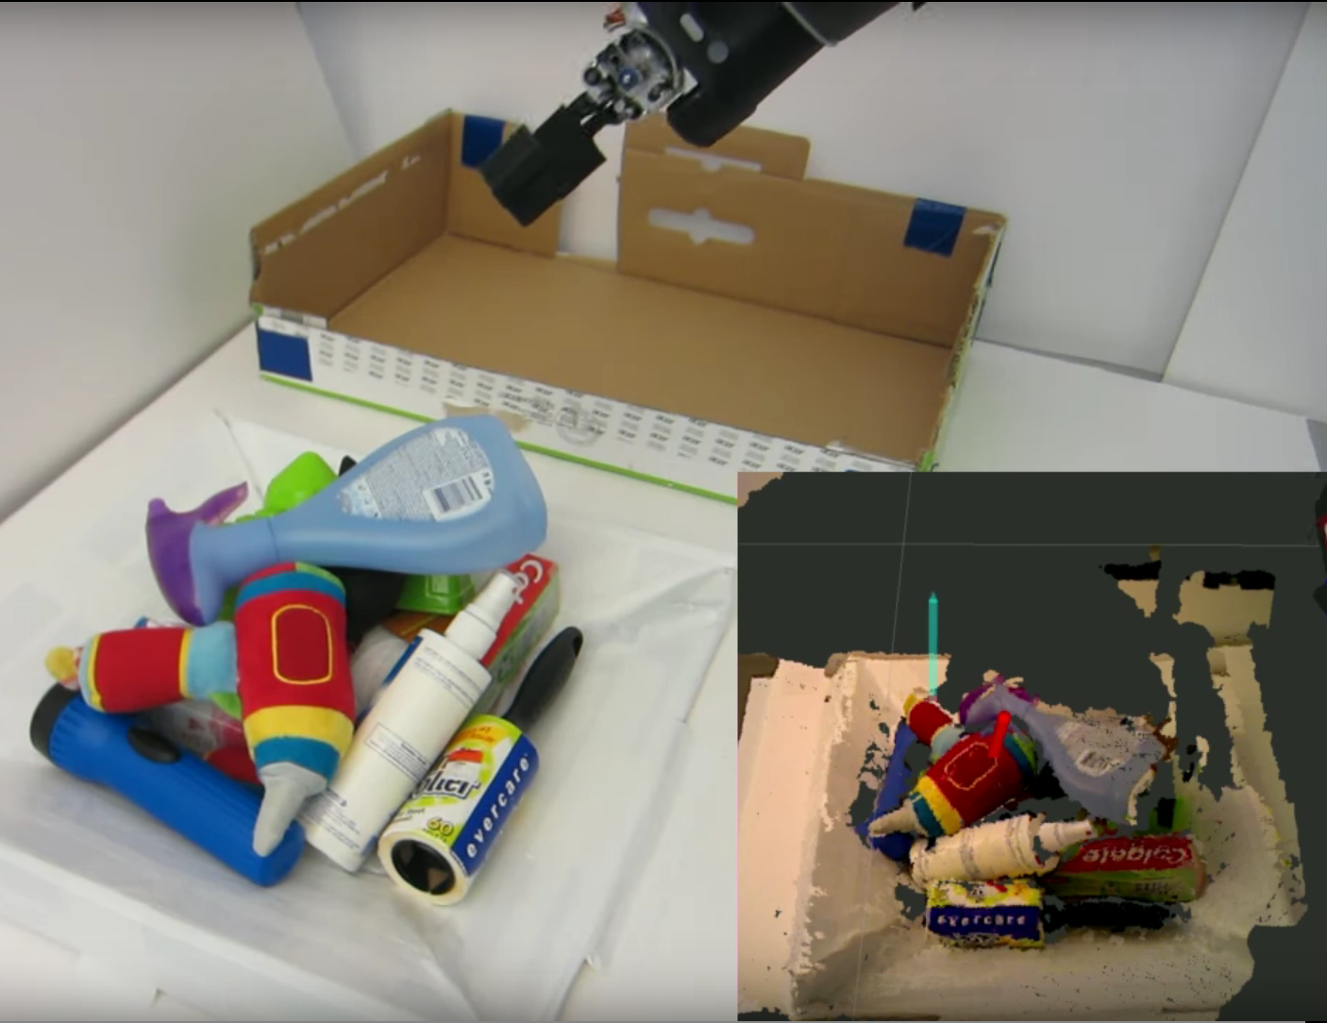
1.1. Existing approaches
The KIT object models database: An object
Model database for object recognition,
Localization and manipulation in service robotics
(2012)
Using Geometry to detect grasps in 3D point clouds.
Ten Pas & Platt (2015)

Slide 22
1.2. Our framework's requirements
Simple representation (few parameters).
Different types of geometry.
Fast to calculate (online manner).

Slide 23
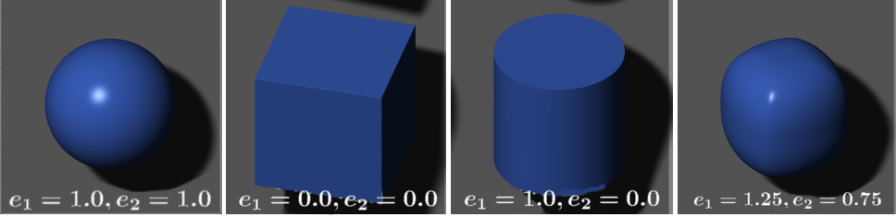
1.3. Superquadrics
Family of geometrical shapes that can represent diverse types of simple, convex objects.

Slide 24
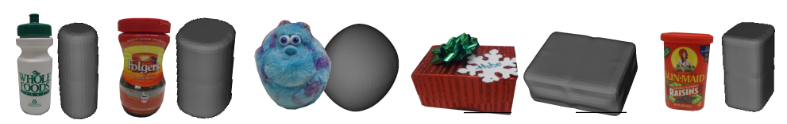
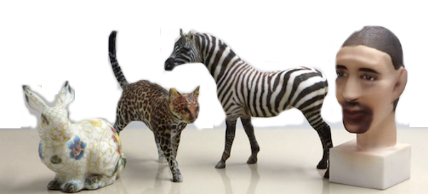
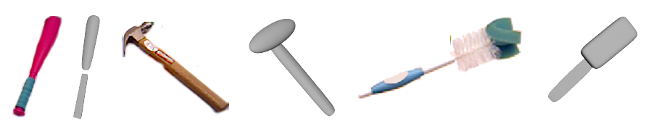
1.3. Superquadrics
1. What can we represent?
Simple, convex
objects
2. What can we NOT represent?
Complex
geometries
3. What could we potentially represent?
Multi-part
objects

Slide 25
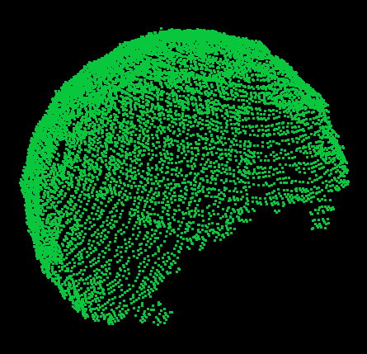
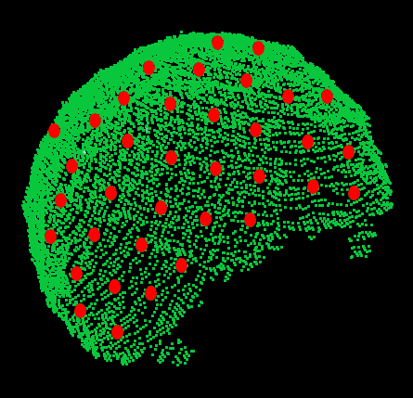
1.3. Superquadrics
We combined 2 methods to enable online superquadric fitting from one-view pointclouds using Levenberg-Marquadt:
Mirroring input
pointcloud
for better
fitting quality
Downsampling
Mirrored
cloud for faster
fitting times.

Slide 26
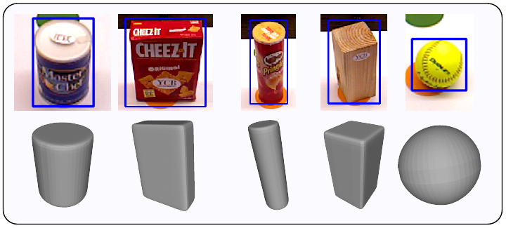
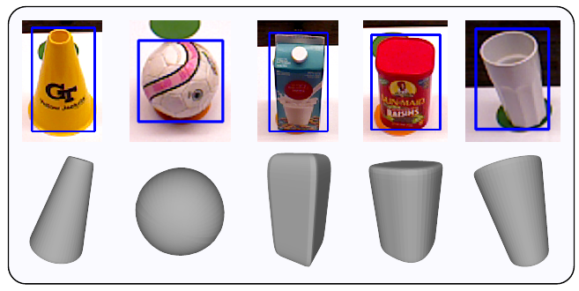
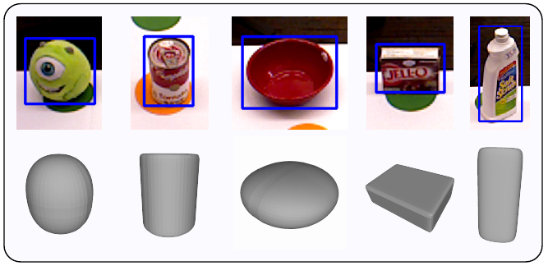
1.4. Results on 15 objects from dataset

Slide 27
1.3. Results on 15 objects from dataset

Slide 28
You are here

Slide 29
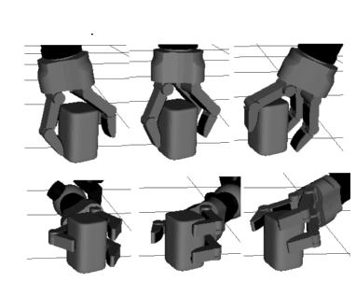
2. Grasp Generation

Slide 30
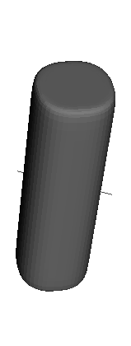
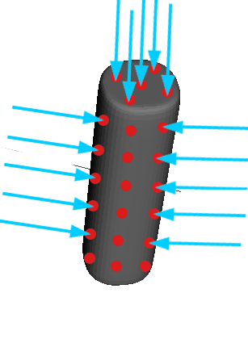
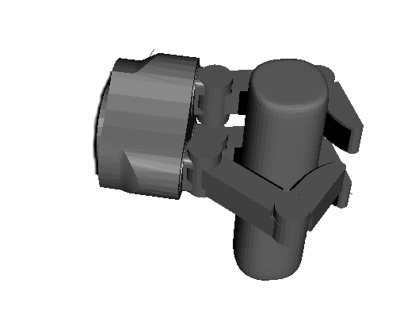
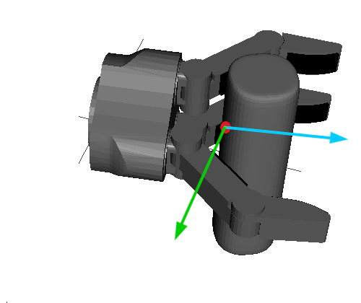
2.1. Generating grasps with heuristic approach
From object
representation
module
From explicit superquadric equation
Hand's approach
direction coincides
with normal. Fingers aligned
with smallest principal axis.
Close fingers
and stop at
contact.
Filter out grasps
with less than
4 contacts.

Slide 31
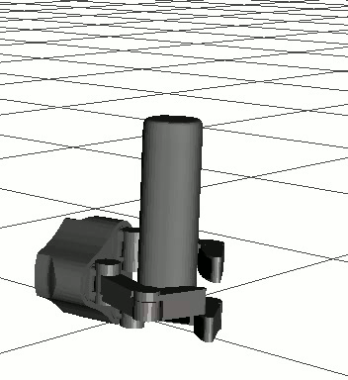
2.2. Generating grasps with heuristic approach
By using this approach, our grasps happen to
have:
1. Palm as close to the object's surface
as possible (power grasp).
2. Hand is aligned to object's principal axis
(which corresponds to human tendency
when robustly grasping simple objects [1]).
[1] “Physical human interactive guidance: Identifying grasping principles from human-planned grasps” Balasubramanian et al. - The Human Hand as an Inspiration For Robot Hand Development, Springer 2014

Slide 32
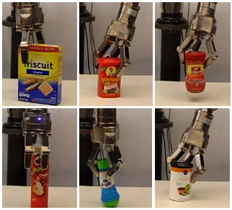
2.3. Preliminary results
Experiments over 45 trials per object (9 locations)

Slide 33

2.4. Grasp Robustness
How robust are these grasps?
Grasp maintenance in the face of unknown disturbing forces and moments applied to the object

Slide 34
2.4. Grasp Robustness: How to measure it?
* Literature: At least 24 metrics [1]
* Most common metric: [2]
* Assumptions: Coulomb friction, simplified contact modeling and
object-hand static assumption.
[1] Evaluating the efficacy of grasp metrics for utilization in a Gaussian process-based grasp predictor
Goins, Carpenter and Balasubramanian. Int. Conference on Intelligent Robots and Systems (IROS 2014)
[2] Planning Optimal Grasps. Ferrari C. and Canny J. Int. Conference on Robotics and Automation (ICRA 1992)

Slide 35
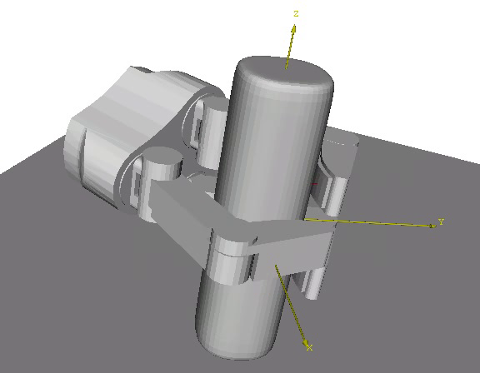
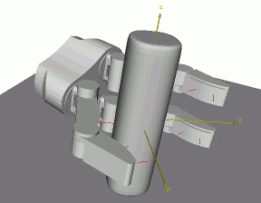
2.4. Grasp Robustness: Evaluating
Force-closure: [1]
Disturbed metric [2]
[1] Planning Optimal Grasps. Ferrari C. and Canny J. Int. Conference on Robotics and Automation (ICRA 1992)
[2] Pose error robust grasping from contact wrench space metrics
Weisz, J. and Allen P.K. - IEEE Int. Conference On Robotics and Automation (ICRA 2012)

Slide 36
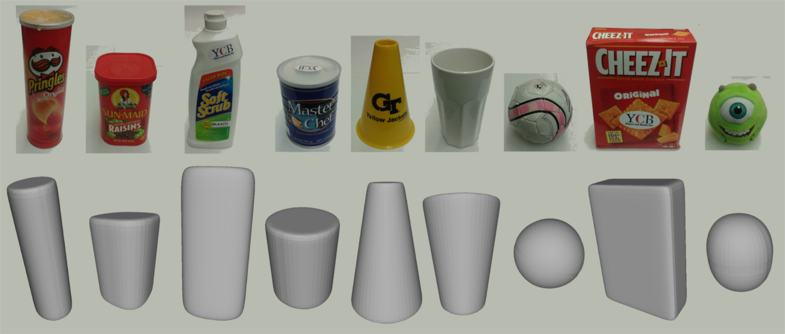
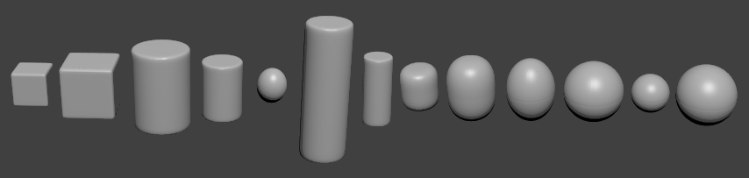
2.4. Grasp Robustness: Test data
We evaluate in 9 real-object models:
And in 13 synthetic models:

Slide 37
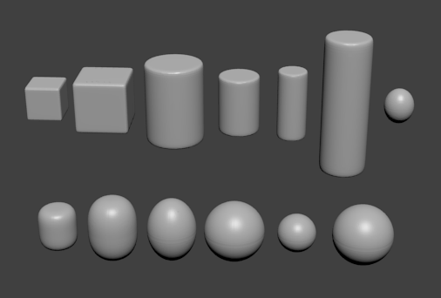
2.4. Grasp Robustness: Test data
Synthetic data based on human
studies from Feix et al.[1]
[1] Analysis of human grasping behavior: Objects characteristics and grasp type
Feix, T. Bullock, I. And Dollar, A. IEEE Transactions on Robotics, 2014

Slide 38
2.4. Results on real / synthetic data
Real
Data
Synthetic
Data

Slide 39
2.5. Conclusion
Using heuristics for grasp generation produce
grasps that are force-closure in > 70%
of the cases.

Slide 40
You are here

Slide 41
Task-Based Grasp Selection
How do we choose
which
candidate
grasps to use?

Slide 42
How do we choose which grasp to use?
On grasp choice, grasp models and the design of hands for manufacturing tasks
Cutkosky, M. IEEE Transactions on Robotics and Automation, 1989.

Slide 43
In this thesis:
3 tasks

Slide 44
3. Pick-up Tasks
Picking up a ball
Picking up a Pringles container
Picking up a ceramic cup

Slide 45
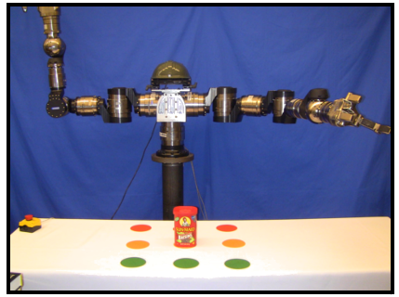
3.1. Problem Definition
Robot with arm at start
configuration
Object set in the robot
workspace at location
Goal: Grasp and pick it up a few
cm away from the table (10 cm).

Slide 46

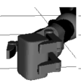
3.2. Grasp Selection
Candidate grasps:
Select a grasp

Slide 47
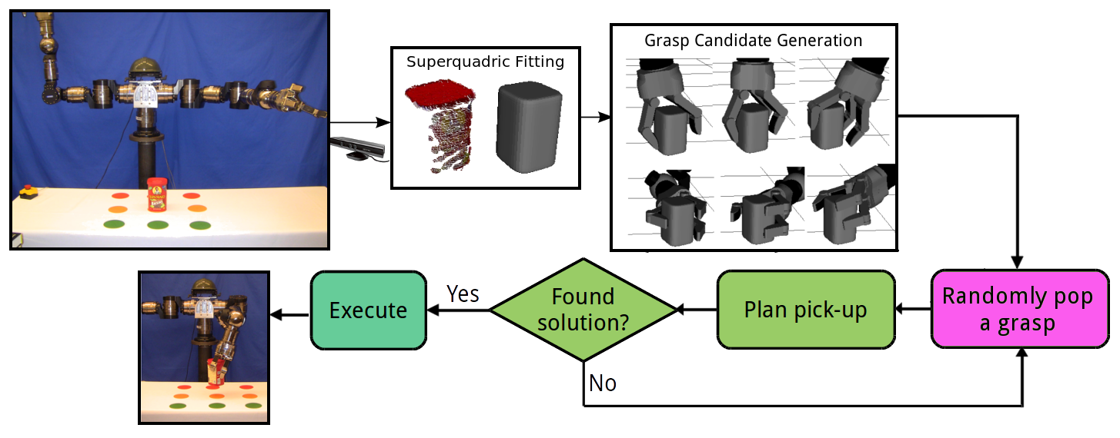
3.2.1. Brute-force approach

Slide 48
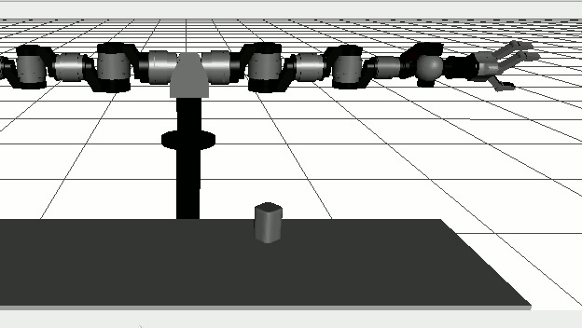
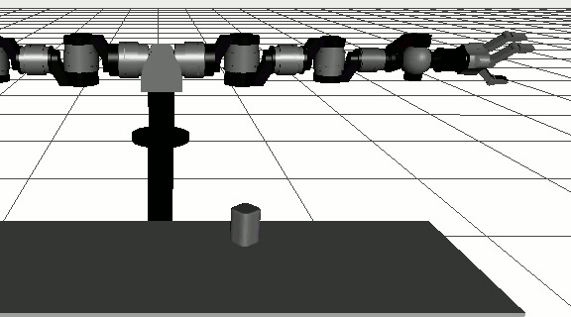
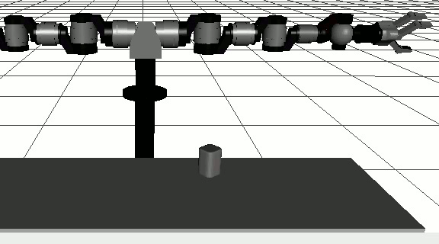
3.2.1. Brute-force approach
Why randomly selecting a grasp is not so smart?
Grasp 12:
Looks good
Grasp 5:
Looks okay
Grasp 25:
Looks bad

Slide 49
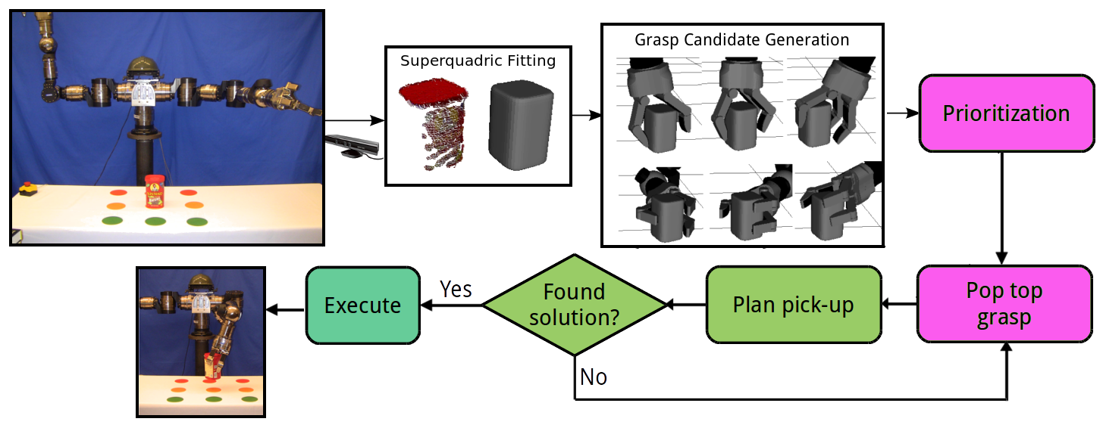
3.2.2. Better approach: Order the grasps

Slide 50
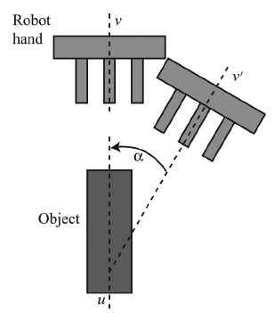
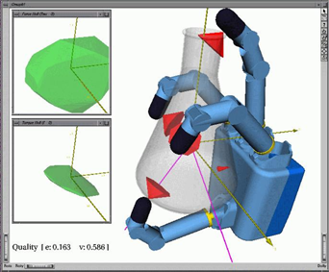
3.3. How do we evaluate the grasps to choose which one to try first?
Normally, most approaches use grasp metrics
(i.e. analytic measurements, such as
or heuristic ones such as skewness )

Slide 51


3.3. How do we evaluate the grasps?
Manipulation =
Arm
Grasp
+

Slide 52
3.3. How do we choose which candidate grasp?
Manipulation =
Metric
Arm
Metric
Grasp
Metric
+

Slide 53
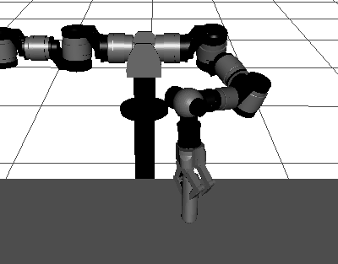


3.4. Arm Metric
What we care for? Freedom of movement with hand executing a given grasp
Grasp 34: 32 IK sols. Grasp 9: 87 IK sols. Grasp 5: 38 IK sols.

Slide 54
3.4. Arm Metric

Slide 55
3.4. Arm Metric
In the proposal:

Slide 56
3.4. Arm Metric
In the proposal:

Slide 57
3.4. Arm Metric
In the proposal:

Slide 58

3.5. Grasp Metric
What do we care for: Grasp stability

Slide 59

3.5. Grasp Metric
What do we care for: Grasp stability
Distance between the object's center of mass and the
hand's approach direction

Slide 60
3.5. For a set of candidate grasps

Slide 61
3.6. Arm-grasp Metric Ordering
Manipulation Metric = Grasp metric + Arm metric
(Length units) (Non dimensional)

Slide 62
3.6. Arm-grasp Metric Ordering
Use 2 steps:
1. Partially order using the arm metric of the grasps.
2. Refine the order obtained above using the grasp metric.

Slide 63

3.6. Arm-grasp Metric
Candidate grasps
Step 1:
Use arm metric to partition the candidate grasp set

Slide 64




3.6. Arm-grasp Metric
Candidate grasps
Very Good
Good
Fair
Bad

Slide 65
3.6. Arm-grasp Metric Ordering
Candidate grasps
Step 2:
Use grasp metric to order the grasps within each subgroup
Very Good
Good
Fair
Bad

Slide 66




3.6. Arm-grasp Metric Ordering
Candidate grasps
Very Good
Good
Fair
Bad

Slide 67
3.6. Arm-grasp Metric Ordering
Candidate grasps
Step 3:
Join the ordered
sets
Very Good
Good
Fair
Bad

Slide 68

3.6. Arm-grasp Metric Ordering
Ordered Candidate
grasps
Candidate grasps
Very Good
Good
Fair
Bad

Slide 69
3.6. Arm-grasp Metric Ordering

Slide 70
3.7. Evaluation of arm-grasp metric ordering in simulation
Use 9 object models obtained from our dataset.
Set 100 random tabletop scenarios.

Slide 71

3.7. Evaluation of arm-grasp metric ordering in simulation
Evaluate 2 factors:
Success rate: Of grasp
selected.
Planning time: Use standard RRT (injecting IK solutions with a probability)
Compare best and worst grasp according to metric.

Slide 72

3.7. Evaluation of arm-grasp metric ordering in simulation
Sample results:

Slide 73
3.7. Evaluation of arm-grasp metric ordering in simulation: Results

Slide 74
3.7. Evaluation of arm-grasp metric ordering in simulation: Results
1. Using a metric to select the first
Grasp to test results in a success rate of
More than 84% in most cases.
This means that in <84% of the cases,
Only a grasp must be tested in order to
Obtain a valid arm motion.
2. The planning times obtained using
Grasps selected based on the metric
Are in general much shorter, most of the
time, half of the time obtained with
other grasps in the candidate set.

Slide 75

3.8. Experimental validation of arm-grasp metric ordering: Results
10 objects evaluated 10 times (each in a different position on the table)

Slide 76
3.8. Experimental validation of arm-grasp metric ordering: Results
Example with plushie (9 positions shown):

Slide 77
3.8. Experimental validation of arm-grasp metric ordering: Results
Total pick-up executed: 98
Total successful executions: 87 (88%)
Total failures: 11 (12%)

Slide 78
3.8. Sample experimental results

Slide 79
4. Pick-and-Place Tasks
Crichton putting
a box inside a box
Crichton putting
a Pringles on top of a box
Crichton putting
a plushie on a different place on the table

Slide 80






4.1. Problem definition: Position constraints
In reality, most of the time you don't care too much for the exact orientation of an object, as long as it is upright.

Slide 81



4.2. Pick-and-place: 2 steps
Reach
Grasp
Place
Need planning for reach and place motions – assuming a grasp was selected.

Slide 82
4.3. Grasp Selection
Candidate grasps:
Select a grasp

Slide 83

4.4. Could we ignore the place step for grasp selection?

Slide 84
4.4. Could we ignore the goal constraint (place)?
The goal constraint (place)
provides information that
should ideally be considered
when selecting the grasp.

Slide 85

4.5. Possible metrics for evaluating pick-and-place
Let's use the metric.
+
Arm component
Grasp component
DEPENDS ON THE
OBJECT POSE

Slide 86
4.5. Possible metrics for evaluating pick-and-place
Should we measure the metric at the beginning (reach) object pose
or at the end (place) object location?
Grasp 13/53
Grasp 9/53

Slide 87

4.5. Possible metrics
Measure at the start pose of the object .
Measure at the goal pose of the object .
Use an average measure of both start and
goal poses ( and ).

Slide 88
Note: Average metric...

Slide 89
4.5.1. Problem: The goal pose is not fully defined (position only)
Propose: Guess the goal pose for the object.

Slide 90
4.5.2. How to guess?
Many possible options even if only variating the yaw angle!

Slide 91


4.5.3. How to guess? Draw inspiration from humans
Liberty Motion Tracker
Data from tracking hand orientations during
multiple pick-and-place operations on the
table shown at the left.

Slide 92
4.5.3. How to guess? Draw inspiration from humans
Rotation is minimum.
Rotation is not constant.
it depends on the start
and goal locations of the
object to be translated.
Data from tracking hand orientations during
multiple pick-and-place operations on the
table shown at the left.

Slide 93

4.5.4. Guessing the goal pose
Using the shoulder
As a reference point,
We calculate the rotation
between the start and
goal positions for the
object.

Slide 94
4.5.5. Guess goal pose for each grasp

Slide 95
4.5.5. Guess the goal pose for each grasp
Use minimum rotation
such that the grasp
evaluated is feasible.
Use as maximum
yaw value for the
sampling-based place
planning.

Slide 96
4.5.5. Guess the goal pose for each grasp
Use minimum rotation
such that the grasp
evaluated is feasible.
Use as maximum
yaw value for the
sampling-based place
planning.

Slide 97
4.6. Arm Planning
Reach motion: Standard IKBiRRT (goal pose of the hand is known)
Place motion: Use Task Space Regions since the goal pose can
Take many possible values.
Here we take advantage of the value
we found earlier and we use it to set the yaw limits of the task space
Region to go between 0 and .

Slide 98

4.6. Simulation experiments
6 object models used:

Slide 99

4.6. Simulation experiments
Set random start poses and goal positions for the 6 objects considered:

Slide 100
4.6. Simulation results
Simulation results of randomized on-table pick-and-place scenarios (~250) per each object}

Slide 101
4.7. Simulation results
Using the average metric
has a higher success rate
and a lower hand displacement
through the pick-and-place
execution.

Slide 102
4.8.1. Experimental Results: On-table

Slide 103
4.8.2. Experimental Results: On-box

Slide 104
4.8.3. Experimental Results: In-box

Slide 105

5. Pouring Tasks

Slide 106
5.1. Related work
1. Exploiting task intervals for whole body robot
Control, Gienger et al. IROS 2006.
2. Force-based robot learning of pouring skills using parametric hidden Markov models, Rozo et al. RoMoCo 2013
3.Pouring skills with planning and learning modeled from human demonstrations. Yamaguchi et al,, IJHR 2015.
4. Generalizing pouring actions between objects using warped parameters. Brandi et al. Humanoids 2014.

Slide 107
5.2. Our assumptions
1. Treat pouring as a planning problem.
2. We do not model the transfer.
3. Success is considered achieved if the object's reference point ends on top of the container's surface.

Slide 108



5.3. Pouring : 3 steps
Reach
Transport
Tilt

Slide 109
5.4. Grasp Selection
Candidate grasps:
Select a grasp

Slide 110
5.4. Grasp Selection
From the previous section we have seen that the goal constraint
gives valuable information for grasp selection.
Let's use the approach we used in pick-and-place (evaluating
At the start, goal and average of both).
For pouring it is not exactly clear how to define “the goal”

Slide 111

5.5. Pouring : Guess goal grasp pose – Observe human behavior

Slide 112

5.5. Pouring : Guess goal grasp pose – Observe human behavior
Regardless of the start pose of the object to be poured, the goal pose before tilting is close to the same for all cases at each container positions.

Slide 113

5.5. Pouring : Guess goal grasp pose – Observe human behavior
For tilting to be possible,
the goal constraint is not
defined on terms of the
object; rather, it depends
mostly on the pose
off the hand with
respect to the
container.

Slide 114

5.5. Pouring : Guess goal grasp pose – Observe human behavior
For tilting to be possible,
the goal constraint is not
defined on terms of the
object; rather, it depends
mostly on the pose
off the hand with
respect to the
container.

Slide 115


5.6. Guess Goal Poses
5.6.1. The goal poses
for symmetrical objects
are defined in terms of
end effector final pose
rather than object's pose.

Slide 116

5.7. Planning strategy – Part 1
Simple
semantic
usage of
constraint
in grasp approach
direction

Slide 117

5.7. Planning strategy – Part 2

Slide 118
5.7. Planning strategy – Arm Motion
Plan Reach:
Same as before, IKBiRRT
Plan Place:
Use Task Space Regions, but instead
of using regular x,y,z constraints, we use
a polar representation of the distance.

Slide 119


5.8. Place Planning
Use Task Space Regions, but instead of using regular x,y,z constraints, we use a polar representation of the distance.

Slide 120


5.9. Tilting planning:

Slide 121

5.10. Pouring : Simulation Experiments
We use a combination of 3 objects with 3 containers: Pringles (cylinder),
white cup (cone) and the bottle of Scrub Cleaner (ellipsoid)

Slide 122



5.10. Pouring : Simulation Experiments
Red Cup
Red Plate
Red Bowl

Slide 123

5.11. Pouring : Experimental Experiments
54 experiments:
* 3 objects, 3 containers,
* 3 positions for the objects
* 6 positions for the containers.

Slide 124
5.11.1. Experimental Results: Plate

Slide 125
5.11.2. Experimental Results: Bowl

Slide 126
5.11.3. Experimental Results: Cup

Slide 127
5.12. Conclusions
For pouring tasks, the goal is expressed as a function of the hand's end pose instead of the object's final pose.
For pouring tasks, grasp selection is mostly affected by the start pose of the object.
Using a polar representation of the task space error for planning the transport arm motion is vital for getting fast solutions.

Slide 128
Summary
Going back to our contributions:

Slide 129
Contributions
(1) We demonstrate that superquadrics are useful primitive shapes suitable to represent
on-the-fly a considerable number of convex household objects; their parametric
nature (3 axis and 2 shape parameters) is shown to be helpful to represent simple
semantic labels for objects (i.e. for a pouring task) useful for grasp and motion plan-
Ning. [SECTION 1]
(2) We introduce a hand-and-arm metric that considers both grasp robustness
and arm end-comfort to select grasps for simple pick-up tasks. We show with real and
simulation results that considering both hand and arm aspects of the manipulation
task helps to select grasps that are easier to execute in real environments without
sacrificing grasp stability on the process. [SECTION 3]
(3) We present grasp selection and planning strategies that exploit task constraints
to select the more appropriate grasp to carry out a manipulation task in an online
and efficient manner (in terms of planning and execution time. [SECTION 4 & 5 ]

Slide 130
Future work
More complex objects.
What about tasks with more than a few steps?
What about tasks that cannot be formulated with just kinematic constraints?
Are heuristics enough? (they were for now)

Slide 131

Thanks for your attention!

