Slide 1


Learning User Preferences for Robot-Human Handovers
Ana C. Huamán Quispe Eric Martinson Kentaro Oguchi
Toyota InfoTechnology Center,
Mountain View, USA
September 28th, 2016

Slide 2
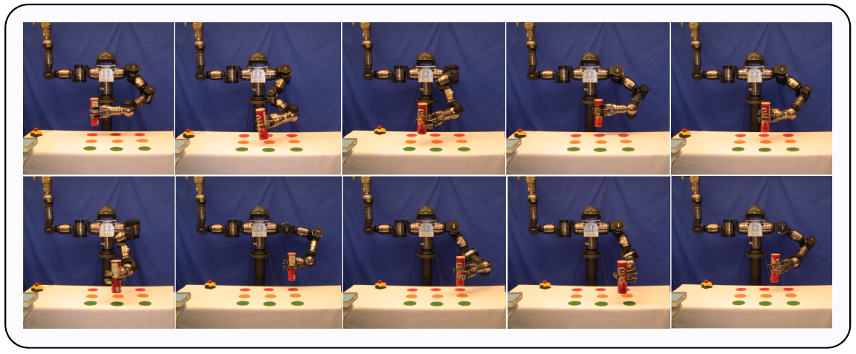
3.8. Experimental validation of arm-grasp metric ordering: Results
10 objects evaluated 10 times (each in a different position on the table)

Slide 3
3.8. Experimental validation of arm-grasp metric ordering: Results
Example with plushie (9 positions shown):

Slide 4
4. Pick-and-Place Tasks
Crichton putting
a box inside a box
Crichton putting
a Pringles on top of a box
Crichton putting
a plushie on a different place on the table

Slide 5
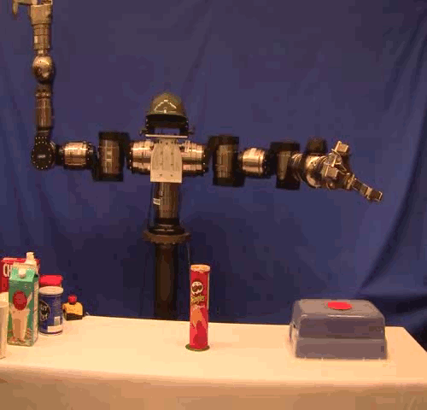
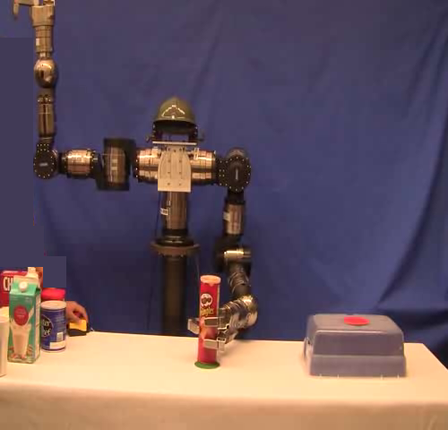
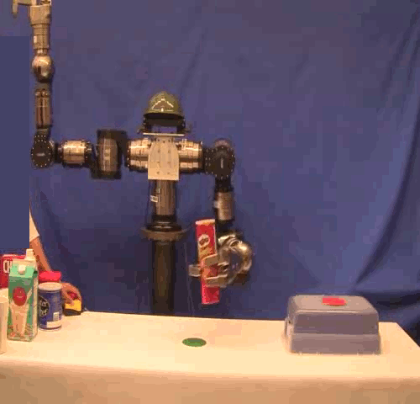
4.2. Pick-and-place: 2 steps
Reach
Grasp
Place
Need planning for reach and place motions – assuming a grasp was selected.

Slide 6
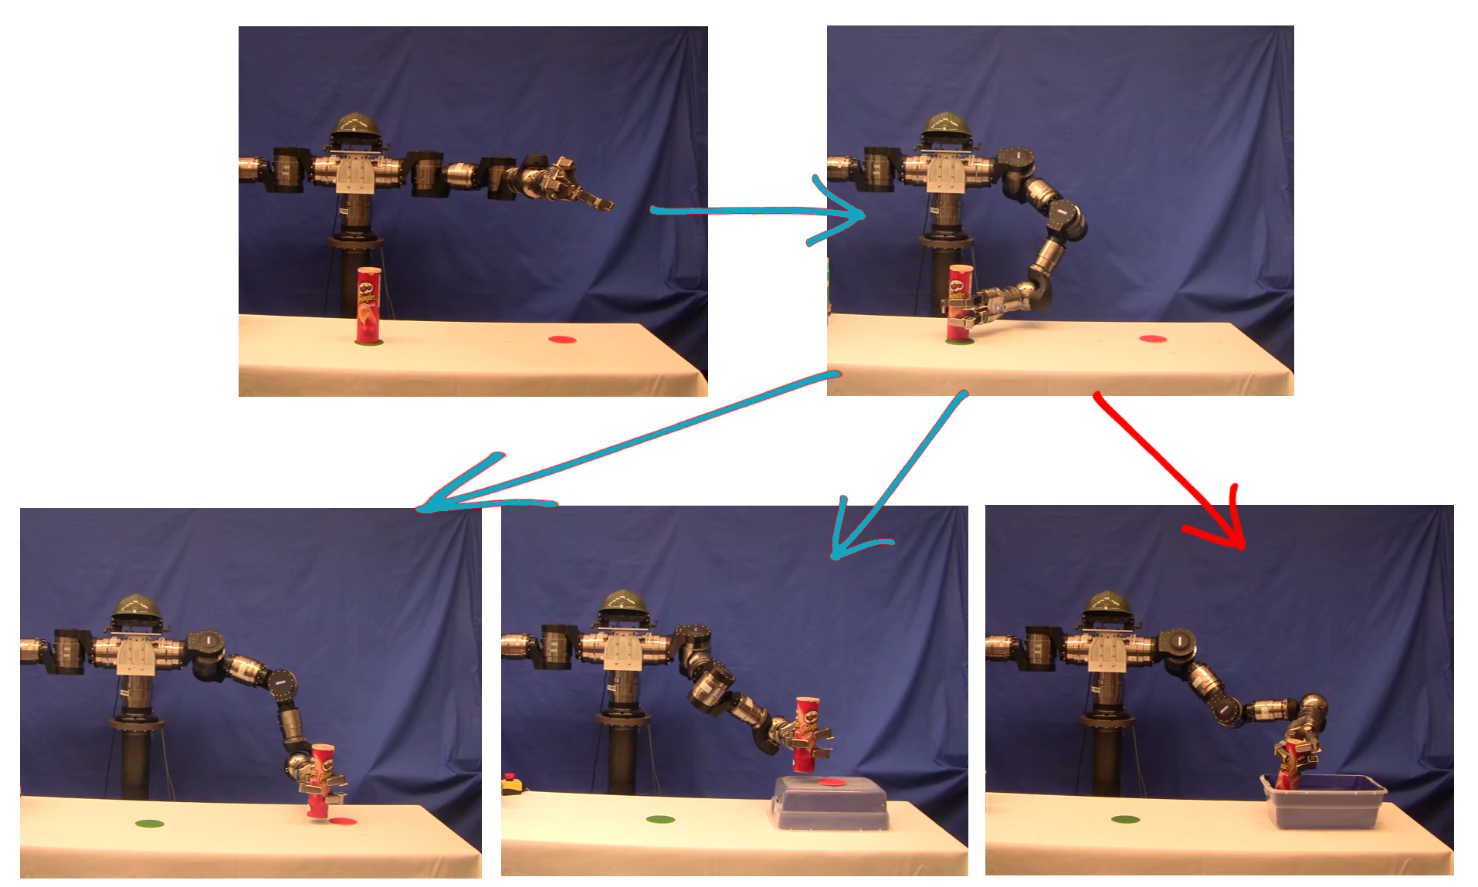
4.4. Could we ignore the place step for grasp selection?

Slide 7
4.4. Could we ignore the goal constraint (place)?
The goal constraint (place)
provides information that
should ideally be considered
when selecting the grasp.

Slide 8
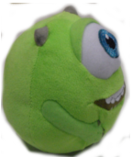
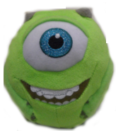
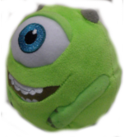
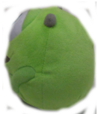
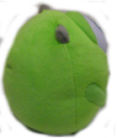
4.5.2. How to guess?
Many possible options even if only variating the yaw angle!

