Slide 1





#GHC15
A Formal Framework to evaluate household robot manipulators
Ana C. Huamán Quispe
October 15th, 2015
2015

Slide 2
About your speaker
Originally from Peru
B.S. in Mechatronics Engineering (UNI)
M.S. in Computer Science (Georgia Tech)
Robotics PhD candidate (Georgia Tech)

Slide 3
About the robot
His name: Crichton
Humanoid torso
2 arms + 2 hands
1 waist motor
Eyes: RGBD camera
Crichton at work

Slide 4
Motivation
Tums Jetsons, courtesy of YouTube

Slide 5
Motivation
SERVICE ROBOTICS
“Those robotics systems that assist people in their daily lives at work, in their house, for leisure and as part of assistance to the handicapped and elderly.”
A Roadmap for US robotics, 2013

Slide 6

Motivation
How far are we from having a Rosie at home?

Slide 7

Motivation
What is the current state-of-the-art in robot manipulation?

Slide 8
What Hollywood tells us
Bicentennial Man (1999)
Robot and Frank (2012)

Slide 9
What really happens...

Slide 10
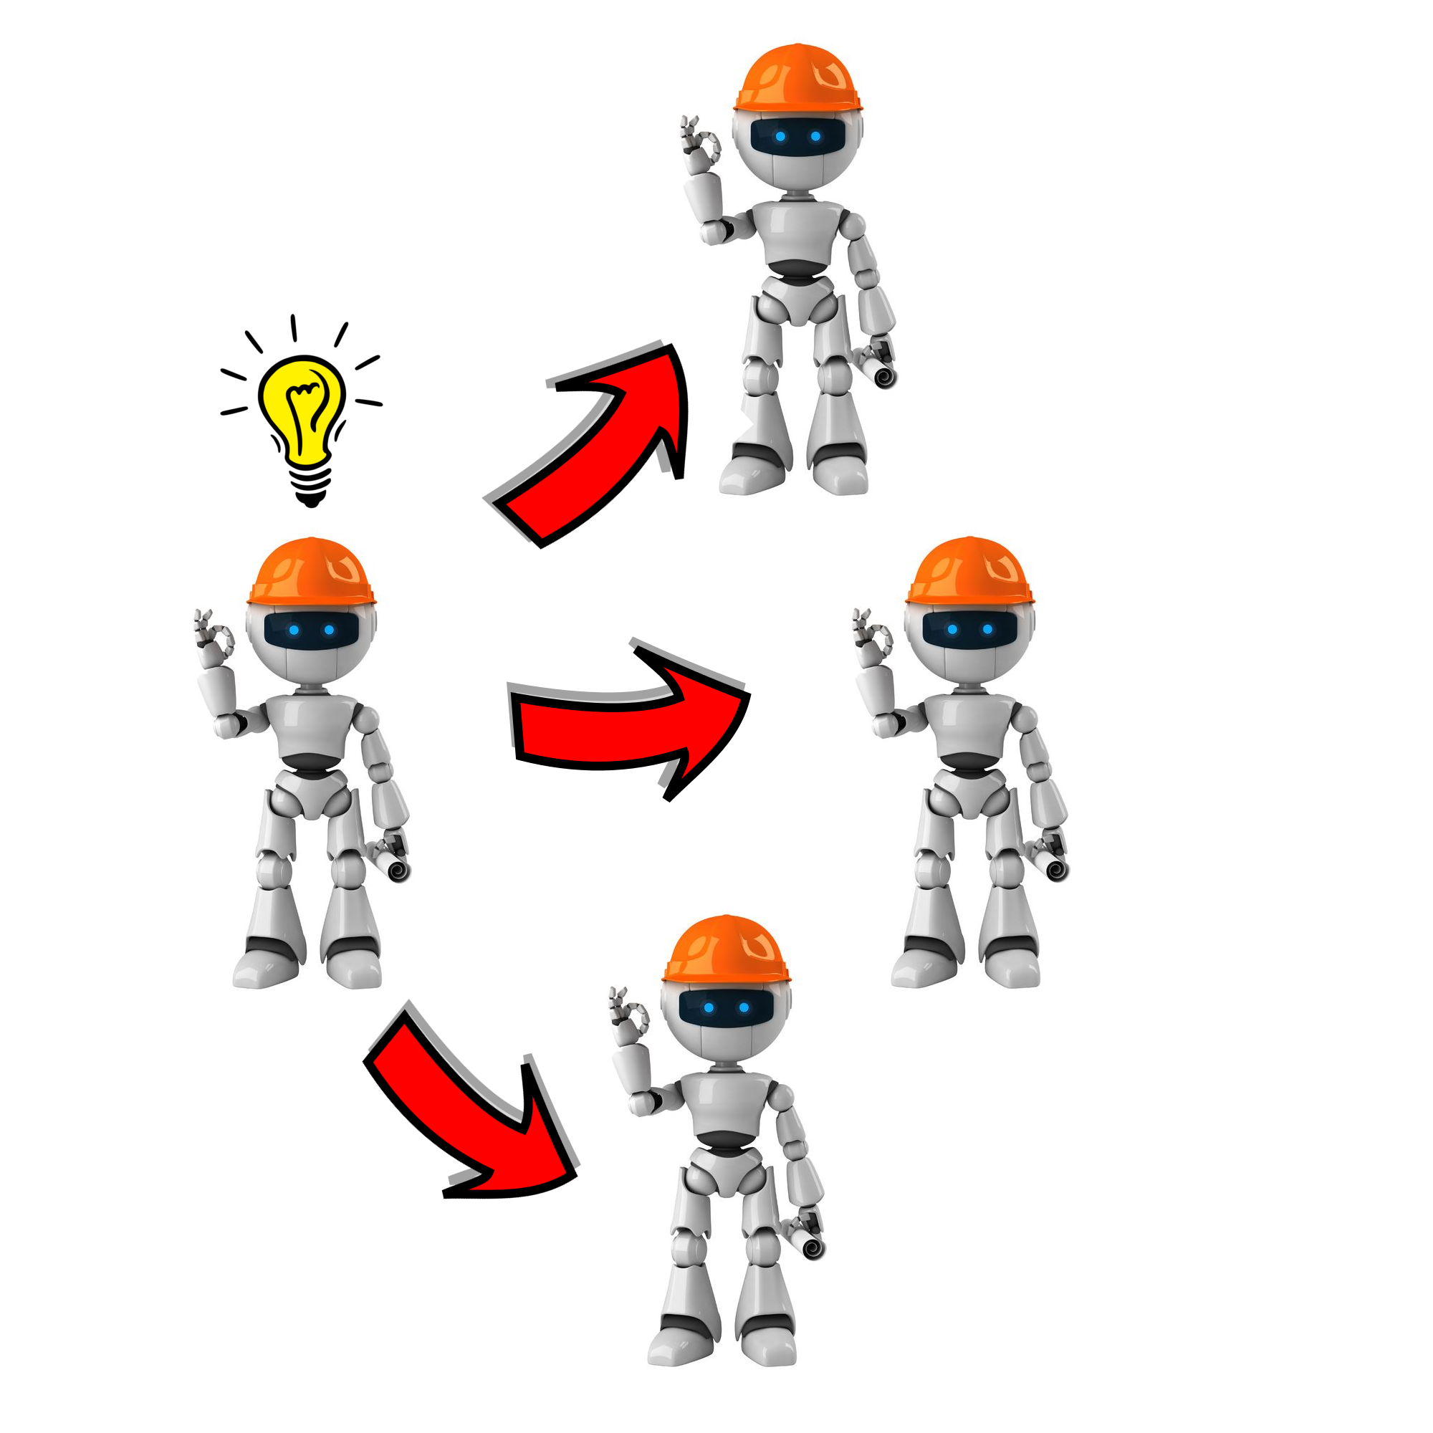
In theory...

Slide 11
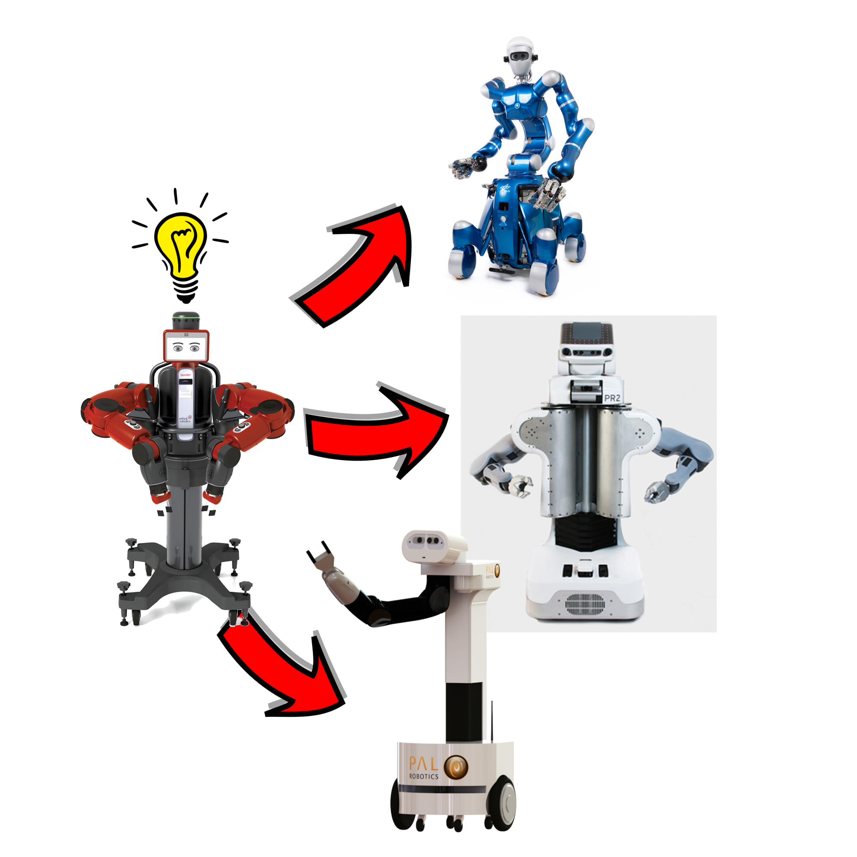
In reality

Slide 12
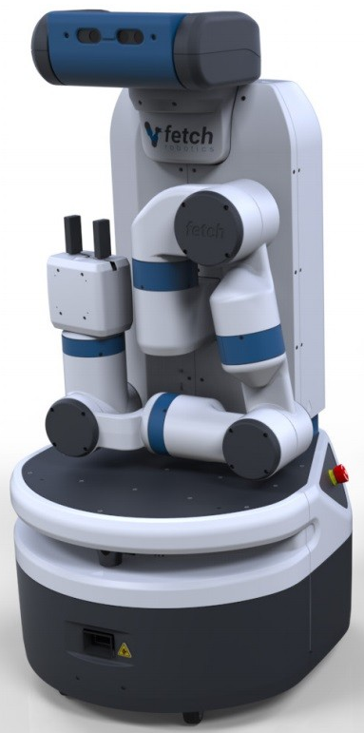
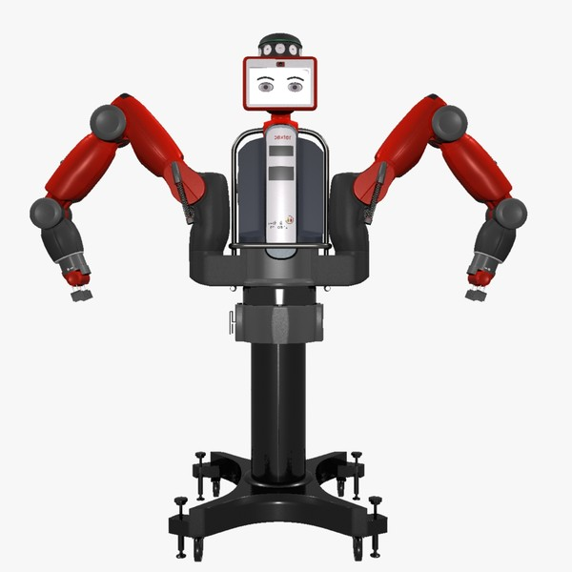
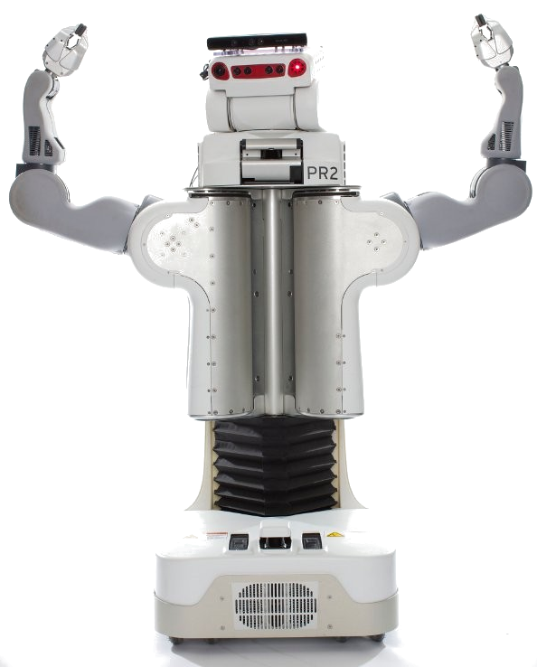
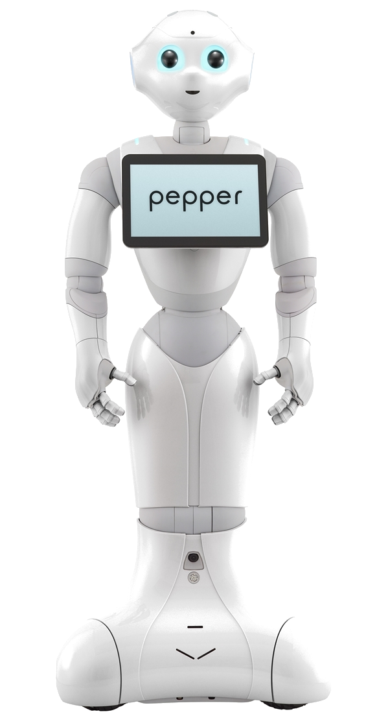
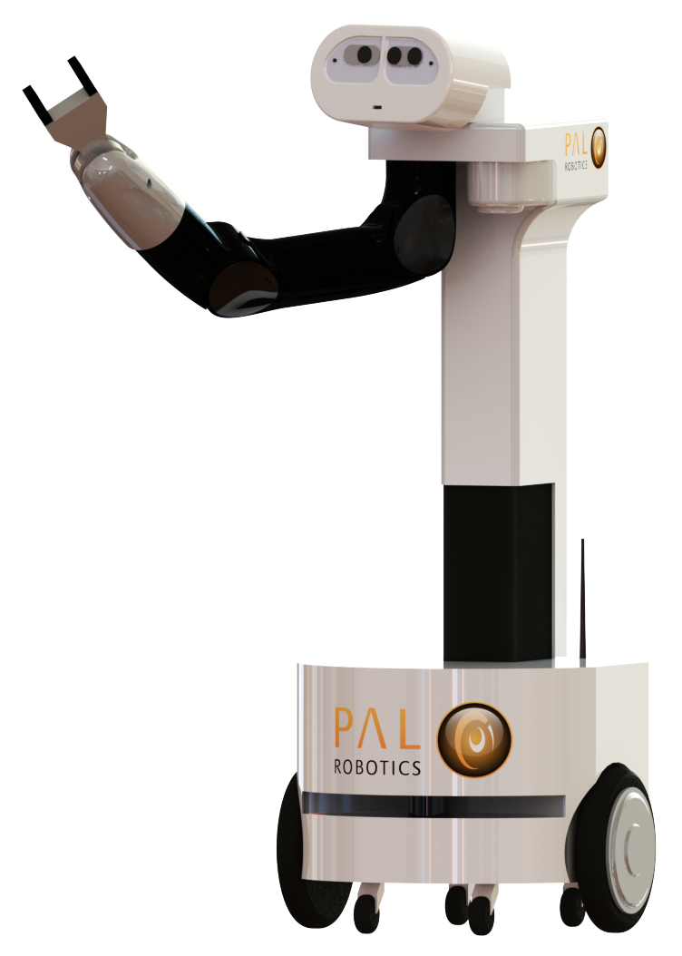
Challenges
1. Diversity of hardware platforms

Slide 13
Challenges
2. Diversity of scenarios considered used

Slide 14
Challenges
3. Diversity of research interests → Different assumptions

Slide 15
We need!
Development of rigorous experimental methodologies in robotics research
Competitions for Benchmarking – Amigoni et al., Robotics & Automation Magazine, 2015

Slide 16
We need!
Development of rigorous experimental methodologies in robotics research
(Benchmarking)
Competitions for Benchmarking – Amigoni et al., Robotics & Automation Magazine, 2015

Slide 17
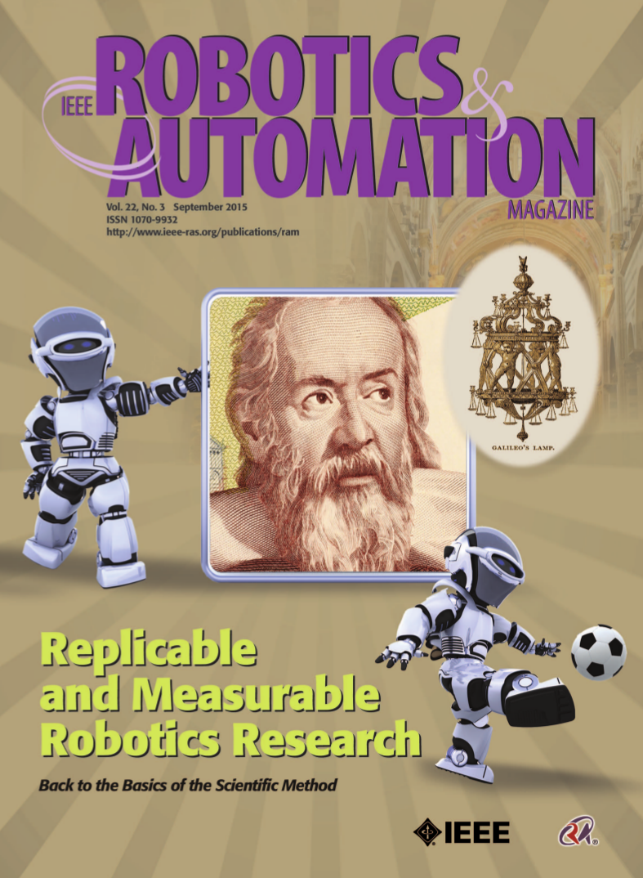
We need!

Slide 18
We need!

Slide 19
Challenges
The lack of...
Standardized benchmark tasks.
Formally defined suitable metrics to evaluate
the integral performance of a robot as a whole.
Comparative data to see how well we do with respect
to other robots.
Guidelines for a realistic experimental setup.

Slide 20
Outline
1. Competitions
2. Formal benchmarking attempts
3. Requirements for principled benchmarking.
4. My research work.

Slide 21
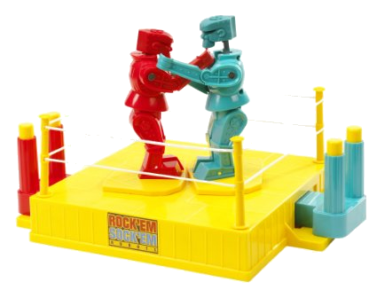
1. Competitions

Slide 22
Advantages
Force technology out of the Laboratory environments.
Provide an opportunity for
research groups to benchmark approaches against each other.
Competitions have clear measures of success.
Competitions require integrated implementation of complete systems.
Recasting Robotics Challenges as Experiments, Anderson et al. Robotics and Automation Magazine, vol. 2, No 18, 2011

Slide 23

1.1. Robocup@Home (2005-present)
Goal:
It aims to develop service and assistive robot technology with high relevance for future personal domestic applications.

Slide 24
1.1. Robocup@Home (2005-present)
Sample tasks:
Hand a bottle of pills to a human.
Grab a can and deliver it to a table.
Pick up 10 known objects from
a shelf.
Pick up 5 similar objects from a tabletop.
Source: YouTube – Nimbro channel

Slide 25
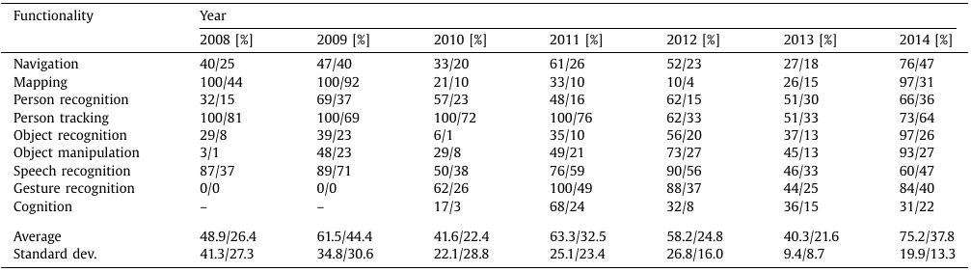
1.1. Robocup@Home (2005-present)
Results:
Robocup@Home: Analysis and Results Of Evolving Competitions for domestic and service robots
L. Iocchi et al, Artificial Intelligence, 2015 – pages 258-281

Slide 26
1.1. Robocup@Home (2005-present)
Results:
As of 2014: 29% average performance
Robocup@Home: Analysis and Results Of Evolving Competitions for domestic and service robots
L. Iocchi et al, Artificial Intelligence, 2015 – pages 258-281

Slide 27
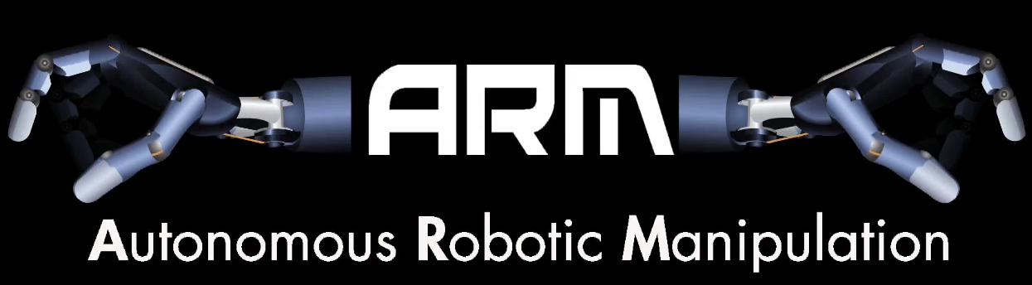
1.2. DARPA Arm Project (2011-2013)
Goal (Software Track):
To develop new techniques for grasping and manipulation
using local sensors for perception.

Slide 28
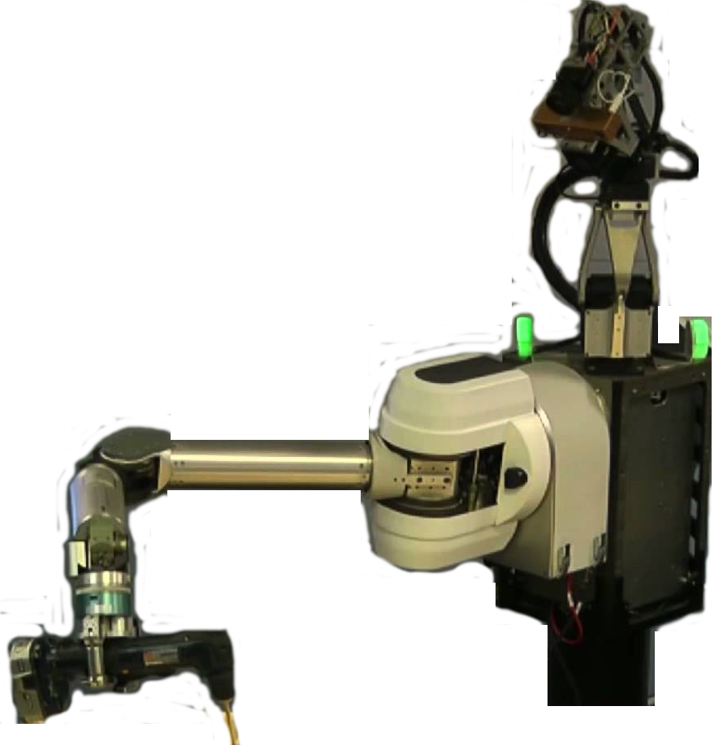

1.2. DARPA Arm Project (2011-2013)
How it worked:
6 TEAMS:
CMU
HRL Laboratories
iRobot
NASA Jet Propulsion Lab.
SRI International
Univ. of Southern California
Hardware
Software
SAME
HARDWARE
TESTED
ON-SITE

Slide 29
1.2. DARPA Arm Project (2011-2013)
Phase I (17 months)
Grasp 12 objects.
Staple a stack of paper.
Turn on a flashlight.
Open a door.
Unlock a door.
Drilling.
Hang up a phone.
Source: YouTube – DarpaTV channel

Slide 30
1.2. DARPA Arm Project (2011-2013)
Phase II (21 months)
Change a tire.
Open a bag, extract pliers
and cut a wire.
Source: YouTube (DarpaTv & M. Klingensmith)

Slide 31
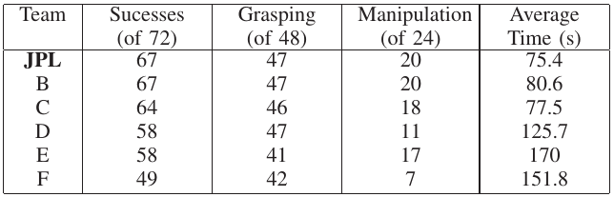
1.2. DARPA Arm Project (2011-2013)
RESULTS – PHASE 1

Slide 32
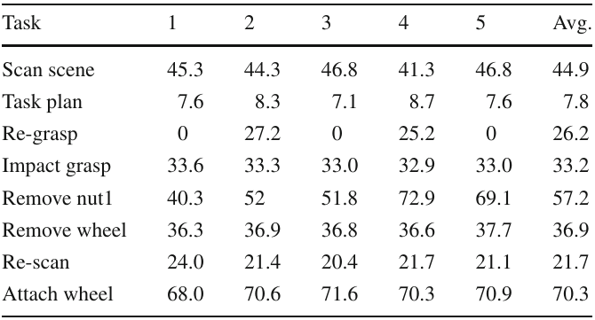
1.2. DARPA Arm Project (2011-2013)
RESULTS – PHASE 2 (TIRE CHANGE)

Slide 33
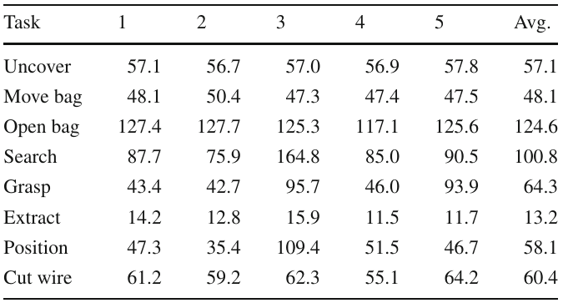
1.2. DARPA Arm Project (2011-2013)
RESULTS – PHASE 2 (CUT THE WIRE)

Slide 34
1.3. Amazon Picking Challenge (2015)
Pick known objects from a
Kiva pod.

Slide 35
1.4. DARPA Robotics Challenge Finals(2015)
Carry and connect a fire hose.
Open a series of doors.
Drive and exit an utility vehicle.
Locate and close leaking valves.

Slide 36
Section 1
1.2. Benchmarking

Slide 37
1.1. Cranfield Assembly Benchmark (1985)
Assemble 17 metallic
parts of a given structure.
Industrial test.
Controlled environment.
Known objects.

Slide 38
Section 1
1.2. Benchmarking

Slide 39
Requirements for principled benchmarking
Replicability:
1. Reproducibility: The possibility to verify, in an independent way, the results of a given experiment.
2. Repeatability: A single result is not sufficient to ensure the success of an experiment.

Slide 40
Requirements for principled benchmarking
Replicability:
1. Reproducibility: The possibility to verify, in an independent way, the results of a given experiment.
2. Repeatability: A single result is not sufficient to ensure the success of an experiment.

Slide 41
Title
Text

Slide 42

Got Feedback?
Rate and review the session on our mobile app
Download at http://ddut.ch/ghc15
or search GHC 2015 in the app store
Notes:
This is the last slide and must be included in the slide deck

