Slide 1


Combining arm and hand metrics for sensible grasp selection
Ana C. Huamán Quispe Heni Ben Amor Henrik I. Christensen
ahuaman@us.toyota-itc.com hbenamor@asu.edu hichristensen@ucsd.edu
Institute for Robotics and Intelligent Machines
Georgia Institute of Technology, USA
August 24th, 2016

Slide 2
Motivation: Manipulation Tasks

Slide 3
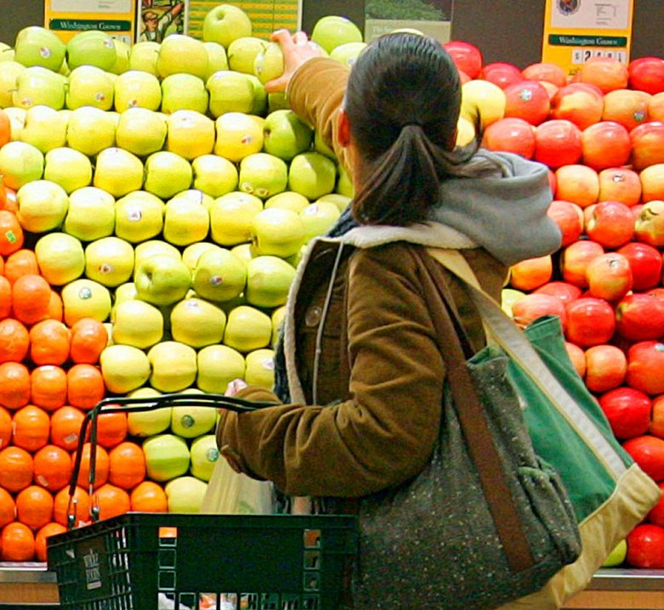

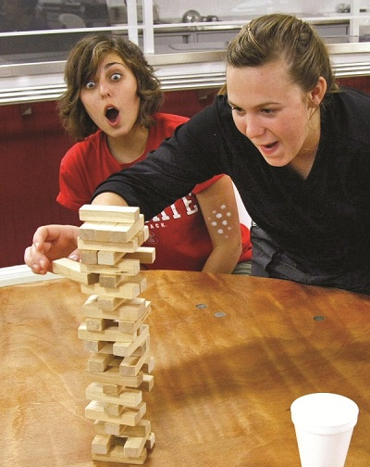
Motivation: Manipulation Tasks

Slide 4
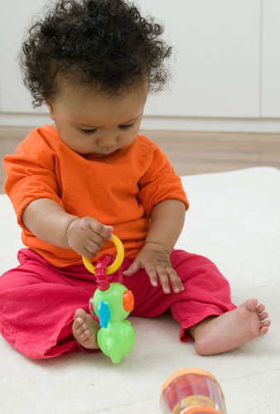

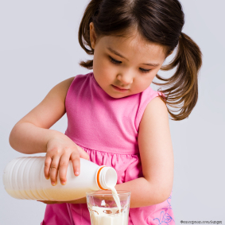
Motivation: Manipulation Tasks
Pick-up objects Pick-and-place Pouring

Slide 5
Motivation: Manipulation Tasks
Humans do it so easily!
Pick-up objects Pick-and-place Pouring

Slide 6
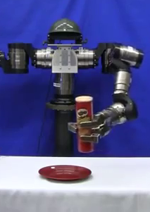
Motivation: Can the robot...?
Pick-up objects LWA4 Robot

Slide 7
Robot Pick-up: Challenges

Slide 8
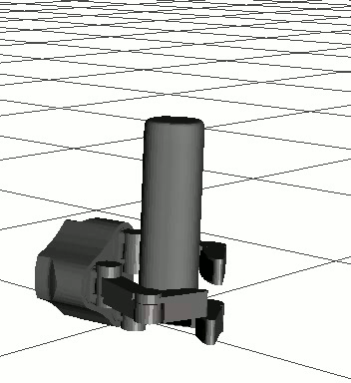
Robot Pick-up: Challenges
Many possible candidate grasps!

Slide 9

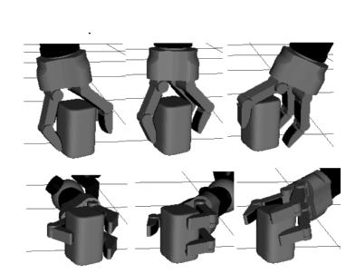
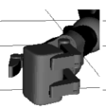
How to select a grasp?
Candidate grasps:
Select a grasp

Slide 10
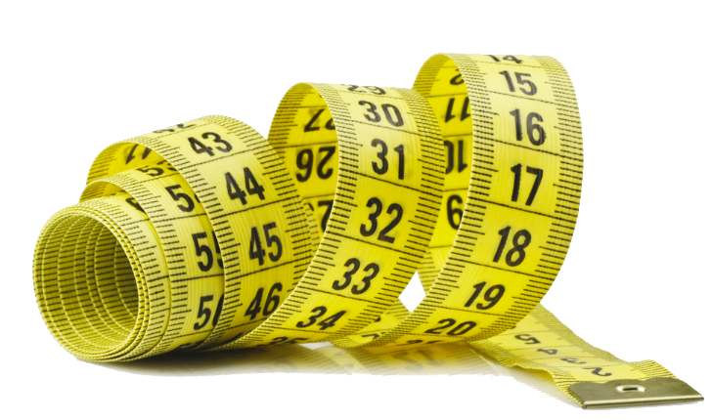
How to select a grasp?
Candidate grasps:
Select a grasp
Use a metric to evaluate the grasps

Slide 11
The common way to select a grasp
* Literature: At least 24 metrics [1]
* Most common metric: [2]
* Assumptions: Coulomb friction,
simplified contact modeling and
object-hand static assumption.
[1] Evaluating the efficacy of grasp metrics for utilization in a Gaussian process-based grasp predictor
Goins, Carpenter and Balasubramanian. Int. Conference on Intelligent Robots and Systems (IROS 2014)
[2] Planning Optimal Grasps. Ferrari C. and Canny J. Int. Conference on Robotics and Automation (ICRA 1992)

Slide 12
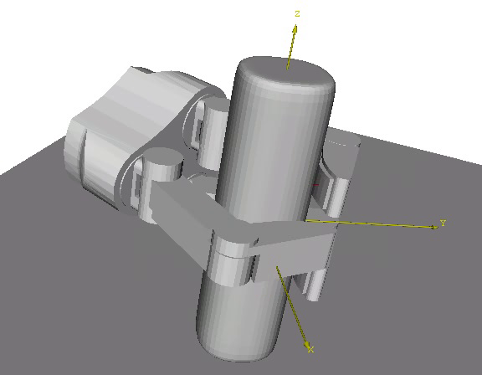
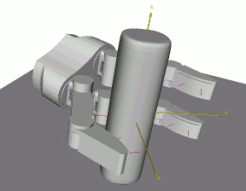
The common way to select a grasp
Force-closure: [1]
Disturbed metric [2]
[1] Planning Optimal Grasps. Ferrari C. and Canny J. Int. Conference on Robotics and Automation (ICRA 1992)
[2] Pose error robust grasping from contact wrench space metrics
Weisz, J. and Allen P.K. - IEEE Int. Conference On Robotics and Automation (ICRA 2012)

Slide 13
Why is the common way not the best way in a real robot?
Picking up a ball
Picking up a Pringles container
Picking up a ceramic cup

Slide 14
A manipulation task is not just about grasping!
For pick-up tasks:
Reaching + Grasping

Slide 15
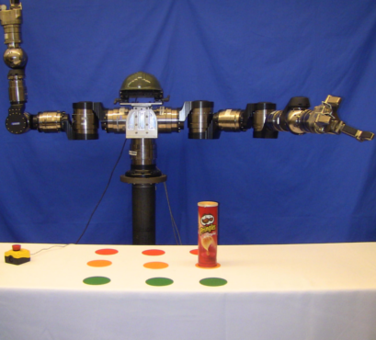
A manipulation task is not just about grasping!

Slide 16
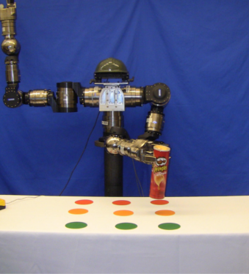


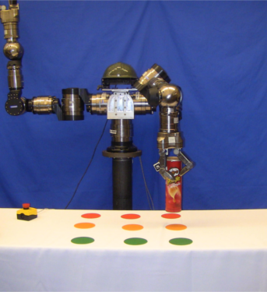
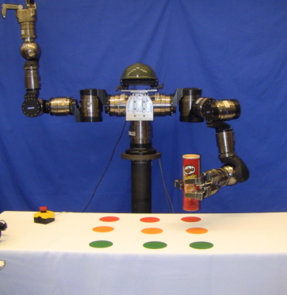

A manipulation task is not just about grasping!

Slide 17
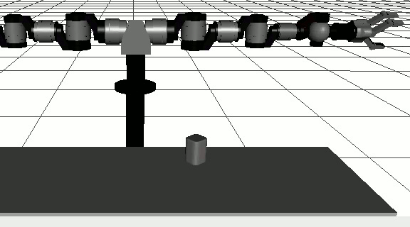
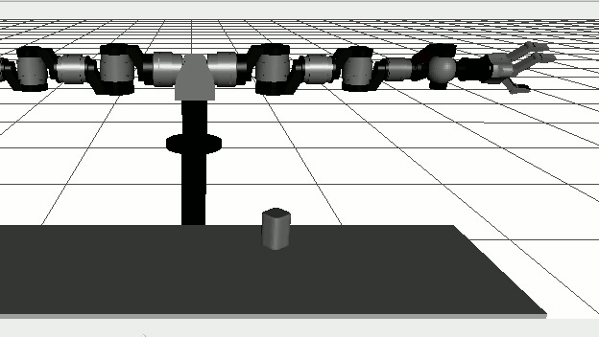
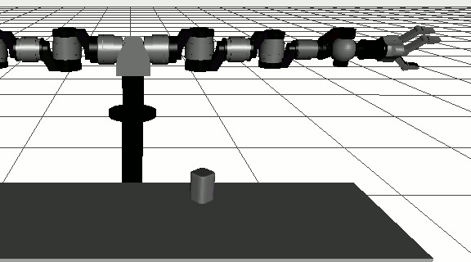
A manipulation task is not just about grasping!
Grasps that entail simple reaching movements are desirable:
Easy to plan (short execution times).
Less accumulated actuation error.
Grasp 12:
Looks good
Grasp 5:
Looks okay
Grasp 25:
Looks bad

Slide 18
How to select a grasp?
Candidate grasps:
Select a grasp
Use a metric to evaluate the grasps

Slide 19


How to select a grasp?
Manipulation Task =
(Pick-up)
Arm
Motion
Grasp
+

Slide 20
How to select a grasp?
Manipulation =
Metric
Arm
Metric
Grasp
Metric
+

Slide 21
How to select a grasp?
Manipulation =
Metric
Arm
Metric
Grasp
Metric
+

Slide 22
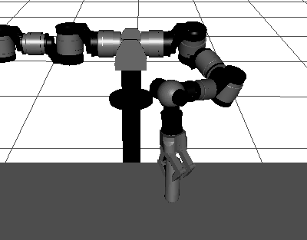
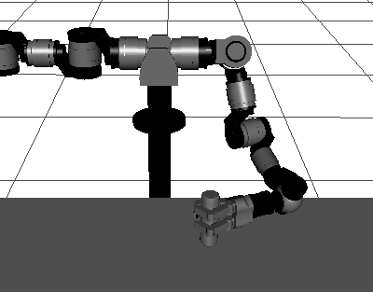
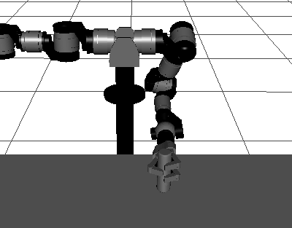
Arm Metric
What we care for? Freedom of movement with hand executing a given grasp
Grasp 34: 32 IK sols. Grasp 9: 87 IK sols. Grasp 5: 38 IK sols.

Slide 23
Arm Metric
For a redundant arm: Number of discretized IK solutions that
allow the arm to execute a given grasp.

Slide 24
Arm Metric
In a previous study:

Slide 25
Arm Metric
In the proposal:

Slide 26
How to select a grasp?
Manipulation =
Metric
Arm
Metric
Grasp
Metric
+

Slide 27
How to select a grasp?
Manipulation =
Metric
Arm
Metric
Grasp
Metric
+

Slide 28
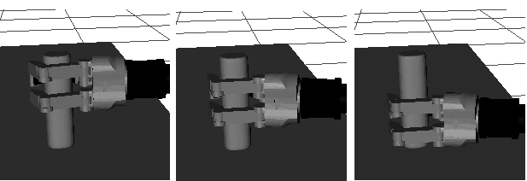
Grasp Metric
What do we care for: Grasp stability

Slide 29
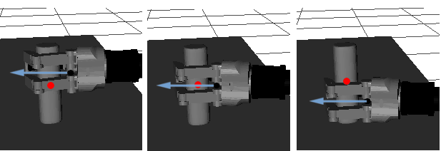
Grasp Metric
What do we care for: Grasp stability
Distance between the object's center of mass and the
hand's approach direction

Slide 30
For a set of candidate grasps

Slide 31
Arm-grasp Metric Ordering
Manipulation Metric = Grasp metric + Arm metric
(Length units) (Non dimensional)

Slide 32
Arm-grasp Metric Ordering
Use 2 steps:
1. Partially order using the arm metric of the grasps.
2. Refine the order obtained above using the grasp metric.

Slide 33
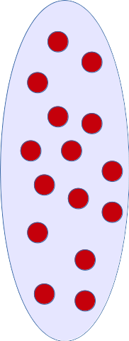
Arm-grasp Metric
Candidate grasps
Step 1:
Use arm metric to partition the candidate grasp set

Slide 34


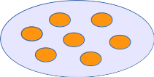

Arm-grasp Metric
Candidate grasps
Very Good
Good
Fair
Bad

Slide 35
Arm-grasp Metric Ordering
Candidate grasps
Step 2:
Use grasp metric to order the grasps within each subgroup
Very Good
Good
Fair
Bad

Slide 36


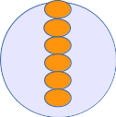

Arm-grasp Metric Ordering
Candidate grasps
Very Good
Good
Fair
Bad

Slide 37
Arm-grasp Metric Ordering
Candidate grasps
Step 3:
Join the ordered
sets
Very Good
Good
Fair
Bad

Slide 38
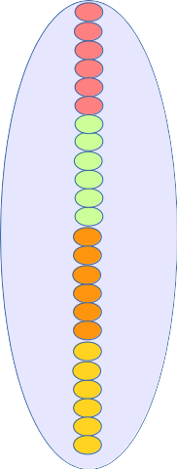
Arm-grasp Metric Ordering
Ordered Candidate
grasps
Candidate grasps
Very Good
Good
Fair
Bad

Slide 39
Arm-grasp Metric Ordering

Slide 40
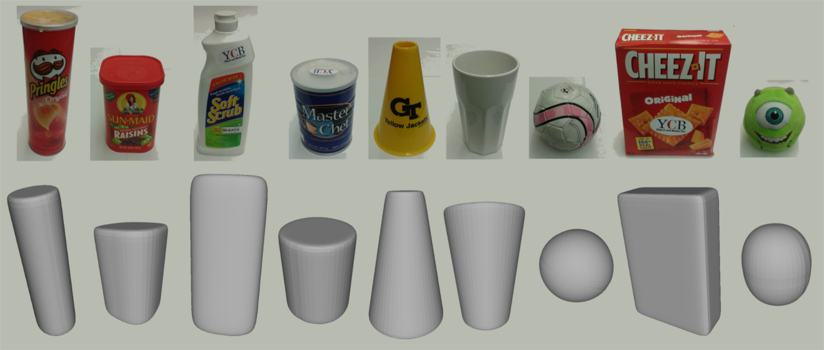
Evaluation of arm-grasp metric ordering in simulation
Use 9 object models obtained from our dataset.
Set 100 random tabletop scenarios.

Slide 41
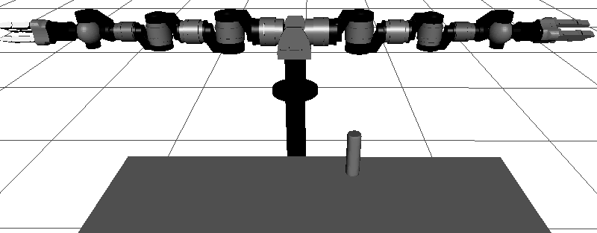
Evaluation of arm-grasp metric ordering in simulation
Evaluate 2 factors:
Success rate: Of grasp
selected.
Planning time: Use standard RRT (injecting IK solutions with a probability)
Compare best and worst grasp according to metric.

Slide 42
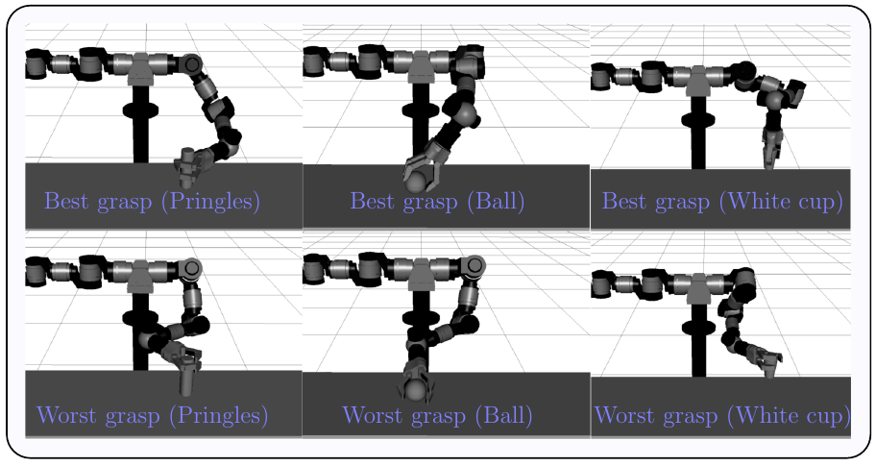
Evaluation of arm-grasp metric ordering in simulation
Sample results:

Slide 43
Evaluation of arm-grasp metric ordering in simulation: Results

Slide 44
Evaluation of arm-grasp metric ordering in simulation: Results
1. Using a metric to select the first
Grasp to test results in a success rate of
More than 84% in most cases.
This means that in <84% of the cases,
Only a grasp must be tested in order to
Obtain a valid arm motion.
2. The planning times obtained using
Grasps selected based on the metric
Are in general much shorter, most of the
time, half of the time obtained with
other grasps in the candidate set.

Slide 45
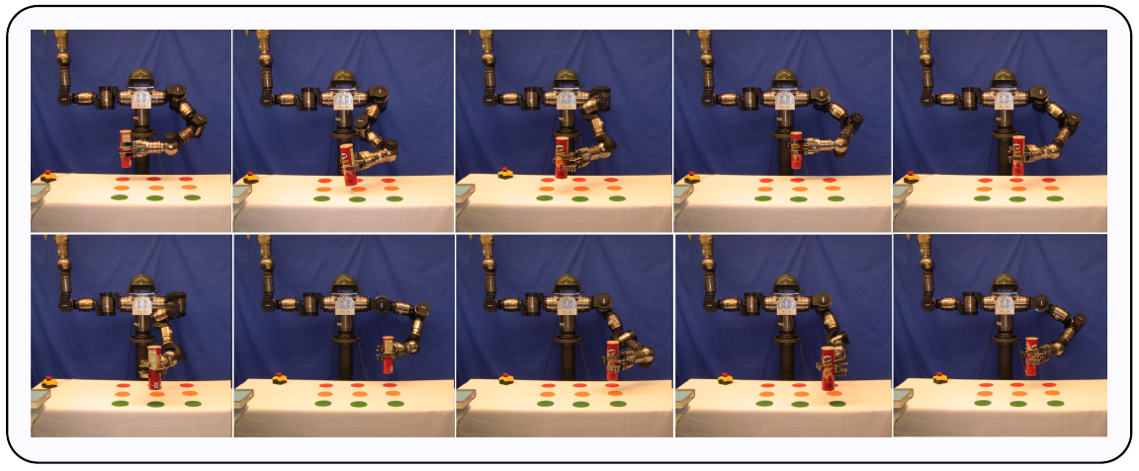
Experimental validation of arm-grasp metric ordering: Results
10 objects evaluated 10 times (each in a different position on the table)

Slide 46
3.8. Experimental validation of arm-grasp metric ordering: Results
Example with plushie (9 positions shown):

Slide 47
3.8. Experimental validation of arm-grasp metric ordering: Results
Total pick-up executed: 98
Total successful executions: 87 (88%)
Total failures: 11 (12%)

Slide 48
Sample experimental results

Slide 49
Summary
When choosing a grasp for pick-up tasks, considering the arm + the grasp produce good results in real experiments: Shorter paths, faster planning times.
Caveat: The approach presented worked well for a very simple pick-up task (one step). What about tasks with more steps? (i.e. pick-and-place, pouring)

Slide 50
Sneak peek

Slide 51
Thank you very much!

