Slide 1

A Robot Manipulation Framework of Novel Objects for Elementary Household Tasks
PhD. Thesis Defense
Ana C. Huamán Quispe
Reading Committee
Prof. Dr. Henrik I. Christensen, (advisor) Georgia Tech
Prof. Dr. C. Karen Liu, Georgia Tech
Prof. Dr. Charles Kemp, Georgia Tech
Prof. Dr. Andrea L. Thomaz, Georgia Tech
Prof. Dr. Peter K. Allen, Columbia University
----
Prof. Dr. Mike Stilman, Georgia Tech
Institute for Robotics and Intelligent Machines
Georgia Institute of Technology, USA
May 13th, 2016

Slide 2
Motivation
Why should you be listening to me for the
next 40 minutes?

Slide 3

Motivation
2040
A world where everybody can have a robot at home
-Paraphrasing: Nature, vol. 530 Issue 759,1 Feb. 2016.
A world where everybody has a robot: Why 2040 could blow your mind

Slide 4
Motivation
2040
A world where everybody can have a robot at home
-Paraphrasing: Nature, vol. 530 Issue 759,1 Feb. 2016.
A world where everybody has a robot: Why 2040 could blow your mind

Slide 5
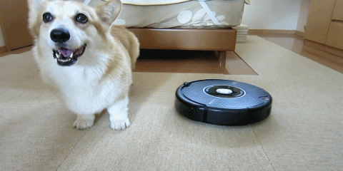
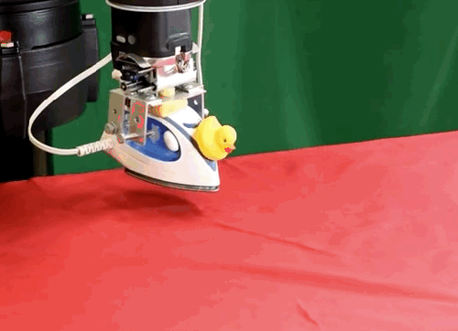
What do you imagine a robot at home is?
Cleaning robots
Robot manipulators
Roomba 880 – iRobot
Projected sales: 25.2 millions (2015-2018)
Laundry Robot – Columbia University
Projected sales: 8100

Slide 6
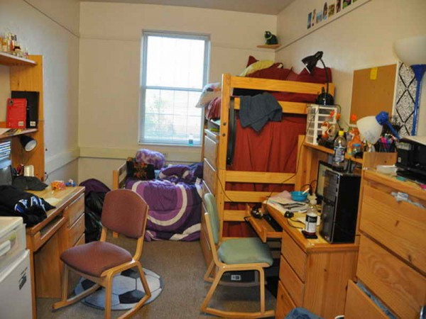
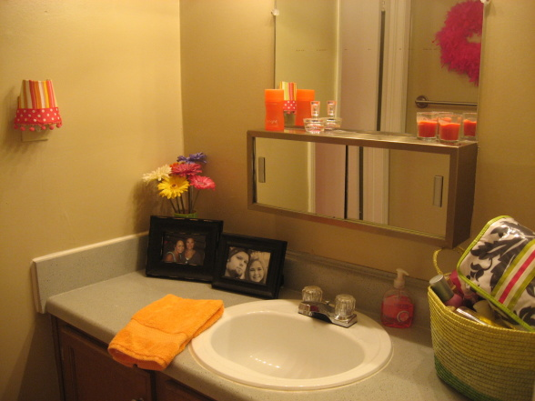
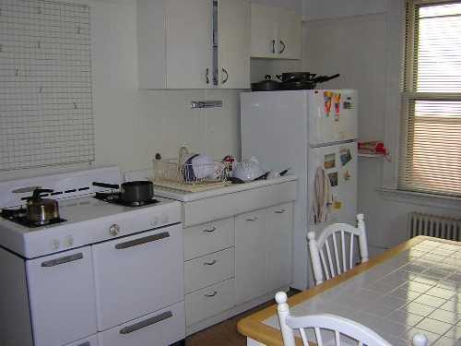
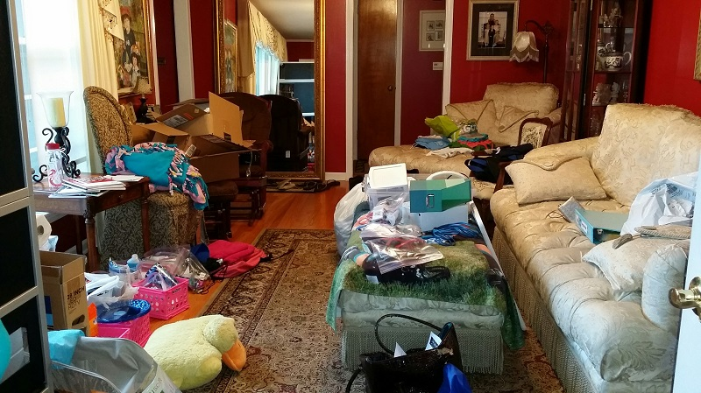
Why there are not more robot manipulators at homes?
Diverse environments

Slide 7
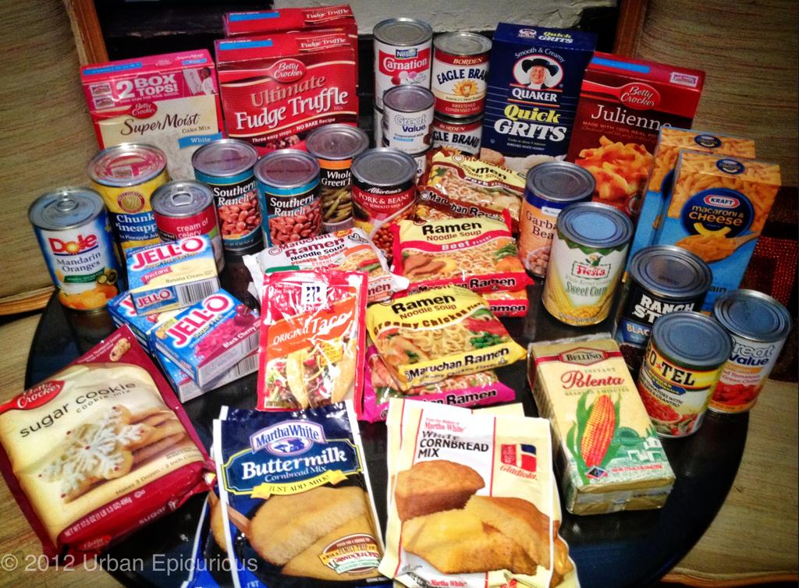
Why there are not more robot manipulators at homes?
Diverse environments
Diverse objects

Slide 8
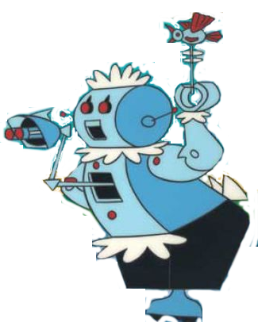
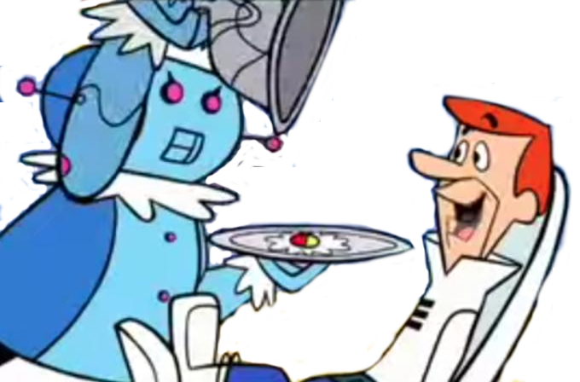
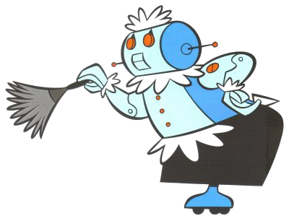
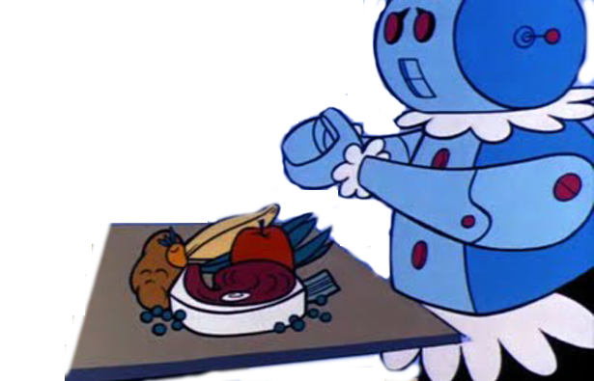
Why there are not more robot manipulators at homes?
Diverse environments
Diverse objects
Diverse tasks

Slide 9
We come to this thesis' main focus:
Simple way to represent objects.
Strategies for grasp generation.
Online performance.
Simple tasks, that can be used as building blocks.

Slide 10
Thesis Statement
Using a parameter-based object representation enables the efficient development of grasp-selection and planning strategies for elementary manipulation tasks.

Slide 11
Tasks explored in this thesis
Pick-up tasks
Pick-and-place tasks
Pouring tasks

Slide 12
Contributions
(1) We demonstrate that superquadrics are useful primitive shapes suitable to represent
on-the-fly a considerable number of convex household objects; their parametric
nature (3 axis and 2 shape parameters) is shown to be helpful to represent simple
semantic labels for objects (i.e. for a pouring task) useful for grasp and motion plan-
ning.
(2) We introduce a hand-and-arm metric that considers both grasp robustness
and arm end-comfort to select grasps for simple pick-up tasks. We show with real and
simulation results that considering both hand and arm aspects of the manipulation
task helps to select grasps that are easier to execute in real environments without
sacrificing grasp stability on the process.
(3) We present grasp selection and planning strategies that exploit task constraints
to select the more appropriate grasp to carry out a manipulation task in an online
and efficient manner (in terms of planning and execution time.

Slide 13
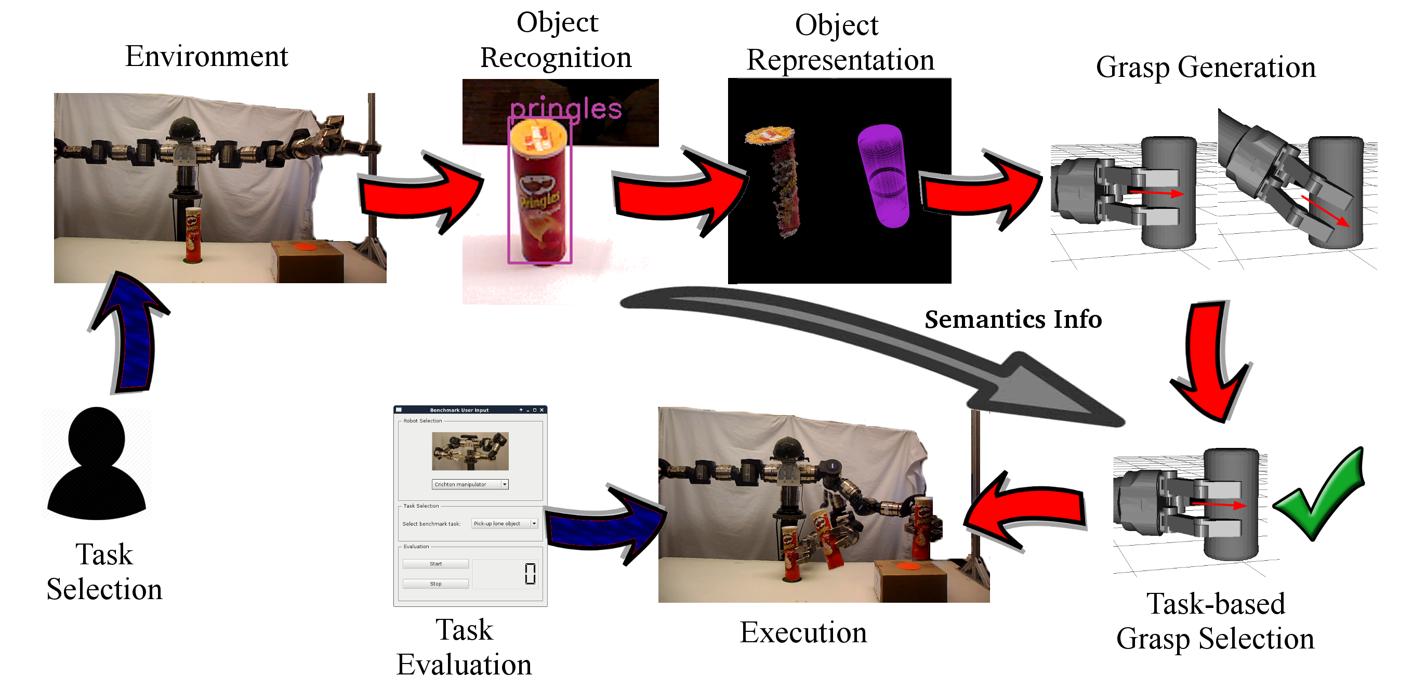
Framework

Slide 14
Publications
A Taxonomy of Benchmark Tasks for Robot Manipulation
A. Huamán Quispe, H. Ben Amor and H.I. Christensen. International Symposium on Robotics Research (ISRR 2015)
Efficient Manipulation Planning with basic primitives
A. Huamán Quispe, B. Melville, C. Erdogan, H. Ben Amor, H. Christensen and M. Stilman
Proceedings of IEEE International Conference on Robotics and Automation (ICRA 2015 )
Handover Planning for Every Occasion
A. Huamán Quispe, Heni Ben Amor and M. Stilman
Proceedings of 2014 IEEE-RSJ International Conference on Humanoid Robots (Humanoids)
Grasping for a Purpose: Using Task Goals for Efficient Manipulation Planning
A. Huamán Quispe, H. Ben Amor, H.I. Christensen and M. Stilman
Computing Research Repository - http://arxiv.org/abs/1603.04338
(Submitted) Combining arm and grasp metrics for sensible grasp selection
A. Huamán Quispe, H. Ben Amor, H.I. Christensen
12th Conference on Automation, Science and Engineering (CASE 2016)
(Submitted) Exploiting Human Heuristics and shape-embedded semantic information to efficiently perform simple manipulation tasks
International Symposium of Experimental Robotics (ISER 2016)

Slide 15
Publications
A Taxonomy of Benchmark Tasks for Robot Manipulation
A. Huamán Quispe, H. Ben Amor and H.I. Christensen. International Symposium on Robotics Research (ISRR 2015)
Efficient Manipulation Planning with basic primitives
A. Huamán Quispe, B. Melville, C. Erdogan, H. Ben Amor, H. Christensen and M. Stilman
Proceedings of IEEE International Conference on Robotics and Automation (ICRA 2015 )
Handover Planning for Every Occasion
A. Huamán Quispe, Heni Ben Amor and M. Stilman
Proceedings of 2014 IEEE-RSJ International Conference on Humanoid Robots (Humanoids)
Grasping for a Purpose: Using Task Goals for Efficient Manipulation Planning
A. Huamán Quispe, H. Ben Amor, H.I. Christensen and M. Stilman
Computing Research Repository - http://arxiv.org/abs/1603.04338
(Submitted) Combining arm and grasp metrics for sensible grasp selection
A. Huamán Quispe, H. Ben Amor, H.I. Christensen
12th Conference on Automation, Science and Engineering (CASE 2016)
(Submitted) Exploiting Human Heuristics and shape-embedded semantic information to efficiently perform simple manipulation tasks
International Symposium of Experimental Robotics (ISER 2016)
Manipulation benchmark tasks for physical robotic systems: A proposed approach
A. Huamán Quispe
Workshop on Policy Representation for Humanoid Robots, Humanoids 2014
It takes two hands to grasp: Towards Handovers in Bimanual Manipulation Planning
A. Huamán Quispe, H. Ben Amor, H. Christensen and M. Stilman
Workshop on Human vs Robot Grasping and Manipulation, RSS 2014

Slide 16
Outline

Slide 17
Outline

Slide 18
Outline

Slide 19
Outline

Slide 20
Outline
Object Recognition
Object Representation
Grasp generation
Pick-up Tasks
Pick-and-place Tasks
Pouring Tasks
Summary

Slide 21
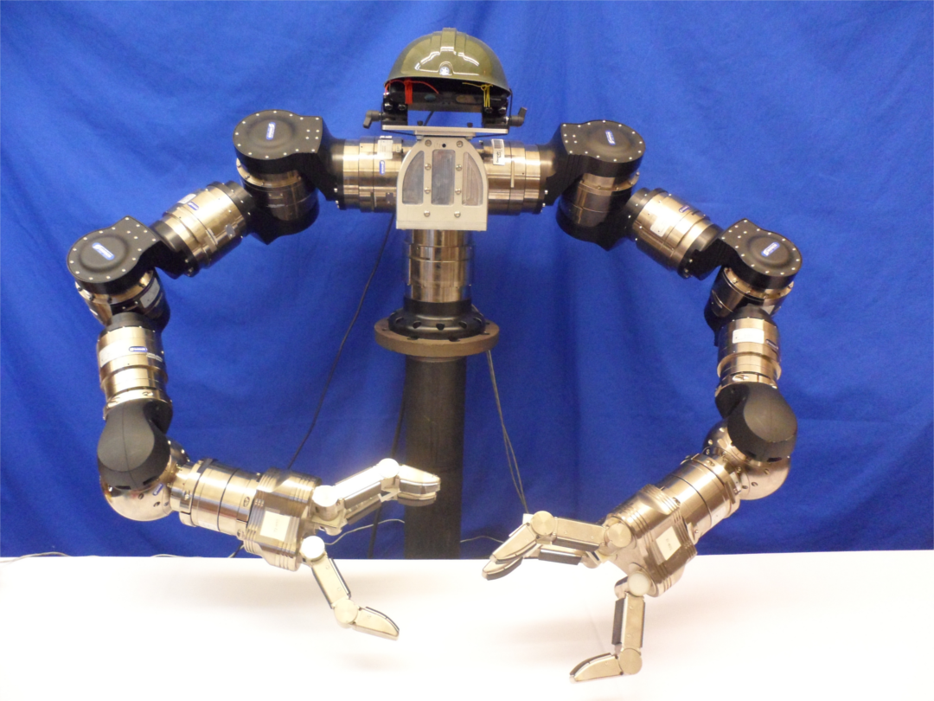
The Robot
PrimeSense
RGB-D sensor
7 DOF arm
(LWA4-Schunk)
3-fingered
Hand (SDH)
No use of ROS

Slide 22
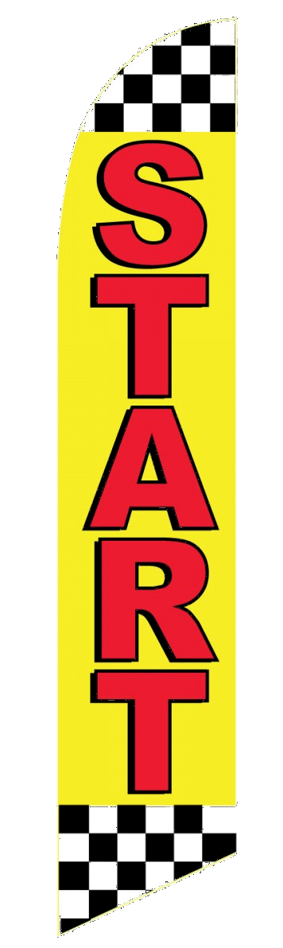
Let's start!

Slide 23
Part I: Perception

Slide 24
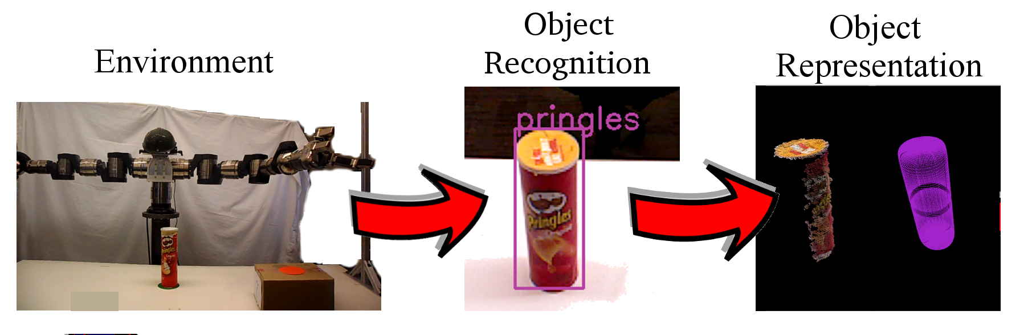
Part I: Perception

Slide 25
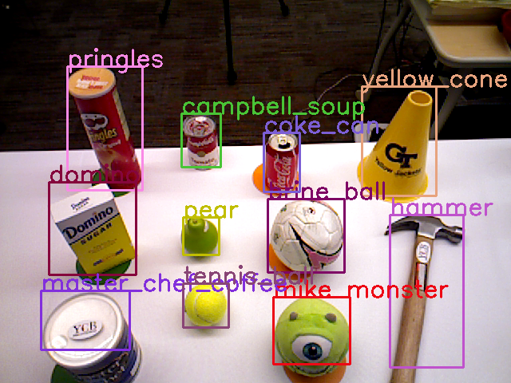
1. Object Recognition

Slide 26
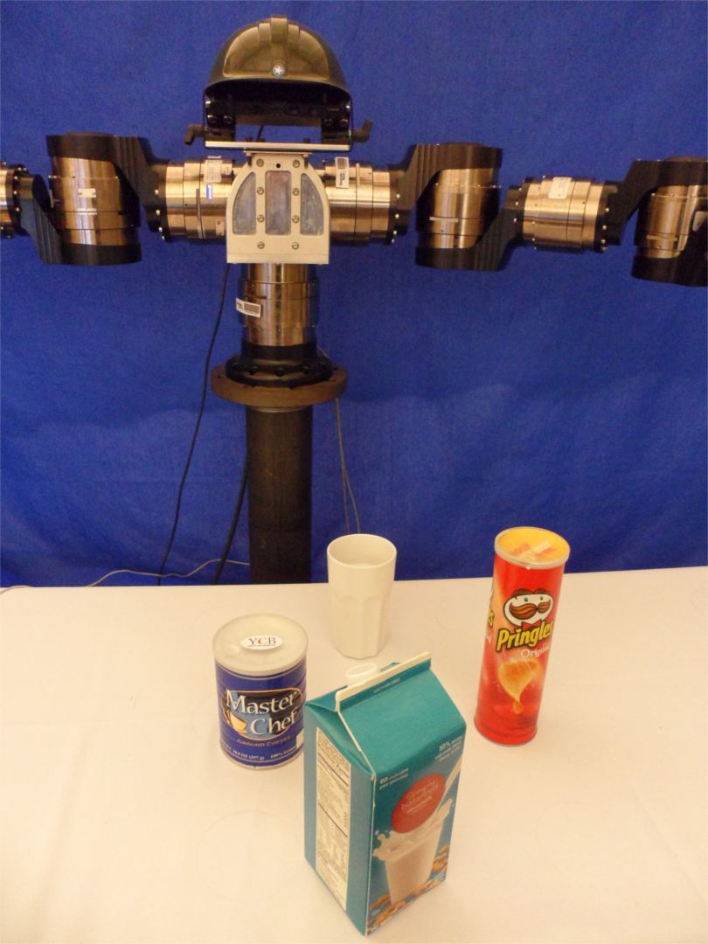
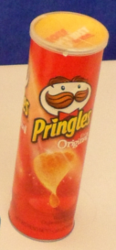
1.1. Robot sees, robot identifies
LABEL: PRINGLES
INFO
Contents can be
poured
“Pick up the Pringles”

Slide 27
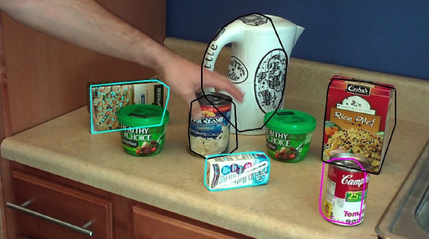
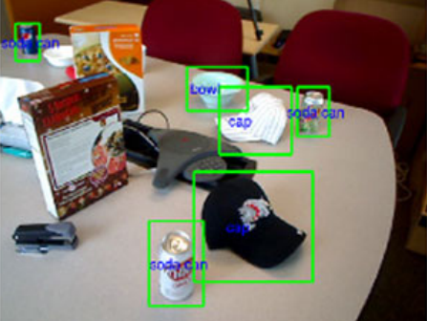
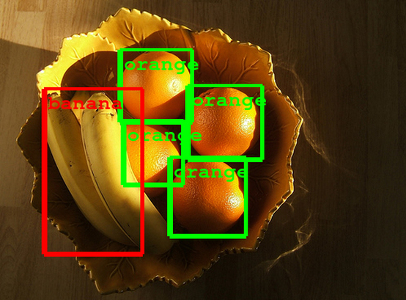
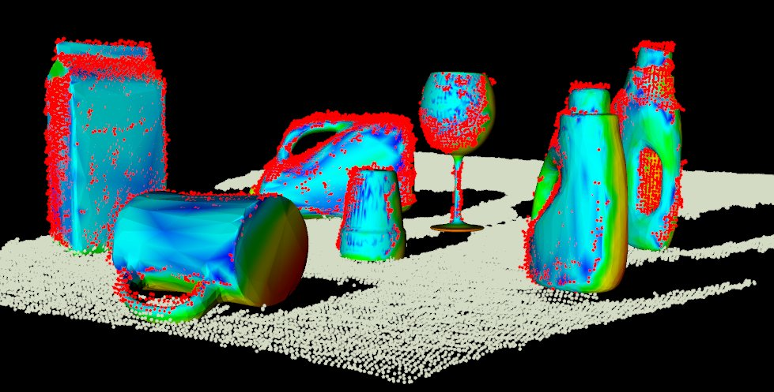
1.2. Existing approaches
The MOPED framework: Object Recognition and Pose Estimation for Manipulation (2011)
RGBD-Object recognition
Features, Algorithms and
a Large Scale benchmark (2013)
Going Deeper with Convolutions
a.k.a. GoogleNet (2014)
Point Cloud Library
Three-Dimensional Object Recognition
and 6 DoF Pose Estimation (2012)

Slide 28
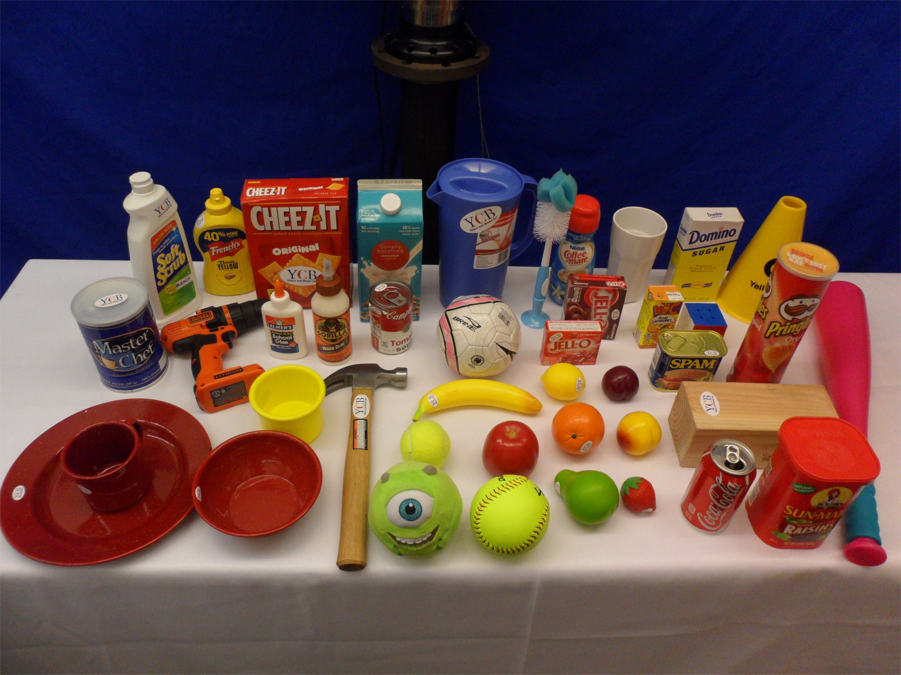
1.3. Dataset
Characteristics:
1. Small size: 42 objects
2. No exact 3D models
available.
3. No extensive offline
training is desirable.
42 objects: 30 from the YCB dataset [1] + 12 objects from our own
[1] The YCB Object and Model Dataset: Towards common benchmarks for manipulation research.
Calli B., Walsman A., Srinivasa S., Abbeel P. and Dollar A. International Conference on Advance Robotics 2015.

Slide 29
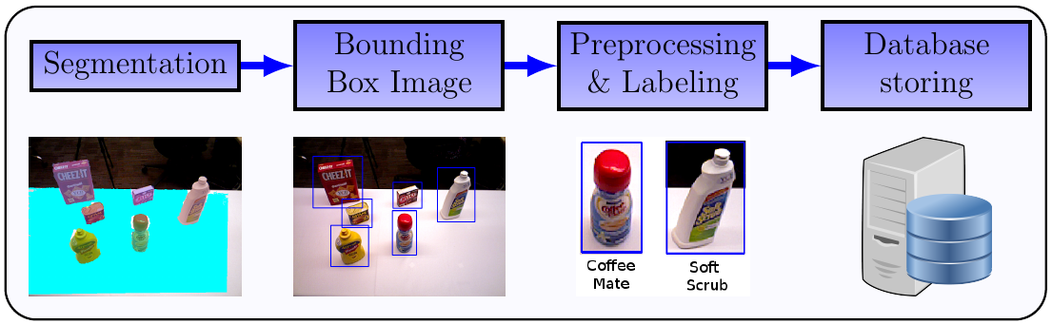
1.4. Approach
1. Use CNN features.
2. Train a Support Vector Machine to recognize object instances.

Slide 30
1.4. Selecting the right features
1. AlexNet : ImageNet classification with deep convolutional neural networks (2012)
2. CaffeNet : Caffe: Convolutional Architecture for fast feature embedding (2014)
3. Fast-RCNN: Towards real-time object detection with region proposal networks (2015)
4. GoogleNet: Going deeper with convolutions (2014)
5. VGG-16 Net: Return of the devil in the details: Delving deep into convolutional nets (2014)

Slide 31
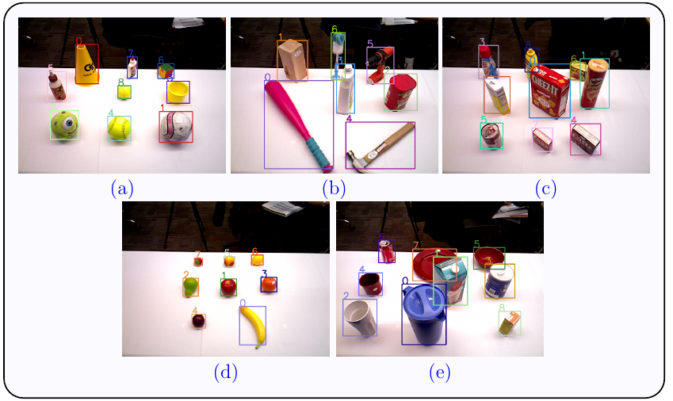
1.4. Evaluated in our dataset (1134 queries)

Slide 32
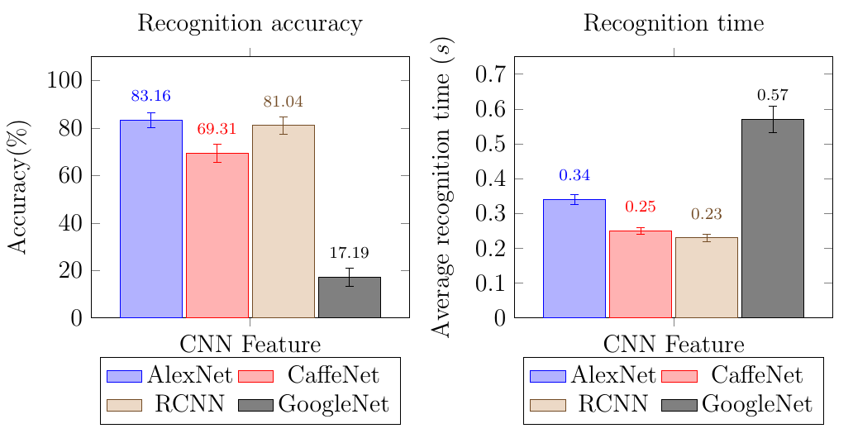
1.5. Evaluation results
Comparative results (accuracy and avg. recognition time) over 1134 queries
in our 42-object dataset

Slide 33
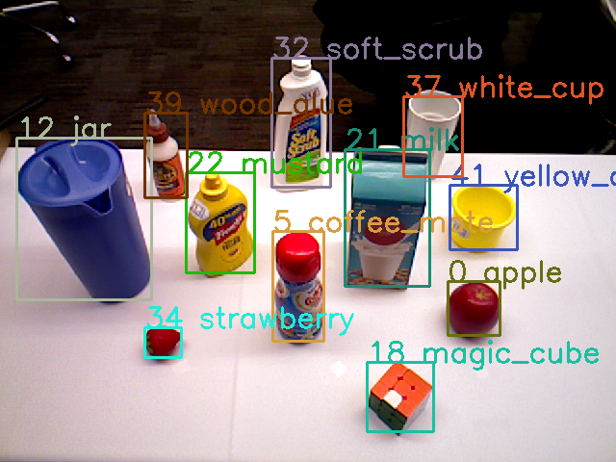
1.6. Results

Slide 34
1.6. Results
Conclusion: AlexNet / RCNN features present the best performance.
In this work, we use RCNNs

Slide 35
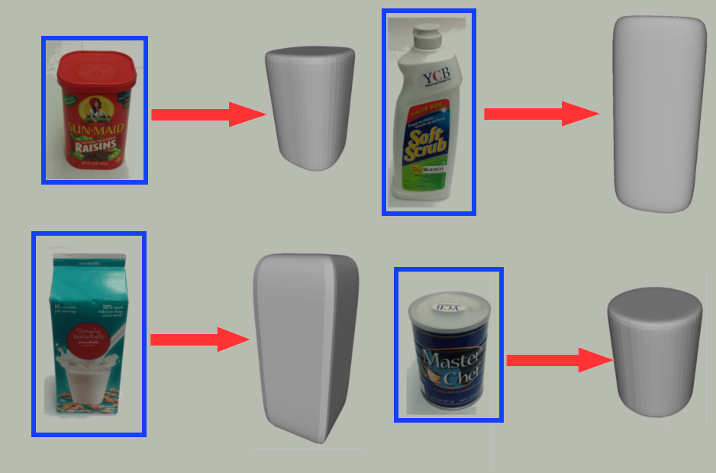
2. Object Representation

Slide 36
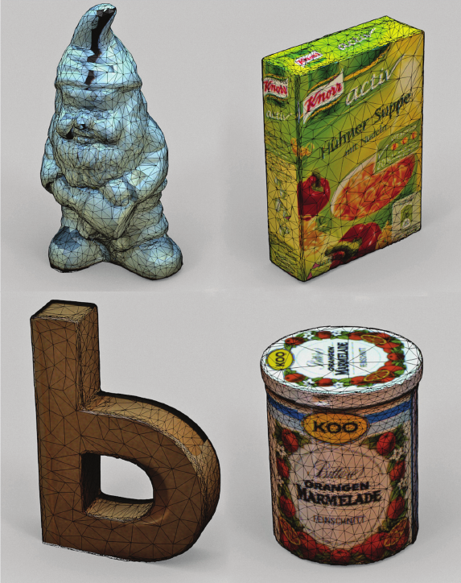
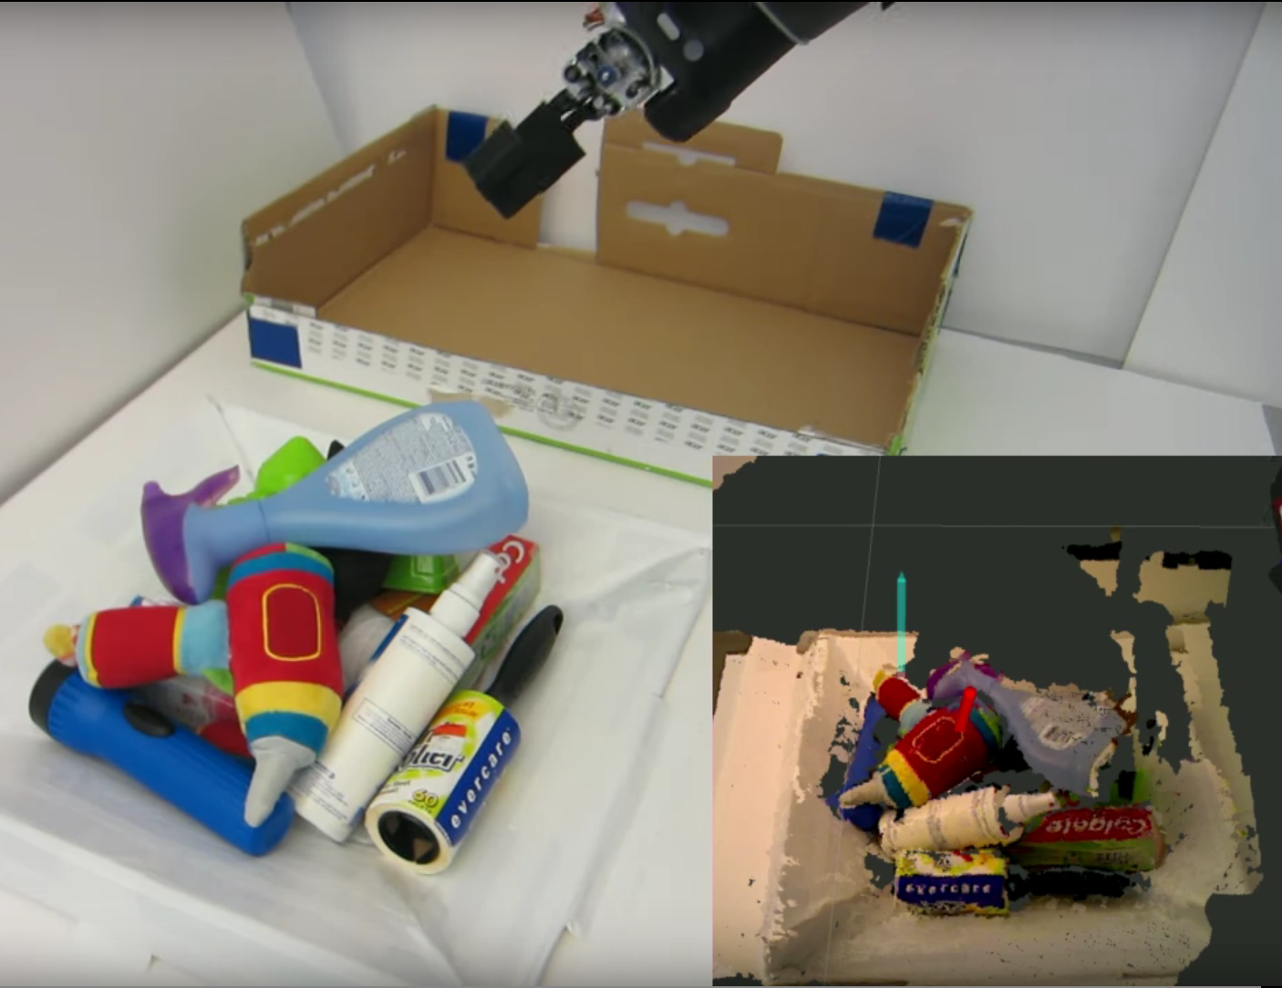
2.1. Existing approaches
The KIT object models database: An object
Model database for object recognition,
Localization and manipulation in service robotics
(2012)
Using Geometry to detect grasps in 3D point clouds.
Ten Pas & Platt (2015)

Slide 37
2.2. Our framework's requirements
Simple representation (few parameters).
Different types of geometry.
Fast to calculate (online manner).

Slide 38
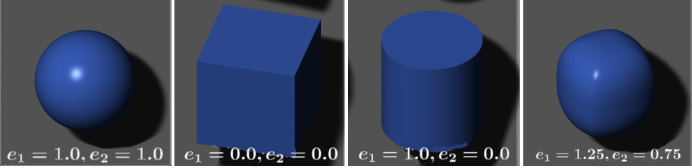
2.3. Superquadrics
Family of geometrical shapes that can represent diverse types of simple, convex objects.

Slide 39
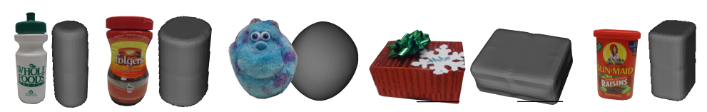
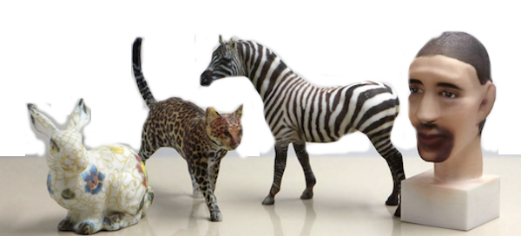
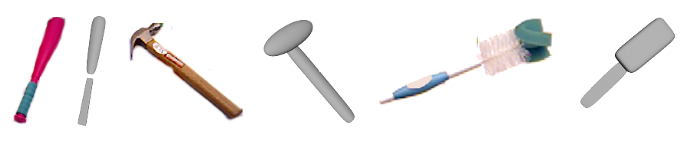
2.3. Superquadrics
1. What can we represent?
Simple, convex
objects
2. What can we NOT represent?
Complex
geometries
3. What could we potentially represent?
Multi-part
objects

Slide 40
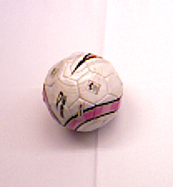
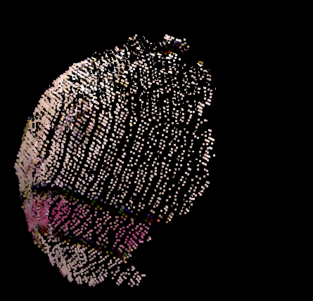
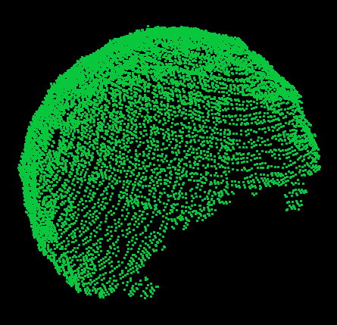
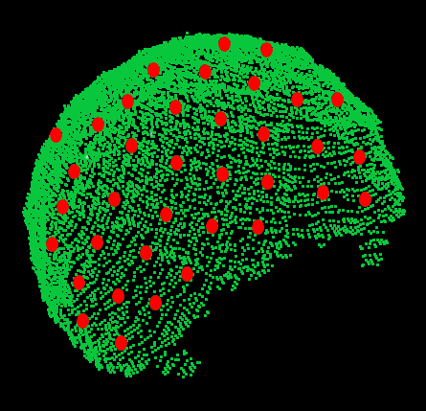

2.3. Superquadrics
We combined 2 methods to enable online superquadric fitting from one-view pointclouds:
Mirroring input
pointcloud
for better
fitting quality
Downsampling
Mirrored
cloud for faster
fitting times.

Slide 41
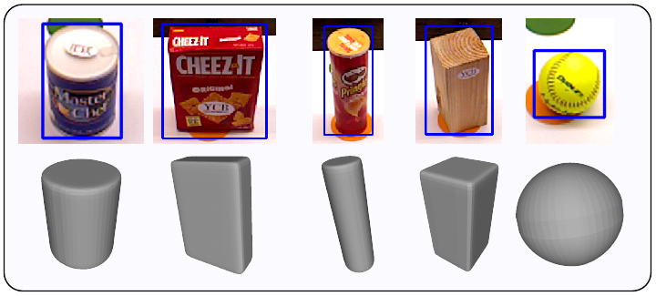
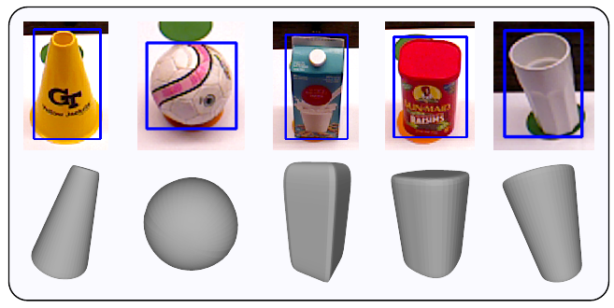
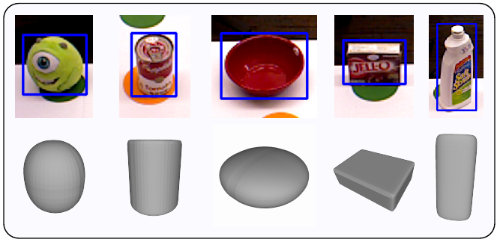
2.4. Results on 15 objects from dataset

Slide 42
2.3. Results on 15 objects from dataset

Slide 43
Part 2: Grasp Generation

Slide 44
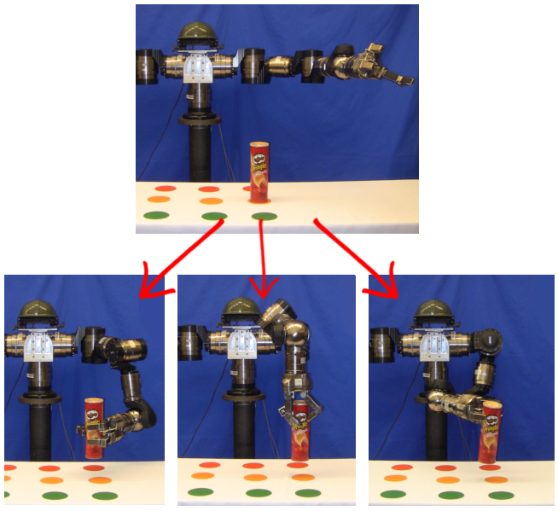
1. Grasp Generation

Slide 45
1.1. Why?
1. For different tasks, different grasps are better suited.
2. Even if a grasp is kinematically feasible, the arm
reach motion might fail.
3. Even if a reach motion is feasible. A subsequent
arm motion to complete the task might fail.

Slide 46
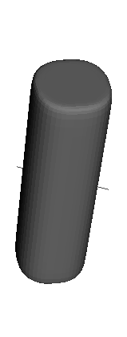
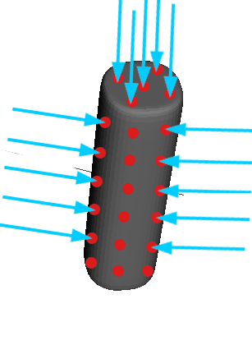
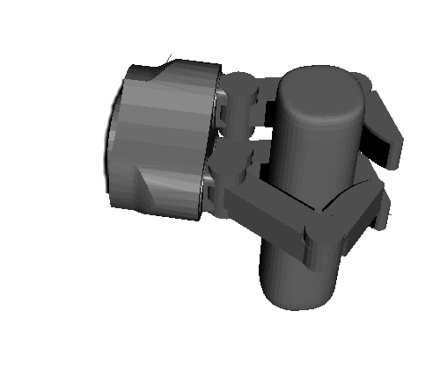
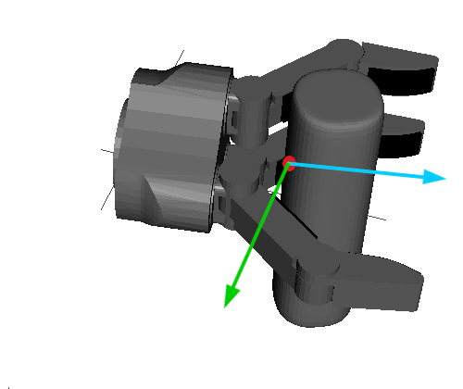
1.2. Generating grasps with heuristic approach
From object
representation
module
From explicit superquadric equation
Hand's approach
direction coincides
with normal. Fingers aligned
with smallest principal axis.
Close fingers
and stop at
contact.
Filter out grasps
with less than
4 contacts.

Slide 47
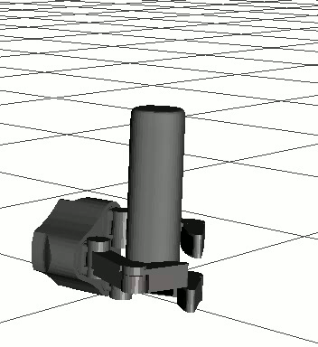
1.2. Generating grasps with heuristic approach
By using this approach, our grasps happen to
have:
1. Palm as close to the object's surface
as possible (power grasp).
2. Hand is aligned to object's principal axis
(which corresponds to human tendency
when robustly grasping simple objects [1]).
[1] “Physical human interactive guidance: Identifying grasping principles from human-planned grasps” Balasubramanian et al. - The Human Hand as an Inspiration For Robot Hand Development, Springer 2014

Slide 48
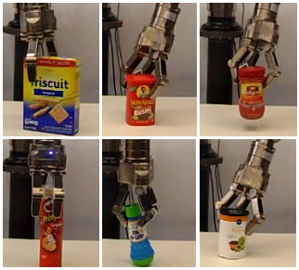
1.3. Preliminary results
Experiments over 45 trials per object (9 locations)

Slide 49

1.4. Grasp Robustness
How robust are these grasps?
Grasp maintenance in the face of unknown disturbing forces and moments applied to the object

Slide 50
1.4. Grasp Robustness: How to measure it?
* Literature: At least 24 metrics [1]
* Most common metric: [2]
* Assumptions: Coulomb friction, simplified contact modeling and
object-hand static assumption.
[1] Evaluating the efficacy of grasp metrics for utilization in a Gaussian process-based grasp predictor
Goins, Carpenter and Balasubramanian. Int. Conference on Intelligent Robots and Systems (IROS 2014)
[2] Planning Optimal Grasps. Ferrari C. and Canny J. Int. Conference on Robotics and Automation (ICRA 1992)

Slide 51
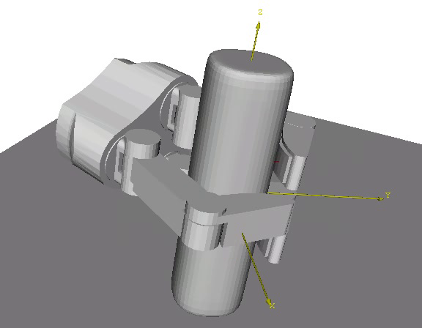
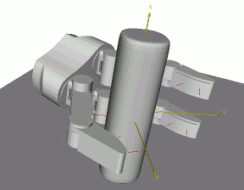
1.4. Grasp Robustness: Evaluating
Force-closure: [1]
Disturbed metric [2]
[1] Planning Optimal Grasps. Ferrari C. and Canny J. Int. Conference on Robotics and Automation (ICRA 1992)
[2] Pose error robust grasping from contact wrench space metrics
Weisz, J. and Allen P.K. - IEEE Int. Conference On Robotics and Automation (ICRA 2012)

Slide 52


1.4. Grasp Robustness: Test data
We evaluate in 9 real-object models:
And in 13 synthetic models:

Slide 53

1.4. Grasp Robustness: Test data
Synthetic data based on human
studies from Feix et al.[1]
[1] Analysis of human grasping behavior: Objects characteristics and grasp type
Feix, T. Bullock, I. And Dollar, A. IEEE Transactions on Robotics, 2014

Slide 54
1.4. Results on real / synthetic data
Real
Data
Synthetic
Data

Slide 55
1.5. Conclusion
Using heuristics for grasp generation produce
grasps that appear to be force-closure in 70%
of the cases.

Slide 56
Part III: Task-Based Grasp Selection

Slide 57
Task-Based Grasp Selection
How do we choose
which
candidate
grasps to use?

Slide 58
How do we choose which grasp to use?
On grasp choice, grasp models and the design of hands for manufacturing tasks
Cutkosky, M. IEEE Transactions on Robotics and Automation, 1989.

Slide 59
In this thesis:
3 tasks

Slide 60
1. Pick-up Tasks
Picking up a ball
Picking up a Pringles container
Picking up a ceramic cup

Slide 61

1.1. Problem Definition
Robot with arm at start
configuration
Object set in the robot
workspace at location
Goal: Grasp and pick it up a few
cm away from the table (10 cm).

Slide 62



1.2. Grasp Selection
Candidate grasps:
Select a grasp

Slide 63

1.2.1. Brute-force approach

Slide 64



1.2.1. Brute-force approach
Why randomly selecting a grasp is not so smart?
Grasp 12:
Looks good
Grasp 5:
Looks okay
Grasp 25:
Looks bad

Slide 65

1.2.2. Better approach: Order the grasps

Slide 66


1.3. How do we choose which candidate grasp to try first?
Normally, most approaches use hand-centric metrics
(i.e. analytic measurements, such as
or heuristic ones such as skewness )

Slide 67


1.3. How do we choose which candidate grasp?
Manipulation =
Arm
Hand
+

Slide 68
1.3. How do we choose which candidate grasp?
Manipulation =
Metric
Arm
Metric
Hand
Metric
+

Slide 69



1.4. Arm Metric
What we care for? Freedom of movement with hand executing a given grasp
Grasp 34: 32 IK sols. Grasp 9: 87 IK sols. Grasp 5: 38 IK sols.

Slide 70
1.4. Arm Metric

Slide 71
1.4. Arm Metric
In the proposal:

Slide 72
1.4. Arm Metric
In the proposal:

Slide 73

1.5. Grasp Metric
What do we care for: Grasp stability

Slide 74

1.5. Grasp Metric
What do we care for: Grasp stability
Distance between the object's center of mass and the
hand's approach direction

Slide 75
1.5. For a set of candidate grasps

Slide 76
1.6. Arm-grasp Metric
Manipulation Metric = Grasp metric + Arm metric
(Length units) (Non dimensional)

Slide 77
1.6. Arm-grasp Metric
Use 2 steps:
1. Use arm metric first to separate the grasps in 4 groups.
2. Use the grasp metric to order the grasps inside each group.

Slide 78
1.6. Arm-grasp Metric
Very Good
Good
Fair
Bad

Slide 79

1.6. Arm-grasp Metric
Candidate grasps
Step 1:
Use arm metric to partition the candidate grasp set

Slide 80




1.6. Arm-grasp Metric
Candidate grasps
Very Good
Good
Fair
Bad

Slide 81
1.6. Arm-grasp Metric
Candidate grasps
Step 2:
Use grasp metric to order the grasps within each subgroup
Very Good
Good
Fair
Bad

Slide 82




1.6. Arm-grasp Metric
Candidate grasps
Very Good
Good
Fair
Bad

Slide 83
1.6. Arm-grasp Metric
Candidate grasps
Step 3:
Join the ordered
sets
Very Good
Good
Fair
Bad

Slide 84

1.6. Arm-grasp Metric
Ordered Candidate
grasps
Candidate grasps
Very Good
Good
Fair
Bad

Slide 85
1.6. Arm-grasp Metric
Arm metric:
Non-dimensional
Grasp metric:
Distance units.

Slide 86
1.6. Evaluation in simulation
Use 9 object models obtained from our dataset.
Set 100 random tabletop scenarios.

Slide 87

1.6. Evaluation in simulation
Evaluate 2 factors:
Success rate: Of grasp
selected.
Planning time: Use standard RRT (injecting IK solutions with a probability)
Compare best and worst grasp according to metric.

Slide 88

1.6. Evaluation in simulation
Sample results:

Slide 89
1.6. Evaluation in simulation: Results

Slide 90
1.6. Evaluation in simulation: Results
1. Using a metric to select the first
Grasp to test results in a success rate of
More than 84% in most cases.
This means that in <84% of the cases,
Only a grasp must be tested in order to
Obtain a valid arm motion.
2. The planning times obtained using
Grasps selected based on the metric
Are in general much shorter, most of the
time, half of the time obtained with
other grasps in the candidate set.

Slide 91

1.7. Experimental validation: Results
10 objects evaluated 10 times (each in a different position on the table)

Slide 92
1.7. Experimental validation: Results
Example with plushie (9 positions shown):

Slide 93
1.7. Experimental validation: Results
Total pick-up executed: 98
Total successful executions: 87 (88%)
Total failures: 11 (12%)

Slide 94
Sample results

Slide 95
2. Pick-and-Place Tasks
Crichton putting
a box inside a box
Crichton putting
a Pringles on top of a box
Crichton putting
a plushie on a different place on the table

Slide 96

2.1. Problem Definition
Robot with arm at start
configuration
Object set in the robot
workspace at location
Goal: Grasp and place it
in a goal, specified either
as (a) Full pose (6D) or
(b) A position (3D)

Slide 97



2.2. Pick-and-place: 2 steps
Reach
Grasp
Place
Need planning for reach and place motions – assuming a grasp was selected.

Slide 98
2.3. Grasp Selection
Candidate grasps:
Select a grasp

Slide 99
2.3. Choosing the grasp
CASE 1
Pick-and-place
fully constrained
CASE 2
Pick-and-place
position constrained

Slide 100



2.4. Fully constrained pick-and-place
: Goal is defined as a homogeneous transformation (position + rotation: 6D)

Slide 101

Why don't just use the best grasp for reaching?

Slide 102
Filter out grasps that cannot be executed at

Slide 103
Still, some grasps produce better arm motions than others
Grasp 13/53
Grasp 9/53

Slide 104







Still, some grasps produce better arm motions than others
START GOAL
START GOAL

Slide 105
2.4.1. End-Comfort Effect
The tendency to maximize comfortable hand and arm postures at the end of simple object manipulation tasks rather than a the start.
-From Cognition to Biomechanics and back: The end-comfort effect and the middle-is-faster effect
Rosenbaum et al. Acta Psychologica, 1996
Cup upside-down
(uncomfortable grasp)
Cup upright
(normal grasp)

Slide 106
2.4.1. The goal should be considered during the grasp selection process
To prune grasps that cannot be reached.
To prioritize grasps that might produce short arm
motions.

Slide 107

2.4.2. Possible metrics for evaluating pick-and-place
Let's use :
+
Arm component
Grasp component
DEPENDS ON THE
OBJECT POSE

Slide 108
2.4.2. Possible metrics for evaluating pick-and-place
Let's use :
Where do we measure
the arm metric? At the
start or at the goal pose?

Slide 109
2.4.2. Possible metrics
Measure at the start pose of the object .
Measure at the goal pose of the object .
Use an average measure of both start and
goal poses ( and ).

Slide 110
Note: Average metric...

Slide 111

2.4.3. Simulation experiments
6 object models used:

Slide 112

2.4.3. Simulation experiments
~500 simulation scenarios. Randomized start and goal positions and orientations on a tabletop surface.
Planning used IKBiRRT.

Slide 113
2.4.3. Simulation Experiments Results

Slide 114
2.4.4. Experimental Validation
Speed: 3x

Slide 115
...Choosing the grasp
CASE 1
Pick-and-place
fully constrained
CASE 2
Pick-and-place
position constrained

Slide 116






2.5. Pick-and-place: Position constraints
In reality, most of the time you don't care too much for the exact orientation of an object, as long as it is upright.

Slide 117
2.5.1. Advantages and disadvantages
Advantage:
Freedom to choose final pose
Disadvantage:
Many possible options.
IK cannot be readily used to filter out grasps at the final pose.

Slide 118
2.5.2. Guessing a “good” goal pose
Propose: Guess the goal pose for the object.

Slide 119
2.5.3. How to guess?
Many possible options even if only variating the yaw angle!

Slide 120


2.5.3. How to guess? Draw inspiration from humans
Liberty Motion Tracker
Data from tracking hand orientations during
multiple pick-and-place operations on the
table shown at the left.

Slide 121
2.5.3. How to guess? Draw inspiration from humans
Rotation is minimum.
Rotation is not constant.
it depends on the start
and goal locations of the
object to be translated.
Data from tracking hand orientations during
multiple pick-and-place operations on the
table shown at the left.

Slide 122

2.5.4. Guessing the goal pose
Using the shoulder
As a reference point,
We calculate the rotation
between the start and
goal positions for the
object.

Slide 123
2.5.5. Guess goal pose for each grasp

Slide 124
2.5.5. Guess the goal pose for each grasp
Use minimum rotation
such that the grasp
evaluated is feasible.
Use as maximum
yaw value for the
sampling-based place
planning.

Slide 125
2.5.6. Simulation results
Simulation results of randomized on-table pick-and-place scenarios (~250) per each object}

Slide 126
2.5.6. Simulation results
Using the average metric
has a higher success rate
and a lower hand displacement
through the pick-and-place
execution.

Slide 127
2.5.7. Experimental Results: On-table

Slide 128
2.5.7. Experimental Results: On-box

Slide 129
2.5.7. Experimental Results: In-box

Slide 130

3. Pouring Tasks

Slide 131
3.3. Experimental Results: Plate

Slide 132
3.3. Experimental Results: Bowl

Slide 133
3.3. Experimental Results: Cup

Slide 134
Summary

