Slide 1
GENERATIVE MUSIC ASSIGNMENT
Ana Bagić

Slide 2
SUMMARY
Introduction​
Markov chains
​Implementation
Code
​Sonic work

Slide 3
GENERATIVE MUSIC
Algorithmic or procedural generation, rather than being composed by a human musician
Rules, parameters or constraints
Sound installations, music performances, video games
Ever-changing, non-repeating musical experience
Notes:
Generative music refers to music that is created through a process of algorithmic or procedural generation, rather than being composed by a actual human musician. And the music is created through a set of rules, parameters, or constraints that are programmed into a computer. It can be created in real-time or it can be pre-composed and played back at a later time.
Generative music is often used in some kind sound installations, music performances, and video games, because it allows for a high degree of flexibility and variability in the music created, and because it can react and adapt to outside factors. It can also be used as a tool for composers and musicians to explore new musical ideas and techniques, as the generative process can generate unexpected and novel musical patterns and structures.
One of the key features of generative music is its ability to create an ever-changing, non-repeating musical experience that can be tailored to the context and environment in which it is played. This makes it an ideal form of music for use in ambient contexts, as well as background music in films, television, and other media.

Slide 4
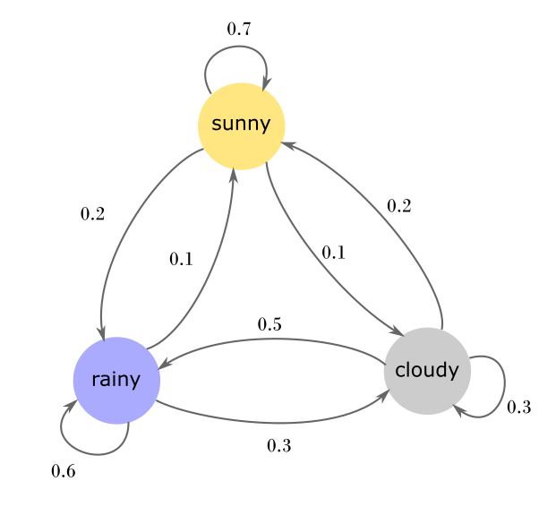
MARKOV CHAINS
Future state only depends on the present state
Set of possible values or states and transition probabilities between states
Notes:
The approach that I decided to use for this project is Markov chains, because it is not complicated to implement and use but if used correctly it gives relatively good results. Markov chain is a simple mathematical concept that can be used in various contexts. It models how random processes evolve over time. It satisfies the "Markov property," which states that the future state of the process only depends on the present state, and not on any past states.
The system is modeled as a set of possible values or states, and the transition probabilities between states are defined by a transition matrix. The transition matrix specifies the probability of moving from one state to another in a single step, and it is typically assumed to be time-invariant.
They are used in a variety of applications, such as in the analysis of natural language processing, stock market predictions, and modeling weather patterns. One of the most common applications is in generating random sequences or patterns that exhibit a certain statistical structure.
On this picture we can see one example of Markov chain for simple weather prediction. For example if it is sunny, there is 10% of it turning to cloudy, 20% to rain and 70% of staying sunny.

Slide 5
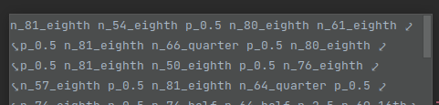
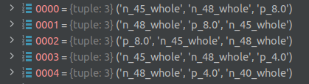
MY implementation
Using existing compositions to create Markov chains
MIDI -> string -> tokens (n-grams) -> Markov chain
Notes:
To create Markov chains for music generation I used existing compositions. From the MIDI file I created a string of all the events in timeline, and by events I mean notes played and pauses. You can see the example of such string in the image above. After that I created tokens which consist of n-grams of values in the string. In this model I used 3-grams, which means that every token has 3 values and every following token consists of 2 last values of the previous token and one next value. Example of such tokens can be seen in the image below. I chose number 3 because it has good tradeoff between having memory of last few notes played (especially about chords) and not being too specific.

Slide 6
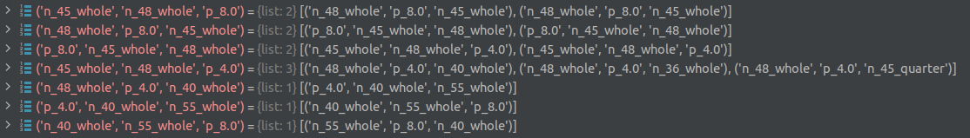
Markov chain using dictionary
Yiruma: River Flows in You and Kiss the Rain
Hans Zimmer: Time and He's a pirate
Notes:
After that a Markov chain is created using dictionary. Keys are tokens and values are all the tokens that are followed by that token. If one token is followed by the same one multiple times in the song, it shows multiple times in the list. I use this method to ensure that tokens that are showing more times have greater chances of being played after specific token. This dictionary can be seen in the picture below. When generating song, first token is chosen at random and next is chosen randomly from the list for that token in the dictionary. To ensure diversity in the song, I made 4 Markov chains using 4 different songs: two from the composer Yiruma (River flows in you and Kiss the rain) and two from the composer Hans Zimmer (Time and He's a pirate). Markov chains are changed with the certain probability. In this implementation I used 1% probability between every note. After generation, string is converted to MIDI and is ready to play.

Slide 7
CODE AND RESULT

