Slide 1
RECOGNIZING AUDIO FEATURES IN MUSIC
By: Anagha Bharadwaj & Thomas Lanzetti
DS 677 - Deep Learning

Slide 2
About the Dataset:
MusicNet Dataset, which contains 330 complete classical music recordings.
Data Format: Provides full .wav audio files alongside CSV-ciphered label files, containing other information such as composer, notes, pitch, instrument, length, etc.
Prior Work Limitations:
CNN-only models achieve decent composer identification accuracy (84%) on short (5-second) samples.
Key Flaw - Missing Temporal Structure: These models fail to adequately capture the long-range temporal structure of music (rhythm, melody, and phrasing) that is crucial for defining a composer's unique style.
The Challenge:
We need an approach that models time effectively to move beyond local acoustic features and achieve robust classification.
The Goal:
To develop a hybrid CNN–GRU model that enhances composer classification accuracy on the MusicNet dataset by combining CNNs for local spectral feature extraction and GRUs for modeling temporal structure.
About Our Project

Slide 3
The Proposition:
Combine CNNs (for local feature extraction like timbre and texture) with GRUs (for sequential modeling of rhythm, melody, and phrasing).
Evaluate Transformer models as an alternative to GRUs, utilizing the self-attention mechanism to capture longer-range dependencies.
Critically compare the performance of Spectrograms against Raw Audio to determine the optimal input representation for hybrid models.
Perform systematic comparative experiments (CNN-only, GRU-only, CNN-GRU, CNN-Transformer) to quantify the benefits of integrated temporal modeling.

Slide 4
CNN Transformer Model
We start from raw MusicNet audio and create multiple 3-second segments per piece to increase data diversity. Each segment goes through pre-emphasis (a simple filter that helps to reduce noise and increase feature extraction). This is then converted into a 40-band Mel-spectrogram (a visual representation of an audio signal's frequency content over time) on a log-scale. This essentially means that the feature dimension is equal to the 40 bands (like frequency bins) of the Mel-Spectrogram. We treat this as a time–frequency sequence (T, 40), pad all segments to a common length, and use this tensor as input to all our models (GRU, CNN, CNN–GRU, and Transformers) for composer, instrument, and tempo classification.
CNN-Transformer Model -> Utilizes the idea of sequential architecture - Main Ideas:
CNN Feature Extraction: the Mel-bins down from 128 to 16 for this part, transforming the spectrogram into a sequence of 1024 features per time step. (Idea further explained later).
Transformer Sequence Modeling - Global context, the self-attention mechanism processes the sequential features, producing a 256-dimensional global feature vector that then in the classifier gets reduced to shape [B, 5] representing the logits (raw scores) for the multi-composer classes.

Slide 5
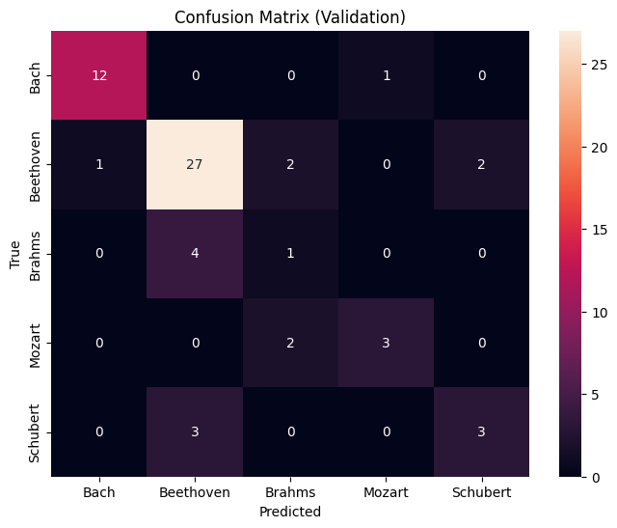
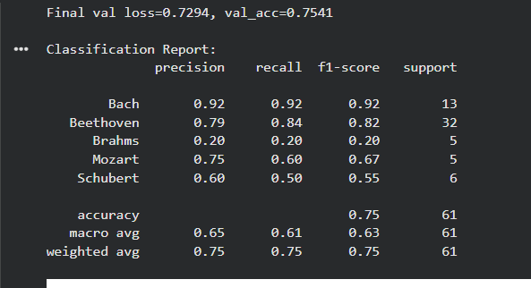
Results
Precision - How often the predictions are correct when it predicts that class
Recall - How much it misses of actual is 1-recall

Slide 6
Overcoming Model Quirks
Problems with overfitting:
With a relatively smaller dataset and class imbalance, transformers are unfortunately prone to overfitting, so I had to mess with a few parameters to overcome this. For example, lowering the learning rate, and increasing to dropout in the model in order to stabilize the weights.
There is also a class imbalance, as shown previously, which caused overfitting in favor of the more heavily represented classes. So, to overcome this issue I used the idea of assigning weights to samples from minority classes in order to make up for the class imbalance.

Slide 7
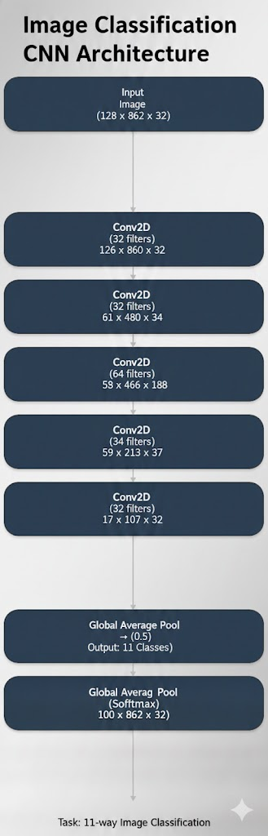
MODEL : CNN
Slide bullets:
Input: 128 × 862 × 3 mel-spectrogram patches
5 stacked Conv2D + MaxPooling blocks to learn time–frequency patterns
Global Average Pooling compresses feature maps to a 32 embeddings
Dropout for regularization, then Dense (11-way softmax) for the classifications
Task | Best Val AUC | Interpretation
Composer | 0.887 | Strong performance; model learns stylistic patterns well
Tempo | 0.865 | Good discrimination; CNN captures rhythmic texture
Tonality | 0.794 | Hardest task; requires global harmonic modeling

Slide 8
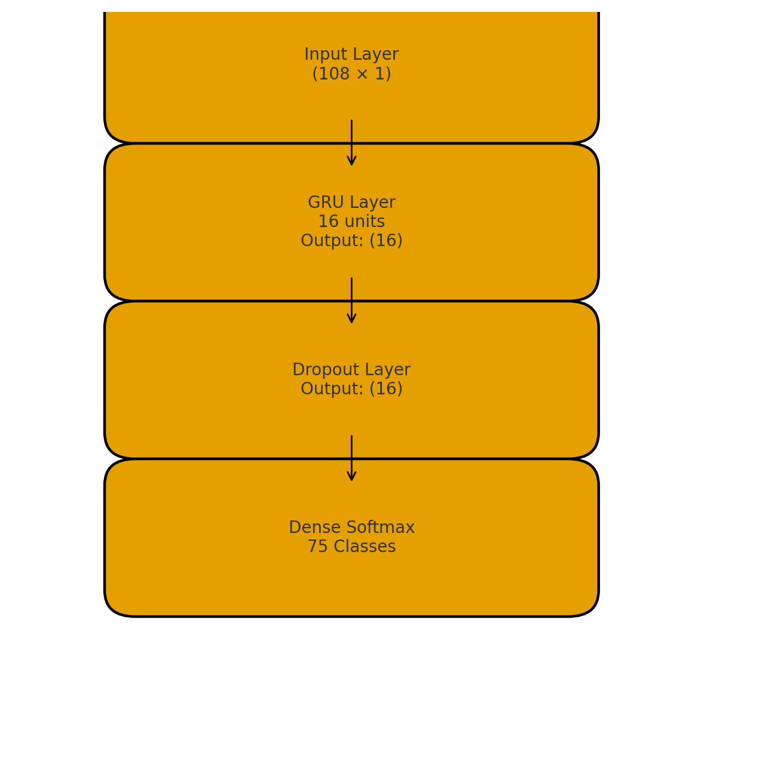
MODEL : GRU
Input: 1D audio sequence, 65 time steps × 1 feature → shape (batch_size, 65, 1).
Shared encoder: GRU(32 units) → 32-D embedding per sample ((batch_size, 32)) + Dropout for regularization (3,360 params).
Three output heads (all use the same 32-D embedding): Instrument: Dense(75, softmax), 2,475 params Composer: Dense(11, softmax), 363 params Tempo: Dense(19, softmax), 627 params
Total size: 6,825 trainable parameters (~26.7 KB) for a compact multi-task GRU model.
Task | Classe | Final Val Accuracy | Final Val Loss | Interpretation
Instrument | 75 | 0.70 | 0.93 | Strong performance; model learns instrument timbre well.
Composer | 11 | 0.50 | 1.62 | Moderate performance; harder task due to overlap in styles.
Tempo | 19 | 0.33 | 2.21 | Weakest task; short segments make tempo harder to infer.

Slide 9
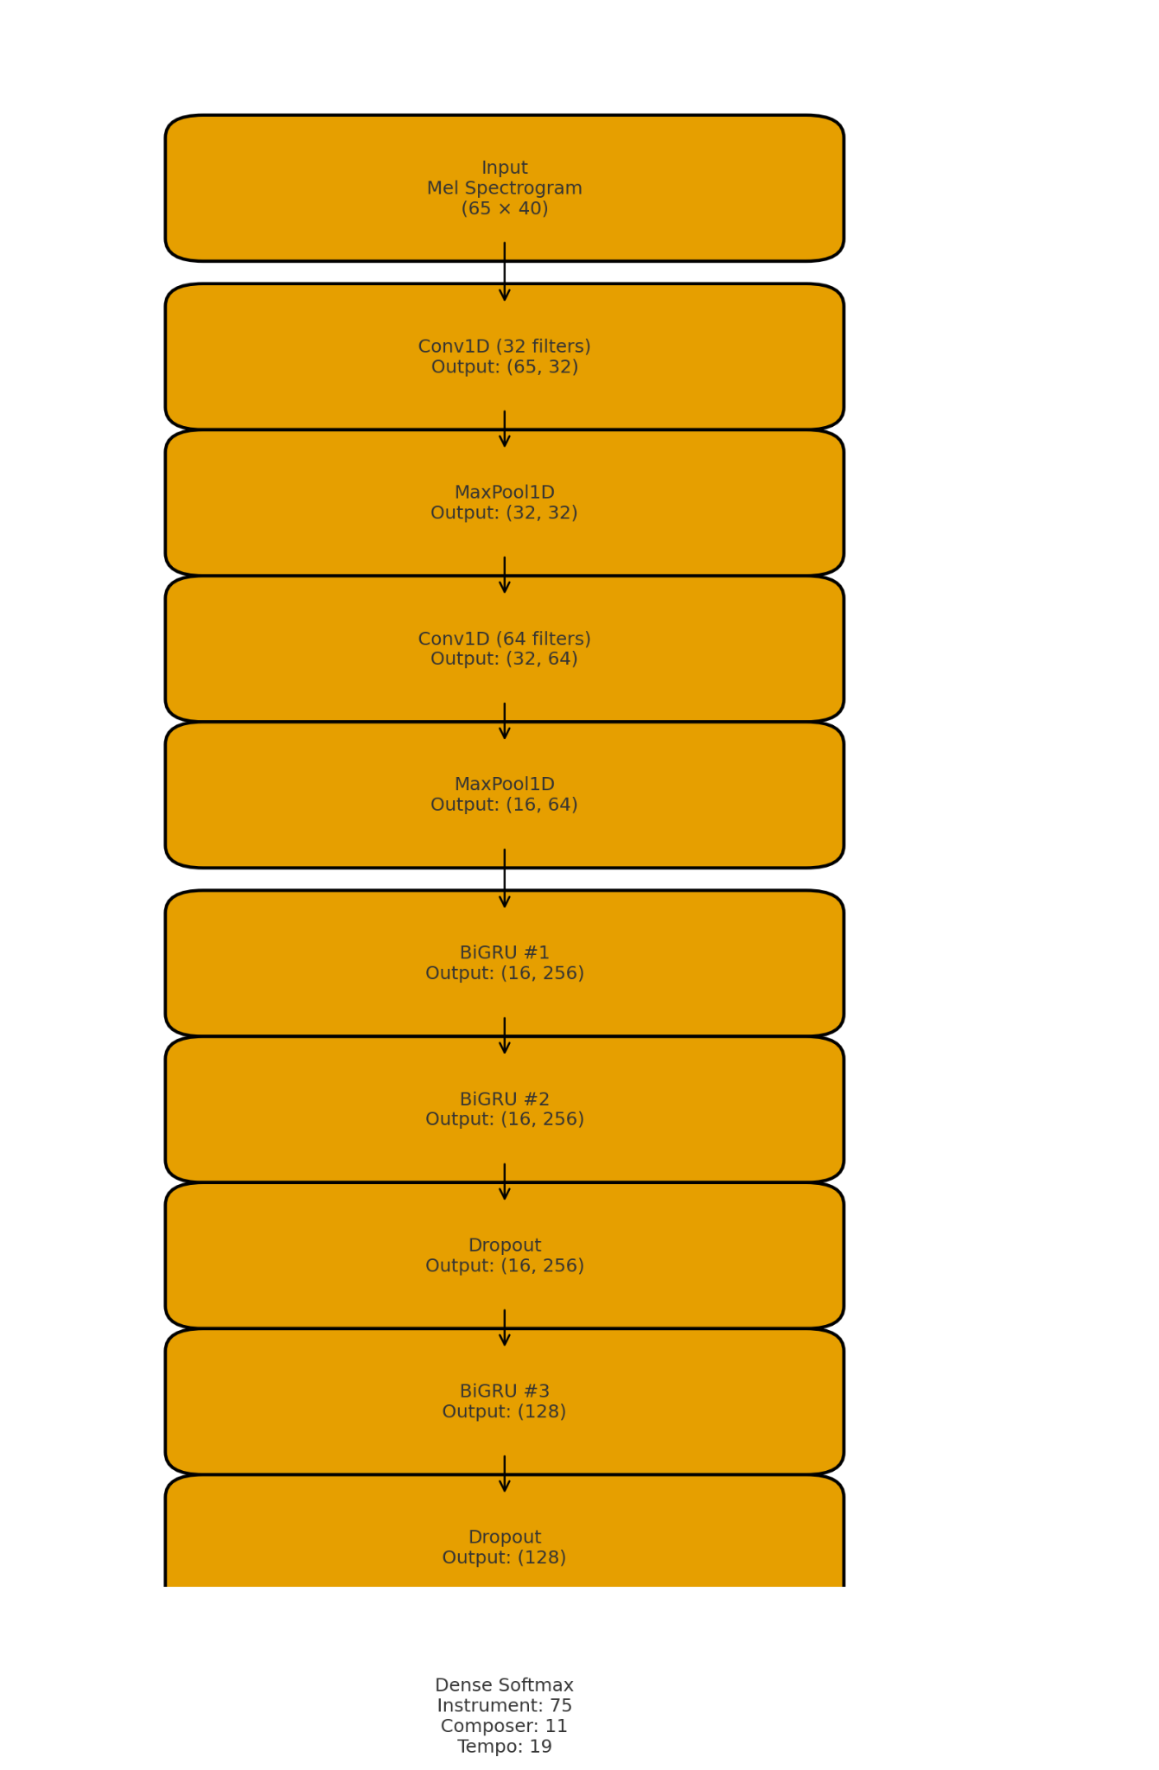
MODEL : CNN-GRU
Input: (65, 40) Mel spectrogram
Conv1D(32) → MaxPool → Conv1D(64) → MaxPool
3× Bidirectional GRU (128 units) with Dropout
Task-specific Dense heads: 75 instruments, 11 composers, 19 tempo classes~0.58M trainable parameters per head
Optimizer: Adam, loss: categorical cross-entropy
Instrument model: train acc ≈ 0.97, best val acc ≈ 0.86
Composer model: train acc ≈ 0.90, val acc plateaus around 0.70 Training/validation curves are close → good generalization Tempo model: train acc ≈ 0.72, val acc ≈ 0.40–0.45, val loss increases Indicates overfitting and that tempo is the hardest attribute
Plots show smooth decrease in training loss and rising accuracy for all tasks, with strongest performance on instrument and composer classification.

Slide 10
Final Results
CNN–GRU Best overall for instrument recognition; also strong on tempo. CNN part learns local time–frequency patterns (timbre, attack, brightness). GRU part models how these patterns evolve across a short phrase.Works well when the label depends on both what the sound looks like and how it changes over time. CNN Very competitive on tempo and tonality/key. Learns stable filters for rhythmic repetition (tempo) and chord/harmonic texture (tonality). Less sensitive to long-range structure, but very effective at local visual patterns in the mel-spectrogram.
GRU-only Simple and lightweight; fastest model to train and run. Performs decently on instrument because timbre changes slowly over time. Weaker on composer and tempo, since averaging the spectrum removes rich frequency details that the GRU could have used.
Transformer (composer only) Trained on composer classification. Self-attention looks at all time steps at once, making it good at capturing long-range stylistic patterns (motifs, harmony progressions, phrase structure). Outperforms CNN/GRU family when the label depends on global style rather than local texture.

Slide 11
Final Results
Instrument: best with CNN–GRU, since it needs timbre detail (CNN) + phrase continuity (GRU).
Tempo: best with CNN, because tempo shows up as regular stripes and repetitions in the spectrogram.
Tonality: moderately captured by CNN, but limited by short segments that don’t contain full cadences.
Composer: best with Transformer, which can integrate information over the entire excerpt, not just a small window.
What this shows about music modeling Different musical properties live on different time scales:
Timbre → local,
Rhythm → mid-range,
Style/key → more global.
No single model is universally best; performance improves when the architecture matches the structure of the musical information it is trying to learn

Slide 12
Remaining Steps
Using the transformer model for other feature classification (i.e. tempo and instruments)
Use longer sample sizes instead of just 3 seconds
Extending training loops (further epochs) for possible higher testing accuracies and metrics.

Slide 13
Thank you

